Slide 1



CCNA-Introduction to
Networks v7.0 (ITN)
Orientation
CCNA V7.0
Prepared by
Dr. Abdelrhman Ahmed

Slide 2
Agenda
Orientation
Certification Exam Changes
Netacad Course Changes
Transition to The Version 7

Slide 3
How CCNA Certification is Changing?
Orientation
200-125
10 CCNA Certifications
CCENT as a Prerequisite for some
ICND1+ICND2 = CCNA RS
200-301
No Prerequisites
No CCENT
No 2 exams scheme

Slide 4
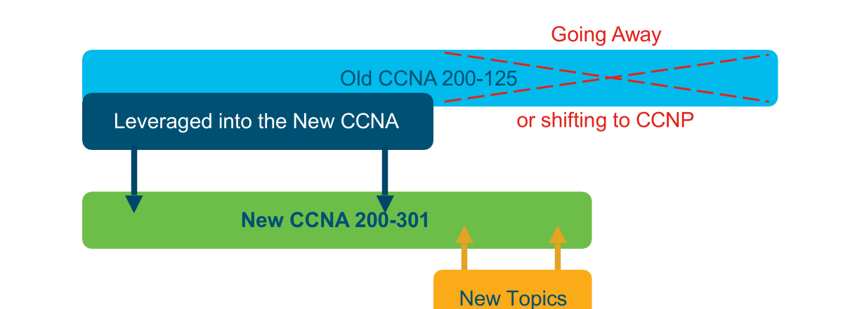
Exam Blueprint Composition
Orientation

Slide 5
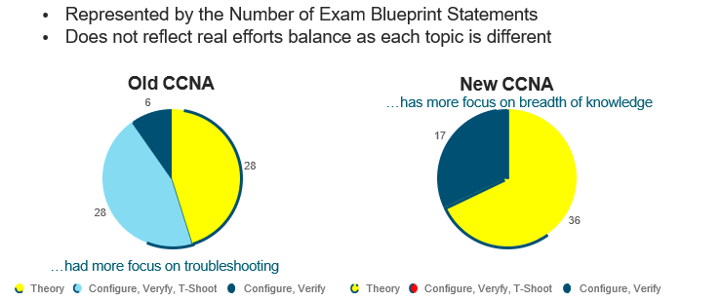
Theory / Practice Balance in the Blueprint
Orientation

Slide 6
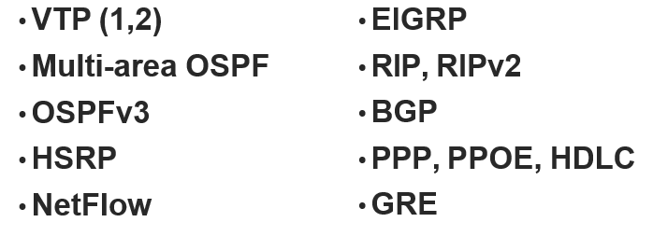
Key topics removed from blueprint:
Orientation

Slide 7
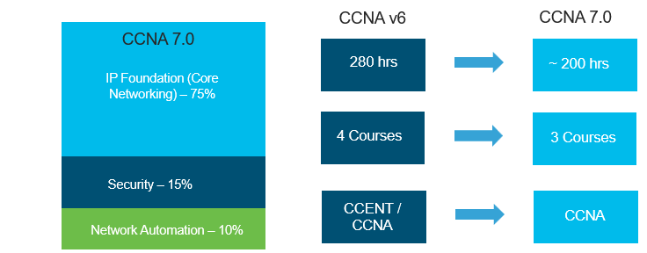
CCNA 7 Focus Areas and Major Differences
Orientation

Slide 8
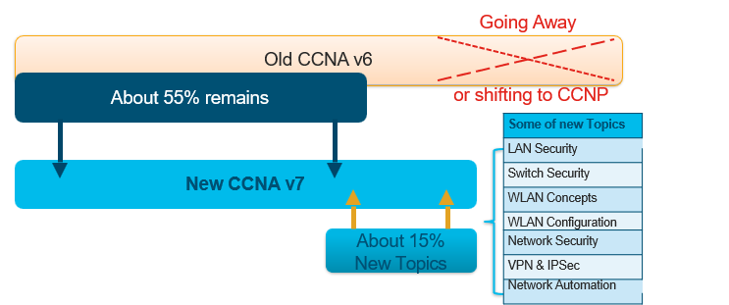
Relative Netacad Course Comparison by Size
Orientation

Slide 9
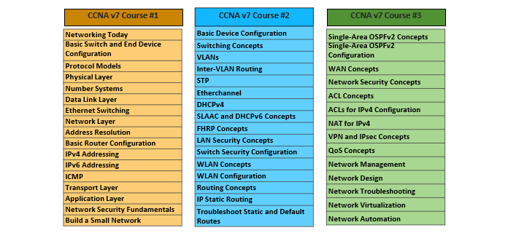
CCNA 7.0 Course Outlines
Orientation

Slide 10



Thank You

