Slide 1



Machine Learning
Prepared by Dr. Yasser Abdelhamid
DS 620
Machine Learning
Lecture 4

Slide 2

Outline
Multivariate regression
Data wrangling
Feature scaling
Normalization
  Standardization (Z-Score Normalization)
  Mean normalization
  Min Max Normalization
Dealing with non-numerical data
  One-Hot encoding
Multicollinearity
Training and testing
  K-Fold cross validation
Ploynomial regression

Slide 3
multivariate regression
Normally, the target variable may depend on more than one feature.
example: House price may depend on number of rooms, age, floor, in addition to house area.

Slide 4
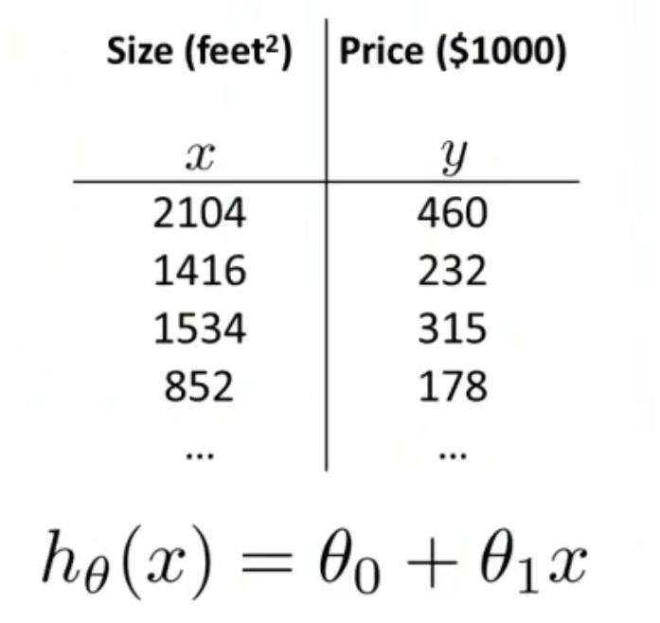
Linear regression with single variable

Slide 5
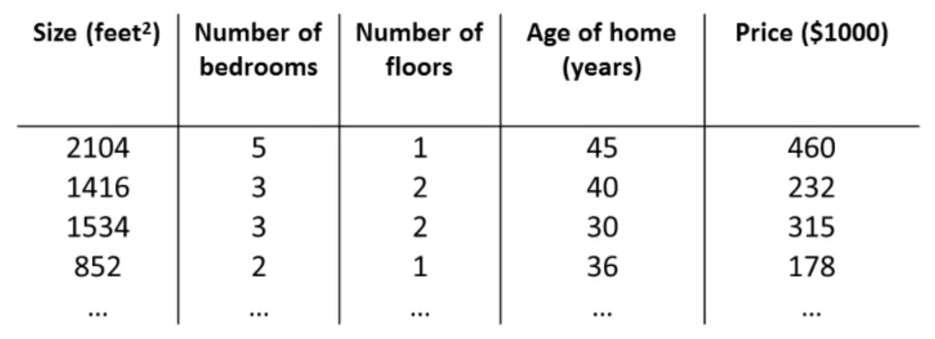
multivariate regression

Slide 6
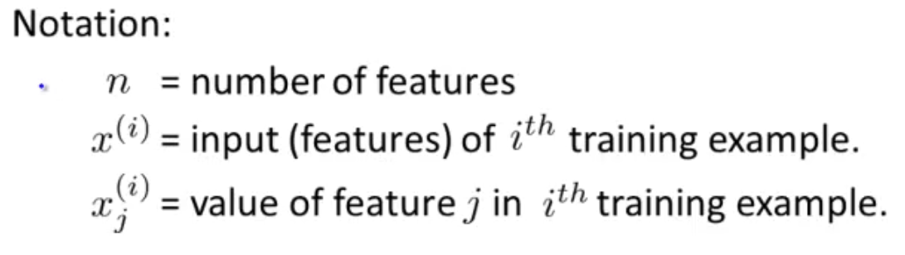
notation

Slide 7
Hypothesis function
Single variable/feature :
h_{Ɵ}(x) = Ɵ₀ + Ɵ₁x
Multiple variables/features:
For n features
h_{Ɵ}(x) = Ɵ₀ + Ɵ₁x₁ + Ɵ₂x₂ + Ɵ₃x₃ + Ɵ₄x₄ + … + Ɵ_{n}x_{n}
_{or more comfortably}
h_{Ɵ}(x) = Ɵ₀x₀ + Ɵ₁x₁ + Ɵ₂x₂ + Ɵ₃x₃ + Ɵ₄x₄ + … + Ɵ_{n}x_{n}
where x₀ is always 1

Slide 8
Hypothesis function
h_{Ɵ}(x) = Ɵ₀x₀ + Ɵ₁x₁ + Ɵ₂x₂ + Ɵ₃x₃ + Ɵ₄x₄ + … + Ɵ_{n}x_{n}
Ɵ and x are two multiplied vectors.
h_{Ɵ}(x) = Ɵ^{T}x

Slide 9
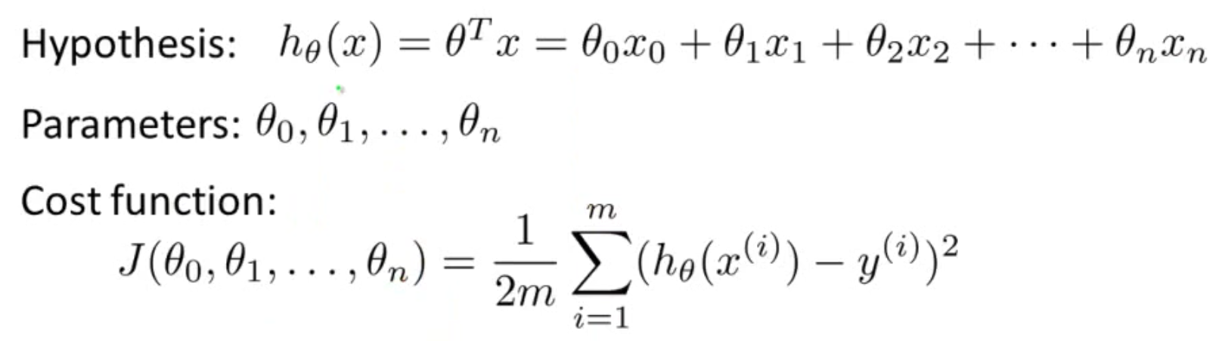
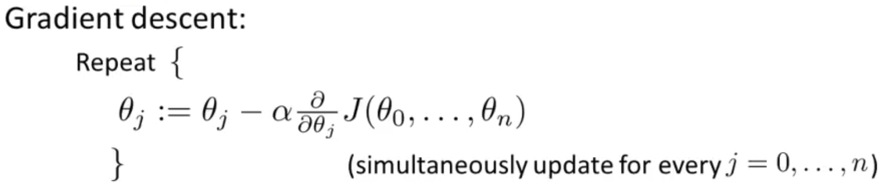
Gradient descent for linear regression with multiple features

Slide 10
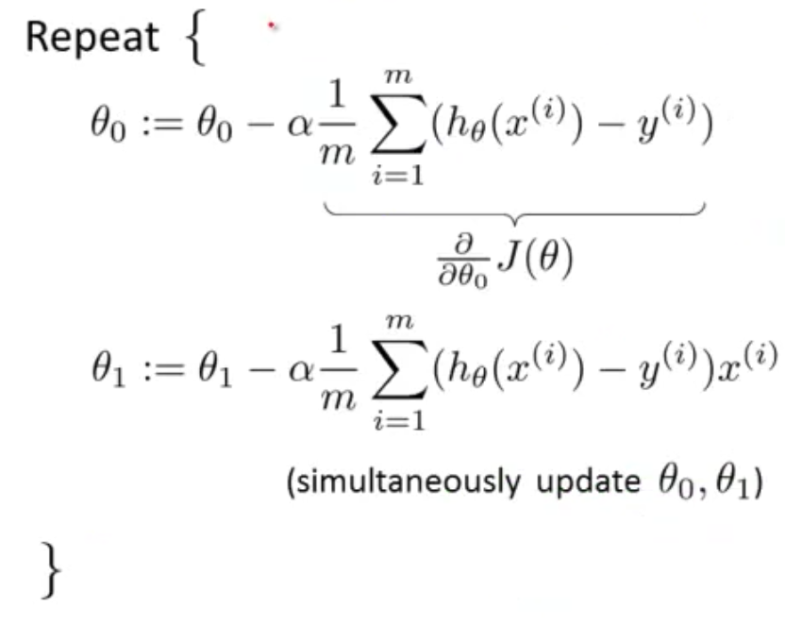
Gradient descent with n = 1

Slide 11
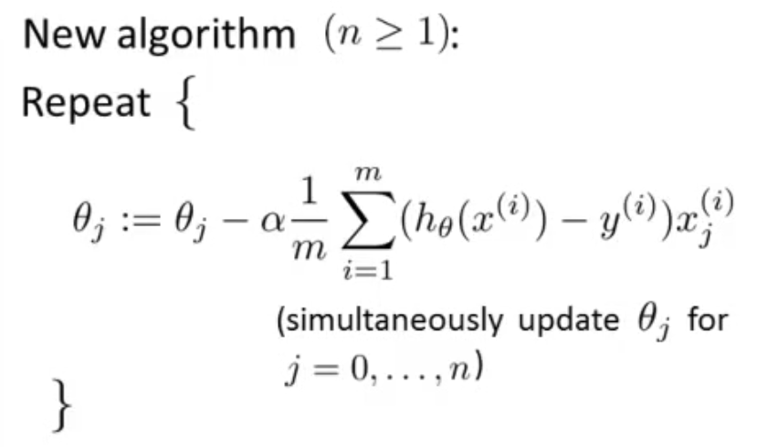
Gradient descent with n >= 1

Slide 12
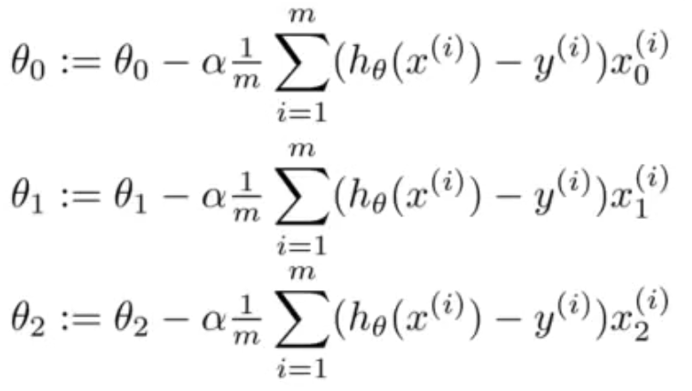
Example for two features

Slide 13
data wrangling
Data wrangling is the process of cleaning, structuring and enriching raw data into a desired format for better decision making in less time.

Slide 14
Gradient descent convergence
Gradient descent need data to be within near/ same scale to reach convergence faster.

Slide 15
Feature scaling
Machine learning algorithms deal with features as numbers only.
We have to work on all features with the same scale.
It is better to deal with small values rather than large values.

Slide 16
Feature scaling
Sometimes the scale of data representing features vary in scale, for example:
X1 | 3 | 5 | 6 | 4 | 2
X2 | 25000 | 38000 | 36000 | 28000 | 24000

Slide 17
Feature scaling
All features are represented in magnitude and unit which are different :
  age is represented in magnitude(integer) and unit(years)
  weight is represented in magnitude(real number) and unit(Kg)

Slide 18
Normalization
Normalization is the process of scaling down feature values to be
between 0 and 1.

Slide 19
Standardization (Z-Score Normalization)
Standardization is the process of scaling feature data based on the standard normal distribution, where the mean is 0 and standard deviation is 1.

Slide 20

Z-Score Normalization
Scaling data according to the standard normal distribution:
Where:
  x is the current attribute value
  μ is the mean of the population, and
  σ Is the standard deviation

Slide 21
Example
i | Area | Bedrooms | z-Score(Area) | z-Score(Bedrooms)
1 | 900 | 2 | -0.563734521 | -0.866025404
2 | 1300 | 3 | 1.240215946 | 0.866025404
3 | 1100 | 3 | 0.338240713 | 0.866025404
4 | 800 | 2 | -1.014722138 | -0.866025404
Mean | 1025 | 2.5
St.Dev. | 221.7355783 | 0.577350269

Slide 22
min max normalization
Scaling values of features to be within 0 and 1.
X - X_{min}
X_{norm} =
X_{max} - X_{min}

Slide 23
Example
i | Area | Bedrooms | Min-Max Norm(Area) | Min-Max Norm(Bedrooms)
1 | 900 | 2 | 0.2 | 0
2 | 1300 | 3 | 1 | 1
3 | 1100 | 3 | 0.6 | 1
4 | 800 | 2 | 0 | 0
Min | 800 | 2
Max | 1300 | 3

Slide 24
Dealing with non-numerical data
Machine learning algorithms deal with numeric data.
Sometimes dataset have text features.
This data has to be encoded in a form that is suitable for ML algorithms.

Slide 25
Non-numerical categorical variables
Ordinal variables:
  Has implicit numeric order.
    excellent, very good, good, pass
    first floor, second floor,…

Slide 26
Non-numerical categorical variables
Nominal variables:
  No numeric ordering.
    male, female
    cairo, giza, …
    red, green, blue

Slide 27
Non-numerical categorical variables Simple encoding
Simple encoding is to give a numerical code for each categorical value.
Simple numerical encoding ( giving a numerical value for each label) may not work for nominal variables.

Slide 28
one hot encoding
Create a separate column for each of the distinct labels of the nominal variable.
Put one if the field value matches the column label,
Put 0 otherwise.

Slide 29
Example
Dummy variables
Gender | Height | Weight
Male | 170 | 77
Female | 156 | 60
Female | 170 | 88
Height | Weight | Male | Female
170 | 77 | 1 | 0
156 | 60 | 0 | 1
170 | 88 | 0 | 1

Slide 30
Multicollinearity
Multicollinearity occurs when independent variables in a regression model are correlated.
This correlation is a problem because independent variables should be independent of each other.
If the degree of correlation between variables is high enough, it can cause problems when you fit the model and interpret the results.

Slide 31
Multicollinearity
To avoid Multicollinearity problem, we remove one of these variables.
Height | Weight | Male | Female
170 | 77 | 1 | 0
156 | 60 | 0 | 1
170 | 88 | 0 | 1
Height | Weight | Male
170 | 77 | 1
156 | 60 | 0
170 | 88 | 0

Slide 32
Training and testing datasets
In order to make sure that the model that we build is generalizing well ( i.e. is able to predict results for unseen instances) We split dataset into two sets.
The first is for training and the second is for testing.

Slide 33
Training and testing datasets
Usually we take:
  80% for training and
  20% for testing.
This method is usually used when there is a sufficient amount of data.

Slide 34
K-Fold cross validation
Divide dataset into k subsets.
{d₁,d₂,…,d_{k}}
For d in {d₁,d₂,…,d_{k}}
  set d as a test set.
  use the rest as training set.
  Calculate error

Slide 35
K-Fold cross validation
Calculate the overall error as the average of all subsets.
K-Fold cross validation method is a good choice when data is not sufficient.

Slide 36
Polynomial function
A polynomial function is a mathematical function that consists of one or more terms, each of which is a constant multiplied by a variable raised to a non-negative integer power.
The general form of a polynomial function is:
f(x)=a₀ + a₁x¹ + a₂x² +... + a_{k}x^{k}
Here, f(x) represents the polynomial function, x is the variable, a₀, a₁, ..., a_{k} are the coefficients of the polynomial, and k is the highest power or degree of the polynomial.

Slide 37
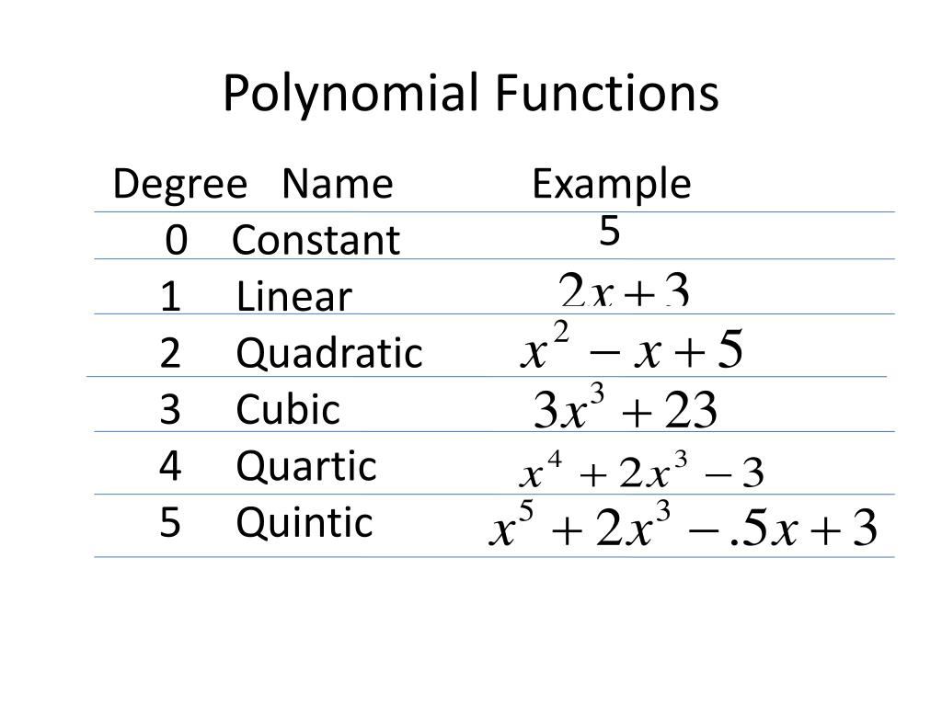
Polynomial function Examples

Slide 38

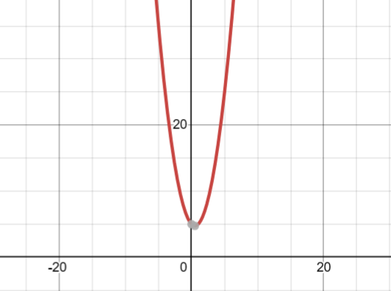
Quadratic

Slide 39
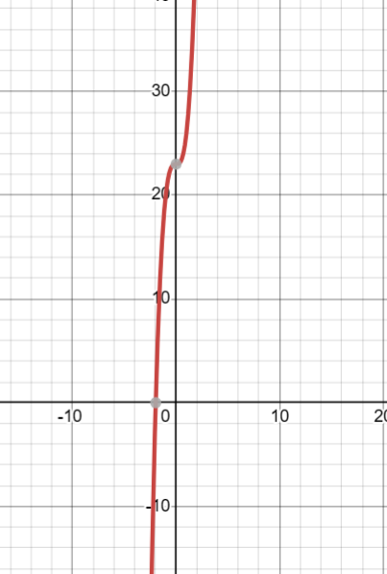

cubic

Slide 40
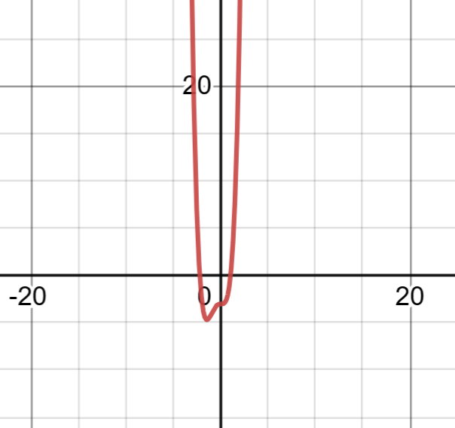

quartic

Slide 41
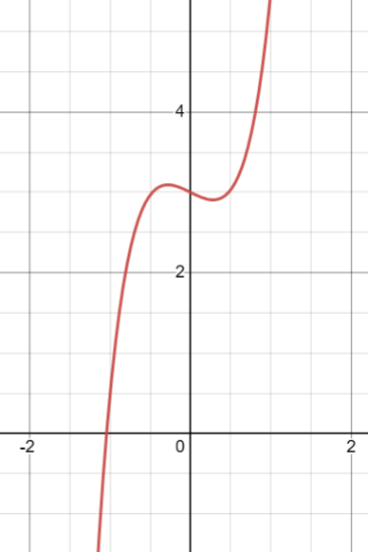

quintic

Slide 42
polynomial regression
Non-linear relationships can be modeled using polynomial functions.
We can model relationships using k^{th} degree polynomials in the following form:
h_{θ}(x)=θ₀ + θ₁x¹ + θ₂x² +... + θ_{k}x^{k}

Slide 43
Example:
h_{θ}(age)=θ₀ + θ₁age + θ₂(age)² + θ₃(age)³ + …
By replacing age, age², age³ … with x₁,x₂,x₃…
h_{θ}(x)=θ₀ + θ₁x₁ + θ₂x₂ + θ₃x₃ + …
which is similar to linear regression.

Slide 44
Summary(1)
Multivariate regression
Data wrangling
Feature scaling
Normalization
  Standardization (Z-Score Normalization)
  Mean normalization
  Min Max Normalization

Slide 45
Summary(2)
Dealing with non-numerical data
  One-Hot encoding
Multicollinearity
Training and testing
  K-Fold cross validation
Ploynomial regression

Slide 46


Thank You

