Slide 1


Social Responsability & Ethics in Marketing
Prepared by Dr. Thana Ahmed
Lecture 10
MGM204
PRINCIPLE OF MARKETING

Slide 2

CONTENT
Definitions
Social criticisms of Marketing
Consumer actions to Promote sustainable Marketing
Business actions toward sustainable marketing
Marketing Ethics
The Sustainable company

Slide 3
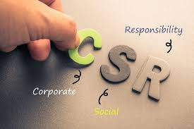
Introduction
Responsible marketers discover what consumers want and respond with market offerings that create value for buyers and capture value in return.
The marketing concept is a philosophy of customer value and mutual gain. Its practice leads the economy by an invisible hand to satisfy the many and changing needs of consumers.
Not all marketers follow the marketing concept, however. In fact, some companies use questionable marketing practices that serve their own rather than consumers’ interests.
Even well-intentioned marketing actions that meet the current needs of some consumers may cause immediate or future harm to other consumers or the larger society.
Responsible marketers must consider whether their actions are sustainable in the longer run.

Slide 4
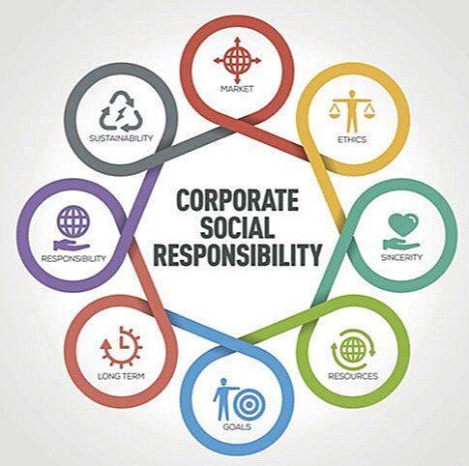
1. Definitions
Social responsibility: an organization’s obligation to maximize its positive impact and minimize its negative impact on society.
Sustainable marketing: Socially and environmentally responsible marketing that meets the present needs of consumers and businesses while also preserving or enhancing the ability of future generations to meet their needs.
Marketing Ethics: Principles and standards that define acceptable marketing conduct as determined by various stakeholders.

Slide 5
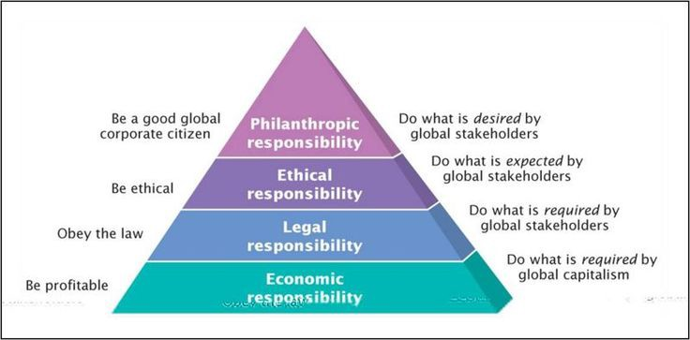
Pyramid Of Corporate Social Responsibility

Slide 6
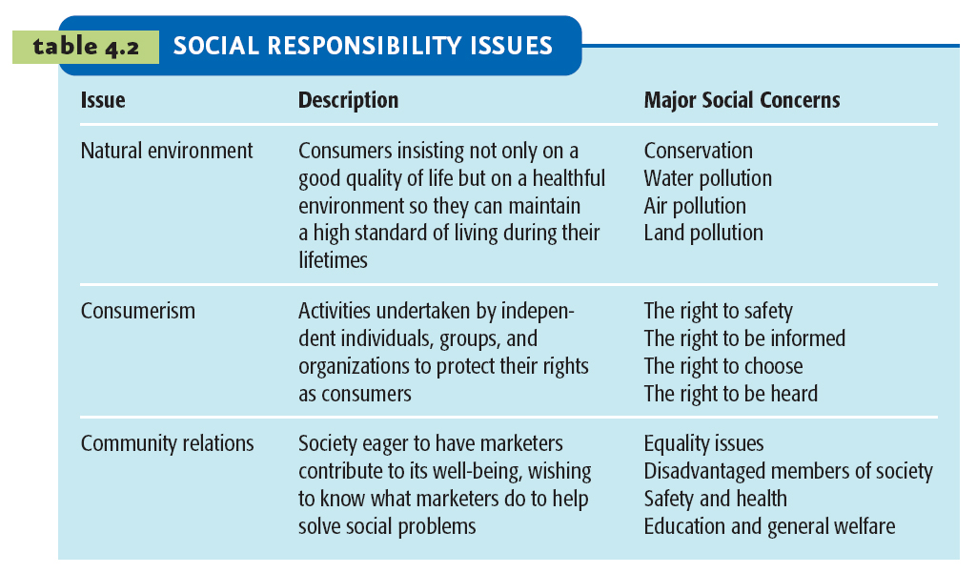
Social Responsibility Issues

Slide 7

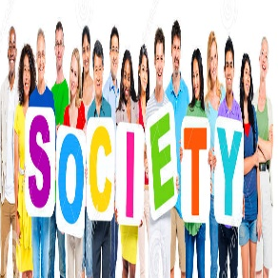

2. Social criticisms of Marketing
Social critics claim that certain marketing practices hurt
Individual Consumers
Society as a whole
Other Businesses

Slide 8
2.1.Marketing’s impact on individual consumers
HIGH PRICES
DECEPTIVE PRACTICES
HIGH-PRESSURE SELLING
SHODDY, HARMFUL, OR UNSAFE PRODUCTS
PLANNED OBSOLESCENCE
POOR SERVICE TO DISADVANTAGED CONSUMERS

Slide 9
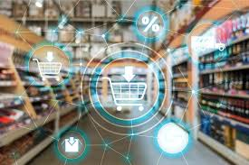
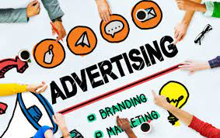
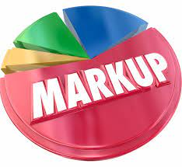
2.1. Marketing’s impact on individual consumers
1.1. HIGH PRICES:
Many critics charge that marketing system causes prices to be higher.
Critics point to three factors:
  High costs of distribution
  High advertising and promotion costs
  Excessive markups.

Slide 10
Critic Point | Socialists view | Marketers view
High costs of distribution | Greedy marketing channel members mark up prices beyond the value of their services. As a result, distribution costs too much, and consumers pay for these excessive costs in the form of higher prices. | Intermediaries do work that would otherwise have to be done by manufacturers or consumers. Their prices reflect services that consumers want—more convenience, larger stores and assortments, more service, longer store hours, and others. They argue that retail competition is so intense that margins are actually quite low.
High advertising and promotion costs | Modern marketing is pushing up prices to finance unneeded advertising, sales promotion, and packaging. Much of this promotion and packaging adds only psychological, not functional, value. | Although advertising adds to product costs, it also adds value by informing potential buyers of the availability and merits of a brand. Brand name products may cost more, but branding assures buyers of consistent quality. Moreover, although consumers can usually buy functional versions of products at lower prices, they want and are willing to pay more for products that also provide psychological benefits—that make them feel wealthy, attractive, or special.
Excessive markups. | Some companies mark up goods excessively. They point to the drug industry, where a pill costing five cents to make may cost the consumer $2 to buy, and to the high charges for auto repairs and other services. | Most businesses try to price fairly to consumers because they want to build customer relationships and repeat business. Also, they assert, consumers often don’t understand the reasons for high markups. For example, pharmaceutical markups help cover the costs of making and distributing existing medicines plus the high costs of developing and testing new medicines.

Slide 11
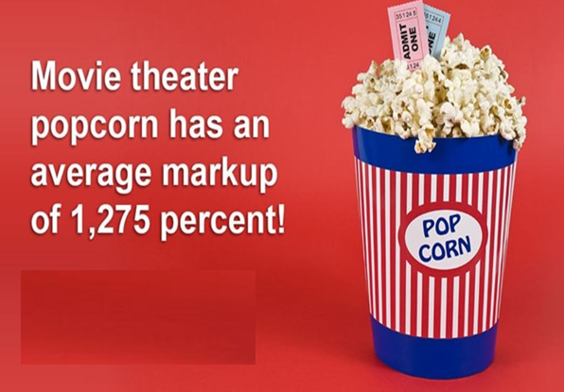

“Today’s medicines finance tomorrow’s miracles.”
HIGH MARKUP PRICES!

Slide 12
2.1. Marketing’s impact on individual consumers
1.2. DECEPTIVE PRACTICES:
Deceptive practices fall into 3 groups:
  Pricing: Deceptive pricing includes practices such as falsely advertising “factory” or “wholesale” prices or a large price reduction from a phony high retail list price.
  Promotion: Deceptive promotion includes practices such as misrepresenting the product’s features or performance or luring customers to the store for a bargain that is out of stock.
  Packaging: Deceptive packaging includes exaggerating package contents through subtle design, using misleading labeling, or describing size in misleading terms.
Deceptive practices have led to legislation and other consumer protection actions.

Slide 13

Example of deceptive pricing
Overstock.com was fined $6.8 million by a California court as a result of a fraudulent pricing lawsuit.
The suit charged that the online giant routinely advertised its prices as lower than fabricated “list prices.”
It recites one example in which Overstock sold a patio set for $449 while claiming that the list price was $999. When the item was delivered, the customer found that it had a Walmart sticker stating a price of $247

Slide 14
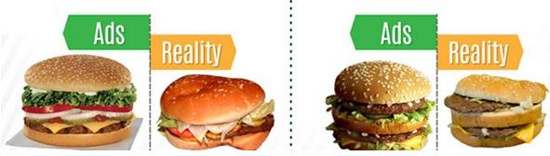
Example of deceptive promotion

Slide 15
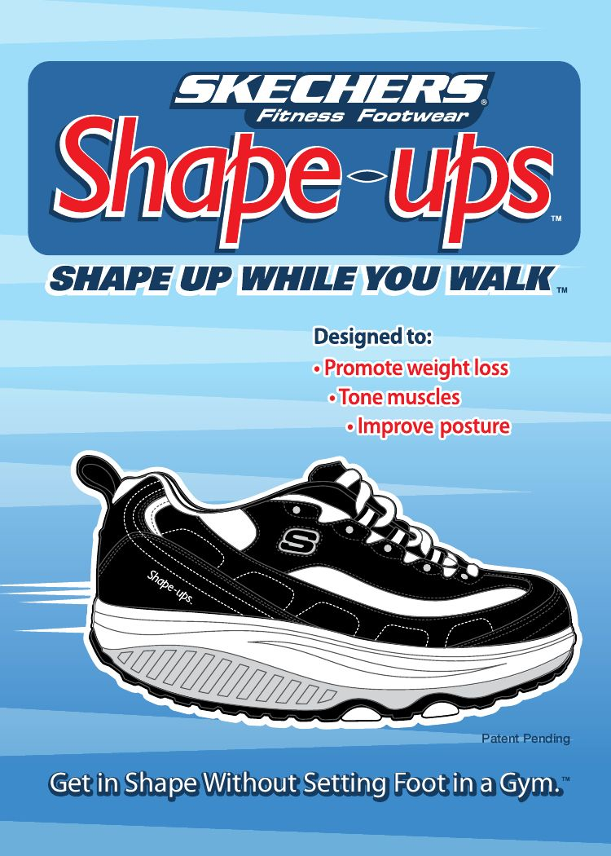
Example of deceptive promotion
x
Skechers paid $55 million in consumer because it made false advertising claims that its rocker-bottom Shapeups and other toning shoes would help customers tone muscles and lose weight.

Slide 16
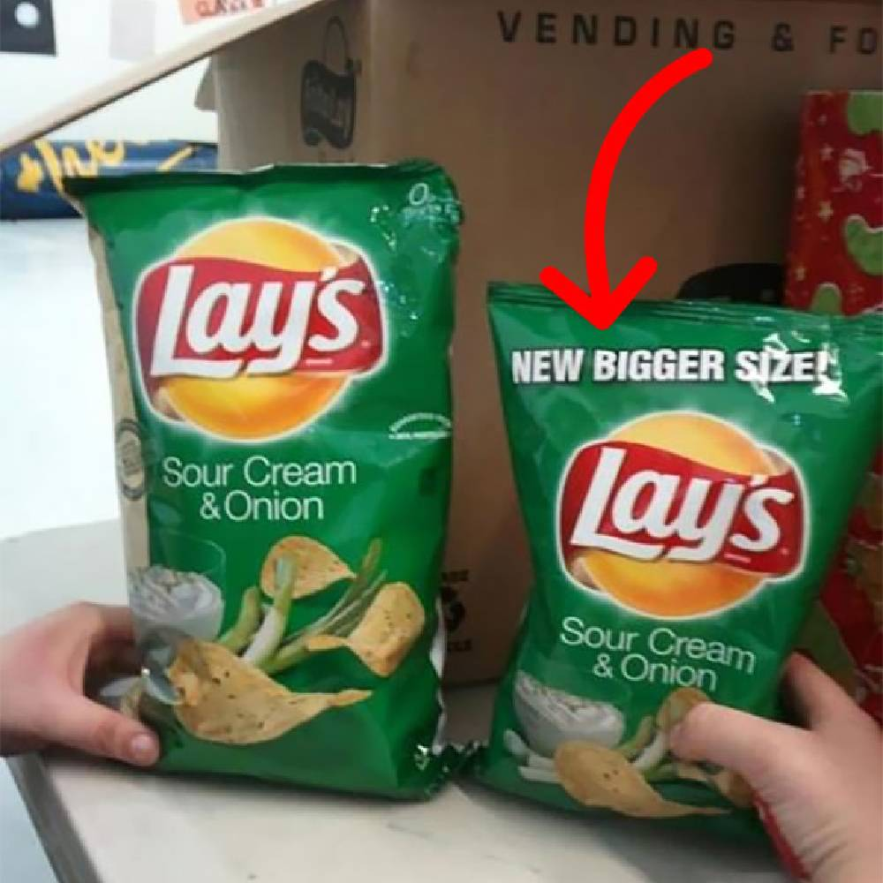
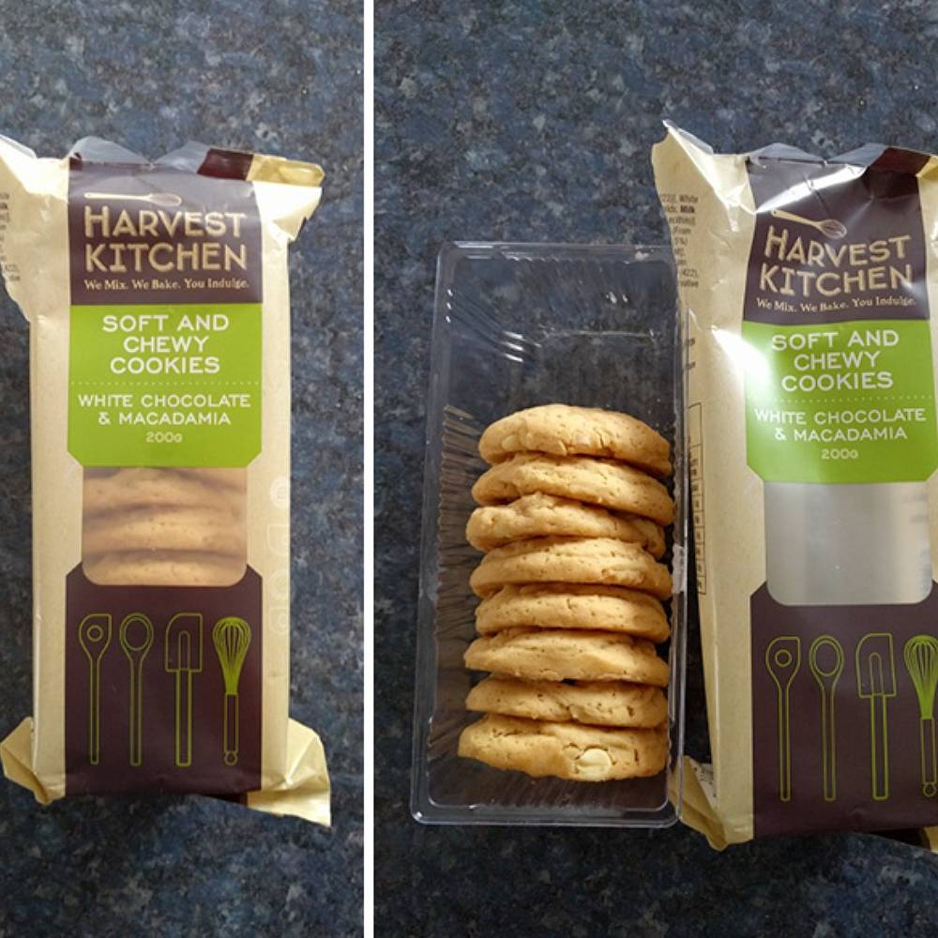
Example of deceptive packaging

Slide 17
Deceptive practices are not good for business!
Marketers argue that most companies avoid deceptive practices.
Such practices harm a company’s business in the long run, they simply aren’t sustainable.
Profitable customer relationships are built on a foundation of value and trust.
If consumers do not get what they expect, they will switch to more reliable products.
In addition, consumers usually protect themselves from deception. Most consumers recognize a marketer’s selling intent and are careful when they buy, sometimes even to the point of not believing completely true product claims.

Slide 18


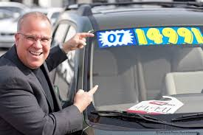
2.1. Marketing’s impact on individual consumers
1.3. HIGH-PRESSURE SELLING:
Salespeople are sometimes accused of high-pressure selling that persuades people to buy goods they had no thought of buying.
Such tactics may work in one-time selling situations for short-term gain, involves building long-term relationships with valued customers.
High-pressure or deceptive selling can seriously damage such relationships.

Slide 19
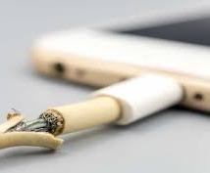
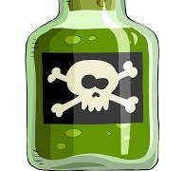

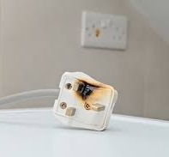
2.1. Marketing’s impact on individual consumers
1.4. SHODDY, HARMFUL, OR UNSAFE PRODUCTS:
Criticism concern poor quality of products (does not meet expectations: product fails, does not perform as promised, delivered late, hard to find customer service, etc…)
A second complaint concerns product safety.
A third complaint is that many products deliver little benefit or may even be harmful.

Slide 20

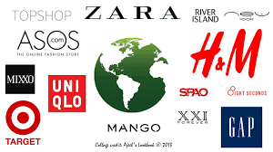
2.1. Marketing’s impact on individual consumers
1.5. PLANNED OBSOLESCENCE:
Critics also have charged that some companies practice planned obsolescence, causing their products to become obsolete before they actually should need replacement. They accuse some producers of using materials and components that will break, wear, rust, or rot sooner than they should.
Other companies are charged with perceived obsolescence—continually changing consumer concepts of acceptable styles to encourage more and earlier buying.

Slide 21
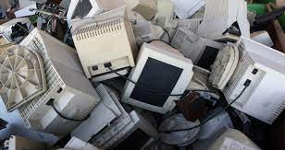
2.1. Marketing’s impact on individual consumers
1.5. PLANNED OBSOLESCENCE:
Marketers respond that consumers like style changes; they get tired of the old goods and want a new look in fashion.
Or they want the latest high-tech innovations, even if older models still work.
No one has to buy a new product, and if too few people like it, it will simply fail.
Finally, most companies do not design their products to break down earlier because they do not want to lose customers to other brands. Instead, they seek constant improvement to ensure that products will consistently meet or exceed customer expectations.
Much of the so-called planned obsolescence is the working of the competitive and technological forces in a free society—forces that lead to ever-improving goods and services. For example, if Apple produced a new iPhone or iPad that would last 10 years, few consumers would want it. Instead, buyers want the latest technological innovations.

Slide 22


2.1. Marketing’s impact on individual consumers
1.6. POOR SERVICE TO DISADVANTAGED CONSUMERS:
Critics accuse major chain retailers of redlining, drawing a red line around disadvantaged neighborhoods and avoiding placing stores there.
Better marketing systems must be built to service disadvantaged consumers. In fact, many marketers profitably target such consumers with legitimate goods and services that create real value.

Slide 23
2.2. Marketing’s impact on society as a whole
False wants and too much materialism
Too few social goods
Cultural Pollution

Slide 24
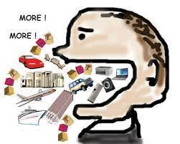
2.2. Marketing’s impact on society as a whole
2.2.1. FALSE WANTS AND TOO MUCH MATERIALSIM
Critics have charged that the marketing system urges too much interest in material possessions
People are now judged by what they own rather than by who they are.
Critics see this interest in material things as a matter of false wants created by marketing. Marketers, they claim, stimulate people’s desires for goods and create materialistic models of the good life. Thus, marketers have created an endless cycle of mass consumption.
In this view, marketing is creating overconsumption and it creates a growing “aspirational gap”

Slide 25
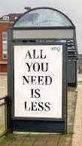
2.2. Marketing’s impact on society as a whole
2.2.1. FALSE WANTS AND TOO MUCH MATERIALSIM
Marketers respond that such criticisms overstate the power of business to create needs.
They claim people have strong defenses against advertising and other marketing tools.
Even minor purchases that may be affected by advertising messages lead to repeat purchases only if the product delivers the promised customer value.
The high failure rate of new products shows that companies are not able to control demand.
On a deeper level, our wants and values are influenced not only by marketers but also by family, peer groups, religion, cultural background, and education. If people are highly materialistic, these values arose out of basic socialization processes rather than marketing efforts.

Slide 26
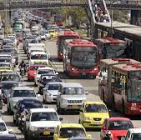
2. Marketing’s impact on society as a whole
2.2.2. TOO FEW SOCIAL GOODS
Business has been accused of overselling private goods at the expense of public goods.
For example, private automobile ownership (private good) requires highways, traffic control, parking spaces, and police services (public goods).
The overselling of private goods results in social costs. For cars, some of the social costs include traffic congestion, gasoline shortages, and air pollution.
For example, American travelers lose, on average, 38 hours a year in traffic jams, costing the United States more than $120 billion a year—$820 per commuter. In the process, they waste 2.9 billion gallons of fuel and emit 56 billion tons of greenhouse gases.

Slide 27

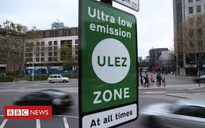
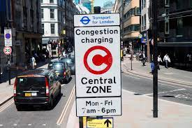
2.2.2. TOO FEW SOCIAL GOODS
One option is to make producers bear the full social costs of their operations (government is requiring automobile manufacturers to build cars with more efficient engines and better pollution-control systems).
A second option is to make consumers pay the social costs. For example, many cities around the world are now charging congestion tolls in an effort to reduce traffic congestion. To decrease rush hour, the Metropolitan Transportation Commission charges a $6 toll during peak commute hours versus $4 at other times.

Slide 28
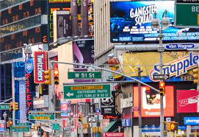
2.2. Marketing’s impact on society as a whole
2.2.3. CULTURAL POLUTION
Our senses are constantly assaulted by marketing and advertising
The critics claim that these messages continually pollute people’s minds with ideas related to materialism, power, or status.
Marketers answer these critics by advocating that advertising is entertaining and informative. Besides, today’s consumers have alternatives they can skip or zap if they don’t want to be exposed to the advertisement.

Slide 29
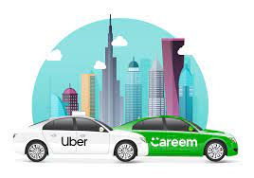
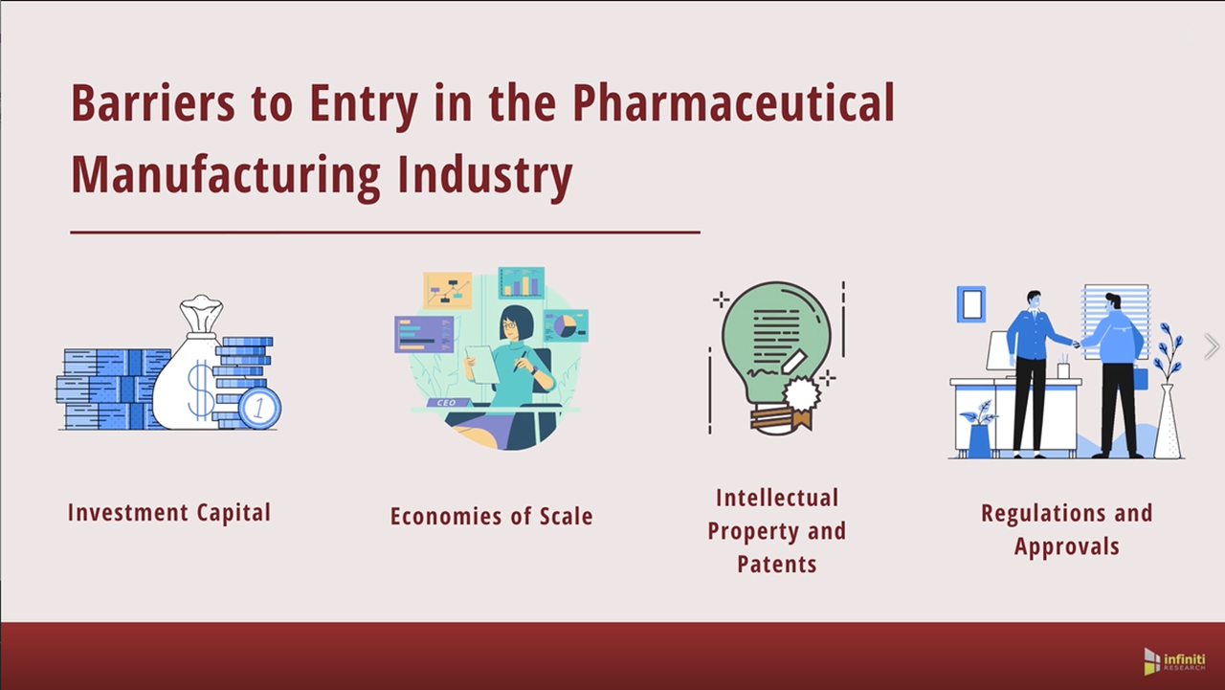
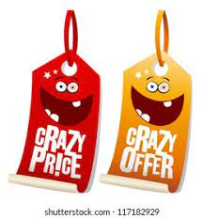
2.3. Marketing’s impact on other businesses
Critics also charge that a company’s marketing practices can harm other companies and reduce competition. They identify three problems:
Acquisitions of competitors
Creating barriers to entry
Unfair competitive marketing practices
Pharmaceutical industry

Slide 30
3. Consumer actions to Promote sustainable Marketing
Two major
movements
Environmentalism
Consumerism

Slide 31
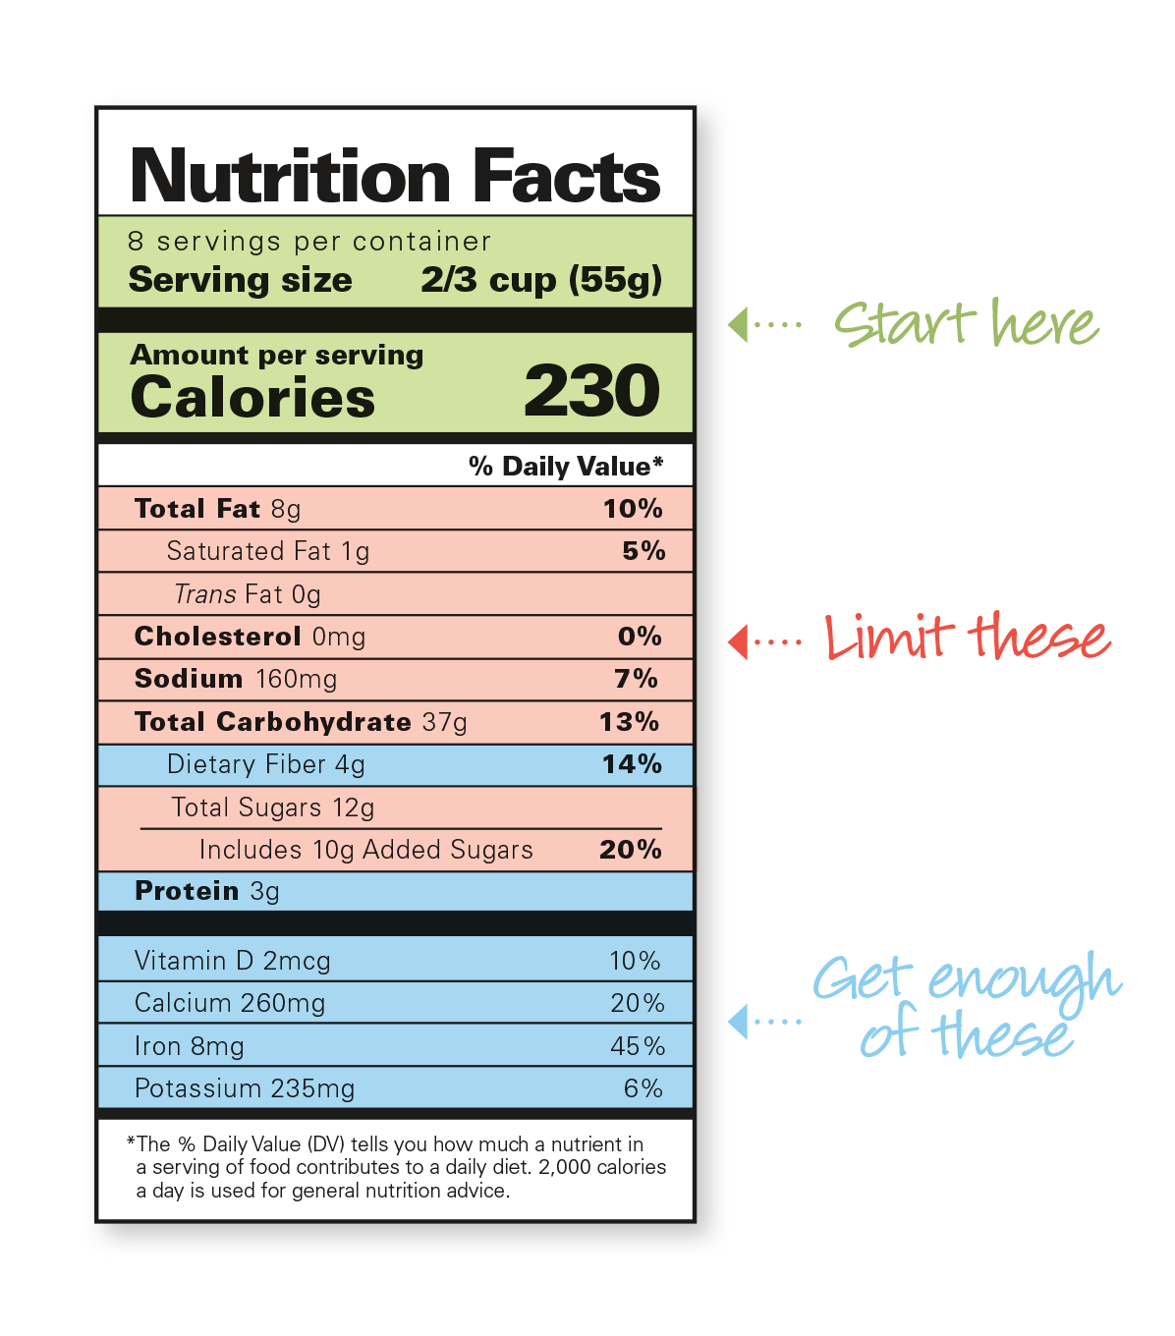
3. Consumer actions to Promote sustainable Marketing
Consumerism: An organized movement of citizens and government agencies to improve the rights and power of buyers in relation to sellers.
Consumer advocates call for the following additional consumer rights:
  The right to be well informed about important aspects of the product
  The right to be protected against questionable products and marketing practices
  The right to influence products and marketing practices in ways that will improve “quality of life”
  The right to consume now in a way that will preserve the world for future generations of consumers

Slide 32

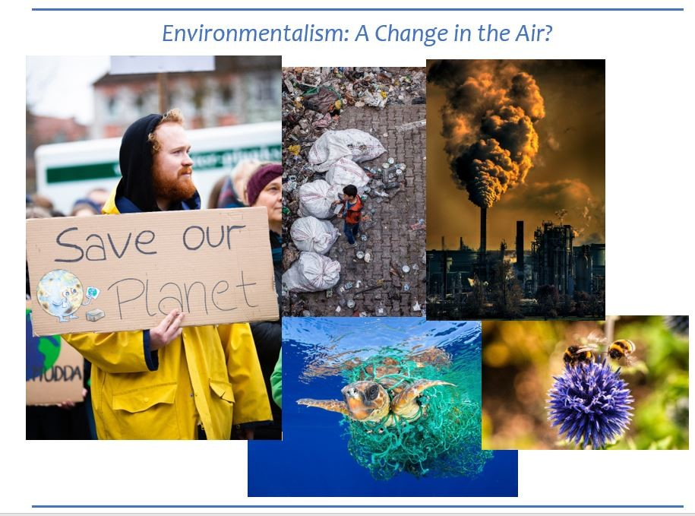
3. Consumer actions to Promote sustainable Marketing
Environmentalism: An organized movement of concerned citizens, businesses, and government agencies designed to protect and improve people’s current and future living environment
Environmentalists are not against marketing and consumption; they simply want people and organizations to operate with more care for the environment
The marketing system’s goal, environmentalists assert, should be to maximize life quality.
Life quality means not only the quantity and quality of consumer goods and services but also the quality of the environment, now and for future generations.
Environmentalism is concerned with damage to the ecosystem caused by global warming, resource depletion, toxic and solid wastes, litter, the availability of fresh water, and other problems. Other issues include the loss of recreational areas and the increase in health problems caused by bad air, polluted water, and chemically treated food.

Slide 33
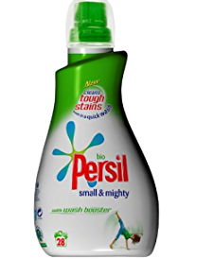
3. consumer actions to Promote sustainable Marketing
In recent years, however, most companies have accepted responsibility for doing no harm to the environment
More and more companies are now adopting policies of environmental sustainability.
Environmental sustainability: A management approach that involves developing strategies that both sustain the environment and produce profits for the company
Persil Small & Mighty concentrated laundry detergents use less packaging, making them cheaper and less polluting to transport. More important, they’ve been reformulated to wash efficiently at lower temperatures, using less energy and water. Unilever estimates that these changes have achieved a 15 percent reduction in greenhouse gas emissions.

Slide 34
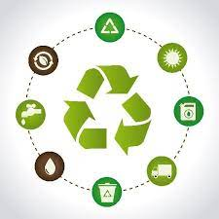
3. consumer actions to Promote sustainable Marketing
Green marketing: The specific development, pricing, promotion, and distribution of products that do not harm the natural environment.
Corporate Goals For The Natural Environment:
  Eliminate concept of waste
  Reinvent concept of a product
  Make prices reflect the cost
  Make environmentalism profitable

Slide 35
4. Business actions toward sustainable marketing
5.1. Sustainable Marketing Principles:
Under the sustainable marketing concept, a company’s marketing should be guided by five sustainable marketing principles:
1. Consumer-oriented marketing
2. Customer value marketing
3. Innovative marketing
4. Sense-of-mission marketing
5. Societal marketing

Slide 36
4. Business actions toward sustainable marketing
Consumer-oriented marketing: A company should view and organize its marketing activities from the consumer’s point of view. Companies should serve and satisfy the needs of a defined group of customers—both now and in the future. Only by seeing the world through its customers’ eyes can the company build sustainable and profitable customer relationships.
Customer value marketing: A company should put most of its resources into customer value-building marketing investments. Enlightened marketing calls for building long run consumer engagement, loyalty, and relationships by continually improving the value consumers receive from the firm’s market offering. By creating value for consumers, the company can capture value from consumers in return.
Innovative marketing: A company should seek real product and marketing improvements. The company that overlooks new and better ways to do things will eventually lose customers to another company that has found a better way.

Slide 37
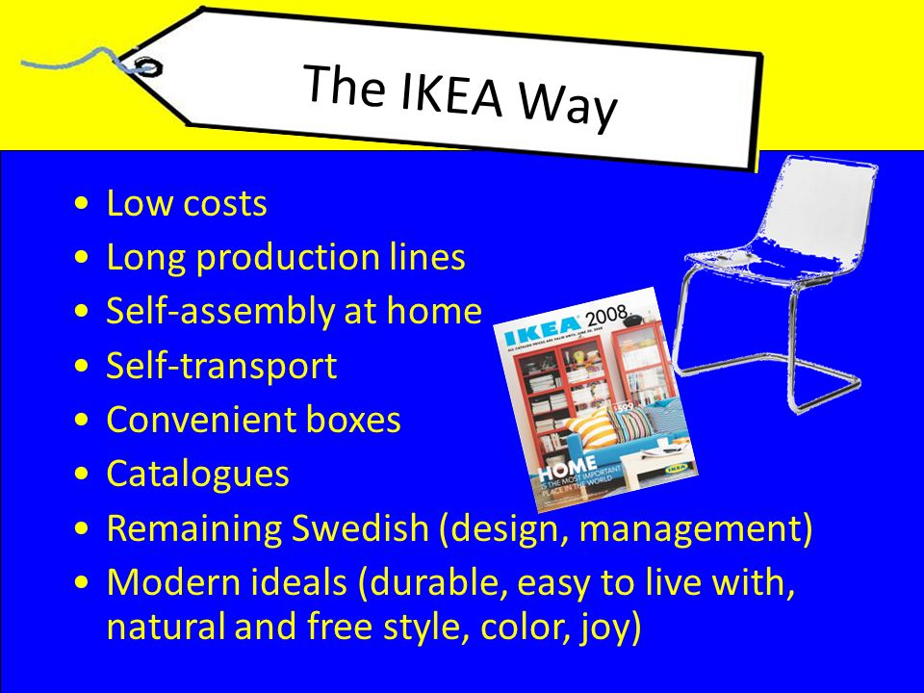
4. Business actions toward sustainable marketing
Sense-of-mission marketing: A company should define its mission in broad social terms rather than narrow product terms. For example, IKEA has a deeply ingrained sense of mission—called The IKEA Way—to create a better everyday life for people by “offering well designed, functional home furnishing products at prices so low that as many people as possible will be able to afford them.”

Slide 38
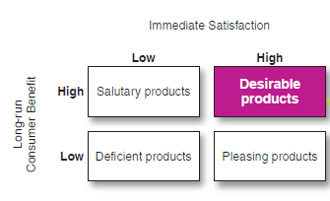
4. Business actions toward sustainable marketing
Societal marketing: A company should make marketing decisions by considering consumers’ wants, the company’s requirements, consumers’ long-run interests, and society’s long-run interests. Sustainable marketing calls for products that are not only pleasing but also beneficial.
Deficient products: Products that have neither immediate appeal nor long-run benefits.
Pleasing products: Products that give high immediate
satisfaction but may hurt consumers in the long run.
Salutary products: Products that have low immediate
appeal but may benefit consumers in the long run.
Desirable products: Products that give both high immediate satisfaction and high long-run benefits.
Societal classification of Products

Slide 39
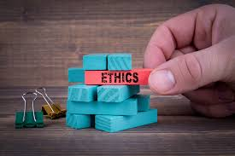
5. Marketing Ethics
Marketing Ethics: Principles and standards that define acceptable marketing conduct as determined by various stakeholders.
In the long run, unethical marketing harms customers and society as a whole. It eventually damages a company’s reputation and effectiveness, jeopardizing its very survival.
Sustainable marketing goals of long-term consumer and business welfare can be achieved only through ethical marketing conduct.

Slide 40
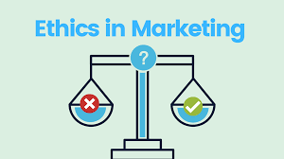
5. Marketing Ethics
The American Marketing Association developed a code of ethics :
    Do no harm. This means consciously avoiding harmful actions or omissions by embodying high ethical standards and adhering to all applicable laws and regulations in the choices we make.
    Foster trust in the marketing system. This means striving for good faith and fair dealing so as to contribute toward the efficacy of the exchange process as well as avoiding deception in product design, pricing, communication, and delivery or distribution.
    Embrace ethical values. This means building relationships and enhancing consumer confidence in the integrity of marketing by affirming these core values: honesty, responsibility, fairness, respect, transparency, and citizenship.

Slide 41

6. The Sustainable company
The sustainable company
At the foundation of marketing is the belief that companies that fulfill the needs and wants of customers will thrive.
Companies that fail to meet customer needs or that intentionally or unintentionally harm customers, others in society, or future generations will decline.
Sustainable companies are those that create value for customers through socially, environmentally, and ethically responsible actions. Sustainable marketing goes beyond caring for the needs and wants of today’s customers.
It means having concern for tomorrow’s customers in ensuring the survival and success of the business, shareholders, employees, and the broader world in which they all live.
It means pursuing the mission of a triple bottom line: people, planet, profits.
Sustainable marketing provides the context in which companies can build profitable customer relationships by creating value for customers in order to capture value from customers in return—now and in the future.

Slide 42


