Slide 1




Mathematics 3 – MAT132
Mathematics 3
Lecture 6
MAT 132
Fourier Series
Prepared by
Dr. Israa Lewaa

Slide 2
Lecture
05
Lecture Objective
Chapter Objectives
Essential information and Important notes for the Fourier series
Even function and odd function
Periodic Function
Fourier series
Extra Practice

Slide 3
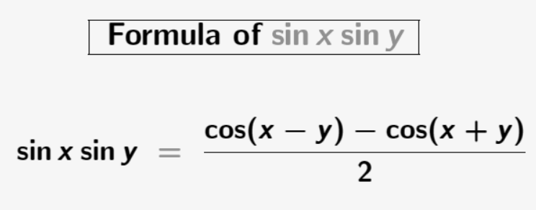
Lecture
05
Important Notes
Chapter Objectives

Slide 4
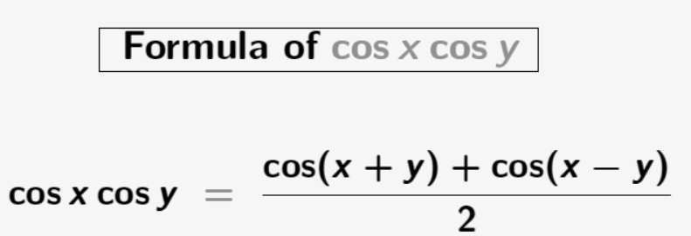
Lecture
05
Important Notes
Chapter Objectives

Slide 5
Lecture
05
Even and Odd Functions
Chapter Objectives
Even and Odd functions

Slide 6
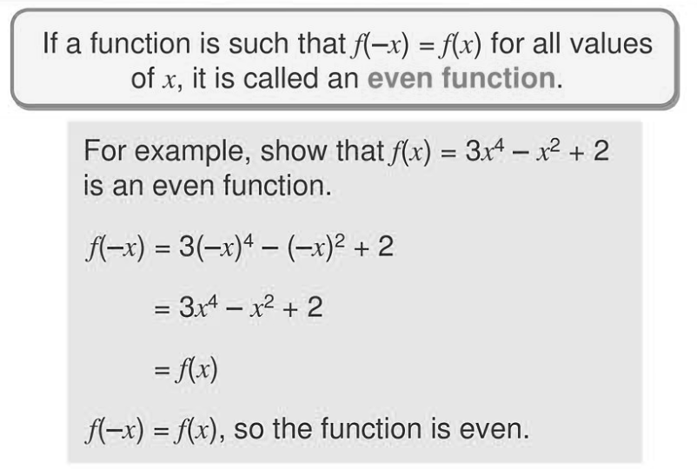
Lecture
05
Even Functions
Chapter Objectives

Slide 7
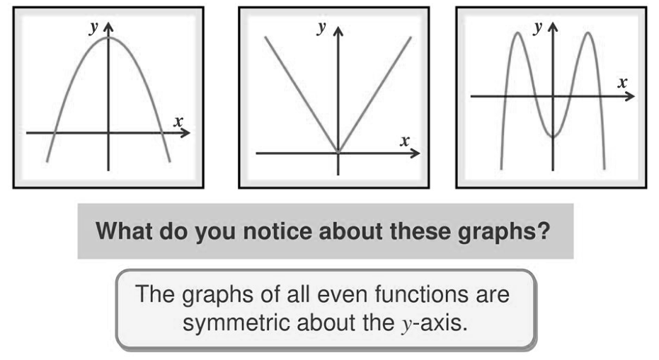
Lecture
05
Graphs of Even Functions
Chapter Objectives

Slide 8
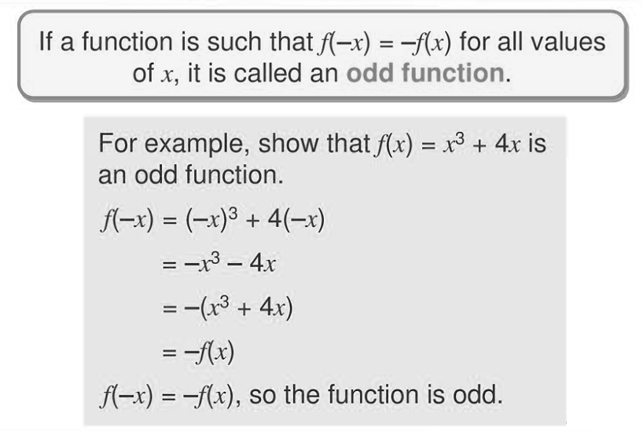
Lecture
05
Odd Functions
Chapter Objectives

Slide 9
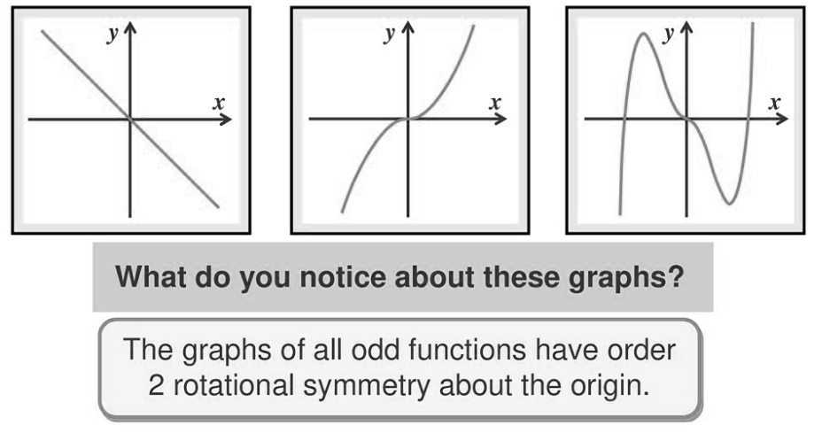
Lecture
05
Graphs of Odd Functions
Chapter Objectives

Slide 10
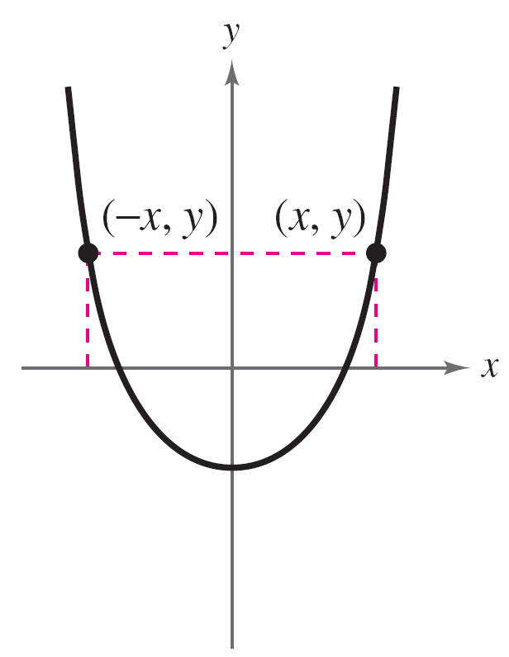
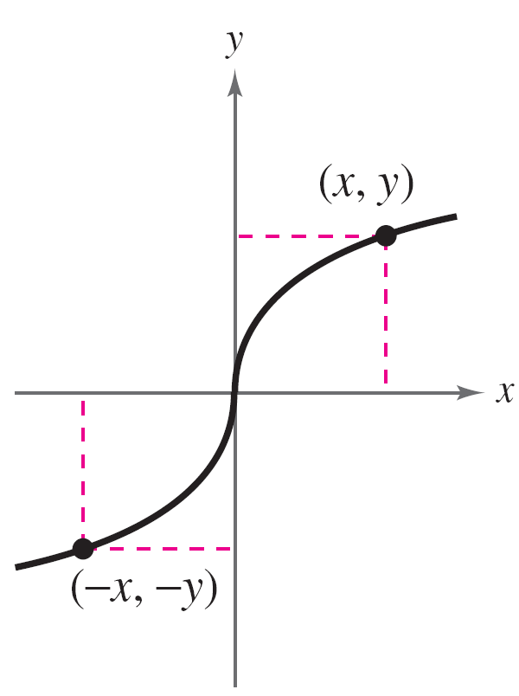
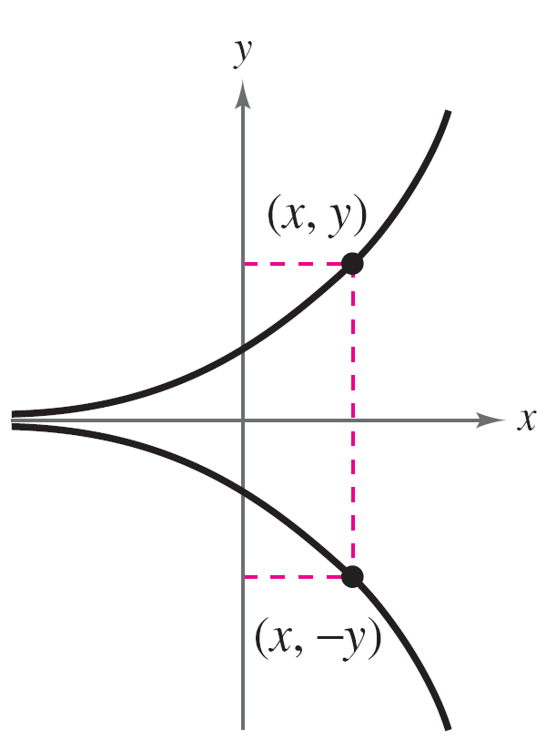
Lecture
05
Important Notes – Even and Odd Functions
Chapter Objectives
A graph that is symmetric with respect to the x-axis is not
the graph of a function (except for the graph of y = 0). These three types of symmetry
Symmetric to y-axis
Even function
Symmetric to origin
Odd function
Symmetric to x-axis
Not a function

Slide 11
Lecture
05
Properties of Even and Odd Functions
Chapter Objectives
If x has an even power, this means that the function is even
If x has an odd power, this means that the function is odd
The sum of even functions gives us an even function
The sum of odd functions gives us an odd function

Slide 12
Lecture
05
Example– Even and Odd Functions
Chapter Objectives
Determine whether each function is even, odd, or neither:
a. g(x) = x³ – x
b. h(x) = x² + 1
c. f (x) = x³ – 1

Slide 13
Lecture
05
Lecture
05
Example– Even and Odd Functions
Chapter Objectives
g(x) = x³ – x
x³ is an x with odd power “3”. So, it is odd function.
x is an x with odd power “1”. So, it is odd function.
So, x³ – x is odd function because The sum of odd functions gives us an odd function.

Slide 14
Lecture
05
Lecture
05
Example– Even and Odd Functions
Chapter Objectives
b. h(x) = x² + 1
x² is an x with even power “2”. So, it is even function.
1 is a constant number. So, it is even function.
So, x² + 1 is even function because The sum of even functions gives us an even function.

Slide 15
Lecture
05
Lecture
05
Example– Even and Odd Functions
Chapter Objectives
c. f (x) = x³ – 1
x³ is an x with odd power “3”. So, it is odd function.
1 is a constant number. So, it is even function.
So, x³ - 1 is NOT EVEN function OR ODD function.

Slide 16
Lecture
05
Lecture
05
Periodic Functions
Chapter Objectives
Periodic Functions

Slide 17
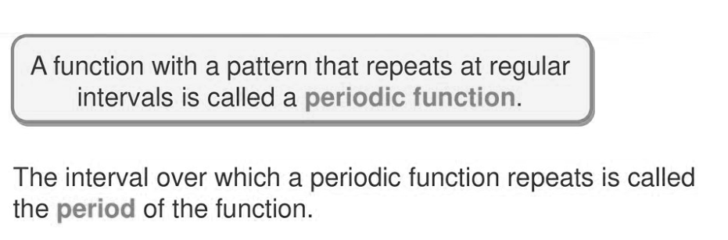
Lecture
05
Lecture
05
Periodic Functions
Chapter Objectives

Slide 18
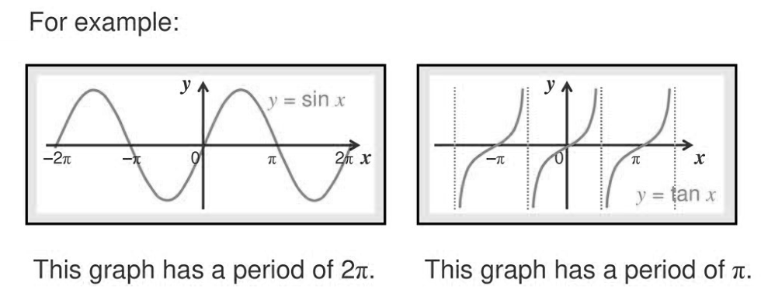
Lecture
05
Lecture
05
Graphs of Periodic Functions
Chapter Objectives

Slide 19
Lecture
05
Lecture
05
Fourier Series
Chapter Objectives
Fourier Series

Slide 20
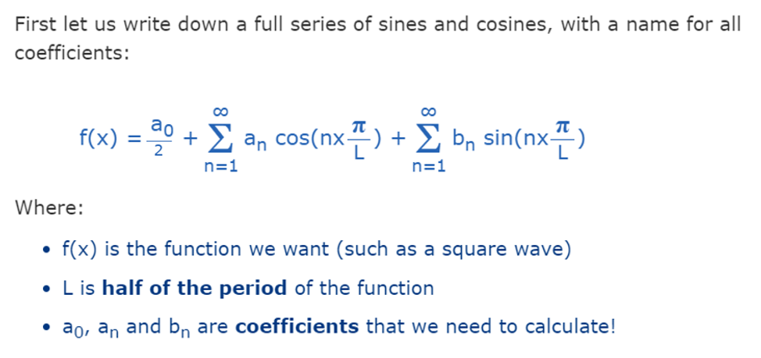
Lecture
05
Lecture
05
Fourier Series
Chapter Objectives

Slide 21
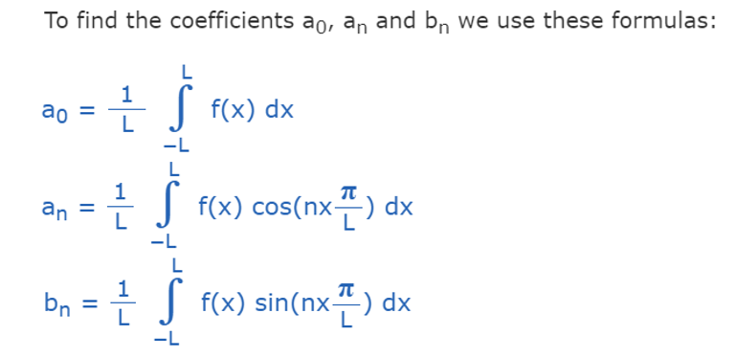
Lecture
05
Lecture
05
Coefficients of Fourier Series
Chapter Objectives

Slide 22


Lecture
05
Lecture
05
Note 1
Chapter Objectives
If the function f(x) is even,

Slide 23
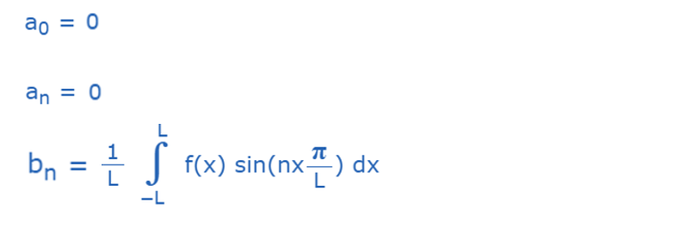
Lecture
05
Lecture
05
Note 2
Chapter Objectives
If the function f(x) is odd,

Slide 24
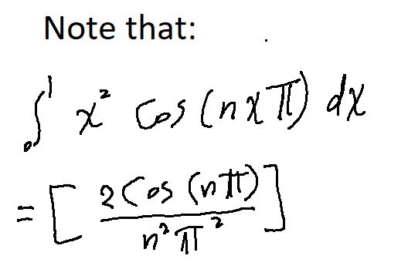
Lecture
05
Lecture
05
Extra Practice – Example 1
Chapter Objectives
Find the Fourier series for the following function:
f(x) = x²
-1 > x> 1

Slide 25
Lecture
05
Extra Practice – Example 1
Chapter Objectives
Find the Fourier series for the following function:
f(x) = x²
-1 > x> 1

Slide 26
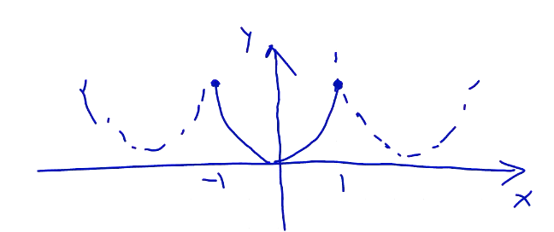
Lecture
05
Extra Practice – Example 1
Chapter Objectives
f(x) = x²
2L = 2 L = 1

Slide 27
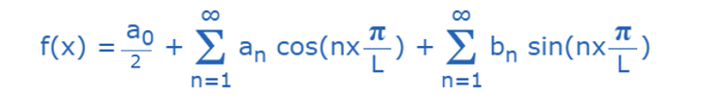
Lecture
05
Extra Practice – Example 1 Solution
Chapter Objectives
The function f(x) = x² is even

Slide 28
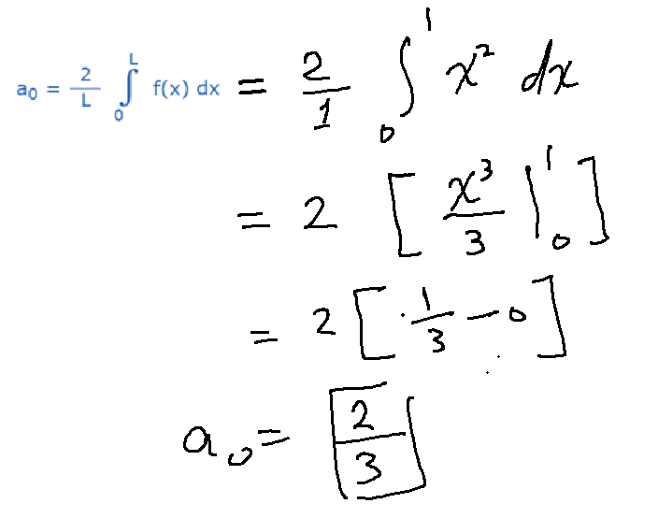
Lecture
05
Extra Practice – Example 1 Solution
Chapter Objectives

Slide 29
Lecture
05
Extra Practice – Example 1 Solution
Chapter Objectives

Slide 30
Lecture
05
Extra Practice – Example 1 Solution
Chapter Objectives

Slide 31
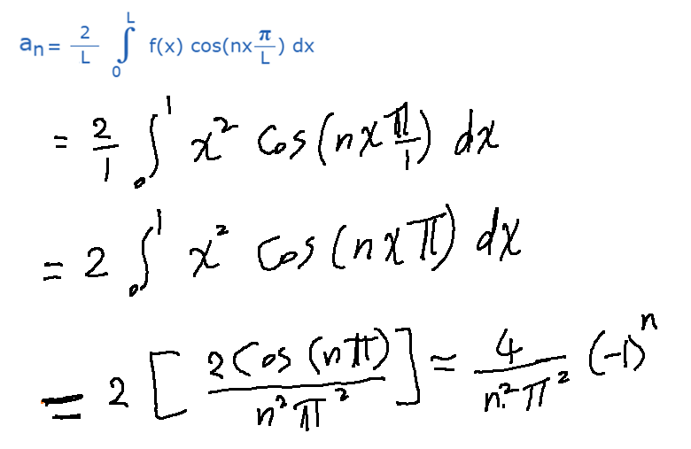
Lecture
05
Extra Practice – Example 1 Solution
Chapter Objectives

Slide 32


Lecture
05
Coefficients Values
Chapter Objectives
$$a_{0}=\frac{2}{3}$$
$$a_{n}=\frac{4}{n^{2}π^{2}}{(−1)}^{n}$$

Slide 33
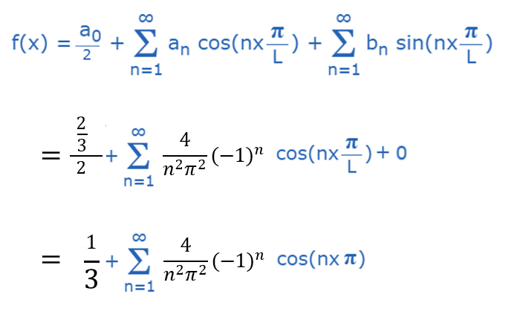
Lecture
05
Extra Practice – Example 1 Solution
Chapter Objectives

Slide 34
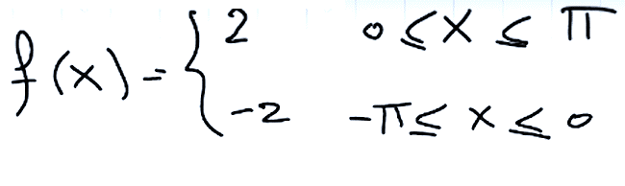
Lecture
05
Extra Practice – Example 2
Chapter Objectives
Find the Fourier series for the following function:

Slide 35
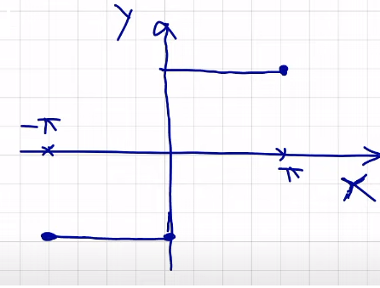
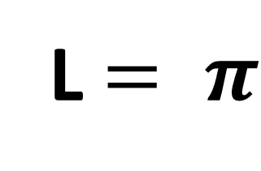
Lecture
05
Lecture
05
Extra Practice – Example 2 Solution
Chapter Objectives
f(x) = x²
2L = 2 L = 1
L $= π$

Slide 36
Lecture
05
Extra Practice – Example 2 Solution
Chapter Objectives
The function f(x) is odd

Slide 37
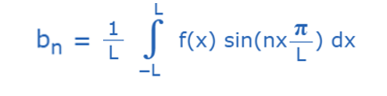
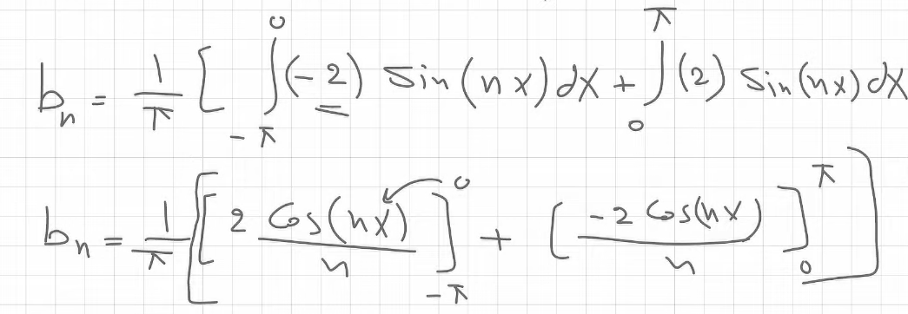
Lecture
05
Lecture
05
Extra Practice – Example 2 Solution
Chapter Objectives

Slide 38
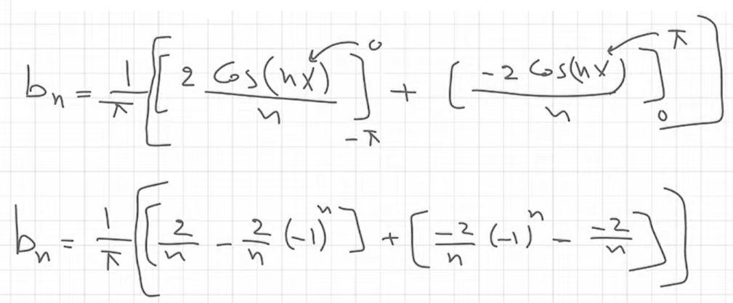
Lecture
05
Lecture
05
Extra Practice – Example 2 Solution
Chapter Objectives

Slide 39
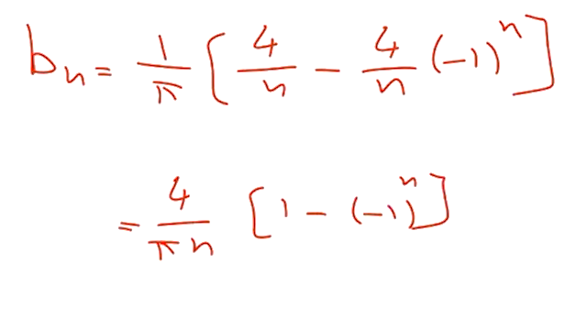
Lecture
05
Lecture
05
Extra Practice – Example 2 Solution
Chapter Objectives

Slide 40
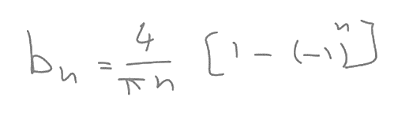


Lecture
05
Lecture
05
Coefficient Values
Chapter Objectives
$$a_{0}=0$$
$$a_{n}=0$$

Slide 41
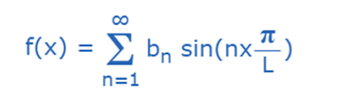
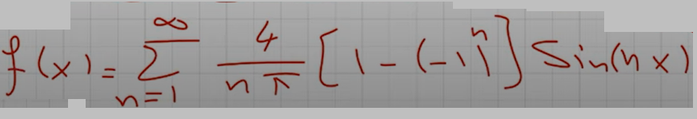
Lecture
05
Lecture
05
Extra Practice – Example 2 Solution
Chapter Objectives

Slide 42
Lecture
05
Lecture
05
Lecture Summary
Chapter Objectives
Essential information and Important notes for the Fourier series
Even function and odd function
Periodic Function
Fourier series
Extra Practice

Slide 43



Thank You

