Slide 1


Project Financial
Management
Prepared by Dr. Walaa Mohamed
PMG 615
CAPITAL INVESTMENTS AND CAPITAL ALLOCATION
Lecture 8

Slide 2

Objective of this lecture
This lecture covers:
Types of capital investments
Capital allocation process
Payback period
Net present value
Internal rate of return

Slide 3
Types of capital investments
The four types of capital investments include going concern projects, regulatory/compliance projects, expansion projects, and other projects.
1. Going concern projects may be needed to maintain the business or reduce costs. Projects that maintain the business do not require detailed analysis. The only issues are whether the existing operations should continue and, if so, whether existing procedures or processes should be maintained. Projects to improve efficiency may involve determining if equipment that is obsolete, but still usable, should be replaced. To reduce financing risk, companies often use a match funding approach, financing projects with capital sources that are consistent with the project life. Analysts often use a company's annual depreciation expense as an estimate of the capital investment it needs for going concern projects.

Slide 4
2. Regulatory/compliance projects may be required by a government agency or insurance company and often involve safety-related or environmental concerns. These projects typically generate little to no revenue and require the company to evaluate alternative ways of carrying out the projects.
3. Expansion projects grow the business and require a complex decision-making process that includes forecasting future demand. Expansion projects can involve entering new markets or introducing new products within the same market. A detailed analysis including forecasting revenues and expenses is required.
4. Other projects, such as new investments outside a company's existing lines of business, also entail a complex decision-making process with detailed analysis due to the uncertainty involved. Other projects are often similar to startups that explore a new technology or business idea. These projects can also involve buying out an existing company in a new industry, which involve risks that include overpaying.

Slide 5
Capital allocation process
The capital allocation process is identifying and evaluating capital projects (i.e., projects where the cash flows to the firm will be received over a period longer than a year). Any corporate decisions with an impact on future earnings can be examined using this framework. Decisions about buying a new machine, expanding business into another geographic area, moving the corporate headquarters to Cleveland, or replacing a delivery truck, to name a few, can be examined using a capital allocation analysis.
For a number of good reasons, capital allocation may be the most important responsibility that a financial manager has. First, because a capital allocation decision often involves the purchase of costly long-term assets with lives of many years, the decisions made may determine the future success of the firm. Second, the principles underlying the capital allocation process also apply to other corporate decisions, such as working capital management and making strategic mergers and acquisitions. Finally, making good capital allocation decisions is consistent with management's primary goal of maximizing shareholder value.
Working capital management represents the relationship between a firm's short-term assets and its short-term liabilities. It aims to ensure that a company can afford its day-to-day operating expenses while also investing the company's assets in the most successful direction possible.

Slide 6
The capital allocation process has four administrative steps:
Step 1: Idea generation. The most important step in the capital allocation process is generating good project ideas. Ideas can come from a number of sources, including senior management, functional divisions, employees, or sources outside the company.
Step 2: Analyzing project proposals. Because the decision to accept or reject a capital project is based on the project's expected future cash flows, a cash flow forecast must be made for each project to determine its expected profitability.
Step 3: Create the firm-wide capital budget. Firms must prioritize profitable projects according to the timing of the project's cash flows, available company resources, and the company's overall strategic plan. Many projects that are attractive individually may not make sense strategically.

Slide 7
Step 4: Monitoring decisions and conducting a post-audit. It is important to follow up on all capital allocation decisions. An analyst should compare the actual results to the projected results, and project managers should explain why projections did or did not match actual performance. Because the capital allocation process is only as good as the estimates of the inputs into the model used to forecast cash flows, a post-audit should be used to identify systematic errors in the forecasting process and improve company operations.

Slide 8
Payback Period & Net Present Value (NPV)
The standard measurements of return on equity for investors in a project are calculated on a cash ﬂow basis. For most managers financial criteria are the preferred method to evaluate projects.
These models are appropriate when there is a high level of confidence associated with estimates of future cash flows. Two models and examples are demonstrated here: payback model and net present value (NPV) model.
Example: (Even Cash inflows)
Project A has an initial investment (cash outflows) of $700,000 and projected cash inflows of $225,000 for 5 years.
Project B has an initial investment of $400,000 and projected cash inflows of $110,000 for 5 years.

Slide 9
  The payback model
  It measures the time it will take to recover the project investment. Shorter paybacks are more desirable. Payback is the simplest and most widely used model. Payback emphasizes cash flows, a key factor in business. Some managers use the payback model to eliminate unusually risky projects (those with lengthy payback periods). The major limitations of payback are that it ignores the time value of money, assumes cash inflows for the investment period (and not beyond), and does not consider profitability.
Payback period (yrs)=Estimated Project Cost/Annual Savings
Rate of return= Annual savings/ Estimated Project Cost
Payback period (yrs) for project A= 700,000/225,000= 3.1 years.
Payback period (yrs) for project B= 400,000/110,000= 3.6 years.
Rate of return of project A= 225,000/700,000= 32.1%
Rate of return of project B= 110,000/400,000= 27.5%

Slide 10

The payback for Project A is 3.1 years and for Project B is 3.6 years. Using the payback method both projects are acceptable since both return the initial investment in less than five years and have returns on the investment of 32.1 and 27.5 percent.
The net present value (NPV) model
It uses management’s minimum desired rate-of-return (discount rate, for example, 15 percent) to compute the present value of all net cash inflows. If the result is positive (the project meets the minimum desired rate of return), it is eligible for further consideration. If the result is negative, the project is rejected. Thus, higher positive NPV’s are desirable.

Slide 11
















I₀ = Initial investment (since it is an outflow, the number will be negative)
Ft = Net cash inflow for period t
k=Required rate of return (nominal)
Net present value
for project A
-700,000+
$ 54,235
Net present value
for project B
-400,000
- $ 31,263

Slide 12
The NPV model accepts project A, which has a positive NPV of $54,235. Project B is rejected since the NPV is negative $31,263. Compare the NPV results with the payback results. The NPV model is more realistic because it considers the time value of money, cash flows, and profitability.
When using the NPV model, the discount rate (return on investment, hurdle rate) can differ for different projects. For example, the expected ROI on strategic projects is frequently set higher than operational projects. Similarly, ROI’s can differ for riskier versus safer projects. The criteria for setting the ROI hurdle rate should be clear and applied consistently.
Strategic Projects involve creating something new and innovative. A new product, a new service, a new retail location, a new branch or division, or even a new factory might be a strategic project because it will allow an organization to gain a strategic advantage over its competitors.
Operational Projects improve current operations. These projects may not produce radical improvements, but they will reduce costs, get work done more efficiently, or produce a higher-quality product.
Unfortunately, pure financial models fail to include many projects where financial return is impossible to measure and/or other factors are vital to the accept or reject decision.

Slide 13

When cash inflows are uneven, we need to calculate the cumulative net cash flow for each period and then use the following formula:
Where,
A is the last period number with a negative cumulative cash flow;
B is the absolute value (i.e. value without negative sign) of cumulative net cash flow at the end of the period A; and
C is the total cash inflow during the period following period A
Cumulative net cash flow is the sum of inflows to date, minus the initial outflow.

Slide 14
Example : Uneven Cash Flows
Company C is planning to undertake another project requiring initial investment of $50 million and is expected to generate $10 million net cash flow in Year 1, $13 million in Year 2, $16 million in year 3, $19 million in Year 4 and $22 million in Year 5. Calculate the payback value of the project.
Solution
Payback Period = 3 + 11/19 = 3 + 0.58 ≈ 3.6 years

Slide 15
Inflation is usually defined as the general rise in the price of the goods and services. So, it has huge impact over the Net Present Value analysis because we use nominal rate of return in discounting cash flows to the present value. Nominal rate of return is the rate which your investment yields without taking into accounts factor of inflation.
In order to take into account inflation rate, we need to calculate real rate of return RR. Usually, it is obtained by subtracting inflation rate from the nominal rate.
Formula
RR = { (1 + MR) / (1+ IR) }-1
Where:
RR = Real rate of return
MR = Nominal rate of return
IR = Inflation rate

Slide 16
Example
DCF is considering investing in a long-term project of 5 years of $ 100,000 which will generate $ 25,000 each year. The nominal rate of return is 15 % and inflation rate is 10 %. Calculate the real rate of return.
Solution
As we know that:
RR = { (1 + MR) / (1+ IR) } - 1
RR = { (1 + 0.15) / (1 + 0.10) } – 1
RR = ( 1.15 / 1.10 ) – 1
RR = 4.6 %

Slide 17
Net present value (NPV) does not take into account the size of the project. For example, say Project A requires initial investment of $4 million to generate NPV of $1 million while a competing Project B requires $2 million investment to generate an NPV of $0.8 million. If we base our decision on NPV alone, we will prefer Project A because it has higher NPV, but Project B has generated more shareholders’ wealth per dollar of initial investment ($0.8 million/$2 million vs $1 million/$4 million).

Slide 18
Internal rate of return (IRR)
The internal rate of return (IRR) is a metric used in financial analysis to estimate the profitability of potential investments. IRR is a discount rate that makes the net present value (NPV) of all cash flows equal to zero in a discounted cash flow analysis.
IRR calculations rely on the same formula as NPV does. Keep in mind that IRR is not the actual dollar value of the project. It is the annual return that makes the NPV equal to zero.
PV inflows = PV outflows
Generally speaking, the higher an internal rate of return, the more desirable an investment is to undertake. IRR is uniform for investments of varying types and, as such, can be used to rank multiple prospective investments or projects on a relatively even basis. In general, when comparing investment options with other similar characteristics, the investment with the highest IRR probably would be considered the best.

Slide 19
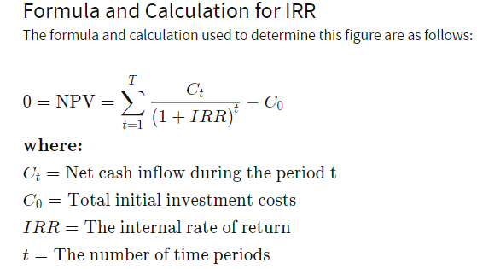
EQUITY RETURNS
IRR is calculated using the same concept as net present value (NPV), except it sets the NPV equal to zero.

Slide 20
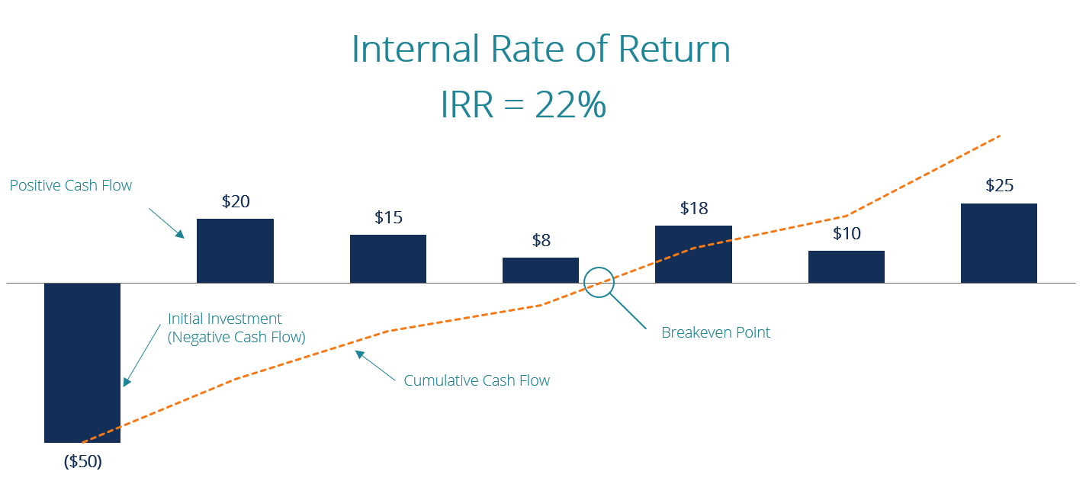
EQUITY RETURNS

Slide 21
The IRR of an investment is the discount rate at which the net present value of costs (negative cash flows ) of the investment equals the net present value of the benefits (positive cash flows) of the investment.
The higher a project’s IRR, the more desirable it is to undertake the project.
A firm (or individual) should, in theory, undertake all projects or investments available with IRRs that exceed the cost of capital. Investment may be limited by availability of funds to the firm and/or by the firm’s capacity or ability to manage numerous projects.
Based on IRR, a company will decide to either accept or reject a project. If the IRR of a new project exceeds a company’s required rate of return, that project will most likely be accepted. If IRR falls below the required rate of return, the project should be rejected.
The minimum IRR above which a project will be accepted is often referred to as the hurdle rate. Projects with IRRs above this rate will be accepted, while those with IRRs below this rate will not be accepted.
The required rate of return for a given project is usually the firm’s cost of capital. However, a project analyst may adjust the required rate of return above or below the firm's cost of capital to account for differences between the project's risk and the average risk of all of the firm's projects (which is reflected in the firm's current cost of capital).

Slide 22
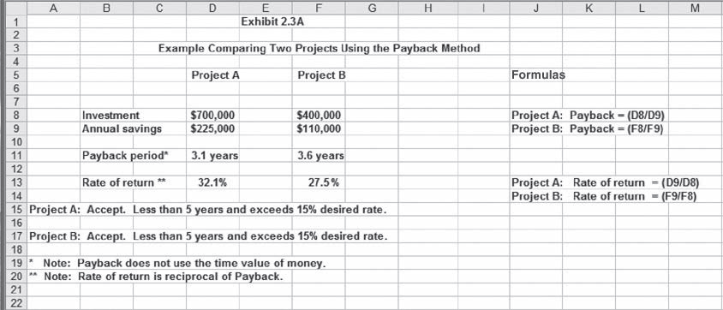

Slide 23


