Slide 1



Organizational Behavior
and Projects
PMG421
Lecture 1
What Is Organizational Behavior?
Prepared by: Mrs. Deena Ibraheem
www.midocean.ae

Slide 2

What Is Organizational Behavior?
The Importance of Interpersonal Skills.
Management and Organizational Behavior.
Management roles.
Management skills.
Effective versus successful managerial activities.
Complementing Intuition with Systematic Study.
Evidence-based management (EBM).
Disciplines that Contribute to the OB Field.
Absolutes in OB.
Challenges and Opportunities for OB.
www.midocean.ae

Slide 3

What Is Organizational Behavior?
www.midocean.ae

Slide 4
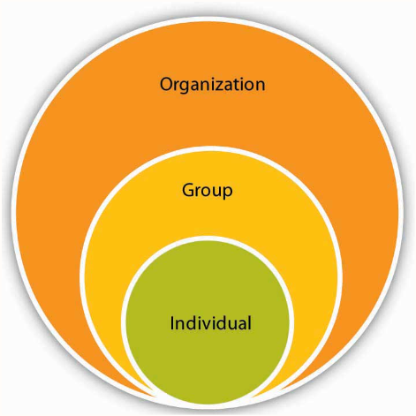
Organizational behavior (OB)
Organizational behavior (OB) is a field of study that investigates the impact individuals, groups, and structure have on behavior within organizations, for the purpose of applying such knowledge toward improving an organization’s effectiveness.
OB is a field of study, meaning that it is a distinct area of expertise with a common body of knowledge. What does it study? It studies three determinants of behavior in organizations: individuals, groups, and structure.
www.midocean.ae

Slide 5

In addition, OB applies the knowledge gained about individuals, groups, and the effect of structure on behavior in order to make organizations work more effectively. OB is the study of what people do in an organization and the way their behavior affects the organization’s performance. Because OB is concerned specifically with employment-related situations, it examines behavior in the context of job satisfaction, absenteeism, employment turnover, productivity, human performance, and management.
www.midocean.ae

Slide 6
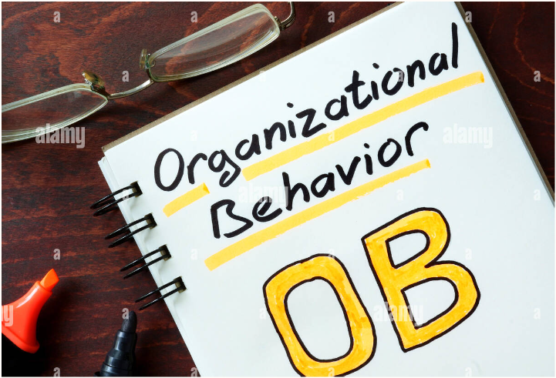
OB includes these core topics:
• Motivation
• Leader behavior and power .
• Interpersonal communication .
• Group structure and processes.
• Attitude development and perception.
• Change processes.
• Conflict and negotiation .
• Work design.
www.midocean.ae

Slide 7
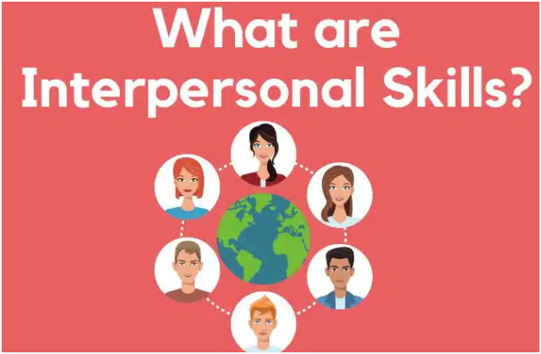
The Importance of Interpersonal Skills
Incorporating OB principles into the workplace can yield many important organizational outcomes. For one, companies known as good places to work— such as, Procter & Gamble, Facebook, and Southwest Airlines have been found to generate superior financial performance. Second, developing managers’ interpersonal skills helps organizations attract and keep high-performing employees, which is important since outstanding employees are always in short supply and are costly to replace. Third, there are strong associations between the quality of workplace relationships and employee job satisfaction, stress, and turnover.
www.midocean.ae

Slide 8

Management and Organizational Behavior
The work of managers can be included in four activities:
Planning, Organizing, Leading, And Controlling.
The planning function encompasses defining an organization’s goals, establishing an overall strategy for achieving those goals, and developing a comprehensive set of plans to integrate and coordinate activities.
. The organizing function includes determining what tasks are to be done, who is to do them, how the tasks are to be grouped, who reports to whom, and where decisions are to be made.
www.midocean.ae

Slide 9
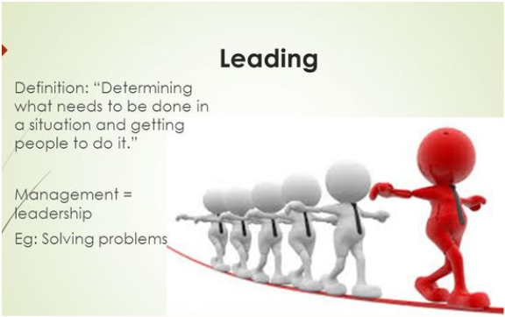
Management and Organizational Behavior
Every organization contains people, and it is management’s job to direct and coordinate those people. This is the leading function.
To ensure things are going as they should, management must monitor the organization’s performance and compare it with previously set goals. If there are any significant deviations, it is management’s job to get the organization back on track. This monitoring, comparing, and potential correcting is the controlling function.
www.midocean.ae

Slide 10
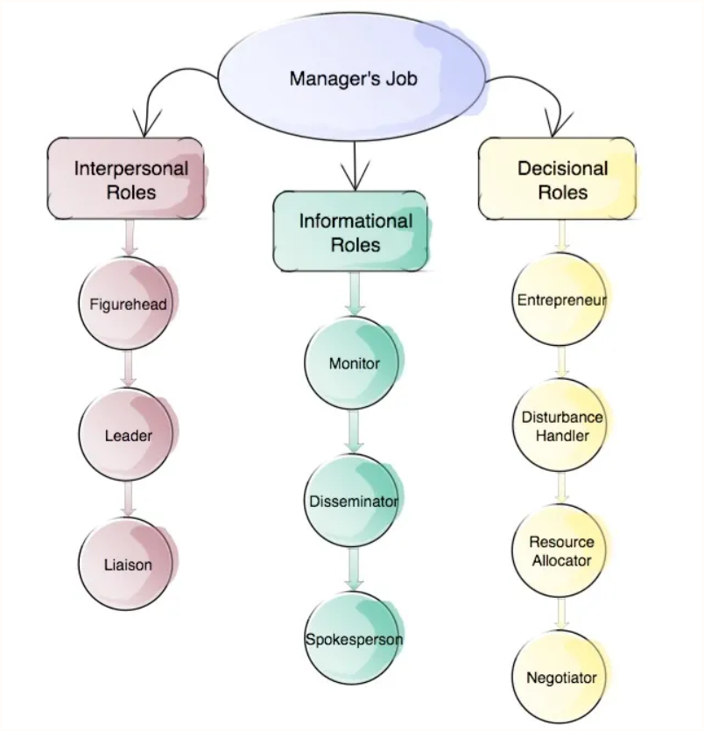
Management roles
10 Roles of Manager:
Managerial Roles by Henry Mintzberg
www.midocean.ae
Notes:
Henry Mintzberg is a Canadian academic and author on business and management.

Slide 11

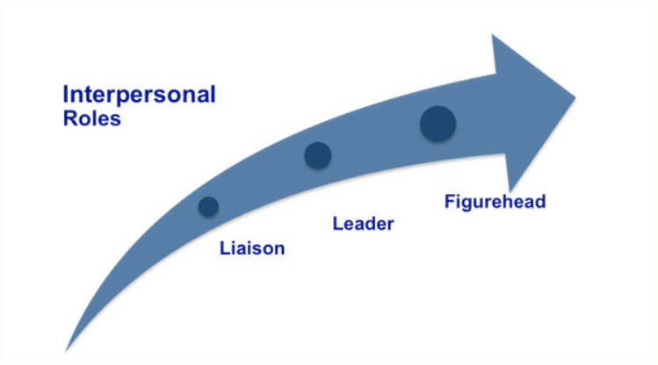
The roles of managers in different institutions can be summarized in three main categories:
Interpersonal,
Informational,
Decisional.
Interpersonal Roles All managers are required to perform duties that are ceremonial and symbolic in nature. (figurehead role)
A leadership role includes hiring, training, motivating, and disciplining employees.
The liaison role, is contacting and fostering relationships with others who provide valuable information
www.midocean.ae

Slide 12

Informational Roles
The monitor role, All managers, to some degree, collect information from outside organizations and institutions, typically by scanning the news media and talking with other people to learn of changes in the public’s tastes, what competitors may be planning.
The disseminator role, Managers act as a conduit to transmit information to organizational members.
A Spokesperson Role , when they represent the organization to outsiders.
www.midocean.ae

Slide 13
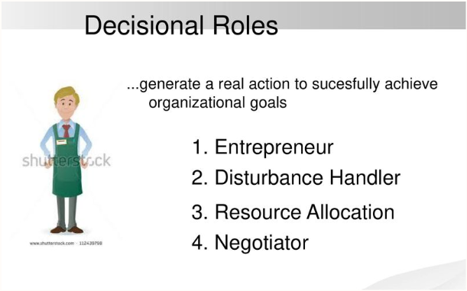
Decisional roles
In the entrepreneur role, managers initiate and oversee new projects that will improve their organization’s performance.
As disturbance handlers, managers take corrective action in response to unforeseen problems.
As resource allocators, managers are responsible for allocating human, physical, and monetary resources.
A Negotiator Role, in which they discuss issues and bargain with other units (internal or external) to gain advantages for their own unit.
www.midocean.ae

Slide 14
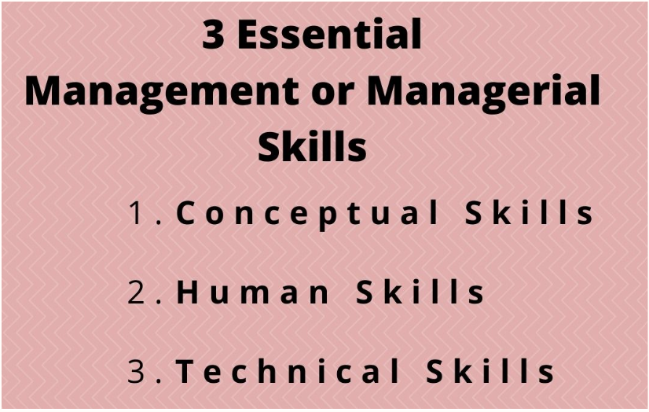
Management skills
Researchers have identified a number of skills that differentiate effective from ineffective managers. Each of these skills is important, and all are needed to become a well-rounded and effective manager.
Conceptual Skills The mental ability to analyze and diagnose complex situations. The ability to integrate new ideas with existing processes and innovate on the job are also crucial conceptual skills for today’s managers.
.
www.midocean.ae

Slide 15
Human Skills: The ability to work with, understand, and motivate other people, both individually and in groups.
Technical Skills: The ability to apply specialized knowledge or expertise. All jobs require some specialized expertise, and many people develop their technical skills on the job.
www.midocean.ae

Slide 16

Effective versus successful managerial activities
www.midocean.ae

Slide 17

Effective versus successful managerial activities
Fred Luthans and his associates looked at what managers do from a somewhat different perspective. Luthans and his associates studied more than 450 managers.
All engaged in four managerial activities:
Traditional management. Decision making, planning, and controlling.
Communication. Exchanging routine information and processing paperwork.
Human resource management. Motivating, disciplining, managing conflict, staffing, and training.
Networking. Socializing, politicking, and interacting with outsiders.
www.midocean.ae
Notes:
Fred Luthans is a management professor specializing in organizational behavior.

Slide 18
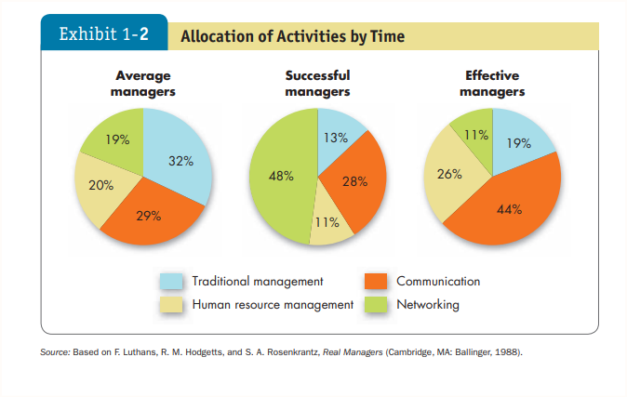
www.midocean.ae

Slide 19

Complementing Intuition with Systematic Study
The casual approach to reading others can often produce misleading predictions, but using a systematic approach can improve your accuracy.
Underlying the systematic approach in this text is the belief that behavior is not random. Rather, we can identify fundamental consistencies underlying the behavior of all individuals and modify them to reflect individual differences.
www.midocean.ae

Slide 20
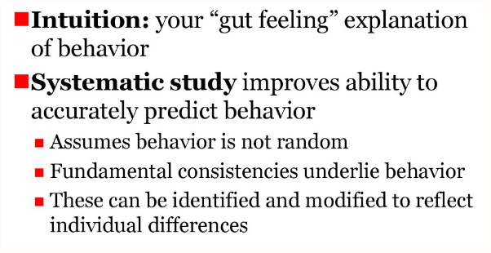
Behavior is generally predictable, and the systematic study of behavior is a mean to making reasonably accurate predictions.
When we use the term systematic study, we mean looking at relationships, attempting to attribute causes and effects, and basing our conclusions on scientific evidence—that is, on data gathered under controlled conditions and measured and interpreted in a rigorous manner.
www.midocean.ae

Slide 21

Evidence-based management (EBM)
Evidence-Based Management (EBM) is an approach helps organizations to continuously improve customer, outcomes, organizational capabilities, and business results under conditions of uncertainty.
The (EBM) Complements systematic study by basing managerial decisions on the best available scientific evidence.
Systematic study and EBM add to intuition,(An instinctive feeling not necessarily supported by research).
www.midocean.ae

Slide 22
Evidence-based management (EBM)
Relying on intuition is made worse because we tend to overestimate the accuracy of what we think we know. Surveys of human resource managers have also shown that many managers hold “commonsense” opinions regarding effective management that have been flatly refuted by evidence.
www.midocean.ae

Slide 23

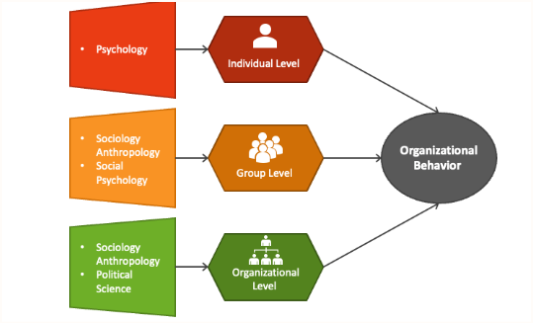
Disciplines that Contribute to the OB Field
www.midocean.ae

Slide 24
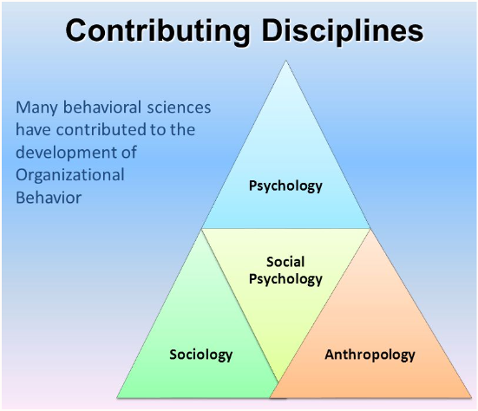
Disciplines That Contribute to the OB Field
OB is an applied behavioral science built on contributions from a number of behavioral disciplines, mainly psychology and social psychology, sociology, and anthropology. Psychology’s contributions have been principally at the individual or micro level of analysis, while the other disciplines have contributed to our understanding of macro concepts such as group processes and organization.
www.midocean.ae

Slide 25

Psychology
Psychology seeks to measure, explain, and sometimes change the behavior of humans. Contributors to the knowledge of OB are learning theorists, personality theorists, counseling psychologists and, most important, industrial and organizational psychologists.
www.midocean.ae

Slide 26

Social psychology
Social psychology, generally considered a branch of psychology, blends concepts from both psychology and sociology to focus on people’s influence on one another. One major study area is change—how to implement it and how to reduce barriers to its acceptance. Social psychologists also contribute to measuring, understanding, and changing attitudes; identifying communication patterns; and building trust. Finally, they have made important contributions to our study of group behavior, power, and conflict.
www.midocean.ae

Slide 27

Sociology
While psychology focuses on the individual, sociology studies people in relation to their social environment or culture. Sociologists have contributed to OB through their study of group behaviors in organizations, particularly formal and complex organizations. Perhaps most important, sociologists have studied organizational culture, formal organization theory and structure, organizational technology, communications, power, and conflict.
www.midocean.ae

Slide 28


Anthropology
Anthropology is the study of societies to learn about human beings and their activities. Anthropologists’ work on cultures and environments has helped us understand differences in fundamental values, attitudes, and behavior among people in different countries and within different organizations. Much of our current understanding of organizational culture, organizational climate, and differences among national cultures is a result of the work of anthropologists or those using their methods.
www.midocean.ae

Slide 29
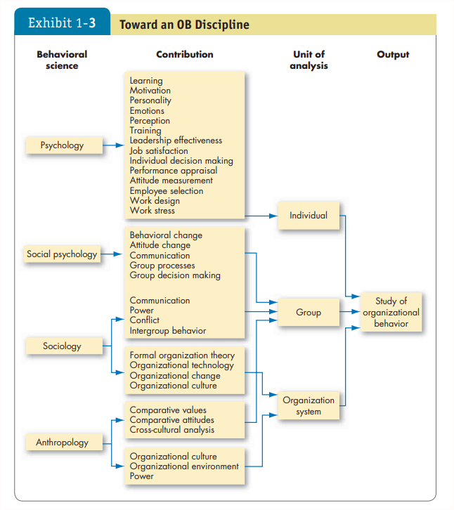
www.midocean.ae

Slide 30
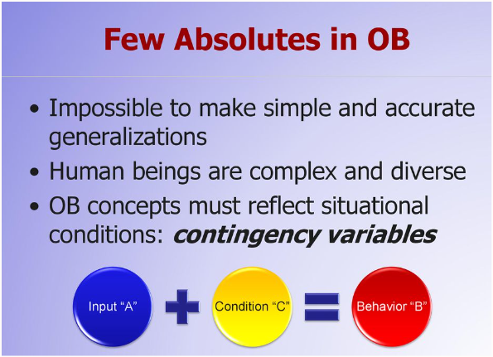
There Are Few Absolutes in OB
Human beings are complex, and few, if any, simple and universal principles explain organizational behavior. Because we are not alike, our ability to make simple, accurate, and sweeping generalizations about ourselves is limited. Two people often act very differently in the same situation, and the same person’s behavior changes in different situations.
www.midocean.ae

Slide 31
There Are Few Absolutes in OB
For example, not everyone is motivated by money, and people may behave differently at a religious service than they do at a party.
It means that OB concepts must reflect situational, or contingency, conditions. The science of OB was developed by applying general concepts to a particular situation, person, or group.
www.midocean.ae

Slide 32

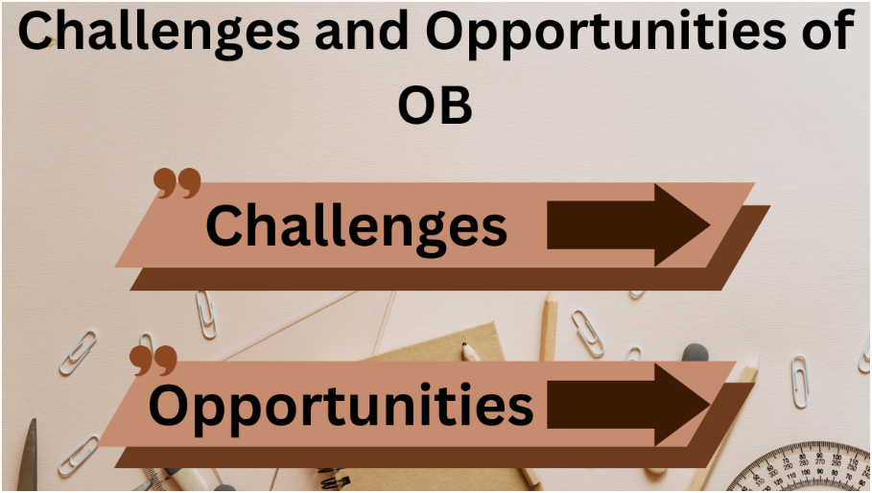
Challenges and Opportunities for OB
www.midocean.ae

Slide 33

Challenges and Opportunities for OB
Economic pressures: Managing employees well when times are tough is just as hard as when times are good, if not harder. In good times, understanding how to reward, satisfy, and retain employees is at a premium. In bad times, issues like stress, decision making, and coping come to the forefront.
Continuing globalization: The world has become a global village. In the process, the manager’s job has changed. Effective managers will anticipate and adapt their approaches to the global issues .
www.midocean.ae

Slide 34


www.midocean.ae

