Slide 1


Human Resources Management
Robert L. Mathis ⏐ John H. Jackson
Prepared by Dr. Samah Abdelfatah
MGM 243
Lecture 04

Slide 2



Part (2):Staffing the Organization
Jobs and Job Analysis
Chapter
06
Lecture 04
MGM 243
Prepared by
Dr. Samah Abdelfatah
www.midocean.ae

Slide 3

Chapter
Learning Outcomes
06
After you have read this chapter, you should be able to:
Discuss workflow analysis and business process re-engineering as approaches to organizational work.
Define job design and identify five design characteristics for jobs.
Explain how work schedules and telework can change jobs and work.
Describe job analysis and the stages and methods used in the process.
Identify both behavioral and legal aspects of job analysis.
List the components of job descriptions.
www.midocean.ae

Slide 4
Chapter
CHANGING JOBS ERA
06
Work and jobs in organizations throughout the world are changing dramatically.
Globalization and technology are primary drivers of this change.
Consider the number of jobs that have been shifted from the United States and Europe to China, India, Romania, Mexico, the Philippines, and other lower-wage countries.
These drivers of change and other elements such as IT, demographics, and worker shortages are providing employers with multiple opportunities to change how work is done and the number of jobs necessary to carry out the work of the organization.
www.midocean.ae

Slide 5
Chapter
NATURE OF JOBS AND WORK
06
Work: Effort directed toward accomplishing results.
Job: Grouping of tasks, duties, and responsibilities that constitutes the total work assignment for an employee.
Ideally, when all the jobs in an organization are added together, they should equal the amount of work that the organization needs to have done— no more, no less.
The degree to which this ideal is or is not met drives differences in organizational productivity.
www.midocean.ae

Slide 6
Chapter
NATURE OF JOBS AND WORK
06
For HR, how work flows through the organization and how to make that work more efficient is important.
Changing the way jobs are done through redesign, perhaps by using teams or flexible scheduling, may make people more satisfied with their jobs.
Formally reviewing jobs and workflow analysis to identify what is expected to be accomplished is part of a framework for training, pay, performance, and other aspects of HR management.
www.midocean.ae

Slide 7
Chapter
WORKFLOW ANALYSIS
06
Workflow Analysis
  A study of the way work (inputs, activities, and outputs) moves through an organization.
Inputs
People
Materials
Equipment
Activities
Tasks and Jobs
Outputs
Goods and Services
Evaluation
www.midocean.ae

Slide 8
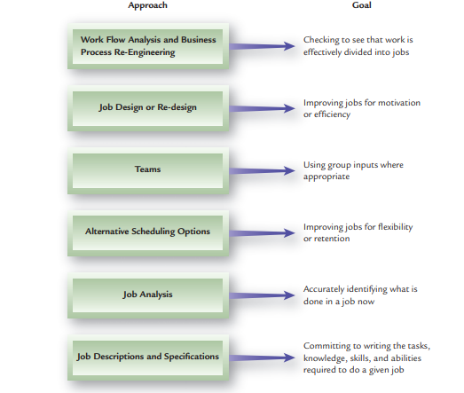
www.midocean.ae

Slide 9
BUSINESS PROCESS RE-ENGINEERING
Business Process Re-engineering (BPR)
Measures for improving such activities as product development, customer service, and service delivery.
Phases of Reengineering
  1. Re-think: Examine how the current organization of work and jobs affects customer satisfaction and service.
  2. Re-design: Analyze how jobs are put together, the workflow, and how results are achieved; then re-design the process as necessary.
  3. Re-tool: Look at new technologies (equipment, computers, software, etc.) as opportunities to improve productivity, service quality, and customer satisfaction.

Slide 10
JOB DESIGN/RE-DESIGN
Job Design
  Organizing tasks, duties, and responsibilities into a productive unit of work.
  Person/job fit Matching characteristics of people with characteristics of jobs.
  Job design can influence the following:
Job Design
Job
Performance
Job
Satisfaction
Physical and
Mental Health

Slide 11
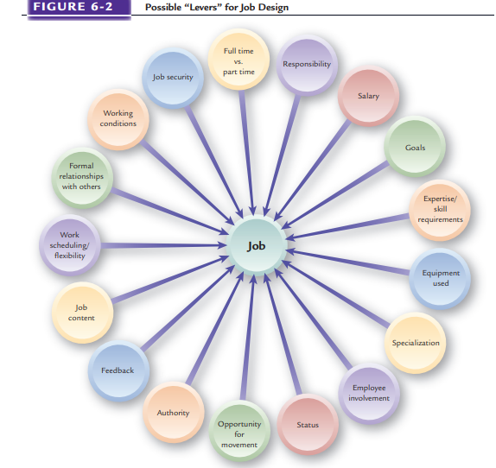
www.midocean.ae

Slide 12
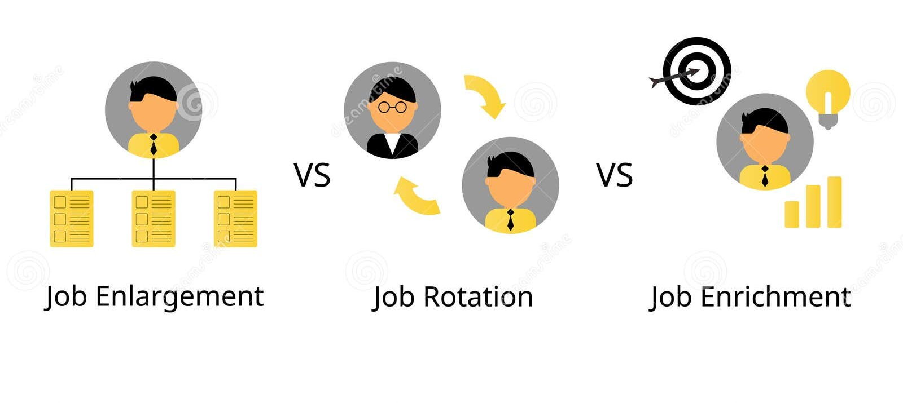

Classic Approaches to Job Design
Job Enlargement
  Broadening the scope of a job by expanding the number of different tasks to be performed.
Job Enrichment
  Increasing the depth of a job by adding the responsibility for planning, organizing , controlling, and evaluating the job.
Job Rotation
  The process of shifting a person from job to job.

Slide 13
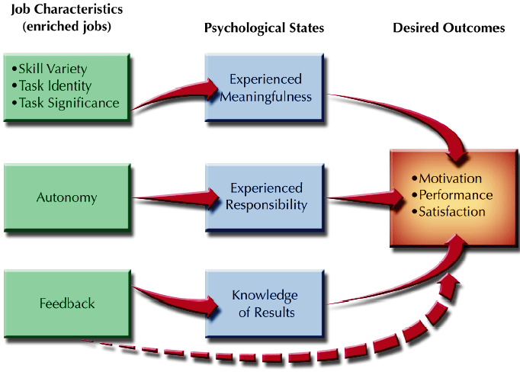
JOB CHARACTERISTICS MODEL
Figure 6–3

Slide 14
CHARACTERISTICS OF JOBS

Slide 15
Using Teams in Jobs

Slide 16
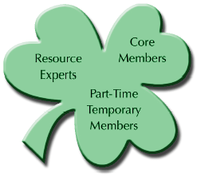
SHAMROCK TEAM

Slide 17
TEAM JOBS
Advantages
  Improved productivity
  Increased employee involvement
  More widespread employee learning
  Greater employee ownership of problems
Disadvantages
  Requires employees to be “group oriented”
  Not appropriate for most work in organizations
  Can be overused
  Difficult to measure team performance
  Individual compensation interferes with team concept

Slide 18
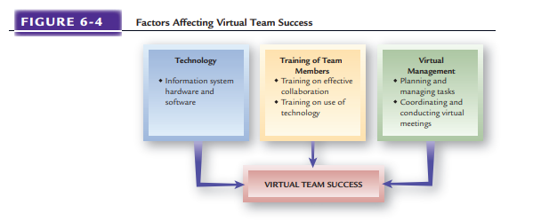

Slide 19

ALTERNATIVE WORK SCHEDULES
Flextime
  A work scheduling arrangement in which employees work a set number of hours per day but vary their starting and ending times.
Compressed Work Week
  A work schedule in which a full week’s work is accomplished in fewer than five days.
  Job sharing Scheduling
  arrangement in which two employees perform the work of one full-time job.

Slide 20

ALTERNATIVE WORK LOCATIONS
Telecommuting
  The process of going to work via electronic computing and telecommunications equipment.
Temporary Locations
  Hoteling
  Virtual office
Effects of Alternative Work Arrangements
  A shift to evaluating employees on results
  Greater trust, less direct supervision
  Lack of direct contact (visibility)

Slide 21
NATURE OF JOB ANALYSIS
Job analysis : Systematic way of gathering and analyzing information about the content, context, and human requirements of jobs.
  Work activities and behaviors
  Interactions with others
  Performance standards
  Financial and budgeting impact
  Machines and equipment used
  Working conditions
  Supervision given and received
  Knowledge, skills, and abilities needed

Slide 22
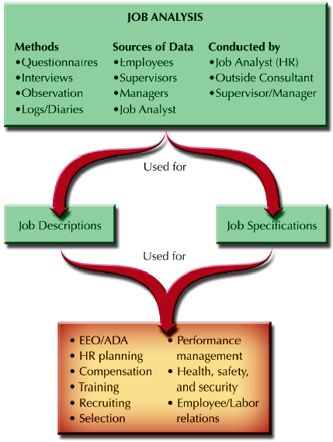
JOB ANALYSIS IN PERSPECTIVE
Figure 6-5

Slide 23
TASK-BASED JOB ANALYSIS
Task
  A distinct, identifiable work activity composed of motions
Duty
  A larger work segment composed of several tasks that are performed by an individual
Responsibilities
  Obligations to perform certain tasks and duties

Slide 24
COMPETENCY APPROACH TO JOB ANALYSIS
Competencies
  Basic characteristics that can be linked to enhanced performance by individuals or teams.
Reasons for using the competency approach
  To communicate value behaviors throughout the organization.
  To raise the competency levels of the organization.
  To emphasize the capabilities of people to enhance organizational competitive advantage.

Slide 25
COMPETENCY ANALYSIS METHODOLOGY
Identify future performance results areas critical to the organization.
Assemble panel groups familiar with the company.
Interview panel members to get examples of job behaviors.
Develop detailed descriptions of competencies.
Rate competencies and levels need to meet them.
Standards of performance are identified and tied to jobs.

Slide 26
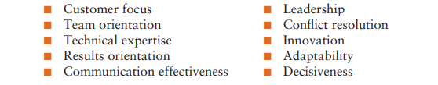
COMPETENCY ANALYSIS METHODOLOGY
Some of the following have been identified as behavioral competencies:

Slide 27
CHOOSING A JOB ANALYSIS APPROACH
Whether to use the task-based or competency-based approach to job analysis is affected by the nature of jobs and how work is changing.
In some high technology industries, employees work in cross-functional project teams and shift from project to project.
Organizations in these industries focus less on performing specific tasks and duties and more on competencies needed to attain results.

Slide 28
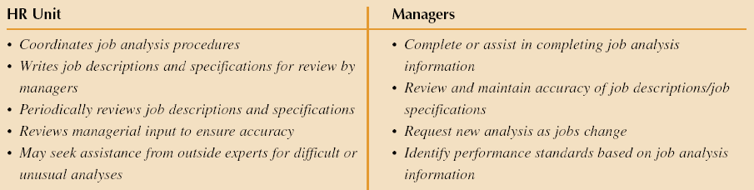
JOB ANALYSIS RESPONSIBILITIES
Figure 6–7

Slide 29
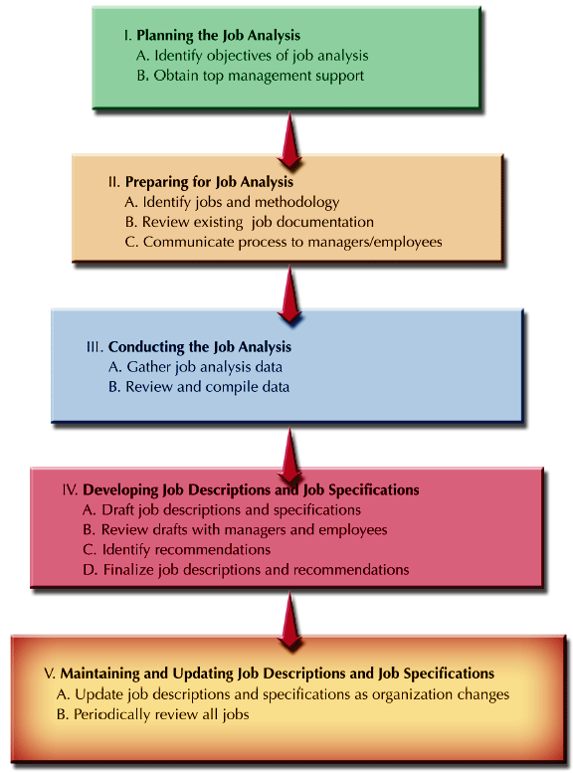
STAGES IN THE JOB ANALYSIS PROCESS
Figure 6–8

Slide 30
JOB ANALYSIS METHODS
Job Analysis
Methods
Observation
Work Sampling
Diary/Log
Interviewing
Questionnaires
PAQ
MPDQ
Computerized
Job Analysis
Gathering information requires a manager or an HR
specialist to visit each job site and talk with the employees performing each job.
Position Analysis Questionnaire (PAQ)
Managerial Job Analysis Questionnaire
An important feature of computerized job analysis is the specificity of data that can be gathered.

Slide 31
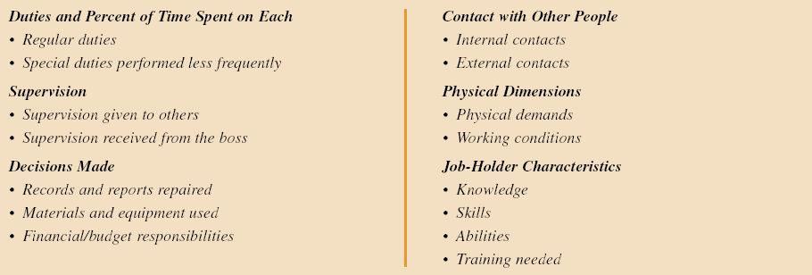
TYPICAL AREAS COVERED IN A
JOB ANALYSIS QUESTIONNAIRE
Figure 6-9

Slide 32
BEHAVIORAL ASPECTS OF JOB ANALYSIS
“Inflation” of Jobs and Job Titles
Behavioral
Aspects of
Job
Analysis
Employee and Managerial Anxieties
Current Incumbent Emphasis

Slide 33
BEHAVIORAL ASPECTS OF JOB ANALYSIS
“Inflation” of Jobs and Job Titles
Employees and managers have some tendency to inflate the importance and significance of their jobs. Because job analysis information is used for compensation purposes, both managers and employees hope that “puffing up” jobs will result in higher pay levels and greater “status” for résumés and more possible promotion opportunities.

Slide 34
BEHAVIORAL ASPECTS OF JOB ANALYSIS
Employee and Managerial Anxieties
Managerial Straitjacket :If job descriptions are written restrictively, some employees may use an omission to limit managerial flexibility. The resulting attitude, “It’s not in my job description,” puts a straitjacket on a manager.
Employee Fears: One fear that employees may have concerns the purpose of a detailed investigation of their job. Perhaps they feel that such a detailed look means someone thinks they have done something wrong. The attitude behind such a fear might be “As long as no one knows precisely what I am supposed to be doing, I am safe.”

Slide 35
BEHAVIORAL ASPECTS OF JOB ANALYSIS
Current Incumbent Emphasis
A job analysis and the resulting job description and job specifications should not describe just what the person currently doing the job does and what his or her qualifications are.
The incumbent may have unique capabilities and the ability to expand the scope of the job to assume more responsibilities.
It is useful to focus on core duties and necessary knowledge, skills, and abilities by determining what the jobs would be if the incumbents quit or were no longer available to do the jobs.

Slide 36
JOB DESCRIPTIONS AND JOB SPECIFICATIONS
Job Description
  Identification of the tasks, duties, and responsibilities of a job
Performance Standards
  Indicator of what the job accomplishes and how performance is measured in key areas of the job description.
Job Specification
  The knowledge, skills, and abilities (KSAs) an individual needs to perform a job satisfactorily.

Slide 37
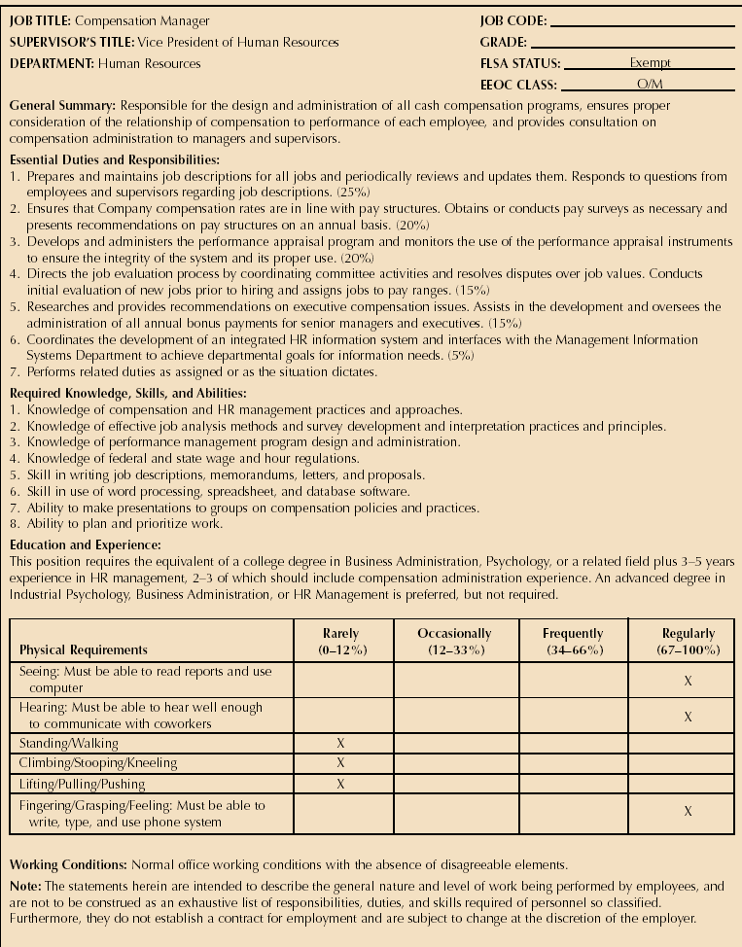
SAMPLE JOB DESCRIPTION AND SPECIFICATIONS
Figure 6–10a

Slide 38
SAMPLE JOB DESCRIPTION AND SPECIFICATIONS
Figure 6–10b

Slide 39
SAMPLE JOB DESCRIPTION AND SPECIFICATIONS
Figure 6–10c

Slide 40
JOB DESCRIPTION COMPONENTS
Identification
  Job title
  Reporting relationships
  Department
  Location
  Date of analysis
General Summary
  Describes the job’s distinguishing responsibilities and components
Essential Functions and Duties
  Lists major tasks, duties and responsibilities
Job Specifications
  Knowledge, skills, and abilities
  Education and experience
  Physical requirements
Disclaimer
  Of implied contract
Signature of approvals

Slide 41
SUMMARY
  Changing Jobs Era
  Nature Of Jobs And Work
  Workflow Analysis
  Job Design/Re-design
  Alternative Work Schedules &Locations
  Nature Of Job Analysis
  Task-based Job Analysis
  Competency Approach To Job Analysis
  Job Analysis Methods
  Behavioral Aspects of Job Analysis
  Job Descriptions And Job Specification

Slide 42



Thank You

