Slide 1

Lecture 8:
Project Budget
PMG 605
Project Resources and Time Management
Dr. Eng.
Abdullah Jameel Halawany

Slide 2
Session Outline
Project Budget
Why a Time-Phased Budget Baseline Is Needed
Elements Of Budgets And Estimates
Creating a Time-Phased Budget
Project Cost Accounting Systems
Budget Contingencies

Slide 3
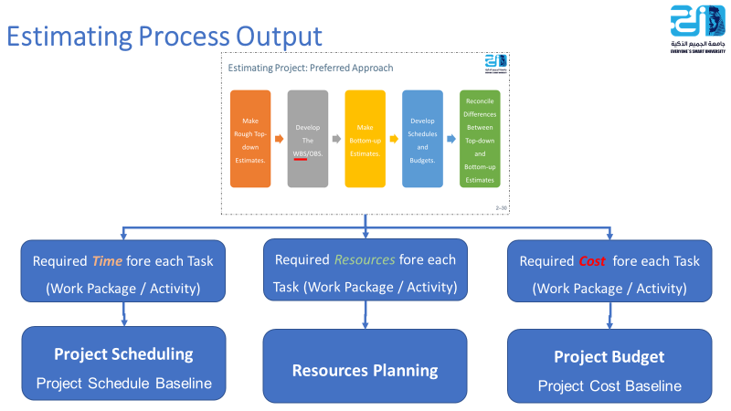
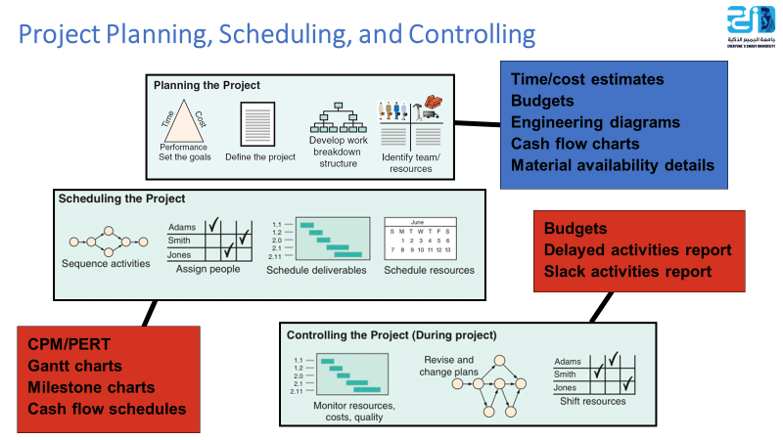
8–3

Slide 4
Project Budget
Project network times are not a schedule until resources have been assigned.
Cost estimates are not a budget until they have been time-phased.
8–4

Slide 5
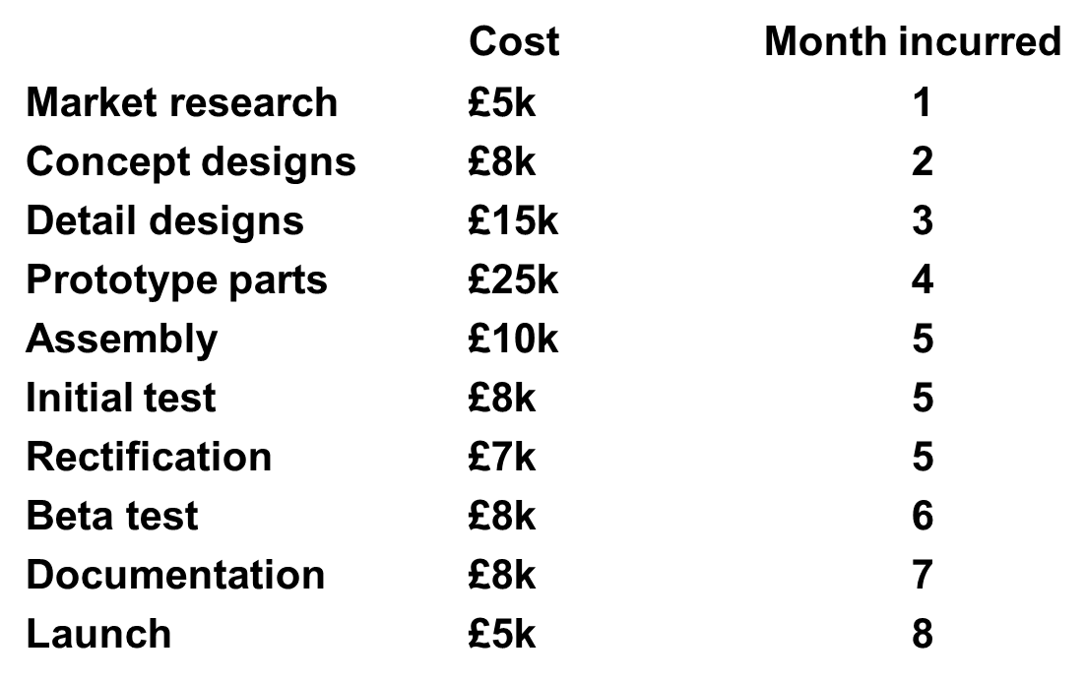
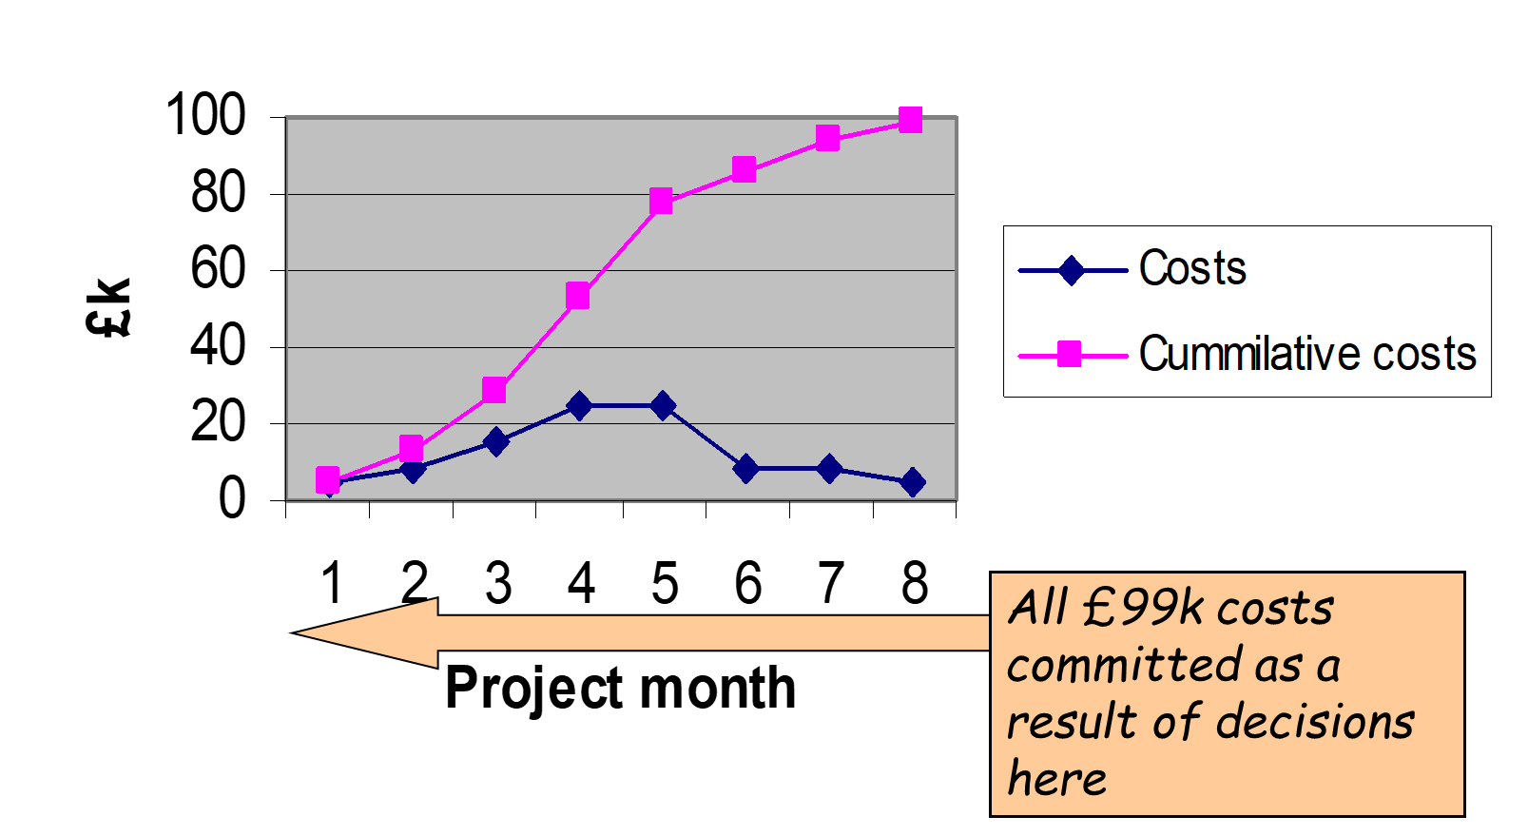
Project Budget
8–5

Slide 6
PROJECT COST ACCOUNTING SYSTEMS

Slide 7
Project Cost Accounting Systems (PCAS)
A project is a system of sometimes hundreds or thousands of elements—workers, materials, and facilities—all which must be estimated, budgeted, and controlled.
To expedite the process, reduce confusion, and improve accuracy, you need another system; in particular, one to help compute estimates, create, store and process budgets, and track costs.
Such a system, called a project cost accounting system (PCAS), is initially set up by the project manager, project accountant or Project Management Office (PMO).
8–7

Slide 8
Project Cost Accounting Systems (PCAS)
While the main focus of the PCAS is on project costs, the system also assists tracking and controlling schedules and work progress.
When a PCAS is combined with other project planning, control, and reporting functions, the whole system is referred to as the project management information system (PMIS).
8–8

Slide 9
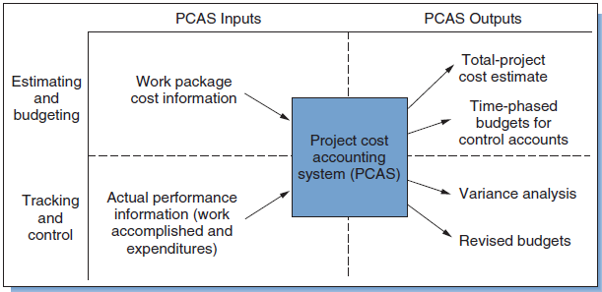
Project Cost Accounting Systems (PCAS)
8–9

Slide 10
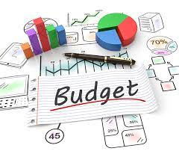
Elements Of Budgets And Estimates

Slide 11
Elements Of Budgets And Estimates
Budgets and cost estimates are the same in that both state the cost of doing something.
The difference is that the estimate comes first and is the basis for the budget.
An estimate may have to be refined many times, but once approved it becomes the budget.
8–11

Slide 12
Elements Of Budgets And Estimates
Organizations and work units are then committed to performing work according to the budget.
It is the agreed upon amount for what the work should cost, and the baseline against which actual expenditures will be compared.
Project budgets and fiscal operating budgets are similar; the difference is that the former covers the life of a project, the latter only a year at a time.
8–12

Slide 13
Elements Of Budgets And Estimates
Estimates and budgets share the following elements:
  Direct Labor Expense
  Direct Non-Labor Expense
  Overhead Expense (Direct Overhead)
  General and Administrative Expense (Indirect Overhead)
  Profit and total billing
8–13

Slide 14
Direct Labor Expense
Direct labor expense is the labor charge for the project.
For each task or work package, an estimate is made of the number of people needed in each labor grade, and the number of hours or days for each.
This gives the distribution of labor hours or days required per labor grade.
The labor hours for the various grades are then multiplied by their respective wage rates.
8–14

Slide 15
Direct Non-Labor Expense
Direct non-labor expense is the total expense of non-labor charges applied directly to the task. It includes subcontractors, consultants, travel, material costs, purchased parts, and freight.
Direct non-labor expenses also include necessities for installation and operation, such as instruction and maintenance manuals, and spare parts.
Note that these are costs incurred only for a specific work package.
On smaller projects, the direct non-labor expenses are individually estimated for each work package.
In larger projects, a simple percentage rate is applied to cover Direct Non-Labor. For example, 5 percent of direct labor cost might be included as travel expense, and 5 percent of material costs as freight.
8–15

Slide 16
Overhead Expenses (Direct Overhead)
Costs that can be allocated in a logical manner to the specific work packages or to specific projects.
They include whatever is necessary to house and support the labor, including building rents, utilities, clerical assistance, insurance, and equipment.
Usually, overhead is computed as a percentage of the direct labor cost.
Frequently the rate is around 100 percent, but it ranges from as low as 25% for companies that do most of their work in the field to over 250% for those with laboratories and expensive facilities and equipment.
8–16

Slide 17
General and Administrative Expense (Indirect
Overhead)
It includes taxes, financing, penalty and warranty costs, accounting and legal support, proposal expenses, marketing and promotion, salaries and expenses of top management, and employee benefits.
For example, corporate level overhead would be allocated across all projects.
Often, G&A overhead is charged on a time basis, so the longer the project duration, the greater the G&A expense for the project.
8–17

Slide 18
Profit and Total Billing
Profit is the amount left over after expenses have been subtracted from the contractual price.
It can also be an agreed-to fixed fee or a percentage of total expenses, determined in part by the kind of contract.
Total billing is the sum of total expenses and profit.
Total billing and profit are included in estimates for the overall project, groups of work packages, and subcontracted work.
They usually do not appear on budgets for lower-level work elements.
8–18

Slide 19
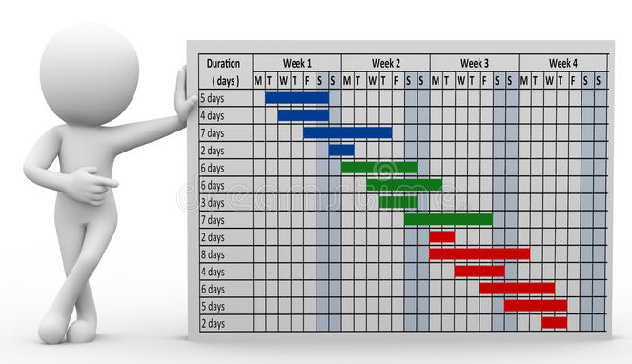
Creating a Time-Phased Budget

Slide 20
Time-Phased Budget
Simultaneous control of schedules and costs can be difficult, and the project manager needs a way to keep track of where expenses are accruing, how well the project is progressing, and where problems are developing.
One way is with a time-phased budget, which consolidates the project budget and the project schedule; this budget shows how budgeted costs are distributed over time according to the project schedule.
8–20

Slide 21
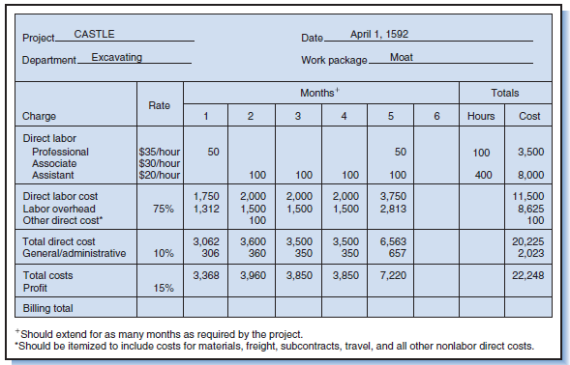
8–21

Slide 22
Time-Phased Budget
In small projects, budgeting and cost monitoring is done using a single budget for the project as a whole. This budget is used to compare actual costs with budgeted costs throughout the project.
On larger projects a single, project-wide budget is too insensitive.
The better way is to subdivide the project budget into smaller budgets called control accounts or cost accounts.
Large projects have tens of control accounts; very large projects have hundreds.
8–22

Slide 23
Creating a Time-Phased Budget
By using information from your WBS and resource schedule, you can create a time-phased cost baseline.
We integrated the WBS and OBS organization breakdown structure so the work packages could be tracked by deliverable and organization responsible.
For each intersection point of the WBS/OBS matrix, you see work package budgets and the total cost.
The total cost at each intersection is called a cost or control account.
8–23

Slide 24
Creating a Time-Phased Budget
For an example of the PC Prototype Project arranged by deliverable and organization unit responsible. For each intersection point of the WBS/OBS matrix, you see work package budgets and the total cost.
For example, at the intersection of the Read/write head deliverable and the Production department we see there are three work packages with a total budget of $200,000.
The sum of all cost accounts in a column should represent the total costs for the deliverable.
Conversely, the sum of the cost accounts in a row should represent the costs or budget for the organizational unit responsible to accomplish the work.
8–24

Slide 25
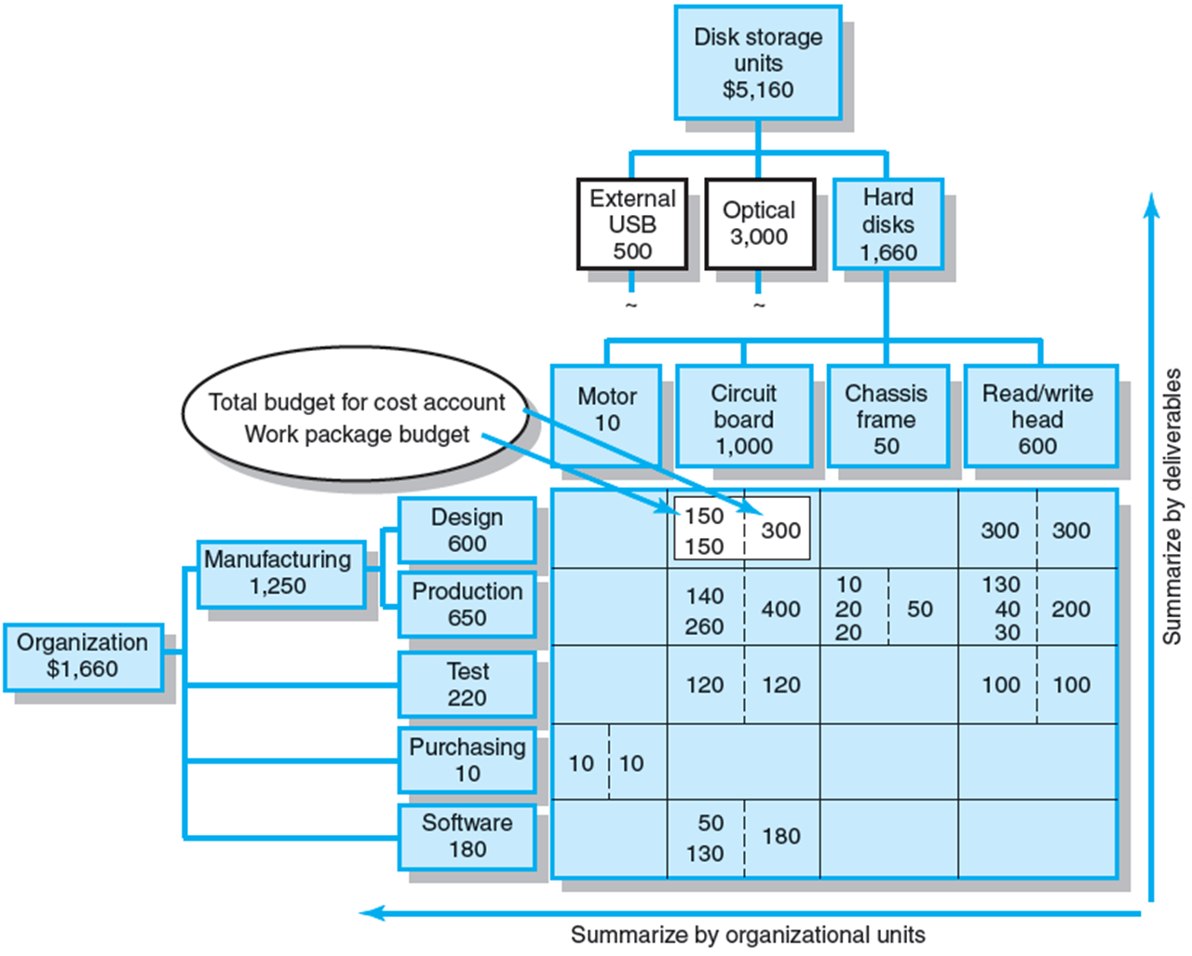
8–25

Slide 26
Creating a Time-Phased Budget
You can continue to “roll up” costs on the WBS/OBS to total project costs.
This WBS provides the information you can use to time phase work packages and assign them to their respective scheduled activities over the life of the project.
8–26

Slide 27
Creating a Time-Phased Budget
The Circuit board work package has a duration of three weeks.
Assuming labor, materials, and equipment are tracked separately, the work package costs for labor are distributed over the three weeks as they are expected to occur— $40,000, $30,000, and $50,000 for each week, respectively.
When the three-week work package is placed in the network schedule, the costs are distributed to the time-phased budget for the same three scheduled weeks.
8–27

Slide 28
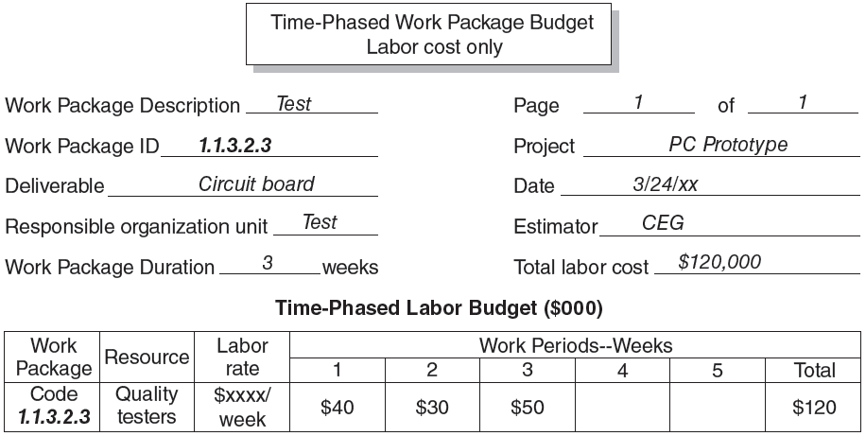
8–28

Slide 29
Creating a Time-Phased Budget
In a few instances an activity will include more than one work package, where the packages are assigned to one responsible person or department and deliverable.
In this case the work packages are consolidated into one activity. This activity includes two WPs.
The first, WP-1.1.3.2.4.1 (Code), is distributed over the first three weeks.
The second, WP-1.1.3.2.4.2 (Integration), is sequenced over weeks 3 and 4. The activity duration is four weeks.
When the activity is placed in the schedule, the costs are distributed starting with the schedule start—$20,000, $15,000, $75,000, and $70,000, respectively.
8–29

Slide 30
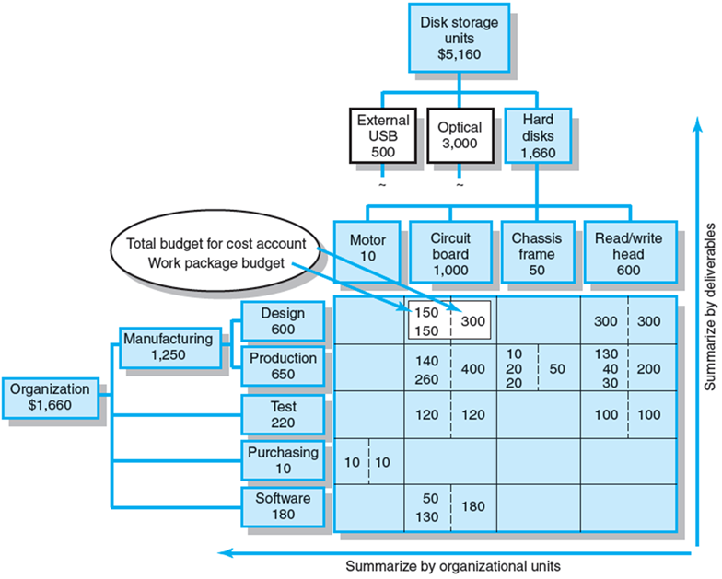
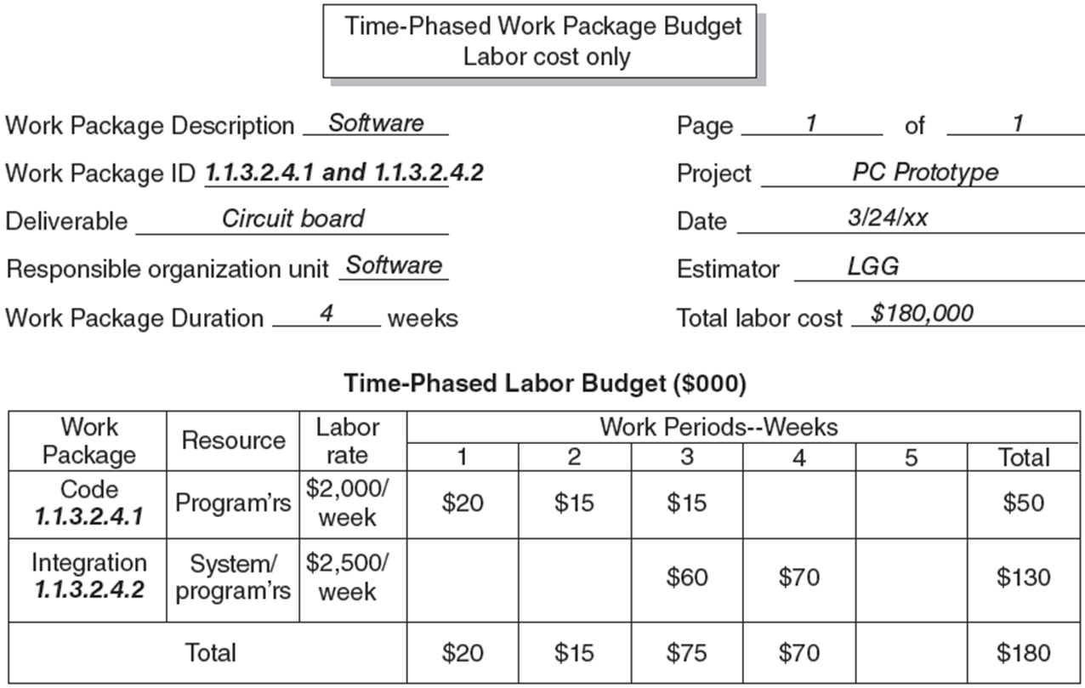
Creating a Time-Phased Budget
8–30

Slide 31
Creating a Time-Phased Budget
These time-phased budgets for work packages are lifted from your WBS and are placed in your project schedule as they are expected to occur over the life of the project.
The outcome of these budget allocations is the project cost baseline (also called planned value—PV), which is used to determine cost and schedule variances as the project is implemented.
8–31

Slide 32
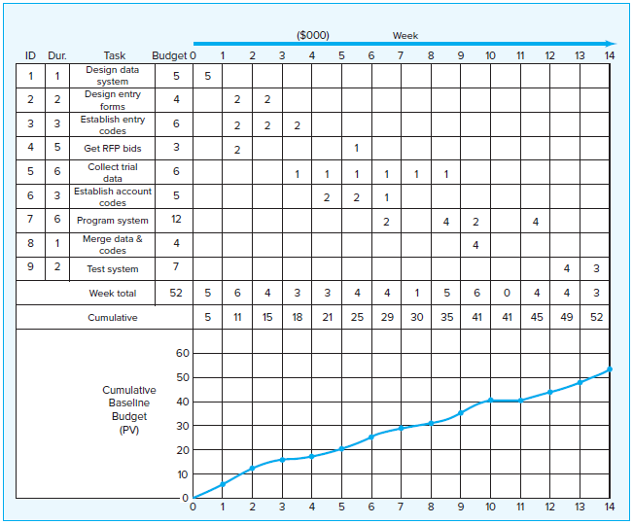
Time-Phased Work Packages Assigned
8–32

Slide 33
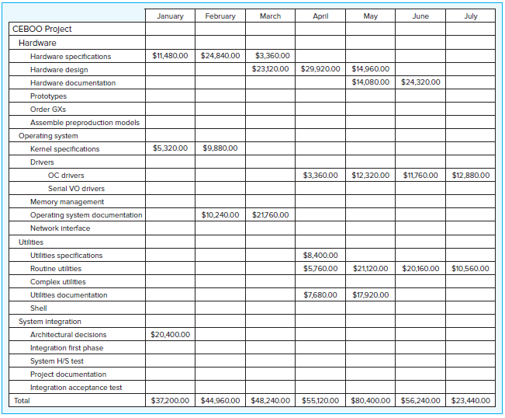
Project Monthly Cash Flow Statement
8–33

Slide 34
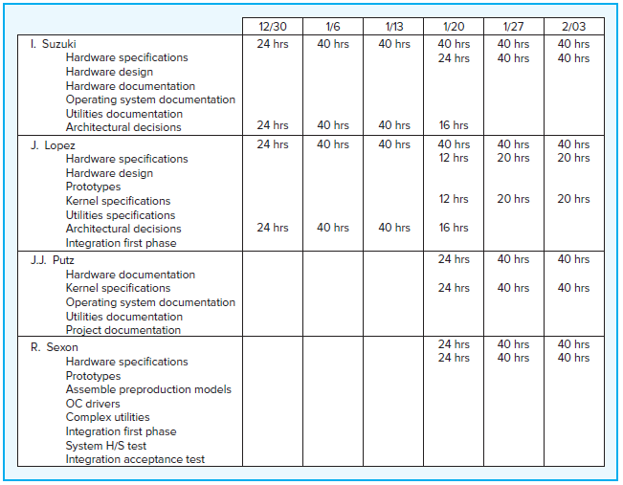
Project
Weekly Resource
Usage Schedule
8–34

Slide 35
Budget Contingencies

Slide 36
Budget Contingencies
The allocation of extra funds to cover uncertainties and
improve the chance of finishing on time
Contingencies are needed because:
Project scope may change
Murphy’s Law is present
Cost estimation must anticipate interaction costs
Normal conditions are rarely encountered
8–36

Slide 37
Benefits To Contingency Funding
Recognizes future contains unknowns
Adds provision for company plans for an increase in project cost
Applies contingency fund as an early warning signal to potential overdrawn budget
8–37

Slide 38
Why a Time-Phased Budget Baseline Is Needed

Slide 39
Why a Time-Phased Budget Baseline Is Needed
Scenario 1
  Planned costs for the first five weeks are $2,000,000.
  Actual costs for the first five weeks are $2,400,000.
How are we doing? It would be easy to draw the conclusion there is a $400,000 cost overrun.
But we really have no way of knowing. The $400,000 may represent money spent to move the project ahead of schedule.
8–39

Slide 40
Why a Time-Phased Budget Baseline Is Needed
Scenario 2
  Planned costs for the first five weeks are $2,000,000.
  Actual costs for the first five weeks are $1,700,000.
Is the project costing $300,000 less than we expected? Perhaps.
But the $300,000 may represent the fact that the project is behind schedule and work has not started. Could it be the project is behind schedule and over cost? We cannot tell from these data.
8–40

Slide 41
Why a Time-Phased Budget Baseline Is Needed
The many systems found in the real world that use only planned funds (a constant burn rate) and actual costs can provide false and misleading information.
These systems do not measure how much work was accomplished for the money spent! Hence, without time phasing cost to match your project schedule, it is impossible to have reliable information for control purposes.
8–41

Slide 42
Cost Analysis with Early and Late Start Times
It is possible to analyze what effect delaying activities will have on project costs.
When funding restrictions constrain project expenditures, cost schedules reveal the places where the schedule must be changed.
For example, Figure shows a peak weekly expense of $82,000 in Weeks 18 and 19. If a weekly budget ceiling of $60,000 per week were imposed on the project, then late start times would be preferred because they would result in a more “level” cost profile and peak expense of only $54,000.
The method for leveling resources is applicable to leveling project costs; costs are treated just as another resource.
8–42

Slide 43
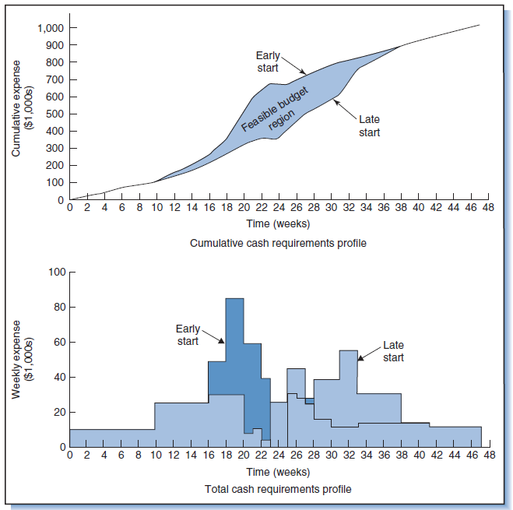
Cost Analysis with Early and Late Start Times
8–43

Slide 44
Cost Analysis with Early and Late Start Times
Owing to the time value of money, the cost of work done farther in the future has a lower net present worth than the same work if done earlier.
Delaying activities in a lengthy project can thus provide substantial savings in the present worth of project costs.
Does this mean that activities should be delayed until their late start date? Not necessarily.
Remember, delaying activities uses up slack time and leaves less extra time to deal with problems that could put the project behind schedule.
8–44

Slide 45
Summary of Today Session

Slide 46
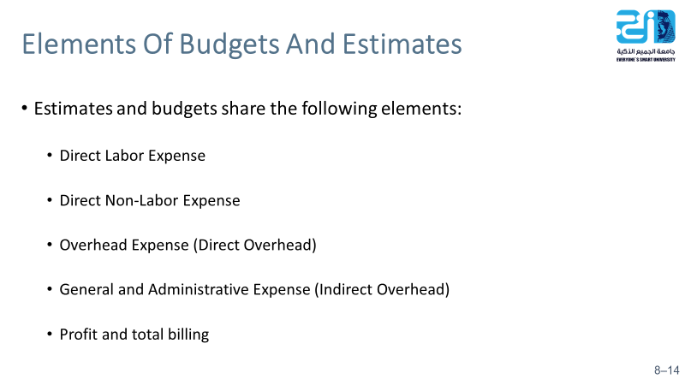
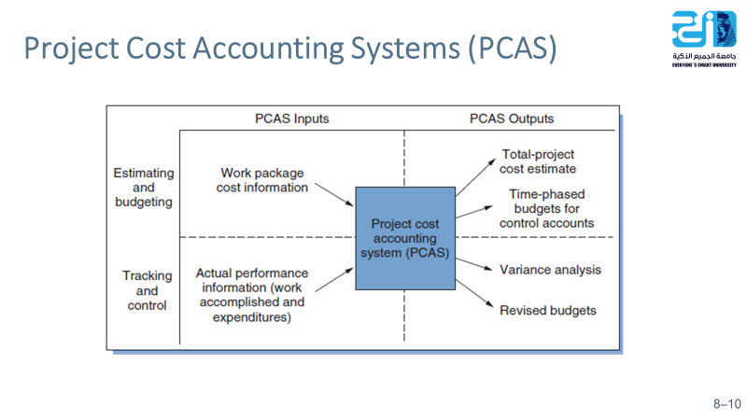
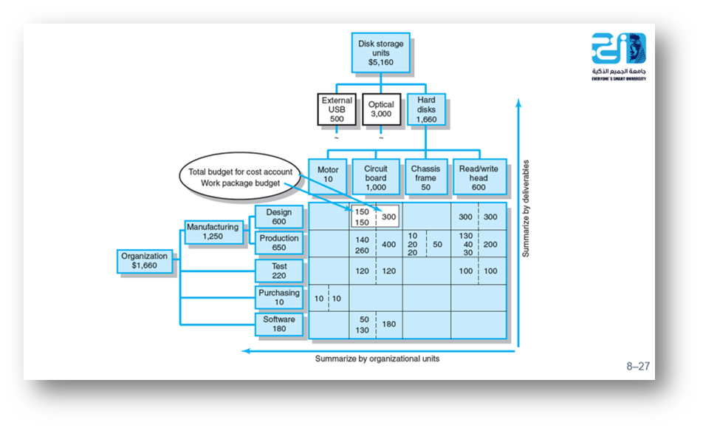
8–46

Slide 47
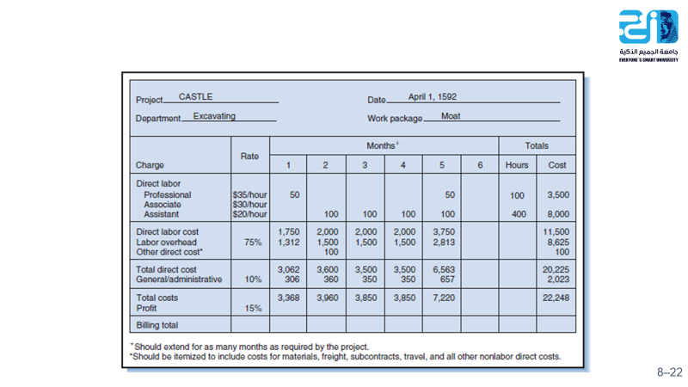
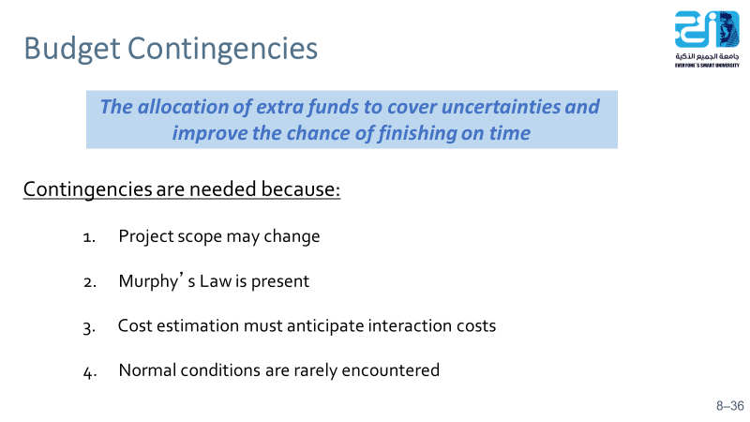
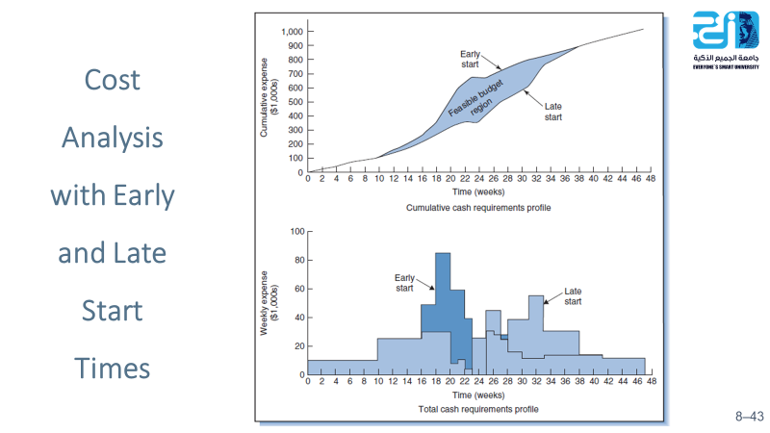
8–47

Slide 48
Resources
Project Management: The Managerial Process Fifth Edition. By: Erik W. Larson, Oregon State University, Clifford F. Gray, Oregon State University
Project Management for Engineering, Business and Technology Fourth Edition. By: John M. Nicholas, Loyola University Chicago, Herman Steyn, University of Pretoria

