Slide 1

Financial Risk Management
Prepared by Dr. Walaa Mohamed
Lecture 5
PMG 633
Market Risk

Slide 2
Chapter Outline
6.1 Introduction to Market Risk
6.2 Basics of Financial Instruments
6.3 Trading
6.4 Market Risk Measurement and Management

Slide 3
Lecture 5
Key Learning Points
Market risk arises from the trading activities of banks and is a consequence of movements in market prices.
Market risk affects all financial instruments and can be general market risk, which reflects the market movements of all comparable financial instruments, or a specific risk, which reflects the risk that an individual financial instrument moves in day-to-day trading.
The basic financial instruments are currencies, equities, bonds, loans, commodities, and derivatives. Banks can take either a long or a short position in financial instruments.

Slide 4
Introduction to Market Risk:
Market risk has two components: a general market risk that affects similar financial assets or financial markets and a specific risk that affects only individual financial assets. General market risk or systematic risk is the risk of an adverse movement in market prices that is applied across a range of assets. Specific risk is the risk of an adverse movement in the price of an individual asset due to factors that apply only to that security or issuer and is not related to the general movement of the markets.

Slide 5
2. Basics of Financial Instruments:
Basic financial assets are also called financial products or financial instruments. Banks use financial instruments for trading purposes and to hedge their financial activities. These financial instruments are considered “plain-vanilla” products because they are relatively simple and do not have complex features.
For instance, common stocks and corporate bonds are both considered plain-vanilla financial instruments. Banks trade both plain-vanilla and complex products, with many com-plex products that can be broken down into two or more simpler products. New financial instruments usually remix already existing, plain-vanilla instruments into more complex structures, requiring sophisticated pricing and legal structures.

Slide 6
1. Currencies
Most countries (or groups of countries) have their own currency (i.e., money).They control its supply through their central bank or a similar institution.
In foreign exchange transactions, one currency is exchanged for another currency. Banking institutions engage in foreign exchange transactions for a wide variety of reasons. For example, they may be conducting operations out-side their home country, requiring them to have cash on hand in a foreign currency to fulfill their obligations in that country.
Exchange rates reflect the relative value of one currency in relation to another currency. For instance, if the exchange rate between the GBP (British pound) and the USD (United States dollar) is 1.50, this means that for each GBP you receive, you must pay USD 1.50. It also means that for each USD you receive, you must pay GBP 0.67 (= 1.5/1.0).

Slide 7
It is common to refer to the different exchange rates of one currency against other currencies in terms of spot exchange rates or spot cross rates. Spot exchange rates are so-called when a currency is quoted against the home currency (e.g., USD in the United States), whereas spot cross rates denote any currency quoted against any other where the home currency is not involved.
Figure 6.1 shows the major exchange rates from September 2014. The table expresses the value of six major currencies against each other and is interpreted as follows: For one unit of the column currency, you must pay the amount shown in the appropriate row. So, on that date, one GBP was worth USD 1.6388, CAD 1.7931, EUR 1.2683, and so on. This implies that one USD was worth GBP 0.6102 (= 1.0/1.6388), CAD was worth GBP 0.5576 (= 1.0/1.7931), and one EUR was worth GBP 0.7884 (= 1.0/1.2683).

Slide 8
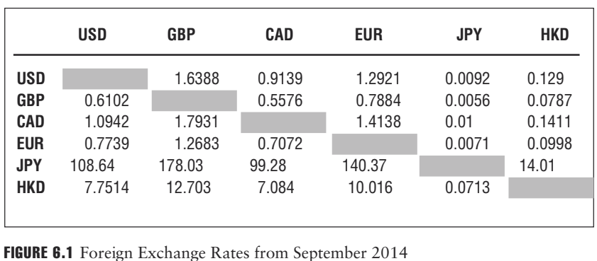

Slide 9
There are multiple factors that influence exchange rates. Key factors include inflation rates, political changes and instability, and currency regimes. Currency regimes determine to what extent a country or its government manages its currency relative to other currencies. Governments may fix their exchange rates, whereby they attempt to keep the relative value of their currency fixed versus another currency or a basket of representative currencies, or float their exchange rates, whereby the relative value of the currency is determined by general market forces.
When banks trade currencies with each other, they sometimes act as a broker on behalf of their clients who need to secure foreign currency to pay their bills. Many large multinational banks also actively trade currencies as principals with other banks with the hope of profiting from exchange rate movements.

Slide 10
2. Fixed Income Instruments
Two of the most commonly referred to and traded fixed income instruments are loans and bonds. Loans and bonds are legally binding contracts through which the borrower (also referred to as the issuer of the bond or loan) borrows the principal amount specified in the bond or loan from an investor and in exchange pays a specified amount of interest, usually at regular intervals. The interest rate referenced in the contract is usually referred to as the coupon rate or nominal rate. This rate may be fixed or floating.
For a plain-vanilla fixed income instrument, the amount of money the borrower receives is set on the day of the bond’s issuance and will remain the same and not be affected by changes in the inflation or exchange rates that can happen over the life of the bond or loan. There are complex fixed income instruments that adjust the interest payments, and, in some cases, even the principal payments, to inflation rates.

Slide 11
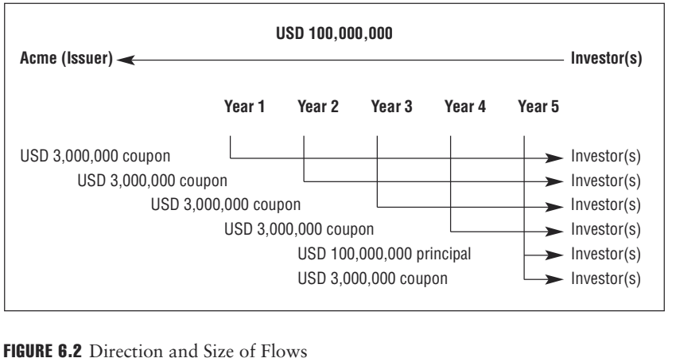
EXAMPLE
Acme Inc. issues a five-year bond to a group of investors. With the bond, the company borrows USD 100 million at a fixed interest rate of 3% per annum. Each year, the company will make one interest payment of 3% * USD 100 million, or USD 3 million, to those investors who purchased and hold the bonds in accordance with their ownership interest. Five years from now, the company will make the last interest payment and repay the principal, the borrowed amount, of USD 100 million. Figure 6.2 shows the direction and size of these flows.

Slide 12
Once issued, most loans and bonds have fixed terms. That is, the coupon rate and the maturity date will not change, and so the size and timing of the loan payments are fixed.
The value of loans and bonds is affected by the interest rate, and the
interest rate is driven primarily by three factors:
1. The interest rate of an equivalent risk-free fixed income instrument
2. The creditworthiness of the borrower or default risk
3. The time to maturity

Slide 13
If the interest rate increases, the value of the loan decreases, because for a fixed-rate bond, the fixed value of the future payments is worth less in present value terms. If the interest rate decreases, the value of the loan increases because the fixed value of the future payments is worth more in present value terms. Hence, loans and bonds are interest rate-sensitive instruments, and their value will fluctuate as interest rates change.
There are also floating-rate bonds and loans where the interest rate and, consequently, the interest payments mirror an index that reflects the level of interest rates. When rates increase, the interest rate on the bond increases as well, and the value of the bond may remain unchanged. Investors should be careful to understand all the characteristics of the bond they may be considering investing in before actually buying the bond.

Slide 14
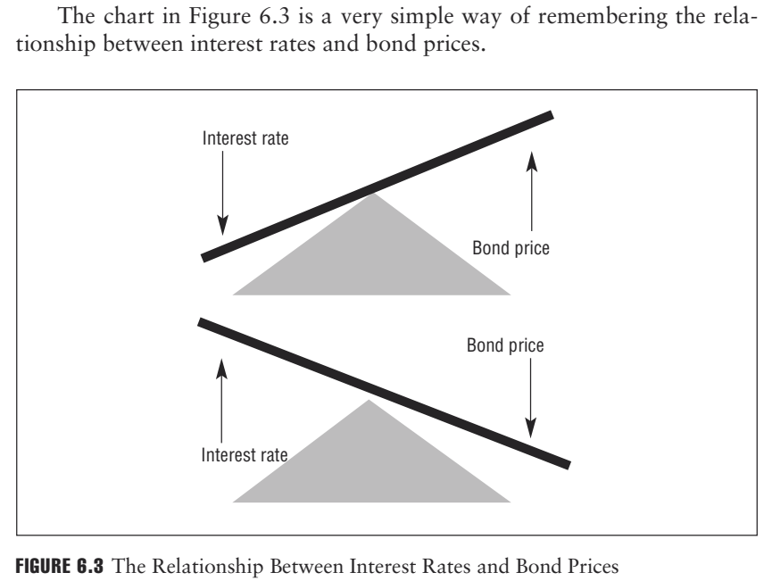
EXAMPLE
When the interest rate is 5%, then the value of USD 100 one year from now is not worth USD 100, but only USD 95.24, because investing USD 95.24 at 5% interest will grow the amount to USD 100. Similarly, when the interest rate increases to 10%, the same USD 100 one year from now is worth only USD 90.91, because investing USD 90.91 at 10% interest will grow the amount to USD 100.

Slide 15
In practice, a risk-free fixed income product would typically be a gov- ernment bond, which may be considered to have no credit or default risk. If there is any risk of default, the interest rate must be adjusted with a premium that reflects the risk of default It should be noted that the concept of government issued securities being risk-free is now being questioned by regulators and investors around the world. With countries experiencing extreme stress as a result of the financial crisis (e.g., the Greek debt crisis), and countries such as Italy, Portugal, Ireland and others requiring international attention to resolve increasing debt, sovereign issued debt instruments are no longer thought to be without risk.

Slide 16
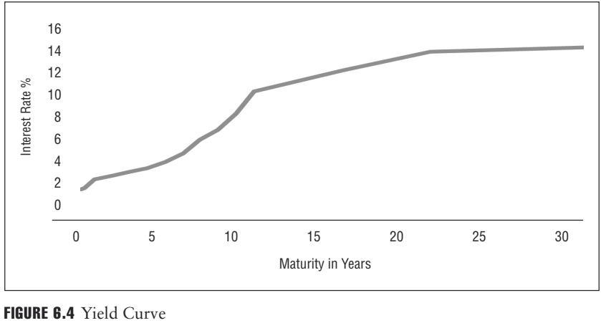
The interest rate depends on several factors, including inflation, the general level of economic activity, the political and economic stability of the country where the issuer is located, and time to maturity. In general, the longer the maturity of the loans or bonds, the higher the interest rate. The explanation is simple: To lend money for a longer time, the lender needs more compensation for the risk of holding the instrument longer, which increases the level of uncertainty. Linking interest rates with maturity creates a yield curve, as shown in Figure 6.4

Slide 17
Banks trade bonds with each other to manage their liquidity, to profit from price appreciation due to changes in interest rates, or to manage their earning assets.
Banks trade loans with each other primarily when they realign their credit portfolio. Usually, the trading of loans is related to credit portfolio management, particularly as it relates to concentration risk.

Slide 18
3. Interbank Loans
Banks also make loans to each other. Some banks have excess deposits either from unexpected inflows of deposits or because they cannot find suitable loan or investment alternatives for their deposits. These banks sell their excess funds to banks that need them to finance the loans they underwrite or investments they make.
Interbank loans can have very short maturities— as short as one day (or overnight). Banks also consider interbank loans to make funds available to their depositors and to manage their liquidity requirements. In many countries, these markets are very active. Like loans and bonds, interbank loans are interest rate-sensitive instruments

Slide 19
Interbank loans are often priced off an index, such as the London Inter- bank Offered Rate, or LIBOR. LIBOR is a daily reference rate average based on the interest rates that London banks charge when lending funds to other banks. LIBOR is quoted for numerous currencies and across different maturities ranging from overnight (one day) to one year. LIBOR rates, irrespective of their maturity, are quoted on an annual basis. LIBOR rates can influence the pricing of various types of financial instruments, including loans that banks make.

Slide 20
EXAMPLE
A USD 10 million floating-rate bond issued by Acme Inc. is priced at a 250 bp (2.50%) premium over three-month LIBOR. The interest rate on the floating-rate bond is determined at the beginning of each quarter.
■On January 1, LIBOR is 3.45%; the interest rate on this floating-rate bond for the next three months would be 3.45% + 2.50%, or 5.95%. The interest payment that Acme Inc. will make for the coming three-month period would then be USD 1,487,500, or USD 10 million * 5.95%/4, as interest rates are quoted on an annual basis.
■On April 1, LIBOR is 2.95%. The interest rate on the floating-rate bond for the next three months would be 2.95% + 2.50% or 5.45%. The interest payment that Acme Inc. will make for the three-month period would then be USD 1,362,500, or USD 10 million* 5.45%/4.

Slide 21
4. Equities
Equities, also called shares or stock, represent a stake in the ownership of a company. The owners of the company are the shareholders, and they participate in the business of the company by voting their shares for or against proposals presented to them by the company’s board of directors, who the shareholders elect. Shareholders, in most cases, receive dividends from the company’s profits. However, some companies do not pay dividends. Instead, they rely on the company’s rapidly growing business prospects to entice new stock investors to drive the stock value higher. Examples of these types of companies are early-stage technology firms that rarely pay dividends.
The price of a share represents the market’s perception of a company’s current value and the value of its projected earnings. The price of shares will fluctuate as the market adjusts its valuation of the company in response to new information about the company.

Slide 22
5. Commodities
Commodities are generally homogeneous products irrespective of the geo-graphical or physical market where they are being sold. For example, agricultural products such as corn, soybeans, and wheat, and energy products such as crude oil, natural gas, and gasoline, are considered commodities, as are precious metals such as gold and silver.
The price of a commodity is chiefly determined by the supply of and demand for the commodity. The rate of change to the supply and demand conditions for a commodity varies widely. For example, a drought in a country’s farming region over several months leads to a decrease in corn growth, resulting in a decrease in the number of bushels of corn that would come to market for a prolonged period of time. As long as the demand for corn stays the same or increases, the price of corn due to its limited supply would increase until the supply and demand imbalance disappears.

Slide 23
Banks, through their brokerage units, may trade commodities on behalf of their customers and also as principals. Commodity trading by banks is neither as common nor as important as foreign exchange, fixed income, or equity trading. In fact, many banks are now exiting commodity trading because of increasing capital requirements associated with those types of transactions.

Slide 24
6. Derivatives
Over the past 20 years, derivatives have emerged as an integral part of the financial markets. Derivatives are financial instruments whose value changes in response to changes in the value of related underlying assets that can also be bought, sold, and traded. Examples of derivative contracts include futures, options, and forward agreements, among others. There are derivatives on currencies, interest rates, equities, commodities, and the price of credit. The types of derivatives are the following:

Slide 25
A forward contract is a nontransferable contract that defines the delivery of assets such as commodities, currencies, bonds or stocks at a specified price, at a specified quantity, on a specified future date. An example of a forward is discussed in Section 6.4.5. Forwards are traded in the over-the-counter (OTC) market.
A futures contract is a standardized and transferable contract that defines the delivery of assets such as commodities, currencies, bonds, or stocks at a specified price, at a specified quantity, on a specified future date. Futures are traded on recognized exchanges.

Slide 26
■Options convey certain rights to the buyer of an option. The two main types of options are a call option and a put option:
-A call option gives the buyer the right, but not the obligation, to buy a financial instrument from the seller of the option on or before a specified time (expiration date) for a specified price, called the strike price.
-A put option gives the buyer the right, but not the obligation, to sell a financial instrument to the seller of the option at a specified time (expiration date) for a specified price, called the strike price.
■Swaps allow two parties to exchange cash flows with each other at a future date.

Slide 27
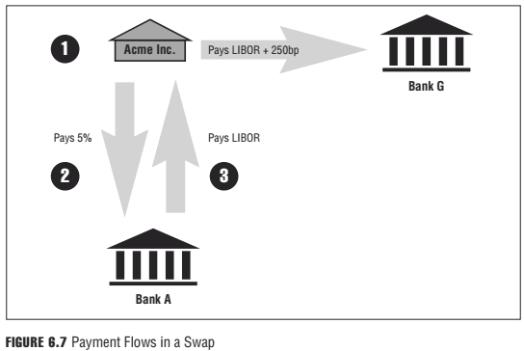

Slide 28
3. Trading:
Banks engage in trading operations and buy or sell financial instruments. In some cases, the trading is conducted on behalf of the bank’s customers—where the bank acts as an intermediary—and does not directly risk the bank’s capital. In other cases, the trading is done to benefit the bank itself by seeking short-term profits from favorable moves in the market prices. This type of trading, known as proprietary trading, puts the bank’s capital directly at risk. Currently, U.S. banks are being discouraged from conducting proprietary trading as a result of the Volcker Rule under the 2010 Dodd-Frank Act.
Trading is risky: Prices may not move in the direction the bank expects, and the value of the financial instruments may change adversely and hurt the bank. The bank must decide how much risk it is willing to assume to make a profit, usually referred to as a bank’s risk appetite. Generally, higher risk implies higher expected return. But higher risk also means that the likelihood of loss increases as well. The trade-off between risk and return is fundamental to any institution. This relationship is shown in Figure 6.8.

Slide 29
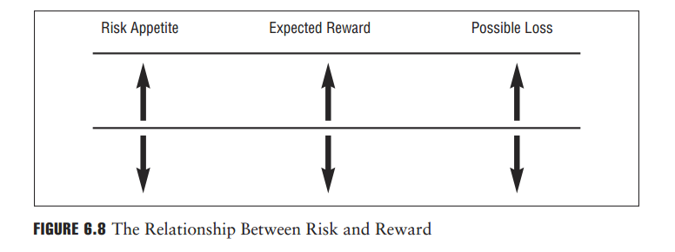

Slide 30
1. Fundamental Trading Positions
In financial markets, a position refers to the ownership status of a particular financial instrument. There are two fundamental trading positions: the long and the short position.
The holder of a long position bought, or owns, the financial instrument and will profit if the price of the instrument goes up or will incur a loss if the price of the instrument goes down.
The opposite position is a short position. The term short position has two different meanings, depending on whether the investor/trader is dealing in futures contracts or in stock, bonds, or other financial instruments.
The holder of a short position in a commodities futures contract has the obligation to deliver a commodity when the contract expires. Usually, pro- ducers of commodities sell short their future production to lock in the price of the commodity in advance. The holder of a short position will profit if the price of the commodity goes down or incur a loss if the price goes up.
In equity markets, if an investor believes that shares of a company are overvalued (i.e., too high) and thinks the price will go down in the near term, the investor can establish a short position by borrowing shares from a broker and then selling the shares. At some time in the future, the investor can buy the shares back and return them to the broker. If the investor sold the shares for more than the cost to purchase the shares, it profits; otherwise, it incurs a loss. This applies to bonds, stocks, or any other financial instruments.

Slide 31
1. Fundamental Trading Positions
In financial markets, a position refers to the ownership status of a particular financial instrument. There are two fundamental trading positions: the long and the short position.
The holder of a long position bought, or owns, the financial instrument and will profit if the price of the instrument goes up or will incur a loss if the price of the instrument goes down.
The opposite position is a short position. The term short position has two different meanings, depending on whether the investor/trader is dealing in futures contracts or in stock, bonds, or other financial instruments.
The holder of a short position in a commodities futures contract has the obligation to deliver a commodity when the contract expires. Usually, pro- ducers of commodities sell short their future production to lock in the price of the commodity in advance. The holder of a short position will profit if the price of the commodity goes down or incur a loss if the price goes up.
In equity markets, if an investor believes that shares of a company are overvalued (i.e., too high) and thinks the price will go down in the near term, the investor can establish a short position by borrowing shares from a broker and then selling the shares. At some time in the future, the investor can buy the shares back and return them to the broker. If the investor sold the shares for more than the cost to purchase the shares, it profits; otherwise, it incurs a loss. This applies to bonds, stocks, or any other financial instruments.

Slide 32
EXAMPLE
The trading desk of Bank G expected the price of gold to decrease in the future from its current level of EUR 800 per ounce. To capitalize on this negative price view, it sold short several hundred gold futures contracts at EUR 800 per ounce. If Bank G held onto these futures con- tracts until they expired, it would be required to deliver the amount of gold that represented the several hundred contracts it sold. Several months later, the price of gold fell to EUR 750 per ounce.
To exit from the trade and close out its position, the bank had to buy the same number of contracts for EUR 750 per ounce. Because Bank G purchased the gold futures contracts for less than it sold them, it realized a profit of EUR 50 per ounce. The bank had a short position in the gold contracts and benefited from the price decline in gold. However, had the price of gold increased to EUR 850 per ounce, Bank G would have lost EUR 50 per ounce on the deal if it sold its contracts at that time to limit its loss.

Slide 33
Bid-Ask Spreads
In buying and selling financial instruments, traders will quote prices at which they are willing to buy or sell the financial instrument. The difference between the buy price (bid) and sell price (ask) سعر الشراء (العرض) وسعر البيع (الطلب)is called the bid-ask spread.
EXAMPLE
A trader at Bank G offers to buy stock of Acme Inc. at EUR 10.15 per share, and another trader offers to sell the same stock at EUR 10.25 per share. The bid-ask spread is EUR 0.10. The size of the bid-ask spread is an indicator of market liquidity: The narrower the bid-ask spread, the closer the buyers and sellers are to placing a true market value on the financial instrument and the more transactional volume or liquidity the market has. This liquidity, referred to as market liquidity, is a very important component of any marketplace, and liquidity is a highly desirable market characteristic that market participants actively seek.

Slide 34
3. Exchange and Over-the-Counter Markets
Financial instruments such as foreign exchange contracts, bonds, equities, commodities, and derivatives are traded on either regulated financial markets, called exchanges, or the over-the-counter markets. An exchange is a centralized marketplace where brokers and traders
meet and, on behalf of their customers or on their own account, buy and sell standardized financial instruments such as equities, bonds, commodities, options, and futures.
For any financial instrument to be traded on an exchange, it must meet both regulatory requirements imposed by the exchange’s regulator and listing requirements imposed by the exchange itself.
For instance, many stock exchanges impose listing requirements on the listed company regarding the number of shareholders, the stability of earnings, and the size of the company’s assets. Futures exchanges list standard contracts that first must be approved by a regulatory body. Any changes to the con-tract’s terms must also be approved.

Slide 35
Whether the transaction takes place on the trading floor of an exchange or in an electronic marketplace owned by an exchange, the parties to the transaction operate according to an agreed set of exchange rules, which in many cases requires clearing their trades and transactions through a clearing house that is typically affiliated with the exchange.
A clearinghouse, often referred to as the central counterparty (CCP), becomes the buyer to each seller and the seller to each buyer, effectively standing in the middle of the transaction to guarantee the financial performance of the trade as agreed by the parties to the transaction. Each clearinghouse or central counterparty has its own rules, regulations, and conventions, which may differ across the different types of financial instruments that are traded on the same exchange that the clearinghouse or central counterparty clears.

Slide 36
While exchanges offer standardized products, price transparency, clear rules that govern the transactions between the buyers and sellers, and collat- eral support through the clearinghouse, they do not offer the flexibility many sophisticated investors need, as such investors must individually structure the trades that they want for hedging or other purposes. These transactions are executed in the over-the-counter markets instead, where both the flexibility and the ability to customize trades and transactions exist.
The over-the-counter or OTC market does not have a physical location for its marketplace. However, there has been a major drive toward requiring the trading of OTC transactions through a centralized electronic marketplace to allow for greater transparency around the OTC marketplace, and a perceived increase in safety as it would relate to counterparty default.

Slide 37
In the OTC market, the buying and selling of financial instruments takes place directly between the two parties to the transaction through the use of phones or computer networks, with each party directly assessing and taking on the risk of the creditworthiness of the other party to the transaction. Most notably, foreign exchange, derivatives, bond, and commodity trading, and some equity trading activities are conducted in the OTC markets. Due to the general need and/or desire in the market to customize instruments and to match as closely as possible the needs and desires of the two parties to the transaction, the OTC market is significantly bigger than the exchange marketplace.
The use of collateral in the OTC market is not regulated or standardized, as it is in the exchange-traded markets. When parties to an OTC transaction demand collateral from each other, they negotiate to determine the size and quality of the specific type of collateral they would be willing to accept to ensure that performance will occur as agreed. In some limited instances, standardized OTC transactions will move to an exchange marketplace for the primary reason of using a clearinghouse to guarantee the transaction. The movement of these transactions to an exchange for this purpose of ensuring counterparty credit is developing rapidly, reflecting the interest from market participants to extend the protection offered by central clearinghouses to OTC transactions. Figure 6.10 is a general comparison.

Slide 38
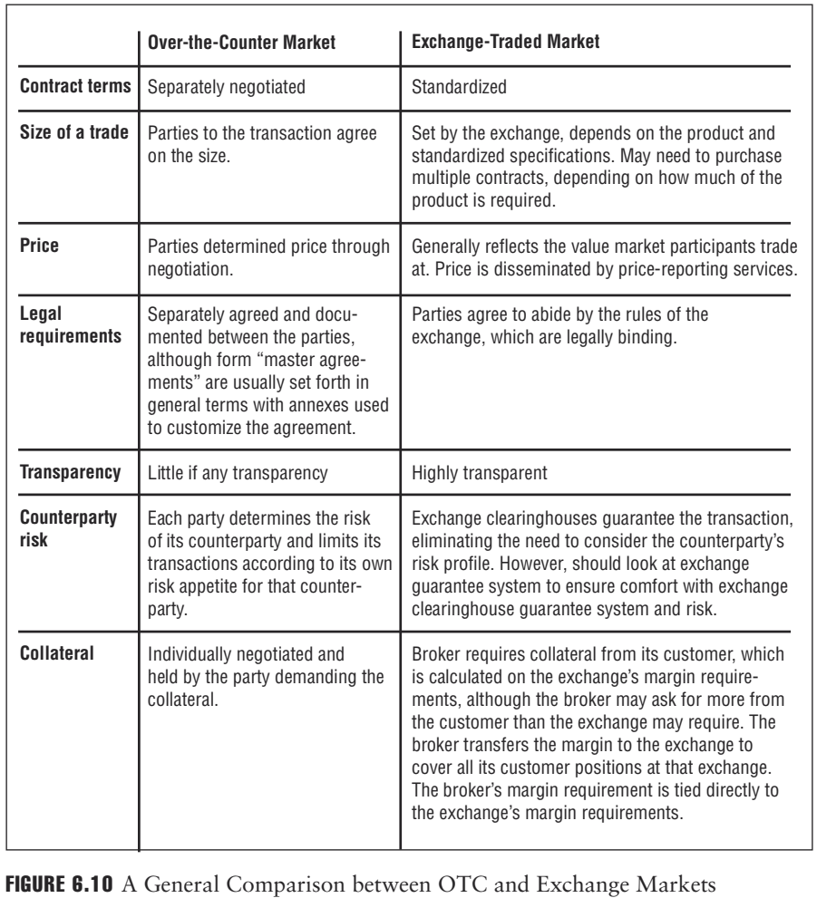

Slide 39
Reference
Foundations of Financial Risk.
An Overview of Financial Risk and Risk-Based Regulation.
Richard Apostolik
Christopher Donohue
Chapter 6

