Slide 1


Slide 2


Slide 3


Slide 4
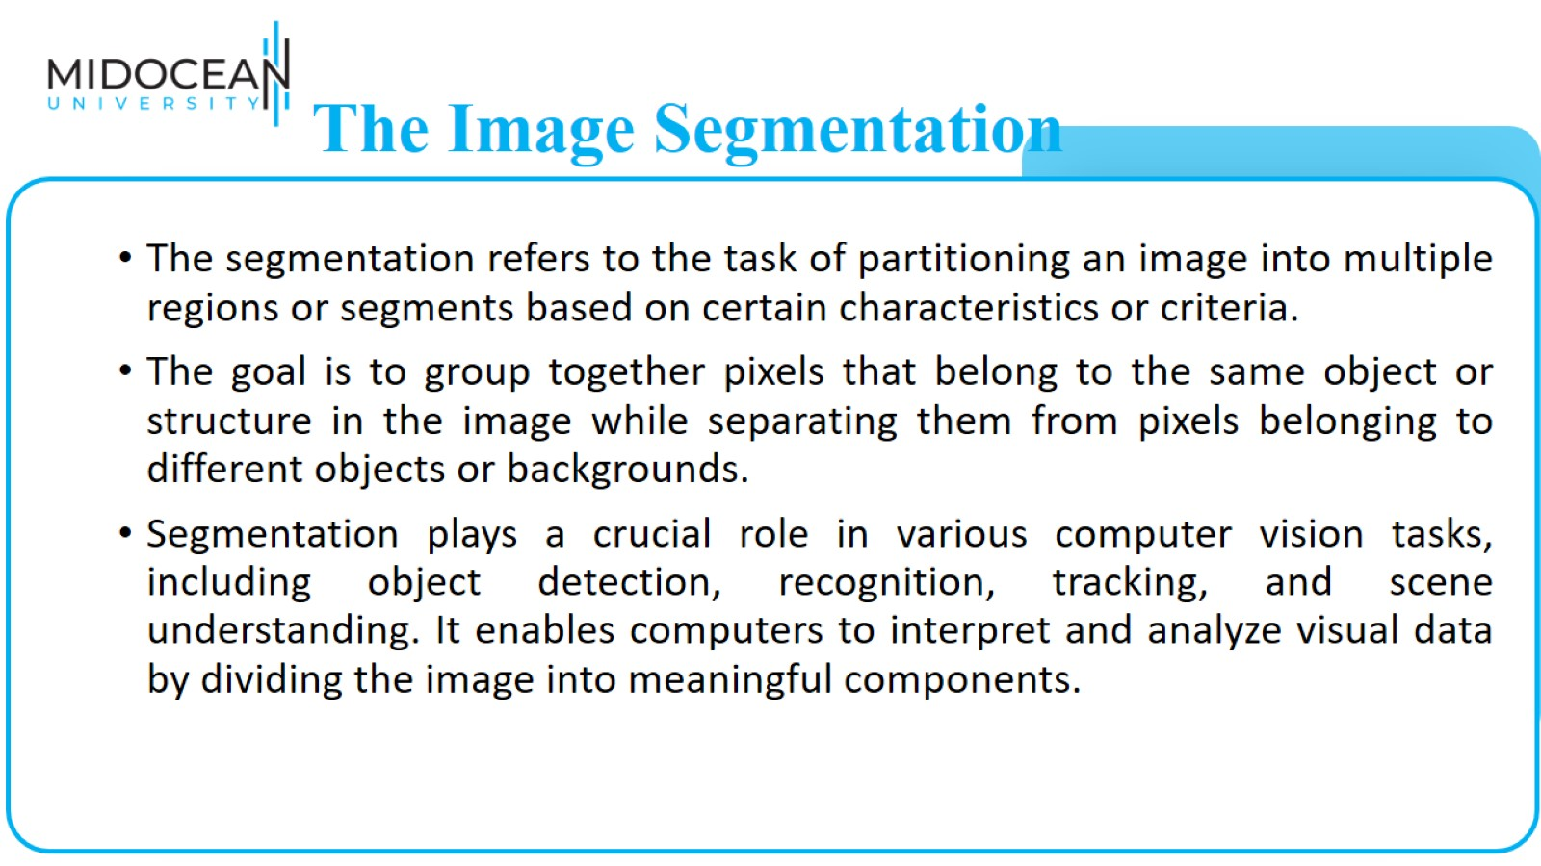
The Image Segmentation

Slide 5
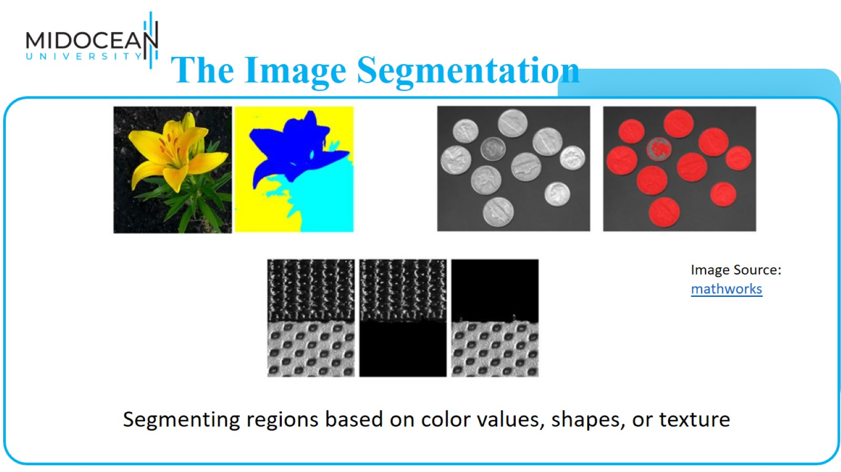
The Image Segmentation

Slide 6
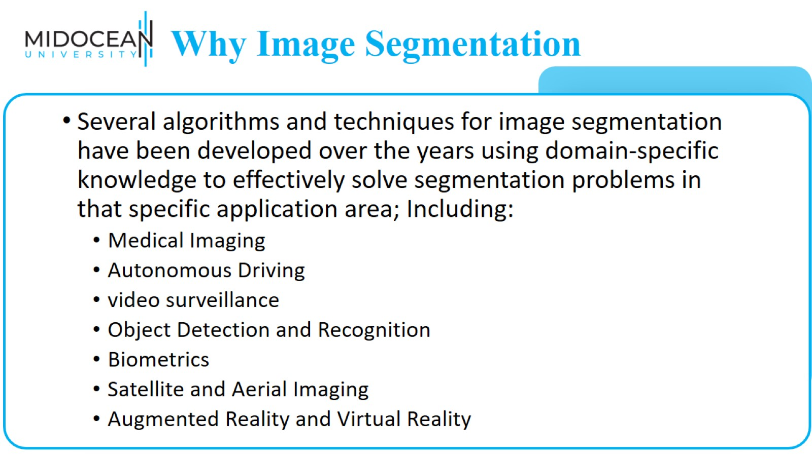
Why Image Segmentation Matters

Slide 7
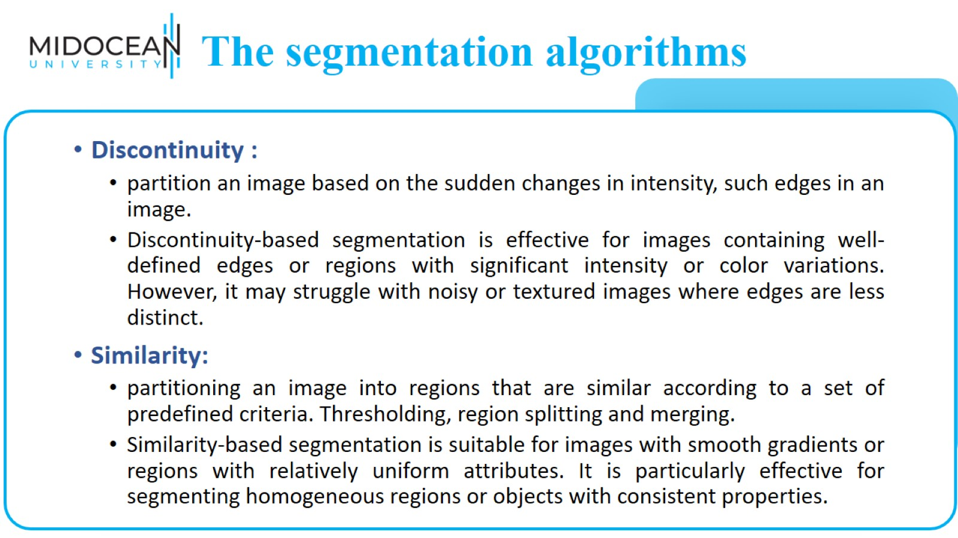
The segmentation algorithms

Slide 8
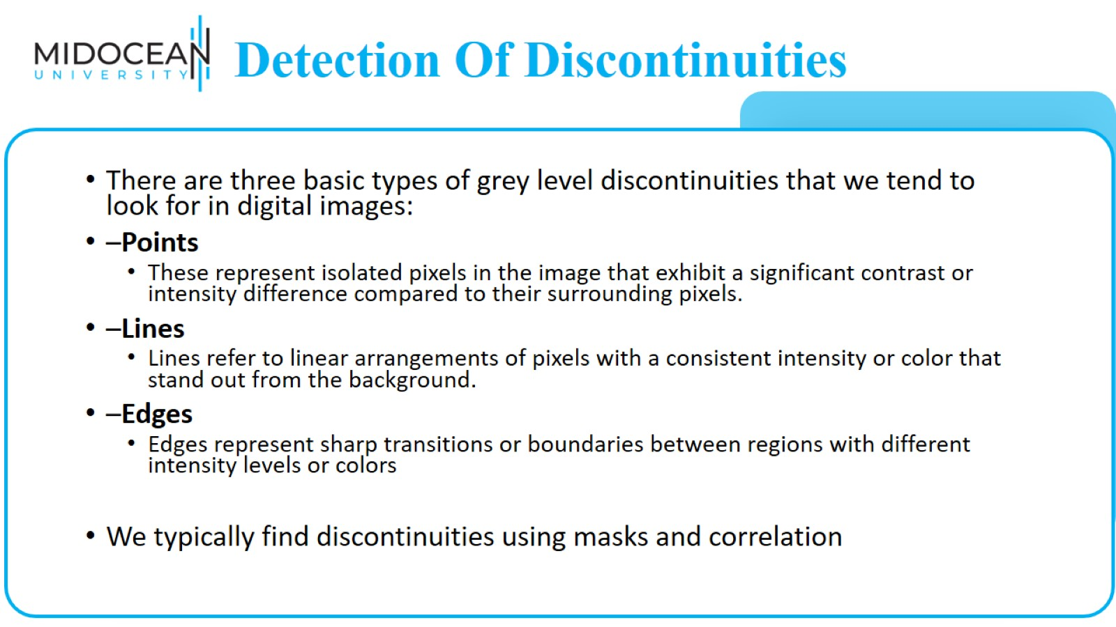
Detection Of Discontinuities

Slide 9
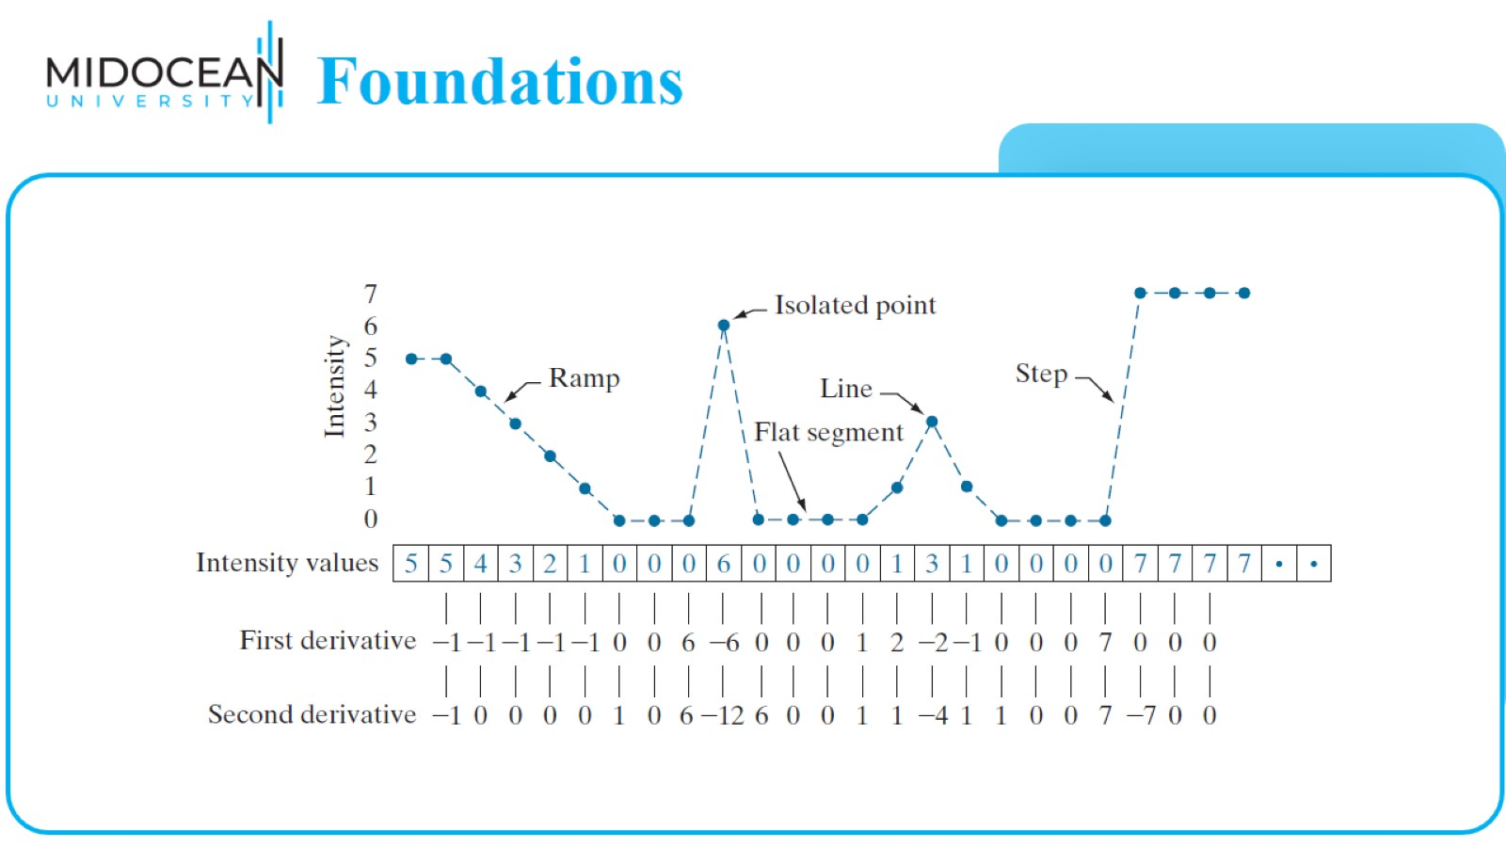
Foundations

Slide 10
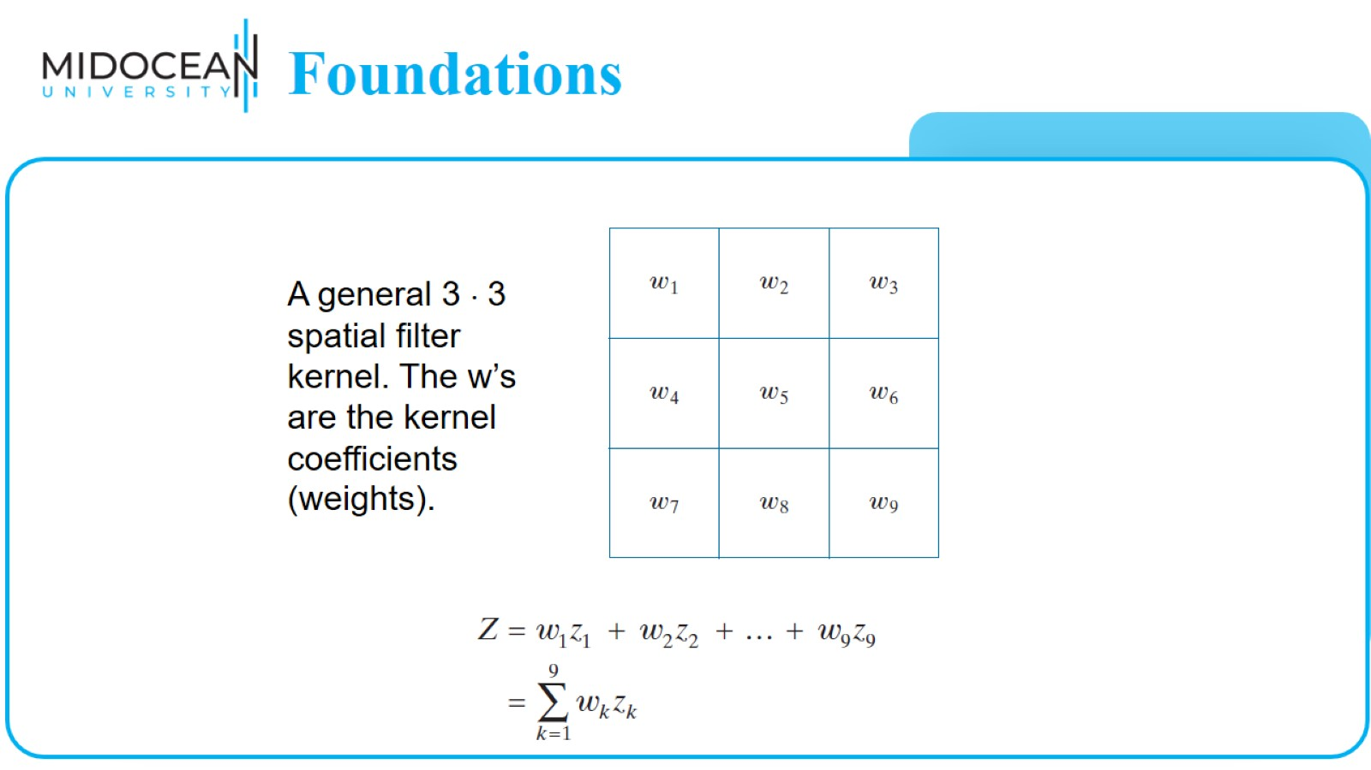
Foundations

Slide 11
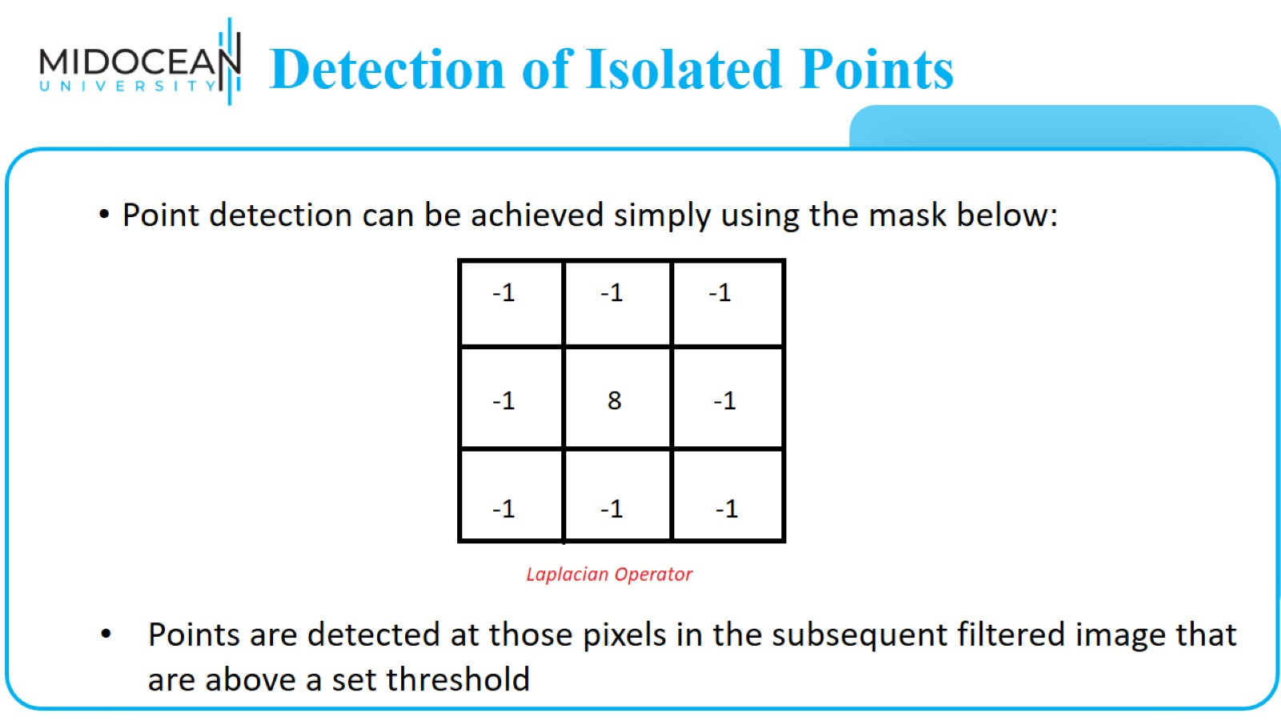
Detection of Isolated Points

Slide 12
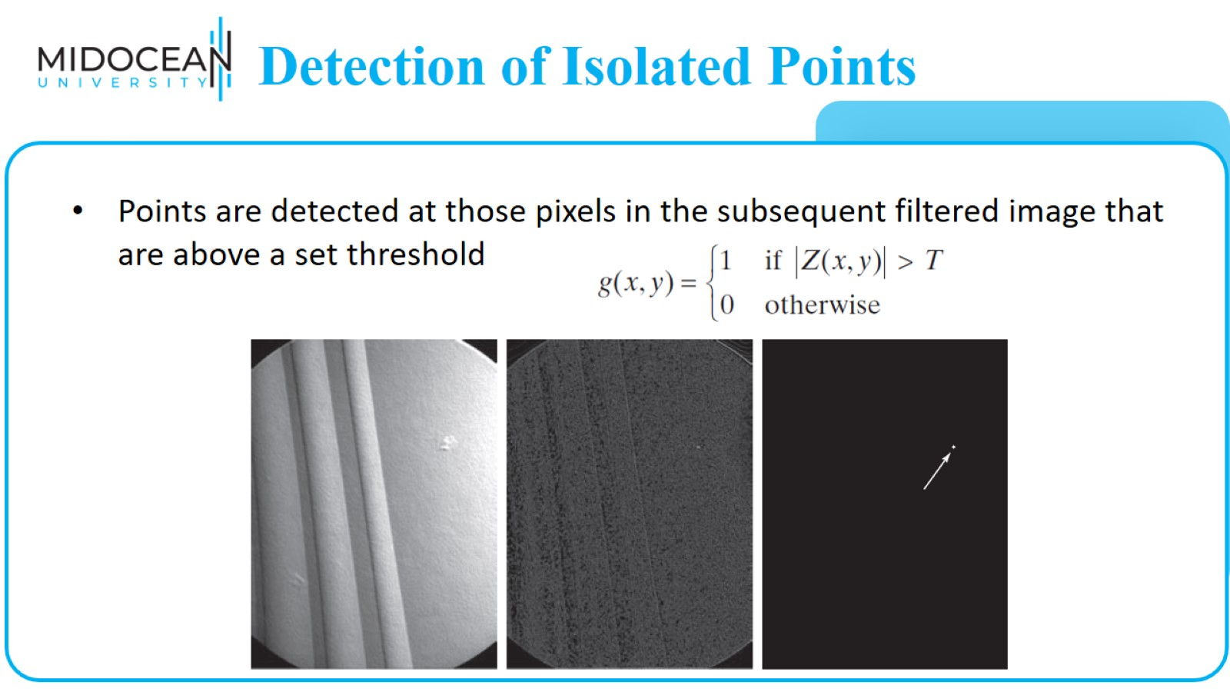
Detection of Isolated Points

Slide 13
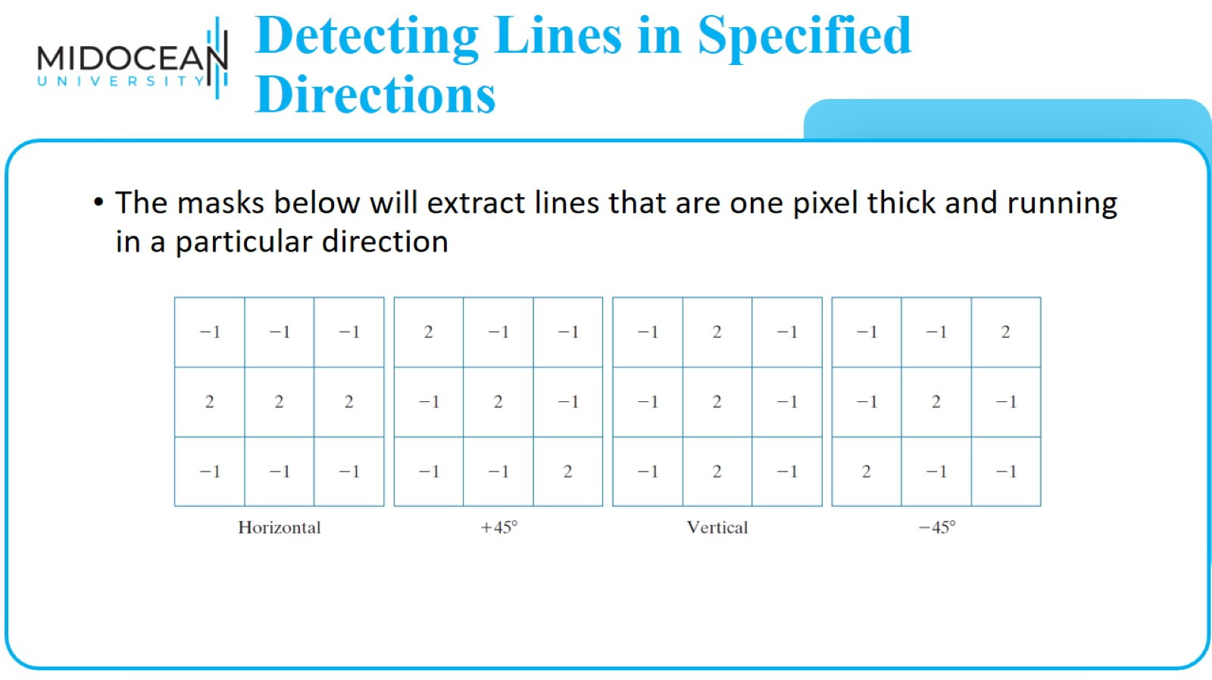
Detecting Lines in Specified Directions

Slide 14
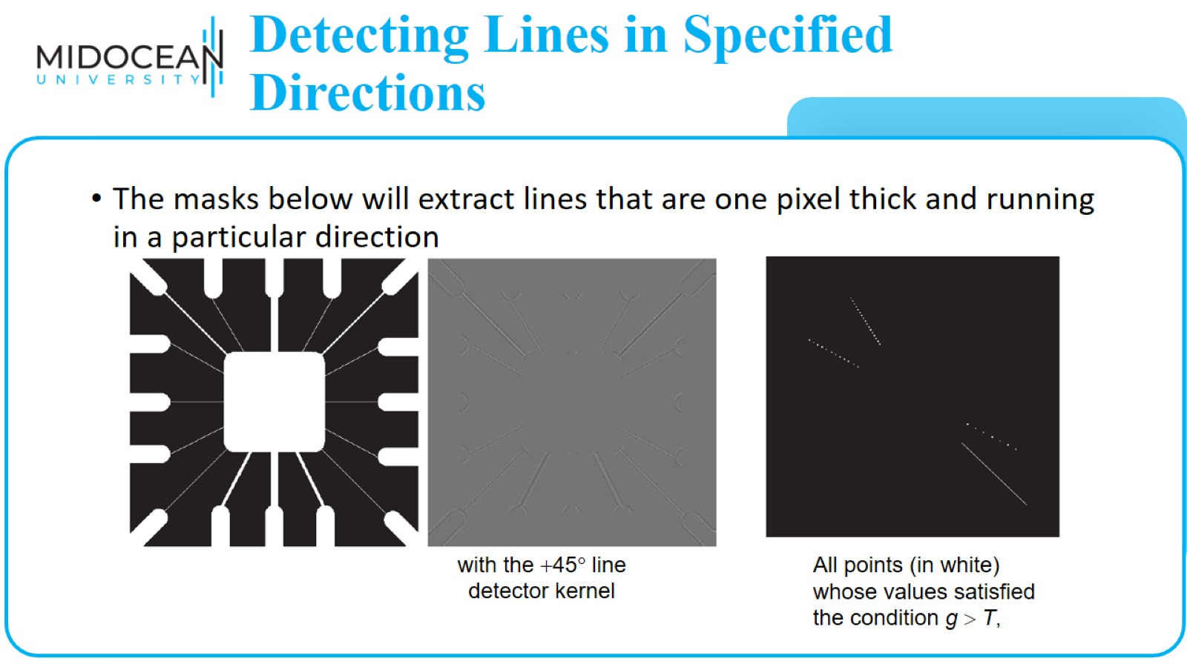
Detecting Lines in Specified Directions

Slide 15
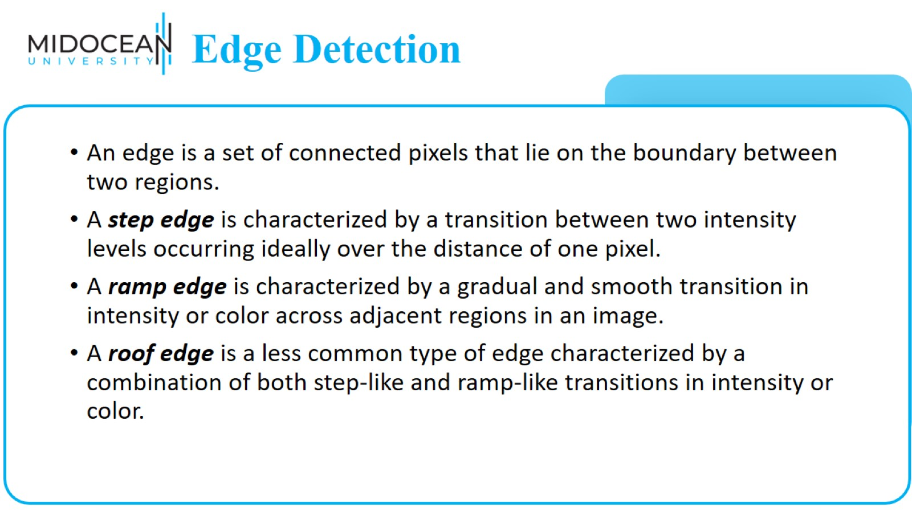
Edge Detection

Slide 16
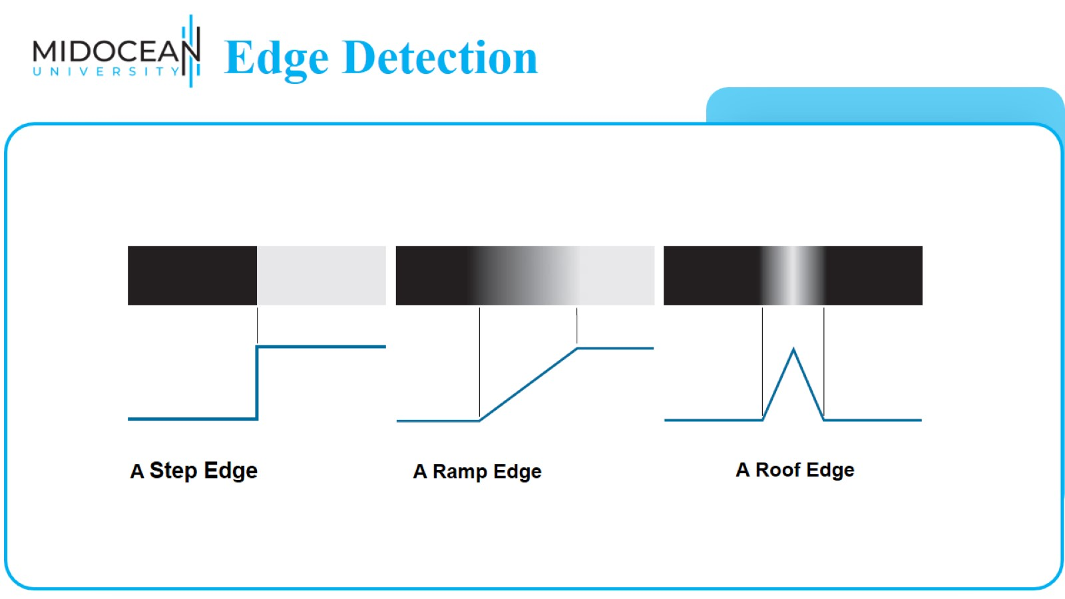
Edge Detection

Slide 17
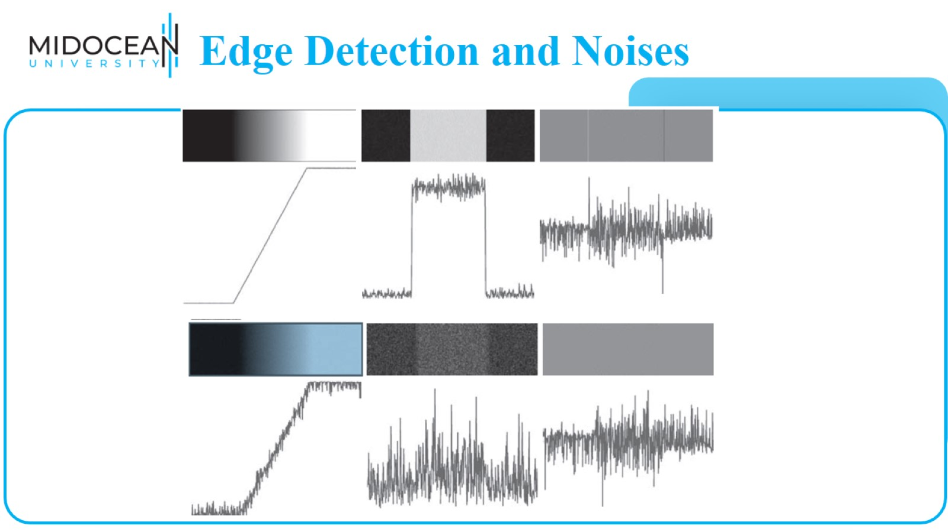
Edge Detection and Noises

Slide 18
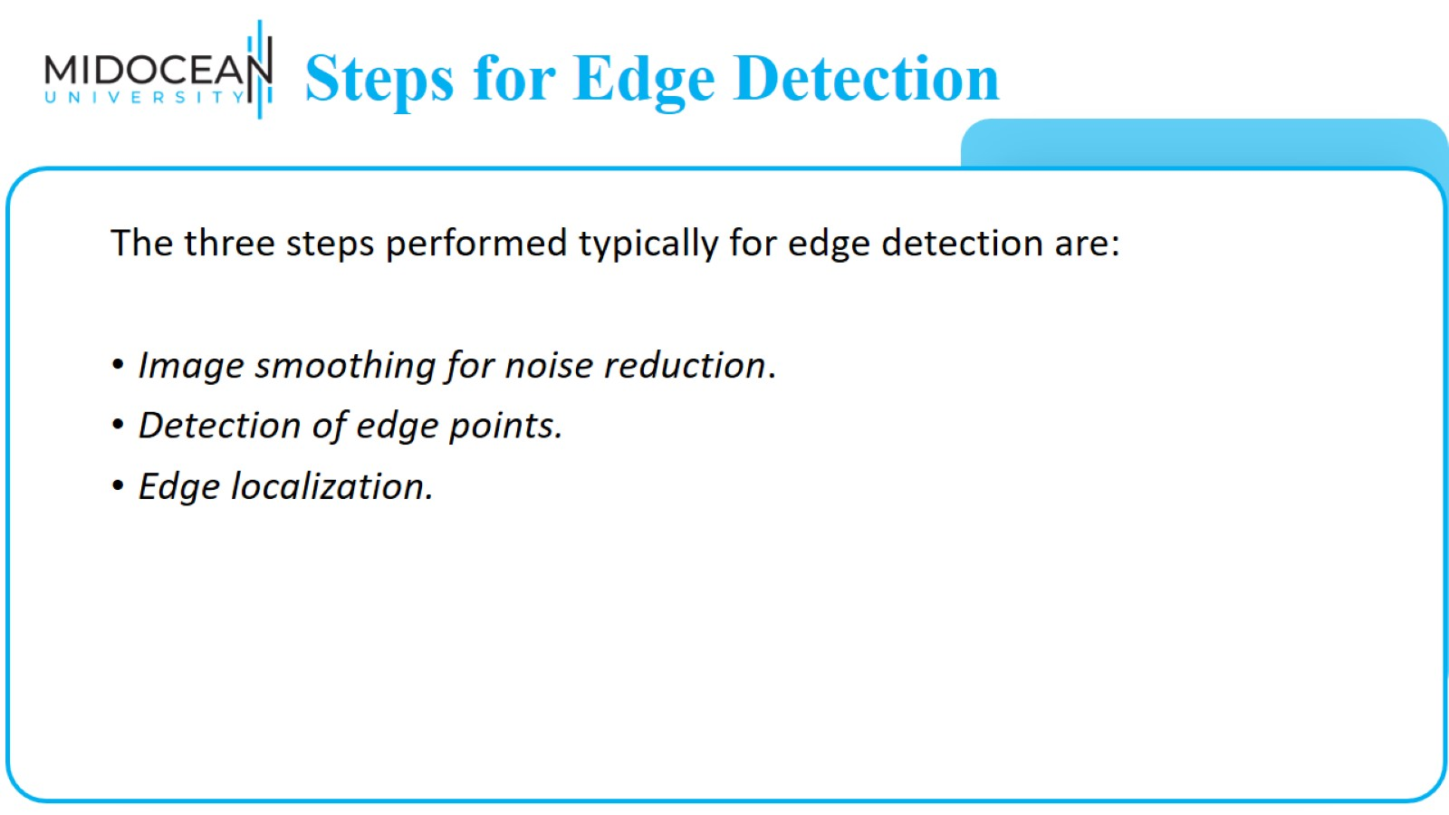
Steps for Edge Detection

Slide 19
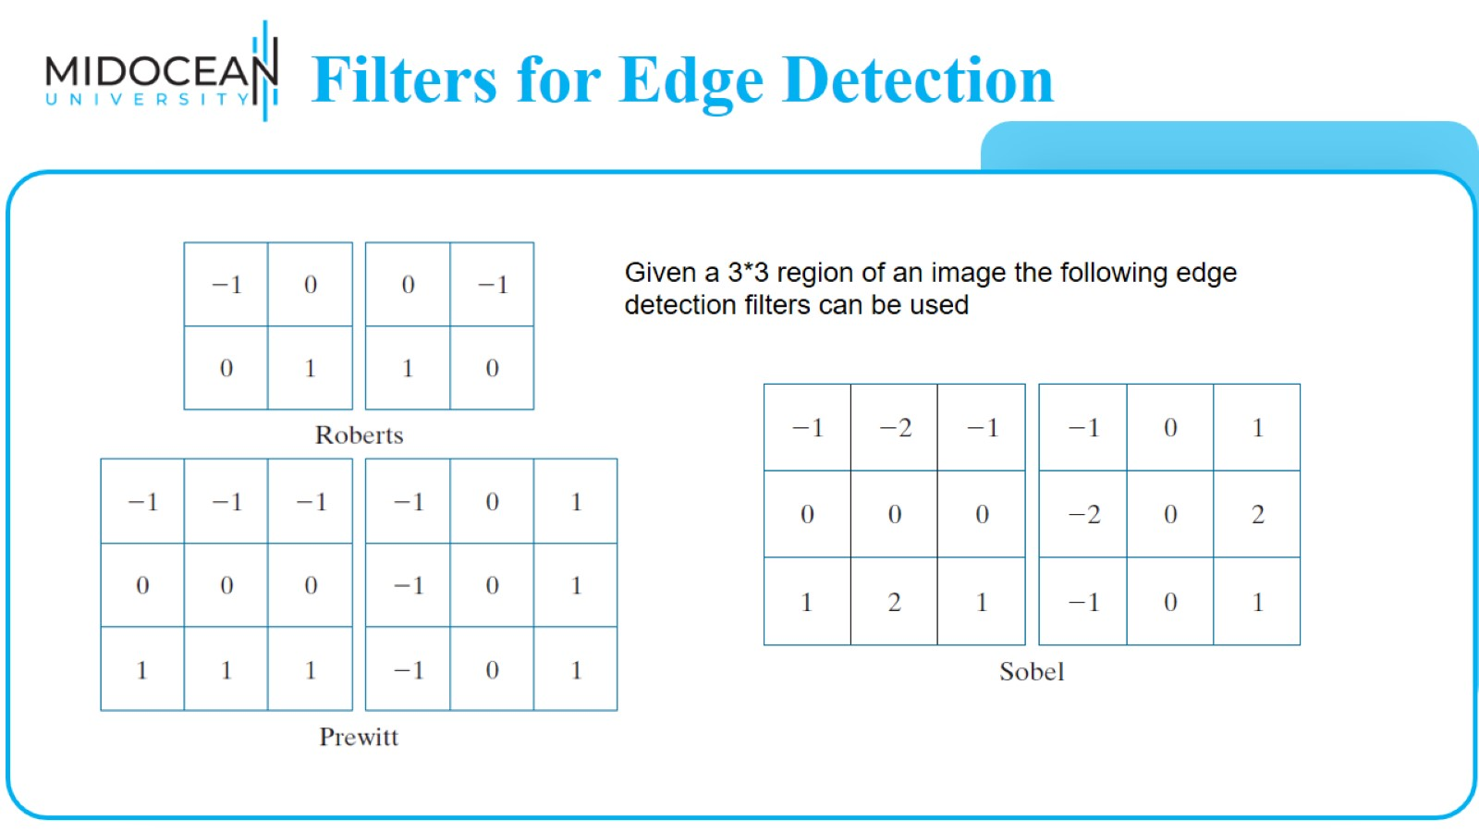
Filters for Edge Detection

Slide 20


Slide 21
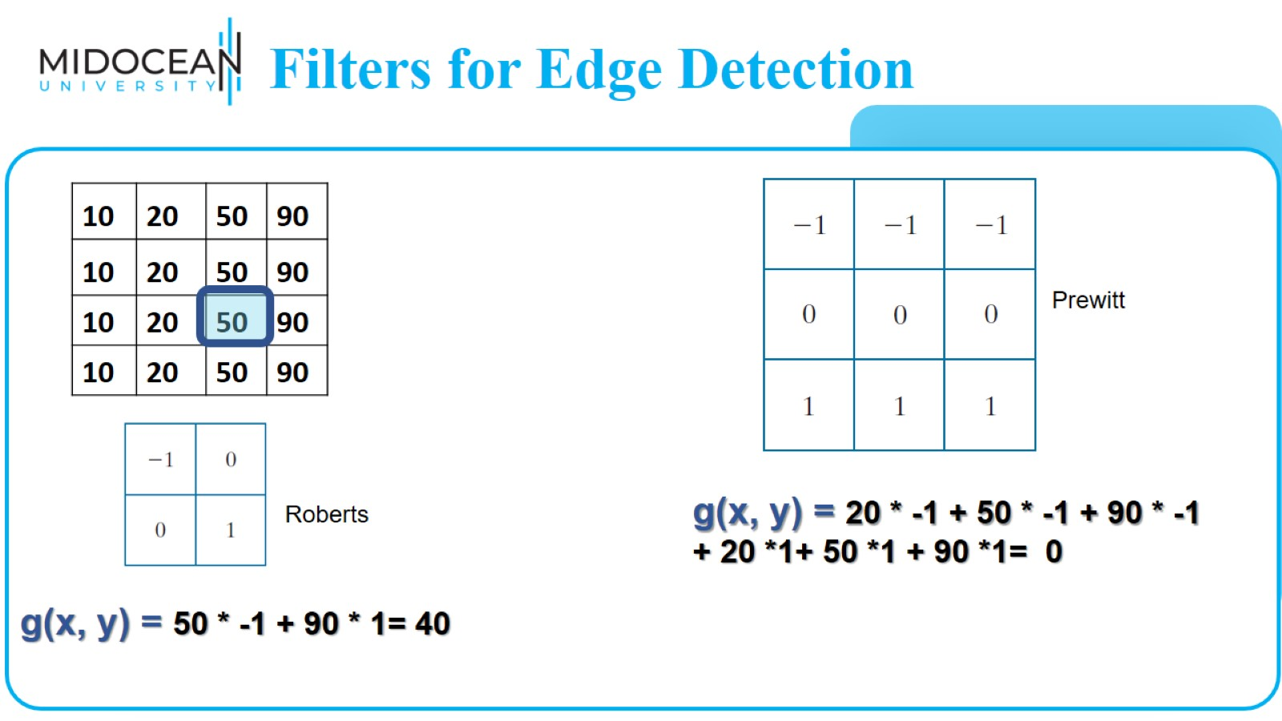
Filters for Edge Detection

Slide 22
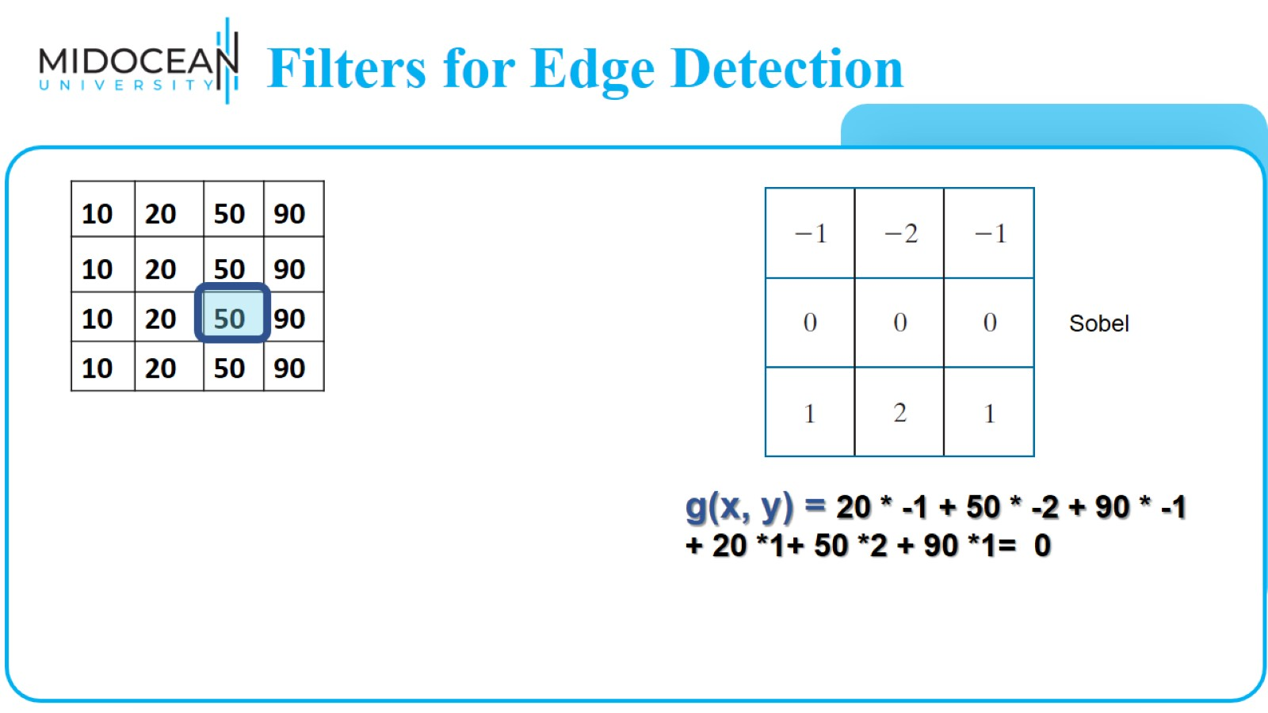
Filters for Edge Detection

Slide 23
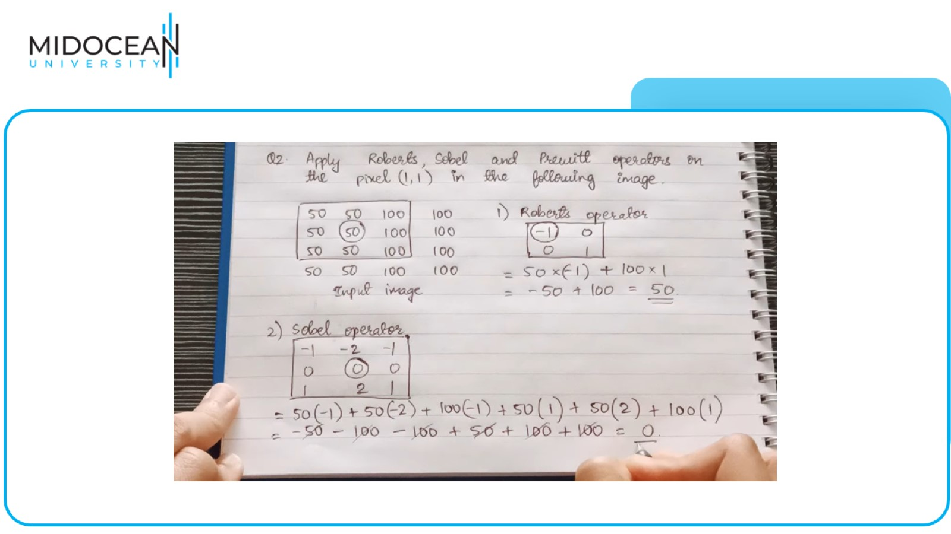

Slide 24
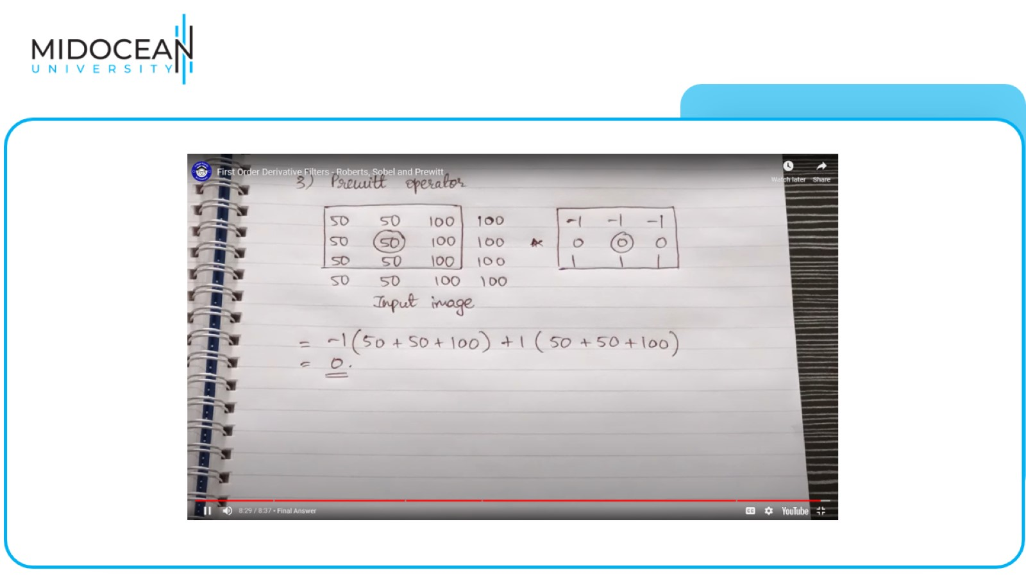

Slide 25
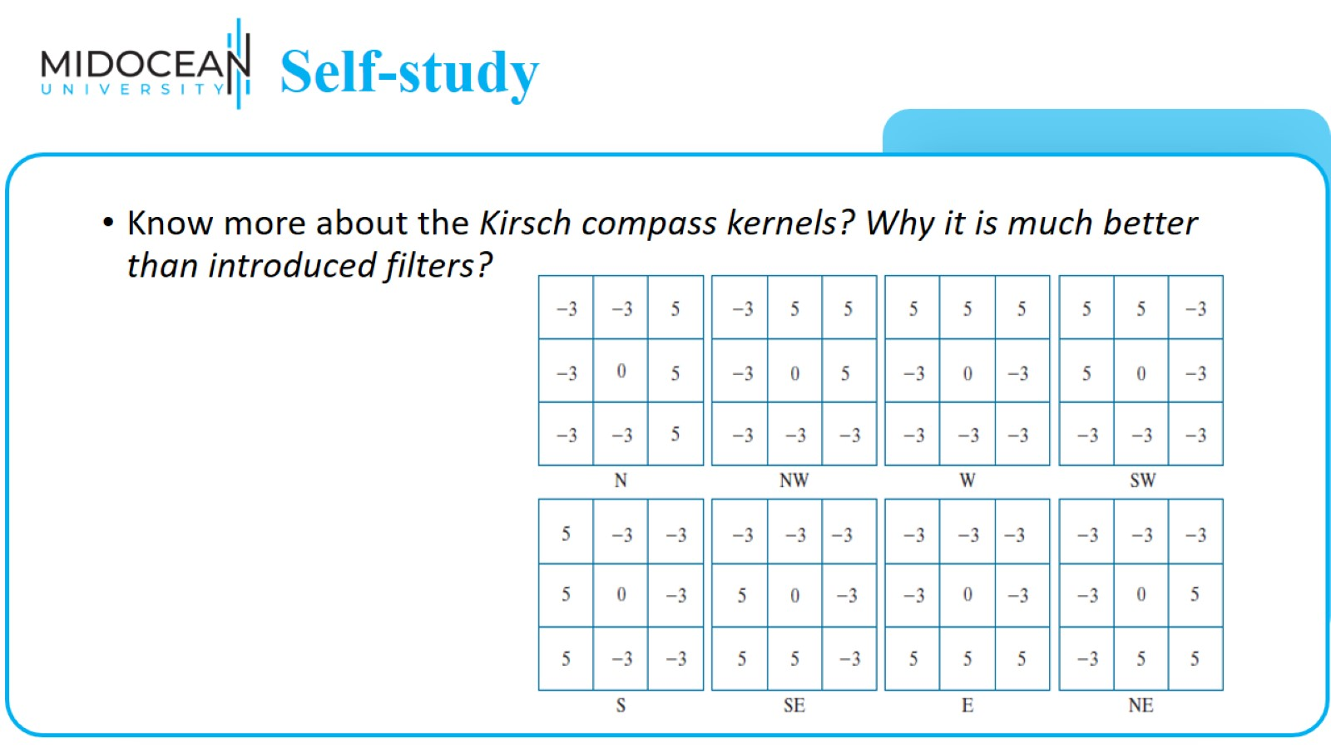
Self-study

Slide 26
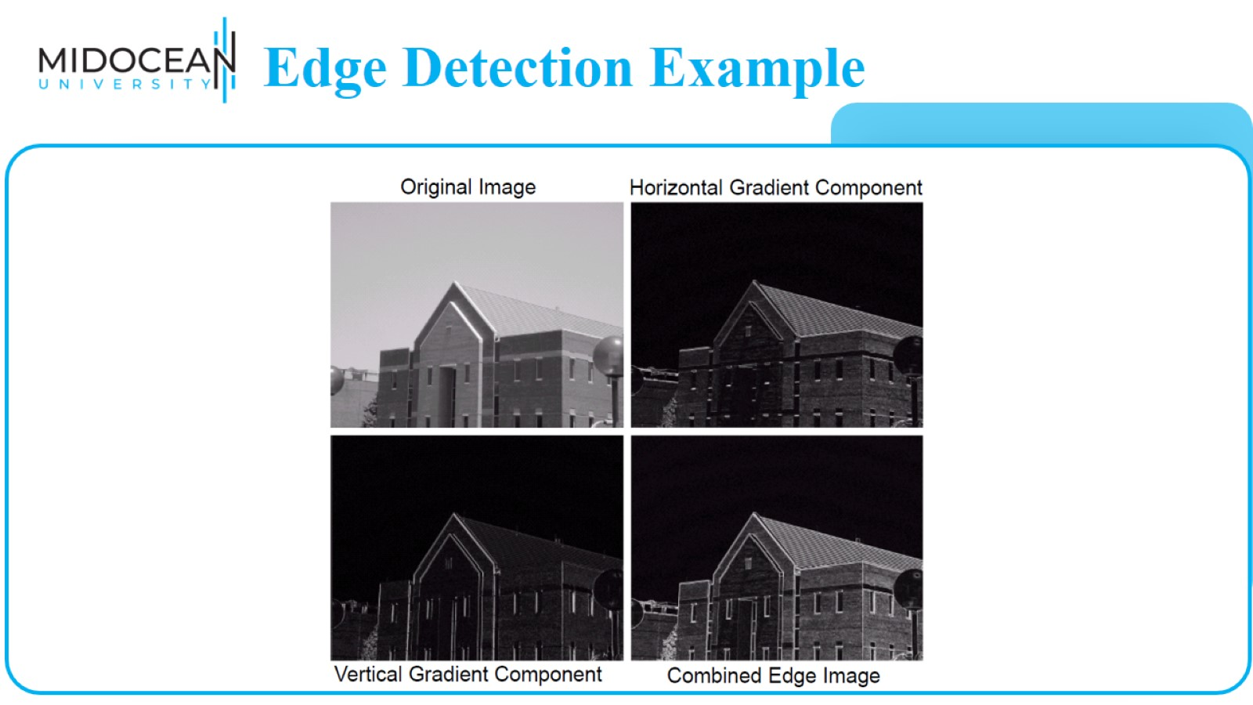
Edge Detection Example

Slide 27
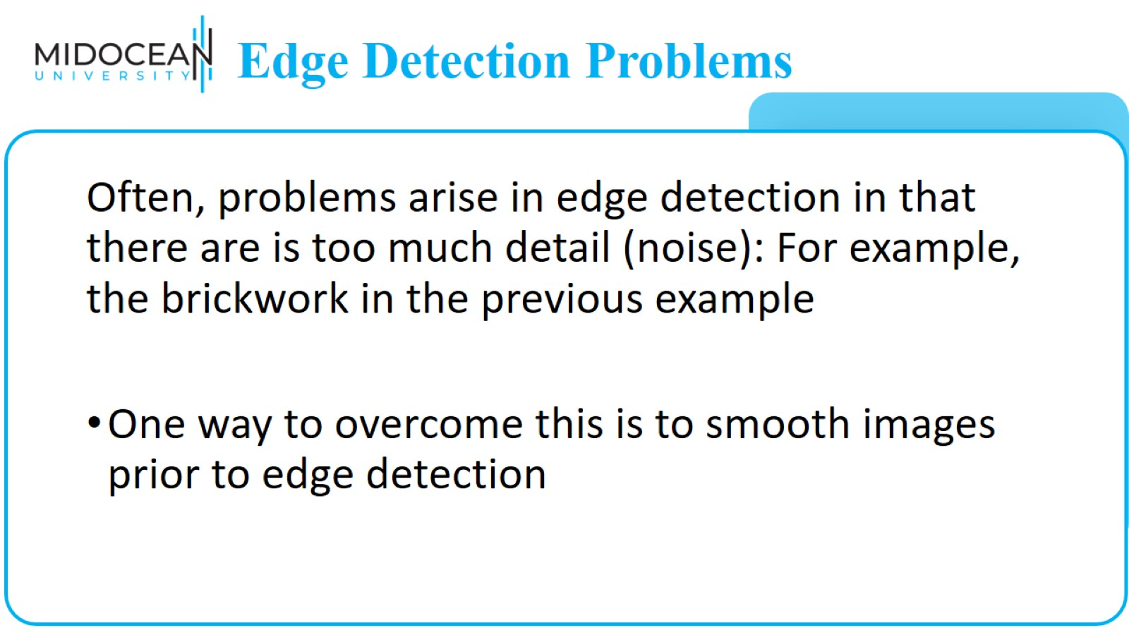
Edge Detection Problems

Slide 28
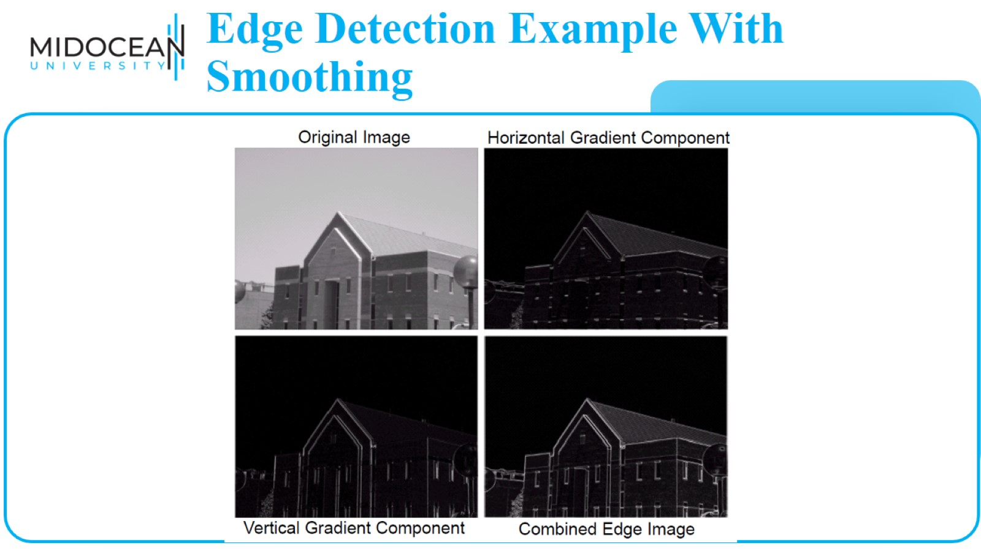
Edge Detection Example With Smoothing

Slide 29
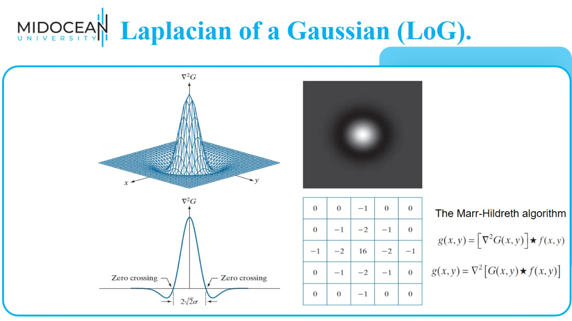
Laplacian of a Gaussian (LoG).

Slide 30
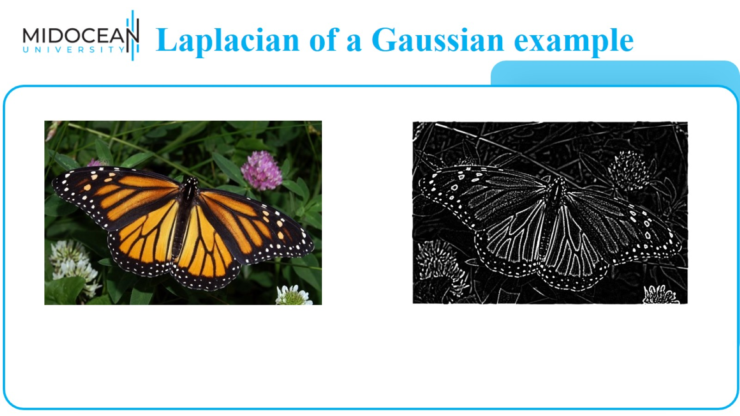
Laplacian of a Gaussian example

Slide 31
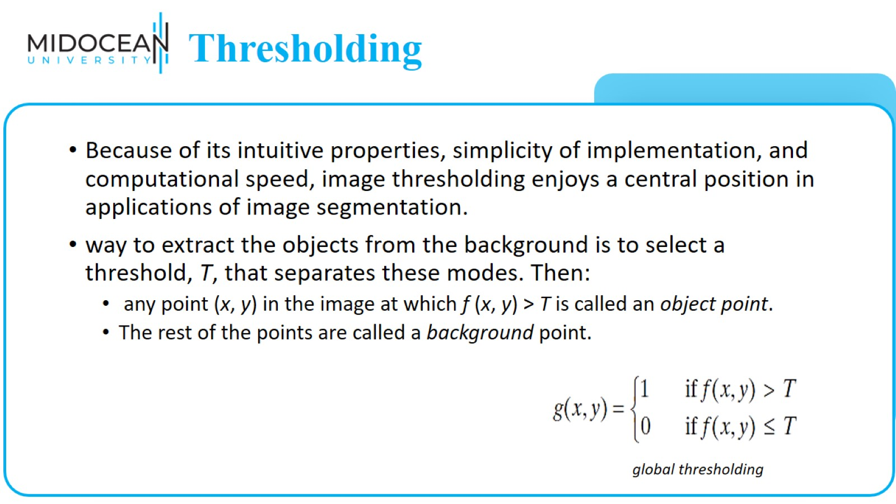
Thresholding

Slide 32
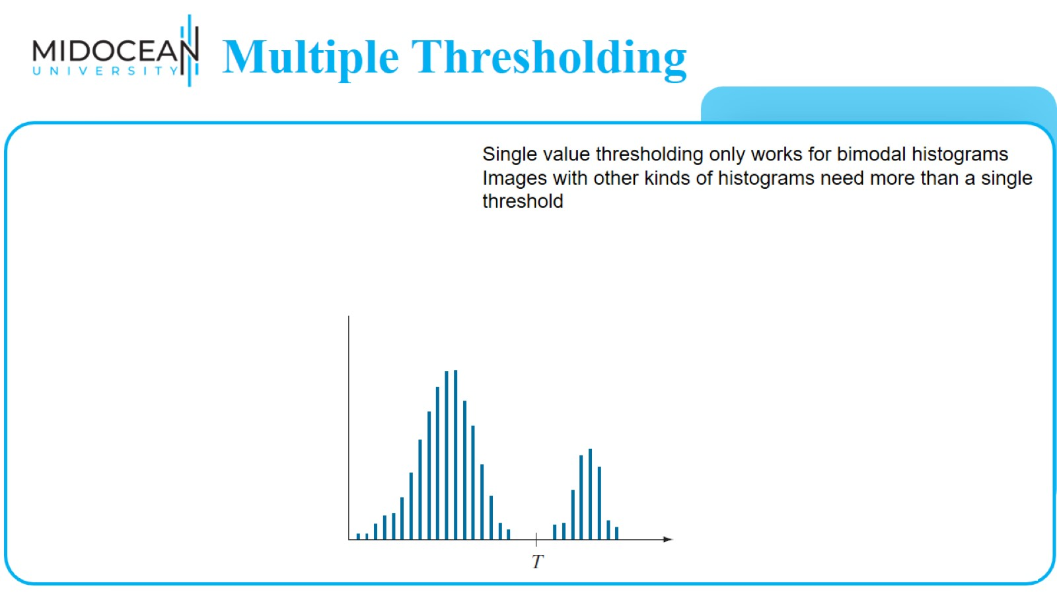
Multiple Thresholding

Slide 33
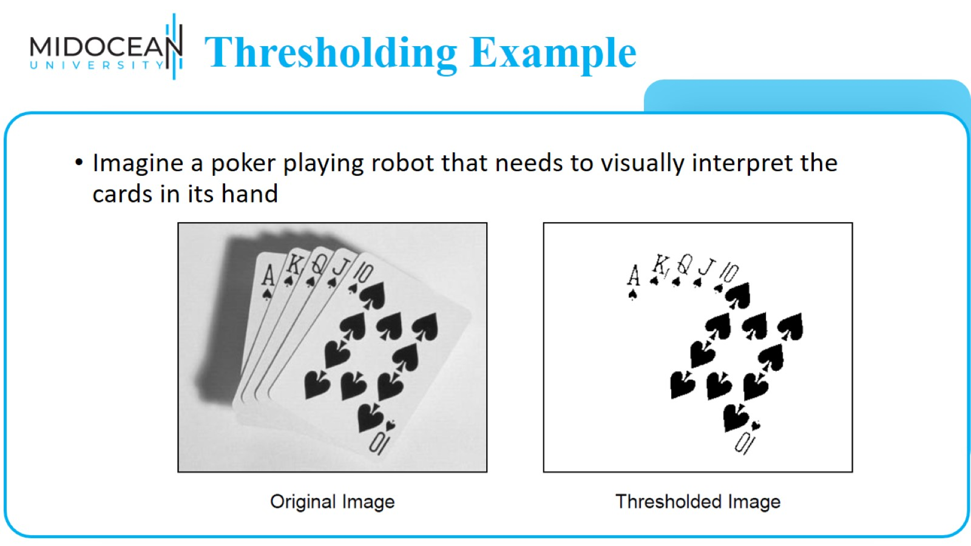
Thresholding Example

Slide 34
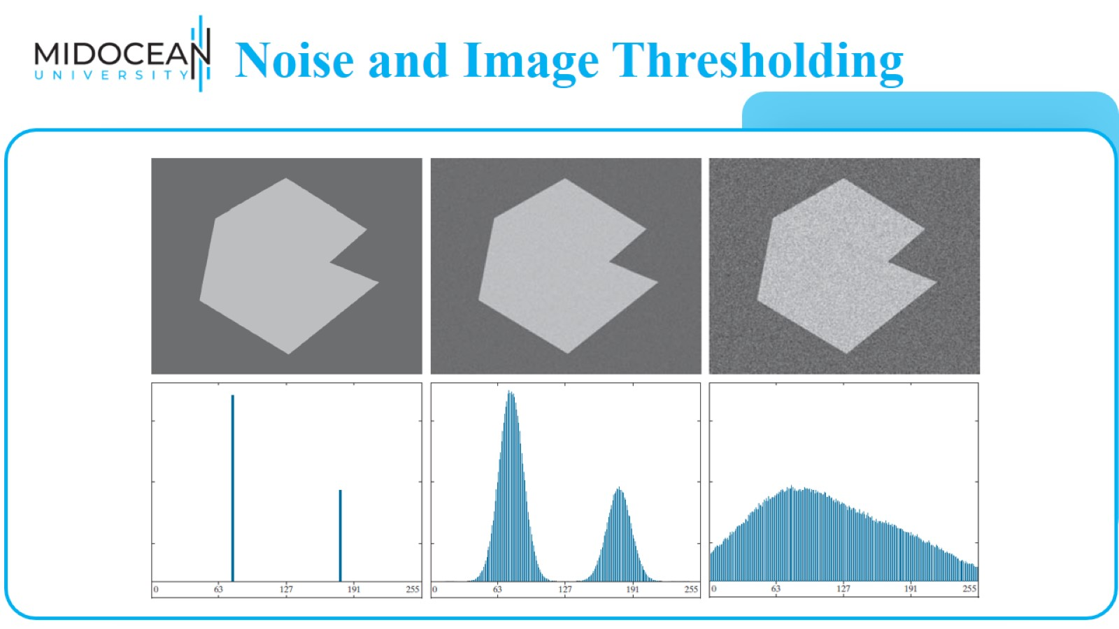
Noise and Image Thresholding

Slide 35
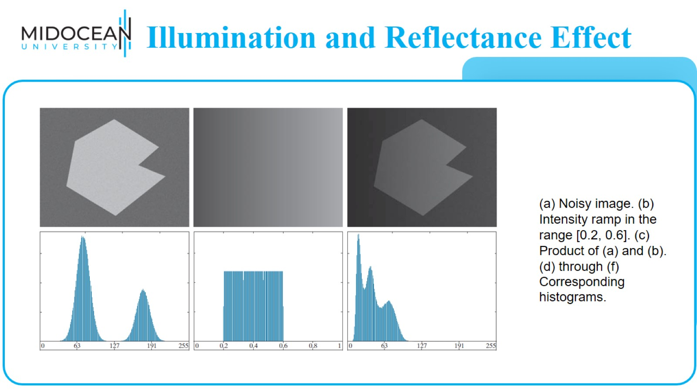
Illumination and Reflectance Effect

Slide 36
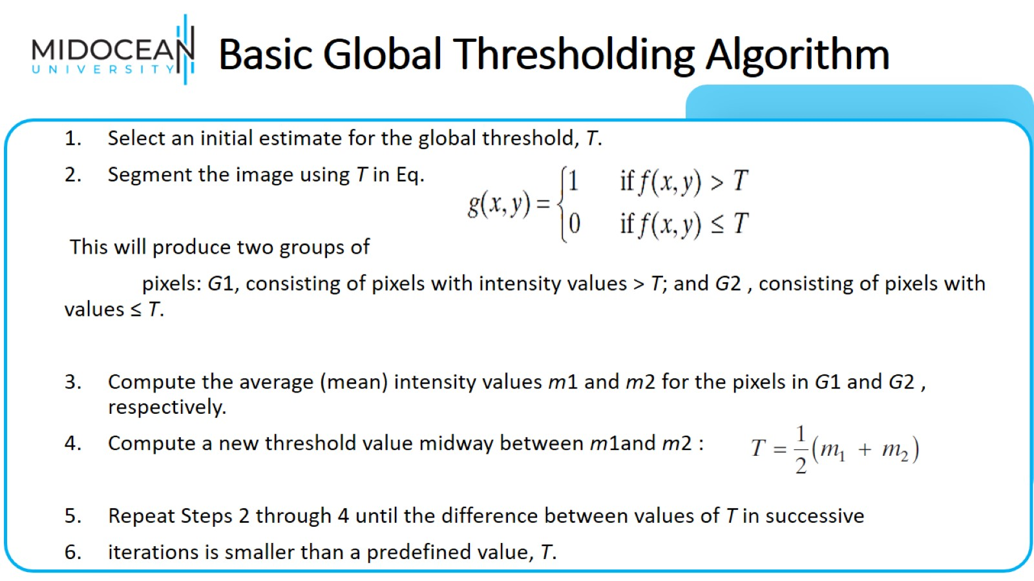
Basic Global Thresholding Algorithm

Slide 37
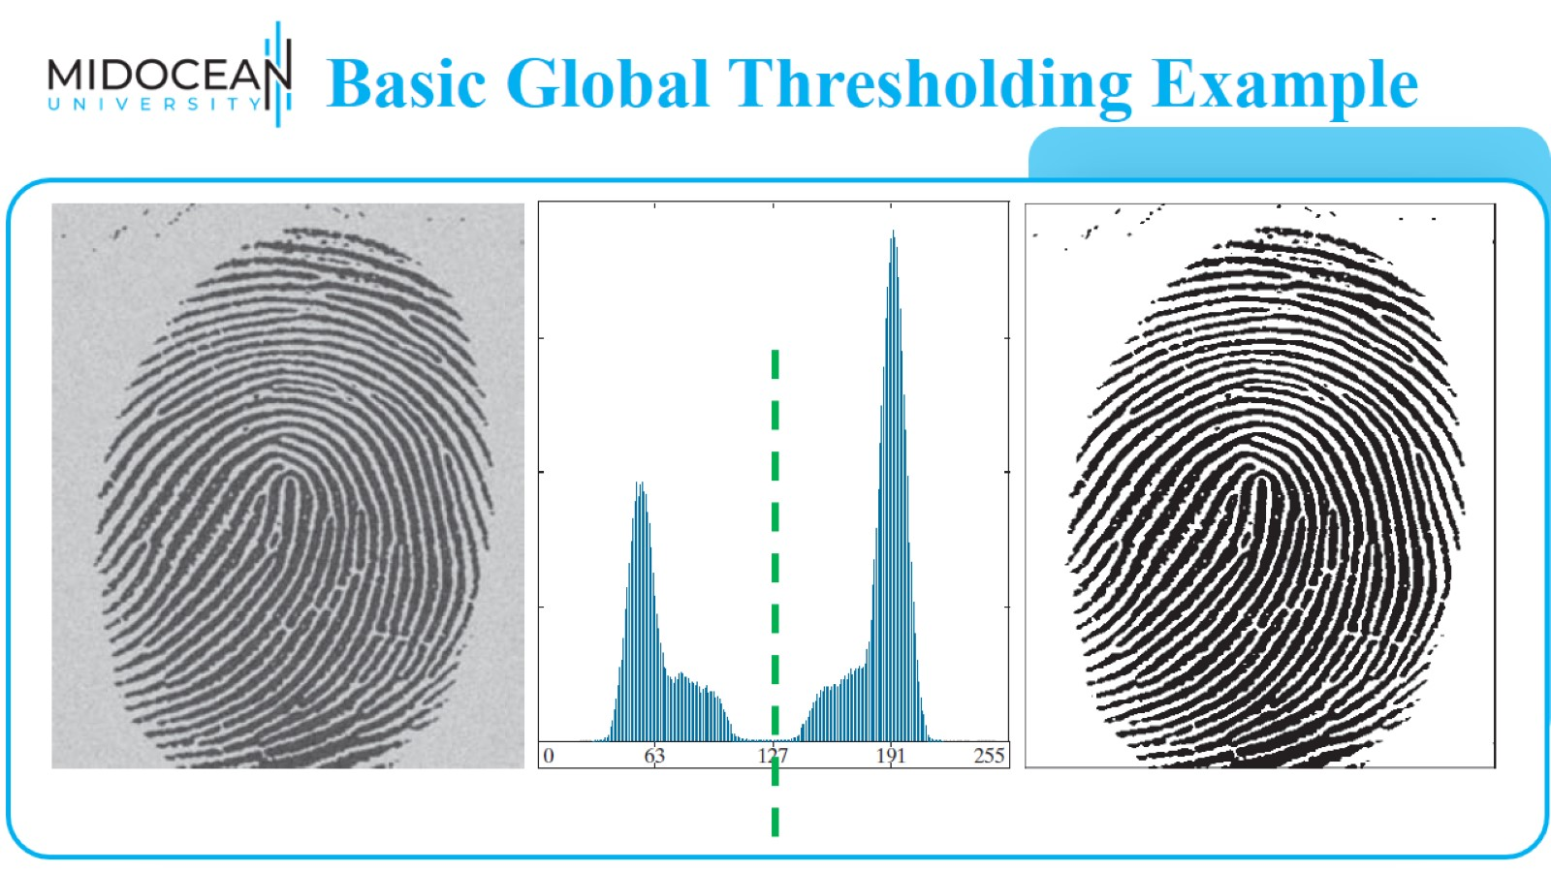
Basic Global Thresholding Example

Slide 38

Feature Extraction

Slide 39
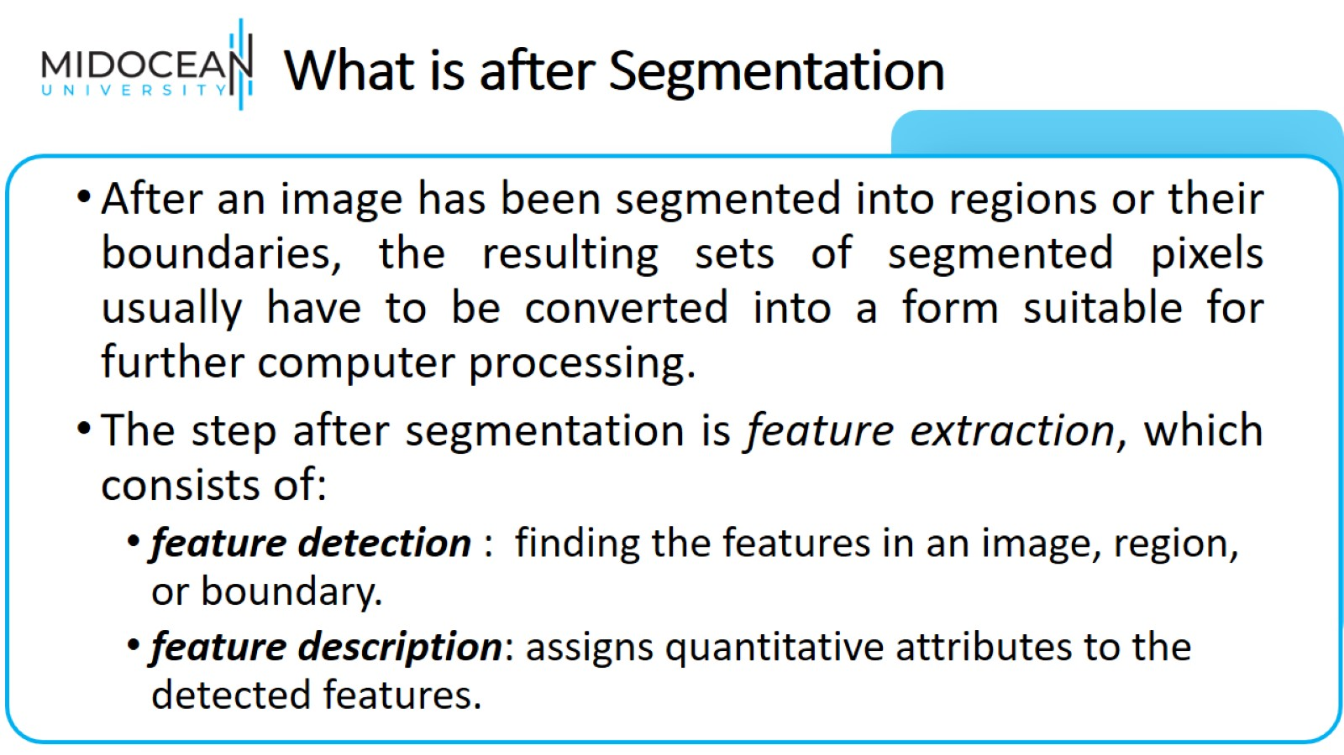
What is after Segmentation

Slide 40
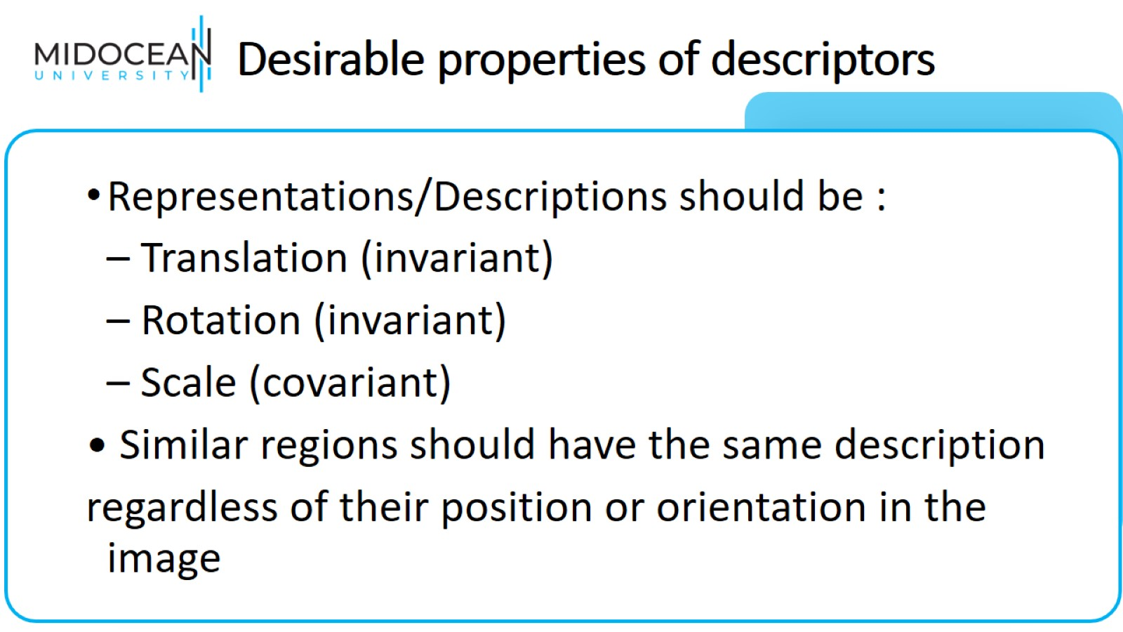
Desirable properties of descriptors

Slide 41
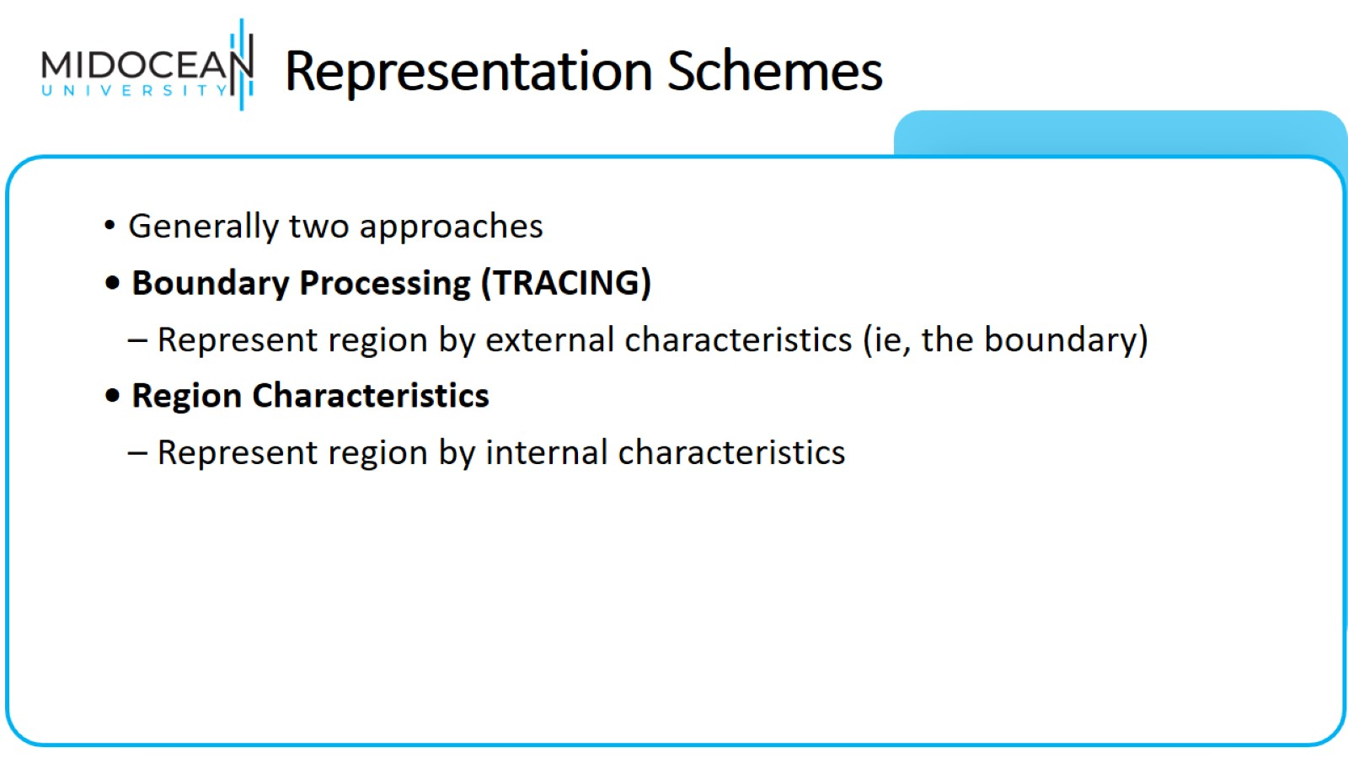
Representation Schemes

Slide 42
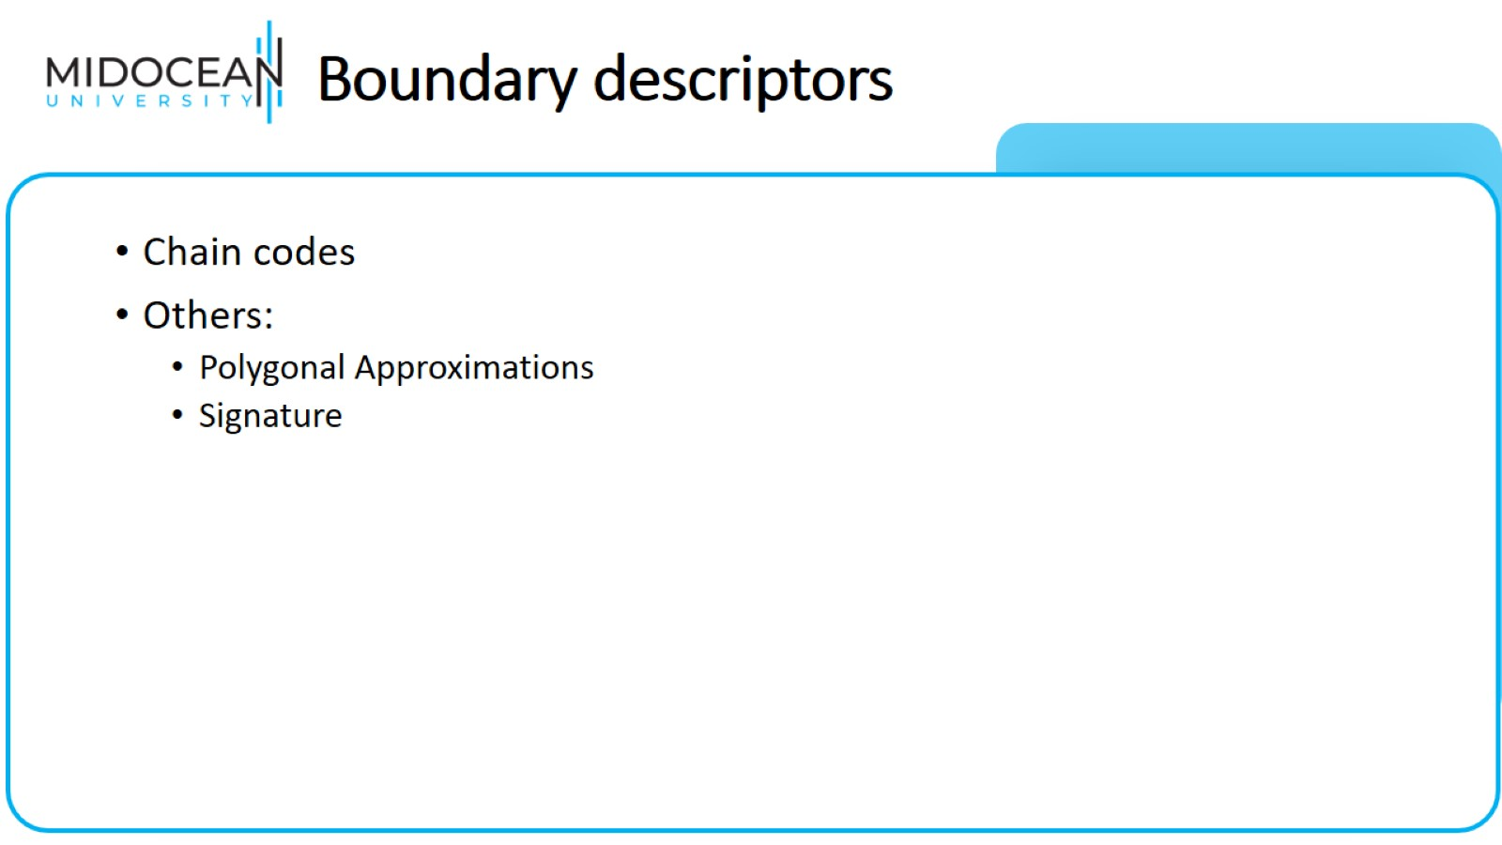
Boundary descriptors

Slide 43
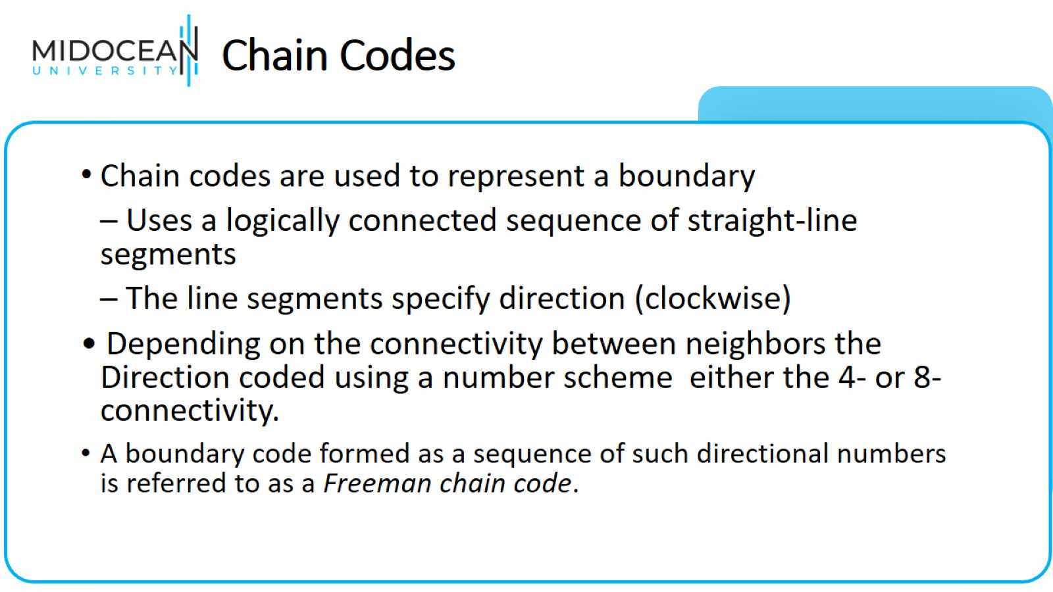
Chain Codes

Slide 44
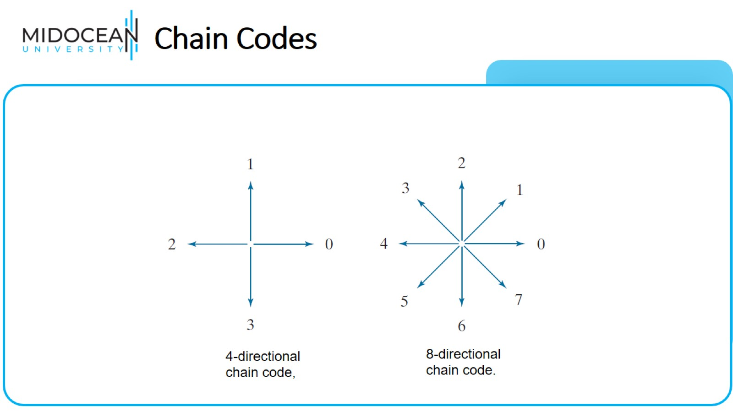
Chain Codes

Slide 45
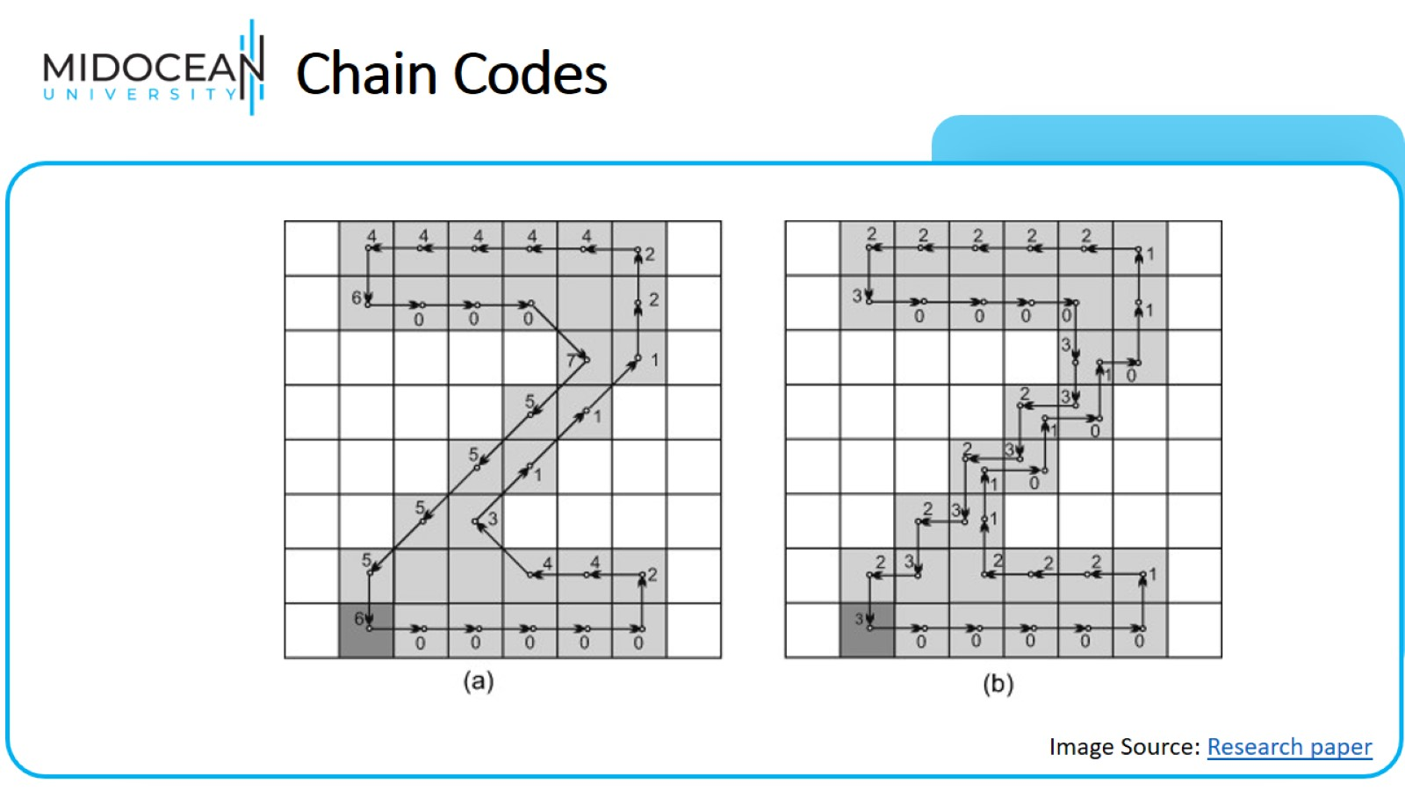
Chain Codes

Slide 46
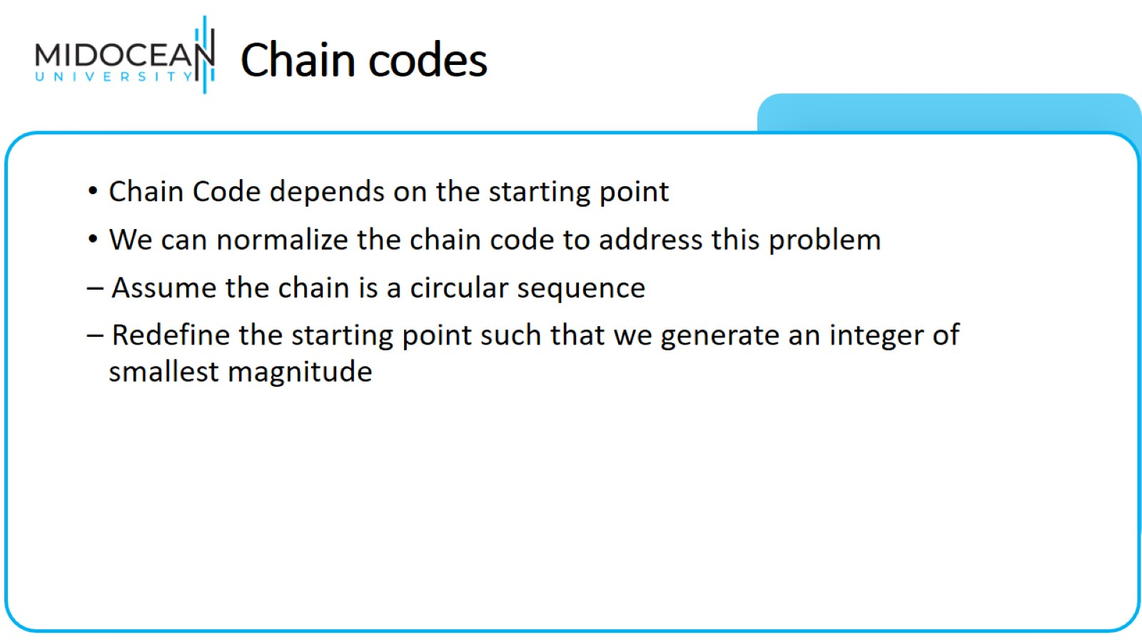
Chain codes

Slide 47
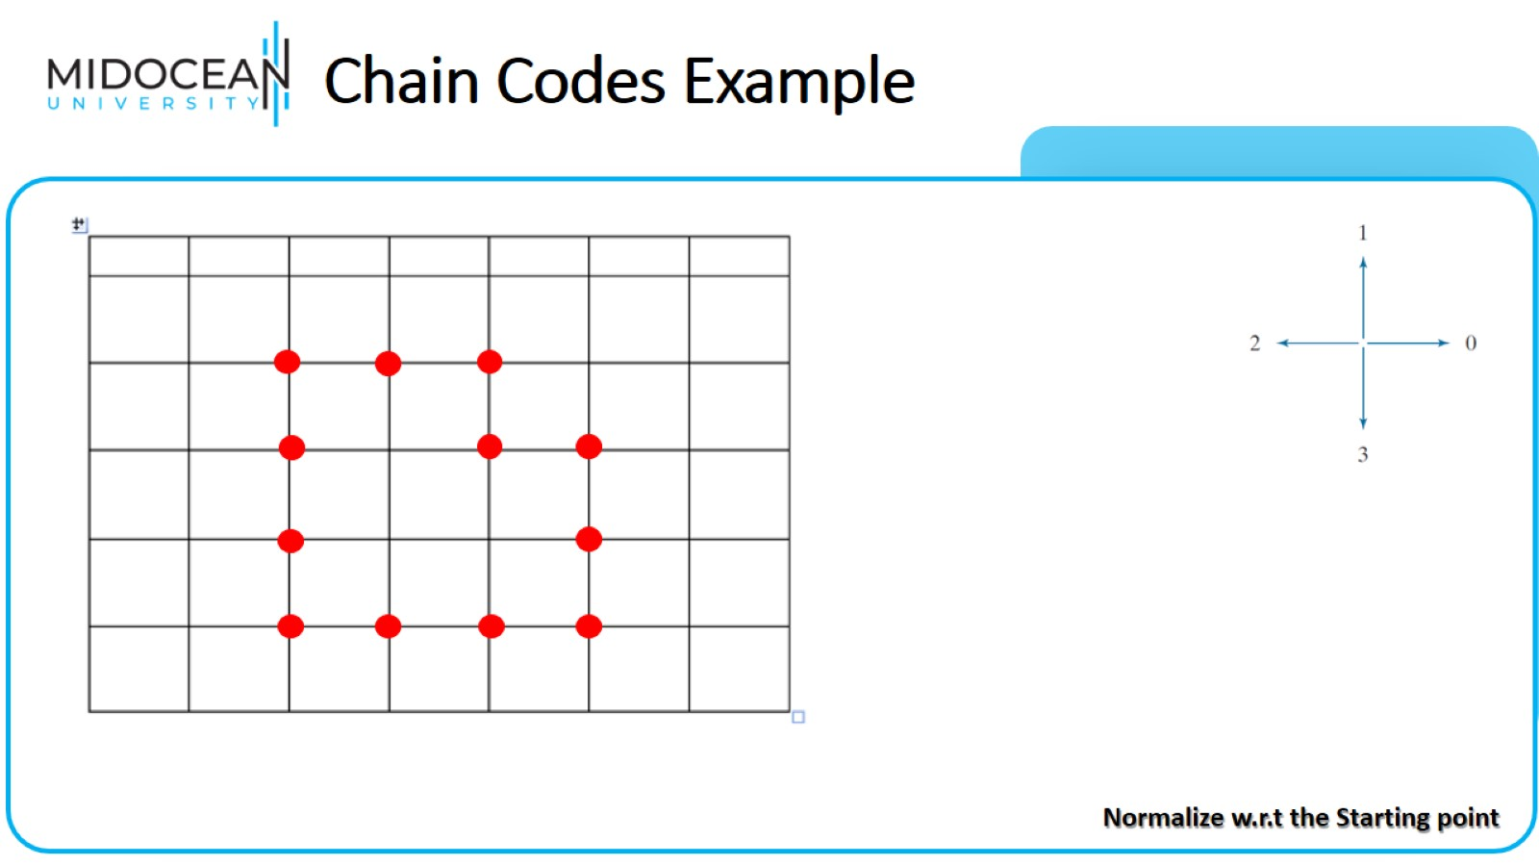
Chain Codes Example

Slide 48
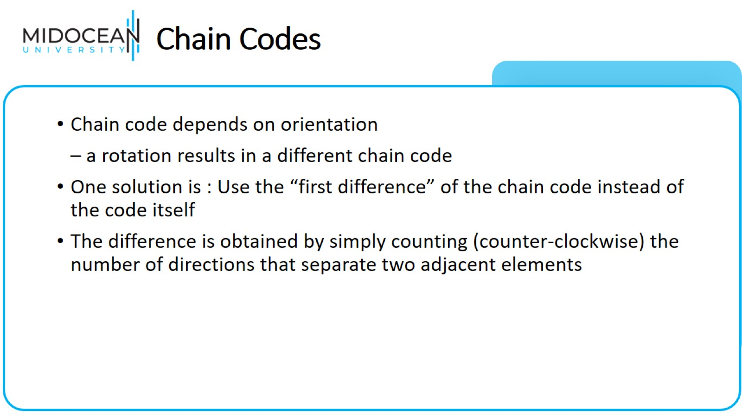
Chain Codes

Slide 49
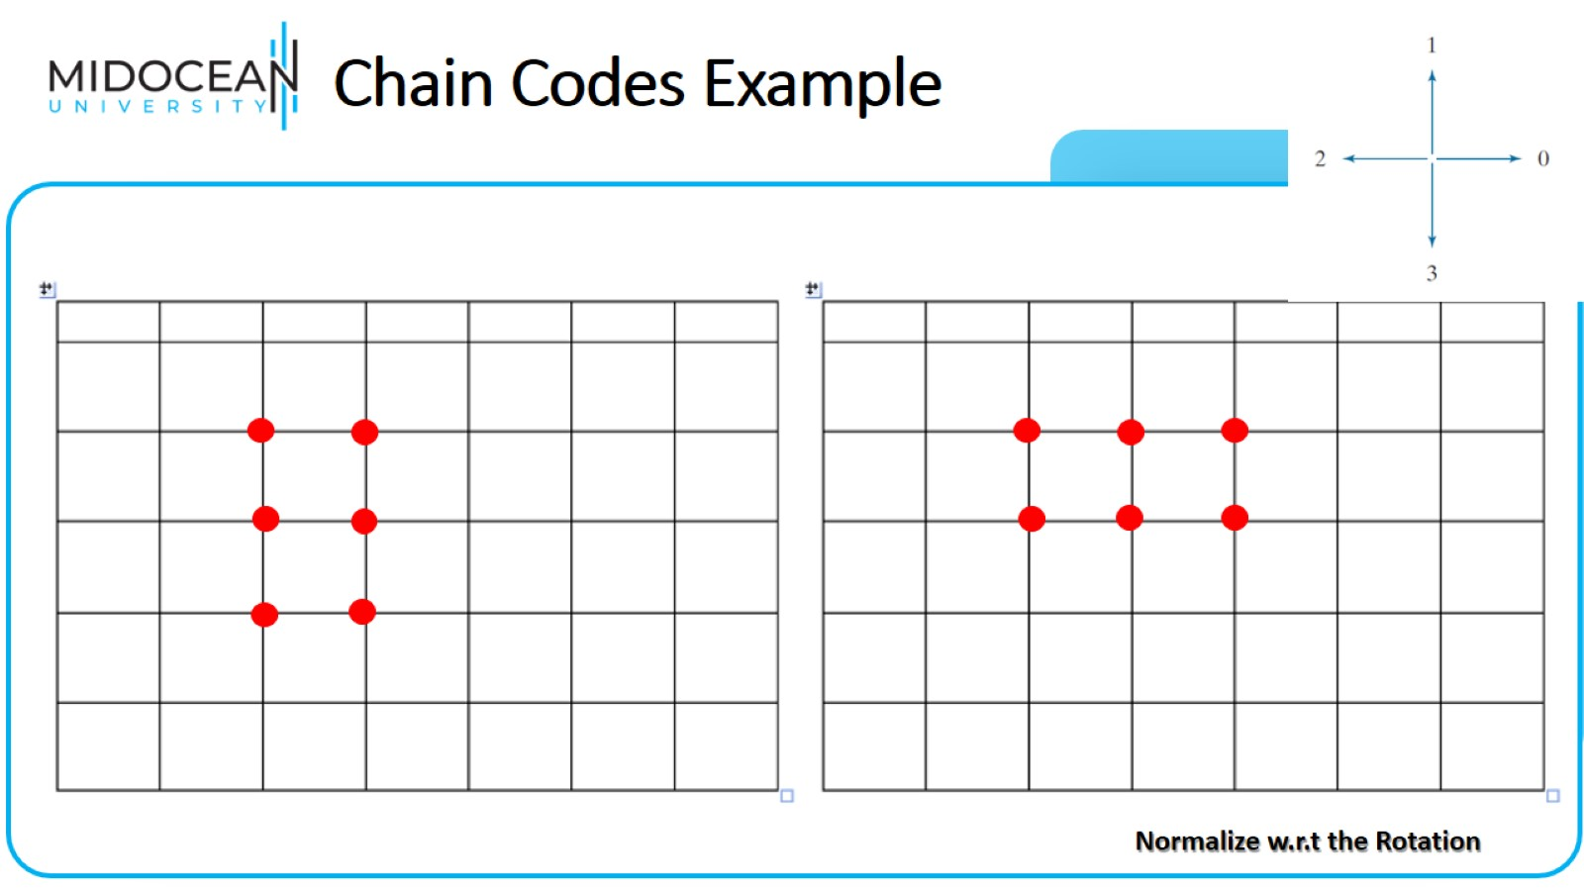
Chain Codes Example

Slide 50


