Slide 1

Introduction to Cryptography
Prepared by Dr. Mohammad Alkhatib
Associate Professor
Major: Information Security
Lecture #6: Digital Signatures

Slide 2

Module 3
Digital Signatures
Introduction to Digital Signatures
Security Services
RSA Digital Signature Scheme
RSA Digital Signature Example
Attacks Against RSA Digital Signature
References:
[1] Katz and Lindell, Introduction to Modern Cryptography. SECOND EDITION. Chapman & Hall/ CRC Press, 2014
[2] C. Paar and J. Pelzl. Understanding Cryptography. A textbook for Student and Practitioners. Springer 2010
[3] Trappe, Wade, and Lawrence C. Washington. 2006 (2nd Edition). Introduction to cryptography: with coding theory. Upper Saddle River, NJ: Prentice Hall

Slide 3
Module 3
Classification of the field of Cryptology
Cryptology
Cryptography
Cryptanalysis
Symmetric Ciphers
Asymmetric Ciphers
Protocols
Block Ciphers
Stream Ciphers
Integer-Factorization Ciphers
Discrete Logarithm Ciphers
Elliptic Curve (EC) Ciphers
DES
AES

Slide 4
Module 3
Introduction to Digital Signature
The property of proving that a certain person generated a message is obviously
also very important outside the digital domain.
In the real, “analog” world, this is achieved by handwritten signatures on paper. For instance, if we sign a contract or sign a check, the receiver can prove to a judge that we actually signed the message.

Slide 5
Module 3
Introduction to Digital Signature
As with conventional handwritten signatures, only the person who creates a digital message must be capable of generating a valid signature.
In order to achieve this with cryptographic primitives, we have to apply public-key cryptography.

Slide 6
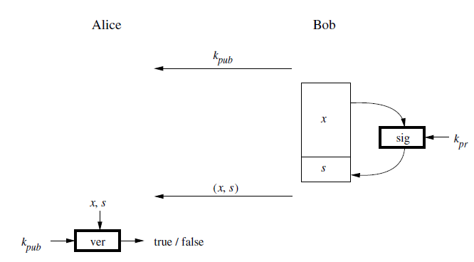
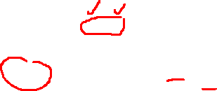
Module 3
Introduction to Digital Signature
The basic idea is that the person who signs the message uses a private key, and the receiving party uses the matching public key.

Slide 7
Module 3
Introduction to Digital Signatures
The process starts with Bob signing the message x
The signature algorithm is a function of Bob’s private key, kpr.
Hence, assuming he in fact keeps his private key private, only Bob can sign a message x on his behalf.
In order to relate a signature to the message, x is also an input to the signature algorithm.

Slide 8
Module 3
Introduction to Digital Signatures
After signing the message, the signature s is appended to the message x and the pair (x, s) is sent to Alice.
Note that a digital signature without the message is the equivalent of a handwritten signature on a strip of paper without the contract or a check that is supposed to be signed.

Slide 9
Module 3
Introduction to Digital Signatures
The digital signature itself is merely a (large) integer value, for instance, a string of 2048 bits.
The signature is only useful to Alice if she has means to verify whether the signature is valid or not.
For this purpose, a verification function is needed which takes both x and the signature s as inputs. In order to link the signature to Bob, the function also requires his public key.

Slide 10
Module 3
Introduction to Digital Signatures
Even though the verification function has long inputs, its only output is the binary statement “true” or “false”.
If x was actually signed with the private key that belongs to the public verification key, the output is true, otherwise it is false.

Slide 11
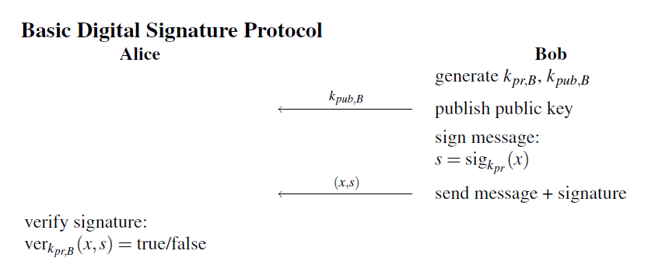
Module 3
Generic Digital Signature Protocol

Slide 12
Module 3
Digital Signatures Properties
The core properties of digital signatures can be described as follows:
A signed message can unambiguously be traced back to its originator since a valid signature can only be computed with the unique signer’s private key.
Only the signer has the ability to generate a signature on his behalf. Hence, we can prove that the signing party has actually generated the message.

Slide 13
Module 3
Digital Signatures Properties
The core properties of digital signatures can be described as follows:
Note that the basic protocol described in previous slide does not provide any confidentiality of the message since the message x is being sent over the communication network.
Of course, the message can be kept confidential by also encrypting it, e.g., with AES or 3DES

Slide 14
Module 3
Security Services
The most important security services that should be provided by security systems are:
Confidentiality: Information is kept secret from all but authorized parties.
Integrity: Messages have not been modified in transit.
Message Authentication: The sender of a message is authentic
Nonrepudiation: The sender of a message can not deny the creation of the message.

Slide 15
Module 3
Security Services
Confidentiality can be achieved by primarily symmetric ciphers and less frequently asymmetric encryption.
Integrity and message authentication are provided by digital signatures and message authentication codes.
Nonrepudiation can be achieved with digital signatures.

Slide 16
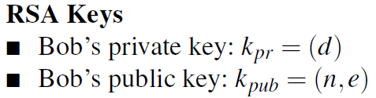
Module 3
RSA Digital Signature Scheme
The RSA signature scheme is based on RSA encryption.
Therefore, its security relies on the difficulty of factoring a product of two large primes (the integer factorization problem).
Suppose Bob wants to send a signed message x to Alice. He generates the same RSA keys that were used for RSA encryption.
At the end of the set-up he has the following parameters:

Slide 17
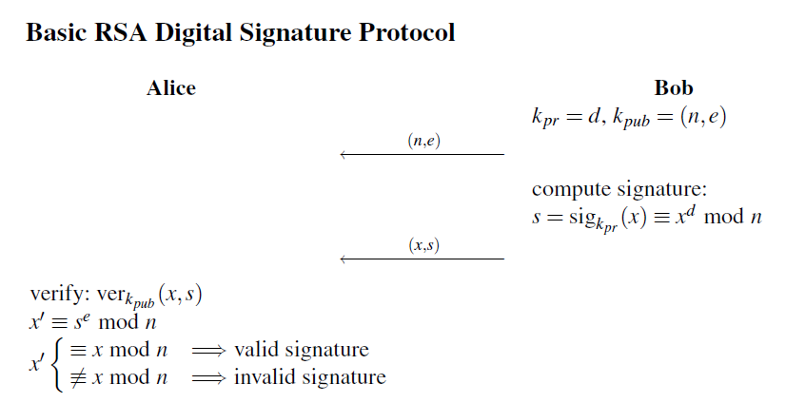
Module 3
RSA Digital Signature Scheme
The actual signature protocol is shown in the following figure. The message x that is being signed is in the range (1,2, . . . ,n−1)

Slide 18
Module 3
RSA Digital Signature Scheme
It can be seen from the protocol in previous slide that:
Bob computes the signature s for a message x by RSA-encrypting x with his private key kpr.
Bob is the only party who can apply kpr, and hence the ownership of kpr authenticates him as the author of the signed message.
Bob appends the signature s to the message x and sends both to Alice.
Alice receives the signed message and RSA-decrypts s using Bob’s public key kpub, yielding x~.

Slide 19
Module 3
RSA Digital Signature Scheme
If x~ and x match, Alice knows two important things:
The author of the message was in possession of Bob’s secret key, If only Bob has had access to the key, it was in fact Bob who signed the message. This is called message authentication.
The message has not been changed in transit, so that message integrity is guaranteed.

Slide 20
Module 3
RSA Digital Signature- Proof of Correctness
We now prove that the scheme is correct, i.e., that the verification process
yields a “true” statement if the message and signature have not been altered during transmission.
We start from the verification operation s^{e} mod n:
s^{e} = (x^{d})^{e} = x^{de} ≡ x mod n
Due to the mathematical relationship between the private and the public key, namely that:
d.e ≡1 mod φ (n),
raising any integer x ∈ Zn to the (d.e)th power yields the integer itself again

Slide 21
Module 3
RSA Digital Signature- Private and Public Keys
The role of the public and the private keys are swapped compared to the RSA encryption scheme.
Whereas RSA encryption applies the public key to the message x, the signature scheme applies the private key kpr.
On the other side of the communication channel, RSA encryption requires the use of the private key by the receiver, while the digital signature scheme applies the public key for verification.

Slide 22
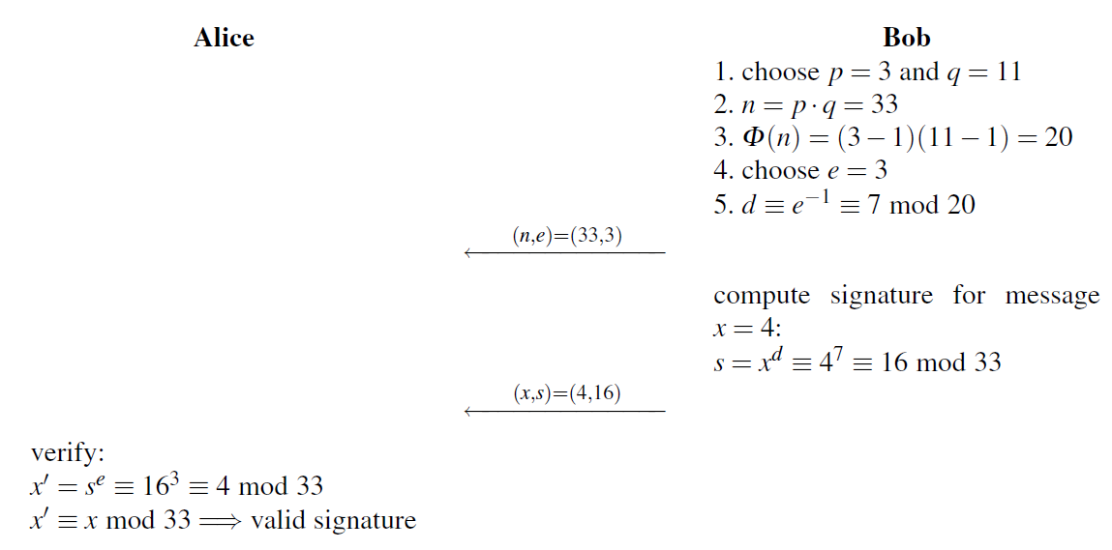
Module 3
RSA Digital Signature- Example
Suppose Bob wants to send a signed message (x = 4) to Alice.

Slide 23
Module 3
RSA Digital Signature- Example
The first steps are exactly the same as it is done for an RSA encryption:
Bob computes his RSA parameters and sends the public key to Alice.
In contrast to the encryption scheme, now the private key is used for signing while the public key is needed to verify the signature.
Alice can conclude from the valid signature that Bob generated the message and that it was not altered in transit, i.e., message authentication and message integrity are given.

Slide 24
Module 3
RSA Digital Signature- Example
It should be noted that we introduced a digital signature scheme only.
In particular, the message itself is not encrypted and, thus, there is no confidentiality.
If this security service is required, the message together with the signature should be encrypted, e.g., using a symmetric algorithm like AES.

Slide 25
Module 3
RSA Digital Signature- Security
Algorithmic Attacks:
This type of attacks attempts to break the underlying RSA scheme by computing the private key d.
The most general type of these attacks tries to factor the modulus n into the primes p and q.
If an attacker succeeds with this, she/he can compute the private key d from e.
In order to prevent factoring attacks the modulus must be sufficiently large, as discussed previously. In practice, 1024 bit or more are recommended.

Slide 26
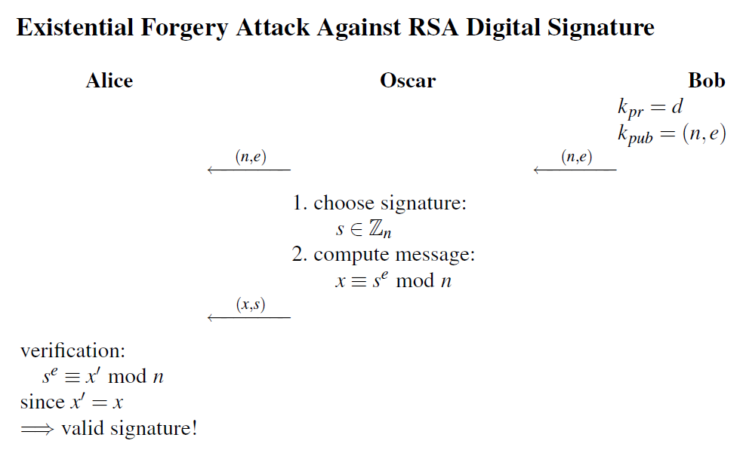
Module 3
RSA Digital Signature- Existential Forgery Attack
Existential Forgery:
This attack allows an attacker to generate a valid signature for a random message x. The attack works as follows:

Slide 27
Module 3
RSA Digital Signature- Existential Forgery Attack
The attacker impersonates Bob, i.e., Oscar claims to Alice that he is in fact Bob.
Because Alice performs exactly the same computations as Oscar, she will verify the signature as correct.
However, by closely looking at Steps 1 and 2 that Oscar performs, one sees that the attack is somewhat odd.

Slide 28
Module 3
RSA Digital Signature- Existential Forgery Attack
The attacker chooses the signature first and then computes the message. As a consequence, he cannot control the semantics of the message x.
For instance, Oscar cannot generate a message such as “Transfer $1000 into Oscar’s account”.
Nevertheless, the fact that an automated verification process does not recognize the forgery is certainly not a desirable feature.
For this reason, schoolbook RSA signature is rarely used in practice, and padding schemes are applied in order to prevent this and other attacks

Slide 29
Module 3
RSA Digital Signature- Existential Forgery Attack
Question: What kinds of countermeasures can be implemented to secure RSA digital signature against Existential Forgery Attack?
Answer: Impose formatting rules on the message x, which can be checked by Alice
The technique that can be implemented to achieve this: RSA Padding.
The existential forgery attack can be prevented by allowing only certain message formats.
The formatting imposes a rule which allows the verifier, Alice in our
examples, to distinguish between valid and invalid messages; this is called padding.

Slide 30
Module 3
RSA Padding
The formatting imposes a rule which allows the verifier to distinguish between valid and invalid messages; this is called padding.
Message length without Padding
1024 bits
m
111..…111
Message length with Padding
900 bits
124 bits
Padding
Oscar computes:
x ≡ s^{e} = mod n
He has a chance of 2⁻¹²⁴ to have a message x with 124 trailing bits with values 1s

