Slide 1




Social Media and Crises
Lecture 9
DGM 730
Social Media Strategy
Prepared by
Dr. Doaa Rady

Slide 2

Lecture
09
Lecture outline
20 Steps for Social Media Strategy
1. Select Relevant and Realistic Social Media Marketing Goals
2. Determine Your Most Relevant Metrics
3. Decide Who You Want as Your Social Media Audience
4. Understand Your Social Media Audience
5. Select the Right Social Media Networks for Your Audience
6. Investigate How Your Competitors Approach Social Media
7. Establish a Realistic Social Media Budget
8. Plan the Types of Content You Intend to Share
9. Set Up Your Accounts Properly Before You Make and Promote Content
10. Establish the Best Times to Post and Set Up a Content Calendar
11. Create Suitable Content to Share with Your Followers
12. Promote Your Social Channels
13. Engage with Your Audiences
14. Build a Community for Your Audience
15. Consider Paid Promotion to Boost Your Audiences
16. Consider Working with Influencers to Widen Your Reach
17. Consider Working with Brand Advocates
18. Consider Using Chatbots as Part of Your Social Media Marketing Strategy
19. Run Cross-Channel Campaigns
20. Track Your Results and Adapt Your Social Media Plan
Social Media Strategy
The role of platforms such as Twitter, Facebook and Youtube.
A look at the processes required to use these tools effectively.

Slide 3

Live
SNS x Heinz Influencer Marketing Case Study
https://wearesns.com/heinz-influencer-marketing/

Slide 4
Lecture
09
Lecture outline
Heinz Influencer Marketing
We collaborated with Heinz in delivering a stunning influencer marketing campaign.
Heinz challenged us to create an online buzz, spark social conversations and talk-ability that Heinz has finally combined two of the nation’s best-loved sauces in Ketchup and Mayonnaise, to create the mouthwatering Saucy Sauce.
Using advanced audience demographics via our in-house platform The Blogger Programme, we sourced 6 influencers who matched key audience demographics as well as authentic content with a playful approach.
As part of the campaign, each influencer was asked to re-create a variety of their favourite food dishes in which they had to include Saucy Sauce. The content had to include key messages – but also be fun and engaging – whilst also delivering the overarching message that the launch of Saucy Sauce is bringing the nation what they have been waiting for.
Live
قمنا باستقطاب 6 أشخاص مؤثرين قاموا بمطابقة التركيبة السكانية للجمهور الرئيسي بالإضافة إلى المحتوى الأصيل بأسلوب مرح.
طُلب من كل مؤثر إعادة إنشاء مجموعة متنوعة من أطباق الطعام المفضلة لديهم والتي كان عليهم تضمين صلصة Saucy فيها. يجب أن يتضمن المحتوى رسائل رئيسية - ولكن أيضًا أن يكون ممتعًا وجذابًا - مع تقديم رسالة شاملة مفادها أن إطلاق Saucy Sauce يجلب للأمة ما كانوا ينتظرونه.

Slide 5
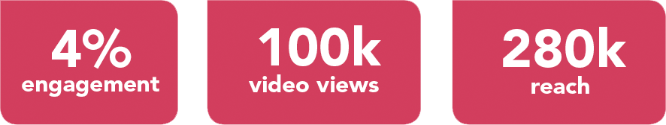
Lecture
09
Lecture outline
Heinz Influencer Marketing
This content was then shared across Instagram and Instagram Stories and during the campaign, the influencers were also tasked with engaging and interacting directly with their followers to help spark further social conversations.
Overall the social media content reached an audience of more than 280,000, with more than 100,000 video views and an average campaign engagement rate of 4%.
The campaign also sparked viral follower interaction around Saucy Sauce.
Live
تمت بعد ذلك مشاركة هذا المحتوى عبر Instagram وInstagram Stories، وخلال الحملة، تم تكليف المؤثرين أيضًا بالتفاعل والتفاعل مباشرة مع متابعيهم للمساعدة في إثارة المزيد من المحادثات الاجتماعية.بشكل عام، وصل محتوى الوسائط الاجتماعية إلى جمهور يزيد عن 280,000 شخص، مع أكثر من 100,000 مشاهدة للفيديو ومتوسط معدل تفاعل للحملة يبلغ 4%.أثارت الحملة أيضًا تفاعلاً واسع النطاق بين المتابعين حول Saucy Sauce.

Slide 6
SNS
Founded back in 2012, Social Network Solutions (SNS) a digital marketing agency that has remained at the forefront of social media, content creation and influencer marketing.
Live
https://wearesns.com/heinz-influencer-marketing/
Case Studies
https://wearesns.com/case-studies/

Slide 7
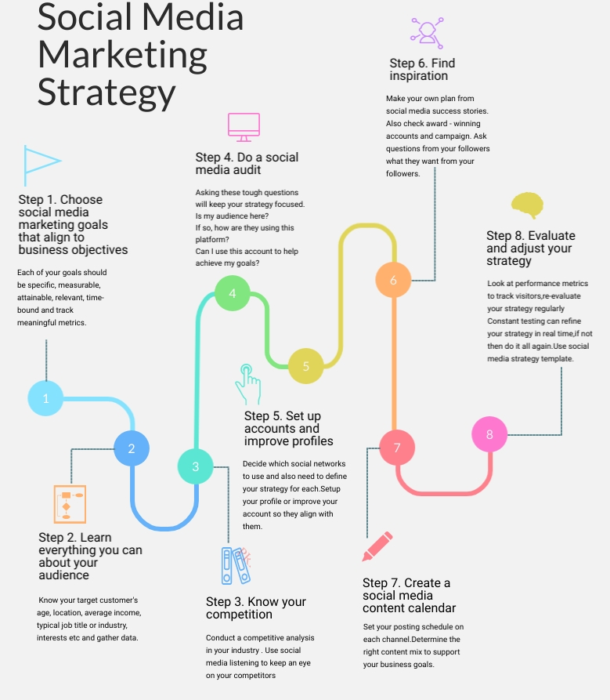
How to Build Social Media Strategy?

Slide 8
Lecture
09
How to Build Social Media Strategy?
1. Select Relevant and Realistic Social Media Marketing Goals
One of the most significant problems faced by many businesses engaged in social media is that they have never spent the time to set relevant and realistic social media marketing goals. They know they need to be on social media, but have no idea why they are there.
Of course, your social media marketing plan needs to fit into your business planning as a whole. Ideally, you will have set strategic goals for how you want your business to progress. Your social media marketing goals should complement your overarching شامل business goals.

Slide 9
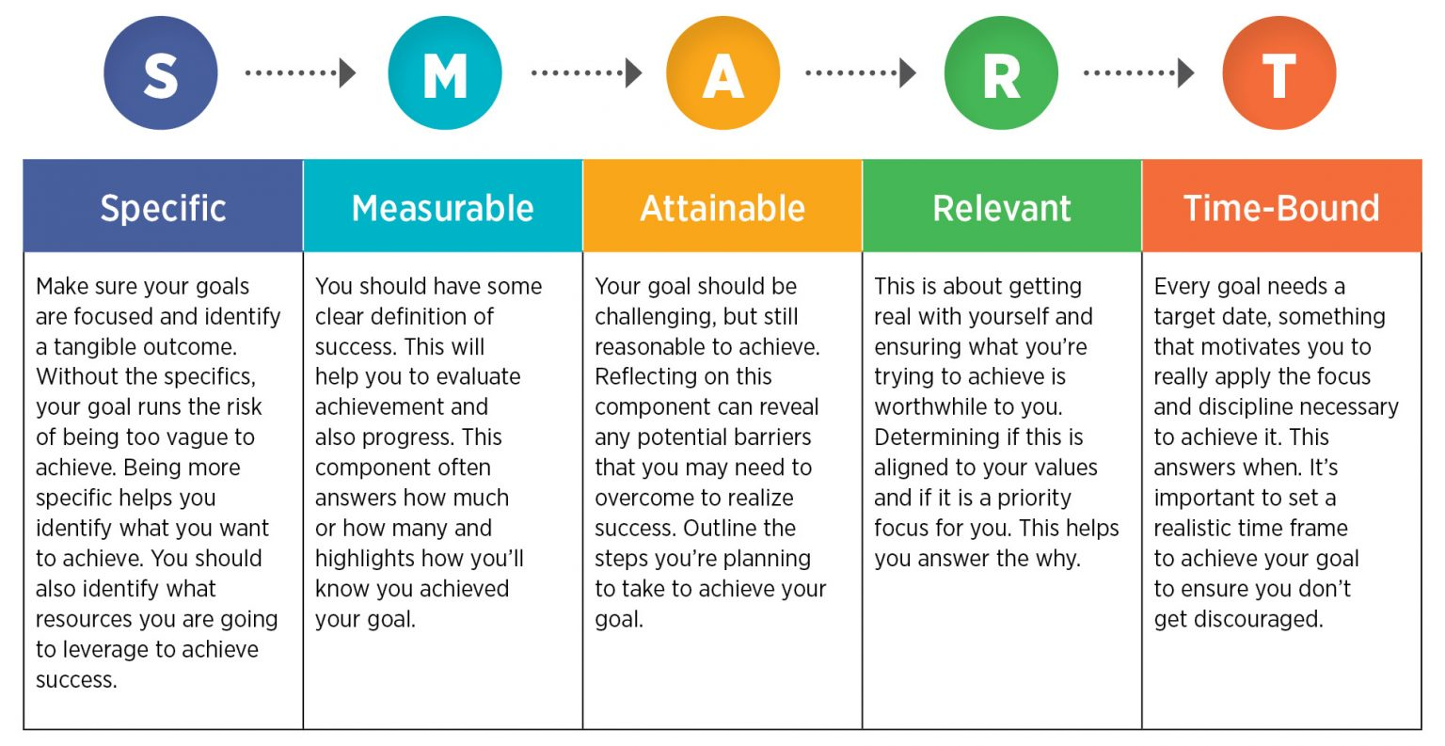
Lecture
09
How to Build Social Media Strategy?
1. Select Relevant and Realistic Social Media Marketing Goals
Suitable Social Media Goals Could include:
Increasing brand awareness
Achieving a set higher quantity of sales
Improving your ROI
Driving people to increase in-store sales
Grow your fan base
عائد الاستثمار
Return on investment (ROI) is an approximate measure of an investment's profitability

Slide 10
Lecture
09
How to Build Social Media Strategy?
2. Determine Your Most Relevant Metricsالمقاييس
The existence of fake followers on any social network means that follower numbers have little value as a metric.
Ideally, you should look at the marketing goals you set, and determine which metrics will provide you with the answer as to whether you are meeting that goal.
For example, if you have a goal that aims to increase your brand awareness, then Post Reach is a relevant statistic. It will tell you how far your content is spreading across social channels.

Slide 11
Lecture
09
How to Build Social Media Strategy?
2. Determine Your Most Relevant Metrics
If your goals are more sales-based, or you want to drive people to take a particular action, then you should take notice of the number of Clicks. Tracking Clicks per campaign will give you a good indication of what drives people to buy or do what you ask of them.
You will often take most interest in the engagements on your posts. This shows how people interact with your content and whether it resounds with them.

Slide 12
Lecture
09
How to Build Social Media Strategy?
قرر من تريد أن يكون جمهورك على وسائل التواصل الاجتماعي
3. Decide Who You Want as Your Social Media Audience
One of the most common mistakes made by firms on social media is to think that all followers will be good for them. There is a good reason why pundits deemphasize the metric Follower Numbers and call them vanity metrics. There is little point in having somebody as a follower unless he is likely to take an interest in the content you share.
This is probably the biggest problem with buying fake followers. fake followers don’t engage with your account. Some aren’t real people at all, merely bots الروبوتات. They certainly won’t make future customers. These people, whether they are real or fake accounts, will not spend any money on your products. They will not refer people to you. They are of no value to you at all.
هناك سبب وجيه وراء قيام النقاد بالتركيز على مقياس أرقام المتابعين ويطلقون عليها مقاييس الغرور.

Slide 13
Lecture
09
How to Build Social Media Strategy?
4. Understand Your Social Media Audience
Not all social media audiences are alike. Different types of people use social media in varying ways. If you’re going to meet your goals, you need to be using the same social media networks as your target audience. Similarly, if you intend to engage in influencer marketing, you need to ensure that you engage influencers whose audience matches your target market.
ليس كل جماهير وسائل التواصل الاجتماعي متشابهة

Slide 14
Lecture
09
How to Build Social Media Strategy?
5. Select the Right Social Media Networks for Your Audience
Some people worry about how they are going to find the time and energy to operate accounts on every social network. In most cases, you don’t need to. You simply need to find the right social networks for your business. You want to discover the social networks where your intended audience spends their time.
You may have to carry out some research first to discover where your intended audience hangs out. This shouldn't be too difficult, particularly if you know your customers. If you don’t already understand this, you could survey them, asking them for their preferred social accounts.

Slide 15
Lecture
09
How to Build Social Media Strategy?
5. Select the Right Social Media Networks for Your Audience
Don’t Waste Time on Social Networks Your Audience Don’t Use
If a sufficiently large proportion of your target audience spends time on a social network, you want to be there too. If they have little interest in a platform, you can give it a miss, and not waste your time and resources there.
There is another factor that you should consider to make your life easier. Many businesses find it easier to use some form of social media marketing platform to help them schedule posts in one place in bulk.

Slide 16
Lecture
09
How to Build Social Media Strategy?
تحقق من كيفية تعامل منافسيك مع وسائل التواصل الاجتماعي
6. Investigate How Your Competitors Approach Social Media
You will usually have competitors who will also run a social strategy. You will definitely need to know what they are doing. What is their focus? Whom are they targeting? What key phrases are they trying to dominate?
You can quickly conduct a competitor analysis to help you better understand their strengths and weaknesses. This should give you a better understanding of what potential customers expect from businesses in your industry.
You might spot your competitors’ weak social areas and be able to exploit the gaps. For instance, one of your competitors might be influential on Twitter, but have a weak Facebook presence, despite your target market using that network. In that case, it may pay you to put more resources into Facebook rather than competing head to head on Twitter.

Slide 17
Lecture
09
How to Build Social Media Strategy?
7. Establish a Realistic Social Media Budget
Social media marketing is as viable a form of marketing as any other marketing type for most companies, and you should be prepared to allocate a budget accordingly. You can't expect social media success if you simply tag it onto the pre-existing list of duties your existing office staff performs.
On the other hand, you shouldn't spend more on your social media activities than you can realistically earn in increased sales, or at least in brand recognition and awareness if that is more where your goals lie.
As with any form of marketing, you should calculate a return on investment (ROI) from your social media expenditure, bearing in mind the goals you set earlier in your strategy.

Slide 18
Lecture
09
How to Build Social Media Strategy?
خطط لأنواع المحتوى الذي تنوي مشاركته
8. Plan the Types of Content You Intend to Share
Of course, to be successful on social media, you will need high-quality content to share. One of the biggest mistakes that businesses do is to share excessive promotional material. Remember, social networks are designed to be social – they were never intended to be a marketplace for you to sell your products.
Therefore, you need to balance the content you share socially, to be a mixture of informative and entertaining items, with a small percentage of promotional material added in. You will also need to like and share other people’s content.
This is probably the most significant reason that most influencers gain that status. They know their audience well and create the perfect content to interest their followers. As a brand, you need to do the same.

Slide 19
Lecture
09
How to Build Social Media Strategy?
8. Plan the Types of Content You Intend to Share
Be Realistic About What You Can Produce
You need to understand any limitations you may face when creating content. For example, you might want to run a great YouTube channel, but if you don’t have the equipment, people, knowledge, and time to create high-quality videos, it is pointless going down that track. You don’t want a YouTube channel with just one or two poorly-filmed videos of talking heads.
لا تريد قناة على YouTube تحتوي على مقطع فيديو واحد أو مقطعين فيديو تم تصويرهما بشكل سيئ لرؤوس المتحدثين.

Slide 20
Lecture
09
How to Build Social Media Strategy?
8. Plan the Types of Content You Intend to Share
Don’t Mix Your Personal Tastes with Those of Your Target Audience
The odds are that you, or the person running your business social account, will also run personal social accounts. You must distinguish between the two types of accounts. Just because you like to make a particular type of post on your own accounts, does not mean that those posts will work on the company accounts.

Slide 21
Lecture
09
How to Build Social Media Strategy?
9. Set Up Your Accounts Properly Before You Make and Promote Content
It is vital that you set your accounts up correctly. You will want a consistent visual look across all of your social channels. Use the correct colors, logos, and similar graphics on each network.
Don’t waste any of your social real estate. Take the time to fill in your bios and profiles fully. Make sure that you link to relevant places, perhaps even create specific landing pages on your website for people who click through from your social accounts.
It is worth taking the time to ensure that you have uploaded all the images on your bios and profiles at the best resolution for the social network.
قم بإعداد حساباتك بشكل صحيح قبل إنشاء المحتوى والترويج له

Slide 22
Lecture
09
How to Build Social Media Strategy?
10. Establish the Best Times to Post and Set Up a Content Calendar
While you could manually make all of your social posts, that is inefficient, and may not lead to the best results. Most of the social networks now use some form of algorithm to filter the results they give people. This means that if you post at a different time to when your target audience is online, they may never see your content.
Ideally, you will want to use one of the social scheduling tools so you can set up and organize multiple posts at the same time.

Slide 23
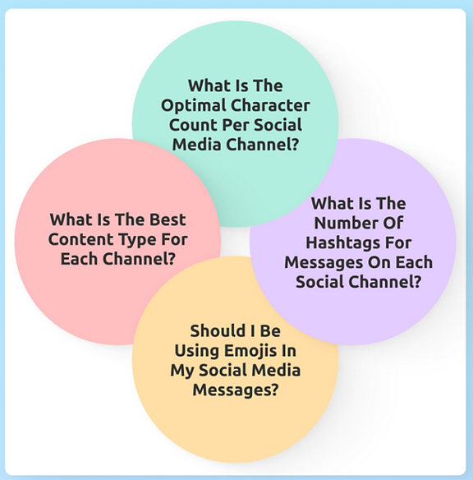
Lecture
09
How to Build Social Media Strategy?
11. Create Suitable Content to Share with Your Followers
There are four questions you should ask yourself when creating content:
Don't forget the importance of images and videos. Visual content is more than 40 times more likely to be shared on social media than other types of content.
من المرجح أن يتم مشاركة المحتوى المرئي على وسائل التواصل الاجتماعي بأكثر من 40 مرة مقارنة بأنواع المحتوى الأخرى.

Slide 24
Lecture
09
How to Build Social Media Strategy?
11. Create Suitable Content to Share with Your Followers
Create Diverse Content
While you want your content to have a general look, particularly within individual social campaigns, you don't want all your social content to look the same. People respond best to variety in their social feeds. Depending on the social network, they like a mix of attractive imagery, entertaining videos, and even some compelling text copy. Of course, some social networks only allow you one or two of these content types, but you can still alter the mix of posts within a medium.

Slide 25
Lecture
09
How to Build Social Media Strategy?
11. Create Suitable Content to Share with Your Followers
Customize Your Content for Each Social Network
It's important to remember that not every social channel is identical. Ideally, you should customize your content for each network.
Twitter
Twitter comes with a self-imposed limitation – you can’t write more than 280 characters in a tweet. So, your message needs to be short and to the point. You can include links in tweets and hashtags (but no more than 1 or 2). Tweets with images perform far better than those without.

Slide 26
Lecture
09
How to Build Social Media Strategy?
11. Create Suitable Content to Share with Your Followers
Customize Your Content for Each Social Network
Facebook
Facebook posts can be longer than tweets, but don't make them excessively so. People can be easily turned off by a wall of text. It is always a good idea to include some personal comments, even if you are simply sharing curated content. Short videos perform well on Facebook. Add an image or video with every Facebook post, but relate them to your text. Link posts often perform well on Facebook
LinkedIn
LinkedIn is a professional network, so you need to ensure that all the posts you share there are suitable for such an audience. People often read posts on LinkedIn hoping to educate themselves, particularly anything that can help further their careers.

Slide 27
Lecture
09
How to Build Social Media Strategy?
11. Create Suitable Content to Share with Your Followers
Customize Your Content for Each Social Network
Instagram
Instagram is an image-based social network, so you need to share interesting, relevant photos, and short videos. You can combine these to tell a Story, which has the advantage of sitting at the top of people's feeds, rather than being lost in regular posts.
Pinterest
Pinterest is also very image-focused. Indeed, people Pin images on themed boards. So you need to focus your Pinterest content around a pinnable picture. Pinterest can be perfect for creatively showcasing products, particularly if you have a predominantly female target audience.

Slide 28
Lecture
09
How to Build Social Media Strategy?
11. Create Suitable Content to Share with Your Followers
Customize Your Content for Each Social Network
YouTube
YouTube is, of course, renowned as the home of medium to long-form video. You set up a channel and post videos to it, preferably following an overall theme. You need something to set you apart from all the other YouTube channels. You should aim to post at least one video per week, so your audience knows they can expect new videos consistently. You should generally avoid simply uploading your existing television ads. Aim to make and upload well-made, high-quality videos. One way to avoid making videos that look too obviously like ads is to make interesting videos that incorporate your products.

Slide 29
Lecture
09
How to Build Social Media Strategy?
11. Create Suitable Content to Share with Your Followers
Customize Your Content for Each Social Network
TikTok
TikTok is beloved by Generation Z and, to a lesser extent, millennials. If they're your target market, then you should be making short-form videos for the platform. Videos on TikTok can be of any length up to 10 minutes, although most are around 15 seconds. Trends are significant to TikTok's audiences, so take note of the latest trends and try to make and share a quick video following the trend as soon as you notice it. As with YouTube, it's vital you choose a niche for your TikTok videos that is likely to interest your target audience. With TikTok videos being short, you need to post often to keep the attention of your viewers.
Generation Z is "the generation of people born in the late 1990s and early 2000s

Slide 30
Lecture
09
How to Build Social Media Strategy?
12. Promote Your Social Channels
Although good content will ultimately sell your social channels, you still need to gain your initial following. People have to find your channels before they can choose to follow you.
You can promote your channels in various ways, some highly visible, others more subtly.
You should place buttons for all your social accounts at various places on your website – on your home page, in your footer, on your About and Communications pages, for example. If you have an email list, you should include a reference to your social channels in any emails and newsletters you send. You can easily add buttons to your social channels in the footer of every email.

Slide 31
Lecture
09
How to Build Social Media Strategy?
13. Engage with Your Audiences
People don’t just go onto social networks to read, look at, or watch content. They go online to interact with other people and to be social. Successful businesses do not just broadcast to their social audiences. They engage with them too.
This is why you should not attempt to cover every social network unless you have a very diverse target market and an army of personnel dedicated to this task. By focusing your attention on the social networks your target market frequents, you can use your resources efficiently.
Some firms have found it very useful to create custom hashtags. Not only can these encourage discussions and sharing, but they also make it easier for you to search for posts that reference your business.
Ideally, you should respond to all social mentions of your business and demonstrate that customer care is a priority for you.

Slide 32
Lecture
09
How to Build Social Media Strategy?
14. Build a Community for Your Audience
One of the best ways of engaging with your audience is to create a clear community for them. You want to be one of their "go-to" places each day. A crucial part of this is establishing a personality online. You want to ensure that your business comes across as having heart and soul, and people don't see you as a faceless corporation.
Try and make your posts interactive and involve your audience. Make a point of asking them for an opinion. You could perhaps include quizzes and questions to collect your followers' views. Whatever you do, make sure your posts are interesting and newsworthy. Don't simply regurgitate your advertisements. You want your followers to return to your posts regularly, so they must find them of value.

Slide 33
Lecture
09
How to Build Social Media Strategy?
15. Consider Paid Promotion to Boost Your Audiences
Most social networks allow you to buy some form of paid ads. Most will enable you to demographically target your ads, making them only visible to your preferred target audience.
Paid promotions allow you to reach relevant audiences to whom you don't currently connect. You can use advertisements to build brand recognition, promote particular posts/videos, or even to sell products.

Slide 34
Lecture
09
How to Build Social Media Strategy?
16. Consider Working with Influencers to Widen Your Reach
We obviously understand the advantages of working with influencers and engaging in influencer marketing. If you select the right influencers, you have the chance to reach a whole new audience, who hopefully will have an interest in your business and its products.
Influencers have already mastered the art of social media marketing – that is their strength. They have built a solid reputation online, and have a large number of keen and interested followers.
You might consider working with influencers, having them to direct their followers to your social sites. You will, of course, have to create content that will interest them when they arrive at your pages, however.
If you select influencers whose followers match your target audience, and you provide quality content to people that the influencers direct your way, you have a chance that these people will then become your social followers too

Slide 35
Lecture
09
How to Build Social Media Strategy?
17. Consider Working with Brand Advocatesفكر في العمل مع المدافعين عن العلامة التجارية
You might already have access to keen and eager people who are happy to promote your brand on social media. You can include these brand advocates in your social media marketing strategy. They may not have the same reach as the top influencers in your niche, but some will already have sizeable audiences and solid reputations, and you have the added advantage that they already know and like your product.
Brand advocacy simply means that the people who love your product or services continue to show support for your brand by promoting your organization organically to new audiences. Your brand advocates can play a significant role in word-of-mouth marketing and drive new business by being enthusiastic fans of what your company does.
Brand advocates can include your executive leadership, company partners, employees, and existing customers.

Slide 36
Lecture
09
How to Build Social Media Strategy?
18. Consider Using Chatbots as Part of Your Social Media Marketing Strategy
If you use messenger-type apps, such as Facebook Messenger or WhatsApp, with your followers, then you could consider adding a chatbot. These can help you resolve problems for your potential or existing customers without the need for any human interruption.
SocialBee describes "the greatest benefit may actually be the fact that a chatbot will provide your customers with a smart assistant with the ability to communicate with them almost like a human consultant and it will progressively begin to get to know your customers and which of your products they are interested in."
If the thought of using a chatbot daunts you, you don't need any coding skills or have to pay a costly development team. There are several existing chatbots you can integrate into your social channels for a monthly fee.

Slide 37
Lecture
09
How to Build Social Media Strategy?
19. Run Cross-Channel Campaigns
Many businesses now have more than one social account and tie them together with cross-channel campaigns. You can even include your influencers and brand advocates in these campaigns too.
Of course, if you sell multiple products targeting different groups of people, you might have quite a few business social accounts. That doesn't mean that you need to include every social account in every campaign. Focus on those accounts that match the target audience for a specific campaign.
Every social network has its quirks and ways of doing things. For instance, hashtags began on Twitter. They're still important there, but you shouldn't use more than one or two per tweet. That network also has a fixed limit of 280 characters. Instagram seems even more beloved of hashtags, and you can use up to 30 hashtags in an Instagram post. They don't like you using the same combination of hashtags in too many posts, however.

Slide 38
Lecture
09
How to Build Social Media Strategy?
19. Run Cross-Channel Campaigns
On the other hand, while some people use hashtags on Facebook, they have never taken off there in the same way they have on Instagram, Twitter, or even TikTok.
So, you can't just use the same items of content, unaltered, on all your social networks in a cross-channel campaign. You need to think of a cross-channel campaign as one giant story you tell across all your social accounts without repeating yourself. You want to tell a connected, cohesive story that does not feel repetitive to your audience, particularly to those who follow you, your influencers, and your brand advocates across multiple social networks.
One way to do this is to share only the content types that each network specializes in for your campaign.

Slide 39
Lecture
09
How to Build Social Media Strategy?
19. Run Cross-Channel Campaigns
For example, you would only share images relating to your campaign on Instagram, videos of more than a few minutes duration on YouTube, short videos on TikTok, and short, sharp 280-character tweets on Twitter (but ensuring you include a suitable visual.)
You will, of course, wish to use consistent branding across all the messages on all your social networks for your cross-channel campaign. Ideally, you might create an overall landing page giving more details about your campaign and linking all your messages there. Remember to create a unique, memorable hashtag for these campaigns (and even encourage people to use it on those networks with less hashtag interest, like Facebook.)

Slide 40
Lecture
09
How to Build Social Media Strategy?
20. Track Your Results and Adapt Your Social Media Plan
Of course, no matter how much you plan your social efforts, there is no guarantee that things will work as you expected. If you don’t track your results, however, you will never know the success of your social campaigns.
You began the process by setting goals and then determined your most relevant metrics. Therefore, you will want to keep a constant eye on how these metrics are progressing. Are your social campaigns having the desired effects on these metrics?
We have previously looked at 15 Instagram Analytics Tools for Influencers. Some of these also provide metrics for other social platforms. Many of the social networks offer their own analytics tools that will provide much of the necessary data. For example, you will find an Insights section for your Facebook page and Analytics sections on Twitter and YouTube.

Slide 41
Lecture
09
How to Build Social Media Strategy?
20. Track Your Results and Adapt Your Social Media Plan
Use these tools to track your success. If they show that you are producing popular, well-shared content, create more of that type. If your content doesn’t perform so well, take note of what does work, and adapt your social sharing to focus on the kind of material your followers preferred.
You could also consider surveying your social audience to discover what they think of your social media marketing strategy. Your followers may come up with valuable ideas that you hadn't thought about. Don’t be afraid to make changes if there is a chance that you can further improve your social success.

Slide 42
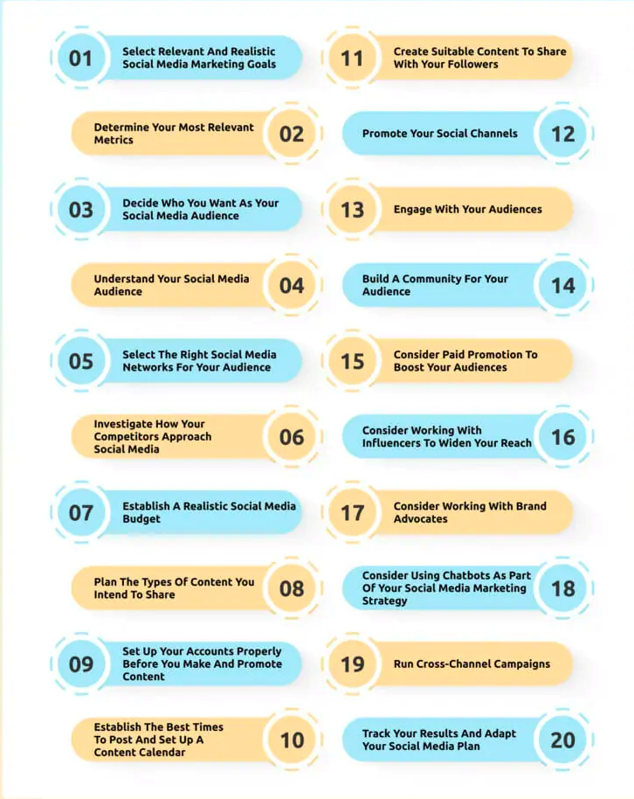
Lecture
09
Conclusion
Social Media Strategy
The role of platforms such as Twitter, Facebook and Youtube.
A look at the processes required to use these tools effectively.

Slide 43
Lecture
09
Recommended Reference
Geyser, W. (2022, December 14). 20 step social media marketing strategy for businesses in 2023. Influencer Marketing Hub. https://influencermarketinghub.com/social-media-marketing-strategy/
Lita, R. (2023, March 23). How to build social media strategy?. SiteProNews. https://www.sitepronews.com/2020/08/07/how-to-build-social-media-strategy/

Slide 44


Thank You

