Slide 1






Portfolio, Program, and Project Management as Enablers of Innovation
Prepared by Dr. Sami Alzahrani
Lecture 11
PMG 665
Program and Portfolio Management

Slide 2

Introduction
In an ever-changing world, it is widely accepted that organizations must innovate in order to survive. The phrase “innovate or die” has become a common refrain. This imperative is succinctly described by Drucker (1993): An established company which, in an age demanding innovation, is not able to innovate, is doomed to decline and extinctionce.

Slide 3

Innovation defined
Although commonly viewed as a modern term, “innovation” has been in use since the 16th century or earlier; Machiavelli described the perils of being an innovator. The term “innovation” is derived from the Latin word innovates, the noun form of Innovare, which means “to renew or change”. The modern definition of innovation is “the introduction of something new”. By that definition, innovation can be as subtle as a process improvement, a new product feature, or as revolutionary as providing a new product, service, or capability, or even a new market.

Slide 4

Innovation defined
“Innovation” today is much like “Branding” was in the ‘90s; greatly overused and highly misunderstood. It’s the new buzzword and its ubiquity is putting the entire concept of innovation in serious jeopardy. Putting temperature sensitive ink on your labels so you know when your beer is cold is not innovation.

Slide 5
Innovation defined
If a project to develop a proof of concept or test a hypothesis meets the rejection criteria, the entire program does not have to fail; a project to develop an alternative proof of concept or test an alternative hypothesis can be launched in support of the program objectives. Being prepared to quickly launch an alternative proof of concept or experiment can mitigate the risk to the program.

Slide 6
Innovation defined
To do so, it is imperative that the lessons learned be captured and leveraged for the new attempt. We will explore further how program management, coupled with portfolio management and project management, integrate to add value to the innovation process and help eliminate barriers.

Slide 7
Types of innovation
However, before discussing these capabilities it is important to acknowledge that there are several broad categories of innovation, each with its own particular challenges. In fact, Moore (2008) identified 13 distinct types of innovation, based on the product or service life cycle involved. Bessant and Tidd (2009, pp. 21–26) identified four dimensions of innovation, including:

Slide 8
Types of innovation
1. Product/service innovation—changes in things that the organization offers.
2. Process innovation—changes in the ways these products/services are created and delivered.
3. Position innovation—changes in terms of the context in which the products/services are introduced.
4. Paradigm innovation—changes in the underlying mental models, which frame what the organization does.

Slide 9
Types of innovation
Within each of these dimensions lies a continuum ranging from evolutionary (incremental) innovation to revolutionary (radical) innovation. To illustrate the point, Bessant and Tidd (2009, pp. 23–25) provide examples of incremental and radical innovation across each of these dimensions:

Slide 10
Types of innovation
- Product/Service Innovation
• Incremental—improved performance of incandescent light bulbs
• Radical—Light-emitting diode (LED)-based lighting, using completely different and more energy efficient principles
- Process Innovation
• Incremental—improved fixed-line telephone services
• Radical—Skype and other Voice over Internet Profile (VoIP) systems

Slide 11
Types of innovation
- Position Innovation
• Incremental—banking services targeted at key segments (e.g., students, retirees, etc.)
• Radical—micro-financing opening up credit for the very poor
- Paradigm Innovation
• Incremental—IBM eliminating its personal computer business to focus on its consulting and service offerings
• Radical—Apple integrating the iPod with iTunes to become an integrated personal entertainment provider [author’s example]

Slide 12
Managing ambiguity and uncertainty
Ambiguity refers to the likelihood that the objectives or the intended result of the initiative will change (the what). Uncertainty refers to the likelihood that objectives cannot be met (the how). Project management can address uncertainty to some degree through effective risk management, but the objectives of the initiative typically must be well understood. Risk management principles can be applied at both the program and component project levels to reduce uncertainty.

Slide 13
Managing change
Change management is a critical component of innovation from the ideation stage to adoption and sustainment of the product, service, or capability. Change management is an art and science unto itself and one that can be challenging if done casually. Prosci (2011) characterizes change management as both a process and a competency:

Slide 14
Managing change
From a process perspective, it is the set of steps followed by a team member on a particular project or initiative. For the given transformational effort, it is the strategy and set of plans focused on moving people through the change. …Effective change management follows a structured process and uses a holistic set of tools to drive successful change.

Slide 15
Managing change
Change management is integral to program and project management and the innovation process. Every innovation initiative, by its nature, results in some degree of change. Disruptive innovations may change people’s perceptions or even create a completely new market. Nearly every one of the conveniences that we enjoy today was at some point a disruptive innovation that launched a whole new market (e.g., your refrigerator, automobile, air conditioning, etc.). This concept is exemplified by Henry Ford’s most famous adage:

Slide 16
Managing change
If I had asked people what they wanted they would have said faster horses.
Although this quote, too, is a myth (Vlaskovits, 2011) it illustrates some important concepts about creativity and the problem to be solved, as well as the aversion to change that many organizations experience.

Slide 17
Opportunistic innovation
We have to acknowledge that there are several dimensions and categories of innovation (on which there is no universal agreement). It must also be recognized that innovation can occur anywhere in the organization and at any time, including during the execution of a program or project; innovation does not explicitly require an “innovation” initiative. This type of innovation is more closely associated with the positive side of risk management, the continuous identification and exploitation of opportunities.

Slide 18
Opportunistic innovation
The proactive identification of opportunities, managed with the same rigor and attention as potential threats, often results in process efficiencies, shortened project life cycles, an improved solution, and/or enhanced benefits. Hillson (2004) recommends that threat-based project risk management be extended to include opportunities and provides a framework to do so.

Slide 19
Innovation management
We have identified multiple dimensions and categories of innovation and the associated continuum of change, ambiguity, uncertainty, and risk. We have also identified the primary elements of the innovation process, from defining the problem (empathy), ideating solutions to the problem (creativity), developing and implementing the solution (execution), to realizing the resulting benefits through adoption. Phillips (2012) elaborates on this life cycle and defines the corresponding activities:

Slide 20
Innovation management
• “Spotting trends to understand potential future needs and opportunities,
• Gathering customer insights, needs, and jobs to be done,
• Generating ideas based on these inputs,
• Managing, developing, and evaluating ideas,
• Prototyping and piloting ideas,
• Selecting the best ideas to commercialize,
• Converting ideas into new products and services,
• Launching new products and services”.

Slide 21
Innovation management
Williams (2011) recommends viewing innovation management as a “value chain” comprising the following elements to resolve the primary points of failure common to organizations seeking to innovate:
• Aligning the innovation approach to the overall organizational strategy
• Strategic Alignment

Slide 22
Innovation management
• Review, selection, and management of multiple ideas
• Portfolio Management
• Execution of individual initiatives within the portfolio
• Execution management (Program and Project Management)

Slide 23
Innovation management
Williams confirms the importance of these elements within the innovation management ecosystem and describes the improved model as the Innovation Portfolio Management Model (IPMM)®, developed by the American Institute for Innovation Excellence (AIIE).

Slide 24
Innovation management
Portfolio, program, and project management integrate with idea management and each other to add value to the innovation process, from organizational strategy to the discrete work packages and deliverables that are ultimately required, as illustrated in Figure 21.1. Program management effectively addresses the change, ambiguity, uncertainty, and risk inherent in the innovation process.

Slide 25
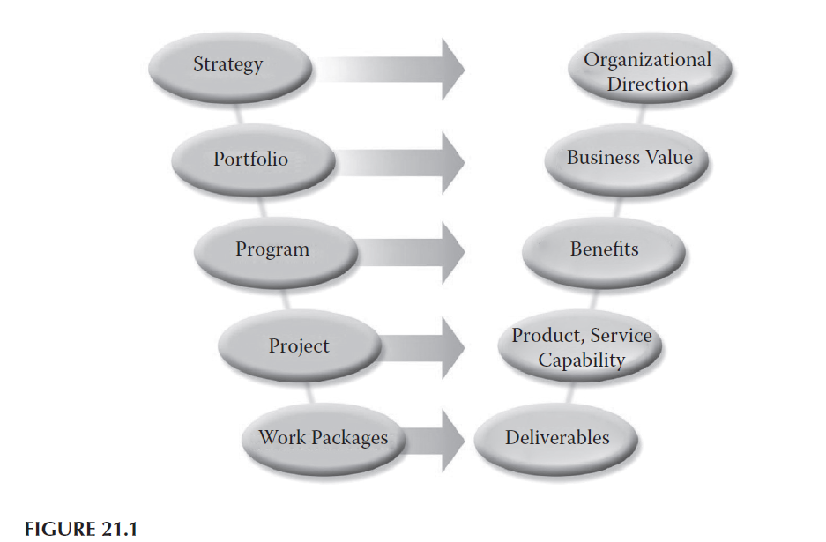
Innovation management

Slide 26
Innovation and portfolio management
Portfolio management is a continuous process that links organizational strategy to execution by matching investment and the allocation of resources to strategic objectives. Per Williams (2011): “Portfolio management enables organizations to identify, select and manage the investments that will maximize business value by balancing the strategic fit, timing and sequencing, investment risk, operational capability and resource capacity.

Slide 27
Innovation and portfolio management
A quality business case, which starts at the ideation stage, is critical to assessing an initiative’s fit within corporate objectives, measuring its projected benefits against investment requirements, uncovering potential risks, and identifying alternatives.

Slide 28
Organizational Context
The parameters used to assess initiatives and balance the organization’s portfolio begin with the organization’s mission. The organization’s mission directs how the strategy is to be executed, which in turn defines how the organization’s vision is to be achieved.

Slide 29
Organizational Context
Through a periodic strategic planning process, the organization’s strategic objectives and performance targets are defined. Initiatives that sustain value are identified and assessed through operations planning and management. Initiatives that create value are identified and assessed during the portfolio planning and management functions.

Slide 30
Organizational Context
The Project Management Institute (PMI®) in its The Standard for Portfolio Management, Second Edition (PMI®, 2008a) explains that “the ultimate goal of linking portfolio management with organizational strategy is to establish a balanced, executable plan that will help the organization achieve its goals”. The organization’s strategy is achieved by (PMI®, 2008a):

Slide 31
Organizational Context
1. Maintaining portfolio alignment–Each initiative must be aligned with one or more strategic goals and reflected in the business case.
2. Allocating financial resources–The priority of each initiative guides financial allocation decisions.
3. Allocating human resources–The priority of each initiative also guides resource planning, hiring, training, and procurement efforts; the organization must have the capability to meet its objectives.
4. Measuring component contributions–The contribution of each initiative toward the strategic goals must be continuously measured.

Slide 32
Organizational Context
“Operations” describes the day-to-day organizational activities, which may include production, manufacturing, finance, marketing, legal, information services, human resources, and other administrative services that are essential to the organization (PMI®, 2008a).

Slide 33
Organizational Context
It is important that innovation program/project teams manage the relationship with the operational areas for two reasons:
1. The outcome and benefits of the innovation program must ultimately be transitioned to operational teams to sustain those benefits, and
2. Resources for the innovation initiative typically come from these operational areas, unless the capability must be procured externally.

Slide 34
Portfolio Management
PMI® (2008a) describes portfolio management as the “centralized management one or more portfolios, which includes identifying, prioritizing, authorizing, managing, and controlling projects, programs, and other related work to achieve specific strategic business objectives”. Portfolio management bridges the gap between the organization’s strategic objectives and execution and can be envisioned as a funnel through which all requests for investment of the organization’s resources must flow for evaluation.

Slide 35
Portfolio Management
Wright explains the five basic questions that must be answered for every initiative (2012, p. 2), see table below.
These factors are continuously assessed for both new initiatives and initiatives that are in process. Monitoring of approved initiative performance is an ongoing cycle supplemented by the portfolio, program, and project management governance processes of phase gate reviews.

Slide 36
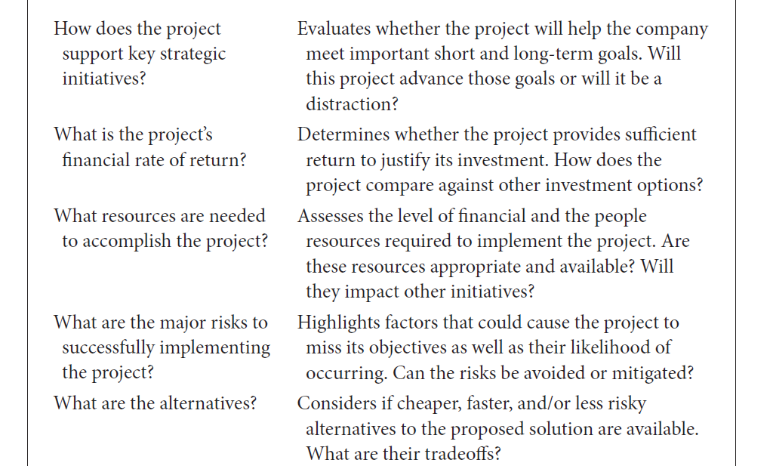
Portfolio Management

Slide 37
Portfolio Management
These phase gate reviews are similar to the new product development stage gate reviews and at some point in the life cycle are integrated. Both are decision points (go/cancel/hold) based on the information available at the time, including:
• Performance metrics—are key performance indicators still within the proper threshold?

Slide 38

Portfolio Management
• Viability of the solution—has the investment to date or expected return on investment been negatively impacted?
• Current risk profile—how likely is it that the solution can still be delivered?
• Availability of resources—does the organization still have the right resources available at the right time?
• Capability assessment—do we have the right knowledge, skills, and competencies?

Slide 39
Resource Allocation
Every organization has a finite amount of resources in terms of money, equipment, material, or labor. Portfolio management endeavors to match the demand for resources to the supply of resources. Ultimately, decision makers must balance the benefit of using those resources on the innovation program against the “lost” opportunity of applying the resources elsewhere. However, the opportunity cost of not developing an innovative solution must also be considered.

Slide 40
Portfolio Balance
Portfolio balance is achieved through the portfolio management governance function. Governance is accountable for investment decisions throughout the portfolio life cycle to identify opportunities, to select activities to fund, and to achieve performance targets by continuously (PMI®, 2008a):

Slide 41
Portfolio Balance
• Selecting and funding the investment portfolio
• Monitoring and controlling portfolio investments
• Communicating decisions about the investment portfolio and constituent components within the portfolio
• Ensuring that the investment portfolio continues to align with strategic objectives

Slide 42
Reference
Program Management: A Life Cycle Approach
by Ginger Levin, PMP, PgMP
Chapter 21

Slide 43
الابداع والابتكار
Innovation & Createvity
الابداع: هو العمليات الذهنية التي تؤدي للتوصل الى الحلول والافكار المفاهيم او التغيرات الفنية والنظريات والاعمال التي تكون جديدة وفريدة.
الابتكار: يتضمن انتاج وتوزيع استخدام المعرفة بطريقة جديدة واقتصادية، حيث ان الابتكار يعد احد المزايا التنافسية للمنظمات.

Slide 44

الفرق بين الابداع والابتكار

