Slide 1

Marketing Management
MGM612
Dr. Magdy alhaj
Marketing Channels Management

Slide 2
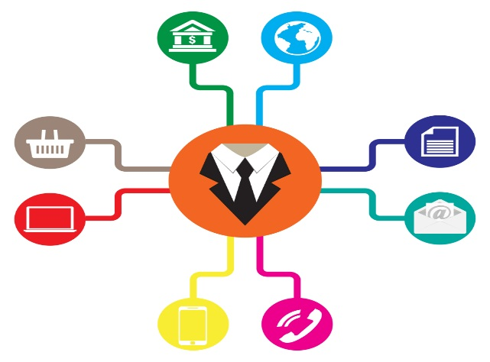

Chapter-10
Learn outcomes
The Marketing Channel Define and Importance of Marketing Channels
Distribution Channel
Types of Marketing Channels
Explain the functions and key activities of marketing channels.
Marketing Channels and Marketing Management Strategy
Channel Conflict
Physical Distribution Management

Slide 3

Chapter-10
The Marketing Channel Define
A marketing channel consists of individuals and firms involved in the process of making a product or service available for consumption or use by consumers and industrial users.
The route taken by a product as it moves from producer to the customer or other ultimate user.
The path taken by the title to goods as it moves through various agencies.
A loose coalition of business firms that have banded together for purposes of trade.

Slide 4

What is a Marketing Channel?
Chapter-10
A marketing channel system is the particular set of interdependent organizations involved in the process of making a product or service available for use or consumption.
Marketing channels determine how and where customers buy.

Slide 5
Chapter-10
Importance of Channel Component
Selecting the channel design mix is challenging
  The alternatives are numerous
  Marketing goals differ between channel members
  Business markets segments vary, thus it may require numerous channels concurrently
  Business market environment constantly changes
  Competition is stiff
  Customer requirements change
  Internet technology is changing the landscape
All of this creates new opportunities and the need for fresh channel strategies

Slide 6
Growing Importance of Marketing Channels
Chapter-10
Explosion of information technology and E-commerce
Greater difficulty of gaining a sustainable competitive advantage
Growing power of distributors, especially retailers in marketing channels
The need to reduce distribution costs

Slide 7
Chapter-10
Managing the Channel
Once a channel structure is specified and goals set, marketing managers need to:
  Develop procedures for selecting intermediaries
  Motivate them to meet goals
  Resolve conflict between them
  Evaluate performance
The following discussion centers around designing and administering the business marketing channel.

Slide 8
Distribution Channel
Chapter-10
The link between the manufacturer and the customer is called the Channel of Distribution
The channel accomplishes all the tasks necessary to get the product/service to market
Tasks can be performed by the manufacturer or be delegated throughout the channel
The question is: “What is the best way to execute the tasks?”

Slide 9
Channel Tasks Include:
Chapter-10
Contacting potential buyers
Negotiating
Selling
Contracting
Transferring title
Training
Financing
Servicing the product
Inventorying
Transporting
Storage

Slide 10
Chapter-10
Direct and Indirect Channels
Who performs the TASKS?
Direct is when the manufacturer performs all the marketing functions
Indirect is when some type of intermediary sells or handles the product

Slide 11
Chapter-10
Types of Marketing Channels
Channels for Consumer Products

Slide 12
Chapter-10
Types of Marketing Channels
Channels for Industrial Products

Slide 13
Chapter-10
Marketing Channel Functions
Specialization and division of labor
Overcoming discrepancies
Providing contact efficiency

Slide 14
Chapter-10
CHANNEL FUNCTIONS
Information
Promotion
Contact
Matching
Negotiation
physical distribution
Financing
Risk taking

Slide 15
Chapter-10
Determinants of Channel Structure and Relationships
INTERNAL
  Company objectives
  Character
  Capital
  Cost
  Coverage
  Control
  Continuity
  Communication
EXTERNAL
  Customer characteristics
  Culture
  Competition

Slide 16
Explain how channel members add value
Chapter-10
Right PLACE
Right TIME
Place UTILITY
  Location – having the product where customers can buy it
Time UTILITY
  Having the product available when the customer wants/needs it

Slide 17
Channel Member Functions
Chapter-10
Gather information
Develop and disseminate persuasive communications
Reach agreements on price and terms
Acquire funds to finance inventories
Assume risks
Provide for storage
Provide for buyers’ payment of their bills
Oversee actual transfer of ownership

Slide 18

Chapter-10
Key Functions Performed in Marketing Channels
Marketing Communications
Advertising the Product
Providing a salesforce that offers information & service to customers
Inventory Management
Ordering appropriate merchandise assortment
Maintaining adequate stock to meet customer demand
Storing merchandise in an appropriate facility
Physical Distribution
Delivering products
Coordinating delivery schedules to meet customer expectations
Arranging for the return of defective merchandise

Slide 19
Chapter-10
Key Functions Performed in Marketing Channels
Market Feedback
Serving on manufacturer advisory boards
Informing other channel members of competitive activity
Participating in test market evaluations
Financial Risk
Offering credit
Managing risks related to product loss or deterioration
Managing risks related to product safety and liability

Slide 20
Chapter-10
Contributions of Intermediaries
Provide Economic Value
Provide Social Value
Provide Marketing Support
Impact Supply-chain Management
Add Value to the Market Offering

Slide 21
Chapter-10
Types of Marketing Channels
1- Direct Channels
2- Indirect Channels
3- Single Marketing Channels
4- Multiple Marketing Channels
5- Vertical Marketing Systems

Slide 22
Chapter-10
Evaluating Channel Alternatives
Evaluation of Capabilities and Costs
Evaluation of Channel Compatibility:
  Product Considerations
  Pricing Considerations
  Marketing Communications Considerations
Evaluation of Availability

Slide 23
Chapter-10
Evaluating Channel Performance
1- Financial Evaluation
2- Evaluate Working Relationships
3- Evaluate Legal and Ethical Issues

Slide 24
Designing a Marketing Channel System
Chapter-10
Analyze customer needs
Establish channel objectives
Identify major channel alternatives
Evaluate major channel alternatives

Slide 25
Chapter-10
Channel Service Outputs
Lost size
Waiting/delivery time
Spatial convenience
Product variety
Service backup

Slide 26
Chapter-10
Identifying Channel Alternatives
Types of intermediaries
Number of intermediaries
Terms and responsibilities

Slide 27
Number of Intermediaries
Chapter-10
Exclusive
Selective
Intensive

Slide 28
Chapter-10
Terms and Responsibilities of Channel Members
Price policy
Condition of sale
Distributors’ territorial rights
Mutual services and responsibilities

Slide 29
Channel Power
Chapter-10
Coercive
Reward
Legitimate
Expert
Referent

Slide 30
Channel Management
Chapter-10
Coordinating two independent entities with shared goals.
The relationship needs to be managed for the long term.
Factors complicating channel management
  Ownership
  Geographic, cultural, and economic distance
  Different rules of law

Slide 31
Chapter-10
Channel-Management Decisions
Selecting channel members
Training channel members
Motivating channel members
Evaluating channel members
Modifying channel members

Slide 32
Chapter-10
Marketing Channels and Marketing Management Strategy
Marketing channel strategy: one of the major strategic areas of marketing management.
  Management must develop and operate its marketing channels in such way as to support and enhance the other strategic variables of the marketing mix in order to meet the demand of the firm’s target markets.

Slide 33
Chapter-10
Channel Strategy versus Logistics Management
Marketing mix
Product strategy
Pricing strategy
Promotion strategy
Distribution strategy
Channel strategy component
Logistics management component

Slide 34
Distribution strategy
Chapter-10
Channel Strategy versus Logistics Management
1st
2nd
Channel strategy is much broader and more basic component than logistics management.
Channel strategy is concerned with the entire process of setting up and operating the contractual organization that is responsible for meeting the firm’s distribution objectives.
Logistics management is more narrowly focused on providing product availability at the appropriate times and places in the marketing channel.
Channel strategy component
Logistics management component
Usually, channel strategy must already be formulated before logistics management can even be considered.

Slide 35
Chapter-10
Flows in Marketing Channels
The actual physical movement of the product from the manufacturer through all of the parties who take physical possession of the product, from its point of production to final consumers.
Product flow
Negotiation flow
Ownership flow
Information flow
Promotion flow

Slide 36
What is Channel Conflict?
Chapter-10
Channel conflict occurs when one member’s actions prevent another channel from achieving its goal.
Types of channel conflict
  Vertical
  Horizontal
  Multichannel

Slide 37
Chapter-10
Causes of Channel Conflict
Goal incompatibility
Unclear roles and rights
Differences in perception
Intermediaries’ dependence on the manufacturer

Slide 38
Strategies for Managing Channel Conflict
Chapter-10
Adoption of superordinate goals
Exchange of employees
Joint membership in trade associations
Cooptation
Diplomacy
Mediation
Arbitration
Legal recourse

Slide 39
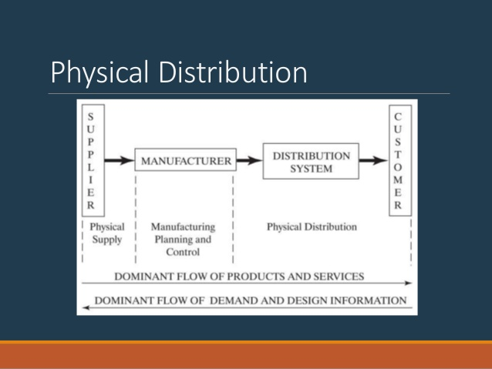

Chapter-10
PHYSICAL DISTRIBUTION
Physical distribution is responsible for delivering to the customer what is wanted on time & at minimum cost
The Objective of distribution management is to design & operate a distribution system that attains the required level of customer services & does so at least cost
TYPES
Physical Supply
◦ goods moving from supplier to manufacturer
◦ “inbound”
Physical Distribution
◦ goods moving from manufacturer to customers
◦ “outbound”

Slide 40
Activities in Physical Distribution
Chapter-10
1.Transportation: It involves various methods of moving goods outside the firms building
2.Distribution Inventory: It includes all finished goods inventory at any point in the distribution system
3.Materials Handling: It is the movement of stored goods inside the distribution center
4.Packaging: Goods moving in a distribution system must be contained protected & identified
5.Order Processing: It includes all activities needed to fill customers orders

