Slide 1





Lecture: #05
Operating System Controls for Security
Dr. Hesham Abou Elfetouh
Cybersecurity Department
Faculty of Informatics
Midocean University
Secure Operating Systems (CYB610)
www.midocean.ae

Slide 2
Chapter
Outline
05
    This chapter covers the following topics and concepts
Programs security
Controls for Security
Developmental Controls for Security
Administrative Controls for Security
Operating System Controls for Security
2
www.midocean.ae
Secure Operating Systems

Slide 3
Chapter
Introduction
05
In Previous Lecture you learned:
Types of Malware
Relocation Base/Bounds Registers and Tagged Architecture
The difference between types of Malware
The Virus Effects
The Virus Signatures
Protected Memory and Address
Buffer Overflows
Cross Site Scripting (XSS) Attacks
The memory corruption defenses
Validating input syntax
3
www.midocean.ae
Secure Operating Systems

Slide 4
Chapter
CHAPTER 5 GOALS
05
When you complete this chapter, you will be able to:
Know What is “Program security”
Explain the Basic approaches to having secure programs
Illustrate how to control security of programs during their development and maintenance
4
www.midocean.ae
Secure Operating Systems

Slide 5
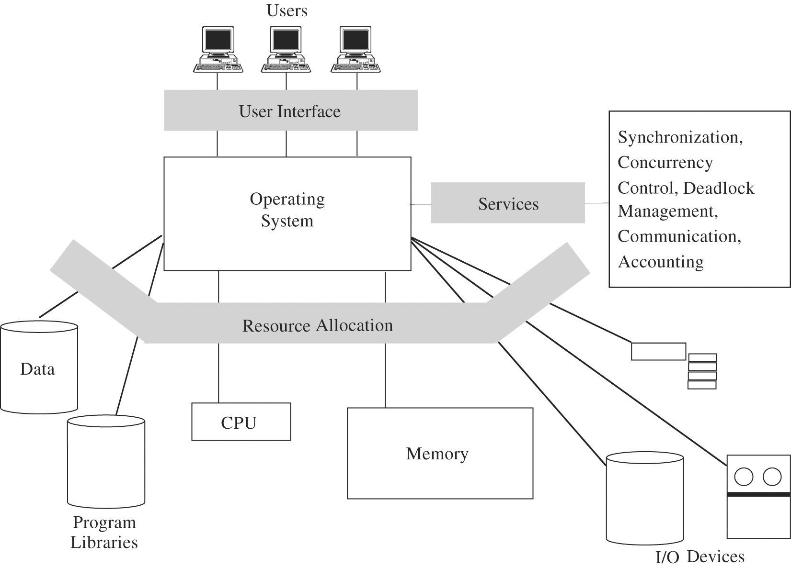
Chapter
Overview of an OS Functions
05
5
www.midocean.ae
Secure Operating Systems

Slide 6
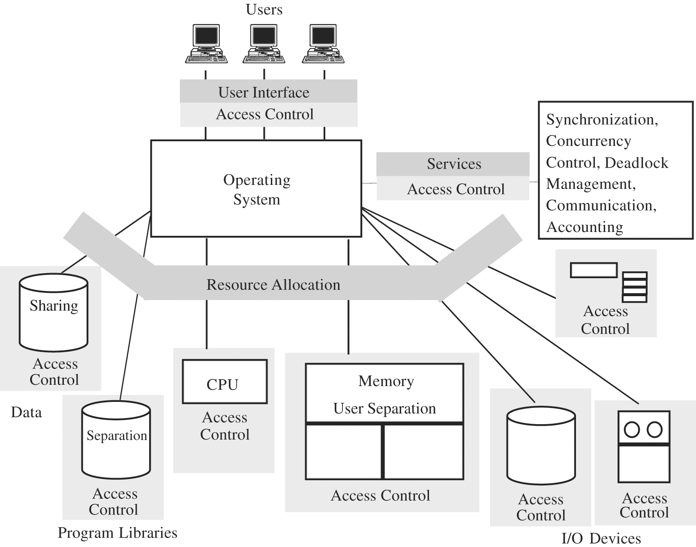
Chapter
Security Functions of a Trusted OS
05
6
www.midocean.ae
Secure Operating Systems

Slide 7
Chapter
Programs security
05
Program is secure if we trust that it provides/enforces:
  Confidentiality
  Integrity
  Availability
7
www.midocean.ae
Secure Operating Systems

Slide 8
Chapter
Programs security
05
What is “Program security?”
Depends on who you ask
  user - fit for his task
  programmer - passes all “his” tests
  manager - conformance to all specification
Developmental criteria for program security include:
  Correctness of security & other requirements
  Correctness of implementation
  Correctness of testing
8
www.midocean.ae
Secure Operating Systems

Slide 9
Chapter
Programs security
05
Fault tolerance terminology:
  Error - may lead to a fault
  Fault - cause for deviation from the intended function
  Failure - system malfunction caused by fault
Note:
Faults - seen by „insiders” (e.g., programmers)
  Failures - seen by „outsiders” (e.g., independent testers, users)
Error/fault/failure example:
  Programmer’s indexing error, leads to buffer overflow fault
  Buffer overflow fault causes system crash (a failure)
Two categories of faults :
  Permanent faults
  Transient faults – can be much more difficult to diagnose
9
www.midocean.ae
Secure Operating Systems

Slide 10
Chapter
Programs security
05
Basic approaches to having secure programs:
  1) Judging s/w security by fixing program faults
    Red Team / Tiger Team tries to crack s/w
      If programs withstands the attack => security is good
  2) Judging s/w security by testing program behavior
    Run tests to compare behavior vs. requirements (think testing or Ss/w engg)
    Important: If a flaw detected as a failure (an effect), look for the underlying fault (the cause)
        Recall: fault seen by insiders, failure – by outsiders
      If possible, detect faults before they become failures
10
www.midocean.ae
Secure Operating Systems

Slide 11
Chapter
Programs security
05
    Any kind of fault/failure can cause a security incident
    => we must consider security consequences for all kinds of detected faults/failures
      Even inadvertent faults / failures
        Inadvertent faults are the biggest source of security vulnerabilities exploited by attackers
    Testing only increases probability of eliminating faults
11
www.midocean.ae
Secure Operating Systems

Slide 12
Chapter
Programs security
05
  3) Judging s/w security by program security analysis
    Best approach to judging s/w security
    Analyze what can go wrong
      At every stage of program development!
        From requirement definition to testing
      After deployment
        Configurations / policies / practices
12
www.midocean.ae
Secure Operating Systems

Slide 13
Chapter
Controls for Security
05
How to control security of programs during their development and maintenance
Outline:
  Introduction
  Developmental controls for security
  Operating system controls for security
  Administrative controls for security
  Conclusions
13
www.midocean.ae
Secure Operating Systems

Slide 14
Chapter
Controls for Security - Introduction
05
“Better to prevent than to cure”
Preventing security flaws
  We have seen a lot of possible security flaws
  How to prevent (some of) them?
  Software engineering concentrates on developing and maintaining high-quality s/w
    We’ll take a look at some techniques useful specifically for developing/ maintaining secure s/w
14
www.midocean.ae
Secure Operating Systems

Slide 15
Chapter
Types of Controls for Security
05
Three types of controls for security (against program flaws):
    Developmental controls
    OS controls
    Administrative controls
15
www.midocean.ae
Secure Operating Systems

Slide 16
Chapter
Developmental Controls for Security
05
Nature of s/w development
  Collaborative effort
  Team of developers, each involved in ≥ 1 of stages:
    Requirement specification
        Regular req. specs: „do X”
        Security req. specs: „do X and nothing more”
16
www.midocean.ae
Secure Operating Systems

Slide 17
Chapter
Developmental Controls for Security
05
  Team of developers, each involved in ≥ 1 of stages:
        Design
        Implementation
        Testing
        Documenting at each stage
        Reviewing at each stage
        Managing system development thru all stages
        Maintaining deployed system (updates, patches, new versions, etc.)
        Both product and process contribute to overall quality
        — incl. security dimension of quality
        ”
17
www.midocean.ae
Secure Operating Systems

Slide 18
Chapter
Developmental Controls for Security
05
  Fundamental principles of s/w engineering
  Modularity
  Encapsulation
  Info hiding
18
www.midocean.ae
Secure Operating Systems

Slide 19
Chapter
Developmental Controls for Security
05
1) Modularity
    Modules should be:
      Single-purpose - logically/functionally
      Small - for a human to grasp
      Simple - for a human to grasp
      Independent – high cohesion, low coupling
        High cohesion – highly focused on (single) purpose
        Low coupling – free from interference from other modules
  Modularity should improve correctness
    Fewer flaws => better security
19
www.midocean.ae
Secure Operating Systems

Slide 20
Chapter
Developmental Controls for Security
05
2) Encapsulation
  Minimizing info sharing with other modules
    => Limited interfaces reduce # of covert channels
  Well documented interfaces
  “Hiding what should be hidden and showing what should be visible.”
20
www.midocean.ae
Secure Operating Systems

Slide 21
Chapter
Developmental Controls for Security
05
3) Information hiding
  Module is a black box
    Well defined function and I/O
  Easy to know what module does but not how it does it
  Reduces complexity, interactions, covert channels, ...
  => better security
21
www.midocean.ae
Secure Operating Systems

Slide 22
Chapter
Developmental Controls for Security
05
Many techniques for building solid software
  Peer reviews
  Hazard analysis
  Testing
  Good design
  Risk prediction & mangement
  Static analysis
  Configuration management
  Additional developmental controls
22
www.midocean.ae
Secure Operating Systems

Slide 23
Chapter
Developmental Controls for Security
05
1) Peer reviews - three types
  Reviews
      Informal
      Team of reviewers
      Gain consensus on solutions
      before development
  Walk-throughs
      Developer walks team through code/document
      Discover flaws in a single design document
  Inspection
      Formalized and detailed
      Statistical measures used
- Various types of peer reviews can be highly effective
23
www.midocean.ae
Secure Operating Systems

Slide 24
Chapter
Developmental Controls for Security
05
2) Hazard analysis
  = systematic techniques to expose
  potentially hazardous system states,
  incl. security vulnerabilities
  Components of HA
    Hazard lists
    What-if scenarios – identifies non-obvious hazards
    System-wide view (not just code)
    Begins Day 1
    Continues throughout SDLC (= s/w dev’t life cycle)
  Techniques
    HAZOP – hazard and operability studies
    FMEA – failure modees and effects analysis
    FTA – fault tree analysis
24
www.midocean.ae
Secure Operating Systems

Slide 25
Chapter
Developmental Controls for Security
05
3) Testing – phases:
  Module/component/unit testing of indiv. modules
  Integration testing of interacting (sub)system modules
  (System) function testing checking against requirement specs
  (System) performance testing
  (System) acceptance testing – with customer against customer’s requirements — on seller’s or customer’s premises
  (System) installation testing after installation on customer’s system
  Regression testing after updates/changes to s/w
  Types of testing
  Black Box testing – testers can’t examine code
  White Box / Clear box testing – testers can examine design and code, can see inside modules/system
25
www.midocean.ae
Secure Operating Systems

Slide 26
Chapter
Developmental Controls for Security
05
4) Good design
  Good design uses:
    Modularity / encapsulation / info hiding
    Fault tolerance
    Consistent failure handling policies
    Design rationale and history
    Design patterns
i. Using modularity / encapsulation / info hiding
  - as discussed above
26
www.midocean.ae
Secure Operating Systems

Slide 27
Chapter
Developmental Controls for Security
05
4) Good design
ii. Using fault tolerance for reliability and security
  System tolerates component failures
  System more reliable than any of its components
    Different than for security, where system is as secure as its weakest component
Fault-tolerant approach:
  Anticipate faults (car: anticipate having a flat tire)
    Active fault detection rather than pasive fault detection
    (e.g., by use of mutual suspicion: active input data checking)
  Use redundancy (car: have a spare tire)
  Isolate damage
  Minimize disruption (car: replace flat tire, continue your trip)
27
www.midocean.ae
Secure Operating Systems

Slide 28
Chapter
Developmental Controls for Security
05
4) Good design
iii. Using consistent failure handling policies
  Each failure handled by one of 3 ways:
    Retrying
      Restore previous state, redo service using different „path”
        E.g., use secondary code instead of primary code
    Correcting
      Restore previous state, correct sth, run service using the same code as before
    Reporting
      Restore previous state, report failure to error handler, don’t rerun service
Example — How fault-tolerance enhances security
  If security fault destroys important data (availability in CIA), use f-t to revert to backup data set
28
www.midocean.ae
Secure Operating Systems

Slide 29
Chapter
Developmental Controls for Security
05
4) Good design
iv. Using design rationale and history
  Knowing it (incl. knowing design rationale and history for security mechanisms) helps developers modifying or maintaining system
29
www.midocean.ae
Secure Operating Systems

Slide 30
Chapter
Developmental Controls for Security
05
4) Good design
v. Using design patterns
  Knowing it enables looking for patterns showing what works best in which situation
  Value of Good Design
  Easy maintenance
  Understandability
  Reuse
  Correctness
  Better testing
  => translates into (saving) BIG bucks !
30
www.midocean.ae
Secure Operating Systems

Slide 31
Chapter
Developmental Controls for Security
05
5) Risk prediction & management
  Predict and manage risks involved in system development and deployment
  Make plans to handle unwelcome events should they occur
  Risk prediction/mgmt are esp. important for security
  Bec. unwelcome and rare events can have security consequences
  Risk prediction/mgmt helps to select proper security controls (e.g., proportional to risk)
31
www.midocean.ae
Secure Operating Systems

Slide 32
Chapter
Developmental Controls for Security
05
6) Static analysis
  Before system is up and running, examine its design and code to locate security flaws
    More than peer review
  Examines
    Control flow structure (sequence in which instructions are executed, incl. iterations and loops)
    Data flow structure (trail of data)
    Data structures
  Automated tools available
32
www.midocean.ae
Secure Operating Systems

Slide 33
Chapter
Developmental Controls for Security
05
Configuration management
  = process of controling system modifications during development and maintenance
  Offers security benefits by scrutinizing new/changed code
Problems with system modifications
  One change interefering with other change
    E.g., neutralizing it
  Proliferation of different versions and releases
    Older and newer
    For different platforms
    For different application environments (and/or customers categories)
33
www.midocean.ae
Secure Operating Systems

Slide 34
Chapter
Developmental Controls for Security
05
Configuration management
Reasons for software modification
  Corrective changes
    To maintain control of system’s day-to-day functions
  Adaptive changes
    To maintain control over system’s modifications
  Perfective changes
    To perfect existing acceptable system functions
  Preventive changes
    To prevent system’s performance degradation to unacceptable levels
34
www.midocean.ae
Secure Operating Systems

Slide 35
Chapter
Developmental Controls for Security
05
8) Additional developmental controls
  8a) Learning from mistakes
    Avoiding such mistakes in the future enhances security
  8b) Proofs of program correctness
    Formal methods to verify pgm correctness
    Logic analyzer shows that:
      initial assertions about inputs...
      ... through implications of pgm statements...
      ... lead to the terminal condition (desired output)
    Problems with practical use of pgm correctness proofs
      Esp. for large pgms/systems
    Most successful for specific types of apps
      E.g. for communication protocols & security policies
Even with all these developmental controls (1-8) –
still no security guarantees!
35
www.midocean.ae
Secure Operating Systems

Slide 36
Chapter
Administrative Controls for Security
05
1) Standards and guidelines for program development
  Capture experience and wisdom from previous projects
  Facilitate building higher-quality s/w (incl. more secure)
  They include:
    Design S&G – design tools, languages, methodologies
    S&G for documentation, language, and coding style
    Programming S&G - incl. reviews, audits
    Testing S&G
    Configuration mgmt S&G
2) Security audits
  Check compliance with S&G
  Scare potential dishonest programmer from including illegitimate code (e.g., a trapdoor)
36
www.midocean.ae
Secure Operating Systems

Slide 37
Chapter
Administrative Controls for Security
05
3) Separation of duties
  Break sensitive tasks into ≥ 2 pieces to be performed by different people (learned from banks)
  Example 1: modularity
    Different developers for cooperating modules
  Example 2: independent testers
    Rather than developer testing her own code
37
www.midocean.ae
Secure Operating Systems

Slide 38
Chapter
Operating System Controls for Security
05
Developmental controls not always used
OR:
Even if used, not foolproof
=> Need other, complementary controls, incl. OS controls
Such OS controls can protect against some program flaws
38
www.midocean.ae
Secure Operating Systems

Slide 39
Chapter
Operating System Controls for Security
05
Trusted software
code rigorously developed an analyzed so we can trust that it does all and only what specs say
  Trusted code establishes foundation upon which untrusted code runs
    Trusted code establishes security baseline for the whole system
  In particular, OS can be trusted s/w
39
www.midocean.ae
Secure Operating Systems

Slide 40
Chapter
Operating System Controls for Security
05
Key characteristics determining if OS code is trusted
  Functional correctness
    OS code consistent with specs
  Enforcement of integrity
    OS keeps integrity of its data and other resources even if presented with flawed or unauthorized commands
  Limited privileges
    OS minimizes access to secure data/resources
    Trusted program s must have „need to access” and proper access rights to use resources protected by OS
    Untrusted program s can’t access resources protected by OS
  Appropriate confidence level
    OS code examined and rated at appropriate trust level
40
www.midocean.ae
Secure Operating Systems

Slide 41
Chapter
Operating System Controls for Security
05
Similar criteria used to establish if s/w other than OS can be trusted
Ways of increasing security if untrusted programs present:
  Mutual suspicion
  Confinement
  Access log
1) Mutual suspicion between programs
  Distrust other program s – treat them as if they were incorrect or malicious
    program protects its interface data
      With data checks, etc.
41
www.midocean.ae
Secure Operating Systems

Slide 42
Chapter
Operating System Controls for Security
05
2) Confinement
  OS can confine access to resources by suspected program
  Example 1: strict compartmentalization
    program can affect data and other program s only within its compartment
  Example 2: sandbox for untrusted programs
  Can limit spread of viruses
42
www.midocean.ae
Secure Operating Systems

Slide 43
Chapter
Operating System Controls for Security
05
3) Audit log / access log
  Records who/when/how (e.g., for how long) accessed/used which objects
    Events logged: logins/logouts, file accesses, program ecxecutions, device uses, failures, repeated unsuccessful commands (e.g., many repeated failed login attempts can indicate an attack)
  Audit frequently for unusual events, suspicious patterns
  It is a forensic measure not protective measure
    Forensics – investigation to find who broke law, policies, or rules (a posteriori, not a priori)
43
www.midocean.ae
Secure Operating Systems

Slide 44
Chapter
Summary
05
What is “Program security”
Basic approaches to having secure programs
Controls for Security
Developmental Controls for Security
Administrative Controls for Security
Operating System Controls for Security
44
www.midocean.ae
Secure Operating Systems

Slide 45



Thank You

