Slide 1


English Language 1
Orientation Lecture
ENG 101
Prepared by
Ahmed Soliman

Slide 2
Who am I?
Ahmed Soliman
Lecturer, College of Management, MIDOCEAN University.
Former Assistant Lecturer, Faculty of Languages and Translation, Badr University in Cairo (BUC).
Former Foreign Language Teaching Assistant, The University of Kansas, USA.
Part-time ESL Instructor, School of Continuing Education, The British University in Egypt.
Former Supervisor of English, Real Soft House Company.

Slide 3
Outline
Main Aims of the Course
Learning Resources
About the Coursebook
Course Content
Assessment
Academic Calendar
Live Discussion

Slide 4
Main Aims of the Course
This course aims to:
Develop basic skills to deal with people in business situations
Increase knowledge of key business concepts worldwide
Manage and actively participate in meetings
Write and read basic business emails
Expand vocabulary related to general business situations
Develop confidence to deal with people and basic issues in the business world

Slide 5

Learning Resources
Required Textbooks
Market Leader Elementary 3rd Edition COURSE BOOK
Market Leader 3rd Edition Elementary Practice File
Essential References
A Dictionary

Slide 6
About the Coursebook
Market Leader is a multi-level business English course for business people and students of business English. It has been developed in association with the Financial Times, one of the leading sources of business information in the world. It consists of 12 units based on topics of great interest to everyone involved in international business.

Slide 7
Course Content
List of Topics | Week No.
Unit 1: Introductions | 2nd
Unit 2: Work and Leisure | 3rd
Unit 3: Problems | 4th
Unit 4: Travel | 5th
Unit 5: Food and Entertaining | 6th
Unit 6: Buying and Selling | 7th
Unit 7: People | 8th
Unit 8: Advertising | 9th
Unit 9: Companies | 10th
Unit 10: Communication | 11th

Slide 8
Assessment
Short Exams (Quizzes) 80%
10 weekly quizzes ( open on Saturday at 10:00 PM KSA Time and close next Saturday at 9:00 PM KSA Time).
The duration of each quiz is 30 minutes.
Each quiz includes 8 questions (8 Marks)
Final Exam 20%
20 questions (20 Marks)
The duration of the final exam is 60 minutes.

Slide 9

Assessment

Slide 10
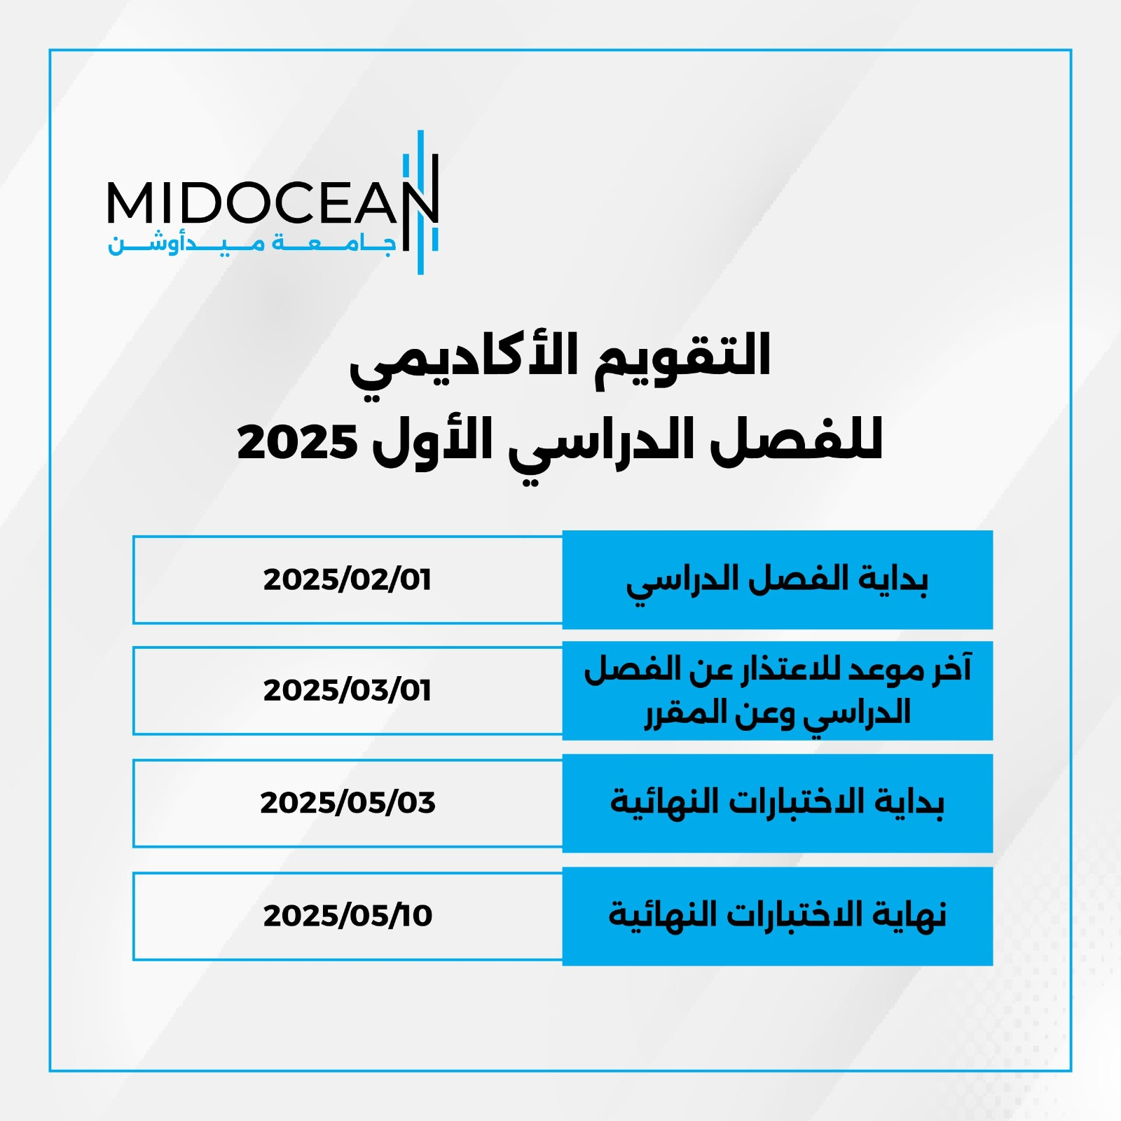

Slide 11
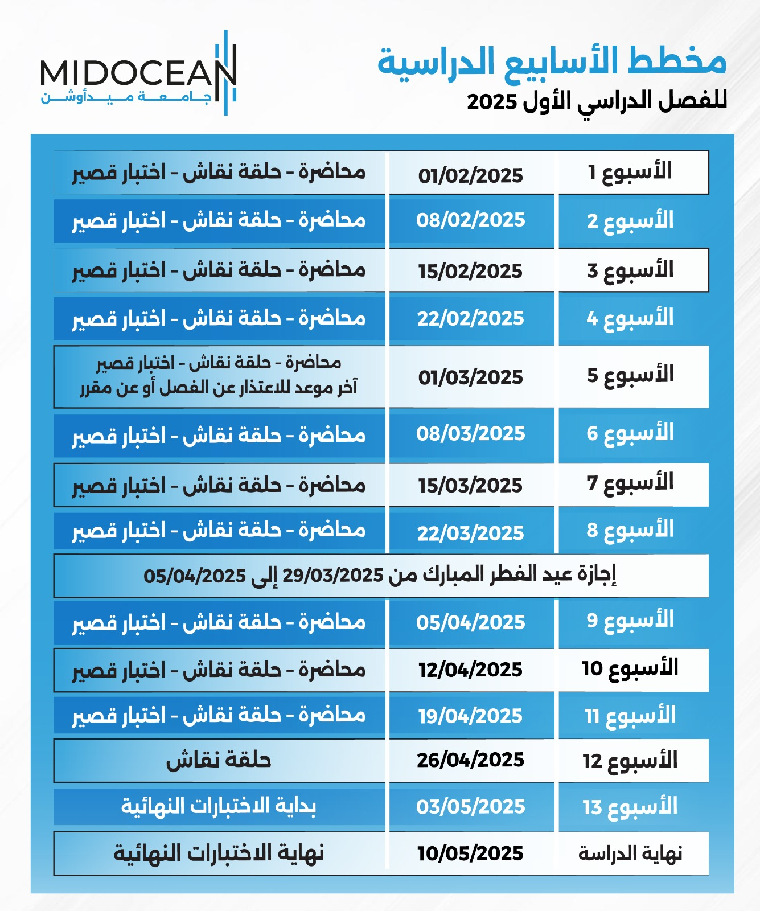

Slide 12

Live Discussion
Wednesday (6:30 - 7:30)
www.midocean.ae

Slide 13


Thank You

