Slide 1


Accounting for Managers
Prepared by Dr. Emad Zaher
Assistant Professor of Accounting
MGM341
Lecture (7)
Budgetary Planning

Slide 2

Budgetary Planning
  Learning Objectives
  LO 1 State the budget concept , benefits ,and the components of the master budget.
  LO 2 Prepare budgets for sales, production, and direct materials.
  LO 3 Prepare budgets for direct labor, manufacturing overhead , and and selling and administrative expenses.
LO 4 Prepare a cash budget
LO 5 Apply budgeting principles to non-manufacturing companies.
Prepared by Dr. Emad Zaher

Slide 3
Effective Budgeting and the Master Budget
Budget: a formal written statement of management’s plans for a specified future time period, expressed in financial terms.
  Primary method of communicating agreed-upon objectives throughout the organization.
  Promotes efficiency.
  Control device - important basis for performance evaluation once adopted
Prepared by Dr. Emad Zaher

Slide 4
The Benefits of Budgeting
  Primary benefits of budgeting:
Requires all levels of management to plan ahead.
Provides definite objectives for evaluating performance.
Creates an early warning system for potential problems.
Facilitates coordination of activities within the business.
Results in greater management awareness of the entity’s overall operations.
It motivates personnel throughout organization to meet planned objectives.
Prepared by Dr. Emad Zaher

Slide 5
Benefits of Budgeting
Question
Which of the following is not a benefit of budgeting?
Management can plan ahead.
An early warning system is provided for potential problems.
It enables disciplinary action to be taken at every level of responsibility.
The coordination of activities is facilitated.
Prepared by Dr. Emad Zaher

Slide 6
Essentials of Effective Budgeting
  Length of the Budget Period
  May be prepared for any period of time.
  Most common - one year.
  Supplement with monthly and quarterly budgets
  Different budgets may cover different time periods.
Prepared by Dr. Emad Zaher

Slide 7
Essentials of Effective Budgeting
The Budgeting Process
  Factors considered in Sales Forecasting:
  General economic conditions
  Industry trends
  Market research studies
  Anticipated advertising and promotion
  Previous market share
  Price changes
  Technological developments
Prepared by Dr. Emad Zaher

Slide 8
The Master Budget
  Set of interrelated budgets that constitutes a plan of action for a specified time period.
  Contains two classes of budgets:
    Operating budgets.
    Financial budgets.
Individual budgets that result in the preparation of the budgeted income statement – establish goals for sales and production personnel.
Prepared by Dr. Emad Zaher

Slide 9
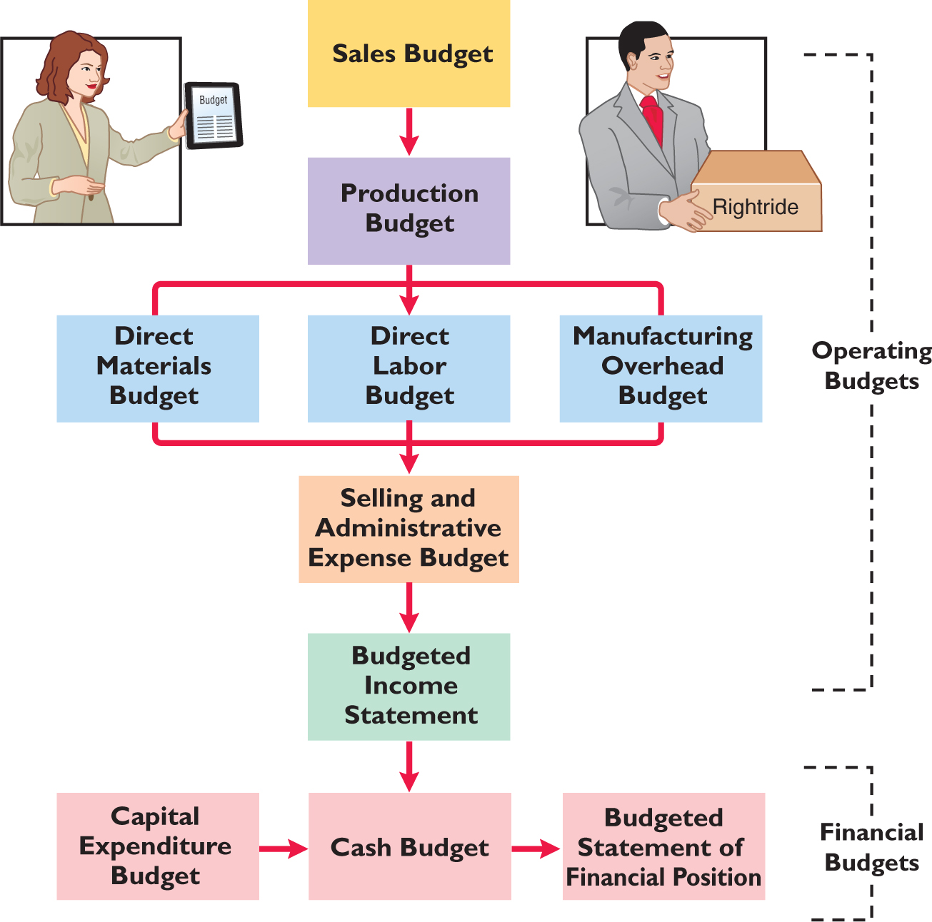
The Master Budget
Prepared by Dr. Emad Zaher

Slide 10
Sales, Production, and Direct Materials Budgets
  Sales Budget
  First budget prepared.
  Derived from sales forecast.
    Management’s best estimate of sales revenue for the budget period.
  Every other budget depends on sales budget.
  Prepared by multiplying expected unit sales volume for each product times anticipated unit selling price.
Prepared by Dr. Emad Zaher

Slide 11
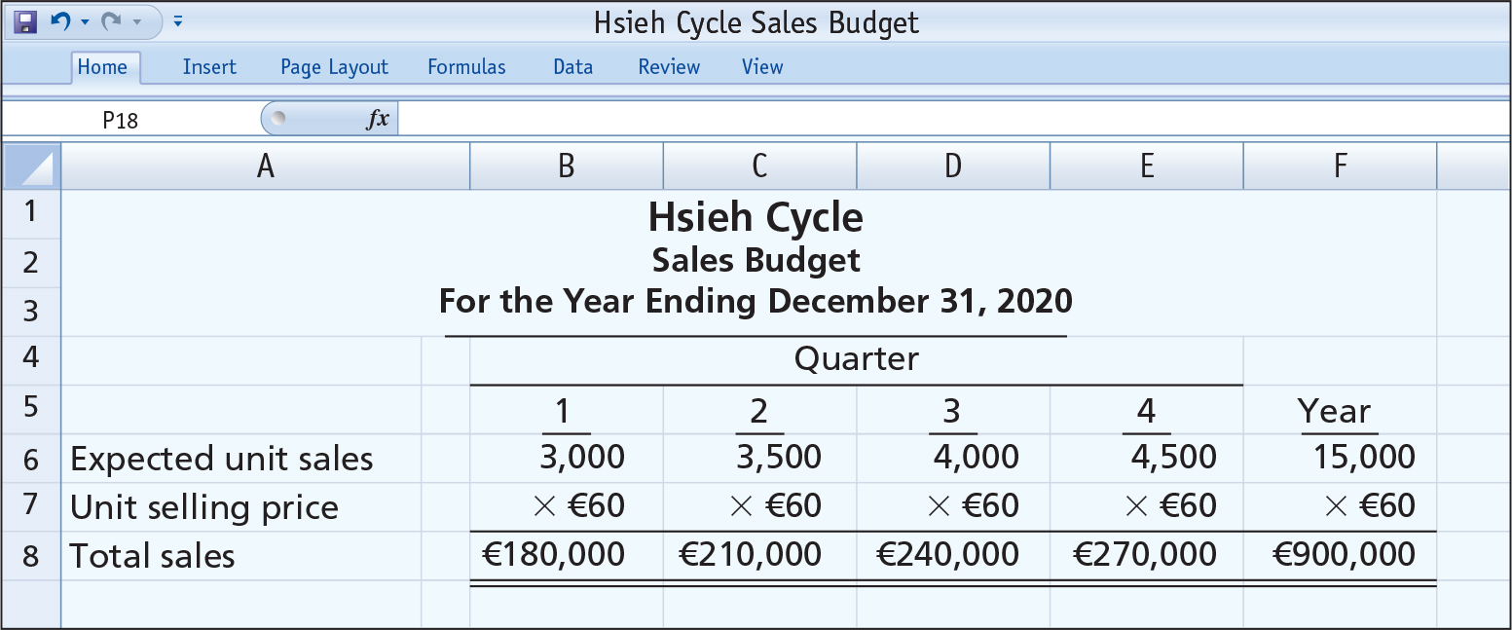
Sales Budget
  Illustration: Hsieh Cycle
  Expected sales volume: 3,000 units in the first quarter with 500-unit increases in each succeeding quarter.
  Sales price: €60 per unit.
Prepared by Dr. Emad Zaher

Slide 12
DO IT!
Karma company is preparing its master budget for 2020.Relevant data pertaining to its sales budget are as follows :
Sales for the year are expected to total 1000000 units.
Quarterly sales are 20% , 40% , 25% ,and 15% respectively.
The sales price is expected to be L.E 4 per unit for the first quarter and then be increased to L.E 6 per unit from the second quarter .
Required
Prepare the sales budget.
Prepared by Dr. Emad Zaher

Slide 13
Sales Budget:
 | Q1 | Q2 | Q3 | Q4
Expected Unit sales | 200,000 | 400,000 | 250,000 | 150,000
× | × | × | × | ×
Price per unit | 4 | 6 | 6 | 6
 | 800,000 | 2,400,000 | 1,500,000 | 900,000
Prepared by Dr. Emad Zaher

Slide 14
Production Budget
  Shows units that must be produced to meet anticipated sales.
  Derived from sales budget plus the desired change in ending finished goods inventory
  Essential to have a realistic estimate of ending inventory.
Budgeted
Sales Units
+
Desired Ending Finished Goods Units
-
Beginning Finished Goods Units
=
Required Production Units
Prepared by Dr. Emad Zaher

Slide 15
Grey Company has 50,000 units in beginning finished goods. If sales are expected to be 120,000 units for the year and Grey desires ending finished goods of 30,000 units, how many units must the company produce?
a. 100,000
b. 120,000
c. 126,000
d. 150,000
Answer (a)
Prepared by Dr. Emad Zaher

Slide 16
DO IT!
The production budget shows expected unit sales are 100,000. The required production units are 104,000. What are the beginning and desired ending finished goods units, respectively?
Beginning Units Ending Units
a. 10,000 6,000
b. 6,000 10,000
c. 4,000 10,000
d. 10,000 4,000
Answer (b)
Prepared by Dr. Emad Zaher

Slide 17
DO IT!
The following forecasts have been prepared.
 | Q1 | Q2 | Q3 | Q4
Units Sales | 120000 | 140000 | 90000 | 105000
- Prior quarter ending finished goods inventory 12000.
- Ending inventory is 10% from next quarter sales.
Required
Prepare the production budget.
Prepared by Dr. Emad Zaher

Slide 18
Production Budget
 | Q1 | Q2 | Q3 | Q4
Expected Unit sales | 120000 | 140000 | 90000 | 105000
+ Ending F.G. Inventory | 14000 | 9000 | 10500 | Zero
- Beginning F.G. Inventory | (12000) | (14000) | (9000) | (10500)
Production units | 122000 | 135000 | 91500 | 94500
Prepared by Dr. Emad Zaher

Slide 19
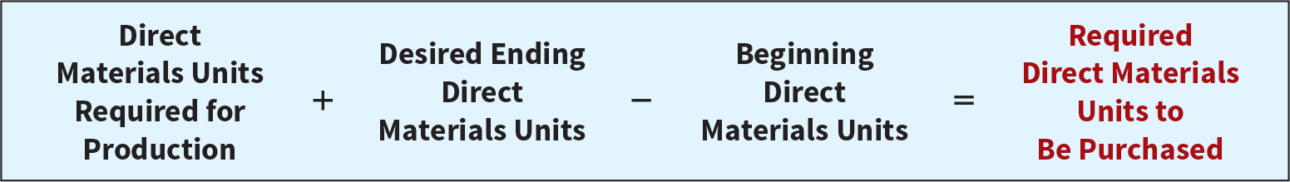
Direct Materials Budget
  Shows both the quantity and cost of direct materials to be purchased.
  Formula for direct materials quantities.
Illustration 9-6
  Budgeted cost of direct materials to be purchased = required units of direct materials x anticipated cost per unit.
  Inadequate inventories could result in temporary shutdowns of production.
Prepared by Dr. Emad Zaher

Slide 20
DO IT!
The following forecasts have been prepared
Quarter | Q1 | Q2 | Q3 | Q4
Units Sales | 121000 | 142000 | 89000 | 103500
Ending Material Inventory | 12000 | 14000 | 8000 | 6000
Needs From Material Production unit 8 unit.
Prior Quarter ending Inventory 13000
Materials cost per unit 1.2$
Required
Prepare the Direct Material budget
Prepared by Dr. Emad Zaher

Slide 21
production budget:
 | Q1 | Q2 | Q3 | Q4
Expected Unit sales | 121000 | 142000 | 89000 | 103500
+
Ending F.G. Inventory | -- | -- | -- | --
Beginning F.G. Inventory | (-) | (-) | (-) | (-)
Production units | 121000 | 142000 | 89000 | 103500
Direct material budget
, | Q1 | Q2 | Q3 | Q4
Production Unit | 121000 | 142000 | 89000 | 103500
(×)
Material Per Unit | 8 | 8 | 8 | 8
Needs From Material | 968,000 | 1,136,000 | 712,000 | 828,000
(+)
Ending Material Inventory | 12000 | 14000 | 8000 | 6000
Beginning Material inventory | (13000) | (12000) | (14000) | (8000)
Material Purchase | 967,000 | 1,138,000 | 706,000 | 826,000
(×)
cost per unit | 1.2 | 1.2 | 1.2 | 1.2
Direct Materials Purchase cost | 1160400 | 1365600 | 847200 | 991200

Slide 22
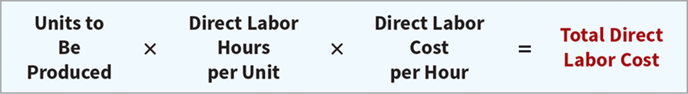
Direct Labor and Manufacturing Overhead
  Direct Labor Budget
  Shows both quantity of hours and cost of direct labor necessary to meet production requirements
  Critical in maintaining a labor force that can meet expected production
  Total direct labor cost formula:

Slide 23
DO IT!
The following forecasts have been prepared:
 | Q1 | Q2 | Q3 | Q4
Production unit | 60,000 | 30,000 | 45,000 | 75,000
  Each unit requires 2 hours .
  Direct labor cost per hour 10 $
Required
Prepare direct labor budget
Prepared by Dr. Emad Zaher

Slide 24
Direct labor budget:
Quarter | Q1 | Q2 | Q3 | Q4
Production Unit | 60000 | 30000 | 45000 | 75000
(×) | × | × | × | ×
Needed labor/ hour | 2 | 2 | 2 | 2
Total hours needed | 120000 | 60000 | 90000 | 145000
(×) | × | × | × | ×
Rate per hour | 10 | 10 | 10 | 10
Total Labor cost | 1200000 | 600000 | 900000 | 1450000
Prepared by Dr. Emad Zaher

Slide 25
Pell Manufacturing is preparing its direct labor budget for May. Projections for the month are that 33,400 units are to be produced and that direct labor time is three hours per unit. If the labor cost per hour is $12, what is the total budgeted direct labor cost for May?
a. 1,159,200.
b. 1,180,800.
c. 1,202,400.
d. 1,296,000.
Answer (c)
Prepared by Dr. Emad Zaher

Slide 26
Manufacturing Overhead Budget
  Shows the expected manufacturing overhead costs for the budget period.
  Distinguishes between fixed and variable overhead costs.
Prepared by Dr. Emad Zaher

Slide 27
DO IT!
The following forecasts have been prepared
 | Q1 | Q2 | Q3 | Q4
Production unit | 121000 | 142000 | 89000 | 103500
Direct labor time per unit 1.5
Direct labor cost per hour 18.5 $
Variable over rate $ 4/ Direct labor hour.
Fixed over head 120000 / quarter
Depreciation 25000/ quarter
Required:
Prepare the needed Budgets
Prepared by Dr. Emad Zaher

Slide 28
Direct labor budget
Quarter | Q1 | Q2 | Q3 | Q4
Production Unit | 121000 | 142000 | 89000 | 103500
(×) | × | × | × | ×
Needed labor/ hour | 1.5 | 1.5 | 1.5 | 1.5
Total hours needed | 181500 | 213000 | 133500 | 155250
(×) | × | × | × | ×
Rate per hour | 18.5 | 18.5 | 18.5 | 18.5
Total Labor cost | 3,357,750 | 3940500 | 2469750 | 2872125
Factory overhead budget:
Quarter | Q1 | Q2 | Q3 | Q4
Direct labor hours | 181,500 | 213,000 | 133,500 | 155,250
(×)
Variable overhead rate | 4 | 4 | 4 | 4
Variable overhead cost | 726,000 | 852,000 | 534,000 | 621,000
(+)
Fixed overhead cost | 120000 | 120000 | 120000 | 120000
Total Factory overhead cost | 846,000 | 972,000 | 654,000 | 741,000
(-)
Deprecations | (25000) | (25000) | (25000) | (25000)
Cash Payments | 821,000 | 947,000 | 629,000 | 716,000

Slide 29
Cash Budget
  Cash Budget
  Shows anticipated cash flows.
  Often considered to be the most important output in preparing financial budgets.
  Contains three sections:
    Cash Receipts
    Cash Disbursements
    Financing
  Shows beginning and ending cash balances.

Slide 30
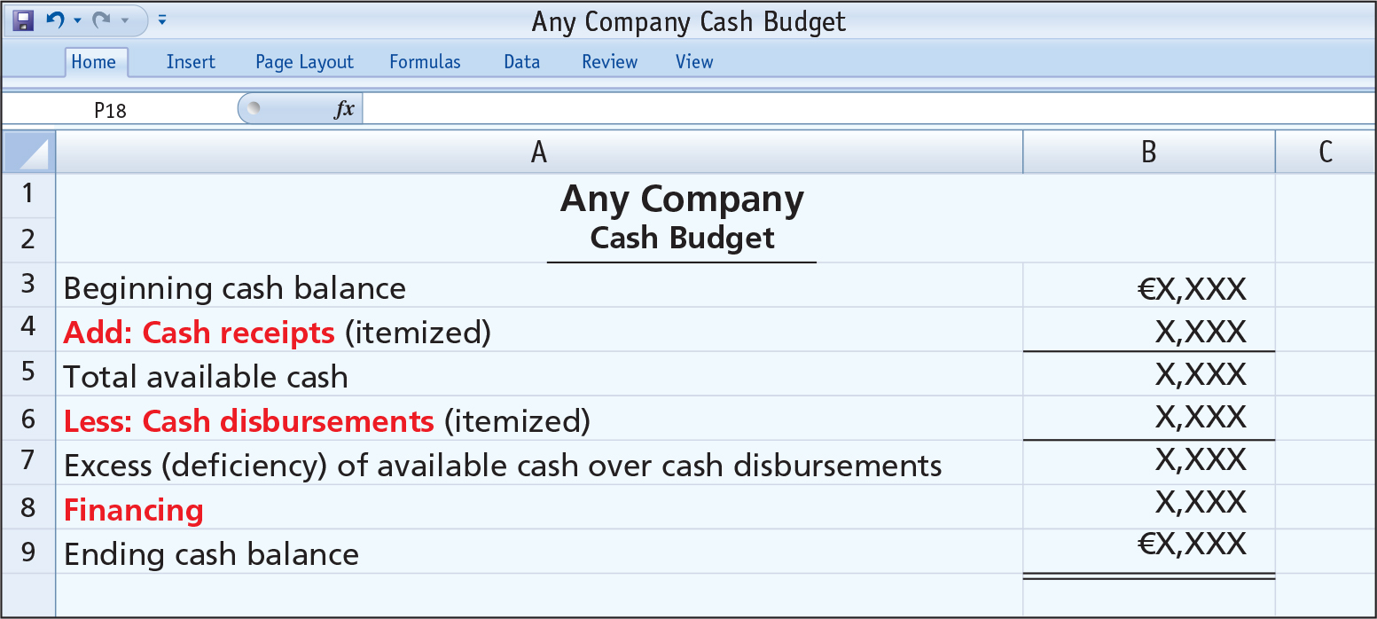
Cash Budget

Slide 31
Cash Budget
  Cash Receipts Section
    Expected receipts from the principal sources of revenue.
    Expected interest and dividends receipts, proceeds from planned sales of investments, plant assets, and the company’s share capital.
  Cash Disbursements Section
    Expected cash payments for direct materials, direct labor, manufacturing overhead, and selling and administrative expense
  Financing Section
    Expected borrowings and repayments of borrowed funds plus interest.

Slide 32
Cash Budget
  Must prepare in sequence.
  Ending cash balance of one period is beginning cash balance for next.
  Data obtained from other budgets and from management.
  Often prepared for the year on a monthly basis.
  Contributes to more effective cash management.
  Shows managers the need for additional financing before actual need arises.
  Indicates when excess cash will be available.

Slide 33
DO IT!
Zaher corporation has gathered the following information:
May 30 ending cash balance | L.E 45000
Dividends paid in June | L.E 12000
Cash expenditure in June of operating exp. | L.E 36800
Depreciation expense in June | L.E 4500
Cash collection in June | L.E 89000
Merchandise purchases paid in cash | L.E 56200
Purchase equipment for cash | L.E 17500
Zaher corporation desires to keep minimum cash balance of L.E 10.000
Required
Prepare a cash budget for June and indicate whether zaher company meets minimum cash requirements.
Prepared by Dr. Emad Zaher

Slide 34
Beginning cash balance | 45000
+
Cash collection | 89000
Total cash available (A) | 134000
Cash disbursements
Merchandise purchases | (56200)
Operating expenses | (36800)
Equipment purchase | (17500)
Payment of dividends | (12000)
Total cash disbursement (B) | 122500
Minimum cash balance | 10.000
Total cash needed (C) | (132500)
Surplus (A – C) | 1500
Prepared by Dr. Emad Zaher

Slide 35
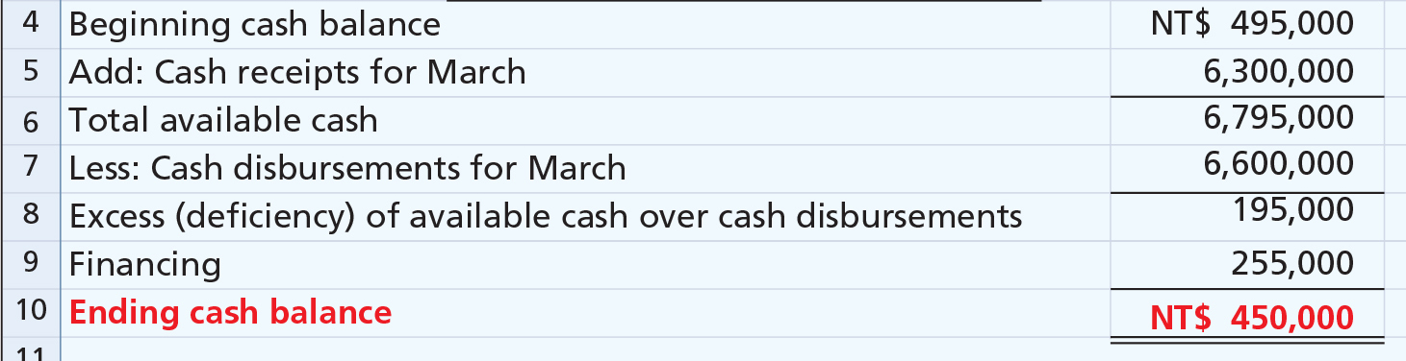
DO IT! 4 Cash Budget
Tviw Ltd. management wants to maintain a minimum monthly cash balance of NT$450,000. At the beginning of March, the cash balance is NT$495,000, expected cash receipts for March are NT$6,300,000, and cash disbursements are expected to be NT$6,600,000. How much cash, if any, must be borrowed to maintain the desired minimum monthly balance?

Slide 36
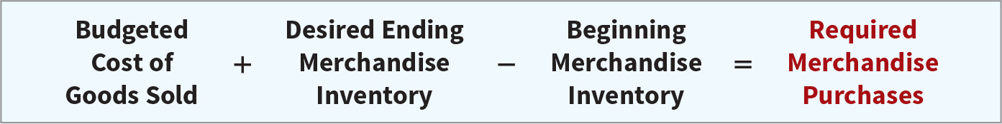
Budgeting in Non-Manufacturing Companies
Merchandisers
Sales Budget: starting point and key factor in developing the master budget.
Use a purchases budget instead of a production budget.
Does not use the manufacturing budgets (direct materials, direct labor, manufacturing overhead).
To determine budgeted merchandise purchases:

Slide 37
DO IT!
1. The direct materials budget must be completed before the production budget because the quantity of materials available for production must be known.
False
2. Financial budgets must be completed before the operating budgets can be prepared.
False
3. A budget can be used as a basis for evaluating performance.
True
4. A budget is a formal written statement of management’s plans for a specified future time period, expressed in financial terms.
True
Prepared by Dr. Emad Zaher

Slide 38
5. Cash Disbursements Section in the cash budget shows the expected cash payments for direct materials, direct labor , manufacturing overhead, and selling and administrative expense.
True
6. In the cash budget cash surplus is computed by subtracting total cash available minus total cash needed.
True
Prepared by Dr. Emad Zaher

Slide 39



Thank You

