Slide 1



Discrete Mathematics
Dr. Shahira Ahmed
IT241
Lecture 5

Slide 2



Discrete Mathematics
Lecture 5
Graphs & Trees
www.midocean.ae

Slide 3

Lecture Outline
Models of Graph
Special Types of Simple Graph
Connectivity
Paths vs walk
Cycle vs circuit
Introduction to Trees
www.midocean.ae

Slide 4
Models of Graphs
Graph theory can be used in models of:
  Social networks
  Communications networks
  Information networks
  Software design
  Transportation networks
  Biological networks
It’s a challenge to find a subject to which graph theory has not yet been applied. Can you find an area without applications of graph theory?

Slide 5
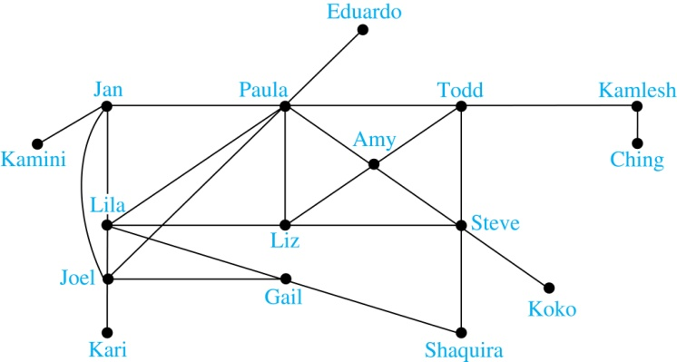
Models of Graphs
Facebook Friendship graphs - undirected graphs where two people are connected if they are friends. Facebook model their users as a graph in which each vertex is a user profile. The edge between two persons is the fact that they are friends.

Slide 6
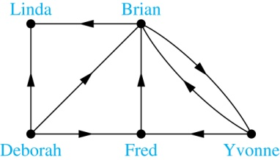
Models of Graphs
Twitter is Directed graph- You follow the university account on Twitter, but the institution may not follow you back.

Slide 7
Models of Graphs
World Wide Web : In a web graph, web pages are represented by vertices and links are represented by directed edges.

Slide 8
Models of Graphs
Airline networks can be modeled using directed multigraphs where
  airports are represented by vertices
  each flight is represented by a directed edge from the vertex representing the departure airport to the vertex representing the destination airport
Road networks can be modeled using graphs where
  vertices represent intersections and edges represent roads.
  undirected edges represent two-way roads and directed edges represent one-way roads.

Slide 9
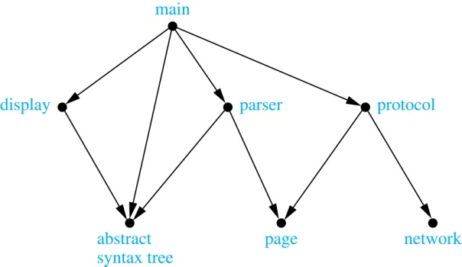
Models of Graphsللاطلاع فقط
The dependency between the modules of a software application.
Example: The dependencies between the seven modules in the design of a web browser are represented by this module dependency graph.

Slide 10
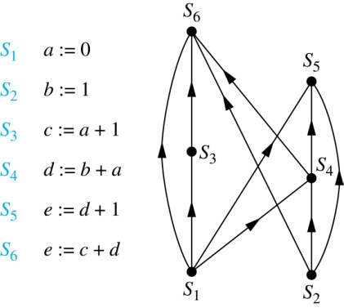
Models of Graphsللاطلاع فقط
Precedence graph : Precedence of statement
  Vertices represent statements in a computer program
  There is a directed edge from a vertex to a second vertex if the second vertex cannot be executed before the first

Slide 11
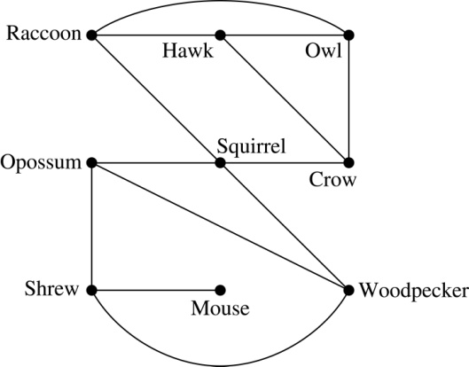
Models of Graphsللاطلاع فقط
Graph models are used extensively in many areas of the biological science.
Niche overlap graphs model competition between species in an ecosystem
  Vertices represent species and an edge connects two vertices when they represent species who compete for food resources.
Example: This is the niche overlap graph for a forest ecosystem with nine species.

Slide 12
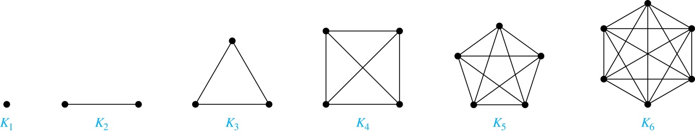
Special Types of Simple Graphs: Complete Graphs
A complete graph on n vertices, denoted by K_{n}, is the simple graph that contains exactly one edge between each pair of distinct vertices.

Slide 13
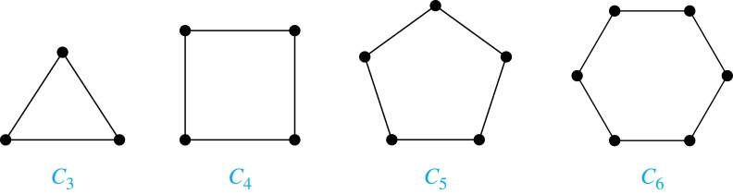
Special Types of Simple Graphs: Cycles
A cycle C_{n} for n ≥ 3 consists of n vertices v₁, v₂ ,⋯ , v_{n}, and edges {v₁, v₂}, {v₂, v₃} ,⋯ , {v_{n-1}, v_{n}}, {v_{n}, v₁}.

Slide 14
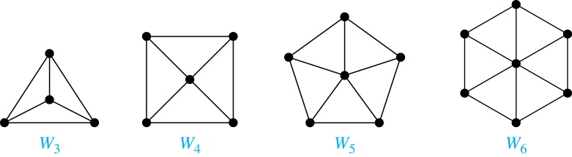
Special Types of Simple Graphs: Wheels
A wheel W_{n} is obtained by
adding an additional vertex to a cycle C_{n} for n ≥ 3
connecting this new vertex to each of the n vertices in C_{n} by new edges.

Slide 15
Special Types of Simple Graphs: n-Cubes
An n-dimensional hypercube, or n-cube, Q_{n}, is a graph with 2^{n} vertices representing all bit strings of length n, where there is an edge between two vertices that differ in exactly one bit position.

Slide 16
Special Types of Simple Graphs: n-Cubes
An n-dimensional hypercube, or n-cube, Q_{n}, is a graph with 2^{n} vertices representing all bit strings of length n, where there is an edge between two vertices that differ in exactly one bit position.

Slide 17
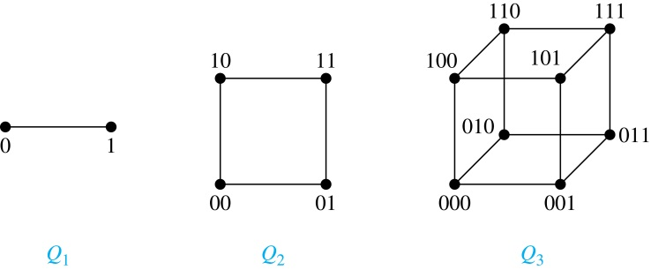
Special Types of Simple Graphs: n-Cubes
An n-dimensional hypercube, or n-cube, Q_{n}, is a graph with 2^{n} vertices representing all bit strings of length n, where there is an edge between two vertices that differ in exactly one bit position.

Slide 18
Special Types of Simple Graphs: n-Cubes
An n-dimensional hypercube, or n-cube, Q_{n}, is a graph with 2^{n} vertices representing all bit strings of length n, where there is an edge between two vertices that differ in exactly one bit position.
Note that you can construct the (n + 1)-cube Qn+1 from the n-cube Qn by making two copies of Qn, prefacing the labels on the vertices with a 0 in one copy of Qn and with a 1 in the other copy of Qn, and adding edges connecting two vertices that have labels differing only in the first bit.

Slide 19
Bipartite Graphs
Definition: A simple graph G is bipartite if V can be partitioned into two disjoint subsets V₁ and V₂ such that every edge connects a vertex in V₁ and a vertex in V₂. In other words, there are no edges which connect two vertices in V₁ or in V₂.
v₁
v₄
v₂
v₅
v₃
v₆
V₁
V₂

Slide 20
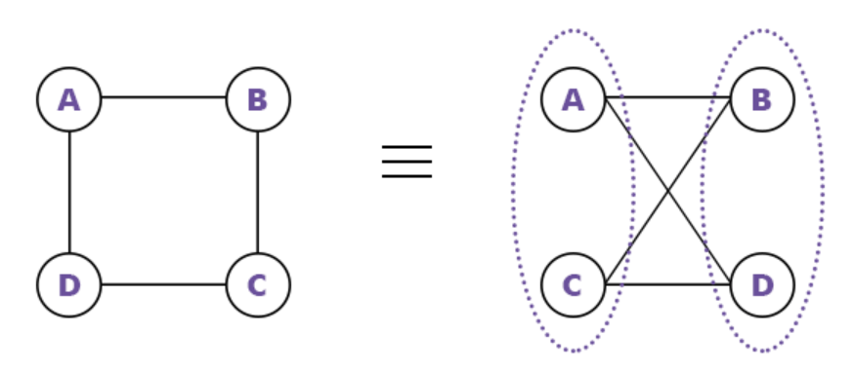
Bipartite Graphs

Slide 21
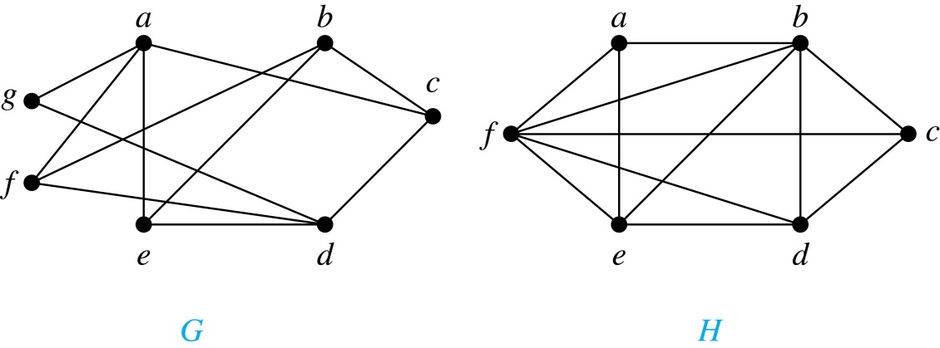
Quiz
The following graph is bipartite?
G is bipartite

Slide 22
Quiz
The following graph is bipartite?
H is not bipartite

Slide 23
Bipartite Graphs
a bipartite graph is a graph where it is possible to color the vertices red or blue so that no two adjacent vertices are the same color.
H is not bipartite
since if we color a red, then the adjacent vertices f and b must both be blue.
G is bipartite

Slide 24
Quiz
Show that C₆ is bipartite.

Slide 25
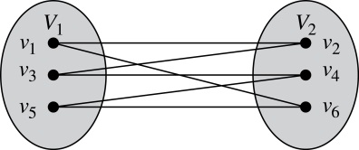
Quiz
Example: Show that C₆ is bipartite.
Solution: We can partition the vertex set into V₁ = {v₁, v₃, v₅} and V₂ = {v₂, v₄, v₆} so that every edge of C₆ connects a vertex in V₁ and V₂ .

Slide 26
Quiz
Example: Show that C₃ is not bipartite.

Slide 27
Quiz
Example: Show that C₃ is not bipartite.
Solution: the two vertices in the same partition are connected. Hence, C₃ is not bipartite.

Slide 28
Complete Bipartite Graphs
Definition: A complete bipartite graph K_{m,n} is a graph that has its vertex set partitioned into two subsets V₁ of size m and V₂ of size n such that there is an edge from every vertex in V₁ to every vertex in V₂.

Slide 29
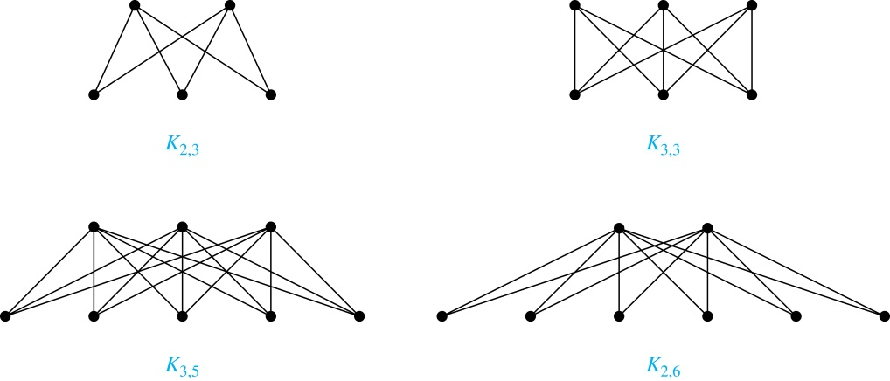
Complete Bipartite Graphs
Example: We display four complete bipartite graphs here.

Slide 30
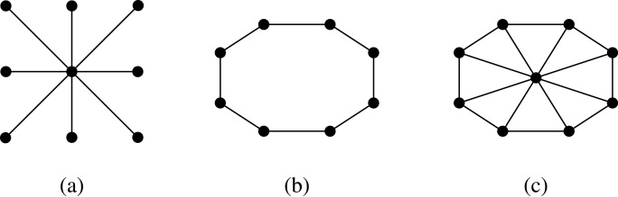
Special Types of Graphs and Computer Network Architecture
Various special graphs play an important role in the design of computer networks.
Some local area networks use a star topology, which is a complete bipartite graph K_{1,n .}All devices are connected to a central control device.

Slide 31
Special Types of Graphs and Computer Network Architecture
Various special graphs play an important role in the design of computer networks.
Other local networks are based on a ring topology, where each device is connected to exactly two others using C_{n .}

Slide 32
Special Types of Graphs and Computer Network Architecture
Various special graphs play an important role in the design of computer networks.
use a W_{n} – based topology, combining the features of a star topology and a ring topology.

Slide 33
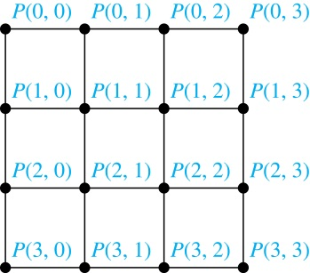
Special Types of Graphs and Computer Network Architecture
Various special graphs also play a role in parallel processing where processors need to be interconnected as one processor may need the output generated by another.
  The n-dimensional hypercube, or n-cube, Q_{n}, is a common way to connect processors in parallel, e.g., Intel Hypercube.
  Another common method is the mesh network for 16 processors.

Slide 34
Applications of bipartite graph
Matching Problem
Job Assignment Problem
Workers
Boys
Girls
Jobs

Slide 35
Connectivity
Basic Idea: In a Graph Reachability among vertices by traversing the edges
Application Example:
  In a city to city road-network, if one city can be reached from another city.
  whether a message can be sent between two computers.
  efficiently planning routes for mail delivery.

Slide 36
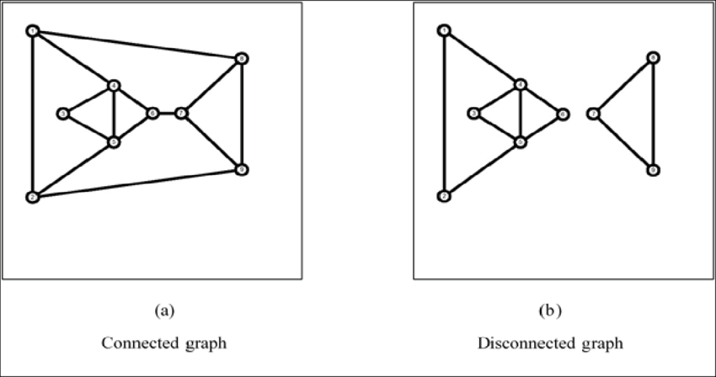
Connectivity

Slide 37
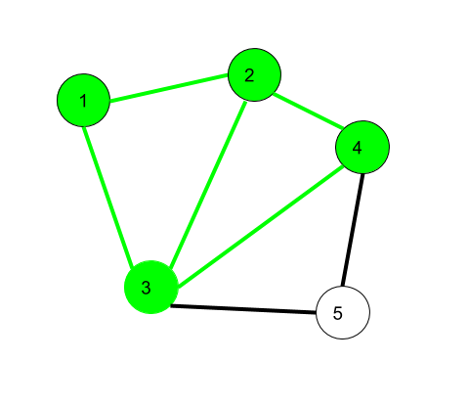
Walk
A walk is a sequence of vertices and edges of a graph i.e. if we traverse a graph then we get a walk.
Edge and Vertices both can be repeated.
  1,2,3,4,2,1,3 is a walk.

Slide 38
Walk
Open walk: A walk is said to be an open walk if the starting and ending vertices are different.
Closed walk: A walk is said to be a closed walk if the starting and ending vertices are the same.
  1,2,3,4,5,3 is an open walk.
  1,2,3,4,5,3,1 is a closed walk.

Slide 39
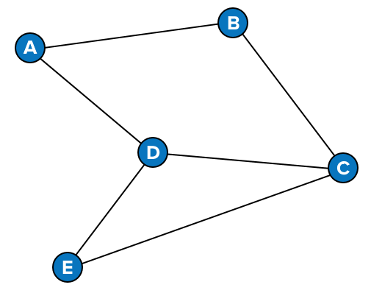
Quiz
Choose (open walk-closed walk-not a walk)
  A,B,E,A,B,D
  A,D,C,B,A
  A,B,C
Solution
  not a walk
  Closed walk
  Open walk

Slide 40
Trails and circuits
Walk with no repeated edge
Closed trail (also called a circuit)

Slide 41
Simple Path
trail with no repeated vertex
Closed path (also called a Cycle)

Slide 42
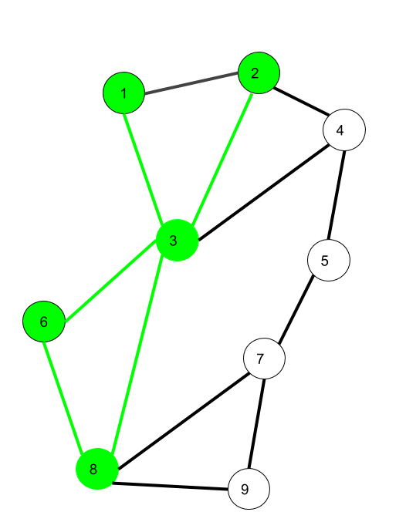
Quiz
Choose (open trail-circuit-a walk)
  1,3,6,8,3,1
  1,3,8,6,3,2
  1,3,8,6,3,2,1
Solution
  Walk
  Open trail
  Closed trail (circuit)

Slide 43
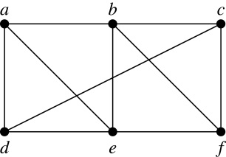
Quiz
Determine if a path, circuit simple or not
  a, d, c, f, e
  d, e, c, a.
  b, c, f, e, b
  a, b, e, d, a, b
  a, d, c, f, e is a simple path of length 4.
  d, e, c, a is not a path because e is not connected to c.
  b, c, f, e, b is a cycle of length 4.
  a, b, e, d, a, b is a walk.

Slide 44
Wal vs trail vs path
Walk
Trail
Path
Closed Walk
Closed Trail
(Circuits)
Closed path(Cycle)

Slide 45
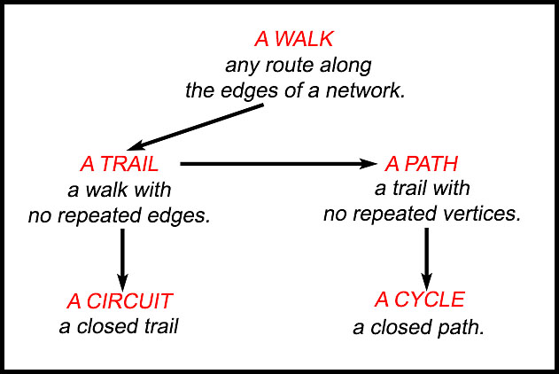
Walk vs Trail vs Path
https://drjsmaths.com/Forms/Networks%20&%20Graph%20Theory/Networks%20-%20Walks,%20paths,%20cycles%20-%20TYS%201.html

Slide 46
Quiz
  Choose(path,cycle,walk)
  a, d, c, b, e
  a, b, e, d, c, b, e, d
  a, d, c, b, e, a
  Solution
    a, d, c, b, e) is a path
    (a, b, e, d, c, b, e, d) is not a path; it is a walk.
    a, d, c, b, e, a) is a cycle
a
b
c
e
d

Slide 47
Euler Paths and Circuits (continued)
Definition: An Euler circuit in a graph G is a simple circuit containing every edge of G.
An Euler path in G is a simple path containing every edge of G.

Slide 48
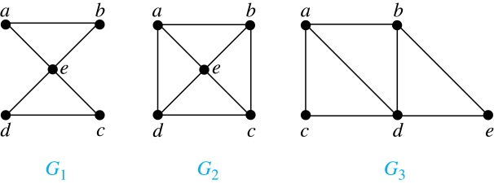
Euler Paths and Circuits (continued)
Example: Which of the undirected graphs G₁, G₂, and G₃ has a Euler circuit?
The graph G_{1 (e.g., a, e, c, d, e, b, a)}

Slide 49
Euler Paths and Circuits (continued)
Example: Which of the undirected graphs G₁, G₂, and G₃ has a Euler path?
The graph G3 (e.g., a, c, d, e, b, d, a, b),

Slide 50
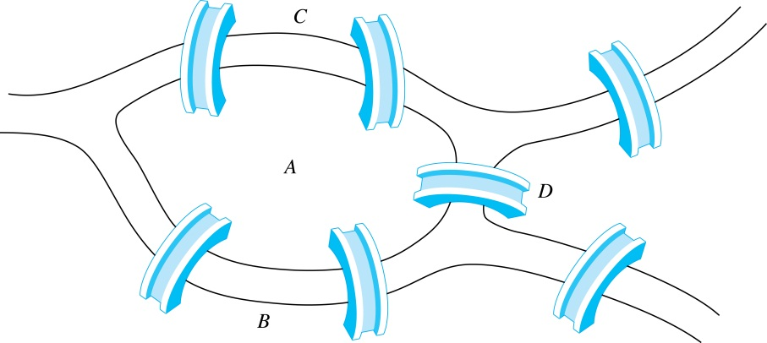
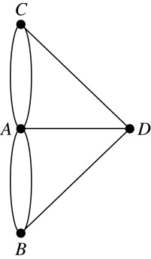
Euler Paths and Circuits
The town of Kӧnigsberg, Prussia (now Kalingrad, Russia) was divided into four sections by the branches of the Pregel river. In the 18th century seven bridges connected these regions.
People wondered whether whether it was possible to follow a path that crosses each bridge exactly once and returns to the starting point.
The Swiss mathematician Leonard Euler proved that no such path exists. This result is often considered to be the first theorem ever proved in graph theory.
Multigraph Model of the Bridges of Kӧnigsberg
The 7 Bridges of Kӧnigsberg

Slide 51
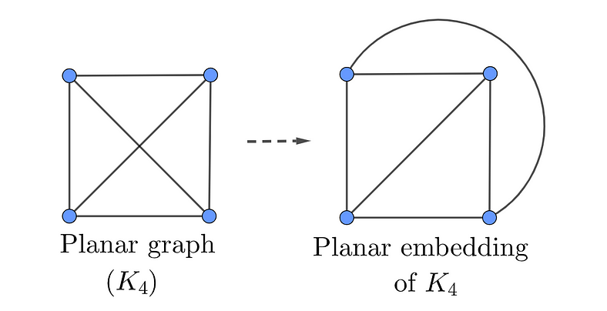
Planar Graphs
A graph (or multigraph) G is called planar if G can be drawn in the plane with its edges intersecting only at vertices of G, such a drawing of G is called an embedding of G in the plane.
Application Example: VLSI design (overlapping edges requires extra layers), Circuit design (cannot overlap wires on board)

Slide 52
Planar Graphs
Representation examples: K_{3,3} is Nonplanar
v₁
v₂
v₃
v₁
v₅
v₁
v₅
R₂₁
R₂
R₁
R₁
R₂₂
v₃
v₄
v₅
v₆
v₄
v₂
v₄
v₂

Slide 53
Graph Coloring Problem
Graph coloring is an assignment of "colors", almost always taken to be consecutive integers starting from 1 without loss of generality, to certain objects in a graph. Such objects can be vertices, edges, faces, or a mixture of the above.
Application examples: scheduling, register allocation in a microprocessor, frequency assignment in mobile radios, and pattern matching

Slide 54
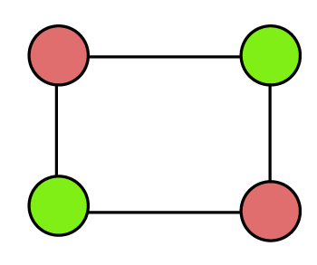
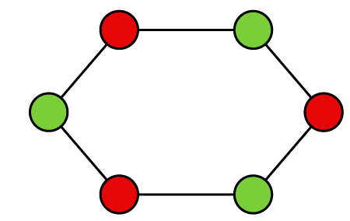
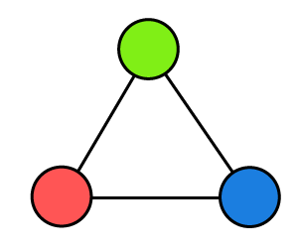



Vertex Coloring Problem
Assignment of colors to the vertices of the graph such that proper coloring takes place (no two adjacent vertices are assigned the same color)
Chromatic number: least number of colors needed to color the graph
$\text{Chromatic} \text{number}$=3
$\text{Chromatic} \text{number}$=2
$\text{Chromatic} \text{number}$=2

Slide 55
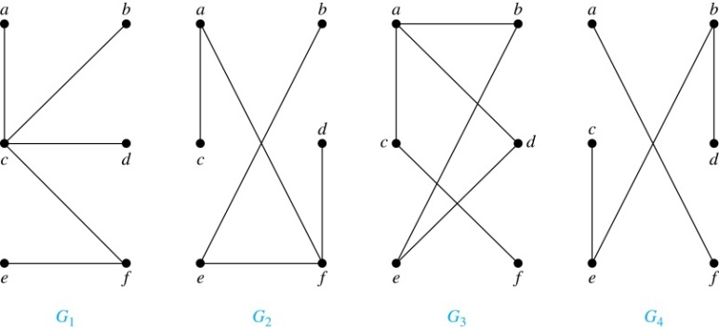
Trees
Definition: A tree is a connected undirected graph with no simple circuits.
Example: Which of these graphs are trees?

Slide 56
Trees
Example: Which of these graphs are trees?
Solution: G₁ and G₂ are trees - both are connected and have no simple circuits
Because e, b, a, d, e is a simple circuit, G₃ is not a tree.
Notes:
e, b, a, d, e

Slide 57
Tree Terminology
a is the parent of b,
` b is the child of a,
c, d, e are siblings,
c, e, f, g are leaves
a
b
d
c
e
f
g

Slide 58
Recap

Slide 59
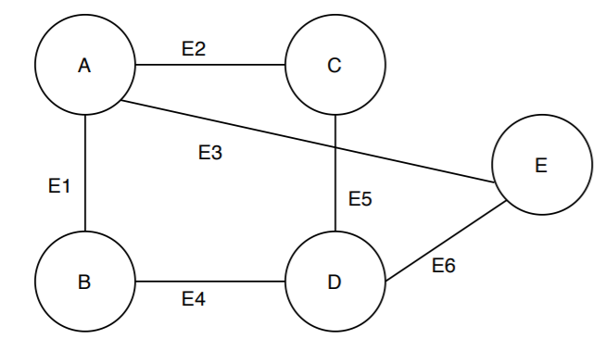
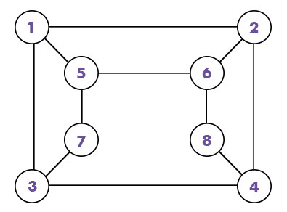
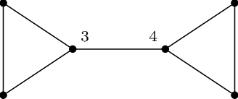
Quiz
Bipartite graph ?

Slide 60
Quiz
Bipartite graph ?
True
True
False

Slide 61
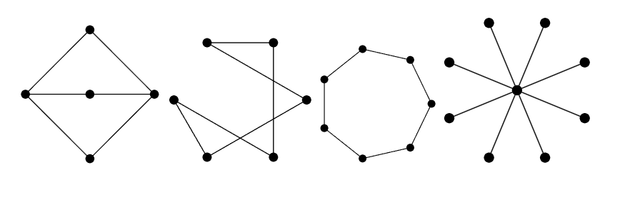
Quiz
Bipartite graph ?

Slide 62
Quiz
Bipartite graph ?
True
True
False
True

Slide 63
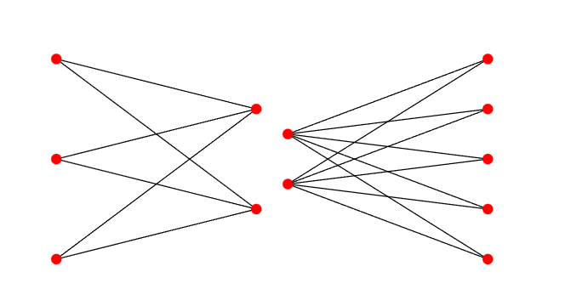
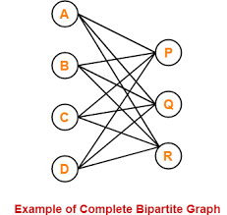
Quiz
Bipartite graph ?
True
True
True

Slide 64
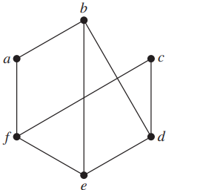
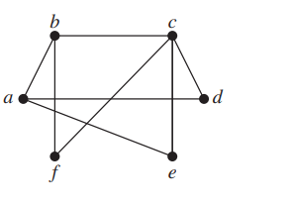
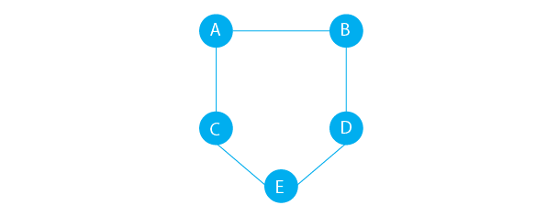
Quiz
Bipartite graph ?
False
False
False

Slide 65
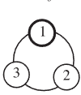
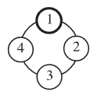
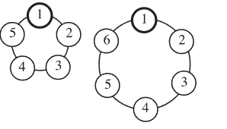
Quiz
Cycle or wheel or complete graph?
Cycle

Slide 66
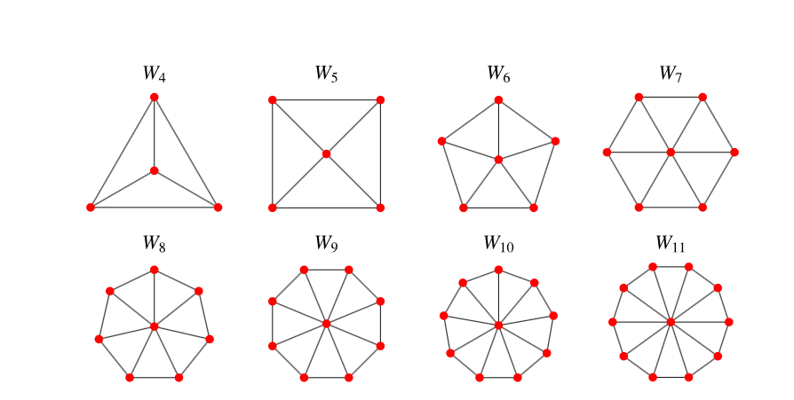
Quiz
Cycle or wheel or complete graph?
Wheel

Slide 67
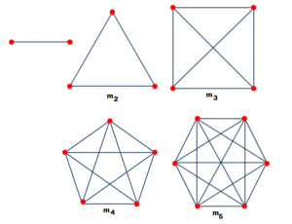
Quiz
Cycle or wheel or complete graph?
A complete graph is a graph in which every vertex has an edge to all other vertices

Slide 68
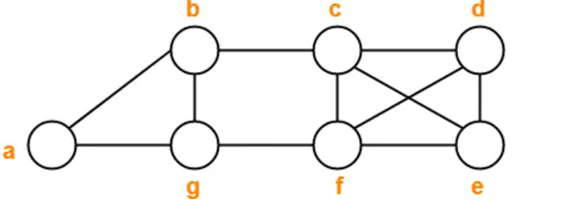
Quiz
Walk, circuit, a path, a cycle or a trail?
  a , b , g , f , c , b
  b , g , f , c , b , g , a
  c , e , f , c
  c , e , f , c , e
  a , b , f , a
  f , d , e , c , b
Trail
Walk
Cycle
Walk
Not a walk
Path
Notes:
Trail
Walk
Cycle
Walk
Not a walk
Path

Slide 69
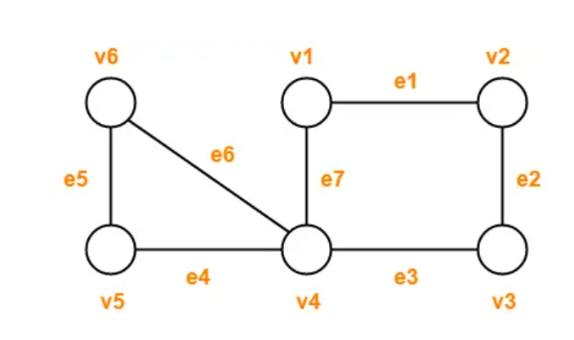
Quiz
Walk, circuit, a path, a cycle or a trail?
  v1v2v3v2
  v4v1v2v3v4v5
  v1v2v3v4v5
  v1v2v3v4v1
  v6v5v4v3v2v1v4v6
Open walk
Trail
Path
Cycle
Circuit
Notes:
Open walk
Trail (Not a path because vertex v4 is repeated)
Path
Cycle
Circuit (Not a cycle because vertex v4 is repeated)

Slide 70
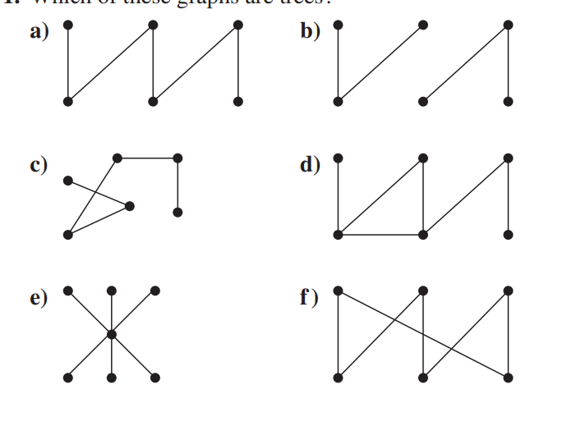
Which of these graphs are trees?
a,e,c

Slide 71
Quiz
A complete graph on n vertices, denoted by K_{n}, is the simple graph that contains exactly --------- edge between each pair of distinct vertices.
Close Path called
Closed trail called
Facebook Friendship graphs - ----------graphs
Twitter is ----------graph-
World Wide Web : In a web graph, web pages are represented by vertices and links are represented by ------------ edges.
An Euler circuit in a graph G is a simple circuit containing --- edge of G.
An Euler path in G is a simple path containing -- edge of G.

Slide 72
One
Cycle
Circuit
Undirected
Directed
Directed
Every
Every

Slide 73
Quiz
wheel is obtained by -------an additional vertex to a cycle Cn for n ≥ ---
A trail is a walk where ------------ edge is repeated.
An open trail starts and ends on ------------- vertices.
A closed trail (circuit) starts and ends on the ---------------------vertex.
Path --------repeated edge ,---------------repeated vertices
Trail--------repeated edge ,---------------repeated vertices
Walk --------repeated edge ,---------------repeated verticese of G.
A tree is a connected undirected graph with ----------- simple circuits.
A planer graph (or multigraph) G is called planar if G can be drawn in the plane with its edges intersecting only at ------------

Slide 74
Quiz
Add,3
no.
different
A same
No No
No has
has has .
no.
vertices

