Slide 1

Global Project Management
Lecture 10
Everyone’s Smart
University
PMG 661
Collaborative Project Management software

Slide 2

Collaborative Project Management software
Collaborative project management software is the technology platform that provides global project managers and project office administrators with the automated tools to create the project management plan, to monitor the execution of the deliverables, to control the issues, risks, quality, cost and time and to obtain approval for the project closure.

Slide 3
Collaborative Project Management software
Project management software is an important tool for traditional projects during processes that include calculations and diagramming techniques, such as ‘activity sequencing’, ‘activity resource estimating’, ‘schedule development’, ‘schedule control’, ‘cost estimating’ and ‘cost control’ (PMI, 2004).

Slide 4
Collaborative Project Management software
For global projects, the implementation of collaborative project management software is also essential for all processes that require effective collaboration between the project manager and the team members in different locations when defining activities, identifying and analysing risks, directing and managing project execution, monitoring progress and controlling project work.

Slide 5
Collaborative Project Management software
This lecture considers the collaborative project management software as the subset of the Project Management Information System (PMIS), which is composed of the essential tools, methods and processes that ensure successful management of global projects.

Slide 6
Collaborative Project Management software
Collaborative project management software can also help to satisfy the organisational governance requirements, by providing program managers, portfolio managers, project managers and executive stakeholders with summarised project performance measurements and consolidated metrics, simplifying the reporting preparation and information distribution activities.

Slide 7
Evaluating collaborative project management software tools
The main objectives of collaborative project management software tools are to centralize the project information (including project plan, schedule, risks, issues and cost) and create automated rules for project administration.

Slide 8
Evaluating collaborative project management software tools
These rules will trigger the distribution of project reports, remind project team members of due actions and issues, alert the project manager of imminent risks and raise the project management awareness of deviations in schedule, cost or quality. International companies can follow the steps below to evaluate the various software alternatives, and compare with the existing system:

Slide 9
Evaluating collaborative project management software tools
1. Define the main objectives of the project management software, together with the company senior management and a representative number of project managers and stakeholders from different countries. Agree on measurable success criteria for the implementation.

Slide 10
Evaluating collaborative project management software tools
2. Analyse past and ongoing global projects in a representative number of company locations, to create an inventory of the different project documents, reports and tools. This will result in a comprehensive view of the various types of project information.

Slide 11
Evaluating collaborative project management software tools
3. For each type of document, report and tool, classify the information items into mandatory, beneficial or optional.
4. Identify the main information items that can trigger alerts and require actions from the project manager or stakeholders.

Slide 12
Evaluating collaborative project management software tools
5. For each software solution being evaluated, identify the items completely or partially available.
6. Evaluate the integration of each solution with other knowledge-sharing and project management tools, such as timesheet allocation, scheduling diagrams, cost tracking mechanisms and quality assessment.

Slide 13
Evaluating collaborative project management software tools
7. Compare the percentages of information available for each PMIS solution and determine which alternative best fits the company requirements.
8. Complete this information with the items in the mind map you created at the beginning of this chapter.

Slide 14
Evaluating collaborative project management software tools
Table below provides an example of an evaluation sheet for three collaborative project management software solutions, illustrating a possible output of the steps above.
To increase the adoption of the new tool by the project team members across the globe, a survey can be prepared to gather various opinions on the software solutions being analyzed.

Slide 15
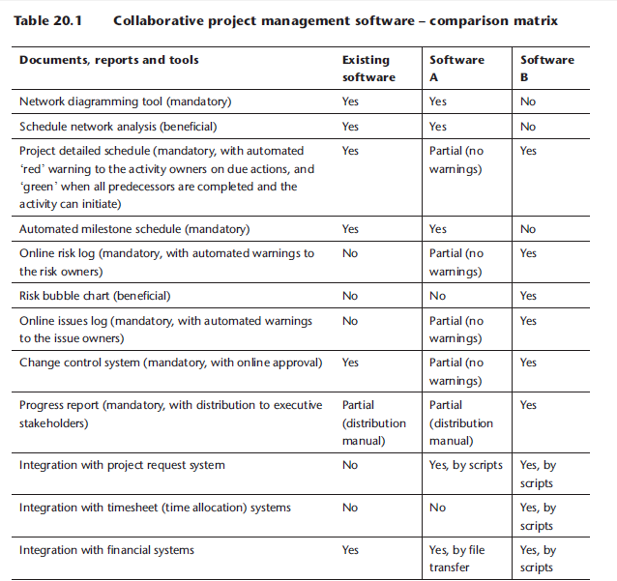

Slide 16
Evaluating collaborative project management software tools
This survey can be used to collect information on the existing software tools, providing additional criteria for the evaluation of the new solution. Table below shows an example of this survey.

Slide 17
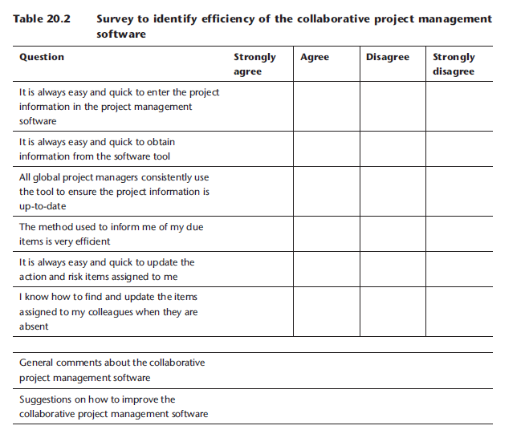

Slide 18
Defining procedures for the collaborative project management software
All global project stakeholders must know how to prepare their computers to access the collaborative project management systems (for example, by installing client software or plugins), how to obtain access to the applications (for example, by requesting user identifications, passwords or access rights) and how to use all the basic functions of the different software components.

Slide 19
Defining procedures for the collaborative project management software
The structure of the documentation might show how the various components are integrated, how the software is integrated with other company tools, how to update the information and how to extract reports and perform consolidations. You can use the checklist on Table below to produce and publish the documentation required by all project stakeholders who need to access and use the collaborative project management software.

Slide 20
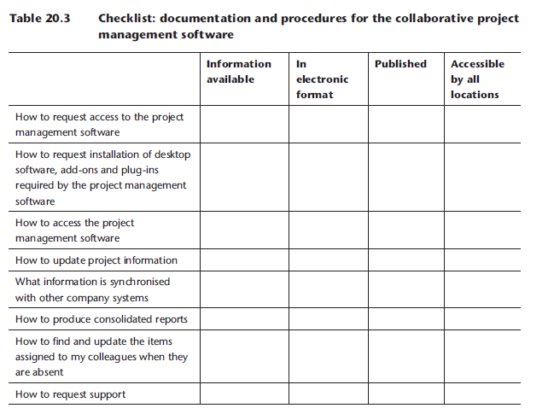

Slide 21
Implementing the new collaborative project management software
Perform a trial installation to validate whether the required functions perform as expected and allow a number of project managers and stakeholders from different countries to use the selected tool. Discuss their impressions on the ease-of-use, intuitiveness and completeness of the different alternatives.

Slide 22
Implementing the new collaborative project management software
You can use the survey (Table 20.2) to evaluate the new software and compare with the existing solution, and detect what the real improvements are, from the perspective of the project team members.

Slide 23
Evaluating the implementation
Some time after implementing the new collaborative project management software, preparing and publishing the documentation, announcing the new solution to all project team members and providing training, you may evaluate the improvements and detect if corrections are required by deploying the same assessment survey (Table 20.2)

Slide 24
Evaluating the implementation
and comparing the new results with the initial findings. The results will serve as a basis for the preparation of a strategy to correct the problems, improve the usability and increase adoption.

Slide 25
Part IV: Key concepts
There are different types of technologies that can improve collaboration during global projects: basic infrastructure (telephones, e-mails, directories and remote access tools), solutions for interactive audio and video conferencing, solutions for interactive exchange of text and images (chat and web conferencing), knowledge-sharing packages and collaborative project management software.

Slide 26
Part IV: Key concepts
The main steps to select and deploy collaborative tools for global projects are the understanding of the technological alternatives, the evaluation of existing technologies, the implementation of changes, the preparation of documentation and procedures and the post-implementation evaluation.

Slide 27
Part IV: Key concepts
Surveys can help to identify problems with the existing technologies and the lack of documentation.
Well-prepared trial periods and pilot groups are extremely helpful for the evaluation of new technologies.

Slide 28

Part IV: Further reading
Edwards, A. and Wilson, J.R. (2004) Implementing Virtual Teams: A Guide to Organizational and Human Factors The authors provide a good analysis of current and future technologies for communications in virtual teams.

Slide 29
Part IV: Further reading
Khazanchi, D. and Zigurs, I. (2006) Patterns of Effective Management of Virtual Projects: An Exploratory Study The authors present a comparison of tools for virtual collaboration and project management.

Slide 30
Part IV: Interactive section
Share your experience of collaborative tools during global projects (www. GlobalProjectManagement.org):
How did you adapt the checklists to your situation?
How did you adapt the surveys to your organization?
What is your opinion on the tools available on the market, do you have positive or negative experiences to share with other people?
Are you using a different category of tool not covered in this book? What feedback can you provide on these tools?

Slide 31
Resources:
Global Project Management
Communication, Collaboration and Management Across Borders
© Jean Binder 2007
Chapter 20

