Slide 1


English Course- Intermediate Level
Prepared by
Ahmed Soliman

Slide 2



Lecture 2
www.midocean.ae

Slide 3
Pronunciation of ED Ending
We pronounce the final ed in three ways: /t/ - /d/ - /id/
Watch the video in the next slide to know the rule
www.midocean.ae

Slide 4

www.midocean.ae

Slide 5
The Rule
voiceless + ed /t/
voiced + ed /d/
t / d + ed /id/
www.midocean.ae

Slide 6
Voiceless Sounds (no vibration): /p/ - /k/ - /f/ - /s/ - /θ/ (th) - /ʃ/ (sh) - /t/ʃ/ (ch)
Voiced Sounds (vibration): /b/ - /g/ - /l/ - /m/ - /n/ - /r/ - /v/ - /z/ - /ð/ (th) - /ʒ/ - /dʒ/
www.midocean.ae

Slide 7
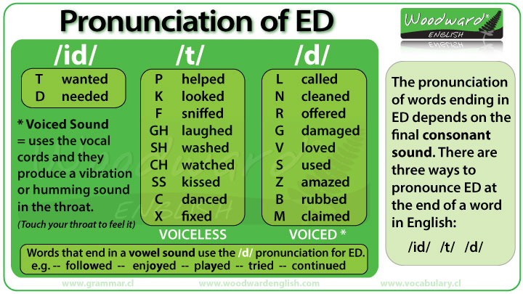
www.midocean.ae

Slide 8
Exercise: Classify the words according to their pronunciation
asked - wanted - moved - watched -helped - kissed - ended - played - missed- offered - claimed
/t/ | /d/ | /id/
asked - helped - missed - kissed- watched | moved- played- offered- claimed | wanted- ended
www.midocean.ae

Slide 9
Listening: Vocabulary and Sample Sentences
come on (idiom): used when do not believe what someone is saying
– Come on! Tuition at that college isn’t that expensive, is it?
make it (idiom): get somewhere on time
– Why didn’t you make it to class the other day?
consequence (noun): something that happens as a result of a person’s actions or choices
– My roommate has to accept the consequences of his poor grades.
blame shift (also, shift blame) (verb): transfer the responsibility of a mistake or problem from one person to another
– If you do poorly in school, don’t try to shift the blame to your roommates who play video games all night. You are responsible for your own progress.
paint yourself into a corner (idiom): do something to put yourself into a difficult situation
– Okay. So, you didn’t study, you didn’t go to class, you didn’t take things seriously, and now the school isn’t going to continue your scholarship. It looks like you’ve really painted yourself into a corner.
weasel out of something (idiom): get out of doing something
– He tried to weasel out of taking the class again by giving the teacher gifts, but it didn’t work.
www.midocean.ae

Slide 10
Listening Exercise
(Audio) https://www.esl-lab.com/academic-english/college-scholarships/
Listen to the recording and answer the questions.
1- The student couldn't take the test because the bus ____.
was lagging behind schedule
had an accident on the highway
had a hard time due to bad weather
2- He didn't make it to class because he ____.
was asleep at home
was still eating breakfast
was playing video games in bed
www.midocean.ae

Slide 11
3- If you miss a test, students _____.
can take a test with a doctor's note
cannot make up a test
can take the test at a later date
4- If the student doesn't pass the test, _____.
his girlfriend will leave him
he will quit school
his parents might get upset
www.midocean.ae

Slide 12
5- The teacher believes that students should _____.
enroll in classes early
be more responsible
get more sleep
www.midocean.ae

Slide 13
Transcript
Student: Oh, Mrs. Smith. Can I take the test now? I just . . ., oh.
Mrs. Smith: Excuse me? What do you mean? The test ended 10 minutes ago, and you weren’t there to take it. Sorry.
Student: Oh, Mrs. Smith. Come on. Come on. That’s not fair.
Mrs. Smith: What do you mean it’s not fair. Everyone else was there. So, why weren’t you in class?
Student: Uh, my bus didn’t come this morning on time. That’s why.
Mrs. Smith: Um. Are you sure? Your friend, Tony, made it to class, and he said you were still in bed an hour ago.
Student: Uhh, yeah, well, that might be true, but I really need to take the test.
Mrs. Smith: Wait. Don’t you realize that you just lied to me?
www.midocean.ae

Slide 14
Student: Uh, well, listen. Mrs. Smith. Listen. My alarm didn’t go off this morning, so it’s not my fault I came late.
Mrs. Smith: So, you’re blaming your alarm clock again? It’s still your responsibility to be here. Wasn’t that your excuse the last two times you missed class?
Student: But Mrs. Smith, Mrs. Smith.
Mrs. Smith: Listen. You know the policy of our program. If you miss a test for an unexcused reason . . . and a lie is definitely unexcused, then you get a zero on the test. There are no exceptions.
Student: Mrs. Smith. Why don’t you want to help me? You never help me. I mean I really need to pass this class.
Mrs. Smith: No, no. no. Listen to yourself. You’re playing what we call the victim. You made some bad choices, and now you have to accept the consequences. Remember: When you point your finger at someone else, like me in this case, three fingers are pointing back at you.
www.midocean.ae

Slide 15
StudeMrs.
Student: But Mrs.Smith. I lose my scholarship if I do poorly in the class; my parents will be really disappointed in me.
Mrs. Smith: I’m really sorry, but that’s not my problem. [Oh, Mrs. Smith!] I can’t help you with that. Don’t try to shift the blame here. [Mrs. Smith!] You painted yourself into a corner. You need to be accountable for your own actions instead of trying to weasel out of your responsibility. While you aren’t doing well in my class though, I must say I almost have to give you an A grade for trying to dodge the outcome of your bad choices.
Student: Mrs. Smith, Mrs. Smith.
Mrs. Smith:Listen. You are learning one thing.
Student: What?
Mrs. Smith:My name.
Student: Agh.
www.midocean.ae

Slide 16




Thank You

