Slide 1


Slide 2
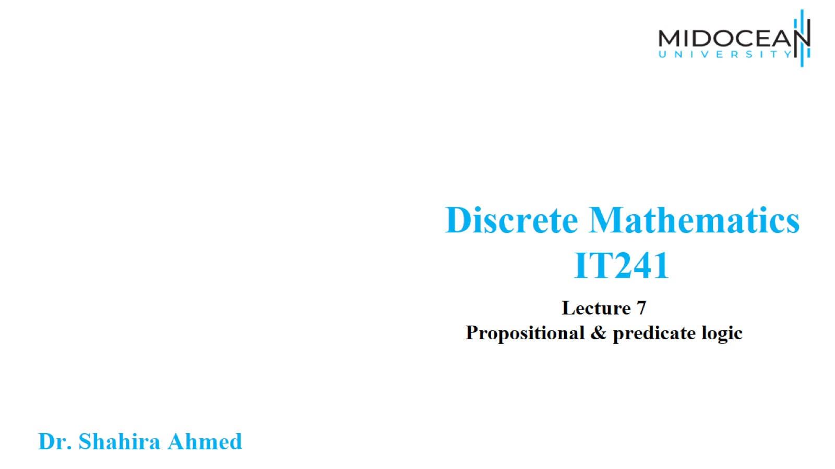

Slide 3
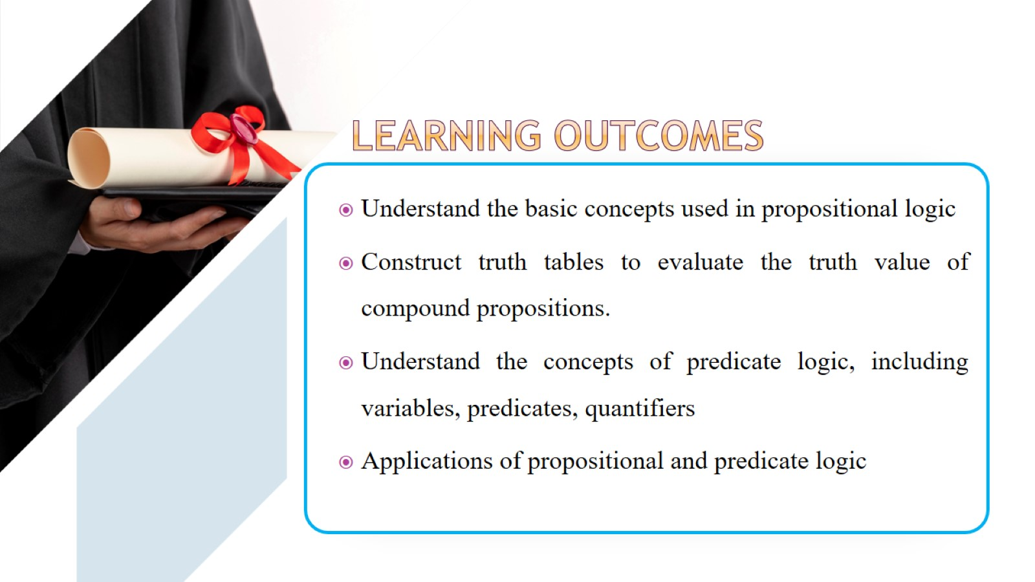

Slide 4
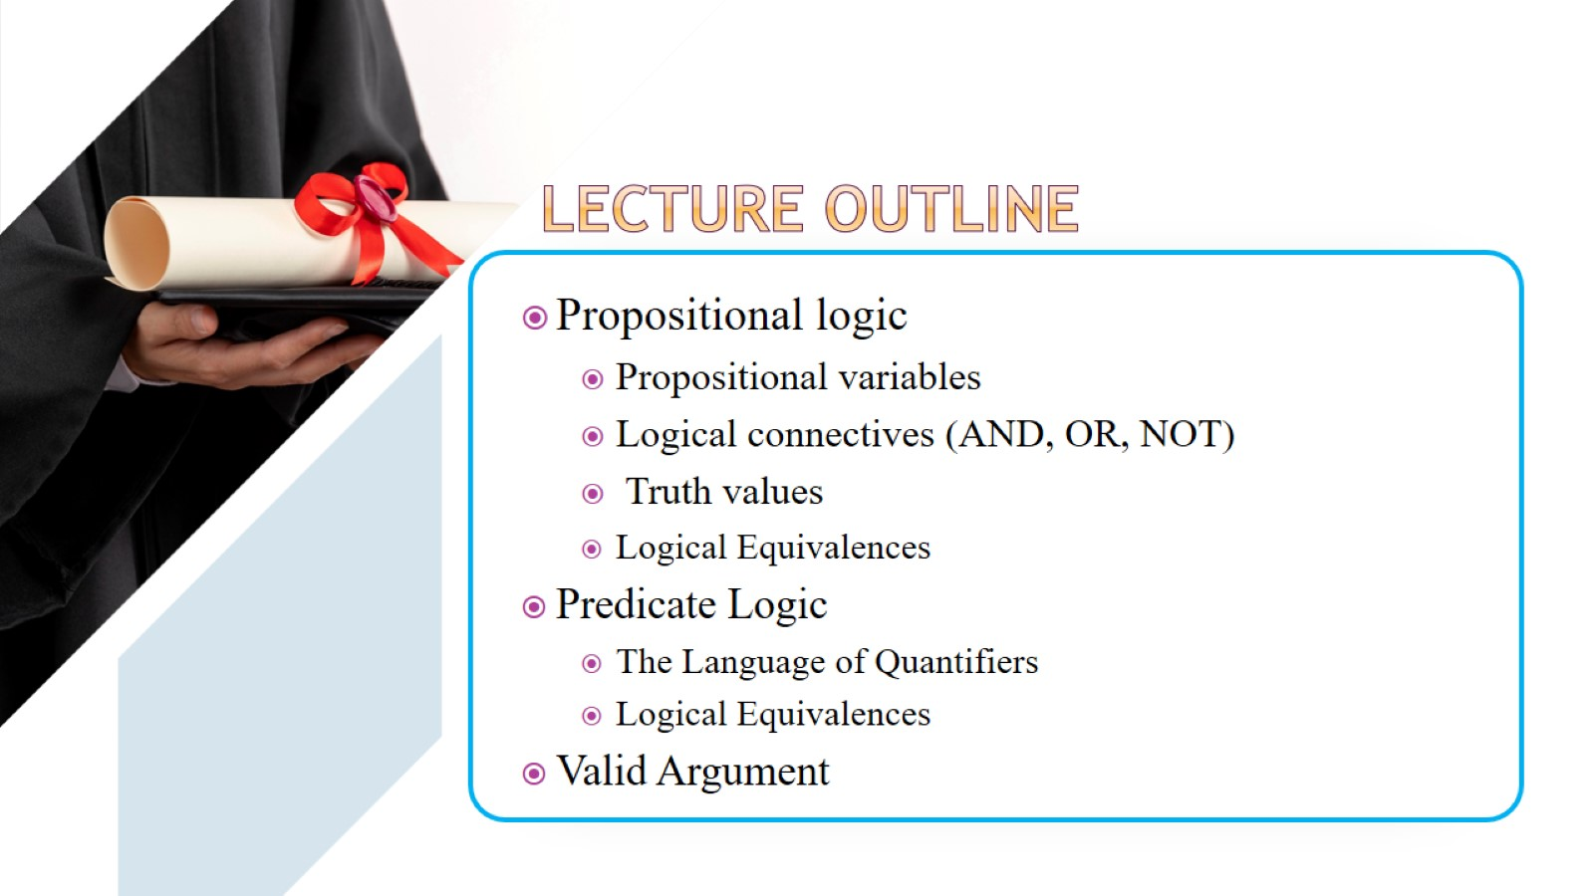

Slide 5
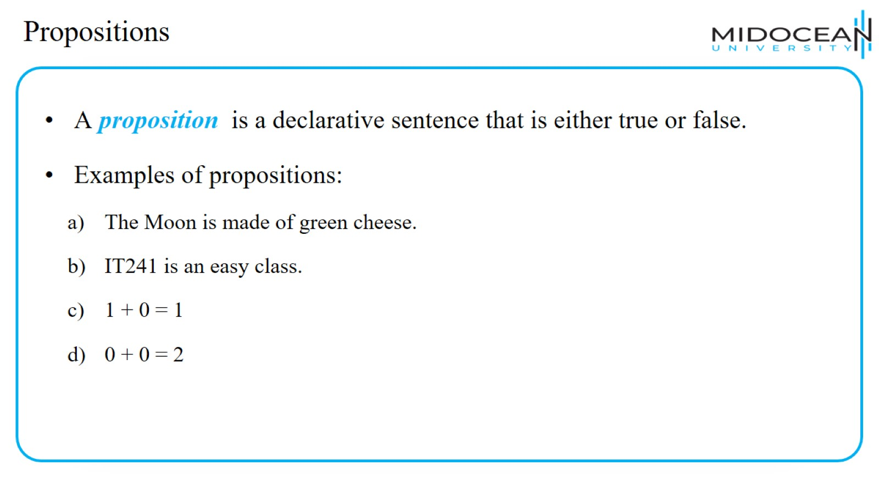
Propositions

Slide 6
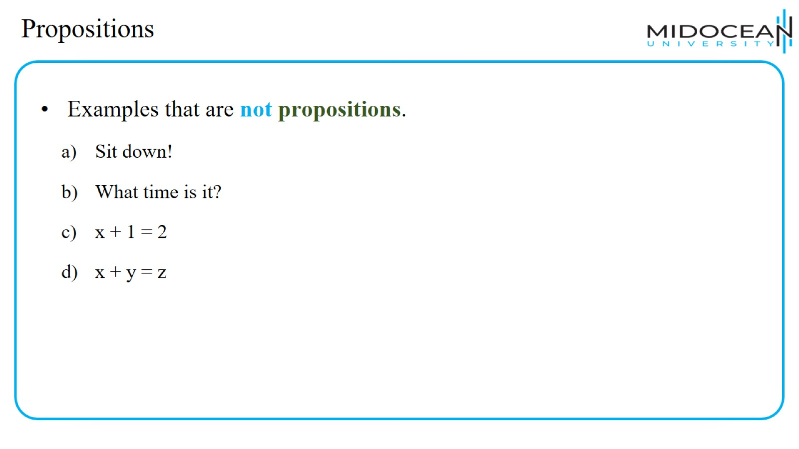
Propositions

Slide 7
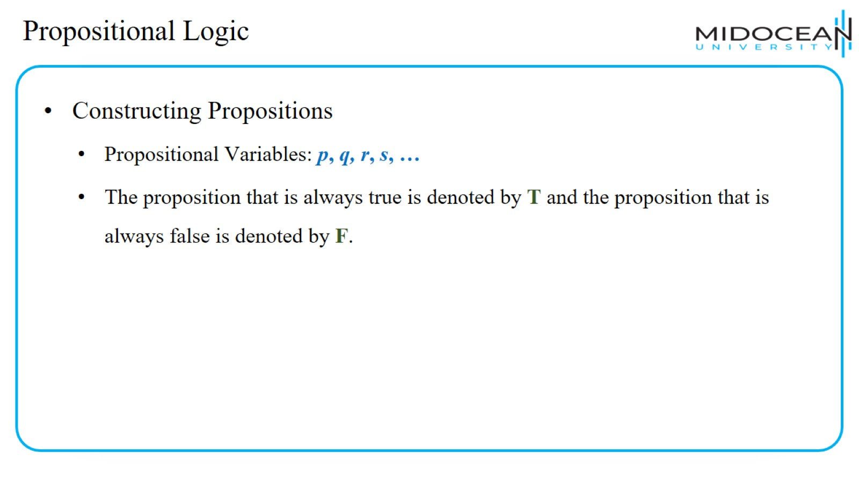
Propositional Logic

Slide 8
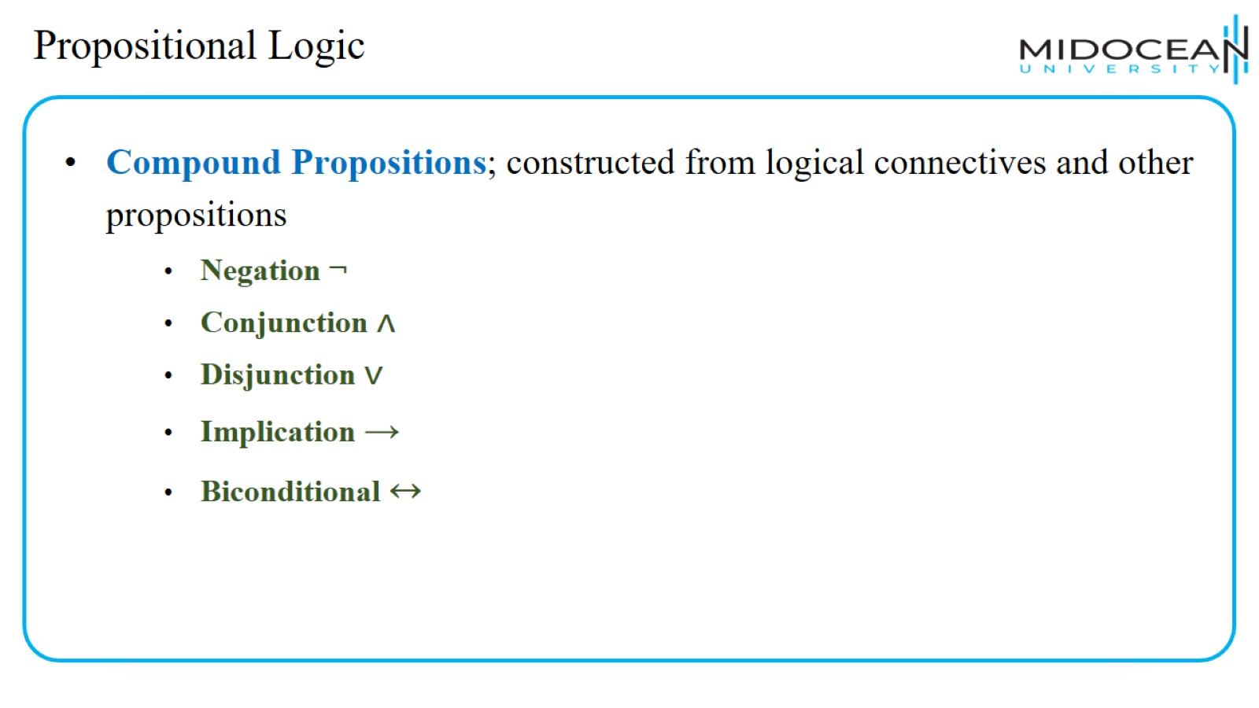
Propositional Logic

Slide 9
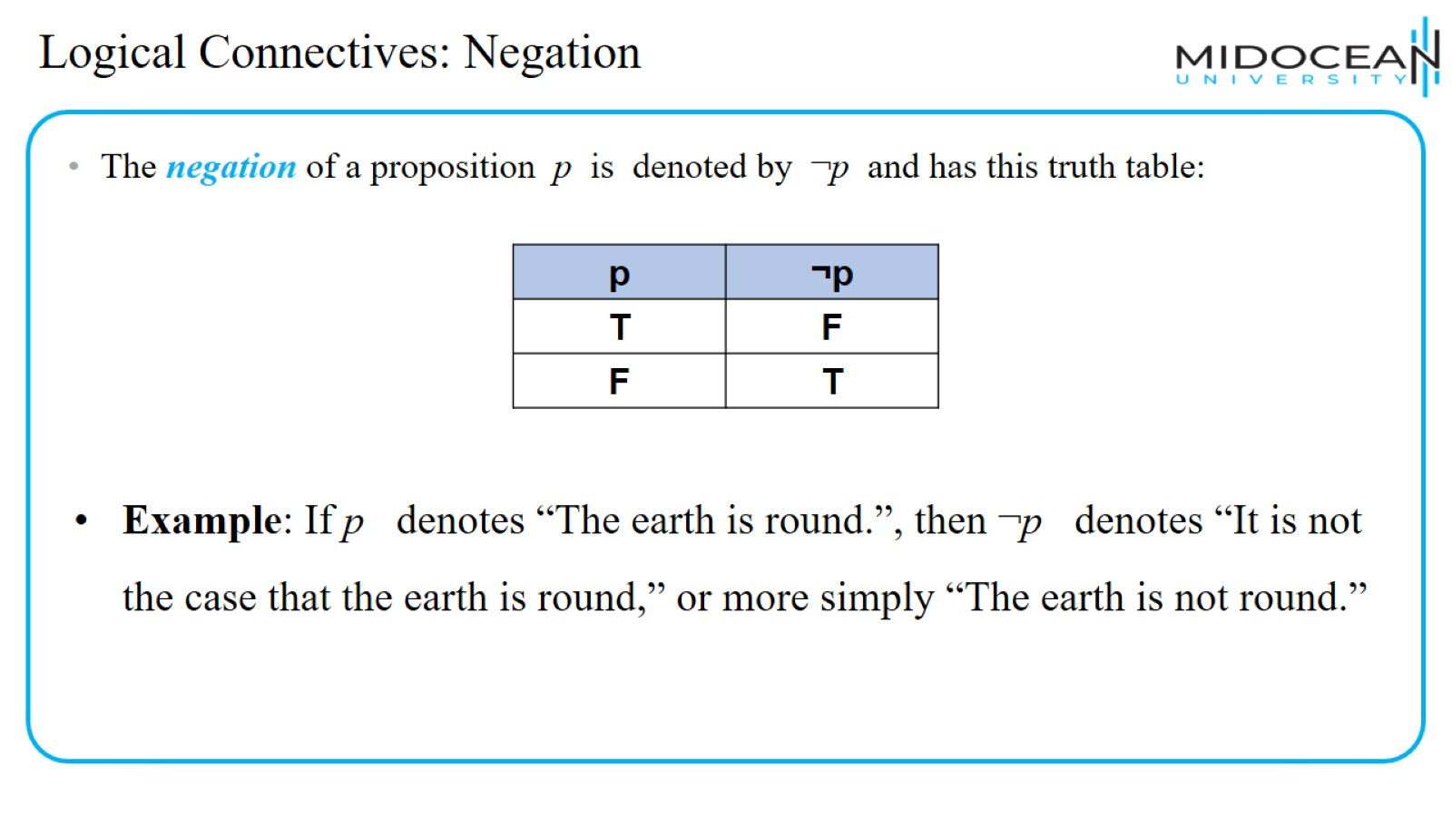
Logical Connectives: Negation

Slide 10
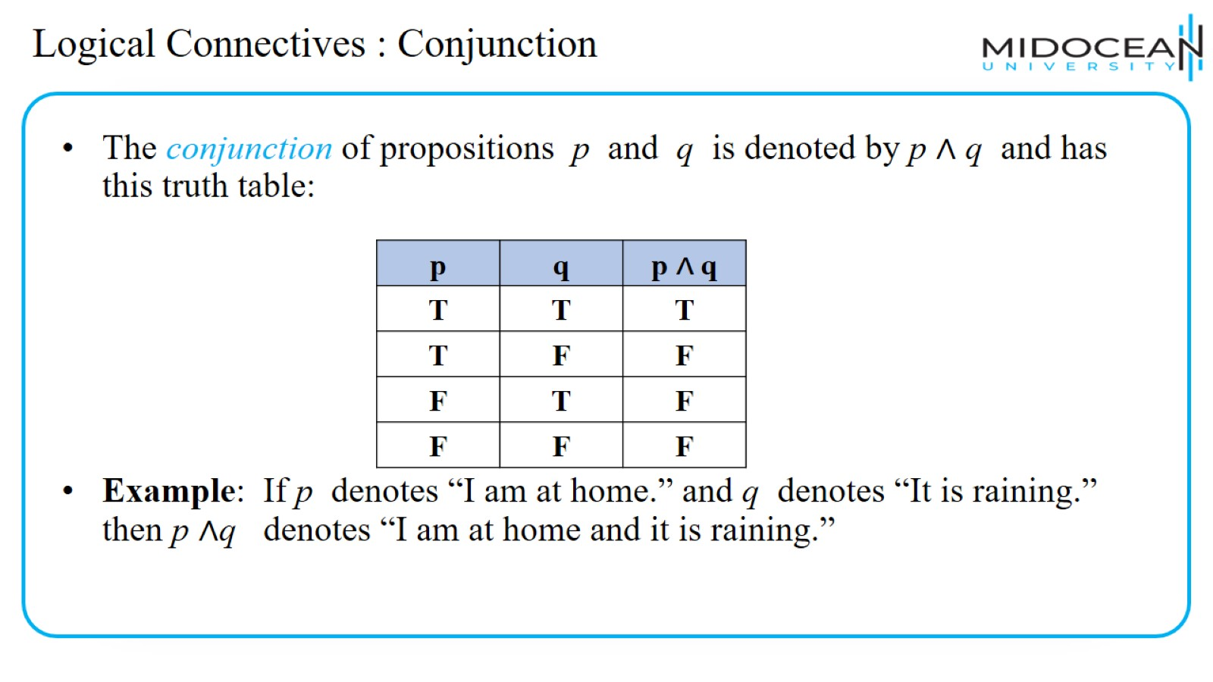
Logical Connectives : Conjunction

Slide 11
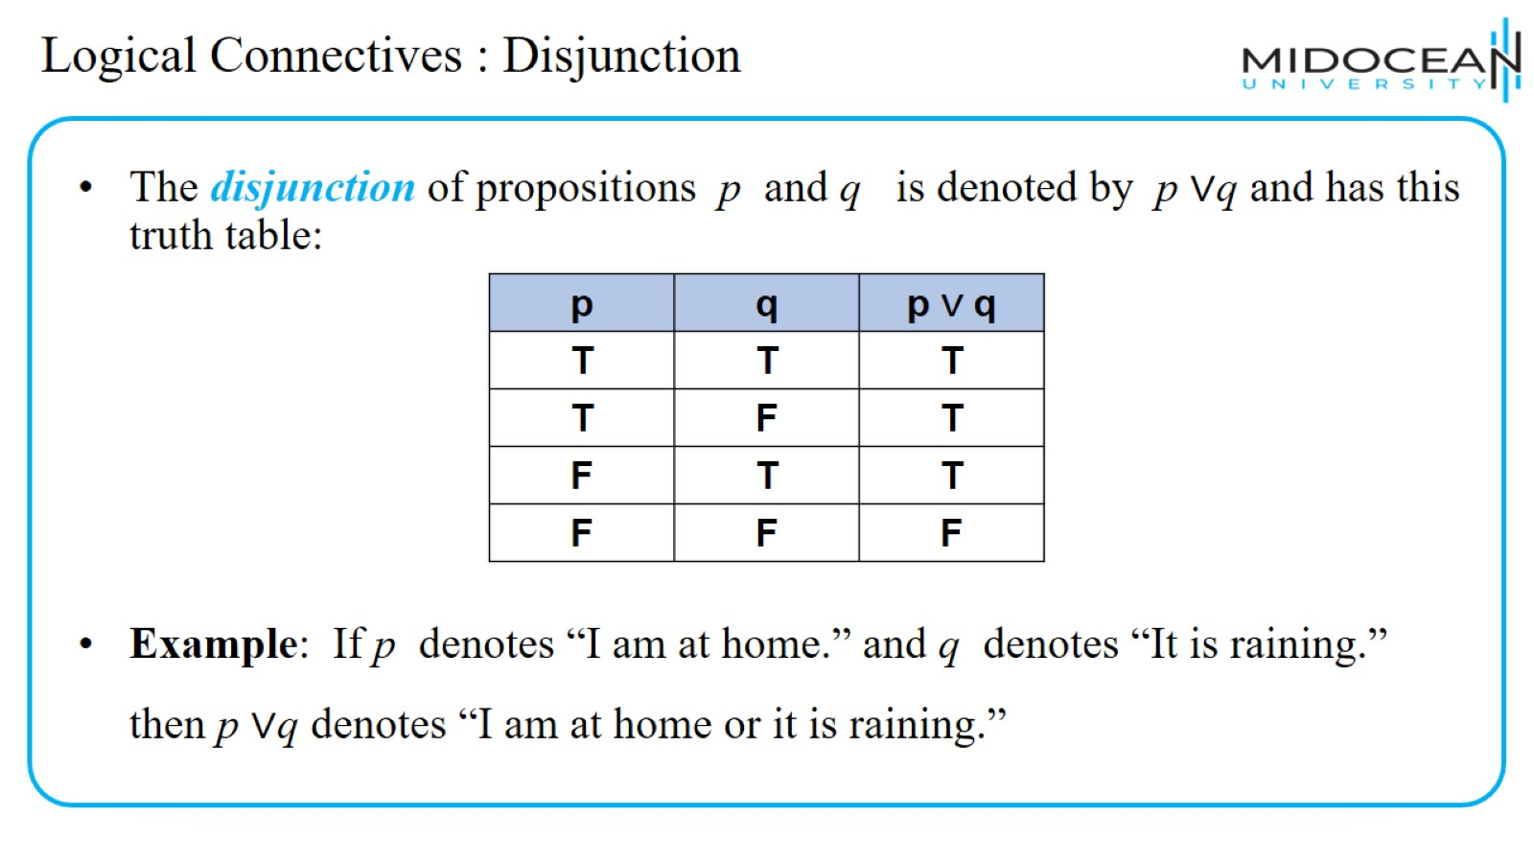
Logical Connectives : Disjunction

Slide 12
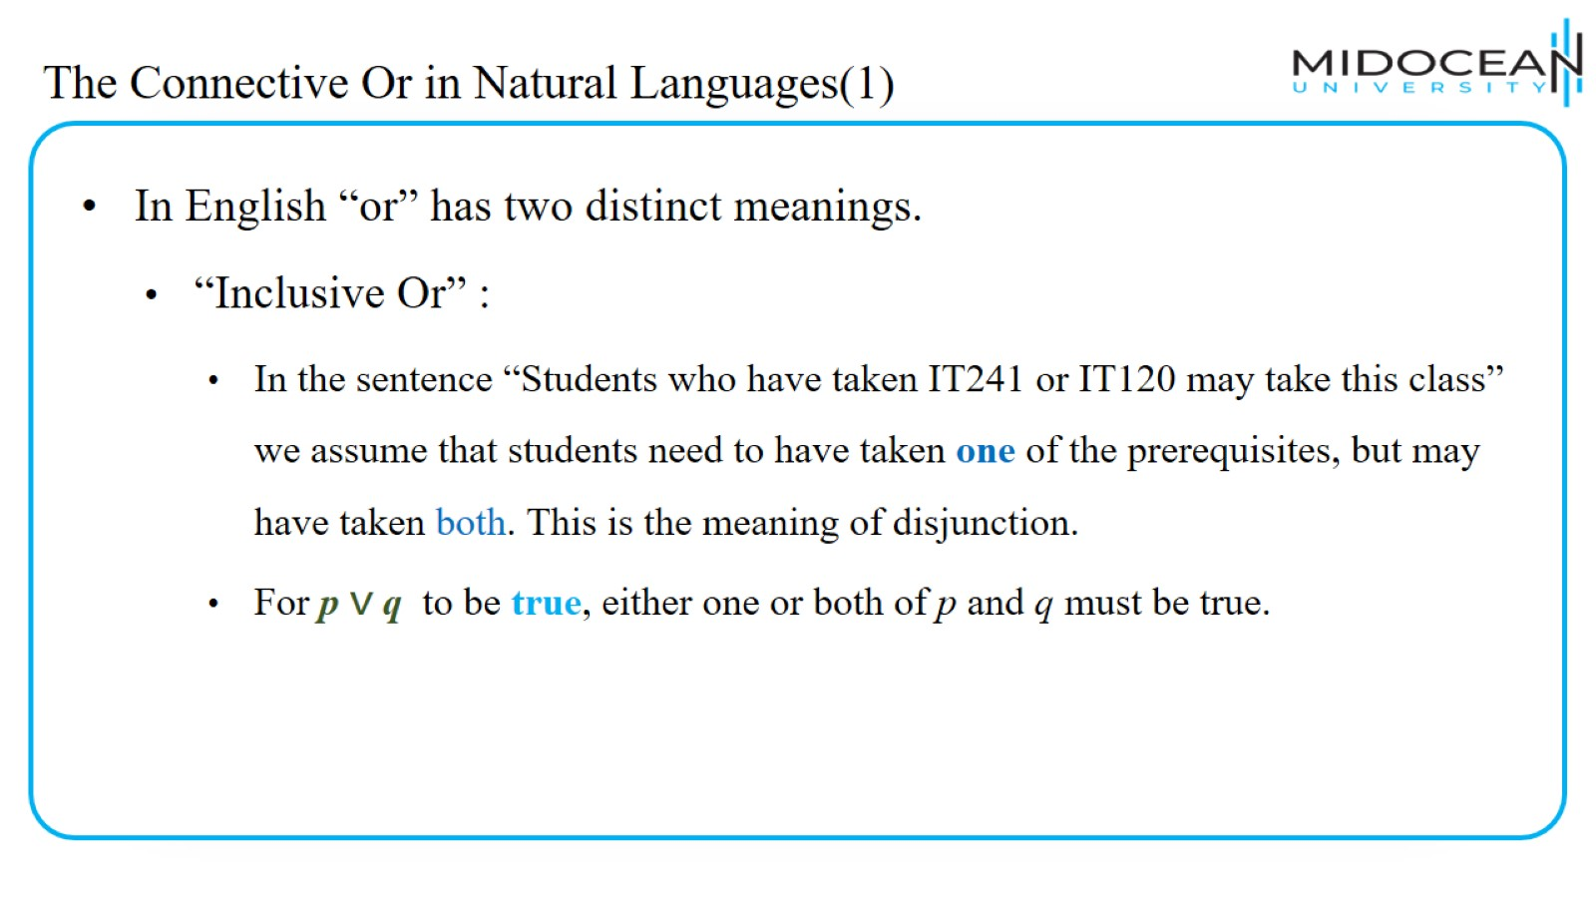
The Connective Or in Natural Languages(1)

Slide 13
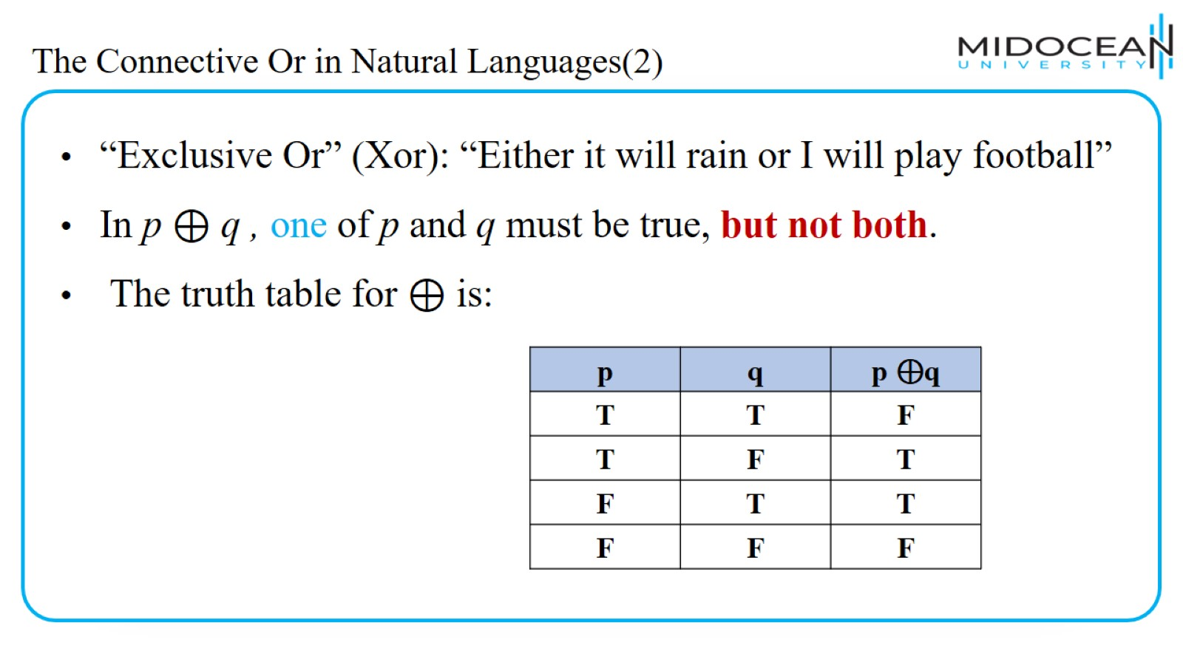
The Connective Or in Natural Languages(2)

Slide 14
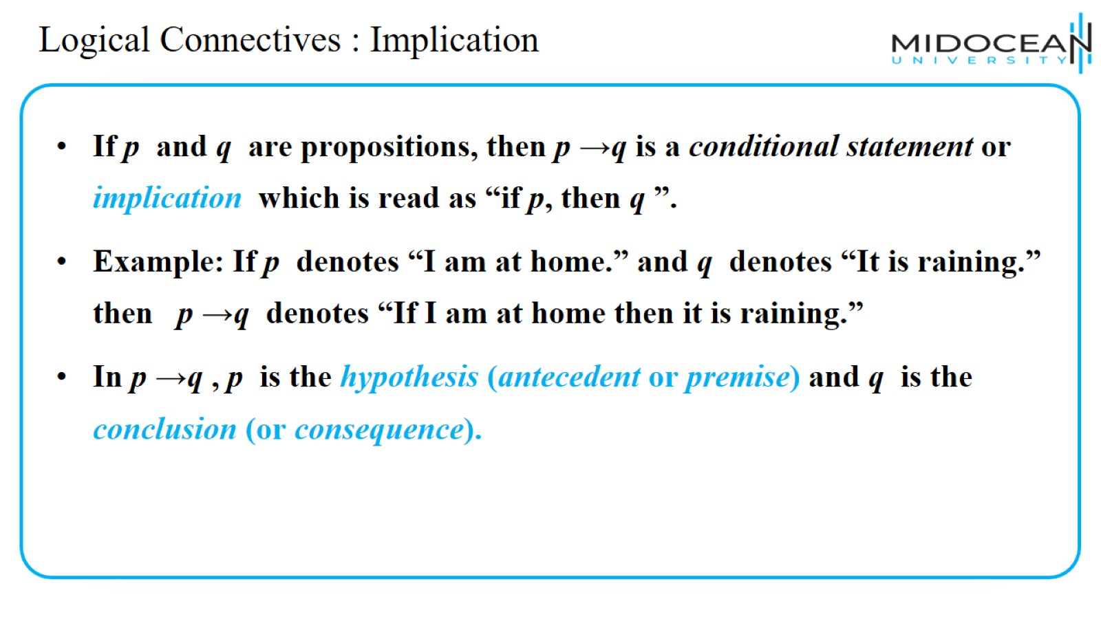
Logical Connectives : Implication

Slide 15
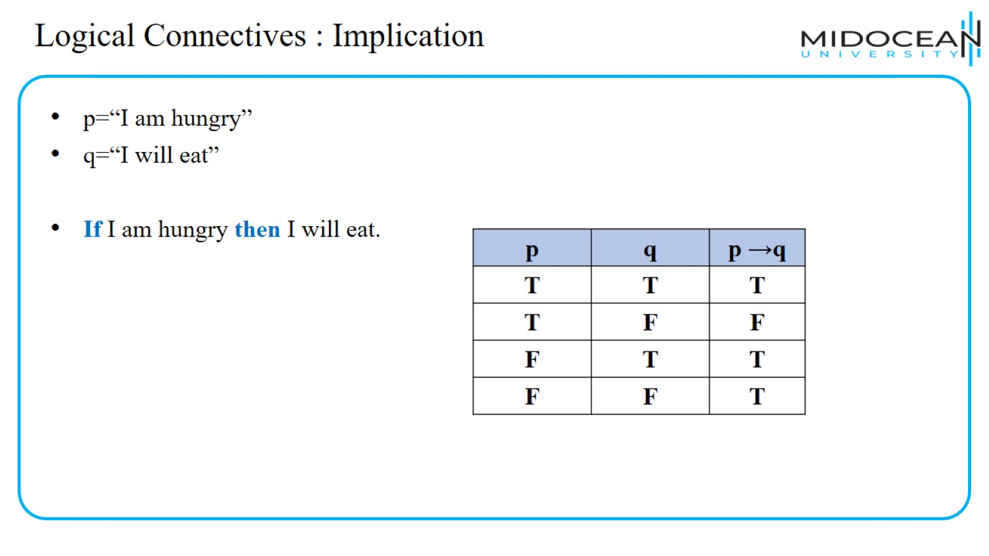
Logical Connectives : Implication

Slide 16
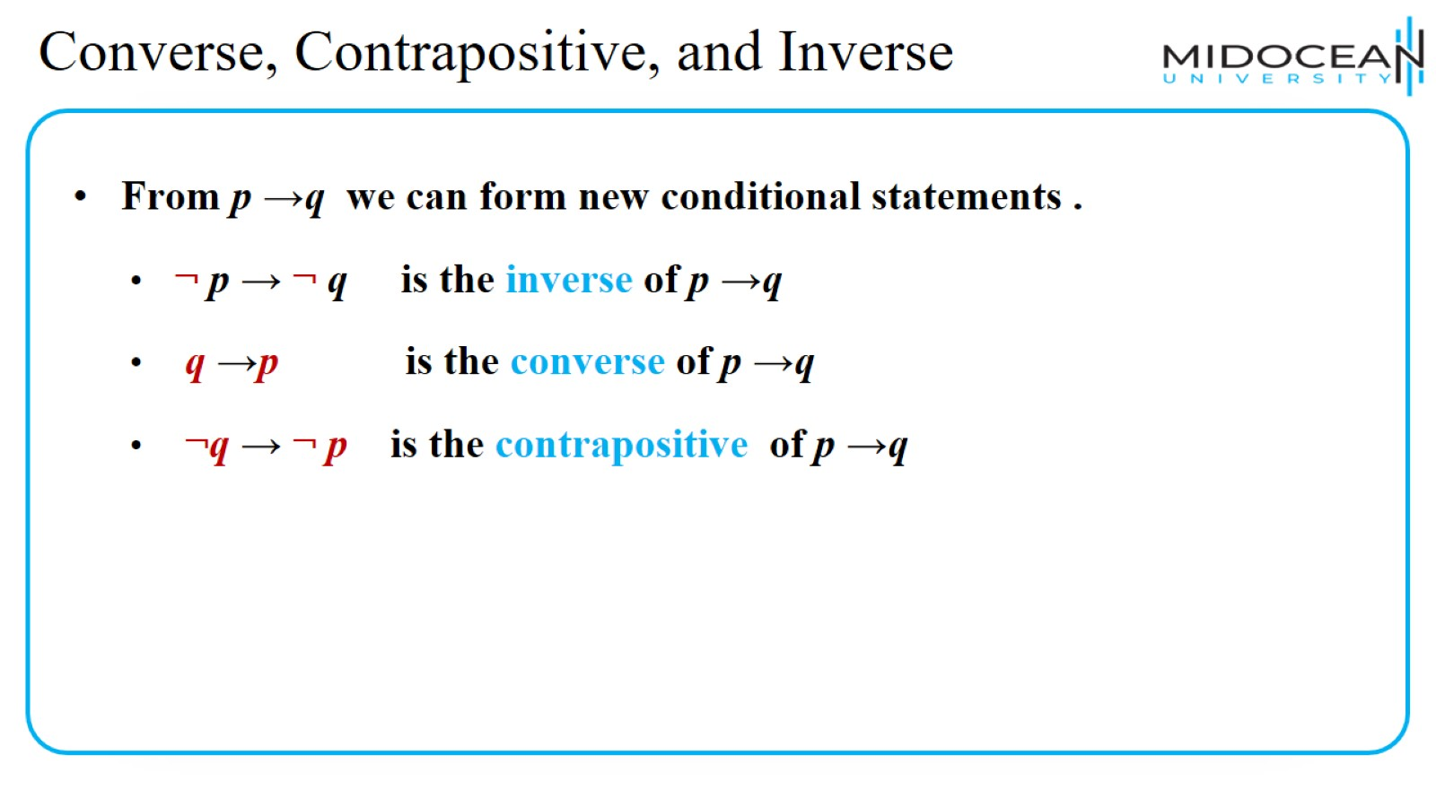
Converse, Contrapositive, and Inverse

Slide 17
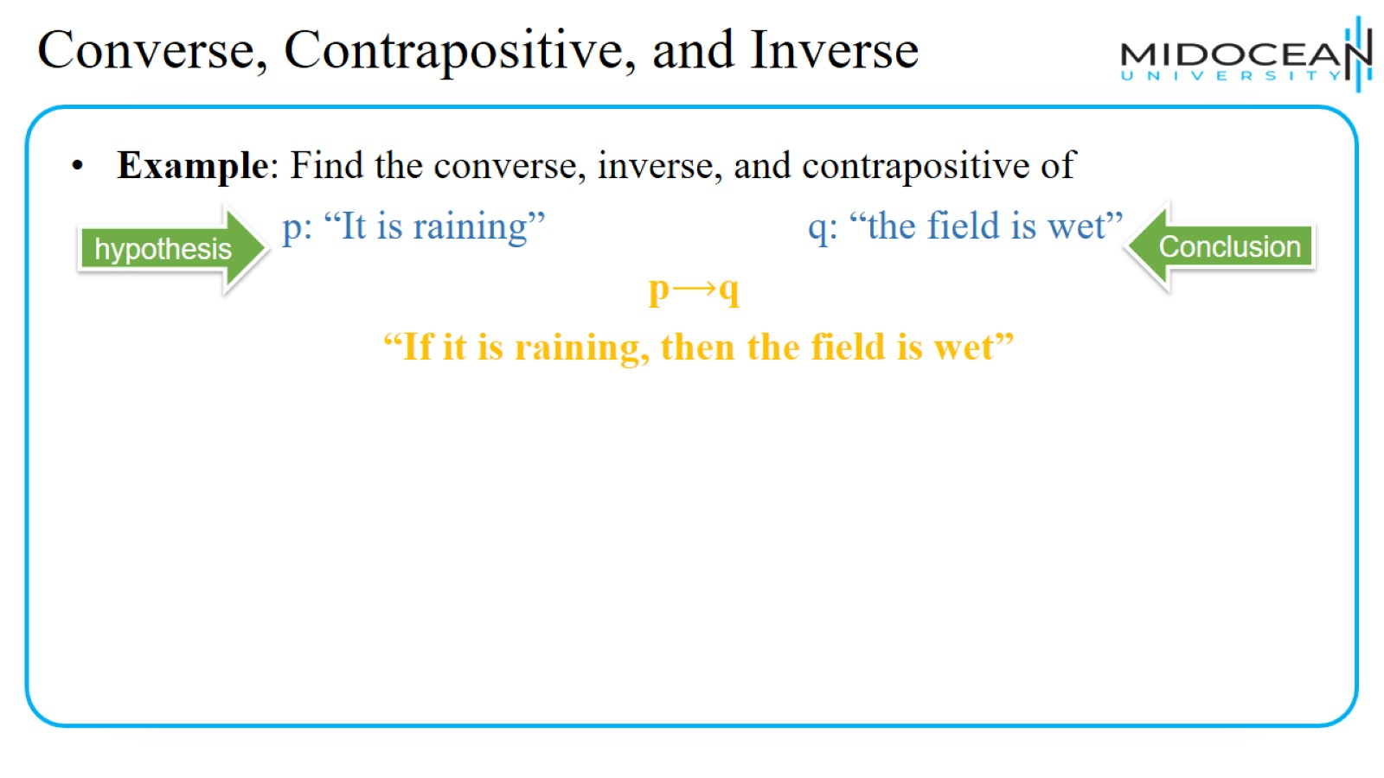
Converse, Contrapositive, and Inverse

Slide 18
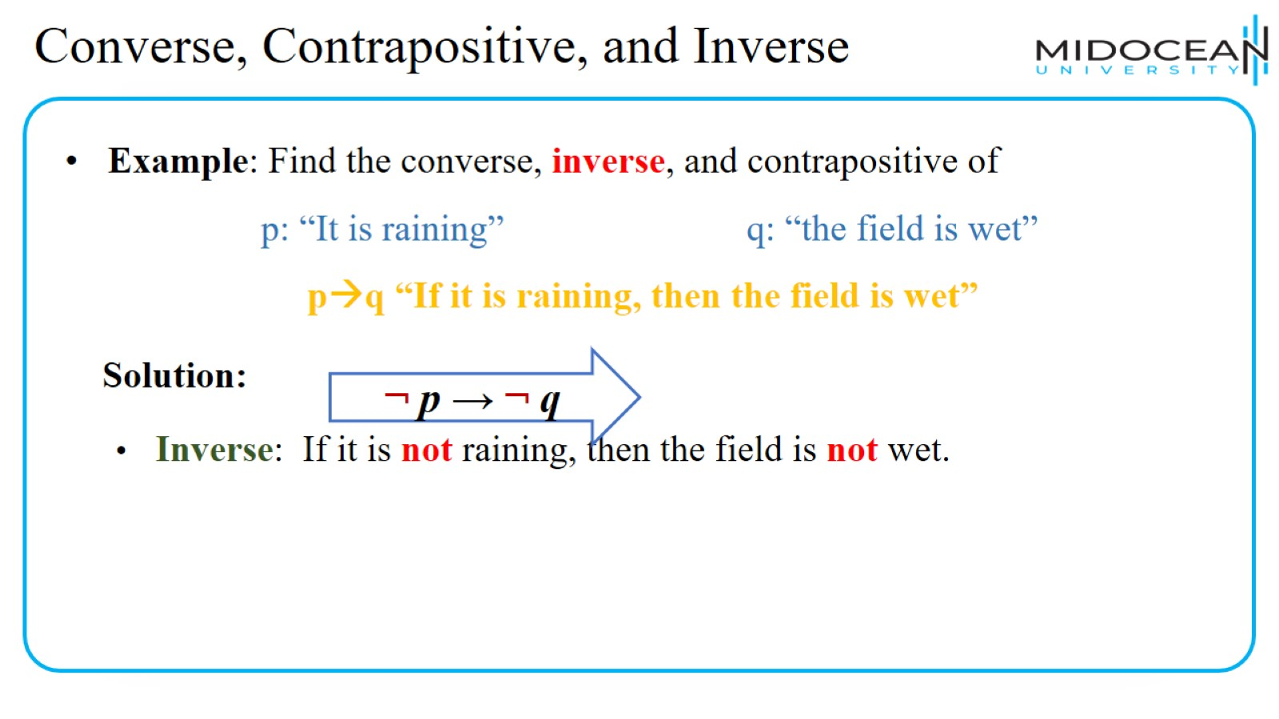
Converse, Contrapositive, and Inverse

Slide 19
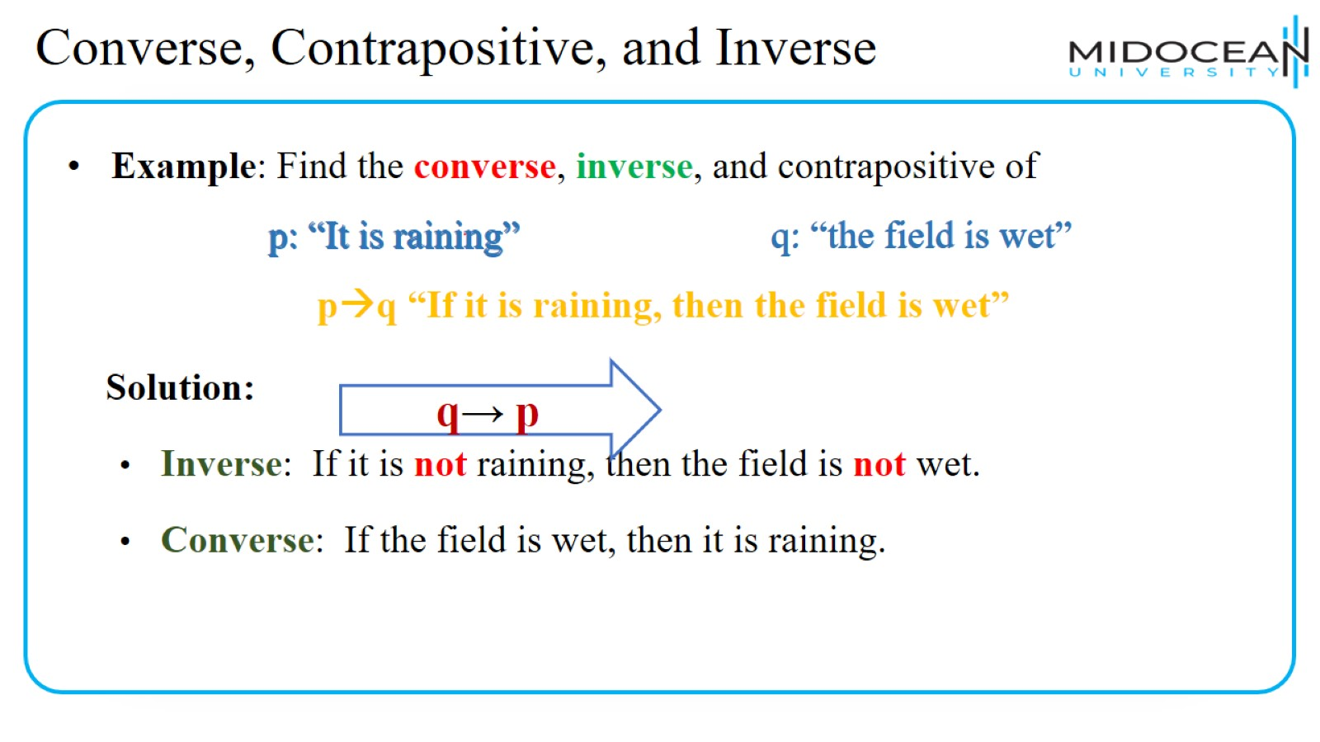
Converse, Contrapositive, and Inverse

Slide 20
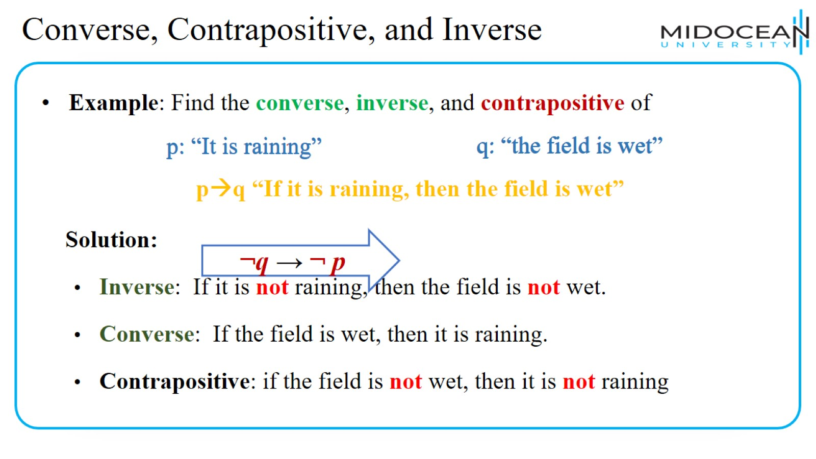
Converse, Contrapositive, and Inverse

Slide 21
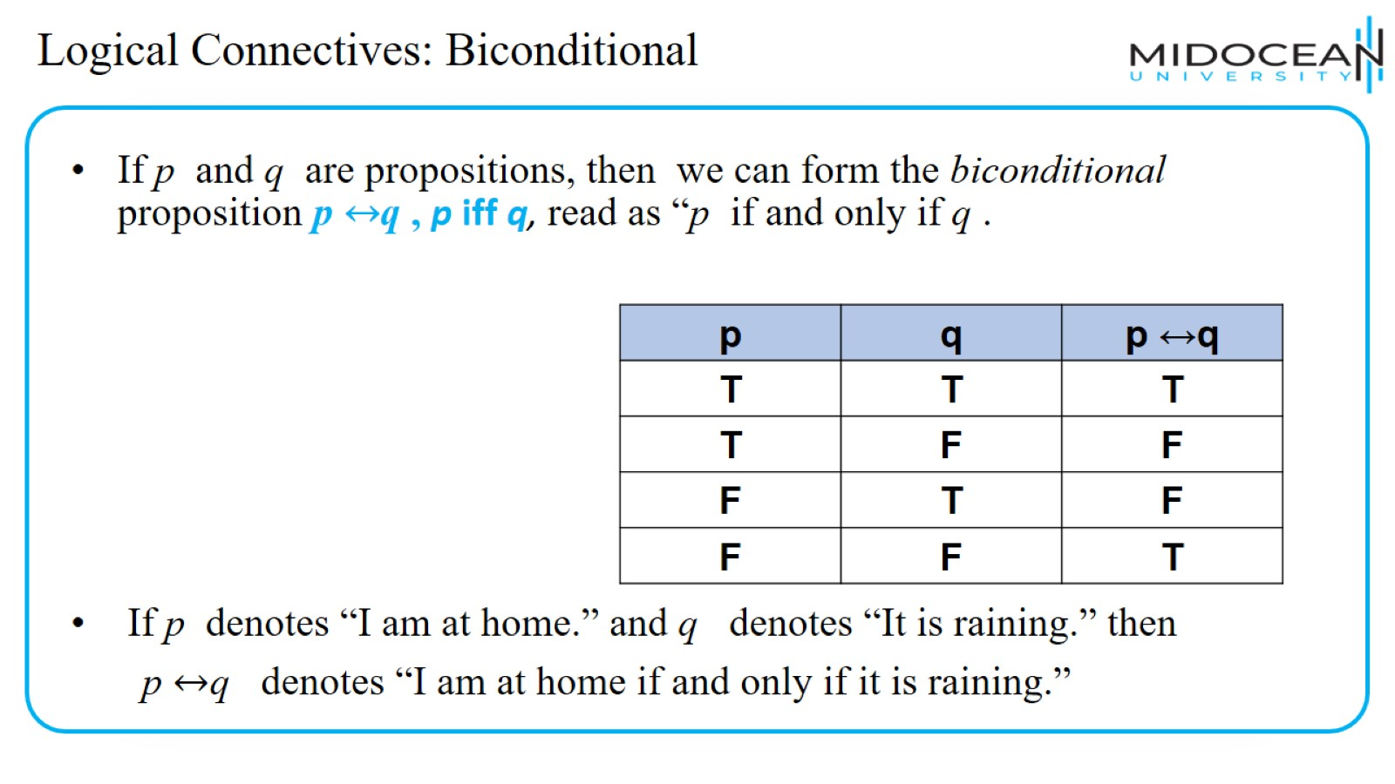
Logical Connectives: Biconditional

Slide 22
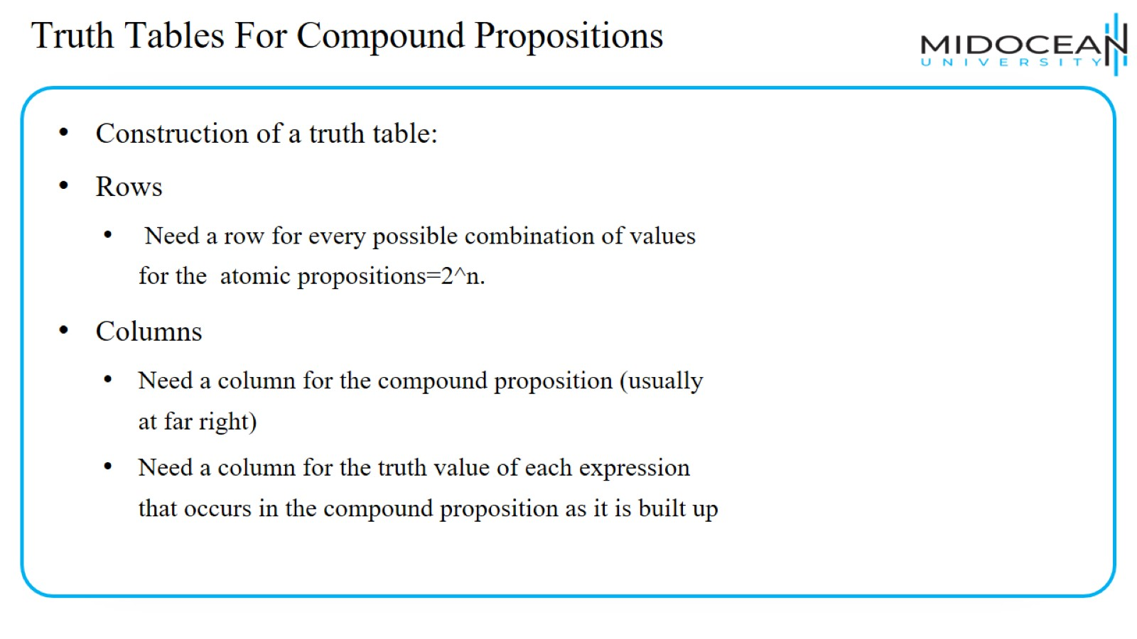
Truth Tables For Compound Propositions

Slide 23
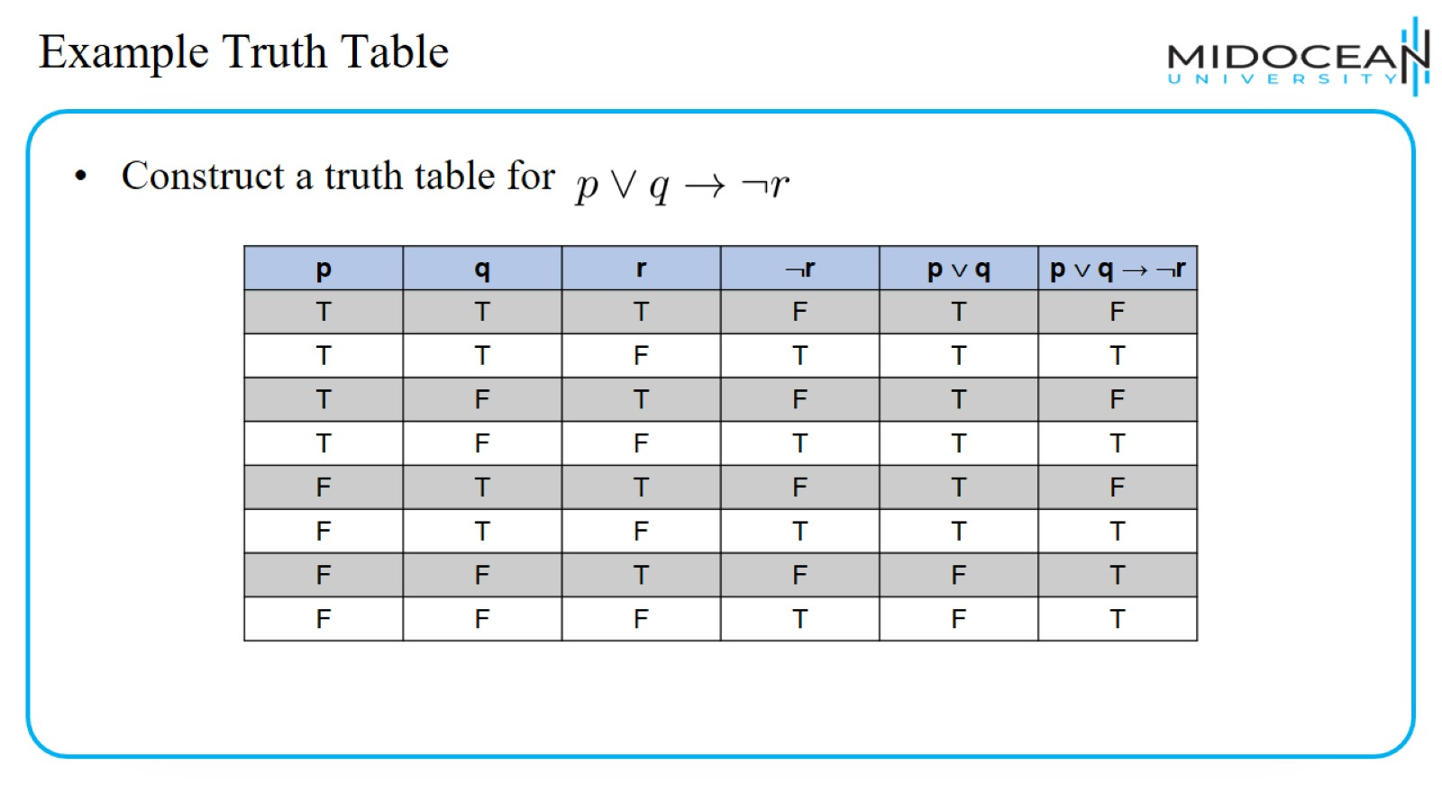
Example Truth Table

Slide 24
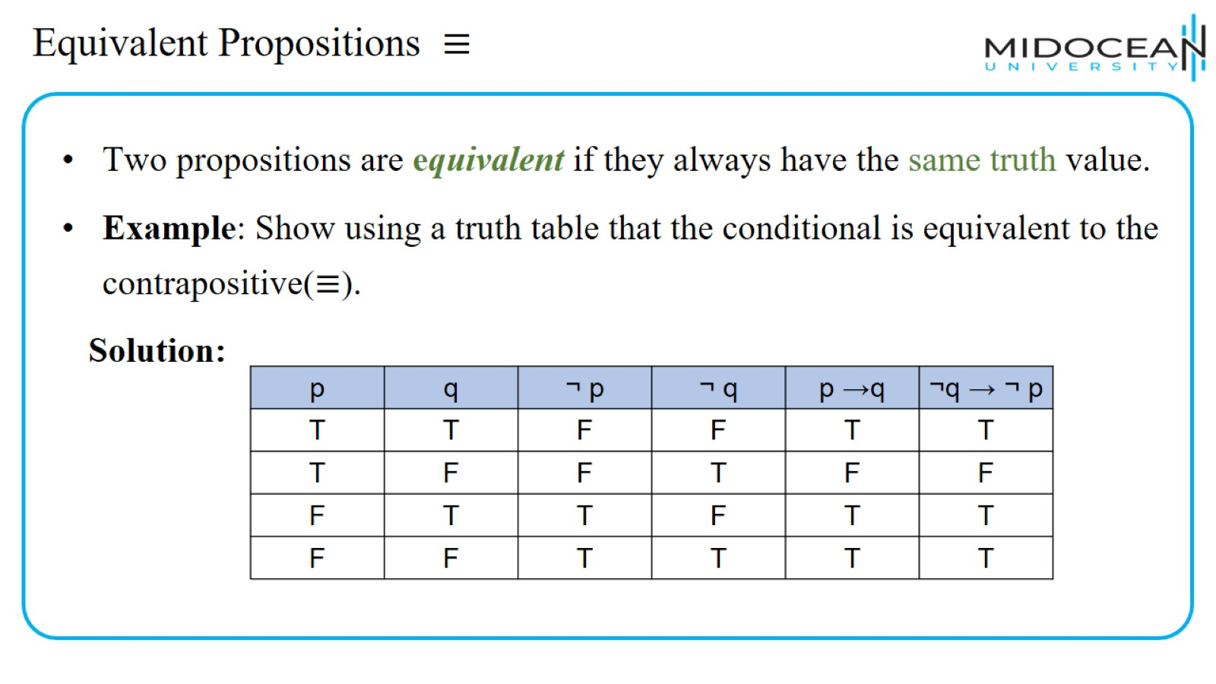
Equivalent Propositions ≡

Slide 25
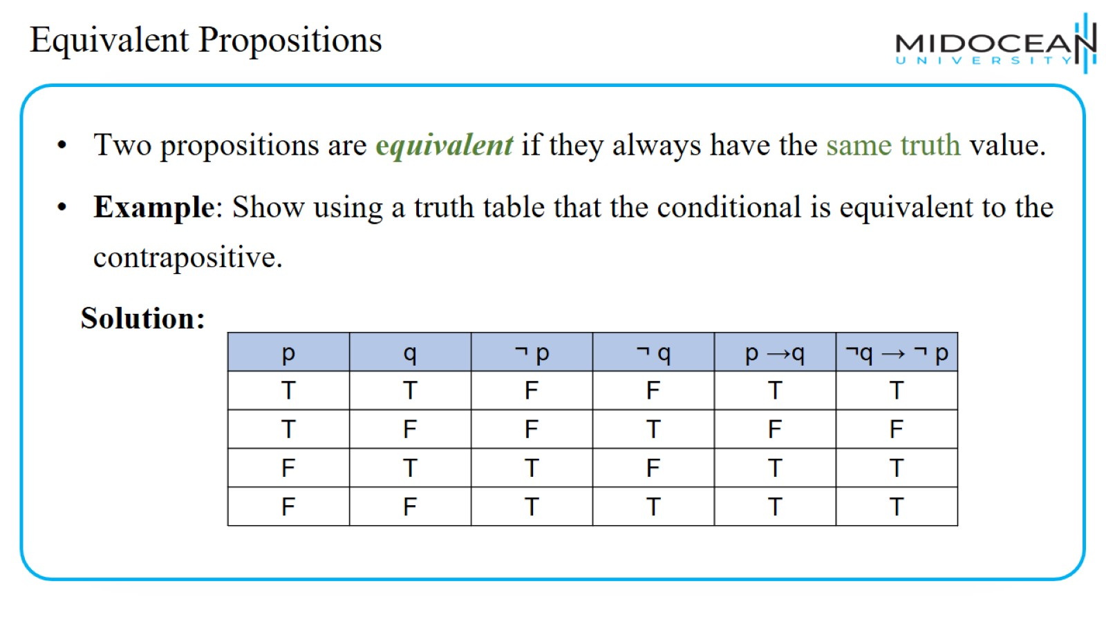
Equivalent Propositions

Slide 26
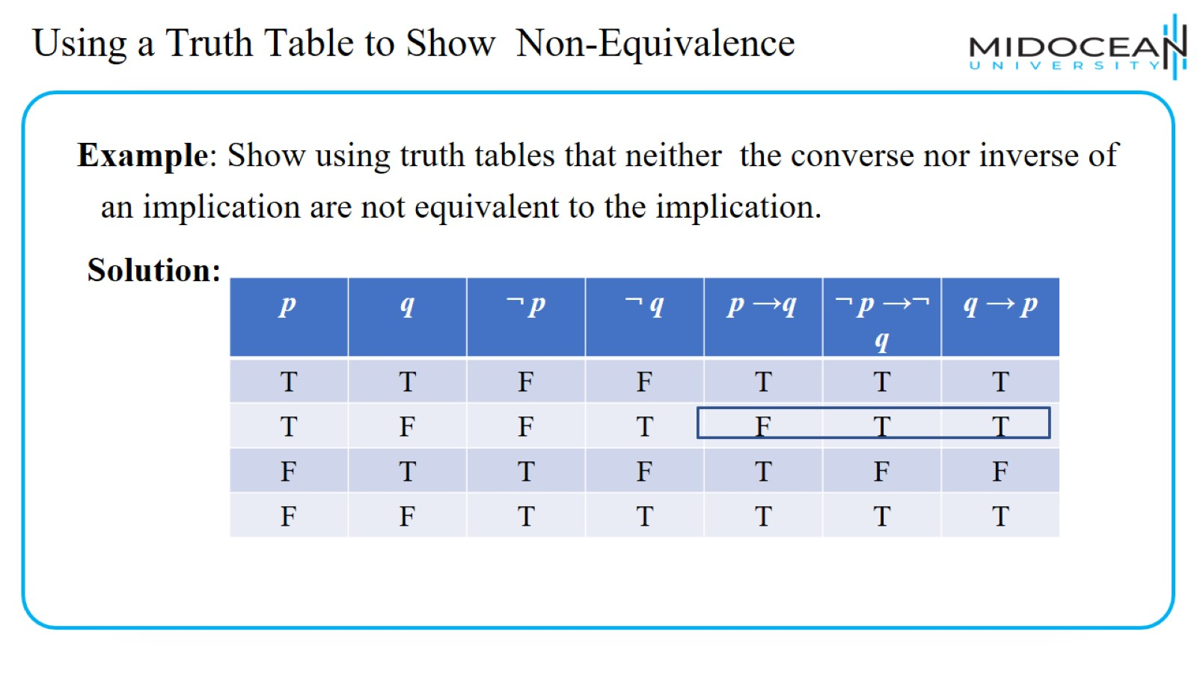
Using a Truth Table to Show Non-Equivalence

Slide 27
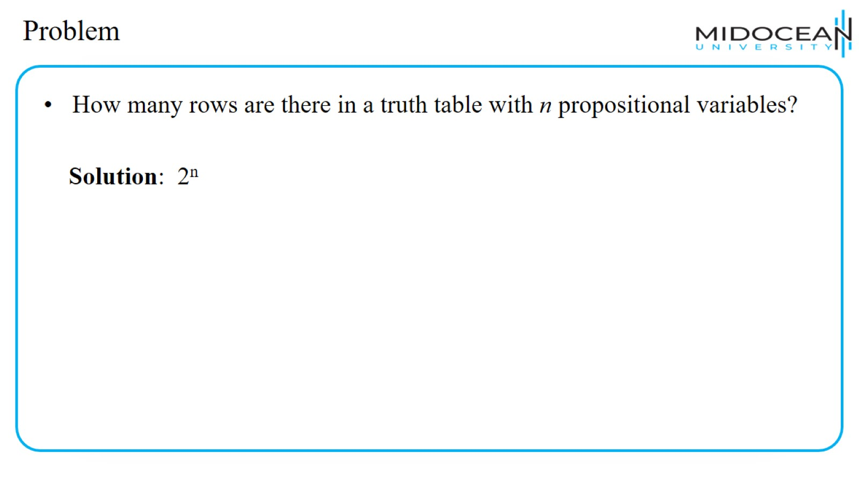
Problem

Slide 28
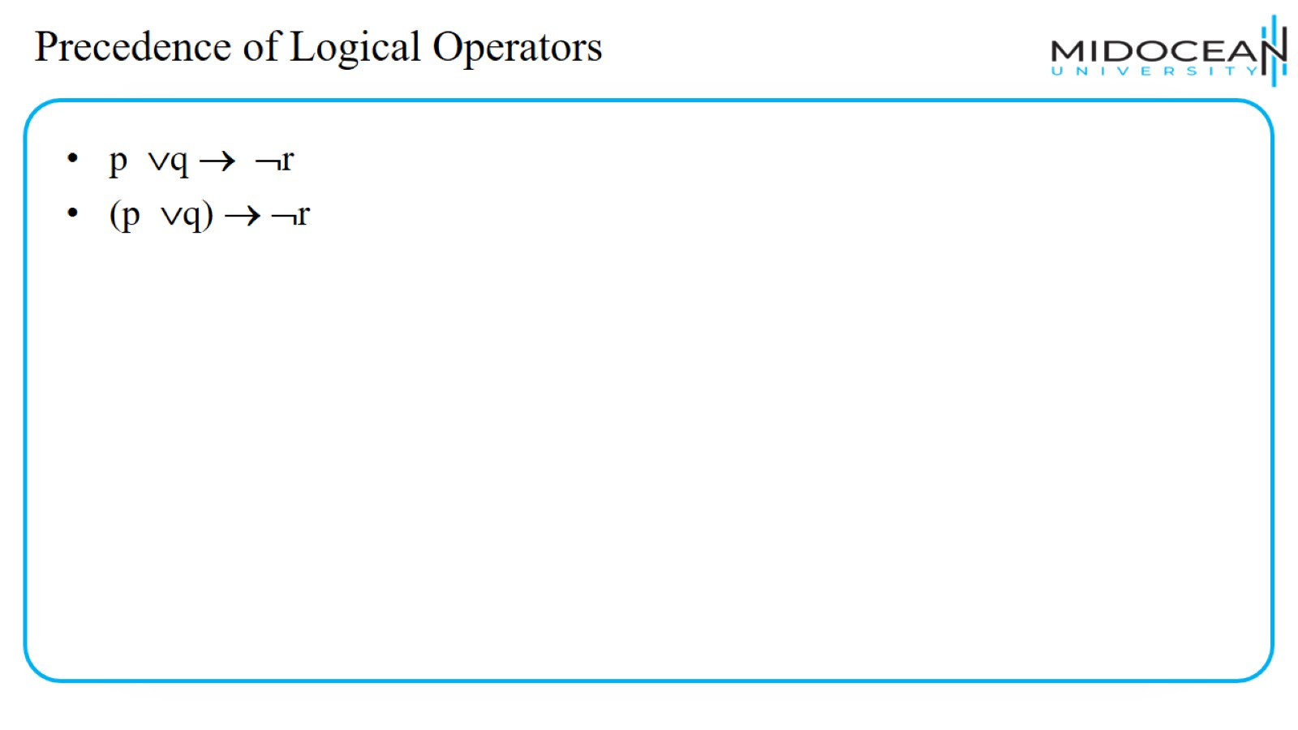
Precedence of Logical Operators

Slide 29
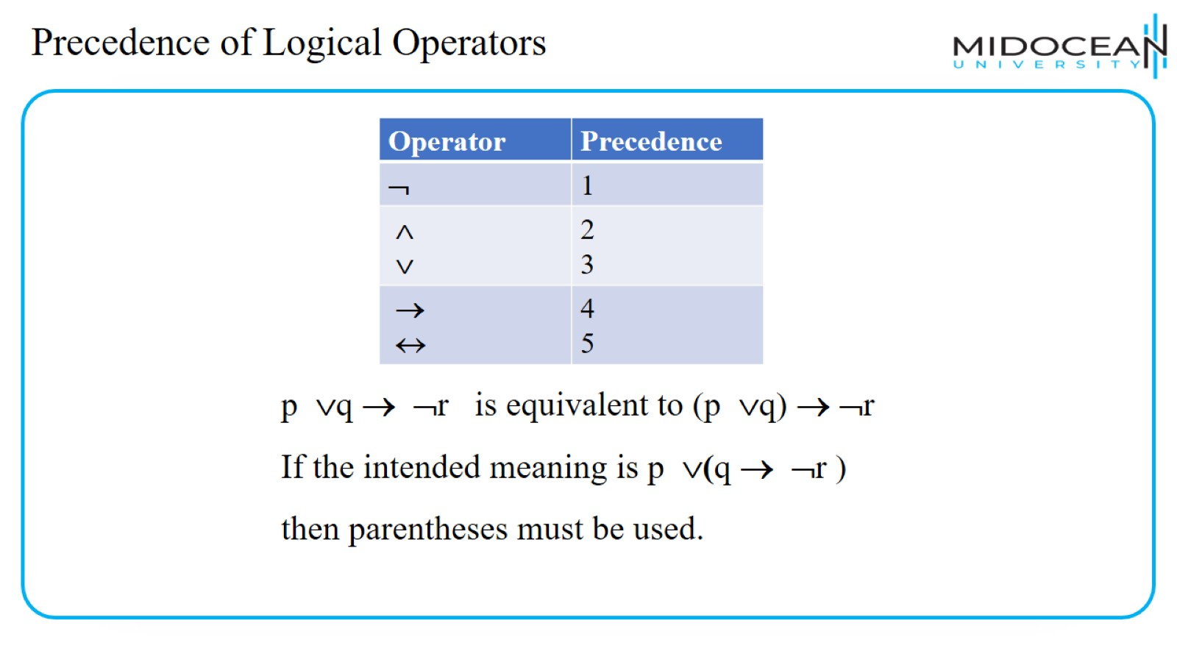
Precedence of Logical Operators

Slide 30
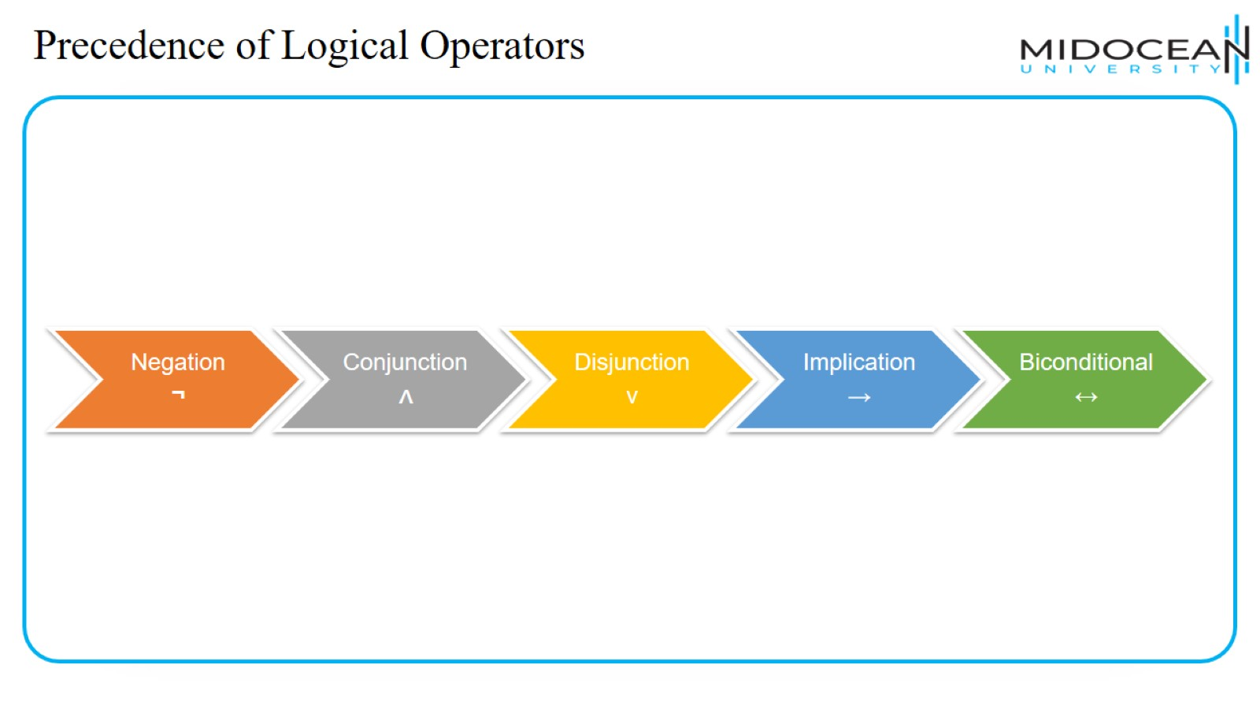
Precedence of Logical Operators

Slide 31
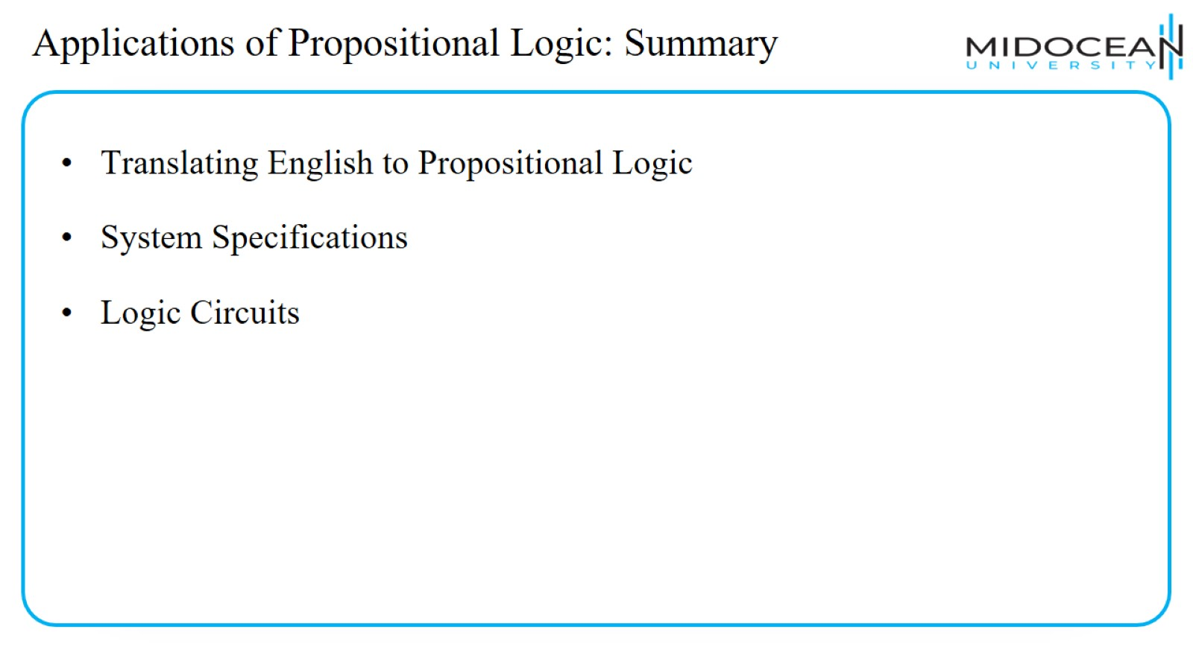
Applications of Propositional Logic: Summary

Slide 32
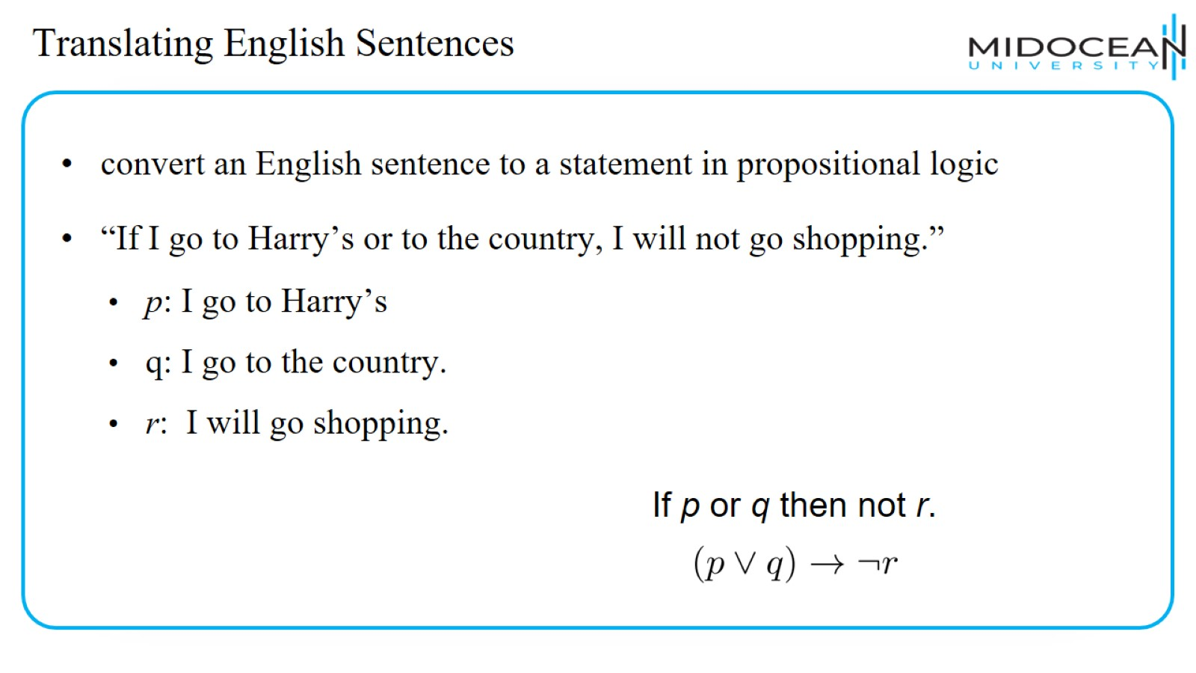
Translating English Sentences

Slide 33
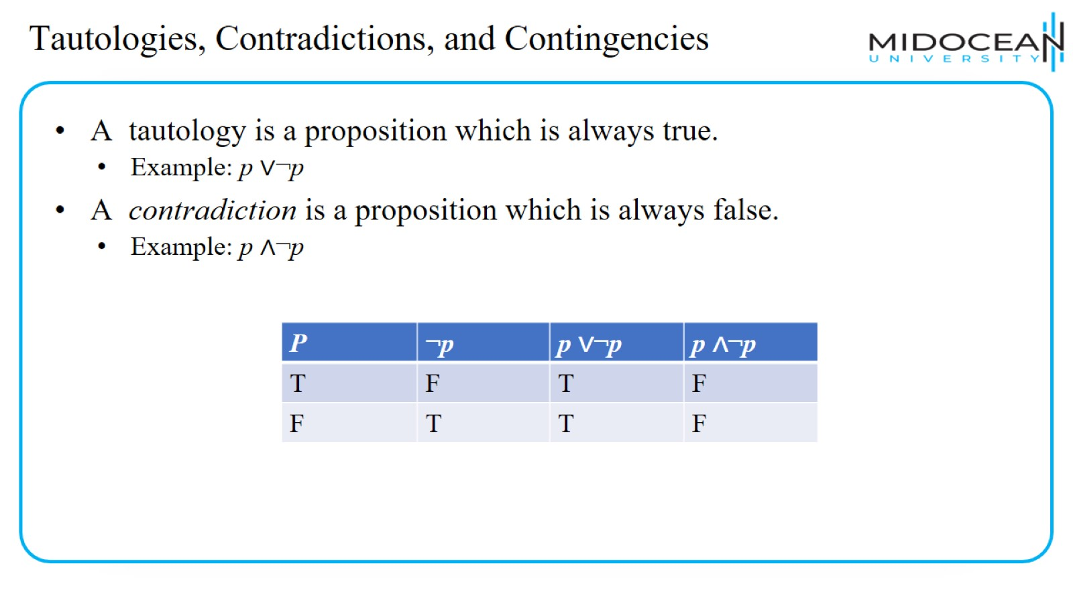
Tautologies, Contradictions, and Contingencies

Slide 34
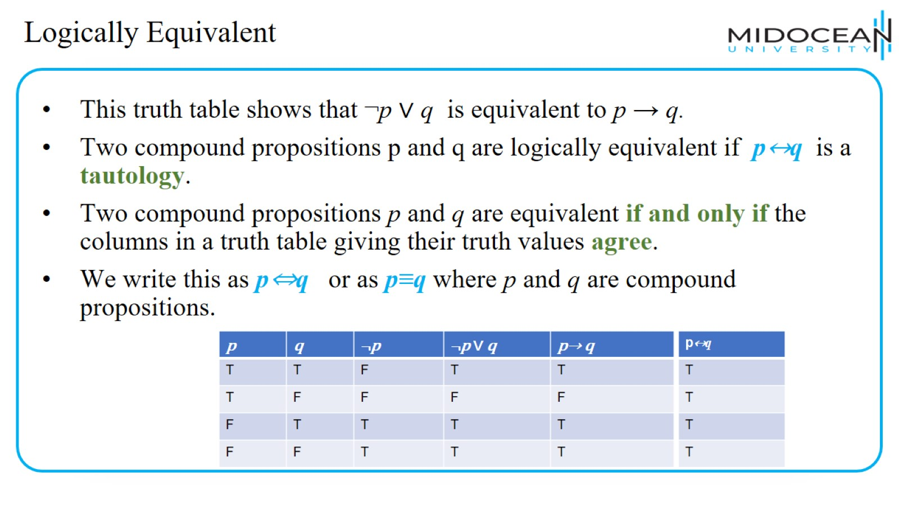
Logically Equivalent

Slide 35
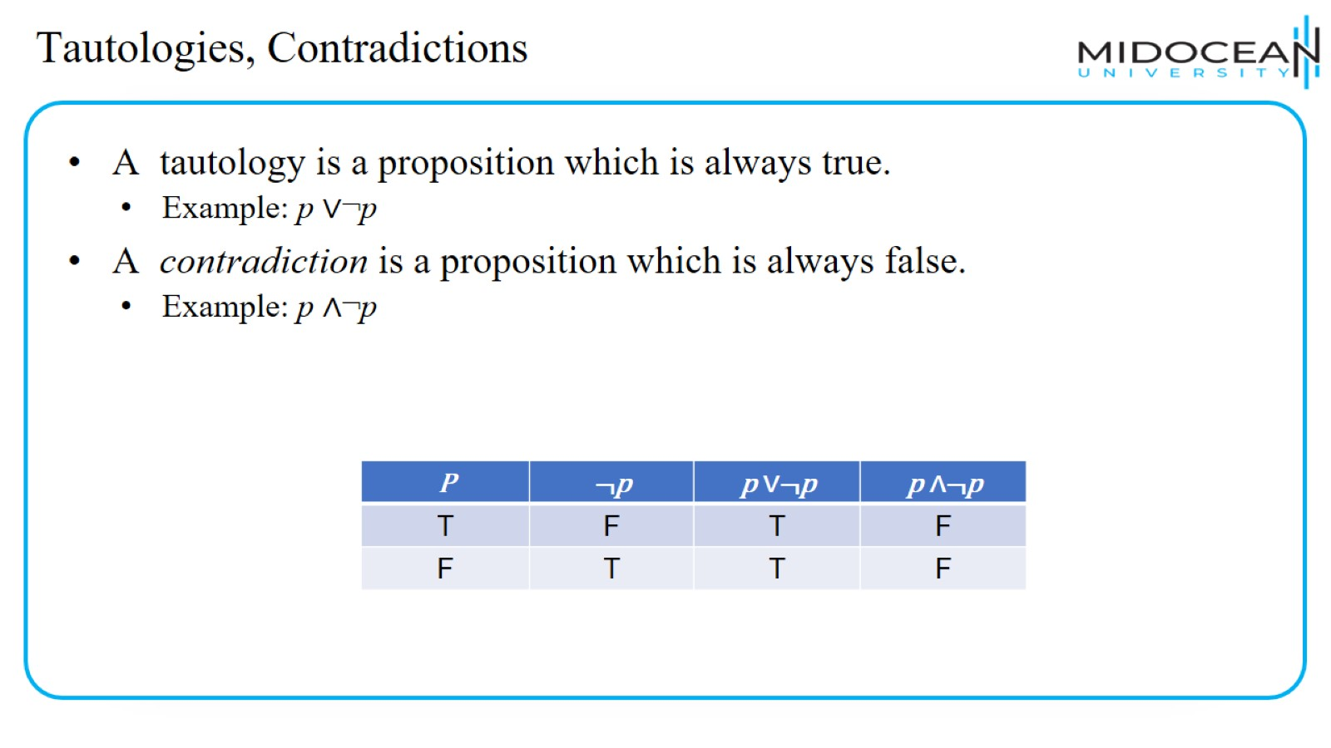
Tautologies, Contradictions

Slide 36
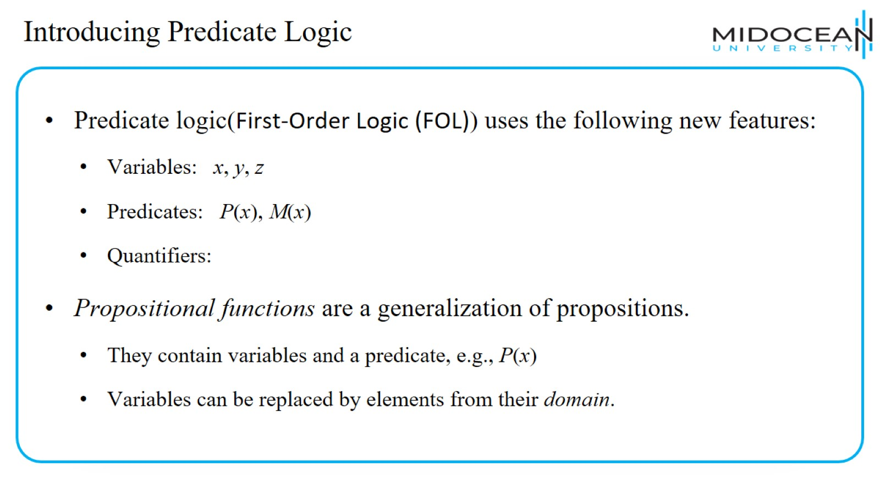
Introducing Predicate Logic

Slide 37
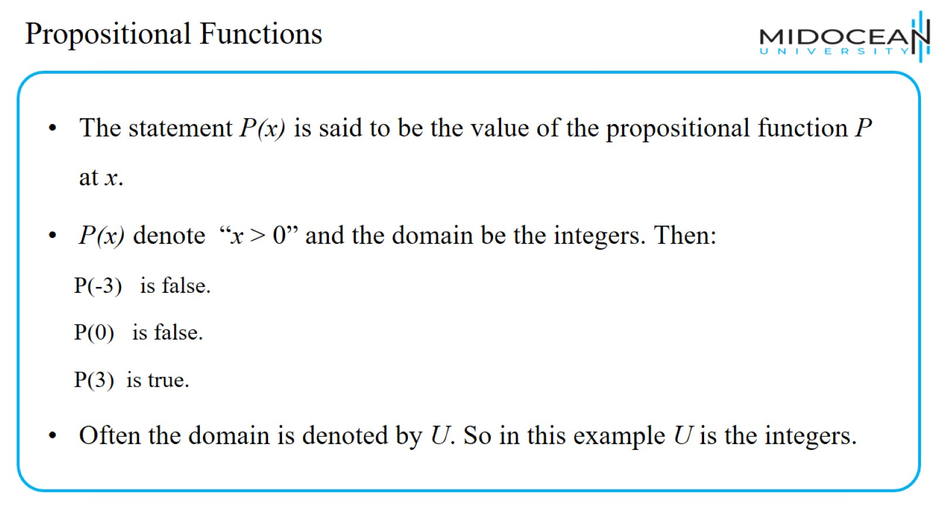
Propositional Functions

Slide 38
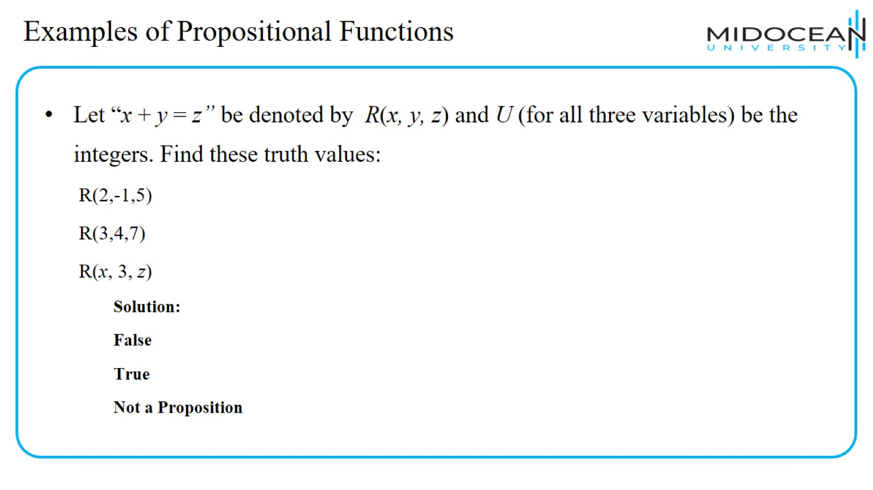
Examples of Propositional Functions

Slide 39
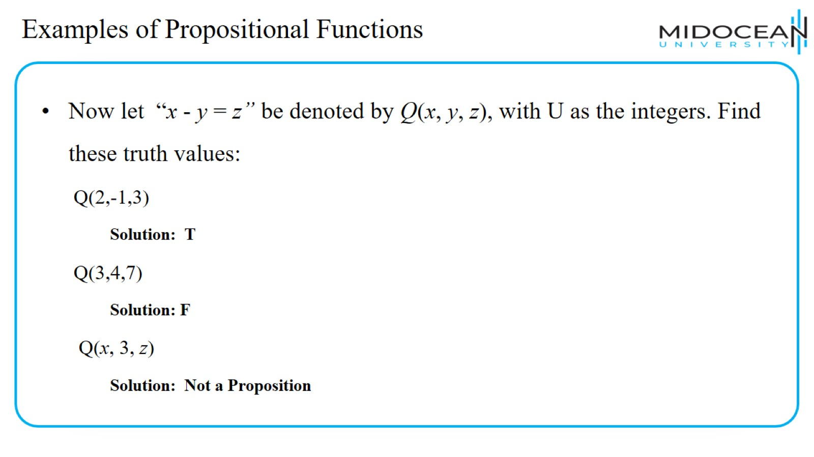
Examples of Propositional Functions

Slide 40
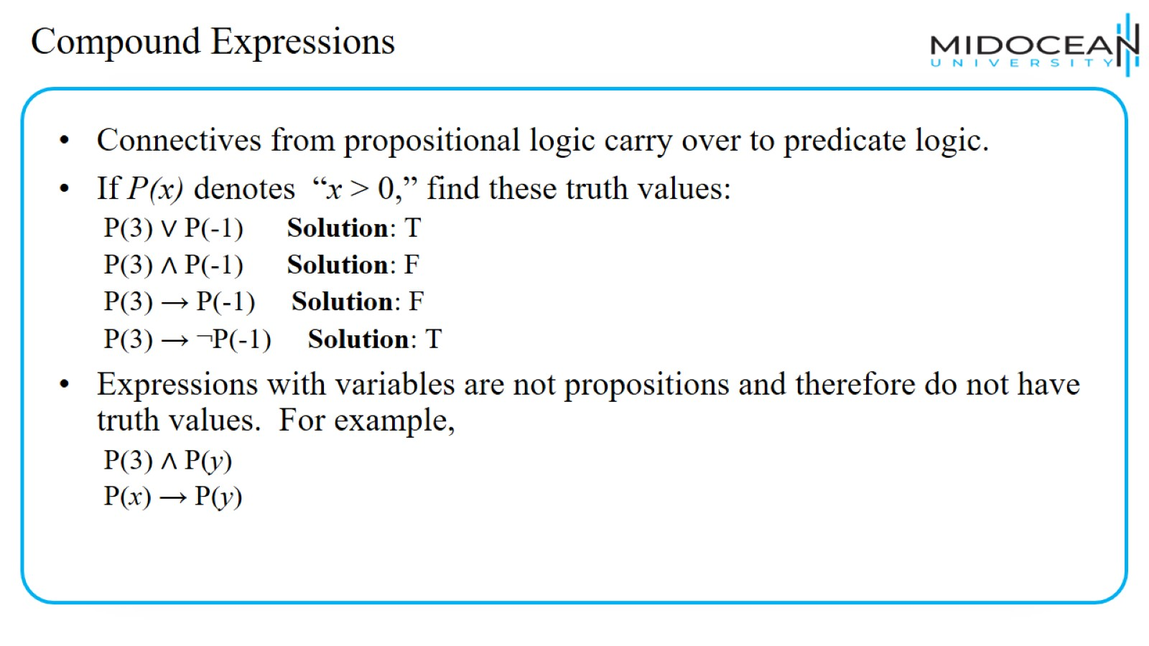
Compound Expressions

Slide 41
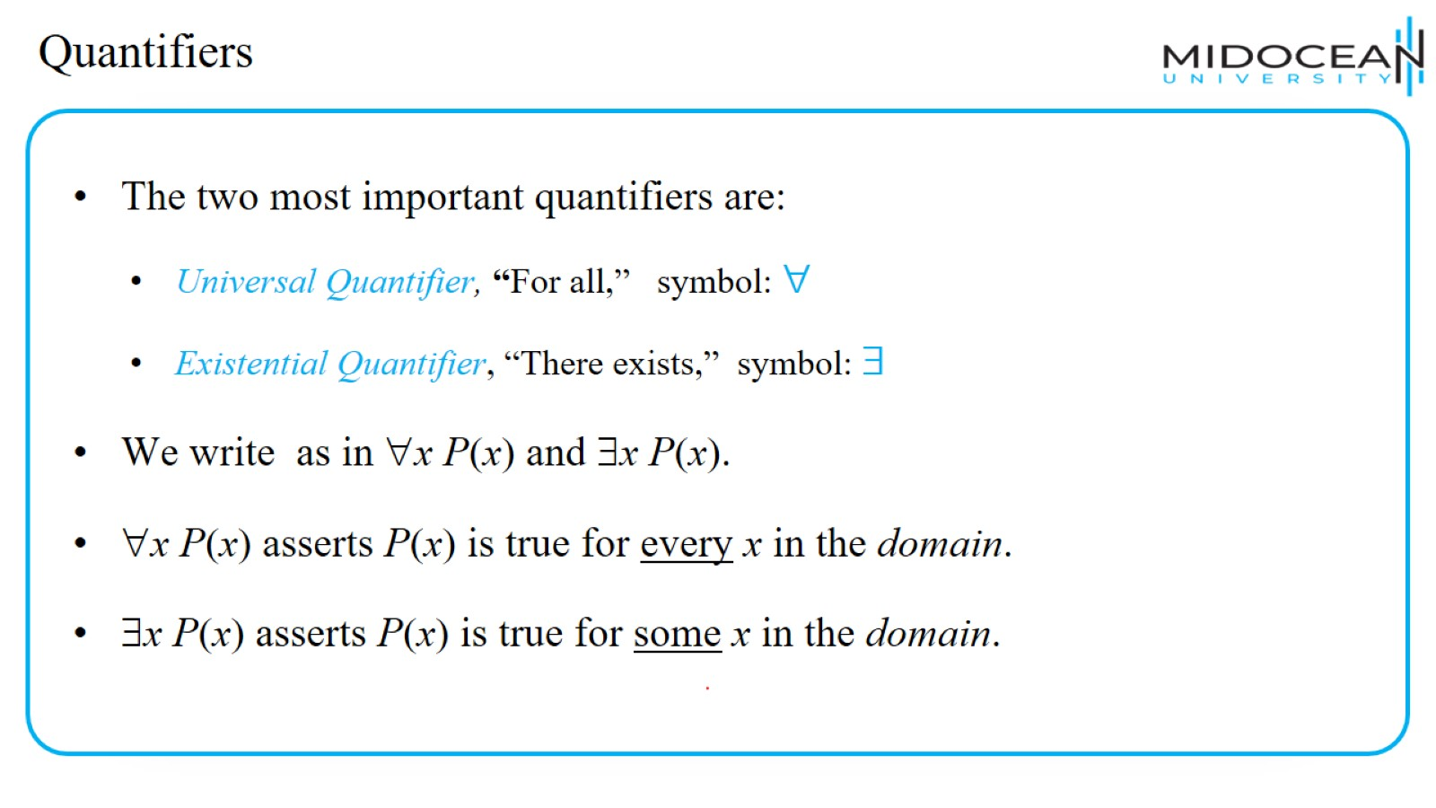
Quantifiers

Slide 42
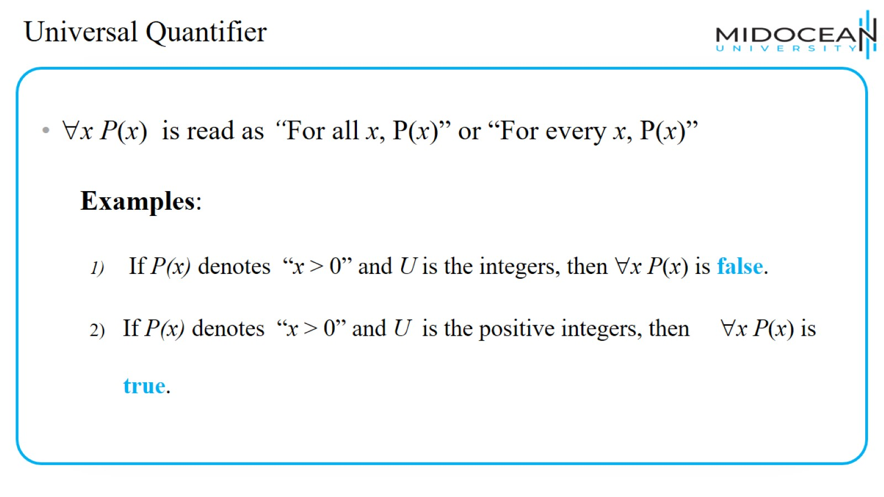
Universal Quantifier

Slide 43
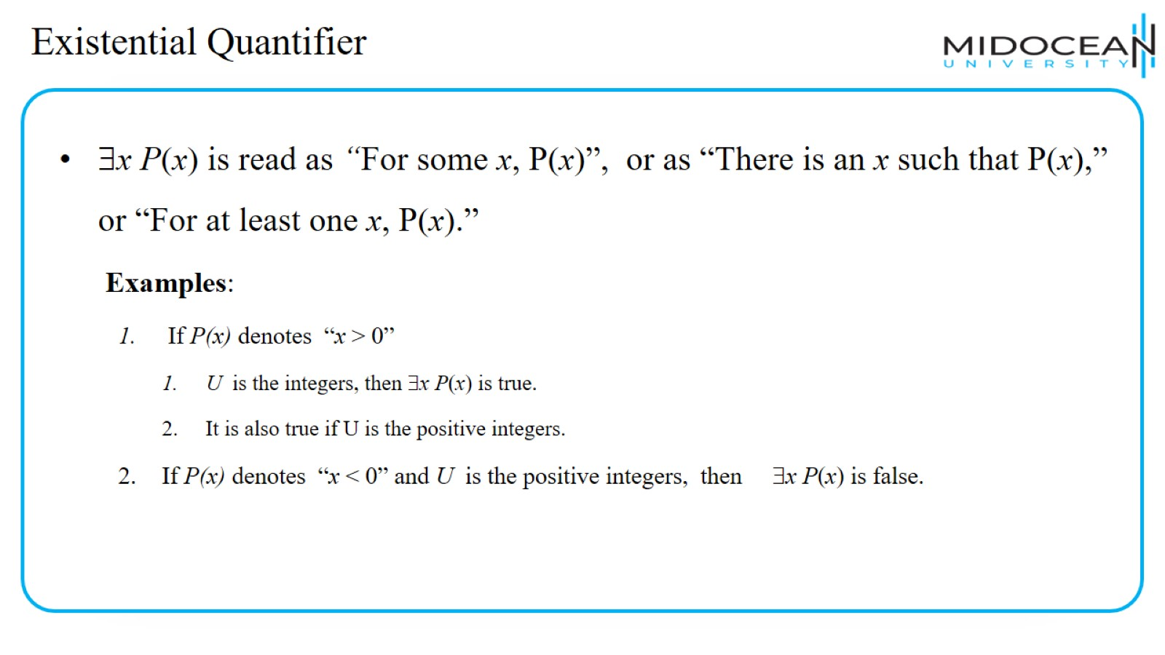
Existential Quantifier

Slide 44
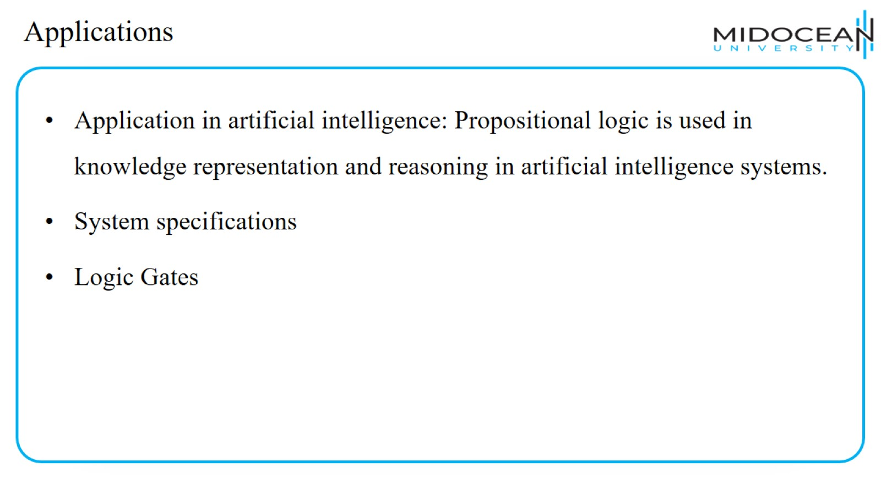
Applications

Slide 45
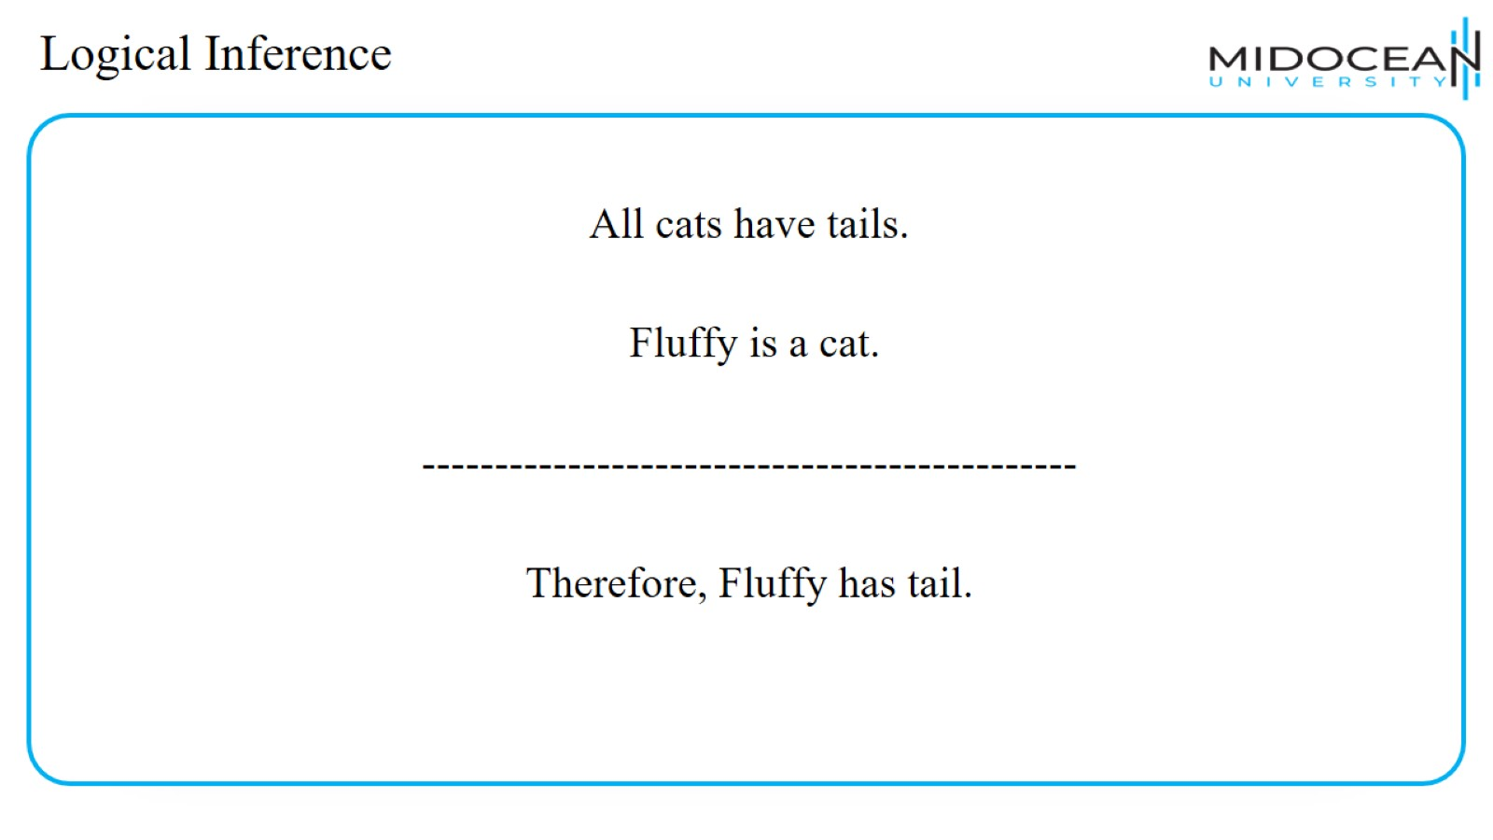
Logical Inference

Slide 46
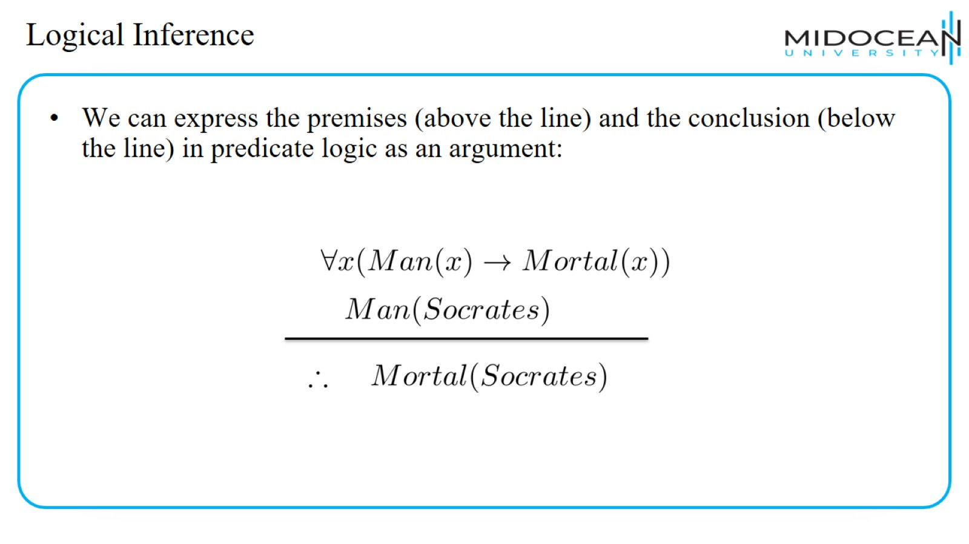
Logical Inference

Slide 47
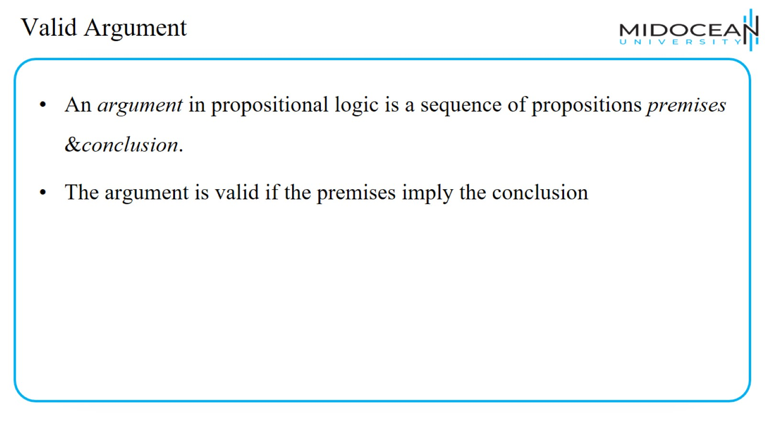
Valid Argument

Slide 48
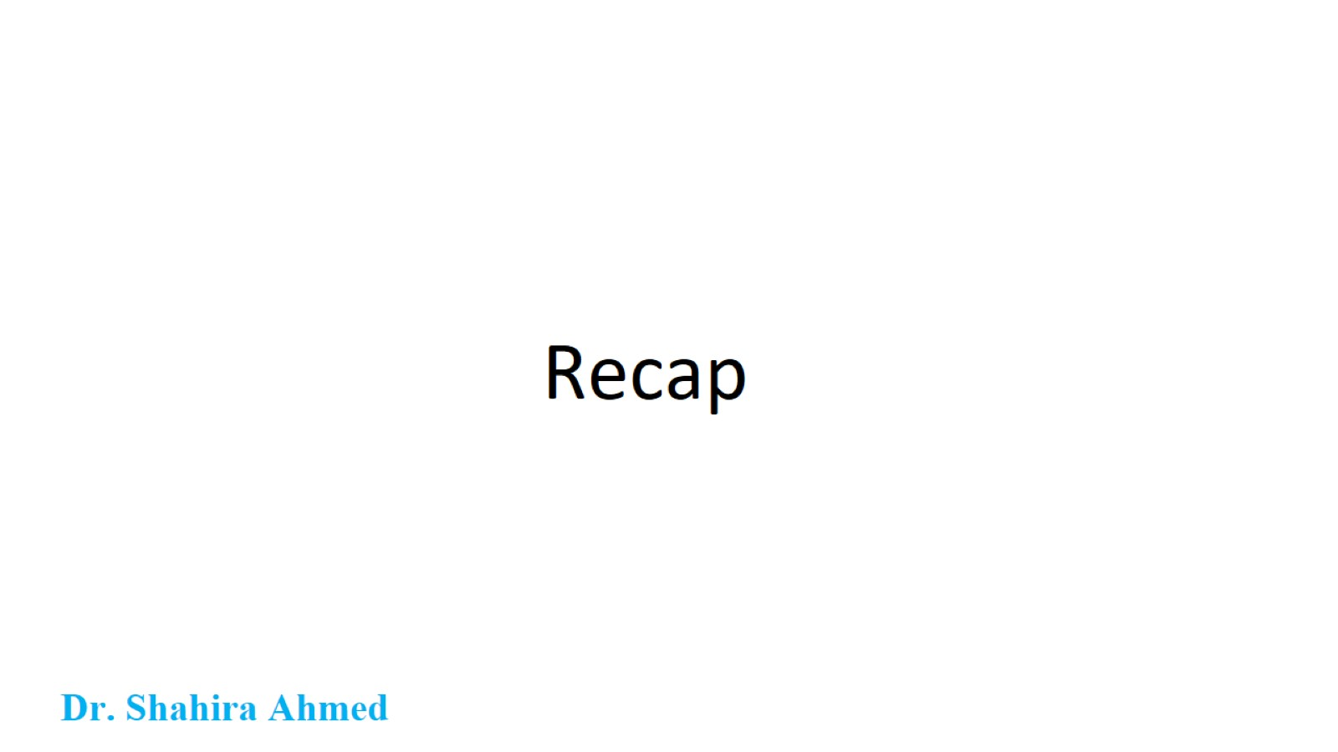
Recap

Slide 49
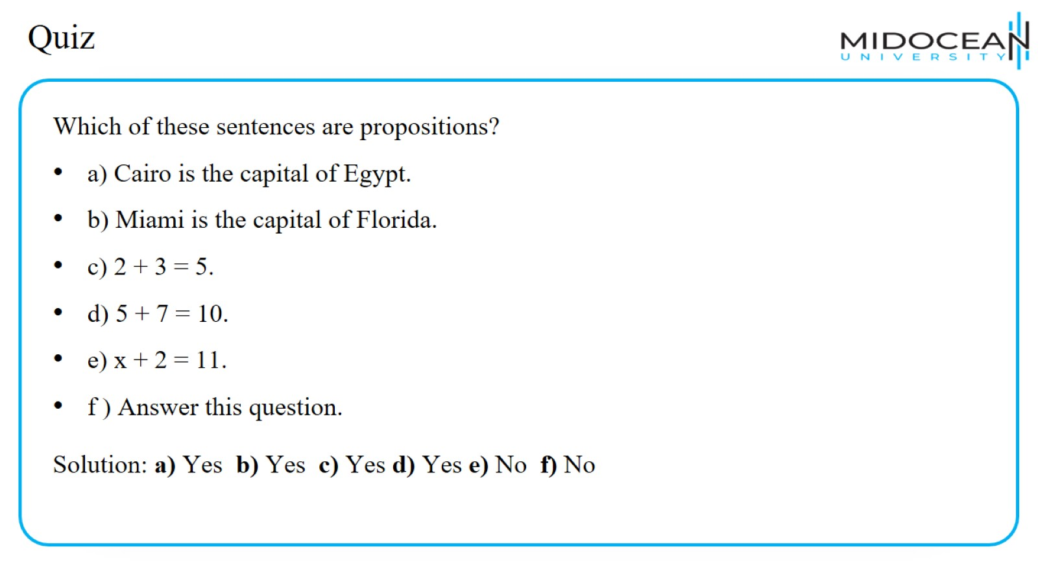
Quiz

Slide 50
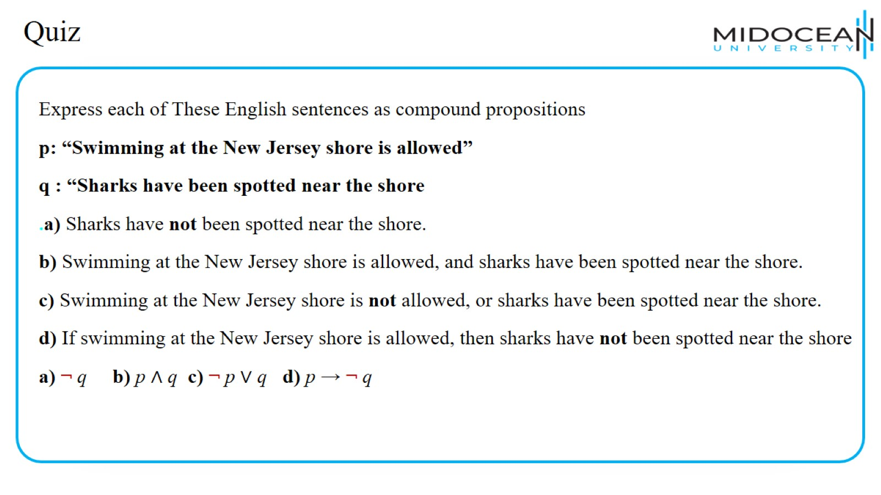
Quiz

Slide 51
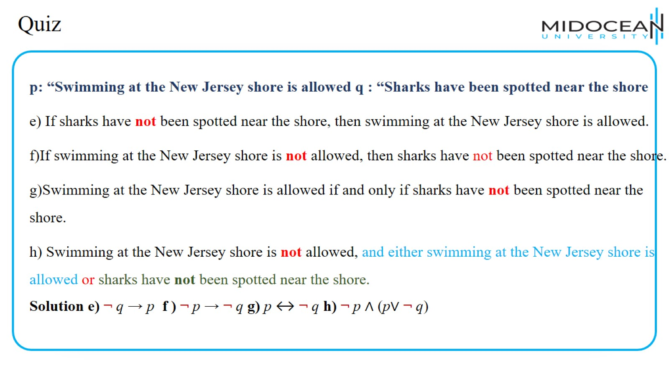
Quiz

Slide 52

Quiz

Slide 53

Quiz

Slide 54

Quiz

Slide 55

Quiz

Slide 56

Quiz

Slide 57

Quiz

Slide 58

Quiz

Slide 59

Quiz

Slide 60

Quiz

Slide 61


Slide 62


