Slide 1

Mathematics
Prepared by Dr.Israa Lewaa
Lecture 1
MAT 112
Functions and Graphs

Slide 2

Lecture
01
Topics
Lecture 1: Functions and Graphs
Lecture 2: Exponential Functions
Lecture 3: Limits and Continuity
Lecture 4: Differentiations
Lecture 5: Additional Differentiation topics
Lecture 6: Curve Sketching
Lecture 7: Integration
Lecture 8: Methods and Applications of integration
Lecture 9: Multivariable Calculus
Lecture 10: Topics by Python

Slide 3
Lecture
01
Functions and Graphs
Functions
Special Functions
Combinations of functions
Linear Equation
Formatting the linear equation to graph it
Graphs in rectangular coordinates

Slide 4
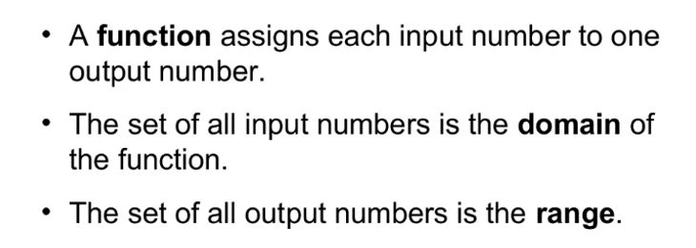
Lecture
01
1. Functions

Slide 5
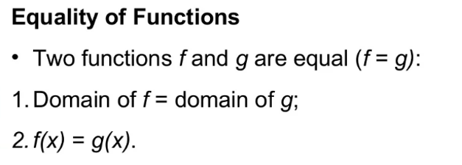
Lecture
01
Equality of Functions

Slide 6
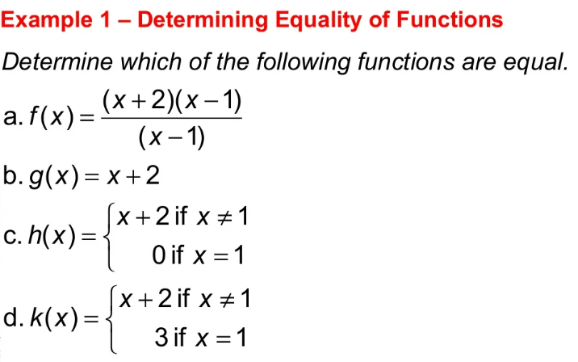
Lecture
01
Example

Slide 7
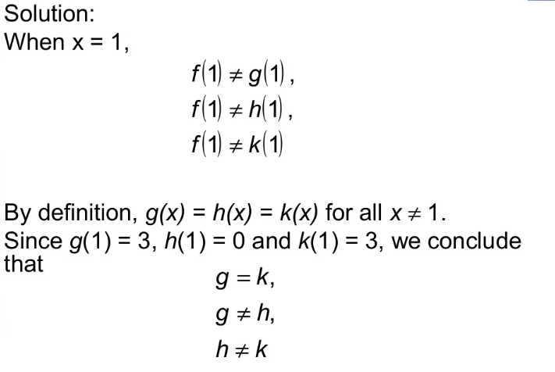
Lecture
01
Solution

Slide 8
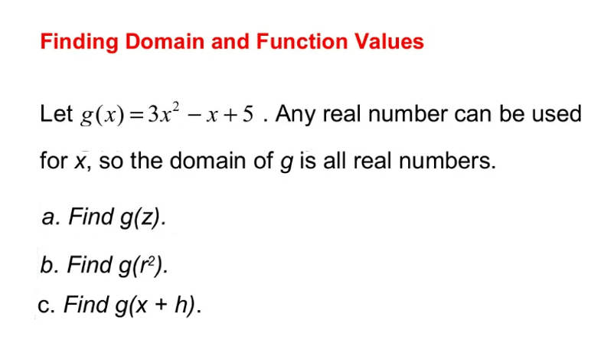
Lecture
01
Example

Slide 9
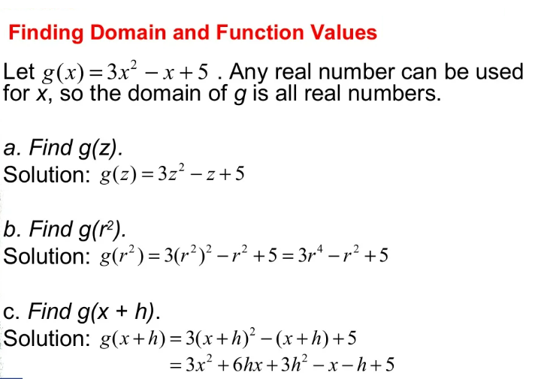
Lecture
01
Example

Slide 10
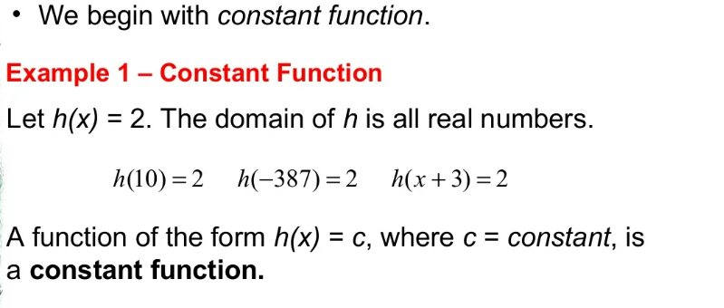
Lecture
01
2- Special Functions

Slide 11
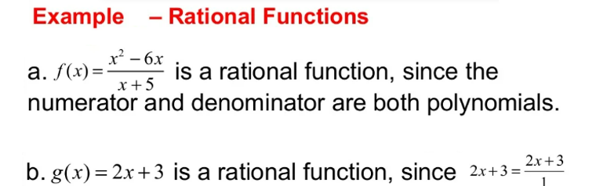
Lecture
01
Example 2

Slide 12
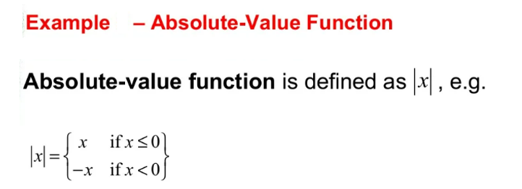
Lecture
01
Example 2

Slide 13
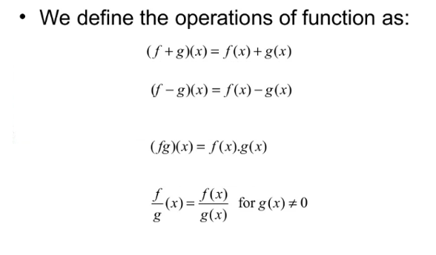
Lecture
01
3. Combinations of functions

Slide 14
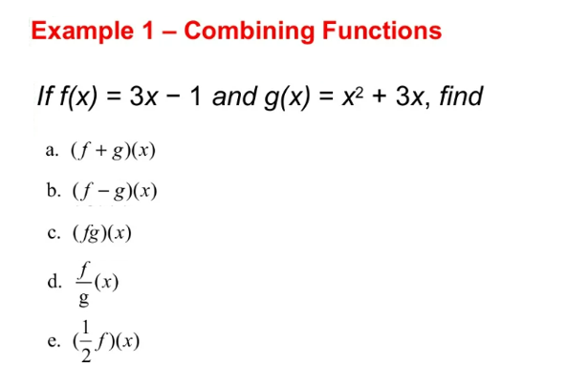
Lecture
01
3. Combinations of functions

Slide 15
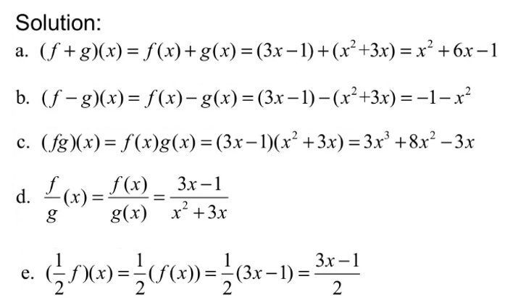
Lecture
01
Solution of Example 3

Slide 16
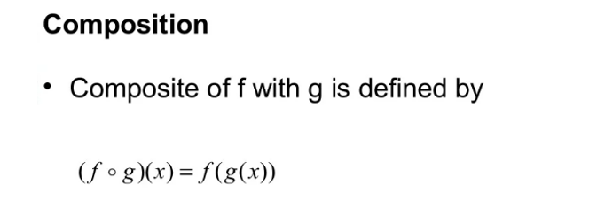
Lecture
01
Composition

Slide 17
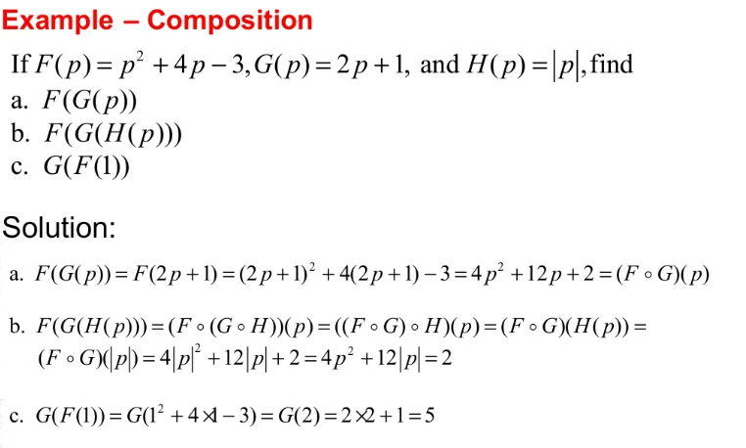
Lecture
01
Example

Slide 18
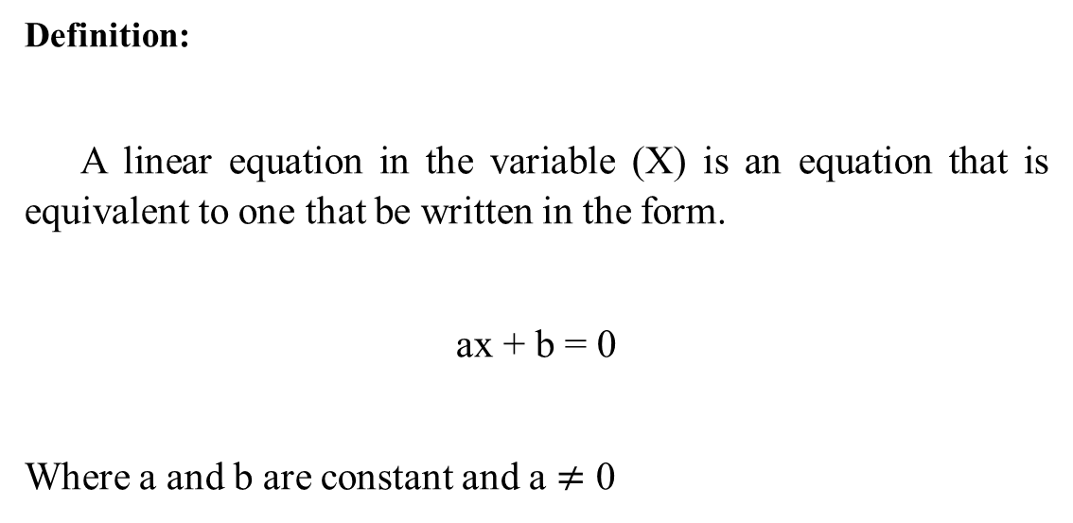
Lecture
01
4- Linear Equations
Definition:
A linear equation in the variable (X) is an equation that is equivalent to one that be written in the form.
ax + b = 0
Where a and b are constant and a $≠$ 0

Slide 19
Lecture
01
Equation Form
→linear equation is also called a first-degree equation, since the highest power of the variable that occurs in Equation (1) is the first.
The general form of a linear equation is:
Ax + By = C

Slide 20
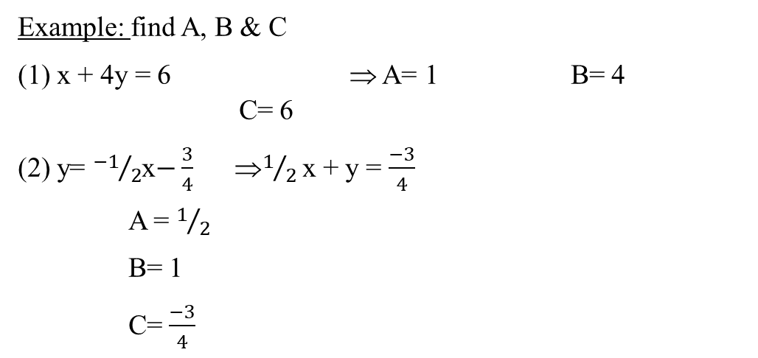
Lecture
01
Example
Example: find A, B & C
(1) x + 4y = 6 ⇒ A= 1 B= 4 C= 6
(2) y= ${−1}/2$x$−\frac{3}{4}$ ⇒$1/2$ x + y = $\frac{−3}{4}$
A = $1/2$
B= 1
C= $\frac{−3}{4}$

Slide 21
Lecture
01
How to Graph a linear Equation ?
How to Graph a linear equation:
To graph a linear equation you need to substitute (X) by zero to get (Y) & substitute (Y) by zero to get (X), to get two points.

Slide 22
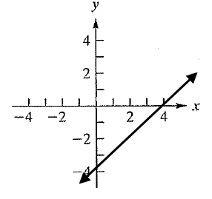
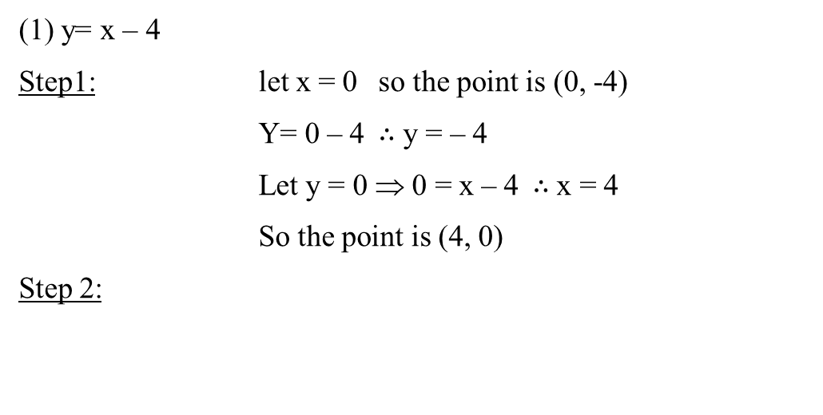
Lecture
01
Example
(1) y= x – 4
Step1: let x = 0 so the point is (0, -4)
Y= 0 – 4 $∴$ y = – 4
Let y = 0 ⇒ 0 = x – 4$∴$ x = 4
So the point is (4, 0)
Step 2:

Slide 23
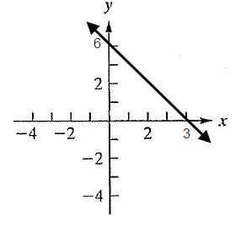
Lecture
01
Example
(2) y = –2 x + 6
Step1: let x= 0 (0, 6)
Let y= 0 (3, 0)
Step2:

Slide 24
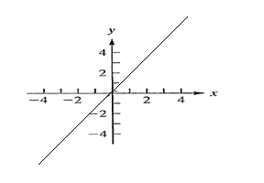
Lecture
01
Example
(3) y= 3x
Step1: let x= 0 (0, 0)
Let x= 2 (2, 6)
Step2:

Slide 25
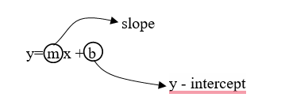
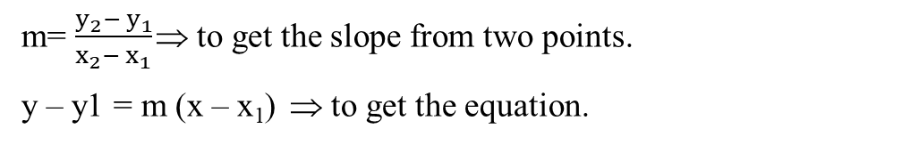
Lecture
01
Example
How to get the slope and the equation:
Rules:
m= $\frac{y_{2}− y_{1}}{x_{2}− x_{1}}$ ⇒ to get the slope from two points.
y – y1 = m (x – x₁) ⇒ to get the equation.

Slide 26
Lecture
01
Example
Example:
Find the equation of a line passing through:
a) (0, 4) , (2, 2)
b) (2, 6) , (1, 4)

Slide 27
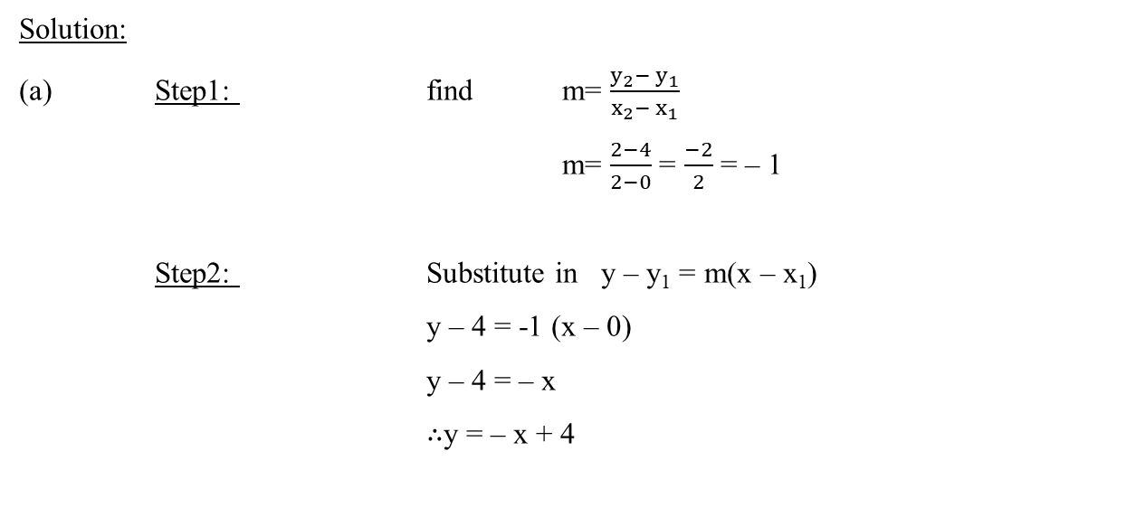
Lecture
01
Example
Solution:
(a) Step1: find m= $\frac{y_{2}− y_{1}}{x_{2}− x_{1}}$
m= $\frac{2−4}{2−0}$ = $\frac{−2}{2}$ = – 1
Step2: Substitute in y – y₁ = m(x – x₁)
y – 4 = -1 (x – 0)
y – 4 = – x
$∴$y = – x + 4

Slide 28
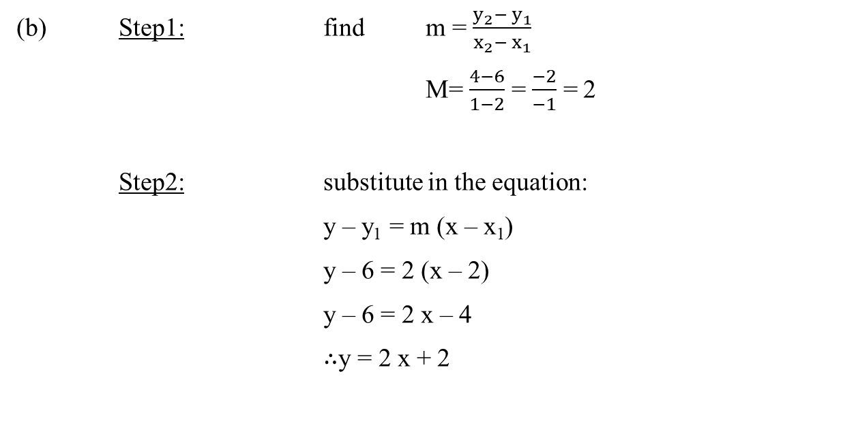
Lecture
01
Example
(b) Step1: find m = $\frac{y_{2}− y_{1}}{x_{2}− x_{1}}$
M= $\frac{4−6}{1−2}$ = $\frac{−2}{−1}$ = 2
Step2: substitute in the equation:
y – y₁ = m (x – x₁)
y – 6 = 2 (x – 2)
y – 6 = 2 x – 4
$∴$y = 2 x + 2

Slide 29
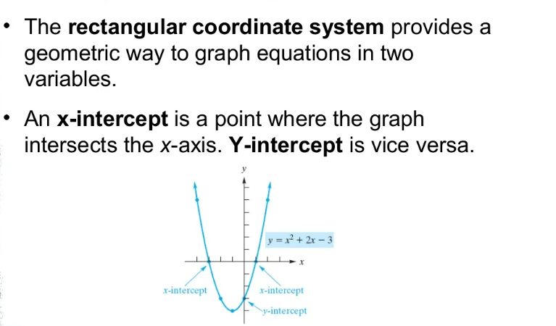
Lecture
01
6- Graphs in Rectangular coordinates

Slide 30
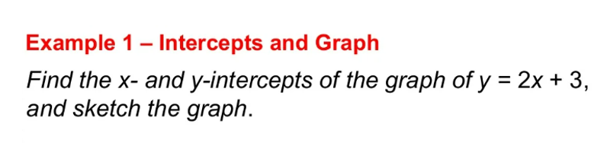
Lecture
01
Example

Slide 31
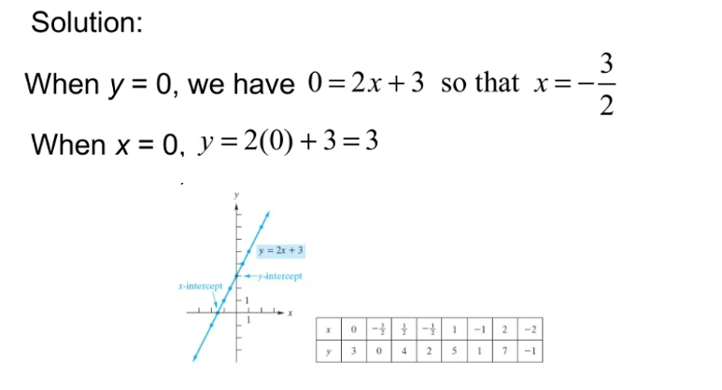
Lecture
01
Example

Slide 32
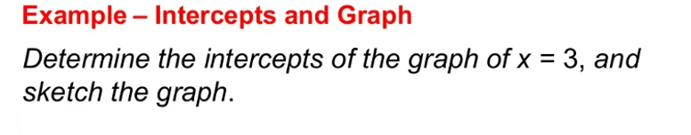
Lecture
01
Example

Slide 33
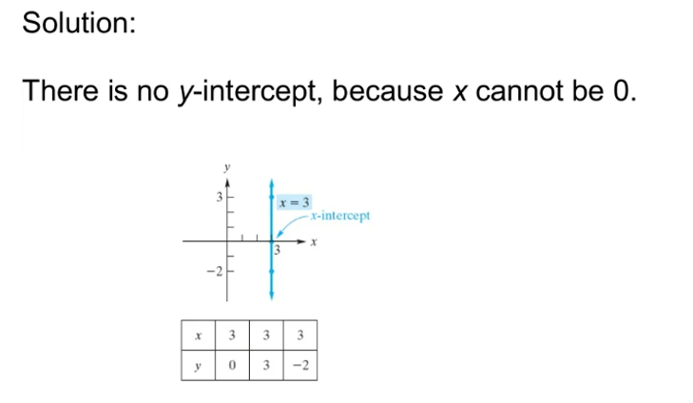
Lecture
01
Example

Slide 34
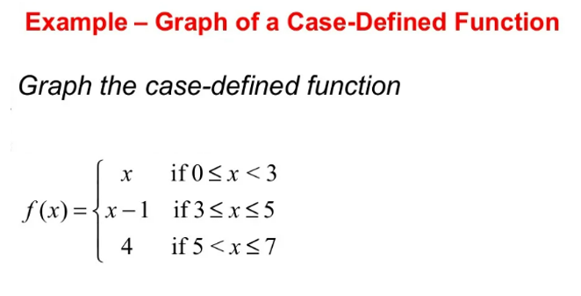
Lecture
01
Example

Slide 35
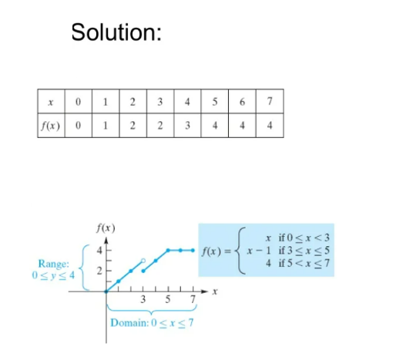
Lecture
01
Example

Slide 36
Lecture
01
Chapter Summary
Functions
Special Functions
Combinations of functions
Linear Equation
Formatting the linear equation to graph it
Graphs in rectangular coordinates

