Slide 1

Network Security
Prepared by Dr. Mohammed Anbar
Lecture 6
An Overview of Cryptography

Slide 2

Chapter
05
Learning objectives
Define the cryptography concepts,
Understand Caesar cipher substitution technique,
Explain sympatric and asymmetric encryption algorithms,
Explain Diffie-Hellman Key Exchange,
Explain Hash functions,
Explain keyed-hash message authentication code,
Explain the basics of cryptanalysis.

Slide 3
Chapter
05
Cryptography Basics
Cryptography is the science of secret or hidden writing
It has two main components:
  Encryption
    Practice hiding messages so that they can not be read by anyone other than the intended recipient
  Authentication & Integrity
    Ensuring that users of data/resources are the persons they claim to be and that a message has not been altered

Slide 4

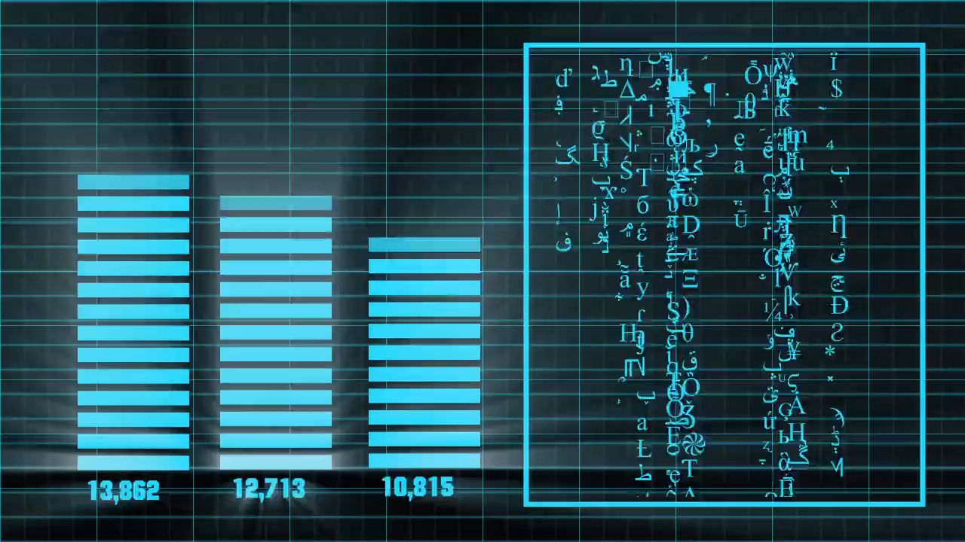
Chapter
05
Types of Encryption Algorithms
Encryption and decryption
use the same key
Uses different keys for encryption
and decryption.

Slide 5

Chapter
05
Symmetric Encryption Algorithms
Symmetric Encryption
AES
DES
IDEA

Slide 6


Chapter
05
Symmetric Key Cryptography
A
B
Enc(msg,Kx)
Enc(msg,K1)
Cipher text
Dec(msg,K1)
Dec(msg,Kx)
Readable text
C
Enc(msg,K2)
Cipher text
Dec(msg,K2)
Cipher text
Readable text

Slide 7

Chapter
05
Asymmetric Encryption Algorithms
Asymmetric Encryption
Elliptic curve
Digital signature

Slide 8
Chapter
05
Asymmetric Key Cryptography
A
B
PVC = private key C
PVB = private key B
PKC = public key C
PKB = public key B
Enc(msg,PKB)
Dec(msg,PVB)
Readable text
Cipher text
C
Enc(msg,PKC)
Dec(msg,PVC)
Cipher text
Readable text

Slide 9
Chapter
05
Encryption - Symmetric Algorithms
Algorithms in which the key for encryption and decryption are the same are Symmetric
  Example: Caesar Cipher
Types:
  Block Ciphers
    Encrypt data one block at a time (typically 64 bits, or 128 bits)
    Used for a single message
  Stream Ciphers
    Encrypt data one bit or one byte at a time

Slide 10
Chapter
05
Symmetric Encryption - Key Strength
Strength of the algorithm is determined by the size of the key
  The longer the key the more difficult it is to crack
Key length is expressed in bits
  Typical key sizes vary between 48 bits and 448 bits
Set of possible keys for a cipher is called keys-space
  For a 40-bit key there are 2⁴⁰ possible keys
  For 128-bit key there are 2¹²⁸ possible keys
  Each additional bit added to the key length doubles the security

Slide 11
Chapter
05
Symmetric Encryption - Key Strength (Cont.)
To crack the key the hacker must use brute-force
  (i.e. try all the possible keys till a key that works is found)
  Supercomputer can crack a 56-bit key in 24 hours
  It will take 2⁷² times longer to crack a 128-bit key (Longer than the age of the universe)Key Strength
* A supercomputer is a computer with a high level of performance as compared to a general-purpose computer

Slide 12
Chapter
05
Substitution Ciphers - Caesar Cipher
Caesar Cipher is a method in which each letter in the alphabet is rotated by three letters.
Caesar cipher substitution technique is vulnerable to brute-force cryptanalysis because its key space is small, i.e., there are only 25 possible keys. In addition, the Caesar cipher substitution technique is vulnerable to frequency analysis.
A B C D E F G H I J K L M N O P Q R S T U V W X Y Z
D E F G H I J K L M N O P Q R S T U V W X Y Z A B C

Slide 13
Chapter
05
Substitution Ciphers - Caesar Cipher (cont.)
0 | 1 | 2 | 3 | 4 | 5 | 6 | 7 | 8 | 9 | 10 | 11 | 12 | 13 | 14 | 15 | 16 | 17 | 18 | 19 | 20 | 21 | 22 | 23 | 24 | 25
A | B | C | D | E | F | G | H | I | J | K | L | M | N | O | P | Q | R | S | T | U | V | W | X | Y | Z
D | E | F | G | H | I | J | K | L | M | N | O | P | Q | R | S | T | U | V | W | X | Y | Z | A | B | C
Let us try to encrypt the message
ATTACK AT DAWN
DWWDFN DW GDZQ
Encryption => c= E(K,P) = (K+P) mod 26
Decryption=> p=D (k,C) = (C- k )mod 26
Encryption Decryption
A = 3+0 mod 26 =3 = D D=3-3 mod 26=0 = A
T= 3+19 mod 26 = 22 =W W= 22-3 mod 26 =19 =T
C= 3+2 mod 26= 5=f f = 5-3 mod 26 = 2= c
Frequency analysis
Notes:
http://www.brianveitch.com/maze-runner/frequency-analysis/index.html

Slide 14
Chapter
05
Substitution Cipher - Monoalphabetic Cipher
Monoalphabetic cipher is a substitution cipher in which for a given key, the cipher alphabet for each plain alphabet is fixed throughout the encryption process. For example, if 'A' is encrypted as 'D', for any number of occurrences in that plaintext, 'A' will always get encrypted to 'D'.
Any letter can be substituted for any other letter. Each letter must have a unique substitute
The monoalphabetic substitution consists in using a mixed alphabet (with the letters in an unusual order) and replacing the letters of the alphabet normal with it.
The key is changed for every message (possibly 26!).
A B C D E F G H I J K L M N O P Q R S T U V W X Y Z
M N B V C X Z A S D F G H J K L P O I U Y T R E W Q

Slide 15
Chapter
05
Substitution Cipher - Monoalphabetic Cipher (cont.)
26! means
For the plaintext letter A you can use the ciphertext letter A, B, C, … , X, Y, or Z. (26 possible letters.)
For B you can use A, B, C, … , X, Y, or Z, but not the letter you did use for A. (25 possible letters.)
For C you can use A, B, C, … , X, Y, or Z, but not the letter you did use for A or B. (24 possible letters.)
For Z you can only use the remaining letter. (1 possible letter.)
The whole number of possible keys is 26×25×24×[...]×2×1=26! (The exclamation mark denotes the factorial of a number.)

Slide 16
Chapter
05
Substitution Cipher - Polyalphabetic Caesar Cipher
Developed by Blaise de Vigenere. Also, called Vigenere cipher
Vigenere Cipher is a method of encrypting alphabetic text.
It uses a simple form of polyalphabetic substitution. A polyalphabetic cipher is any cipher based on substitution, using multiple substitution alphabets.
The encryption of the original text is done using the Vigenère square or Vigenère table.

Slide 17
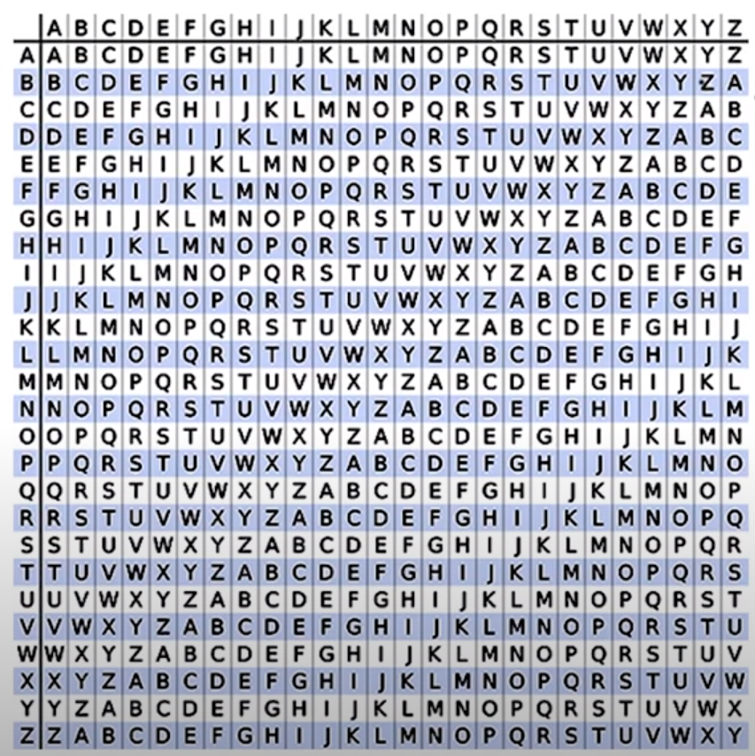
Chapter
05
Substitution Cipher - Polyalphabetic Caesar Cipher (cont.)
Plain text
Encryption
Plaintext: ATTACKATDAWN
Key: Lemon
Keystream: lemonlemonle
Cipher text:
LXFOPVEFRNHR
Key
Vigenère square or Vigenère table

Slide 18
Chapter
05
Substitution Cipher - Polyalphabetic Caesar Cipher (cont.)
Plain text
Decryption
Key: Lemon
Cipher text:
LXFOPVEFRNHR
Keystream: lemonlemonle
Plaintext: ATTACKATDAWN
Key
Vigenère square or Vigenère table

Slide 19
Chapter
05
Symmetric Encryption - Limitations
Any exposure to the secret key compromises the secrecy of the ciphertext.
A key needs to be delivered to the recipient of the coded message for it to be decrypted.
Potential for eavesdropping attack during transmission of key.

Slide 20


Chapter
05
Encryption - Asymmetric Algorithms
Uses a pair of keys for encryption
  Public key for encryption
  Private key for decryption
Messages encoded using the public key can only be decoded by the private key
  Secret transmission of key for decryption is not required
  Every entity can generate a key pair and release its public key
Plain Text
Cipher
Cipher Text
Cipher
Plain Text
Public Key
Private Key
Notes:
1. Must have done this as an assignment last year.

Slide 21
Chapter
05
Asymmetric Encryption - Types
Two most popular algorithms are RSA & El Gamal
  RSA
    Developed by Ron Rivest, Adi Shamir, Len Adelman
    Both public and private key are interchangeable
    Variable Key Size (512, 1024, or 2048 bits)
    Most popular public key algorithm
  El Gamal
    Developed by Taher ElGamal
    Variable key size (512 or 1024 bits)
    Less common than RSA, used in protocols like PGP

Slide 22
Chapter
05
Asymmetric Encryption - Weaknesses
Efficiency is lower than Symmetric Algorithms. It's a slow process compared to symmetric cryptography. Therefore, it's not appropriate for decrypting bulk messages.
Potential for a man-in-the-middle attack
Since public keys aren't authenticated, nobody can be certain that a public key belongs to the person supplied.

Slide 23
Chapter
05
Diffie-Hellman
Diffie-Hellman is the first key agreement algorithm
  Invented by Whitfield Diffie & Martin Hellman
  Provided the ability for messages to be exchanged securely without having to have shared some secret information previously
  Inception of public key cryptography which allowed keys to be exchanged in the open
No exchange of secret keys
  Man-in-the-middle attack avoided

Slide 24


Chapter
05
Diffie-Hellman Key Exchange
A
Secure Key Exchange
B
Attacker

Slide 25



Chapter
05
Diffie-Hellman Key Exchange
Public key = Generator ^{private key} mod Prime
Public key (A) = 3 ¹⁵ mod 17 =6
Public key (B) = 3 ¹³ mod 17 =12
Attacker
Prime = 17
Generator =3
Public(A) =6
Public(B) =12
A
B
Public(B) =12
Public(A) =6
Prime = 17
Generator =3
Private key (B) =13
Public key(B) = 12
Secret key = 6 ¹³ mod 17= 10
(3¹⁵)¹³
Prime = 17
Generator =3
Private key(A)=15
Public key(A) =6
Secret key = 12 ¹⁵ mod 17= 10
(3¹³)¹⁵
3 ^{15*13}

Slide 26

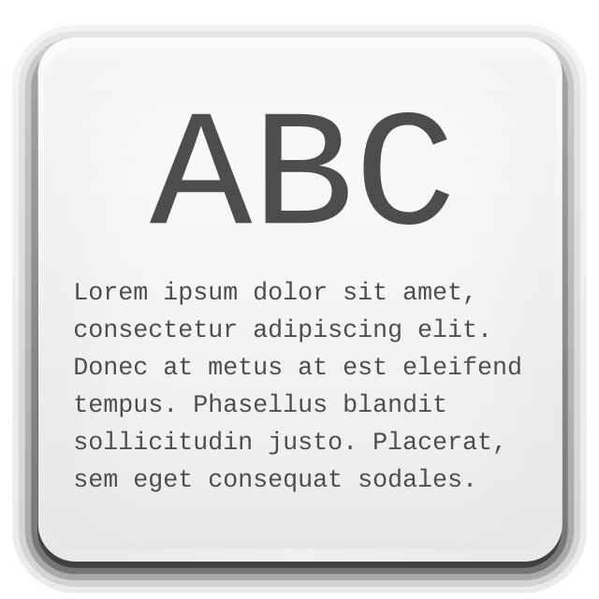

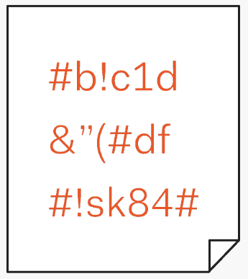

Chapter
05
Hash functions
Hashing is one-way cryptographic algorithm means that the ciphertext cannot
be decrypted to reveal the original plaintext
Plain Text
Hash function
Hash value

Slide 27
Chapter
05
Hash functions (cont.)
Hash functions represent a third cryptography type alongside symmetric and asymmetric cryptography.
A hash function is a function that maps data of any size to data of a fixed size.
The value returned by a hash function is called hash value or simply h which It is often viewed as a digital fingerprint.
Hashing only provides integrity services; confidentiality services are not supported. A one-way cryptographic algorithm is a hash function. The adoption of a one-way cryptographic algorithm prevents the ciphertext from being decoded to expose the original plaintext.
A hashing function's able to produce completely distinct hash values even when the input plaintext is slightly altered is another noteworthy feature. This characteristic is helpful for data security since it produces clearly different hashes whenever an attacker makes even a small alteration to the original data.

Slide 28
Chapter
05
Hash functions (cont.)
A
B
H (M, hash value )
H (M, hash value )
If the hash value generated by A = the hash value generated by B then integrity achieved

Slide 29
Chapter
05
Common Hash Functions
Random-length message
MD5
Hash value: fixed-length output of 128 bits
Random-length message
SHA-256
Hash value: fixed-length output of 256 bits

Slide 30
Chapter
05
keyed-hash message authentication code
In cryptography, an HMAC (sometimes expanded as either keyed-hash message authentication code or hash-based message authentication code) is a specific type of message authentication code (MAC) involving a cryptographic hash function and a secret cryptographic key.
As with any MAC, it may be used to simultaneously verify both the data integrity and authenticity of a message.
HMAC can provide authentication using a shared secret instead of using digital signatures with asymmetric cryptography.
It trades off the need for a complex public key infrastructure by delegating the key exchange to the communicating parties, who are responsible for establishing and using a trusted channel to agree on the key prior to communication.

Slide 31
Chapter
05
keyed-hash message authentication code (cont.)
The key length plays an important role in hashing algorithm. The bigger the key size, the harder to break in the key while the smaller the key size, the easier to break in the key and the algorithm is more vulnerable to collision attack where the hashing algorithm generates the same hash value for different input
MD5 – Uses a 128-bit shared secret key. The variable-length message and 128-bit shared secret key are combined and run through the HMAC-MD5 hash algorithm. The output is a 128-bit hash. The hash is appended to the original message and forwarded to the remote end.
SHA – SHA-1 uses a 160-bit secret key. The variable-length message and the 160-bit shared secret key are combined and run through the HMAC-SHA1 hash algorithm. The output is a 160-bit hash. The hash is appended to the original message and forwarded to the remote end.

Slide 32

Chapter
05
Cryptanalysis attacks
Cryptanalysis= the science of breaking encryption
  To determine the weak points of a cryptographic system, it is important to attack the system. These attacks are called Cryptanalytic attacks.
  The main goal of a Cryptanalysis attack is to recover the key in use rather than simply to recover the plaintext of a single ciphertext.

Slide 33
Chapter
05
Cryptanalysis Techniques
  Attempt to infer some meaning without even breaking the encryption, such as noticing an unusual frequency of communication or determining something by whether the communication was short or long.
  Attempt to deduce the key, in order to break subsequent messages easily
  Attempt to find weaknesses in the implementation or environment of the use of encryption.
  Attempt to find general weaknesses in an encryption algorithm, without necessarily having intercepted any messages.

Slide 34
Chapter
05
Cryptanalytic attacks
Known-Plaintext Analysis (KPA)
Chosen-Plaintext Analysis (CPA)
Ciphertext-Only Analysis (COA)
Man-In-The-Middle (MITM) attack
Adaptive Chosen-Plaintext Analysis (ACPA)

Slide 35
Chapter
05
Cryptanalytic attacks
  Known-Plaintext Analysis (KPA) :
  In this type of attack, some plaintext-ciphertext pairs are already known. The attacker maps them in order to find the encryption key. This attack is easier to use as a lot of information is already available.
  Chosen-Plaintext Analysis (CPA) :
  In this type of attack, the attacker chooses random plaintexts and obtains the corresponding ciphertexts and tries to find the encryption key. It’s very simple to implement like KPA but the success rate is quite low.
  Ciphertext-Only Analysis (COA) :
  In this type of attack, only some ciphertext is known and the attacker tries to find the corresponding encryption key and plaintext. It’s the hardest to implement but is the most possible attack as only ciphertext is required.
  Man-In-The-Middle (MITM) attack :
  In this type of attack, the attacker intercepts the message/key between two communicating parties through a secured channel.
  Adaptive Chosen-Plaintext Analysis (ACPA) :
  This attack is like CPA. Here, the attacker requests the cipher texts of additional plaintexts after they have ciphertexts for some texts.

Slide 36
Chapter
05
References
Stallings, W. (2006). Cryptography and network security principles and practices 4th edition
Vincent Nestler, Gregory White, wm. Arthur Conklin, Principles of Computer Security: CompTIA Security+ and Beyond – Lab Manual, ISBN: 978-0-07-174856-8, MHID: 0-07-174856-3, McGraw Hill, 2011

Slide 37

Thank you

