Slide 1


Improving Quality of Health Services
Prepared by Dr. Abdulaziz Alsaedi
MHA611
Healthcare Systems
Lecture 03

Slide 2

Outlines:
Quality definition.
Quality Aspects.
Quality dimensions
Total Quality Management (TQM).
TQM Principles.
TQM implementation.
Summary

Slide 3

Chapter
Learning Objectives
02
Understanding the Quality of care concepts.
Understanding the different aspects of quality of care.
Understanding the dimensions of quality of care.
Understanding how to evaluate and measure quality of care.
Understanding how to improve the quality of care.
Understanding different models used for improving the quality of care.
Understanding how to implement the TQM approach in health care.
Book: Health Care System around the world

Slide 4
Part One:
Definitions and concepts of quality of care

Slide 5

Chapter
Quality of care concept:
02
What does Quality mean?
Book: Health Care Science

Slide 6

Chapter
Quality of care concept:
02
Doing the right things right the first time.
Book: Health Care Science

Slide 7



Chapter
Quality of care concept:
02
Compliance with standards.
Book: Health Care Science

Slide 8

Chapter
Quality of care concept:
02
Meeting recipients’/ patients’ needs and expectations.
(W. Edwards Deming)
Book: Health Care Science

Slide 9



Chapter
Quality of care concept:
02
Providers’ perspective
Insurers’ perspective
Receivers’ perspective
Book: Health Care Science

Slide 10
Chapter
Quality of care concept:
02
The Institute of Medicine (IOM) defines quality as:
"The degree to which health care services for individuals and populations increase the probability of desired health outcomes and are consistent with current professional knowledge of best practice."
Book: Health Care Science

Slide 11

Chapter
Aspects of Quality ( MAP)
02
Measurable
Appreciative
Perceptive
Book: Health Care Science

Slide 12

Chapter
Quality of care concept:
02
Measurable Quality
It can be defined objectively as compliance with, or adherence to standards.
These standards may take the form of practice parameters or protocols, or they may establish acceptable expectations for patient and organizational outcomes.
Book: Health Care Science

Slide 13

Chapter
Quality of care concept:
02
Appreciative Quality
It is the comprehension and appraisal of excellence beyond minimal standards and criteria.
Requires the judgments of skilled, experienced practitioners and sensitive, caring persons.
Peer review bodies rely on the judgments of professionals in determining the quality or non-quality of specific patient-practitioner interactions.
Book: Health Care Science

Slide 14

Chapter
Quality of care concept:
02
Perceptive Quality:
It is the degree of excellence which is perceived by the recipient or the observer of care rather than by the provider of care.
It is generally based more on the degree of caring expressed by physicians, nurses, and other staff than on the physical environment and technical competence.
Book: Health Care Science

Slide 15
Part Two:
Benefits of providing high-quality care

Slide 16

Chapter
Quality of care concept:
02
What are the benefits gained from providing quality care?
Book: Health Care Science

Slide 17

Chapter
Dimensions of Quality:
02
Dimensions of Quality
Book: Health Care Science

Slide 18

Chapter
Dimensions of Quality:
02
1. Safety:
Avoiding injuries to patients from the care that is intended to help them.
How is the Safety measured?
Mortality rate.
Adverse events.
Medical errors
Medication errors.
Book: Health Care Science

Slide 19

Chapter
Dimensions of Quality:
02
2. Timely:
Reducing waits and sometimes harmful delays for both those who receive and those who give care.
How is the “Timely” measured?
By waits or delays in receiving needed care, services, or test results.
TAT
Waiting time in ER
Waiting time for urgent consultations
Book: Health Care Science

Slide 20

Chapter
Dimensions of Quality:
02
3. Effectiveness:
Providing services based on scientific knowledge to all who could benefit, and refraining from providing services to those not likely to benefit.
How is the Effectiveness measured?
How well evidenced-based practices are followed
Hospital-acquired infections,
In-patients who develop pressure ulcers
Book: Health Care Science

Slide 21

Chapter
Dimensions of Quality:
02
4. Efficiency:
Avoiding waste, including waste of equipment, supplies, ideas, and energy.
How is the Efficiency measured?
Length of Stay (LOS)
Patients seen by the clinic
Book: Health Care Science

Slide 22

Chapter
Dimensions of Quality:
02
5. Equitability:
Providing care that does not vary in quality because of personal characteristics such as gender, ethnicity, geographic location, and socioeconomic status.
How is the equitability measured?
Differences in quality measures.
Source: Crossing the Quality Chasm, IOM, 2001

Slide 23

Chapter
Dimensions of Quality:
02
6. Patient-centeredness:
Providing care that is respectful of and responsive to individual patient preferences, needs, and values, and ensuring that patient values guide all clinical decisions.
How is the patient-centeredness measured?
Primary care patients who said that doctors treated them with respect and dignity.
Source: Crossing the Quality Chasm, IOM, 2001

Slide 24

Chapter
Dimensions of Quality:
02
7. Continuity:
The coordination of needed healthcare services for a patient or specified population among all practitioners and across involved organizations over time.
How is the continuity measured?
Level of coordination and cooperation.
Source: Crossing the Quality Chasm, IOM, 2001

Slide 25

Chapter
Dimensions of Quality:
02
8. Appropriateness:
The degree to which the care/ intervention is relevant to the patient’s clinical needs, given the current state of knowledge.
How is the appropriateness measured?
Compliance with the clinical protocol/ guideline.
Source: Crossing the Quality Chasm, IOM, 2001

Slide 26

Chapter
Dimensions of Quality:
02
9. Availability:
The degree to which appropriate care/ intervention is obtainable to meet the patient’s needs.
How is the availability measured?
Complaints regarding the unavailability of services.
Incidents related to the unavailability of services.
Waiting time to obtain the services.
Source: Crossing the Quality Chasm, IOM, 2001

Slide 27

Chapter
Dimensions of Quality:
02
10. Efficacy:
The potential, capacity, or capability to produce the desired effect or outcome, as already shown, e.g., through scientific research (evidence-based) findings.
How is the efficacy measured?
Patient satisfaction with the procedure/ medication.
Source: Crossing the Quality Chasm, IOM, 2001

Slide 28

Chapter
Dimensions of Quality:
02
11. Competency:
The practitioner’s ability to produce both the health and satisfaction of customers. The degree to which the practitioner adheres to professional and/ or organizational standards of care and practice.
How is the competency measured?
Peers review.
Source: Crossing the Quality Chasm, IOM, 2001

Slide 29

Chapter
Dimensions of Quality:
02
12. Respect and Caring:
The degree to which those providing services do so with sensitivity to the individual’s needs, expectations, and differences. Or the degree to which the individual or a designee is involved in his or her own care decision.
How is the competency measured?
Patient Satisfaction.
Source: Crossing the Quality Chasm, IOM, 2001

Slide 30

Chapter
Dimensions of Quality:
02
What should be evaluated?
Source: Crossing the Quality Chasm, IOM, 2001

Slide 31
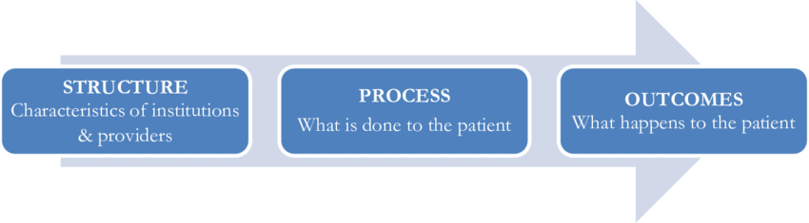
Chapter
Evaluating the Quality of care:
02
As Donabedian first noted in 1966, all evaluations of the quality of care can be classified in terms of one of three aspects of caregiving they measure: structure, process, or outcomes.
Source: The Healthcare Quality Book

Slide 32

Chapter
Evaluating the Quality of care:
02
Structure:
When quality is measured in terms of structure, the focus is on the relatively static characteristics of the individuals who provide care and of the settings where the care is delivered.
These characteristics include the education, training, and certification of professionals who provide care and the adequacy of the facility’s staffing, equipment, and overall organization.
Source: The Healthcare Quality Book

Slide 33

Chapter
Evaluating the Quality of care:
02
Process:
Process, which refers to what takes place during the delivery of care, also can be the basis for evaluating the quality of care.
The quality of the process in turn can vary on two aspects: appropriateness, which refers to whether the right actions were taken, and skill, which refers to how well actions were carried out and how timely they were.
Source: The Healthcare Quality Book

Slide 34
Chapter
Evaluating the Quality of care:
02
Process:
Ordering the correct diagnostic procedure for a patient is a measure of appropriateness.
When evaluating the process of care, however, appropriateness is only half the story.
The other half is in how well and how promptly (i.e., skillfully) the procedure was carried out.
Source: The Healthcare Quality Book
Book: Health Care Science

Slide 35
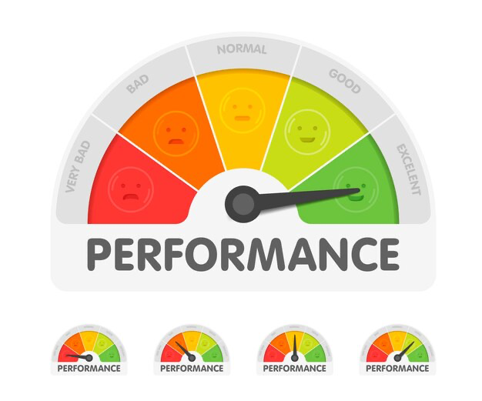
Chapter
Evaluating the Quality of care:
02
Outcome:
Outcome measures, which capture whether healthcare goals were achieved, are another way of assessing quality of care.
Because the goals of care can be defined broadly, outcome measures have come to include the costs of care as well as patients’ satisfaction with care.
Source: The Healthcare Quality Book

Slide 36
Part Three:
Quality Improvement

Slide 37

Chapter
Quality of care concept:
02
How do we improve the quality of care and services we provide?
Book: Health Care Science

Slide 38
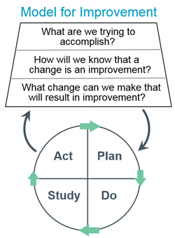
Chapter
Quality improvement:
02
API Improvement Model:
The Associate in Process Improvement (API), developed a simple model for improvement based on Deming’s PDSA cycle.
The model contains three fundamental questions that form the basis of improvement: What are we trying to accomplish? How will we know that a change is an improvement? What change can we make that will result in improvement?
Focus on the three questions and the PDSA cycle allows the model’s application to be as simple or sophisticated as necessary.
Book: Health Care Science

Slide 39
Chapter
Quality improvement:
02
API Improvement Model:
Source: The Healthcare Quality Book

Slide 40

Chapter
Quality improvement:
02
FOCUS-PDCA Model:
The Hospital Corporation of America designed the FOCUS PDCA model to create a more specific and defined approach to process improvement.
The key feature of FOCUS PDCA is the preexistence of a process that needs improvement. The intent of this model is to maximize the performance of a preexisting process, although the inclusion of PDCA provides the option of using this model for new or redesign projects.
Source: The Healthcare Quality Book
Book: Health Care Science

Slide 41
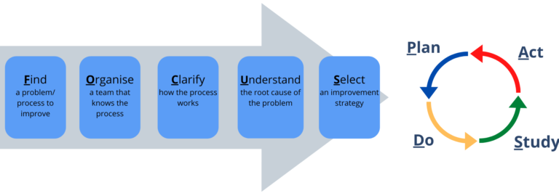
Chapter
Quality improvement:
02
FOCUS-PDCA Model:
Source: www.futurelearn.com

Slide 42
Chapter
Quality improvement:
02
Joran Trilogy:
The trilogy describes three interrelated processes: quality planning, quality control, and quality improvement.
Quality Planning
Quality Improvement
Quality Control
Source: The Healthcare Quality Book

Slide 43
Chapter
Quality improvement:
02
Quality Planning
Identify who the customers are.
Determine the needs of those customers
Translate these needs into our language
Develop a product that can respond to those needs
Optimize the product features to meet our needs and customer need
Quality Control
Prove that the process can produce the product under operating conditions with minimal inspection
Transfer the process to operations.
Quality Improvement
Develop a process which is able to produce a product
Optimize the process
Source: Juran’s Quality Handbook.

Slide 44

Chapter
Total Quality Management:
02
Total Quality Management

Slide 45

Chapter
Total Quality Management:
02
Concepts and Definitions:
Total Quality Management is one of the most prominent developments in management for the past two decades.
Total Quality Management is defined as “a management philosophy concerned with people and work processes that focuses on customer satisfaction and improves organizational performance”.
Total Quality Management can cope with all the healthcare organization’s problems and challenges, such as quality, cost, patient safety and satisfaction, and the growth of technology.
http://dx.doi.org/10.1016/j.jtumed.2015.05.004

Slide 46

Chapter
TQM Principles:
02
1. Customer focused:
The customer ultimately determines the level of quality. No matter what an organization does to foster quality improvement.
The customer determines whether the efforts were worthwhile.
2. Total employee involvement:
An organization must ensure all employees buy into the processes and system.
Employees should not fear change and be empowered.
Source: https://asq.org/quality-resources/total-quality-management/implementing-tqm

Slide 47
Chapter
TQM Principles:
02
3. Process-oriented:
TQM focuses on process thinking.
A process is a series of steps that take inputs from suppliers and transform them into outputs that are delivered to customers.
These steps should be defined and monitored to detect unexpected variation.
4. Integrate systems:
Total Quality Management believes that all systems should communicate with each other to discuss useful information and make better decisions.
Source: https://asq.org/quality-resources/total-quality-management/implementing-tqm

Slide 48
Chapter
TQM Principles:
02
5. Strategic and systematic approach:
A critical part of the management of quality is the strategic and systematic approach to achieving an organization’s vision, mission, and goals. This process, called strategic planning or strategic management, includes the formulation of a strategic plan that integrates quality as a core component.
6. Continual improvement:
Continual improvement drives an organization to be both analytical and creative in finding ways to become more competitive and more effective at meeting stakeholder expectations.
Source: https://asq.org/quality-resources/total-quality-management/implementing-tqm

Slide 49
Chapter
TQM Principles:
02
7. Fact-based decision making:
In order to know how well an organization is performing, data on performance measures are necessary. TQM requires that an organization continually collect and analyze data in order to improve decision-making accuracy, achieve consensus, and allow prediction based on past history.
8. Communication:
During times of organizational change, as well as part of day-to-day operations, effective communication plays a large part in maintaining morale and motivating employees at all levels.
Source: https://asq.org/quality-resources/total-quality-management/implementing-tqm

Slide 50
Chapter
TQM Implementation:
02
When planning and implementing a total quality management system or quality management strategy, there is no one solution for every situation or workplace.
Each organization is unique in terms of its culture, management practices, and the processes used to create and deliver its products and services.
Quality management strategies vary from organization to organization; however, a set of primary elements should be present in some format.
Source: https://asq.org/quality-resources/total-quality-management/implementing-tqm

Slide 51
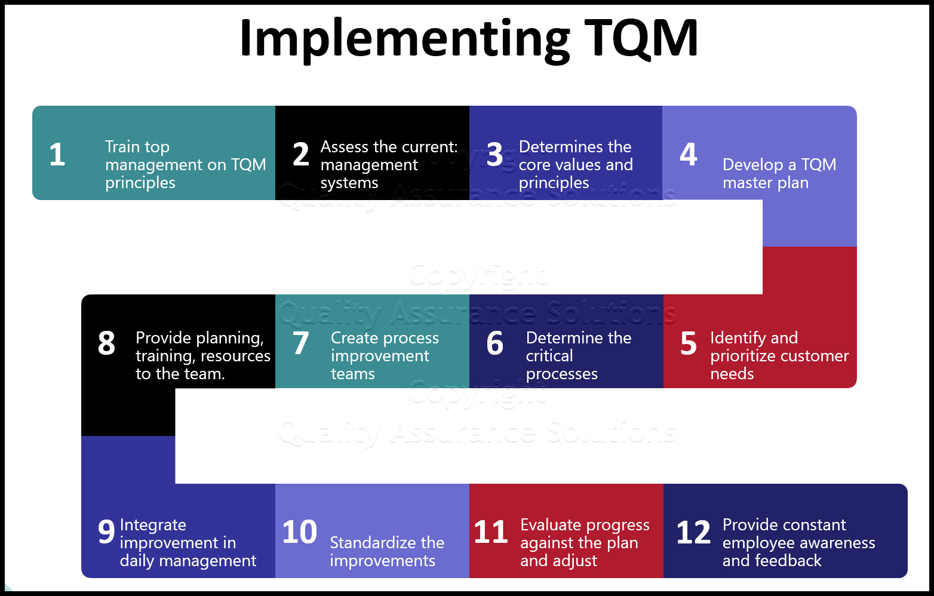
Chapter
TQM Implementation:
02
Source: https://asq.org/quality-resources/total-quality-management/implementing-tqm

Slide 52
Chapter
Summary
02
Quality is defined based on the stakeholders.
Quality should be measurable, appreciative, and perceptive.
Healthcare organizations should focus on the dimensions of quality to ensure providing high-quality care.
There are different models for improving the quality of care.
The Total Quality Management approach is one of the most commonly used improvement models.
Book: Health Care Science

Slide 53



Thank You

Slide 54
Chapter
References:
02
Wang, H. (2016). Comparative Health Systems: A Global Perspective. In International Encyclopedia of Public Health. Jones & Bartlett Learning. https://doi.org/10.1016/B978-0-12-803678-5.00085-0
Rivki, M., Bachtiar, A. M., Informatika, T., Teknik, F., & Indonesia, U. K. (2013). Health Care Systems Around The World (Issue 112).
Will, K. K., Mutyala, J., & Essary, A. C. (2023). Health Systems Science. Jaapa, 36(6), 45–46. https://doi.org/10.1097/01.jaa.0000931464.13332.f1

