Slide 1



IT111 - Introduction to Information Technology
Bachelor of Science in Information Technology
Lecture 6 Computer Organization
Prof. Lamiaa Fattouh Ibrahim
Everyone Smart University
Faculty of Informatics
Spring 2023
1
1
Introduction to Information Technology, Prof. Lamiaa Fattouh Ibrahim, Spring 2022-2023

Slide 2
Objectives
After studying this chapter, the student should be able to:
List the three subsystems of a computer.
Describe the role of the central processing unit (CPU).
Describe the main memory and its addressing space.
Define the input/output subsystem.
Understand the interconnection of subsystems.

Slide 3
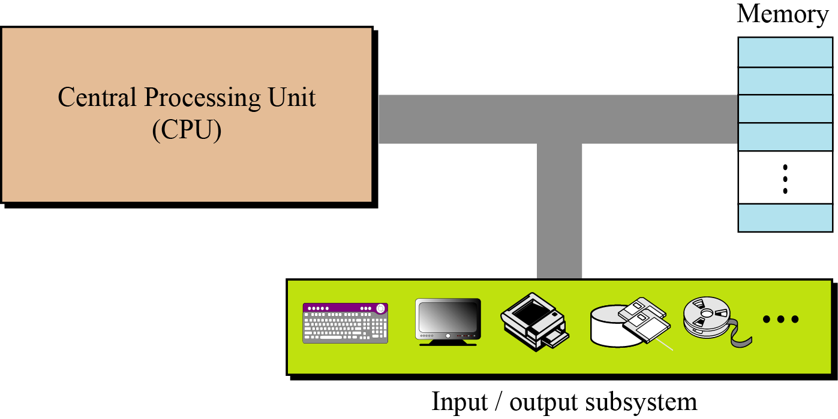
5-1 INTRODUCTION
We can divide the parts that make up a computer into three broad categories or subsystem: the central processing unit (CPU), the main memory, and the input/output subsystem.
Figure 5.1 Computer hardware (subsystems)

Slide 4
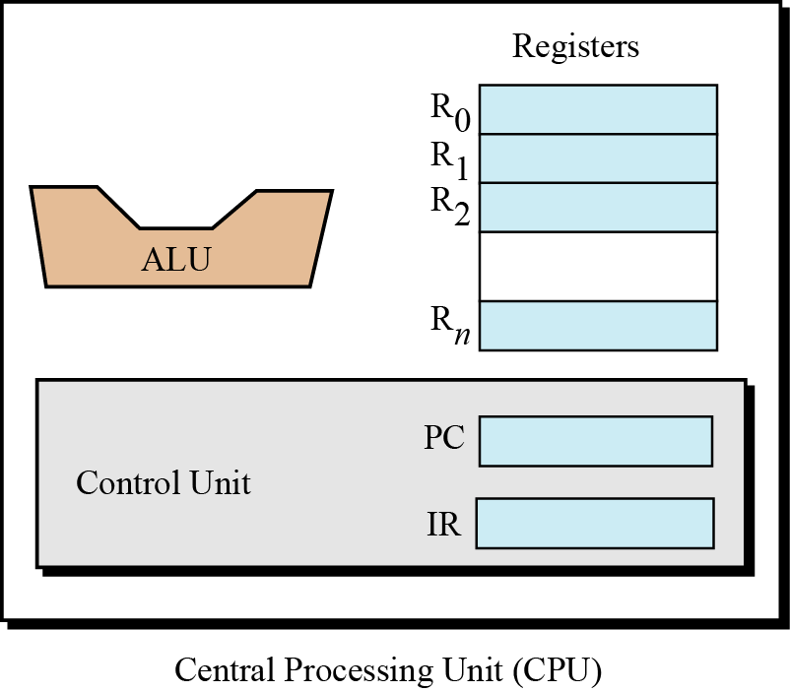
5-2 CENTRAL PROCESSING UNIT
The central processing unit (CPU) performs operations on data. In most architectures it has three parts:
  An arithmetic logic unit (ALU)
  A control unit
  A set of registers, fast storage locations.
Figure 5.2 Central processing unit (CPU)

Slide 5
5.2.1 The arithmetic logic unit (ALU)
The arithmetic logic unit (ALU) performs logic, shift, and arithmetic operations on data.
Logic operations
We discussed several logic operations, such as NOT, AND, OR, and XOR, in Chapter 4.
These operations treat the input data as bit patterns and the result of the operation is also
a bit pattern.

Slide 6
5.2.1 The arithmetic logic unit (ALU)
Shift operations
We discussed two groups of shift operations on data in Chapter 4: logical shift operations and arithmetic shift operations. Logical shift operations are used to shift bit patterns to the left or right, while arithmetic operations are applied to integers. Their main purpose is to divide or multiply integers by two.
Arithmetic operation
We discussed some arithmetic operations on integers and reals on Chapter 4. We mentioned that some operations can be implemented more efficiently in hardware.

Slide 7
5.2.2 Registers
Registers are fast stand-alone storage locations that hold data temporarily. Multiple registers are needed to facilitate the operation of the CPU. Some of these registers are shown in Figure 5.2.
Figure 5.2 Central processing unit (CPU)
Data registers
Instruction register
Program counter

Slide 8
5.2.3 The control unit
The third part of any CPU is the control unit. The control unit controls the operation of each subsystem. Controlling is achieved through signals sent from the control unit to other subsystems.
Figure 5.2 Central processing unit (CPU)

Slide 9
5-3 MAIN MEMORY
Main memory is the second major subsystem in a computer (Figure 5.3). It consists of a collection of storage locations, each with a unique identifier, called an address. Data is transferred to and from memory in groups of bits called words. A word can be a group of 8 bits, 16 bits, 32 bits, or 64 bits (and growing). If the word is 8 bits, it is referred to as a byte. The term “byte” is so common in computer science that sometimes a 16-bit word is referred to as a 2-byte word, or a 32-bit word is referred to as a 4-byte word.

Slide 10
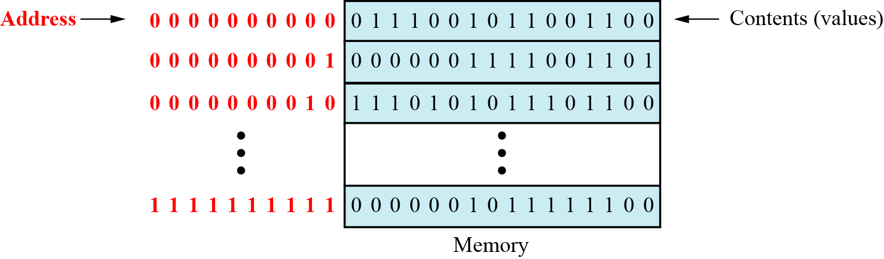
Figure 5.3 Main memory

Slide 11
5.3.1 Address space
To access a word in memory requires an identifier. Although programmers use a name to identify a word (or a collection of words), at the hardware level each word is identified by an address. The total number of uniquely identifiable locations in memory is called the address space. For example, a memory with 64 kilobytes and a word size of 1 byte has an address space that ranges from 0 to 65,535.

Slide 12
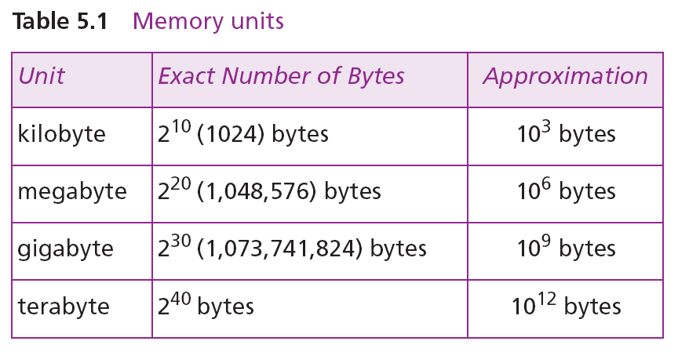
Memory addresses are defined using unsigned
binary integers.

Slide 13
Example 5.1
A computer has 32 MB (megabytes) of memory. How many bits are needed to address any single byte in memory?
Solution
The memory address space is 32 MB, or 225 (25 × 220). This means that we need log₂ 225, or 25 bits, to address each byte.
Example 5.2
A computer has 128 MB of memory. Each word in this computer is eight bytes. How many bits are needed to address any single word in memory?
Solution
The memory address space is 128 MB, which means 227. However, each word is eight (23) bytes, which means that we have 224 words. This means that we need log₂ 224, or 24 bits, to address each word.

Slide 14
5.3.2 Memory types
Two main types of memory exist: RAM and ROM.
Random access memory (RAM)
Static RAM (SRAM)
Dynamic RAM (DRAM)
Read-only memory (ROM)
Programmable read-only memory (PROM).
Erasable programmable read-only memory (EPROM).
Electrically erasable programmable read-only memory (EEPROM).

Slide 15
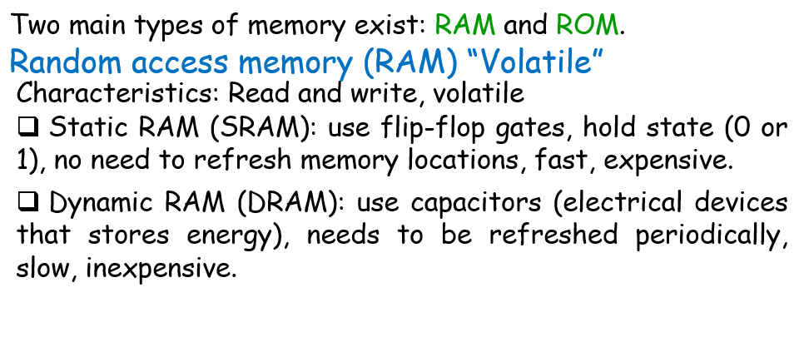
Memory Types
Two main types of memory exist: RAM and ROM.

Slide 16
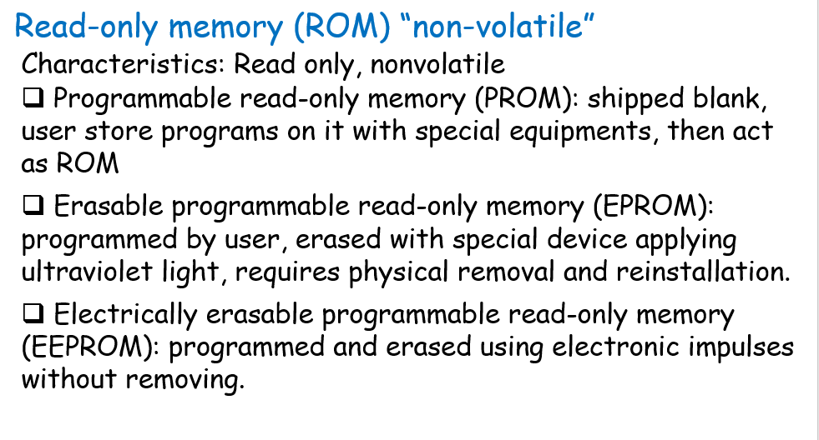
Memory Types: continue

Slide 17
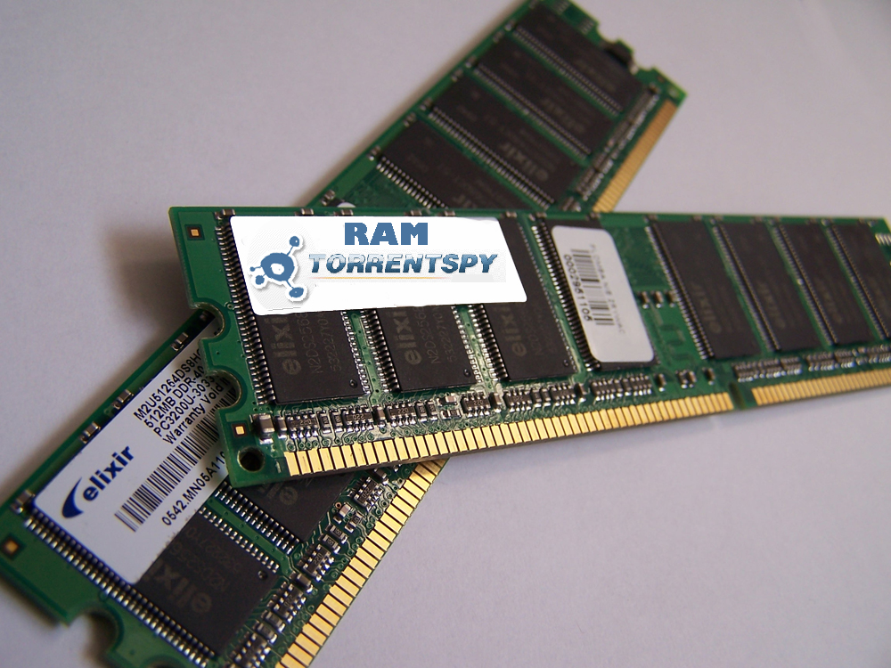

Slide 18
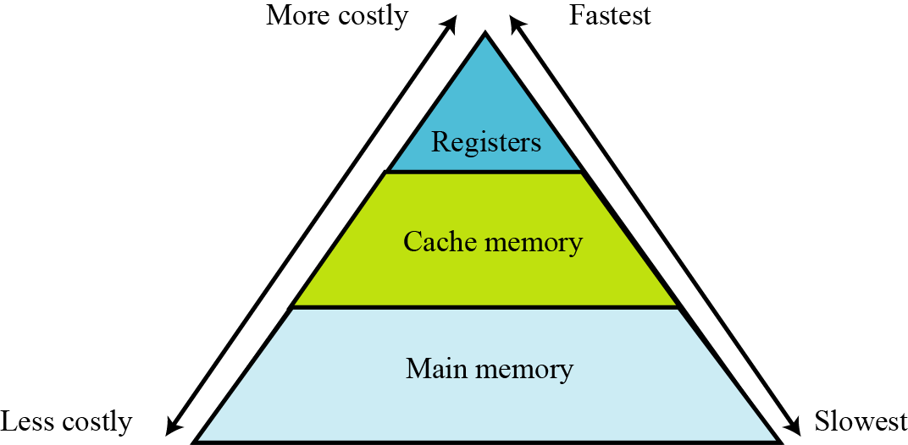
5.3.3 Memory hierarchy
Computer users need a lot of memory, especially memory that is very fast and inexpensive. This demand is not always possible to satisfy—very fast memory is usually not cheap. A compromise needs to be made. The solution is hierarchical levels of memory.
Figure 5.4 Memory hierarchy

Slide 19
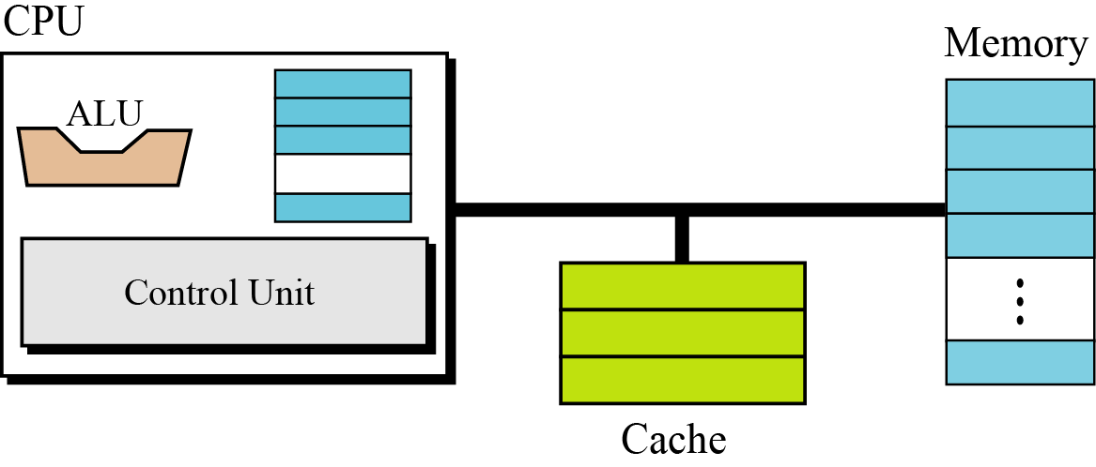
5.3.4 Cache memory
Cache memory is faster than main memory but slower than the CPU and its registers. Cache memory, which is normally small in size, is placed between the CPU and main memory (Figure 5.5).
Figure 5.5 Cache memory

Slide 20
5-4 INPUT/OUTPUT SUBSYSTEM
The third major subsystem in a computer is the collection of devices referred to as the input/output (I/O) subsystem. This subsystem allows a computer to communicate with the outside world, and to store programs and data even when the power is off. Input/output devices can be divided into two broad categories: non-storage and storage devices.

Slide 21
5.4.1 Non-storage devices
Non-storage devices allow the CPU/memory to communicate with the outside world, but they cannot store information.
Keyboard and monitor
Printer

Slide 22
5.4.2 Storage devices
Storage devices, although classified as I/O devices, can store large amounts of information to be retrieved at a later time. They are cheaper than main memory, and their contents are nonvolatile—that is, not erased when the power is turned off. They are sometimes referred to as auxiliary storage devices. We can categorize them as either magnetic or optical.

Slide 23
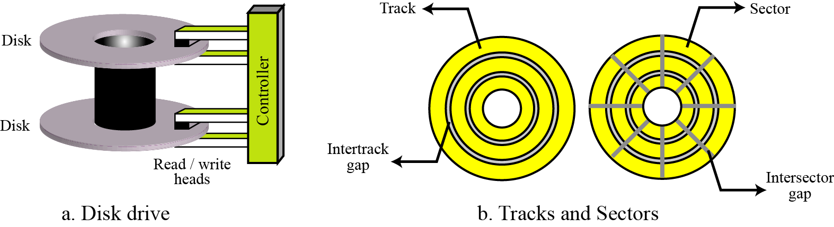
Magnetic storage devices
Figure 5.6 A magnetic disk

Slide 24
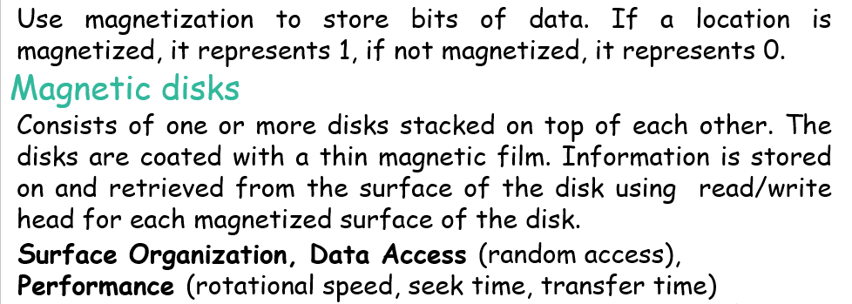
Magnetic Storage devices
A magnetic disk

Slide 25
Magnetic Storage devices
Data access. A magnetic disk is considered a random access device. In a random access device, a data item can be accessed randomly without the need to access all other data items located before it. However, the smallest storage area that can be accessed at one time is a sector. A block of data can be stored in one or more sectors and retrieved without the need to retrieve the rest of the information on the disk.

Slide 26
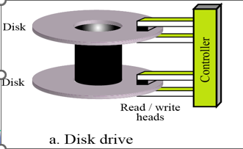
Magnetic Storage devices
Performance. The performance of a disk depends on several factors, the most important being the rotational speed, the seek time, and the transfer time.
The rotational speed defines how fast the disk is spinning.
The seek time defines the time to move the read/write head to the desired track where the data is stored.
The transfer time defines the time to move data from the disk to the CPU/memory.

Slide 27
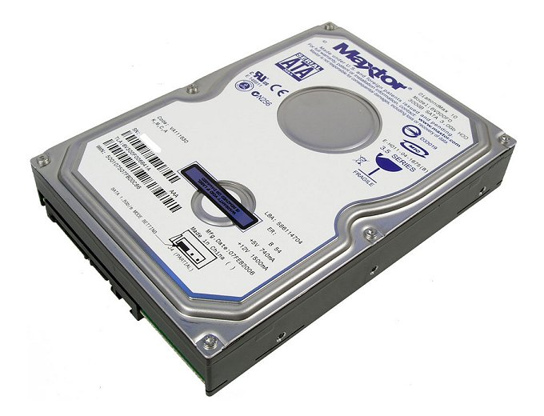

Slide 28
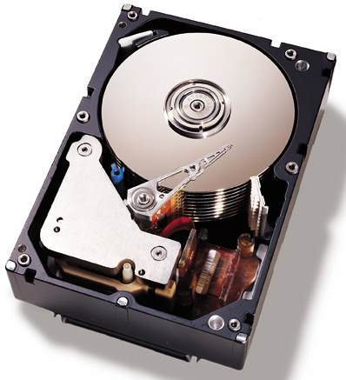

Slide 29
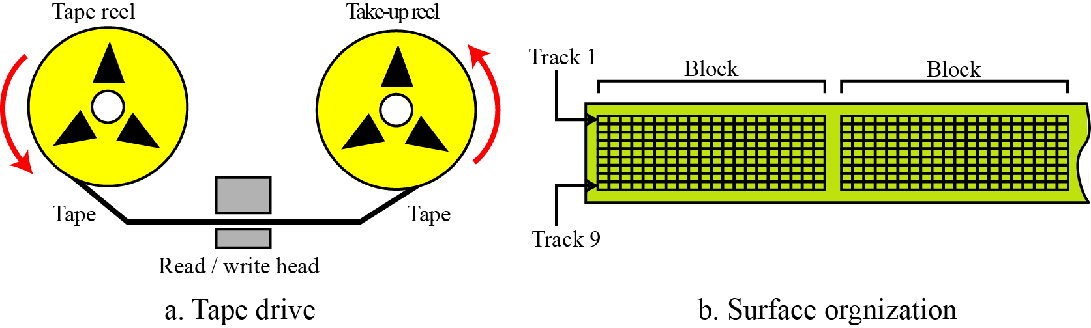
Magnetic tapes
        Comes in various sizes.
        One common type is half inch plastic tape coated with a thick magnetic film.
        The tape is mounted on the two reels and uses a read/write head that reads or writes information when the tape is passed through it.
        Surface Organization, Data Access (sequential access),
        Performance (slower but cheaper, used for backups)

Slide 30
❑❑ Surface organization. The width of the tape is divided into nine tracks, each location on a track storing 1 bit of information. Nine vertical locations can store 8 bits of information related to a byte plus a bit for error detection.
❑❑ Data access. A magnetic tape is considered a sequential access device. Although the surface may be divided into blocks, there is no addressing mechanism to access each block. To retrieve a specific block on the tape, we need to pass through all the previous blocks.
❑❑ Performance. Although magnetic tape is slower than a magnetic disk, it is cheaper. Today, people use magnetic tape to back up large amounts of data.

Slide 31
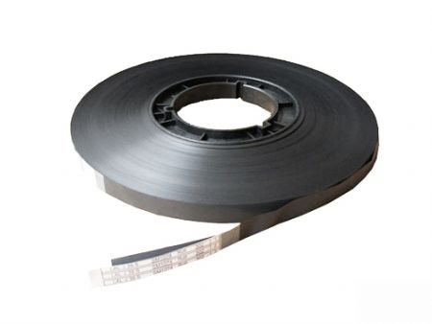
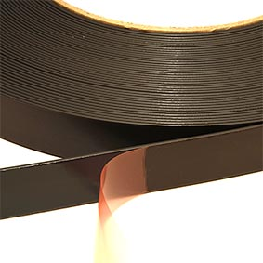

Slide 32
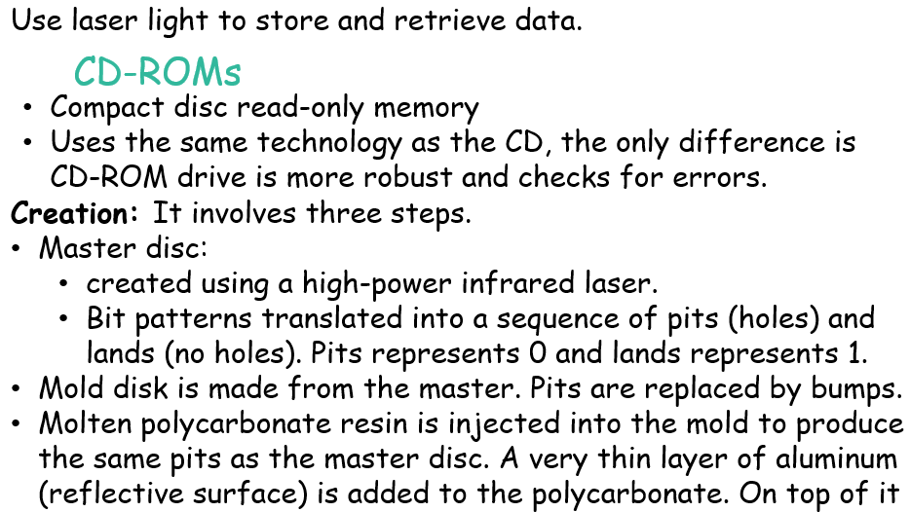
Optical Storage devices

Slide 33
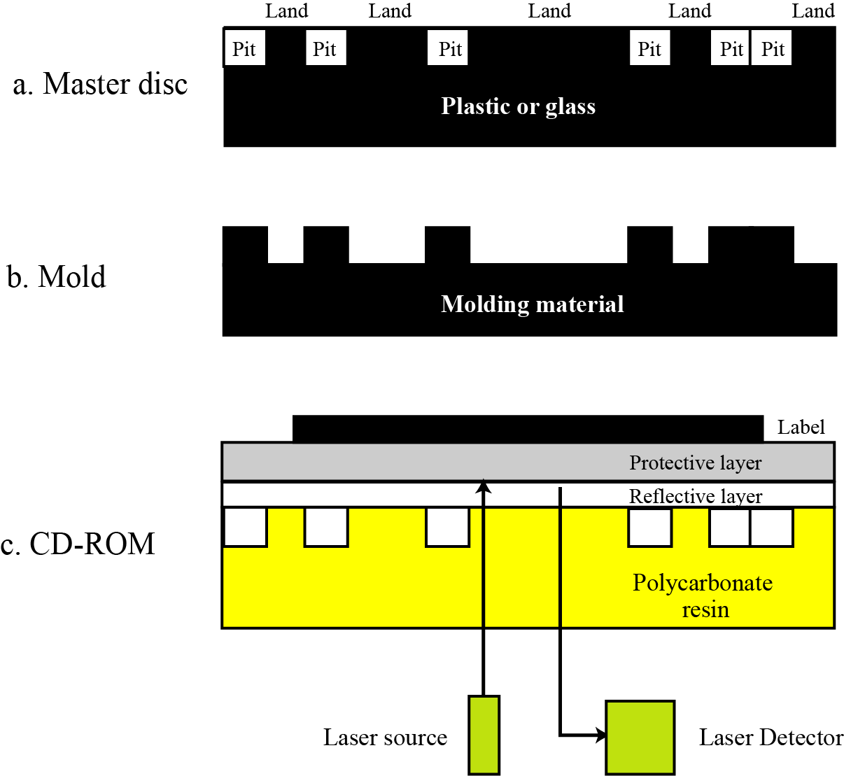
Optical storage devices
Figure 5.8 Creation and use of CD-ROMs

Slide 35
5-5 SUBSYSTEM INTERCONNECTION
The previous sections outlined the characteristics of the three subsystems (CPU, main memory, and I/O) in a stand-alone computer. In this section, we explore how these three subsystems are interconnected. The interconnection plays an important role because information needs to be exchanged between the three subsystems.

Slide 36
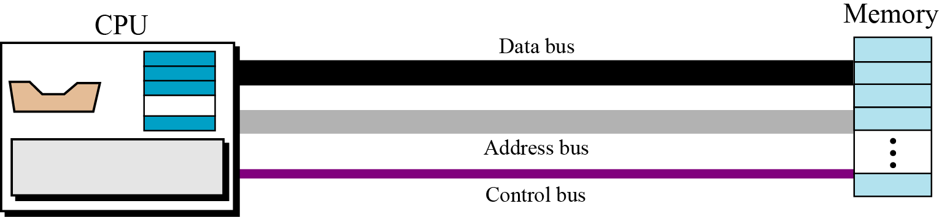
5.5.1 Connecting CPU and memory
The CPU and memory are normally connected by three groups of connections, each called a bus: data bus, address bus, and control bus (Figure 5.12).
Figure 5.12 Connecting CPU and memory using three buses

Slide 37
5.5.2 Connecting I/O devices
I/O devices cannot be connected directly to the buses that connect the CPU and memory because the nature of I/O devices is different from the nature of CPU and memory. I/O devices are electromechanical, magnetic, or optical devices, whereas the CPU and memory are electronic devices. I/O devices also operate at a much slower speed than the CPU/memory. There is a need for some sort of intermediary
to handle this difference. Input/output devices are therefore attached to the buses through input/output controllers or interfaces. There is one specific controller for each input/output device (Figure 5.13).

Slide 38
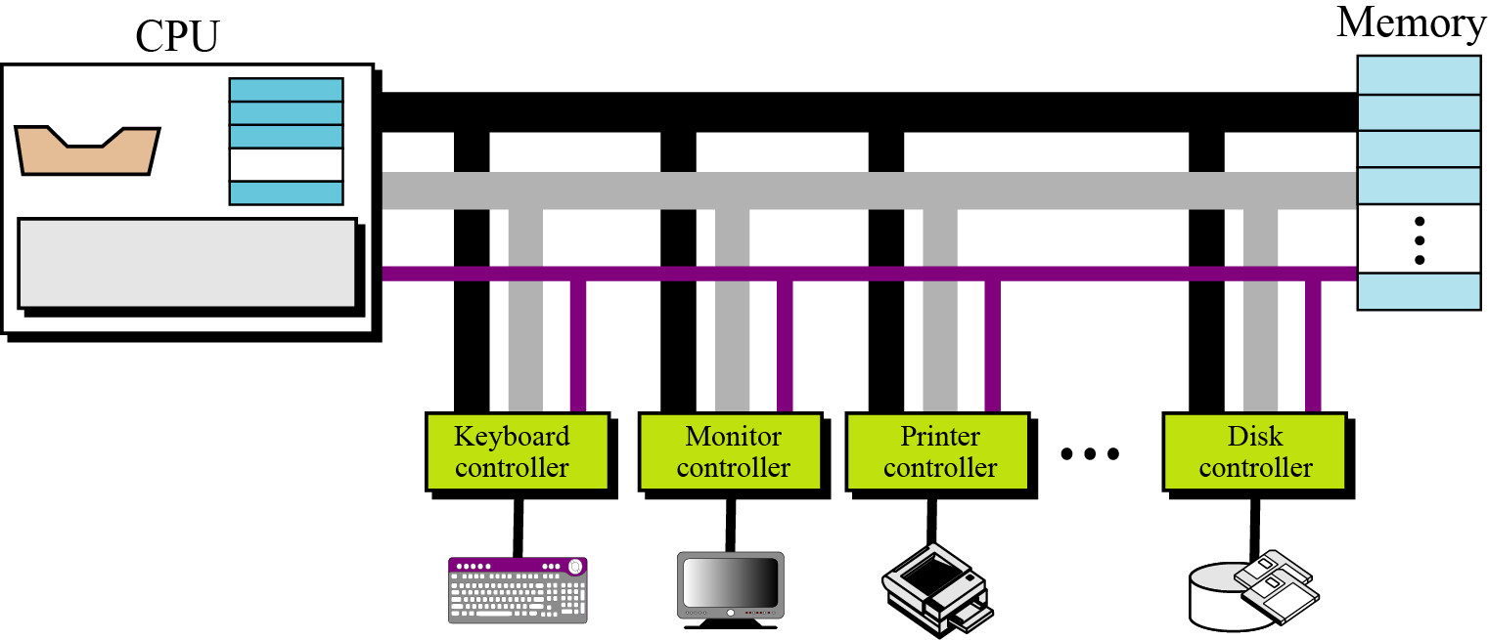
Figure 5.13 Connecting I/O devices to the buses

Slide 39
Summary
The three subsystems of a computer.
Describe the role of the central processing unit (CPU).
Describe the main memory and its addressing space.
Define the input/output subsystem.
Understand the interconnection of subsystems

Slide 40
Thank You

