Slide 1



Project communication
Prepared by Dr. Merna Emad
Manage & Monitor Communications
Lecture 5
www.midocean.ae

Slide 2

Section 2
Monitoring communications
Lecture
Putting it into practice
Section 1
Managing communications

Slide 3
Section one
Managing communications

Slide 4
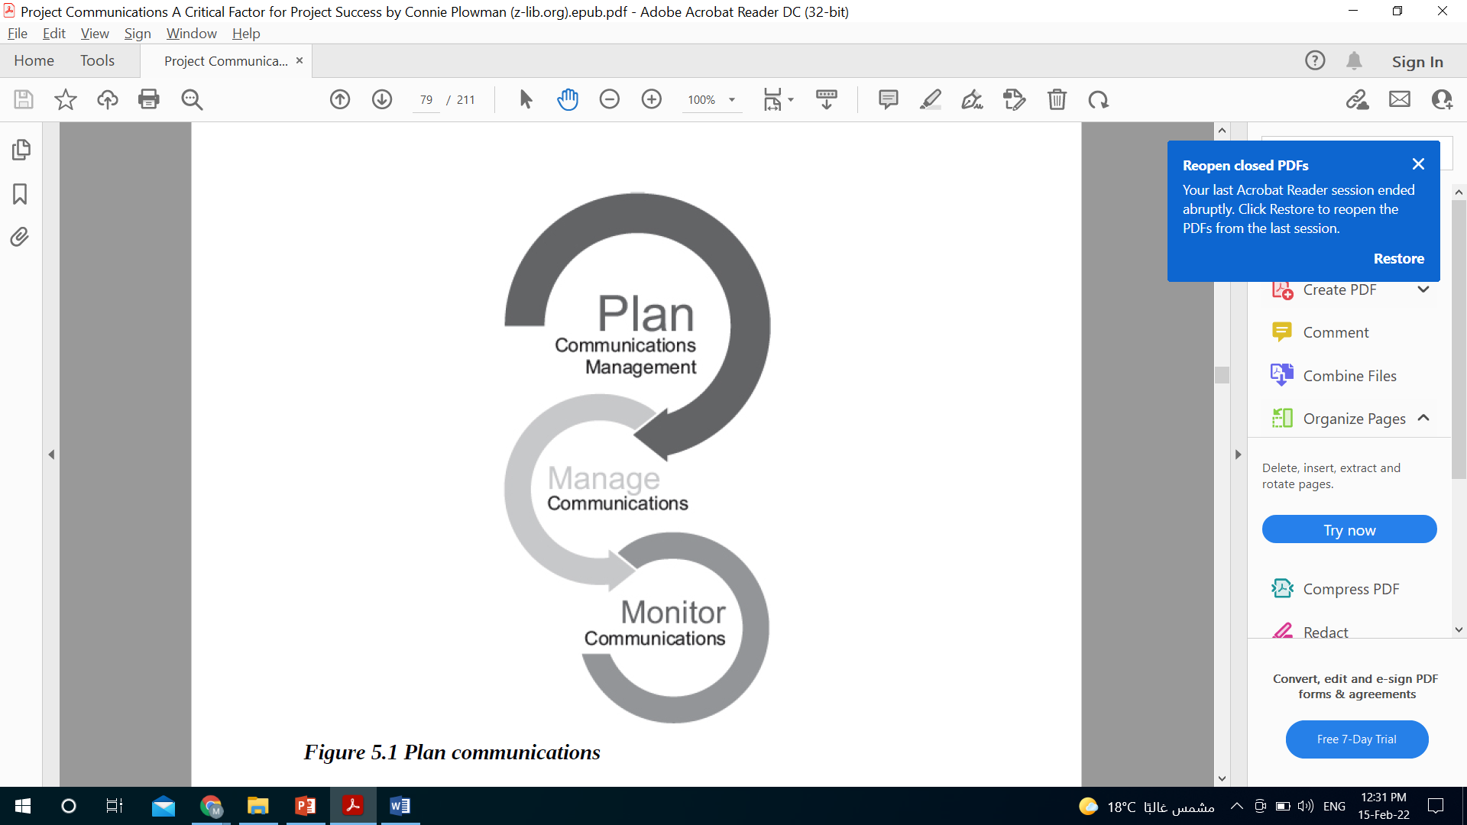
Managing Communications

Slide 5
Managing Communications
What is “managing communications”?
Managing communications is “the process of ensuring timely and appropriate collection, creation, distribution, storage, retrieval, management, monitoring, and the ultimate disposition of project information.”

Slide 6
Managing Communications
Why is “managing communications” important?
Among the project team, we need to make sure that everyone who is working on the project is kept informed—that they have the information they need for successful completion of their assigned tasks and deliverables.
Outside the project team, we need to ensure that stakeholders are also well informed—that they have the information they need to stay up-to-date and continue to support the project,
or move from being unaware or resisting the project to a more supportive position.

Slide 7
Managing Communications
Why is “managing communications” important?
In other words
From a broad perspective, managing communications on a project means ensuring that the project communications management plan is being executed. In practice, managing communications starts with managing your conversations with all stakeholders.

Slide 8

Managing Communications
Why is “managing communications” important?
Ideally, your interactions end by accomplishing at least one of the following:
Providing information needed to support the role of the person/group or their project needs
Reducing their uncertainty about the project, their role, or others involved in the project
Building their trust in the project’s goals, plan, and participants

Slide 9
Managing Communications
How do you effectively manage conversations?
Let’s look at the conversation process developed by Development Dimensions International (DDI).
Through DDI’s years of extensive study and research, they found that “people come to work with both practical needs (to get work done) and personal needs (to be respected and valued).” The same is true with project teams. Team members are focused on getting the work done to achieve the project objective (practical needs) and to know that they are valued contributors and integral key members to the project team (personal needs).

Slide 10
Managing Communications
How do you effectively manage conversations?
Let’s look at the conversation process developed by Development Dimensions International (DDI).
The skills used to meet the personal and practical needs in our communications are called “Interaction Essentials”.
Personal Needs
Practical Needs

Slide 11

Managing Communications
How do you effectively manage conversations?
Personal Needs
Support
Self-esteem
Empathy
Share
Involvement

Slide 12

Managing Communications
Personal Needs
Self-esteem
By maintaining or enhancing self-esteem, we are managing communications by reassuring team members that they have the necessary expertise to be part of the team, by giving praise for doing a great job, or suggesting a better way of working.
To maintain self-esteem, we would have fact-based discussions, focus on the problem (not the person), and show our respect and support.

Slide 13

Managing Communications
Personal Needs
Self-esteem
“Joe, you have the most knowledge about the problem on this project. This project is very important to our customers. We really need your expertise in handling this situation.”

Slide 14
Managing Communications
Personal Needs
Self-esteem
To enhance self-esteem, we would focus on recognizing great ideas and key contributions. This is an opportunity to build and show confidence in the project team member or stakeholder. In order to do this, we must be specific and sincere.

Slide 15
Managing Communications
Personal Needs
Self-esteem
“Sally, great job in speaking up today at the project team meeting to express your concerns with the project schedule. You are correct. It is very aggressive. I really appreciate your ongoing contributions to the team.”

Slide 16

Managing Communications
Personal Needs
Empathy
By listening and responding with empathy, we are managing communications to build understanding, address the positive and negative emotions, and show that we care about others’ feelings while working with the facts.

Slide 17
Managing Communications
Personal Needs
Empathy
“Maria, now that we have developed the project plan together, what are your thoughts? What does project success look like for you?”

Slide 18

Managing Communications
Personal Needs
Involvement
By asking for help and encouraging involvement, we are managing communications to seek ideas, ask for help, get commitment, and really be involved with the project and working together as a team. This is an opportunity to ask open-ended questions.

Slide 19
Managing Communications
Personal Needs
Involvement
“Brian, I know this is a very large, complex project. You might be feeling a bit overwhelmed with doing all this project work, as well as getting your regular work done.”

Slide 20

Managing Communications
Personal Needs
Share
By sharing our thoughts, feelings, and rationale, we are managing communications to build trust. Trust is everything when it comes to working as a high-performing project team. To build trust, we must share our feelings, have open and honest communications, and discuss “why” decisions, changes, or actions are taken. The benefit of sharing is building relationships.

Slide 21
Managing Communications
Personal Needs
Share
“I understand how you are feeling. I had a similar experience working on a large, complex project, and worried about getting my regular work done. By developing a simple time management system, I scheduled time in my calendar to do project work, and time for my operations work. It worked for me. It might also work for you.”

Slide 22

Managing Communications
Personal Needs
Support
By providing support without removing responsibility, we are managing communications to build ownership. In managing projects, everything is “owned” by someone. When you own a task or responsibility, you are more likely to see it to completion and be successful. As the project manager, it is your responsibility to provide the necessary resources to help team members get their project tasks done and remove any obstacles that get in their way. With support, you are building confidence in others to be successful.

Slide 23
Managing Communications
Personal Needs
Support
“What can I do to help you? What is in your way of getting the project done? Perhaps there are some barriers that I can remove for you to be successful.”

Slide 24
Managing Communications
Why these principles are important
Using these five key principles—self-esteem, empathy, involvement, share, and support—in managing project communications ensures that the personal needs of your project team and stakeholders are being addressed. That they feel “valued, respected, and understood.”
How will you know their personal needs?
For the project team, we suggest simply asking each team member.
For outside stakeholders, we suggest identifying their needs during stakeholder analysis and documenting them in your stakeholder register as part of knowing your audience.

Slide 25
Managing Communications
How do you effectively manage conversations?
Let’s look at the conversation process developed by Development Dimensions International (DDI).
The skills used to meet the personal and practical needs in our communications are called “Interaction Essentials”.
Personal Needs
Practical Needs

Slide 26

Managing Communications
Practical Needs
What are these needs?
A “five-step conversation roadmap” called the Interaction Guidelines. Consider it as “a vehicle to frame conversations in a quick, logical, and thorough way—from start to finish—to cover all the specific information people need” on the project.

Slide 27
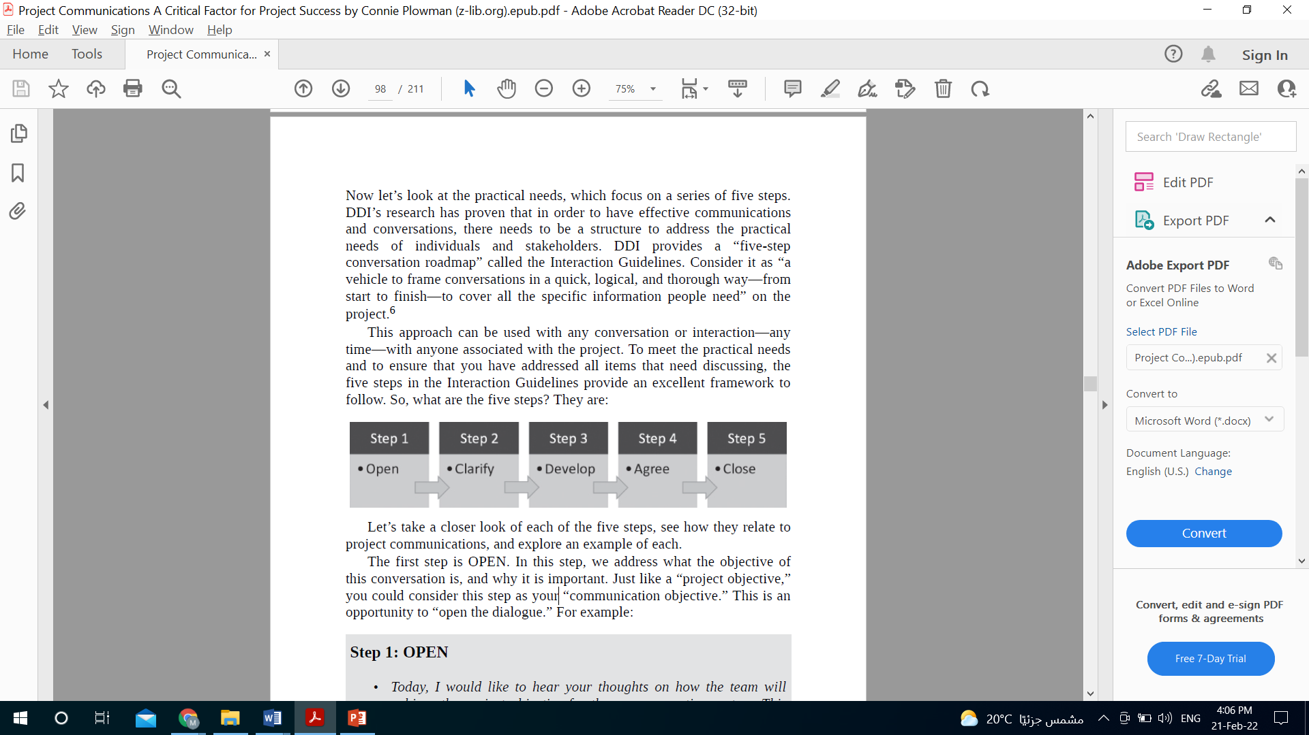
Managing Communications
Practical Needs
What are these needs?

Slide 28
Managing Communications
Practical Needs
When to use this approach?
In order to have effective communications and conversations, there needs to be a structure to address the practical needs of individuals and stakeholders.
It can be used with any conversation or interaction—any time—with anyone associated with the project. To meet the practical needs and to ensure that you have addressed all items that need discussing, the five steps in the Interaction Guidelines provide an excellent framework to follow.

Slide 29

Managing Communications
Practical Needs
Open
The first step is OPEN. In this step, we address what the objective of this conversation is, and why it is important.
Just like a “project objective,” you could consider this step as your “communication objective.” This is an opportunity to “open the dialogue.”

Slide 30
Managing Communications
Practical Needs
Open
Today, I would like to hear your thoughts on how the team will achieve the project objective for the new accounting system. This new system will reduce our invoicing time by 30 days, and accelerate receiving customer payments.

Slide 31
Managing Communications
Practical Needs
Clarify
In this step, we are gathering information by seeking details and sharing data about the project problem.
This is an opportunity to ask questions, to identify roadblocks, and reveal any concerns.
This step is essential for establishing clarity and gaining mutual understanding.

Slide 32
Managing Communications
Practical Needs
Clarify
We both agree that this is a very difficult project, and must be delivered on time, within budget, and according to project specifications. So let’s look at the facts that we have. I don’t want to miss anything.

Slide 33
Managing Communications
Practical Needs
Develop
In this step, we are developing ideas, leveraging our creativity, utilizing the expertise of others, and discussing what resources and support are needed to make these ideas a reality.
This is an opportunity for you (as the project manager) to also share your ideas and suggestions.

Slide 34
Managing Communications
Practical Needs
Develop
In order to achieve the project objective, we really need a high-performing project team. I would like to hear your ideas on this. What do you think it will take to be a high-performing team, and what additional resources do you think are needed?

Slide 35
Managing Communications
Practical Needs
Agree
In this step, we are putting together our action plan with specific dates, details, and alternatives if needed.
This is an opportunity to show commitment and how progress on the action plan will be tracked.

Slide 36
Managing Communications
Practical Needs
Agree
So let’s agree to meet every Monday morning at 9 a.m. to review the action plan together, and make any necessary adjustments. I will send a calendar request for our weekly meetings.

Slide 37

Managing Communications
Practical Needs
Close
In this step, we want to summarize the important items that have been discussed, and to provide our support and encouragement.
This is an opportunity to build confidence and trust.

Slide 38
Managing Communications
Practical Needs
Close
Let’s recap what we have decided. Do you have any questions? I have complete trust and confidence in you. I know that you will do an excellent job on this. You are the right person to handle this difficult situation.

Slide 39
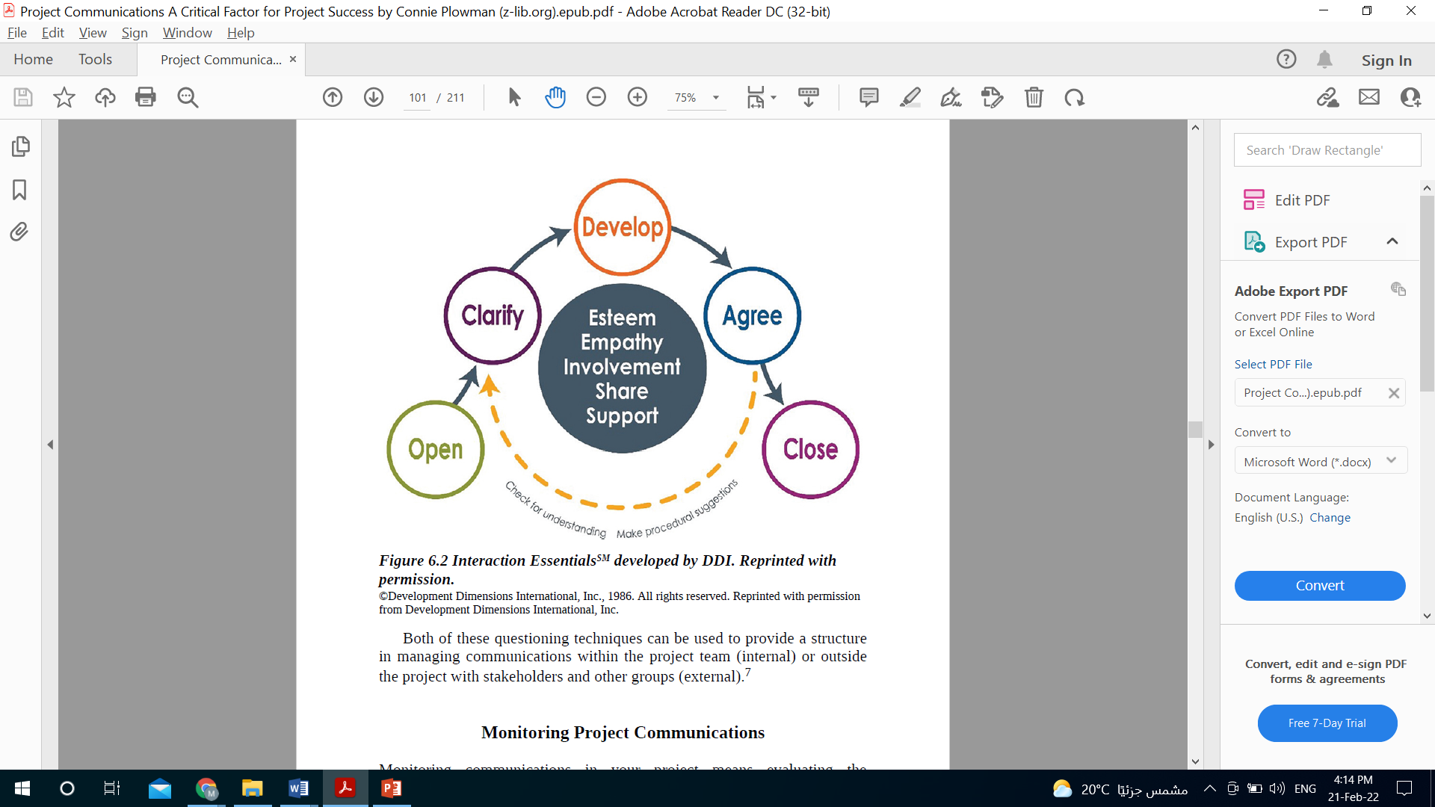
Managing Communications
Personal Needs
Practical Needs

Slide 40
Section Two
Monitoring communications

Slide 41
Managing Communications

Slide 42

Monitoring Communications
Does Monitoring and controlling the same thing?
Monitoring communications occurs in the monitoring and controlling process group. the Control Communications process was eliminated since there are many things outside the purview of the project team that they cannot control, such as when, how, where, or why people communicate.
However, there are still some elements of control in communicating on projects. While we may not be able to control everything — like when and how stakeholders communicate—we can control our reaction, attitude, approach, and response to their communications.

Slide 43
Monitoring Communications
What is Monitoring Communications?
Monitoring communications in your project means evaluating the communications that are taking place, so that you can ensure you are achieving the intent of your project communications management plan.
However, there are still some elements of control in communicating on projects. While we may not be able to control everything — like when and how stakeholders communicate—we can control our reaction, attitude, approach, and response to their communications.

Slide 44

Monitoring Communications
How is it going?
During monitoring communications
Providing continuous oversight is necessary to constantly be aware of the communication taking place throughout the project, whether it is communicating about project status, activities, or results, or keeping stakeholders current with project information.
Over the life of the project, we should also seek opportunities to make improvements in our communications, processes, and environment. This can be done through feedback, surveys, ongoing conversations, etc.— various ways where we are asking for (and using) the valuable inputs and diverse perspectives of others.

Slide 45
Monitoring Communications
How is it going?
During monitoring communications
The project communications management plan should be revisited regularly and revised as needed. When the team receives input on implementing more effective ways of communicating with stakeholders, the project communications management plan should be updated to reflect this improved way of working.
And finally, we need to deliver project information in a way that influences and inspires, that reduces uncertainty and builds trust, and that grows the project knowledge and support of individuals and groups interested in our project at all levels, both inside and outside the organization.

Slide 46

Monitoring Communications
Methods of Monitoring Communications
Measure the effectiveness of Your project communications
Incorporate Feedback loops

Slide 47
Monitoring Communications
Measure the effectiveness of Your project communications
Peter Drucker, well known for his innovative thinking in the way we do business, is often quoted as saying, “What gets measured gets managed.”
What actions do we take when things aren’t working?
Great questions. Communication is known for being difficult to measure, as it is hard to prove a cause–effect relationship between communication and action. However, let’s see if we can take a closer look at measuring the effectiveness of our project communications with helpful steps that we can take as project managers, team members, and project sponsors.

Slide 48

Monitoring Communications
Measure the effectiveness of Your project communications
Before you start evaluating the effectiveness of your project communication, you need to determine
What
When
How

Slide 49
Monitoring Communications
Measure the effectiveness of Your project communications
What
are you measuring? What are the criteria for the measurement?
Start with the outcome you desire to achieve. The purpose of your project communications is to keep all stakeholders informed so that the project progresses smoothly and ultimately achieves its objectives.
Different elements of your project communications management plan will do this in different ways. Stand-up meetings are meant to keep the team informed.
Status reports keep stakeholders outside the project team apprised of progress. When deciding what to measure, revisit the specific goals of each tactic in your project communications management plan.

Slide 50
Monitoring Communications
Measure the effectiveness of Your project communications
How
Will you measure it?
Depending on what you define as your outcomes, there are several approaches to measuring communications:
Usage data: Technology applications lend themselves most readily to quantitative measures. Intranet sites can track analytics on who is using the site, how often, and for how long.
E-mail marketing applications can track open and click-through rates.
Online collaboration tools can track which team members are most active and where the most conversations are happening. Correlating this data with project deliverables and deadlines can potentially show areas where communications are, or are not, accomplishing the desired objectives.

Slide 51
Monitoring Communications
Measure the effectiveness of Your project communications
How
Will you measure it?
Depending on what you define as your outcomes, there are several approaches to measuring communications:
Surveys: If you want to know if communications are working for the people who receive them, just ask. Surveys can range from simple feedback questions that provide qualitative and/or anecdotal information to more formal surveys with quantitative results.
You can survey directly about project communications, or about desired outcomes like increased support for the project among stakeholders.

Slide 52
Monitoring Communications
Measure the effectiveness of Your project communications
How
Will you measure it?
Depending on what you define as your outcomes, there are several approaches to measuring communications:
Planned versus actual communications: Your project communications management plan should outline your different communication tactics and how often you plan to use them—for example, status reports will be sent every 2 weeks.
Measure how closely you are keeping to the plan and compare that with other project outputs. As with usage data, you may be able to correlate your communication efforts with positive or negative aspects of the project’s progress.

Slide 53
Monitoring Communications
Measure the effectiveness of Your project communications
When
Will you measure its effectiveness?
It is a good idea to start measuring early, and then measure frequently throughout the life of the project. If you don’t discover until the end of the project that your communications were ineffective, you have missed an opportunity—and possibly hindered your project’s success in the process.
If your initial findings lead you to make changes to what or how you communicate, then measure again to ensure that the changes you made have actually improved your project communications.
Project communications should be iterated and refined to ensure they are effectively informing all of your stakeholders.

Slide 54
Monitoring Communications
Feedback loops
The feedback part of the process occurs in reverse, with the receiver responding to the sender to ensure that he/she actually understood what you intended to communicate.
Why is it important?
It verifies that what you intended to communicate is what is actually understood by the receiver. Whether you are the sender or receiver of the message, one essential element in feedback is closure. Too often, there are items left unacknowledged, unclear, or unresolved in a conversation or interaction.
It provides crystal clear that the subject has been closed, agreed upon, and next steps decided. This is why Step 5 (Close) in the conversation guidelines outlined earlier in this chapter is so important

Slide 55

Monitoring Communications
Feedback loops
How to ask feedbacks?
According to Tom Peters, coauthor of In Search of Excellence, the “four most important words in management are…. “what do you think?

Slide 56
Monitoring Communications
Feedback loops
Why to ask for feedbacks?
It provides space for team members or stakeholders to address any remaining uncertainties they may have, and/or confirm their understanding of your message.
It helps build trust by demonstrating that you value their personal and practical needs and want to ensure they are addressed by your message.

Slide 57
Monitoring Communications
Feedback loops
Feedback from yourself
Finally, when engaging in a conversation or electronic exchange, check in with yourself using your own internal feedback loop. How can you be sure you are communicating what matters? Ask yourself: Am I adding value to this discussion? Is it a fact or my opinion? Is it relevant to the topic? Has someone already said this, and I am just repeating what someone else said?

Slide 58
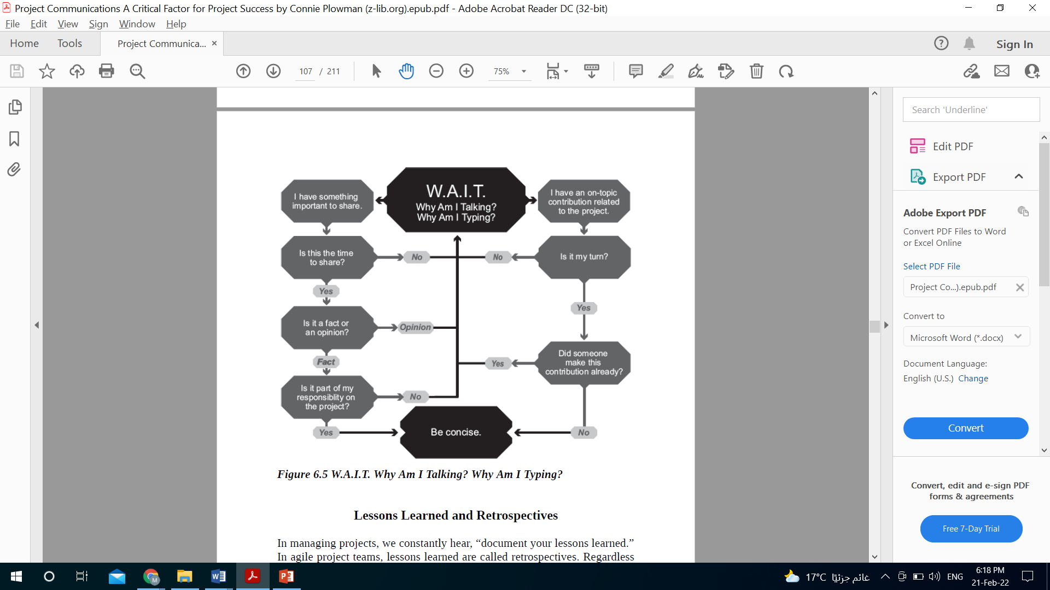
Monitoring Communications
Feedback loops
Feedback from yourself

Slide 59
Section Two
Putting it into Practice

Slide 60
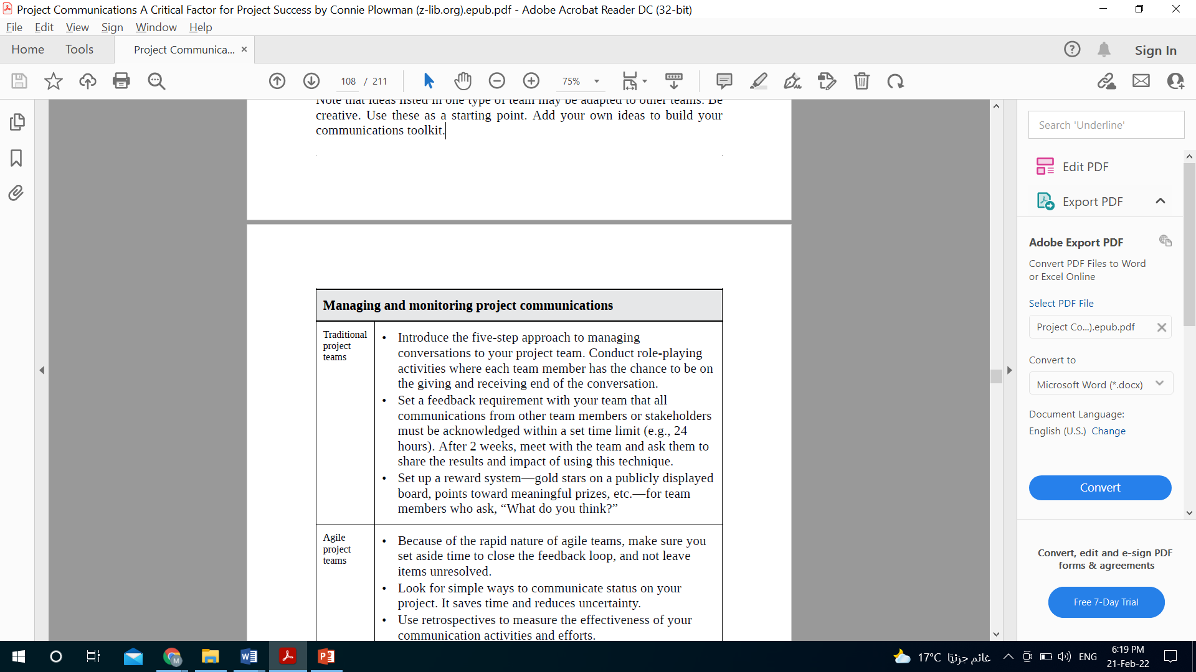
Putting it into Practice
For traditional Teams

Slide 61
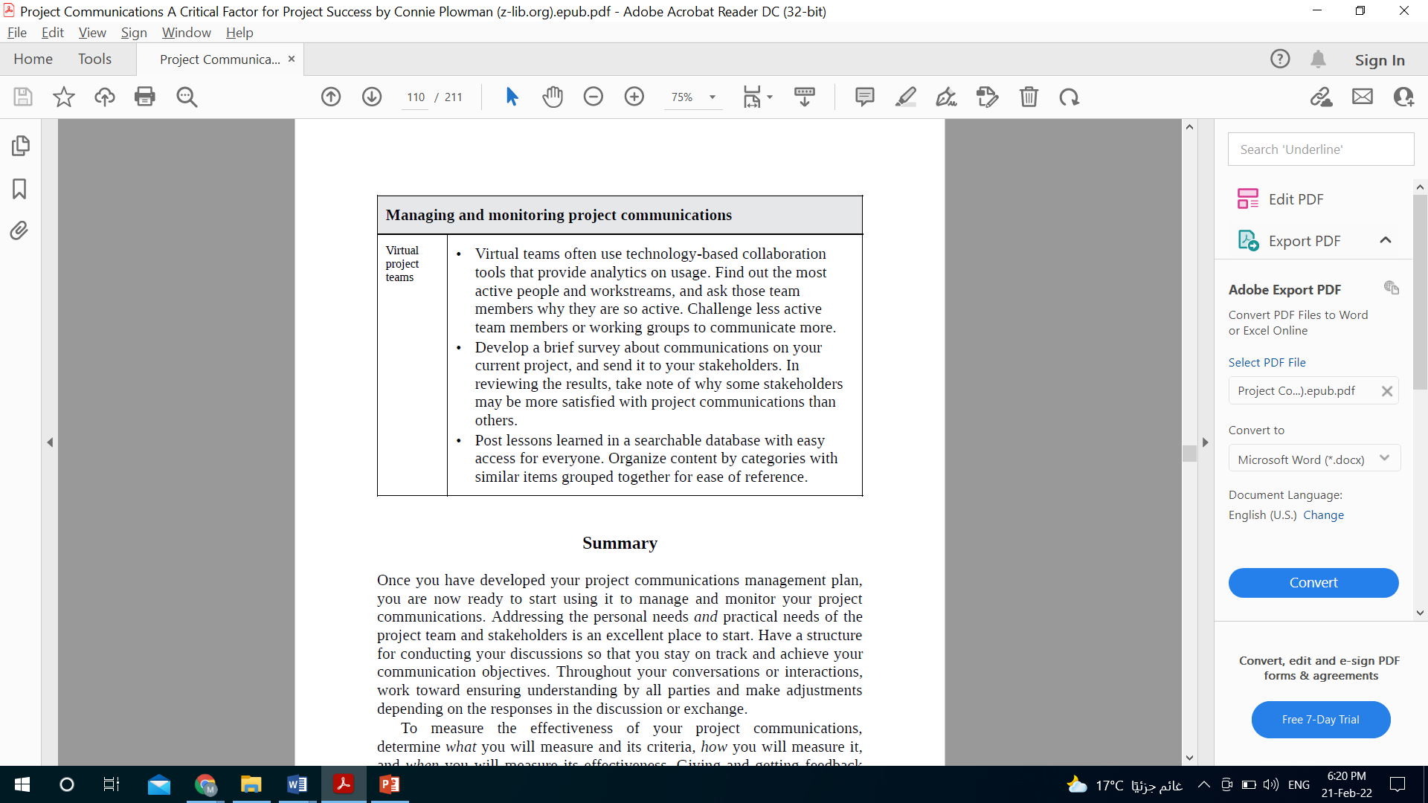
Putting it into Practice
For Virtual Teams

Slide 62


