Slide 1








COLLAGE OF INFORMATICS MIDOCEAN UNIVERSITY UAE
ENHANCE STUDENT PERFORMANCE USING ENSEMBLE LEARNING AND FEATURE SELECTION IN SAUDI ARABIA
PRESENTED BY:
MARYA BAWAZIR
Hala Hajjar
SUPERVISOR NAME: HAGAR SALEH

Slide 2

CONTENT
PROBLEM STATEMENT
RELATED WORK
OBJECTIVES
CONCLUSION AND FUTURE woRK
INTRODUCTION
METHOLOGY
RESULTS

Slide 3

Introduction
  Artificial Intelligence (AI) is transforming modern education.
  Learning Management Systems (LMSs) generate valuable academic and behavioral student data in Saudi Arabia.
  traditional assessment methods are still widely used to evaluate student performance.
  Machine Learning (ML) can utilize LMS data to predict student performance and identify academically at-risk students early.
  AI-Based Early Warning Systems (EWS) can support timely interventions and data-driven decision-making in Saudi educational institutions.

Slide 4
Problem Statement
Educational institutions need an effective way to identify at-risk students at an early stage
Existing monitoring approaches are insufficient to capture complex patterns in student data
There is a need to utilize LMS data (academic, behavioral, demographic) for accurate prediction
This study proposes an AI-based early warning system to classify students into Excellent, Good, Pass and Fail.
The system applies multiple ML models within a stacking ensemble framework to improve prediction accuracy

Slide 5

RELATED WORK:
BETTAHI ET AL. (2025) Proposed a CR-NODE mODEL USING TEMPORAL DATA FROM THE CANVAS LMS DATASET (~89K STUDENT RECORDS) TO PREDICT EARLY DROPOUT. THE MODEL ACHIEVED HIGH PERFORMANCE WITH BALANCED PREDICTION RESULTS AND IMPROVED INTERPRETABILITY USING EXPLAINABLE AI.
[1] Bettahi et al. (2025)
EMBARAK ET AL. (2024) PRoposed the RADAR system using machine learning algorithms on a preprocessed student dataset to identify patterns inDICATING AT-RISK STUDENTS. THE SYSTEM ACHIEVED EFFECTIVE EARLY PREDICTION AND SUPPORTED TARGETED INTERVENTIONS, LEADING TO IMPROVED STUDENT PERFORMANCE.
[3] Embarak & Hawarna (2024)
AKÇAPINAR ET AL. (2019) APPLIed learning analytics ON A DATASET OF 76 STUDENTS USING INTERACTION DATA FROM A VIRTUAL CLASSROOM WITH PREPROCESSING AND FEATURE SELECTION TECHNIQUES. THE KNN MODEL ACHIEVED THE BEST PERFORMANCE WITH UP TO 89% ACCURACY IN PREDICTING UNSUCCESSFUL STUDENTS.
[15] Akçapınar et al. (2019):

Slide 6
SUMMARY OF RELATED WORK
Paper | Year | Models | Limitation | Dataset | Type | The best model | Result
Bettahi et al.[1] | 2025 | CR-NODE Logistic Regression, Random Forest, XGBoost, Gradient Boosting, LSTM, and Basic Neural ODE | It focuses exclusively on predictive accuracy without evaluating whether deployment actually improves student outcomes. | large public university Dataset. | Private -Need request-. | CR-NODE | CR-NODE achieves the best balance
Embarak & Hawarna [3] | 2024 | Data analysis, machine learning, feature selection, XAI, RADAR | The study relied on a specific dataset from a specific computing major, which may limit the generalizability of the findings to other situations. | Students from a school district Dataset. | Private | RADAR system | The RADAR system can help at-risk students receive better support and direction
Akçapınar, et al.[15] | 2019 | Prediction model Classification model | Transferability and generalizability of prediction models into the different courses are still limited. | The study was conducted at a state university in Turkey with 76 students in online learning activities for a period of 14 weeks | Private -Need request- | K-Nearest Neighbors (KNN) | The kNN algorithm accurately predicted unsuccessful students at the end of the term with a rate of 89%.

Slide 7
RELATED WORK:
QUEIROGA ET AL. (2022) APPLIed machine learning models on a large national dataset (~258K STUDENTS FROM URUGUAY) USING LEARNING ANALYTICS AND FEATURE ENGINEERING TO PREDICT AT-RISK STUDENTS. THE RANDOM FOREST MODEL ACHIEVED HIGH PERFORMANCE (AUROC > 0.90, F1 > 0.88), DEMONSTRATING EFFECTIVE EARLY PREDICTION AND SUPPORTING EDUCATIONAL DECISION-MAKING.
[5] Queiroga et al. (2022)
JOHORA ET AL. (2025) PROPOSED AN EXPLAINABLE MACHINe learning approaCH USING A DATASET OF 872 UNDERGRADUATE STUDENT RECORDS WITH PREPROCESSING AND FEATURE ENGINEERING TECHNIQUES. A STACKING ENSEMBLE MODEL ACHIEVED THE BEST PERFORMANCE WITH AN ACCURACY OF 86.38%, SUPPORTED BY XAI METHODS (SHAP AND LIME) FOR INTERPRETABILITY.
[7] Johora et al. (2025)
[10] Hamadneh et al. (2022):
HAMADNEH ET AL. (2022) APPLIed AI techniquES USING A DATASET OF 234 STUDENTS FROM THE BLACKBOARD LMS IN A BLENDED LEARNING ENVIRONMENT, WITH PREPROCESSING AND STATISTICAL ANALYSIS. A MULTILAYER PERCEPTRON (NEURAL NETWORK) ACHIEVED STRONG PREDICTIVE PERFORMANCE WITH LOW ERROR IN FORECASTING STUDENT ACADEMIC OUTCOMES.

Slide 8
SUMMARY OF RELATED WORK
Paper | Year | Models | Limitation | Dataset | Type | The best model | Result
Queiroga et al [5] | 2022 | Random Forest, Decision Tree, AdaBoost, MLP, Naive Bayes, Logistic Regression | Needs annual data preprocessing and retraining; results based on Uruguay data only; one model showed bias and weak performance. | Nationwide K-12 dataset (Uruguay), 258,440 students; demographic data, grades, absences, social welfare, school data (2015–2020) | Private | Random Forest | Achieved high performance (AUROC > 0.90, F1 > 0.88) and successfully predicted at-risk and dropout students early
Johora, Fatema Tuz, et [7] | 2025 | Random Forest, Gradient Boosting, XGBoost, SVC, KNN, Decision Tree, Logistic Regression, Stacking Ensemble, SHAP, LIME | Small dataset (872 students) from Bangladesh only; limited generalizability; based on survey data | 872 undergraduate students from multiple universities; demographic, academic, and behavioural features (31 features) | Private | Stacking Ensemble (RF + GB + SVC) | Achieved 86.38% accuracy; SHAP and LIME identified key factors such as attendance affecting student performance
Hamadneh, Nawaf N., et al. [10] | 2022 | Artificial Neural Networks, Multilayer Perceptron Neural Network, Multilayer Perceptron Neural Network with Firefly Algorithm | Limited to one university, a small dataset, and a few features | Dataset from the Blackboard Learning Management System at the Saudi Electronic University | Private | Neural Network trained by Firefly Algorithm | Achieved strong prediction performance with a root mean square error of 0.39 and identified midterm exams, assignments, attendance, and study mode as key factors

Slide 9
OBJECTIVE
MAIN OBJECTIVE:
Develop an AI-Based Early Warning System to predict students’ academic performance and identify academically at-risk students using private LMS dataset in Saudi Arabia.
SUB-OBJECTIVES
  Transform the final mark into four performance classes: Excellent, Good, Pass, and Fail.
  Handle class imbalance using SMOTE.
  Select the most important predictive features using Random Forest Feature Importance.
  Evaluate and compare traditional and ensemble ML models.
  Optimize selected models using Grid Search with Stratified Cross-Validation.
  Identify the best-performing model for early academic risk prediction.

Slide 10







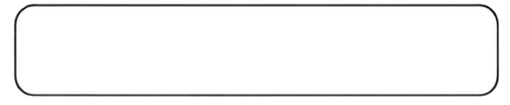


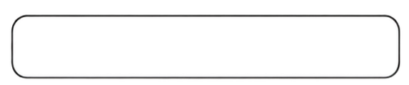


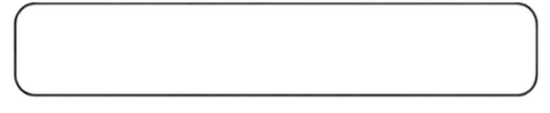











Start
AI-Based Early Warning System Framework
(Student Risk Classification)
1. Data Collection
2. Data Pre-processing
  Handle Missing Values
  Encoding categorical Variable
  Convert Percentage Features to Numeric
Target Variable (Y)
Student Performance Class
(Fail / Pass / Good / Excellent)
3. Feature Engineering
Proposed Framework
  Feature Selection / Feature Importance
4. Train / Test Split (Stratified)
Train Set (80%)
Test Set (20%)
Stratified Split to Maintain Class Distribution
5. Handle Class Imbalance
  Apply SMOTE on Training Set Only
6. Traning Models
Hyperparameter
Tuning
  Traditional Machine Learning Models
LG
SVM
DT
  Grid Search CrossValidation
RF
KNN
Naive Bayes
  Ensemble Learning Models
  XGBoost
AdaBoost
XGBoost
7. Model Evaluation
  Accuracy
  Precision
  Recall
  F1-Score
  Confusion Matrix
8. Student Performance Prediction (Risk Classification)
Risk Prediction Results
Class 0
Fail
(At Risk)
Class 1
Pass
(Low Risk)
Class 2
Good
(Moderate
Risk)
Class 3
Excellent
(Low Risk)
  Identify At-Risk Students
  Provide Insights
  Support Intervention Planning
End
End: Student Risk Classification & Insights Generated

Slide 11
METHOLOGY
1.DATA COLLECTION
  Private LMS dataset from Saudi Arabia
  1,395 students
  17 academic and behavioral features
  Target: Final Mark → Excellent, Good, Pass, Fail
4.CLASS IMBALANCE HANDLING – SMOTE
  SMOTE was applied only to the training set to address class imbalance.
  The dataset was imbalanced (Good: 51.97%, Pass: 7.67%); therefore, SMOTE was applied to the training data.
2.DATA PREPROCESSING
  Data cleaning
  Remove % symbols
  Encode categorical variables into numerical values
5.FEATURE SELECTION
  Applied RF Feature Importance.
  Ranked features based on predictive importance.
  Selected the most important features.
3.TRAIN–TEST SPLIT
  80% Training - 20% Testing
  Stratified split to preserve class distribution

Slide 12
METHOLOGY
6.MODEL TRAINING
8.EXPERIMENTAL CONFIGURATIONS
Eight ML models were trained and compared:
  Traditional ML: LR, SVM, KNN, DT, RF, NB
  Ensemble Learning: AdaBoost, XGBoost
Models were evaluated under TWO configurations:
  Without applying SMOTE: Full Feature Set+ Selected Features.
  With applying SMOTE: Full Feature Set+ Selected Features.
7.HYPERPARAMETER OPTIMIZATION
9.MODEL EVALUATION
Models were optimized using:
  Grid Search
  Stratified 3-Fold Cross-Validation
  Weighted F1-Score as the optimization criterion
Performance was evaluated using:
  Accuracy
  Precision
  Recall
  F1-Score
  Confusion Matrix

Slide 13
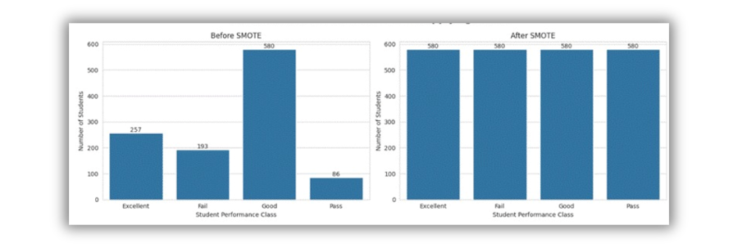
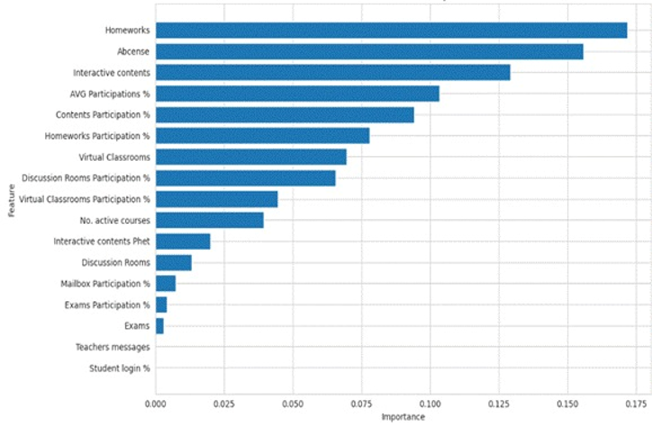
RESULT
1- DistRIBUTION OF STUDENT PERFORMANCE CLASSES
2- FEAtURE IMPORTANCE ANALYSIS USING RF
The following tables describe:
  Result without applying SMOTE: Full Feature Set+ Selected Features.
  Result with applying SMOTE: Full Feature Set+ Selected Features.

Slide 14
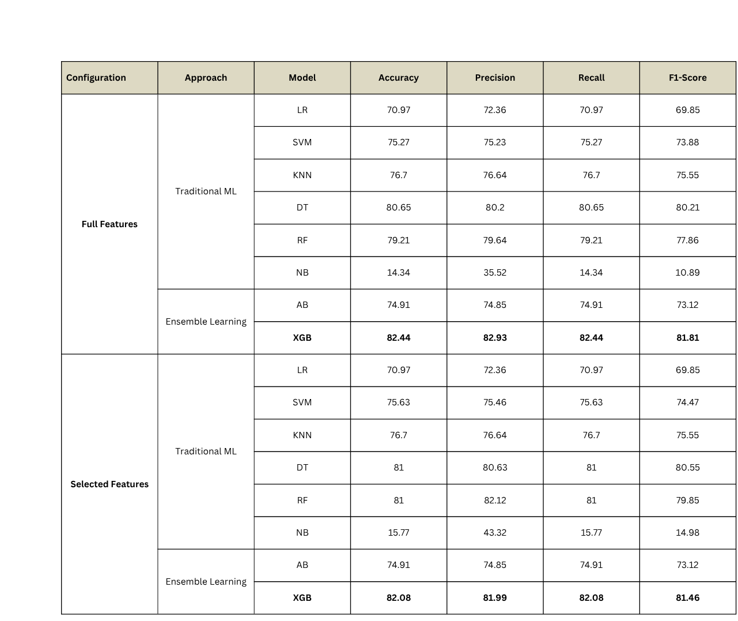
Results without Applying SMOTE

Slide 15
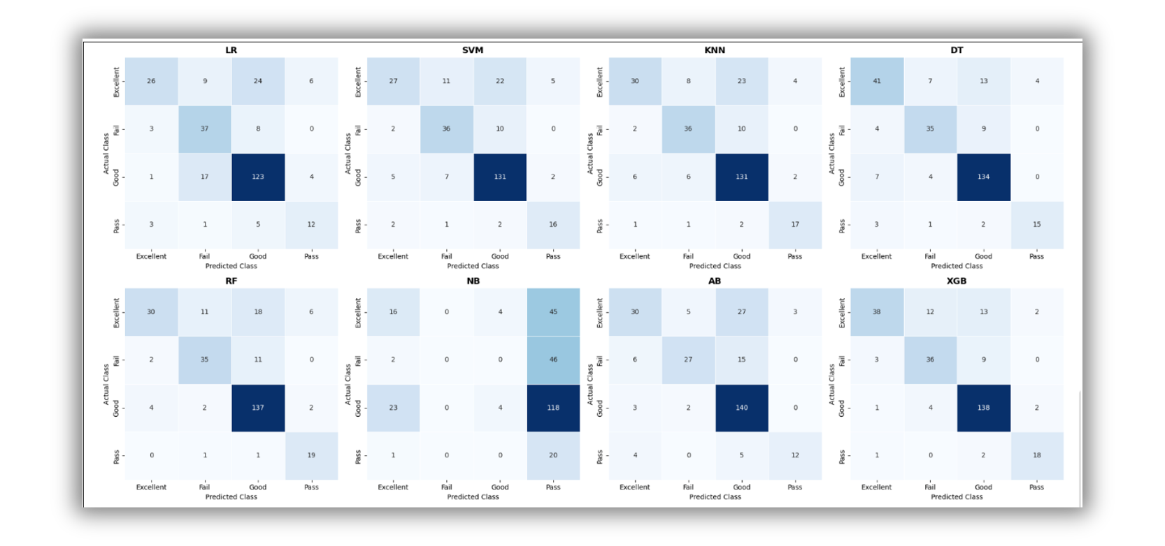
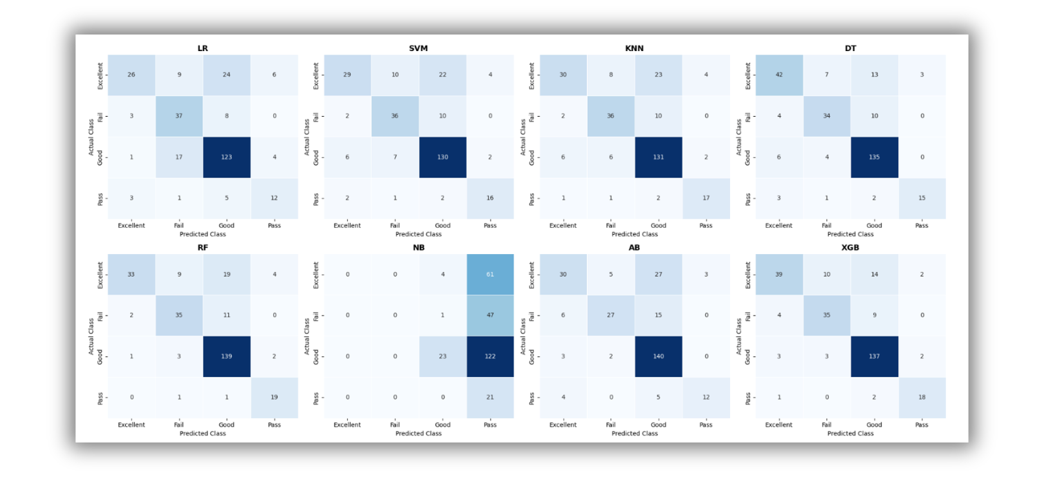
without SMOTE-full features
without SMOTE-Selected features

Slide 16
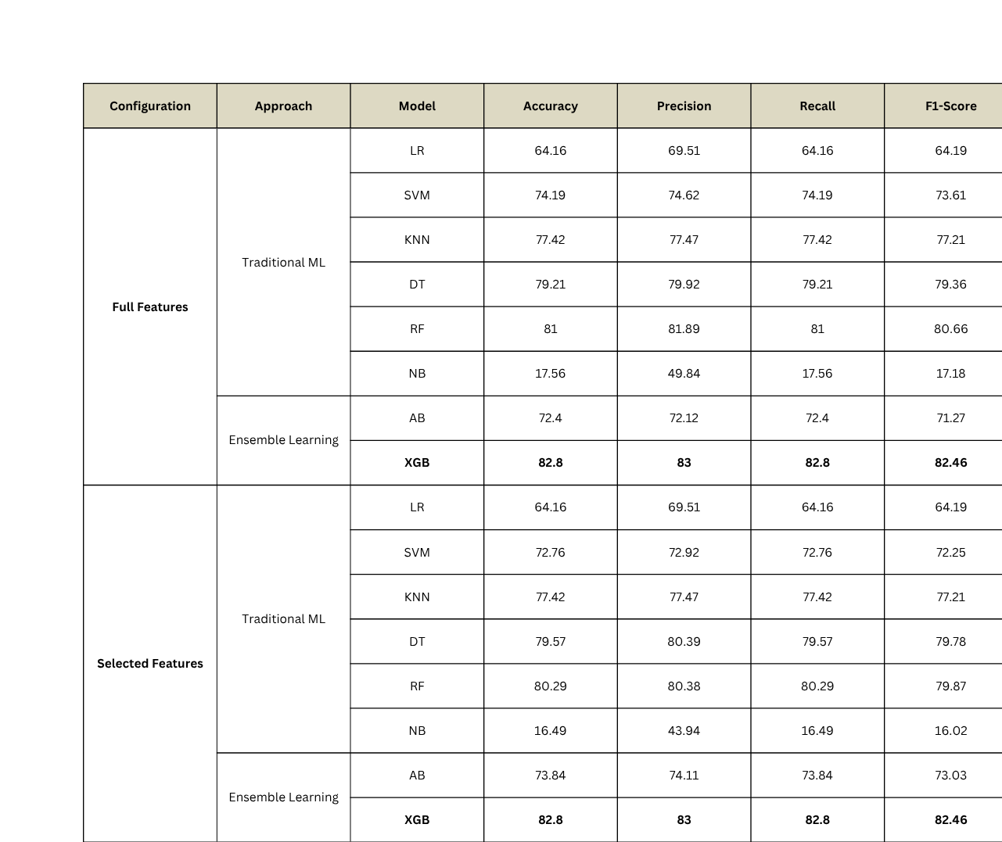
Results with Applying SMOTE

Slide 17
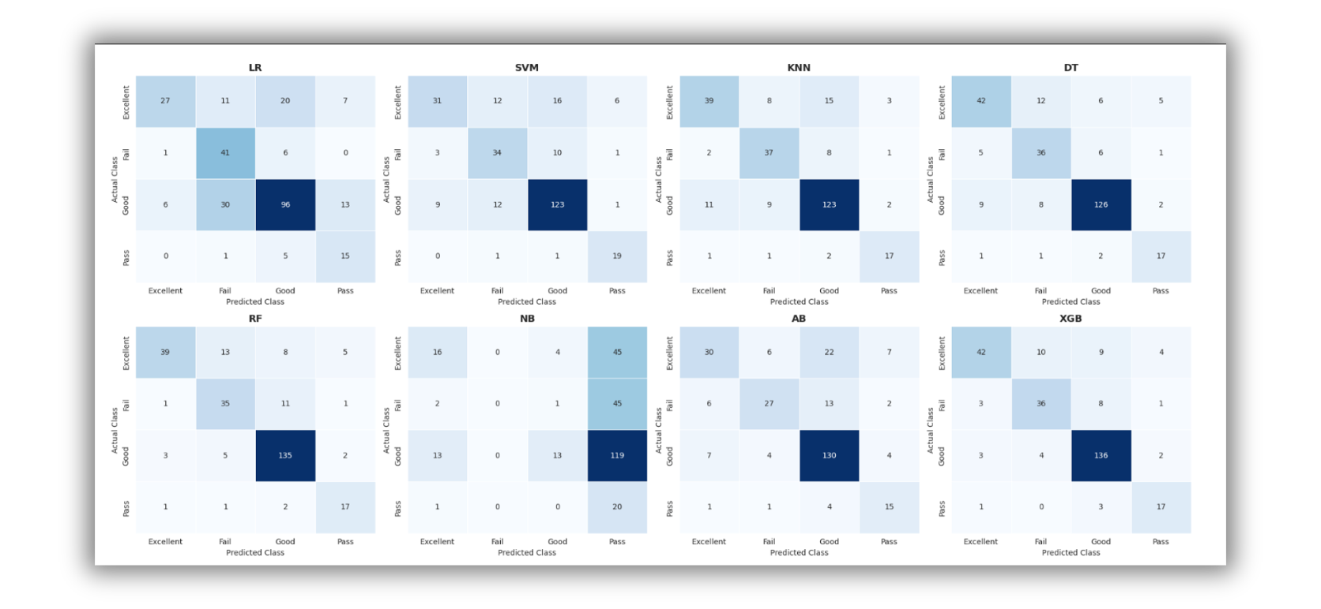
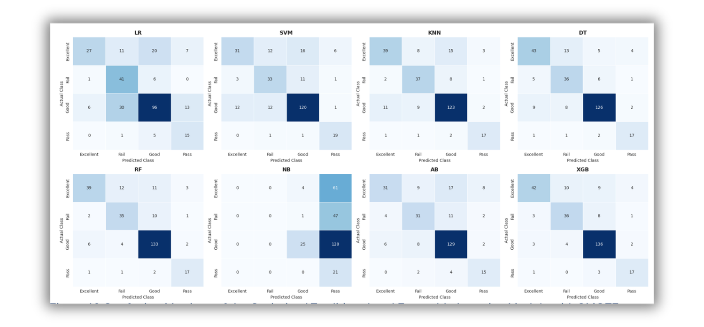
with SMOTE-full features
with SMOTE-Selected features

Slide 18
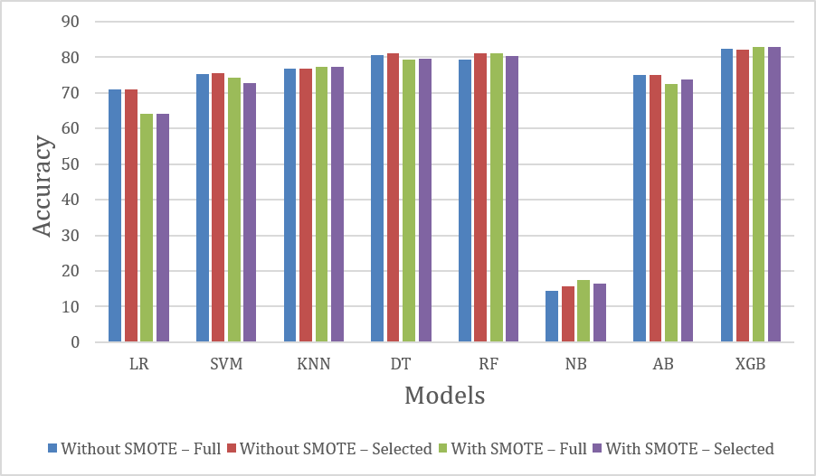
Comparison of ML models using full and selected feature sets with and without SMOTE.

Slide 19
CONCLUSION AND FUTURE WORK
CONCLUSION
  Proposed an AI-based Early Warning System using a private Saudi LMS dataset.
  Evaluated 8 ML models under two experimental configurations.
  XGBoost achieved the best performance:
Accuracy: 82.80%
Precision: 83.00%
Recall: 82.80%
F1-score: 82.46%
  Feature Selection reduced model complexity while maintaining competitive performance.
  SMOTE improved class balance and enhanced minority-class prediction.
  The framework supports early identification of at-risk students and enables timely educational interventions.
FUTURE WORK
  Validate the framework using larger and multi-institutional datasets.
  Integrate additional educational and behavioral features.
  Investigate DL models (LSTM, Transformer, Hybrid models).
  Develop a real-time Early Warning System for continuous monitoring.
  Incorporate Explainable AI (SHAP & LIME) to improve model transparency.
  Develop a personalized intervention recommendation system.

Slide 20
REFRENCES
[1]BETTAHI, ABDELKARIM, HAMID HARROUD, AND FATIMA-ZAHRA BELOUADHA. "EARLY STUDENT RISK DETECTION USING CR-NODE: A COMPLETION-FOCUSED TEMPORAL APPROACH WITH EXPLAINABLE AI." ALGORITHMS 18.12 (2025): 781.
[3]EMBARAK, OSSAMA H., AND SHATHA HAWARNA. "AUTOMATED AI-DRIVEN SYSTEM FOR EARLY DETECTION OF AT-RISK STUDENTS." PROCEDIA COMPUTER SCIENCE 231 (2024): 151-160.
[5]QUEIROGA, EMANUEL MARQUES, ET AL. "EARLY PREDICTION OF AT-RISK STUDENTS IN SECONDARY EDUCATION: A COUNTRYWIDE K-12 LEARNING ANALYTICS INITIATIVE IN URUGUAY." INFORMATION 13.9 (2022): 401.
[7] JOHORA, FATEMA TUZ, ET AL. "AN EXPLAINABLE AI-BASED APPROACH FOR PREDICTING UNDERGRADUATE STUDENTS ACADEMIC PERFORMANCE." ARRAY 26 (2025): 100384.
[10]HAMADNEH, NAWAF N., ET AL. "USING ARTIFICIAL INTELLIGENCE TO PREDICT STUDENTS’ ACADEMIC PERFORMANCE IN BLENDED LEARNING." SUSTAINABILITY 14.18 (2022): 11642.
[15]AKÇAPINAR, GÖKHAN, ARIF ALTUN, AND PETEK AŞKAR. "USING LEARNING ANALYTICS TO DEVELOP EARLY-WARNING SYSTEM FOR AT-RISK STUDENTS." INTERNATIONAL JOURNAL OF EDUCATIONAL TECHNOLOGY IN HIGHER EDUCATION 16.1 (2019): 40.

Slide 21


THANK YOU
MARYA BAWAZIR
Hala Hajjar
SUPERVISOR NAME: HAGAR SALEH

