Slide 1

PMG 506
Advanced Project Management
LECTURE 11: PMOs, and; OPM – Review
Everyone’s Smart
University
دكتور مهندس استشاري ادارة المشروعات
Eng. Dr. Akram Mustafa Suliman Ali,
PhD. AU, BEng. & MSc. AAST, CEng CMarEng MIMarEST, PE, PMP®,
ASQ CSSBB, ISO Lead Auditor, NDT Level II,

Slide 2
ANNOUNCEMENT!
سيتم اضافة 4 درجات لرفع منحنى الاختبار الفصلي
الاختبار الفصلي للمعتذرين الاسبوع القادم
الامتحان النهائي سيشمل المحاضرات من 6 الى 11 باستثناء محاضرة 7
  INITIAL PROJECT COORDINATION AND THE PROJECT CHARTER
  STARTING THE PROJECT PLAN: THE WBS
  PROJECT RISK MANAGEMENT
  BUDGETING, ESTIMATING TIMES AND COSTS
  PROJECT MONTITORING AND CONTROLLING
  PMOs, and; OPM

Slide 3
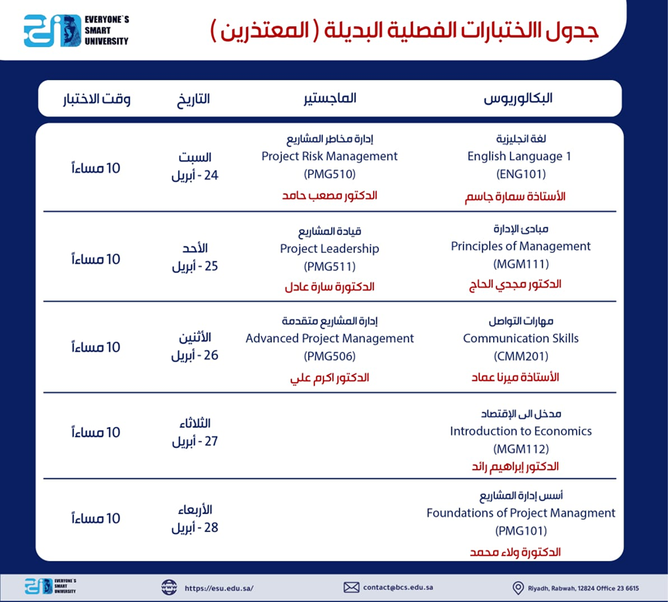

Slide 4
PROJECT

Slide 5
project
Instructions:
اخر موعد للتسليم هو يوم الخميس 820-05-2021 في تمام الساعة ٩ مساءً.
الإجابة متاحة باللغة الإنجليزية أو اللغة العربية مع مراعاة أن تكون المصطلحات العلمية باللغة الانجليزية.
يتم تسليم المشروع في صيغة ملف . pdf مع الالتزام نموذج الجامعة ولن تقبل أي مستندات أخري.
يجب مراعاة أقسام البحث الرئيسية (مقدمة
Introduction
، دراسات علمية سابقة Literature Review، طريقة البحث Methodology ،النتائج والمناقشة Results and Discussion ، وأخيراً المراجع
References
. وان كان هناك ملحقات Appendices يتم إضافتها)
يجب الالتزام بـ Theme موحّد كما يلي:
حجم الخط 12.
نوع الخط Arial.
لون الخط أسود.
المسافة بين الأسطر line spacing 1.5
عدد صفحات البحث (لا يقل عن ثلاث صفحات ولا يزيد عن ست صفحات).
Title of Project
Your role in the project

Slide 6
PROJECT
You are required to document your role in administering a project.
The project may be set in a business, social, sporting, or family environment but must be of a significant size and scale.
If you do not have an actual project to write about you may complete the project hypothetically.
This report will be between three to six pages in length.
This is a significant research project.

Slide 7
Project
Your report must address each ONE of the following issues:
Identify and describe the purpose, scope, and objectives of the project. Display this information using an appropriate tool.
Describe how the team is given an outline of the project.
Describe the strategies that are going to be set up to maintain communication with the team members.
Describe the tools that are going to be used to monitor the goals, time frames or milestones.
Identify project milestones and activities. Display this information using an appropriate tool.
Create a budget and link the costs to the key milestones for a project.
Describe how you are going to divide tasks and resources amongst a project team. Display this information using an appropriate tool.
Briefly describe how the progress will be monitored.
How are current project records maintained? Who has responsibility for this? provide some recommendations on how this process could be improved.
Describe the current procedure for finalizing projects. Create your own procedure and identify how you will evaluate the success of the project.
Legislation that may affect the project including health and safety, and anti-discrimination legislation.

Slide 8
Cost CRASHING

Slide 9
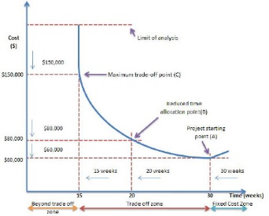
SCHEDULE COMPRESSION ANALYSIS
Time is of the essence
  Seller is placed on notice that delivery agreements are strictly binding
Liquidated Damages
  Estimated damages for specific types of defaults as defined in the contract

Slide 10
PMOs

Slide 11
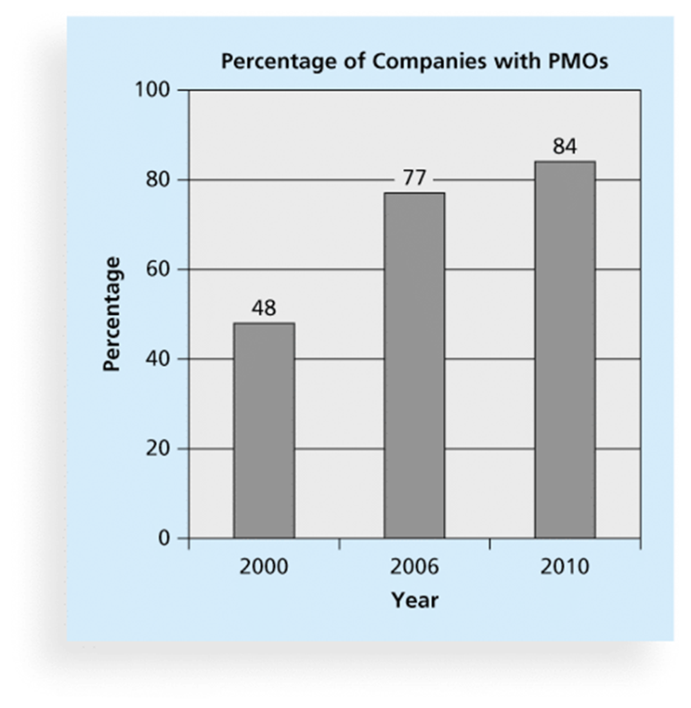
Project Management Offices
A Project Management Office (PMO) is an organizational group responsible for coordinating the project management function throughout an organization

Slide 12
PMO Definition
A PMO is an organizational body or entity assigned various responsibilities related to the centralized and coordinated management of those projects under its domain - PMBOK
Other responsibilities include:
  Manage shared resources across all projects
  Identify and develop a project management methodology, best practices, and standards
  Coach, mentor, train, and provide oversight
  Monitor compliance with project management standards, policies, procedures, and templates via project audits
  Develop and manage project policies, procedures, templates, and other shared documentation
  Coordinate communication
A strategic driver for organizational excellence

Slide 13
Project Management Office Role and FUNCTION
A project Management Office (PMO):
is a structure that standardizes the project-related governance processed and facilities of sharing resources, methodologies, tools and techniques among an organizations.
Its role may be supportive (consultative),Controlling or Directive (higher degree of control).
PMO’s Primary function is to support PM in :
  Managing shared resources across projects in its domain
  Developing Project Management methodology, practices and standards
  Coaching ,mentoring, training and oversight
  Auditing compliance with Project policies, procedures and templates
  Coordinating communications across projects

Slide 14
PMO Templates
Project Charter
Feasibility Study
Business Case
Project Management Plan
Change Management
Communications Management
Cost Management
HR Management
Procurement Management
Quality Management
Risk Management
Risk Register
Schedule Management
Work Breakdown Structure
Scope Management
Transition Out Planning
Lessons Learned
Project Acceptance

Slide 15
opm

Slide 16
Organizational Project Management (OPM)
OPM is a framework for keeping the organization as a whole focused on the overall strategy.
OPM provides direction for how portfolios, programs, projects, and other organizational work should be prioritized, managed, executed and measured to best achieve the strategic goals.

Slide 17
opm3

Slide 18
Opm3 Bridges the gap between organizational strategy and successful projects

Slide 19
WHAT IS OPM3?
OPM3 is an acronym for the
Organizational Project Management Maturity Model
a standard developed under the stewardship of the Project Management Institute.

Slide 20
The purpose of this standard
is to provide a way for organizations to understand organizational project management and to measure their maturity against a comprehensive and broad-based set of organizational project management Best Practices.
OPM3 also helps organizations wishing to increase their organizational project management maturity to plan for improvement.

Slide 21
Organizational Maturity Levels
Level 5 – Optimizing | Processes and performance continually improved through quantitative measures and analysis.
Level 4 – Quantitatively Managed | Product quality and process performance are quantitatively measured. A repository of measures exists to support fact-based decision-making.
Level 3 – Defined | Processes are defined, understood, and consistently applied from an organizational perspective. Processes are proactively managed and improved.
Level 2 – Managed | Repeatable processes are practiced on a project level. Process discipline is maintained through times of stress. Visibility to Status and delivery of work products at defined intervals.
Level 1 - Initial | Processes are ad hoc. Results are unpredictable. Success is dependent on heroics of the project team.

Slide 22
OPM3 SPECIFICALLY ADDRESSES THE FOLLOWING 10 AREAS:
1. Standardization and Integration of Processes
2. Utilization of Performance Metrics
3. Commitment to the Project Management Process
4. Alignment and Prioritization of Projects
5. Implementation of Continuous Improvement Processes
6. Using Success Criteria for results analysis
7. Understanding People and Competence
8. Allocation of Resources to Projects
9. Organizational Fitness
10. Teamwork.

Slide 23
Popular project management maturity models

