Slide 1



Organizational Structure and Design
Lecture 6
MGM111
Principle of Management
Prepared by
Dr. Bothaina Mahmoud Fouad

Slide 2
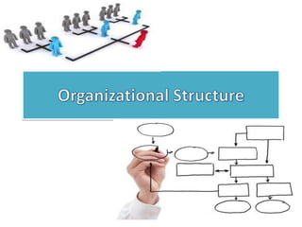
www.midocean.ae
Organizational Structure
Organization Structure Design
Learning Outcomes of the Lecture

Slide 3
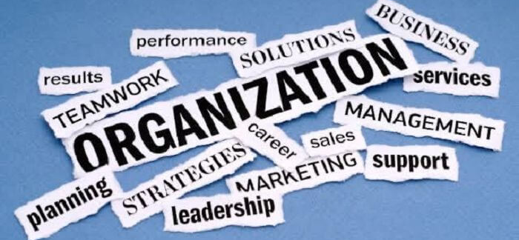
The Organization?

Slide 4
The Organization Definition
A group of people who work together in a structured way for a shared purpose
is a two or more people who work together in a structured way to achieve a specific goal or set of goals
can be any structured body such as department, business, company in private or public sector or nonprofit association.

Slide 5
Other definition
organization
people
resource
Goals and objectives
is an arrangement of people and resources to accomplish some specific purpose

Slide 6
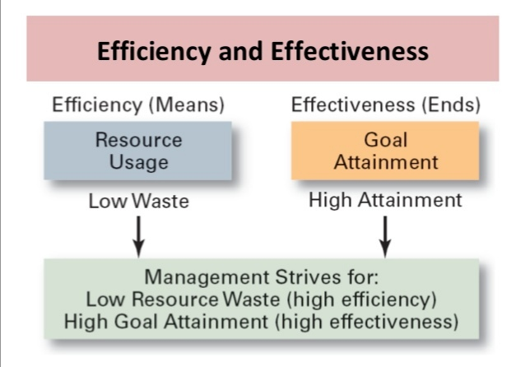
Organizational Performance

Slide 7
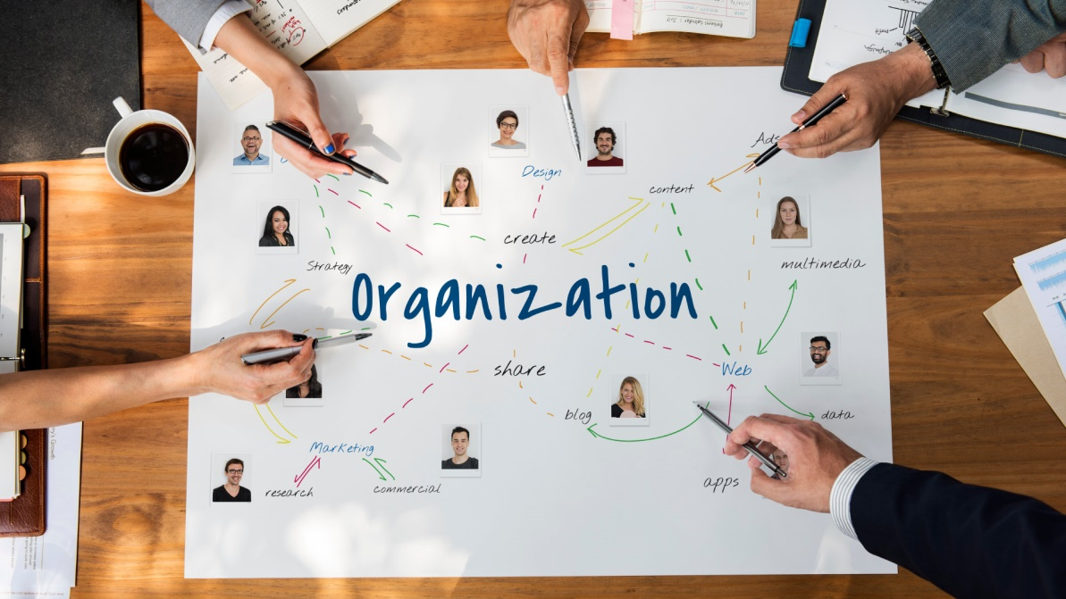
www.midocean.ae
  The formal arrangement of jobs within an organization
1. Organizational Structure

Slide 8
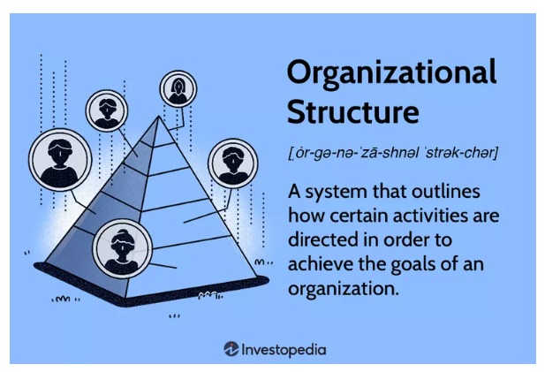
Organizational Structure Definition
An organizational structure is a system that outlines how certain activities are directed to achieve the goals of an organization. These activities can include rules, roles, and responsibilities.

Slide 9

Why Do We Need the Organizational Structure
Organizational structure provides a clear framework for decision-making and resource allocation, enabling a company to operate effectively and achieve its goals. The structure can vary widely depending on the size of the company, its industry, and its culture, among other factors

Slide 10
Why Do We Need the Organizational Structure in details
Divides work to be done into specific jobs and departments
Assigns tasks and responsibilities associated with individual jobs
Coordinates diverse organizational tasks
Clusters jobs into units
Establishes relationships among individuals, groups, and departments
Establishes formal lines of authority
Allocates and deploys organizational resources

Slide 11
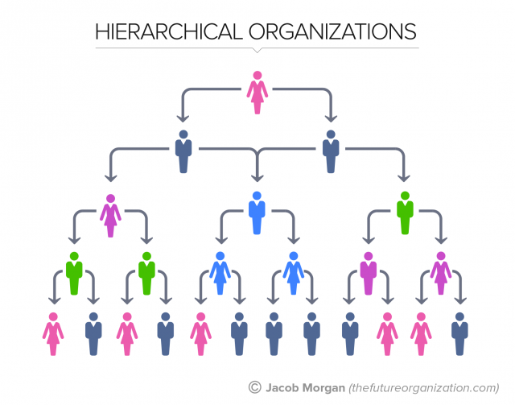
www.midocean.ae
Types of organizational structures
1. Hierarchical structure: This is a traditional organizational structure with a transparent chain of command and relationships. Each employee reports to a single manager, and decision-making power flows from top to bottom.

Slide 12
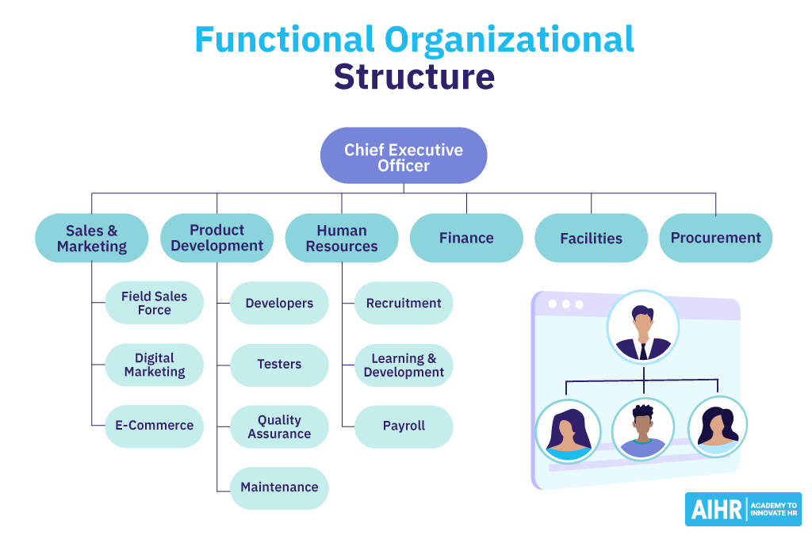
www.midocean.ae
Types of organizational structures
2. Functional structure: In an available form, departments are organized by function, such as marketing, finance, or operations. Each department is responsible for a specific set of tasks, and employees within each department have specialized skills.

Slide 13
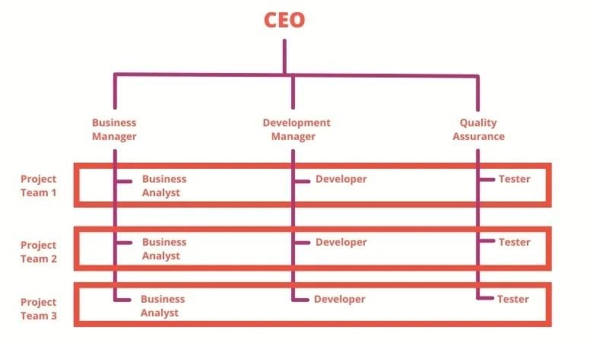
www.midocean.ae
Types of organizational structures
3. Matrix structure: A matrix structure combines elements of both a functional org structure and project-based systems. Employees may report to an active manager and a project manager, allowing for greater collaboration and flexibility.

Slide 14
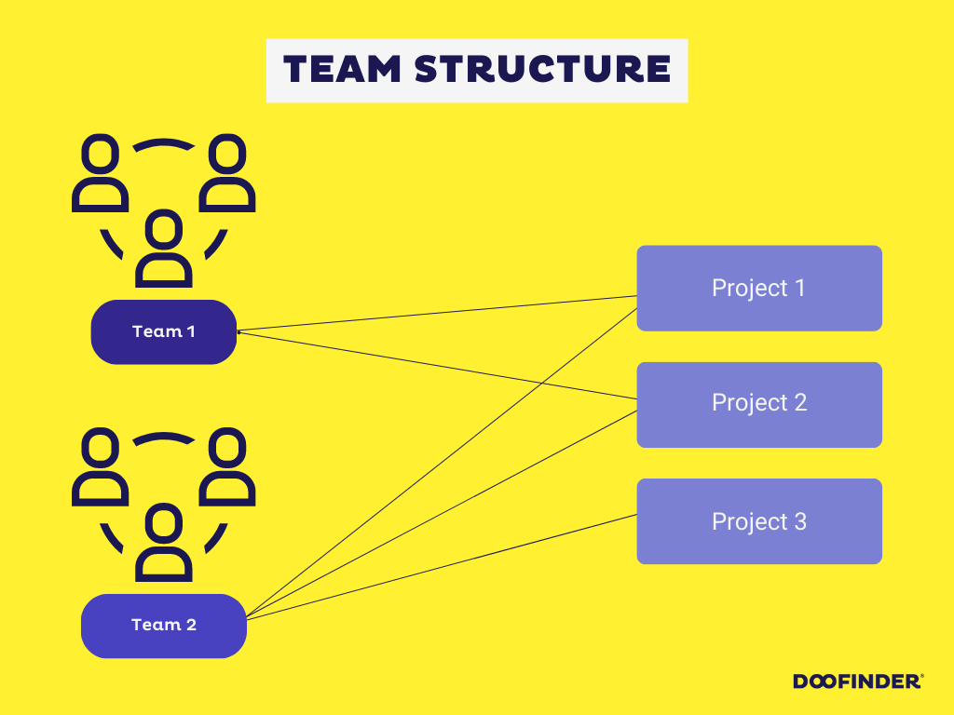
www.midocean.ae
Types of organizational structures
4. Team-based organizational structure: In a team-based system, the organization is divided into self-managing teams that work together to achieve a common goal. Each unit has a specific set of tasks and is responsible for deciding how to move human resources to accomplish them.

Slide 15
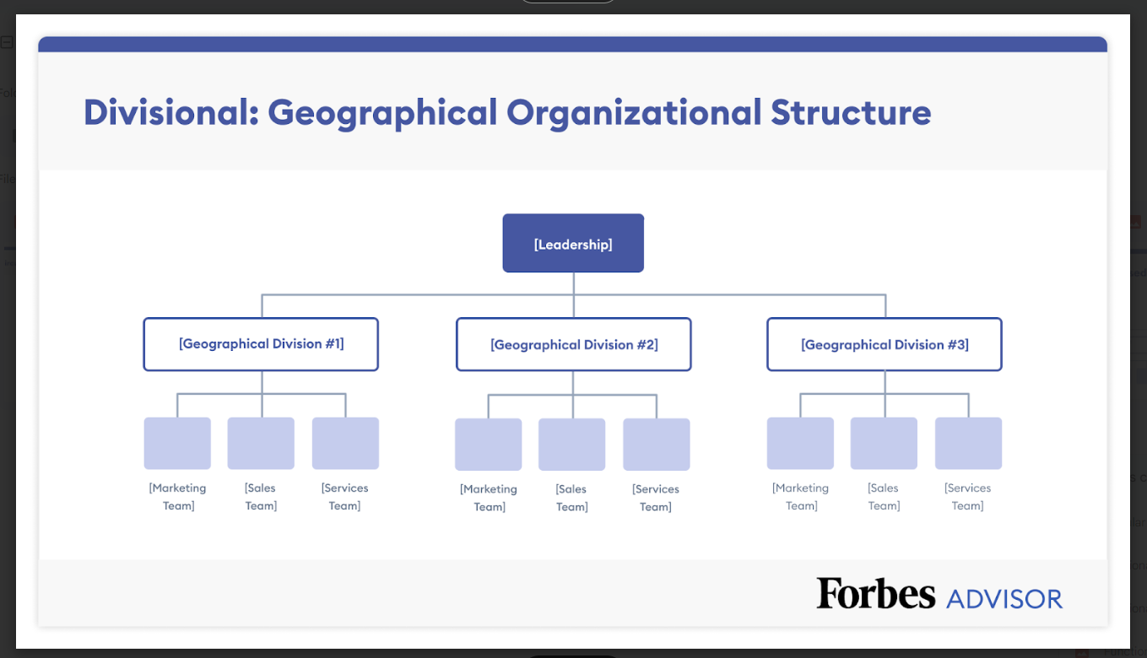
www.midocean.ae
Types of organizational structures
5. Divisional or multidivisional structure: A divisional structure is typically used by larger companies with multiple lines of business. Each division operates as a separate entity with its functional departments and reporting under one organizational structure.

Slide 16
www.midocean.ae
  a process for shaping the way organizations are structured and run. It involves many different aspects of life at work, including team formations, shift patterns, lines of reporting, decision-making procedures, communication channels, and more.
2. Organization Structure Design

Slide 17
Organizational Design
  It involves decisions about six key elements:
    Work specialization
    Departmentalization
    Chain of command
    Span of control
    Centralization and decentralization
    Formalization
www.midocean.ae

Slide 18
Work Specialization
  The degree to which tasks in the organization are divided into separate jobs with each step completed by a different person.

Slide 19
  Overspecialization can result in human diseconomies from boredom, fatigue, stress, poor quality, increased absenteeism, and higher turnover
Remember

Slide 20
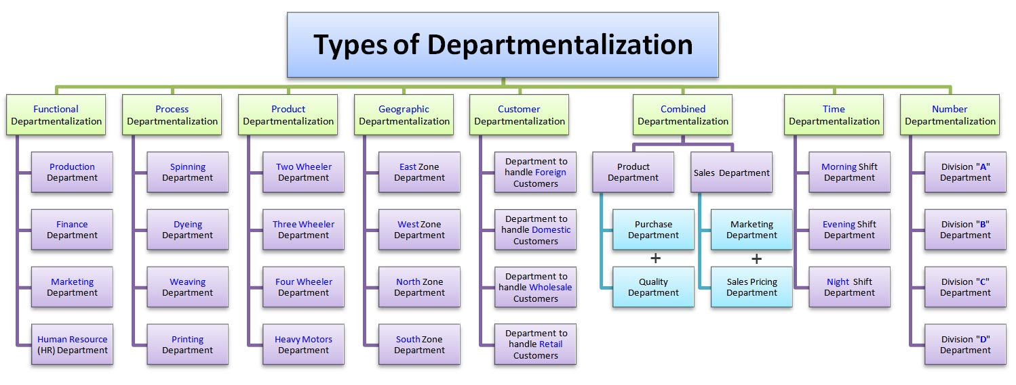
  Departmentation by Type

Slide 21
Types of departmentalization are listed as follows
Functional departmentalization.
Process departmentalization.
Product departmentalization.
Geographic departmentalization.
Customer departmentalization.
Combined departmentalization.
Time departmentalization.

Slide 22
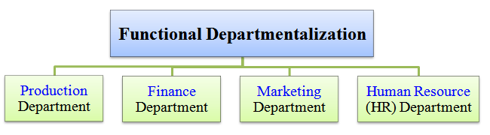
In functional departmentalization, departments are segregated i.e. separated from each other based on functions or tasks they perform.
Examples; production department, finance department, marketing department, human resource (HR) department, etc. Here, all activities, which are directly or indirectly connected with production are grouped together to make a production department.

Slide 23
Advantages Vs. Disadvantages of Functional Departmentalization
+ Efficiencies from putting together similar specialties and people with common skills, knowledge, and orientations
+ Coordination within functional area
+ In-depth specialization
– Poor communication across functional areas
– Limited view of organizational goals

Slide 24
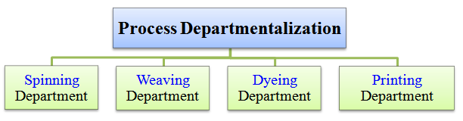
In process departmentalization, departments are separated based on their role in a production process.
Best example can be seen in a textile mill where we may have a spinning department, weaving department, dyeing department, printing department, etc. Here, inside a textile mill, all activities, which are directly or indirectly related with spinning are grouped together to make a spinning department.

Slide 25
Advantages Vs. Disadvantages of Process Departmentalization
+ More efficient flow of work activities
– Can only be used with certain types of products

Slide 26
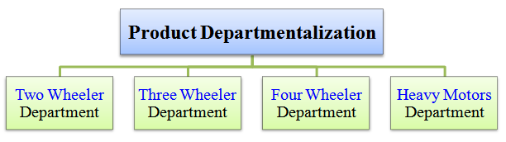
In Product departmentalization, departments are separated based on a type of product produced by the company. Here, every individual department is responsible for producing and selling the type of product assigned to them.
A good example is witnessed in an automobile manufacturing company. In such a company, we generally see departments like a two-wheeler department, three-wheeler department, four-wheeler department, heavy motors department, etc., which manufacture vehicles such as motorcycles (bikes), auto-rickshaws, cars, buses and trucks, respectively. Here, inside an automobile company, all activities, which are directly or indirectly related to car manufacturing are grouped together and assigned to four-wheeler or car department.

Slide 27
Advantages Vs. Disadvantages of Product Departmentalization
+ Allows specialization in particular products and services
+ Managers can become experts in their industry
+ Closer to customers
– Duplication of functions
– Limited view of organizational goals

Slide 28
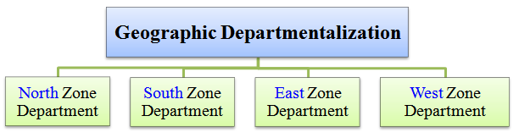
In geographic departmentalization, separate departments are made based on the company's (i.e. institution's) operations to be carried out either over a vast area or within some restricted area through branches or offices established at different zones or places in that area.
For example, a large company may operate globally through its different zonal departments established on a country basis. In a similar context, a small business or firm may operate only within city boundaries through its offices established in east zone, west zone, north zone and south zone of the city.

Slide 29
Advantages Vs. Disadvantages of Geographical Departmentalization
+ More effective and efficient handling of specific regional issues that arise
+ Serve needs of unique geographic markets better
– Duplication of functions
– Can feel isolated from other organizational areas

Slide 30
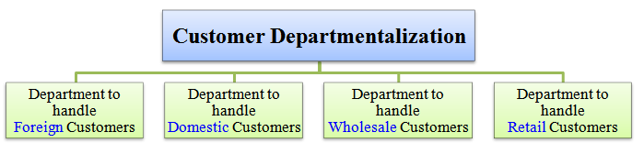
In customer departmentalization,
departments are separated from each other based on the types or groups of customers to be handled or dealt with.
For example, customers can be classified under types such as, international or foreign customers, inland or domestic customers, bulk purchasing or wholesale customers, retail customers, etc.
Each group of customers needs different tactics and strategies to handle them better. Hence, an appropriate customer departmentalization serves this purpose

Slide 31
Advantages Vs. Disadvantages of Customer Departmentalization
+ Customers’ needs and problems can be met by specialists
Duplication of functions
Limited view of organizational goals

Slide 32
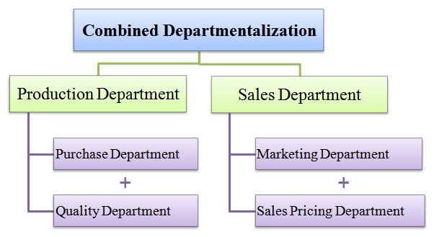
In combined departmentalization,
a company or an organization uses a mixture or combination or union of two or more different bases of departmentalization.
For example, in practice, owing to rising market competition and emerging complexity of tasks most organizations often uses a combination of above-discussed.

Slide 33
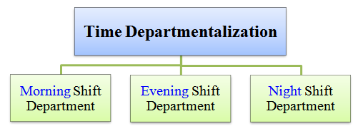
Time departmentalization,
departments are separated based on the division of their working time or job shifts.
For an example, departments can be made based on night shift, morning or regular shift, evening shift, etc.
This method of departmentalization is generally seen among those organizations who render 24-hours emergency and/or essential public services for 365 days a year. Examples of such organizations include; hospitals, hotels, airports, police, security, and so on.

Slide 34
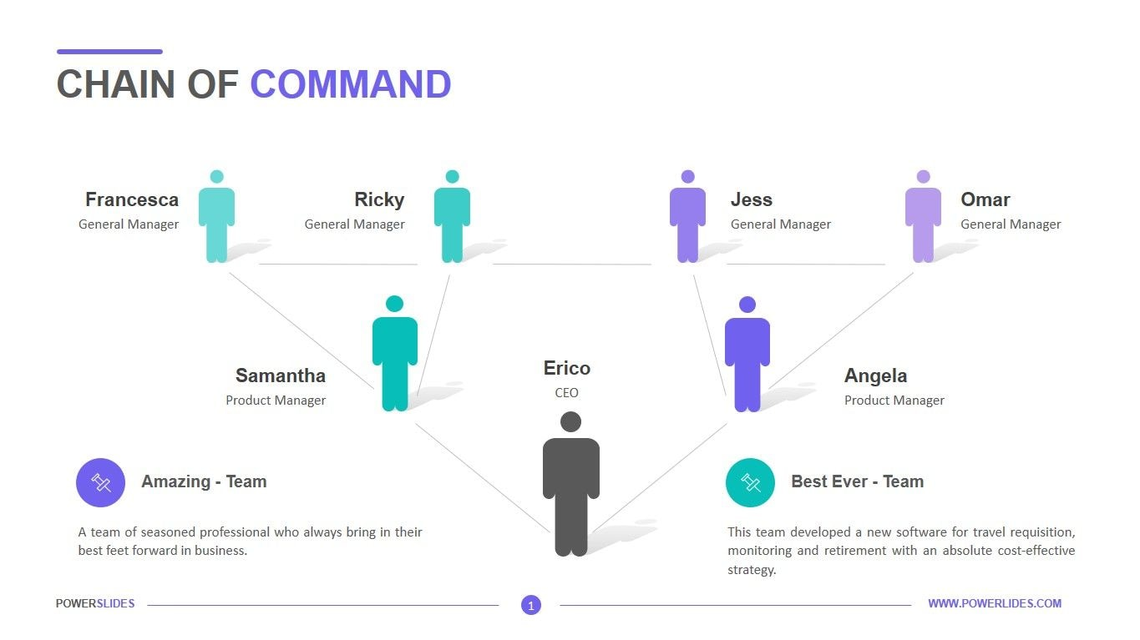
Chain of Command
  The continuous line of authority that extends from upper levels of an organization to the lowest levels of the organization and clarifies who reports to whom

Slide 35
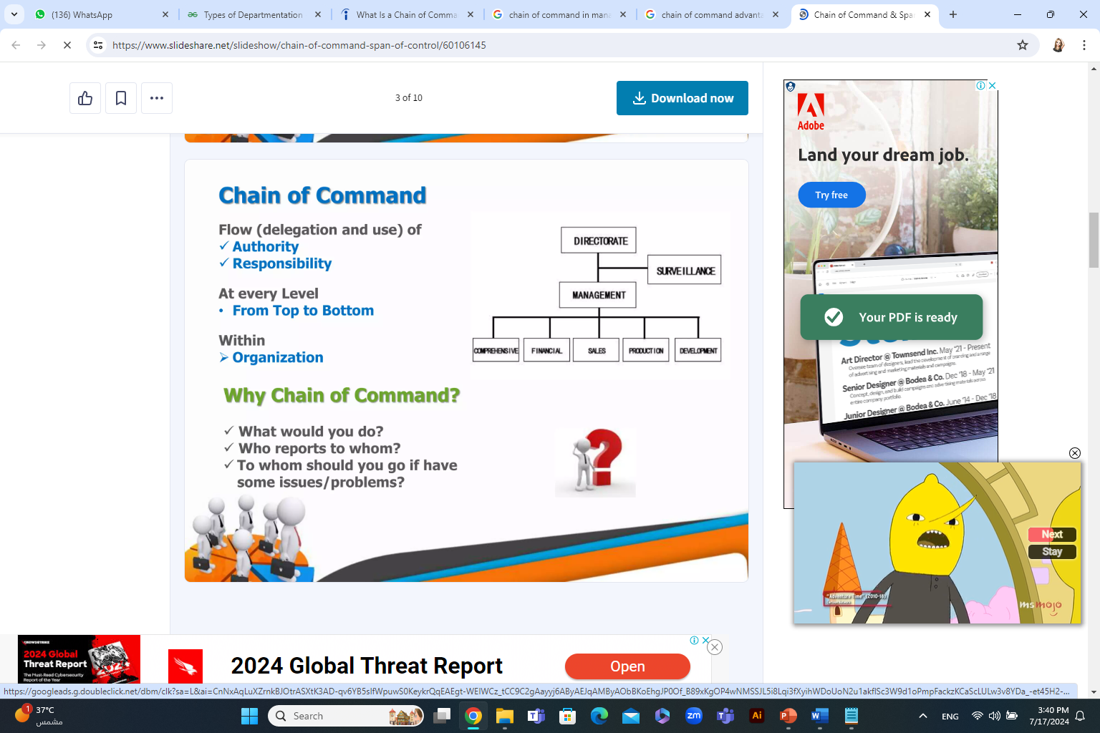
Chain of Command

Slide 36
Chain of Command
Authority
  The rights inherent in a managerial position to tell people what to do and to expect them to do it
Responsibility
  The obligation or expectation to perform. Responsibility brings with it accountability (the need to report and justify work to manager’s superiors)
Unity of Command
  The concept that a person should have one boss and should report only to that person
Delegation
  The assignment of authority to another person to carry out specific duties

Slide 37
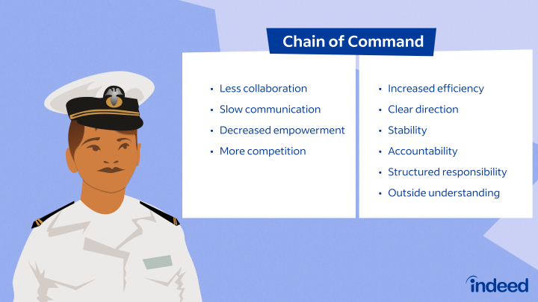
Chain of Command advantages Vs. Disadvantages
Advantages:
Increased efficiency,
Clear directions,
Structured responsibility,
Stability
Disadvantages:
less collaboration,
slower communication,
decreased employee empowerment
More competition

Slide 38
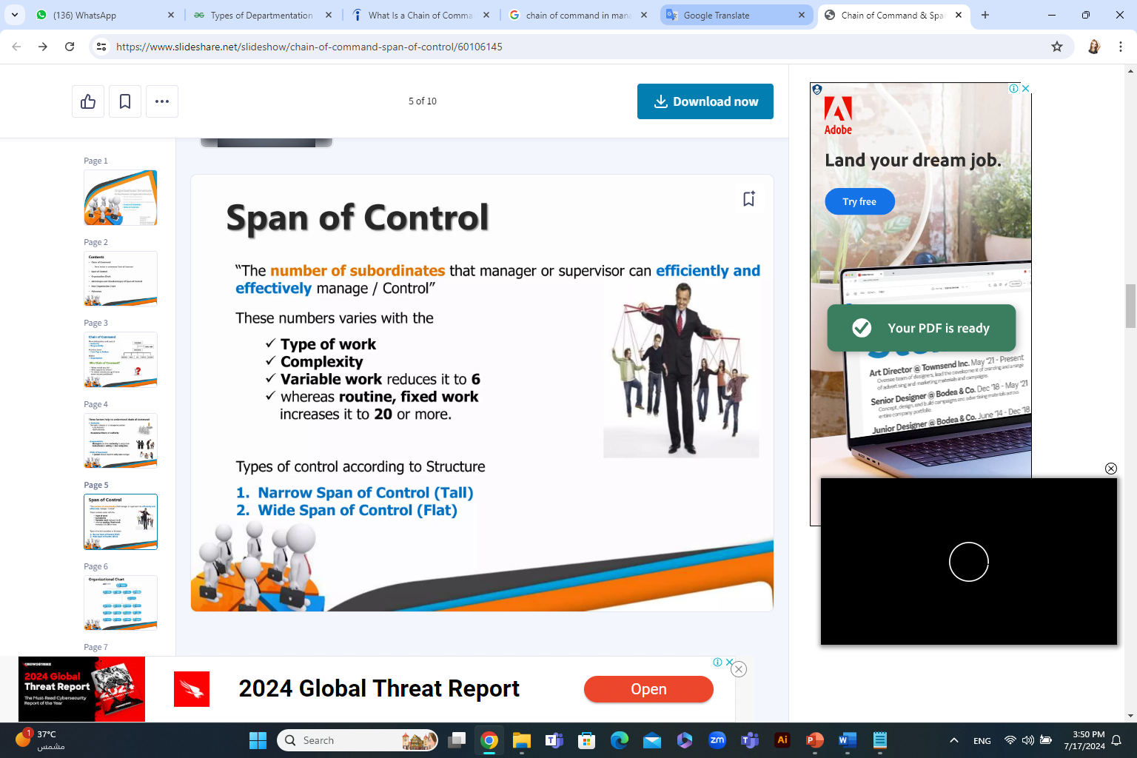
Span of Control
The number of employees who can be effectively and efficiently supervised by a manager
Width of span is affected by:
Skills and abilities of the manager and the employees
Characteristics of the work being done
Similarity of tasks
Complexity of tasks
Physical proximity of subordinates
Standardization of tasks
Sophistication of the organization’s information system
Strength of the organization’s culture
Preferred style of the manager

Slide 39
Centralize vs. Decentralize
Centralization
The degree to which decision making is concentrated at a single point in the organization
  Organizations in which top managers make all the decisions and lower-level employees simply carry out those orders
Decentralization
The degree to which lower-level employees provide input or actually make decisions
Employee Empowerment
Increasing the decision-making discretion of employees

Slide 40
Factors that Influence the Amount of Centralization and Decentralization
More Centralization
Environment is stable
Lower-level managers are not as capable or experienced at making decisions as upper-level managers
Lower-level managers do not want to have a say in decisions
Decisions are significant
Organization is facing a crisis or the risk of company failure
Company is large
Effective implementation of company strategies depends on managers retaining say over what happens
More Decentralization
Environment is complex, uncertain
Lower-level managers are capable and experienced at making decisions
Lower-level managers want a voice in decisions
Decisions are relatively minor
Corporate culture is open to allowing managers to have a say in what happens
Company is geographically dispersed
Effective implementation of company strategies depends on managers having involvement and flexibility to make decisions

Slide 41
Formalization
  The degree to which jobs within the organization are standardized and the extent to which employee behavior is guided by rules and procedures.

Slide 42



Thank You

