Slide 1

The Cultures of New Media
Prepared by
Dr. Mohamed Owies
Lecture No.4
The Cultures of New Media

Slide 2


Lecture 4
The content of Lecture 4
The lecture 4 sheds light on a number of important topics, including the following:
Out of Sight
Social Presence Theory
Key Concepts and Dimensions Social Presence Theory
Privacy and computer-mediated communication
Anonymity and Privacy in Social Media
Hyperpersonal Interaction
Writing Ourselves Into Being

Slide 3

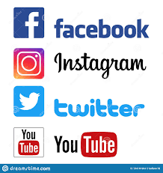
Lecture 4
Out of Sight
Idiosyncrasy of digital sociality, especially when communication is text-based, is that it makes us largely invisible.
When we use services such as Facebook, Twitter, and YouTube, we often cannot be seen by others, nor can we see who else is there at the same time.
Similarly, people who happen to be reading the same blog or looking at the same Instagram photo at the same time are also largely invisible to one another.

Slide 4
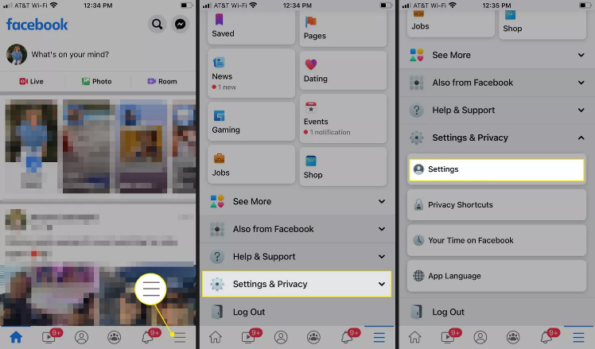
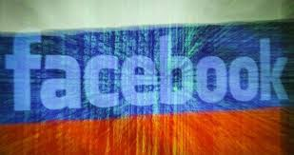
Lecture 4
Out of Sight
Even though some sites, platforms, and services have indicators that display whether people are online or not, one is still physically invisible (even though sometimes represented by a profile photo or other avatar).

Slide 5
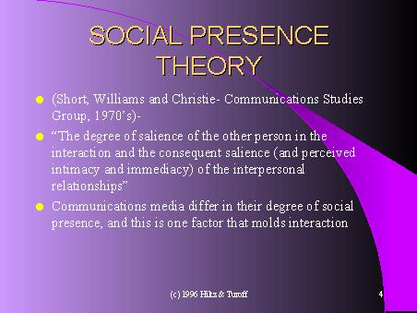
Lecture 4
Social Presence Theory
What is Social Presence Theory?
Social Presence Theory (SPT) was originally defined by Short, Williams, and Christie (1976) as, “the degree of salience of the other person in the interaction and the consequent salience of the interpersonal relationships.” A more modern definition of social presence theory was refined by Gunawardena (1995) to state, “the degree to which a person is perceived as a ‘real person in mediated communication.”
Lowenthal (2010) feels that definitions of social presence tend to lie on a continuum where a focus on the interpersonal emotional connection between communicators is on one end and a focus on if someone is perceived as being ‘present’, ‘there’ or ‘real’ at the other end.

Slide 6
Lecture 4
Social Presence Theory
According to call ‘social presence theory’, the sense of awareness of an interaction partner is very important for the social effects of any communication medium.
The theory suggests that increased social presence leads to a better perception of the person with whom we are communicating (Short et al. 1976).

Slide 7
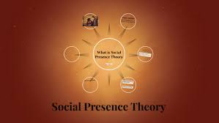
Lecture 4
Social Presence Theory
The lack of non-verbal cues and of other information about the communication partner, and the social context of interaction, has been thought by some to increase uninhibited communication, such as being aggressive or using foul language (Culnan & Markus 1987: 429).
In an influential article (Gunawardena & Zittle, 1997), social presence was found to be a significant predictor of audience satisfaction within a computer-mediated form of communication
Richardson and Swan (2003) also found that overall perceived learning was predicted by the perceived social presence in online course

Slide 8
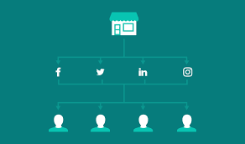
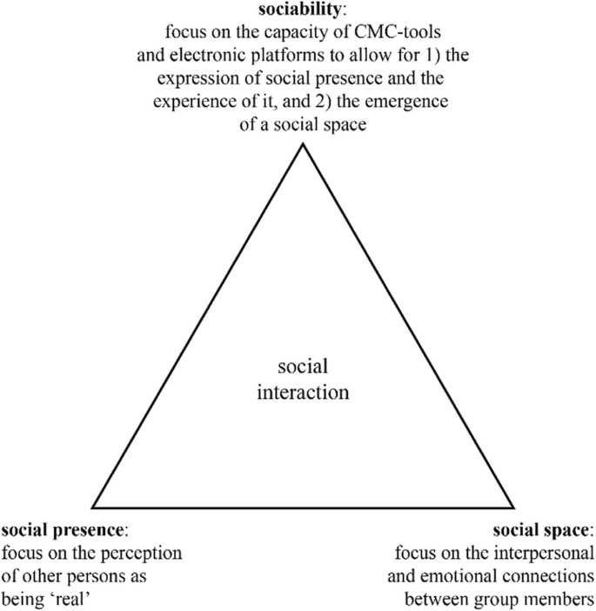
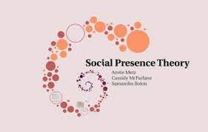
Lecture 4
Social Presence Theory

Slide 9
Lecture 4
Key Concepts and Dimensions
Social Presence Theory
Key Concepts and Dimensions
According to Short, Williams, and Christie (1976), social presence as a construct was primarily composed of two main concepts: intimacy (Argyle & Dean, 1965) and immediacy (Wiener &Mehrabian, 1968).
Intimacy
Argyle and Dean (1965) posited that intimacy in a communication medium is influenced by a number of
factors, such as: physical distance, eye contact, smiling, and personal topics of conversation.
Immediacy
Immediacy was conceptualized by Wiener and Mehrabian (1968), as paraphrased by Cobb (2009), as a measure of psychological distance that a communicator puts between himself and the object of his communications.

Slide 10
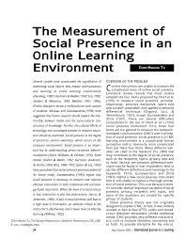
Lecture 4
Measurements
Social Presence Theory
There is still little agreement on how to measure social presence (Lin, 2004; Stein & Wanstreet, 2003). Below we provide three examples of instruments:
The Social Presence Scale (SPRES) was developed by Gunawardena and Zittle (1997) to measure the “immediacy” concept. On this scale, the respondents were asked to complete fourteen Likert items to indicate their perceived social presence at an inter-university “GlobalEd” computer conference.

Slide 11
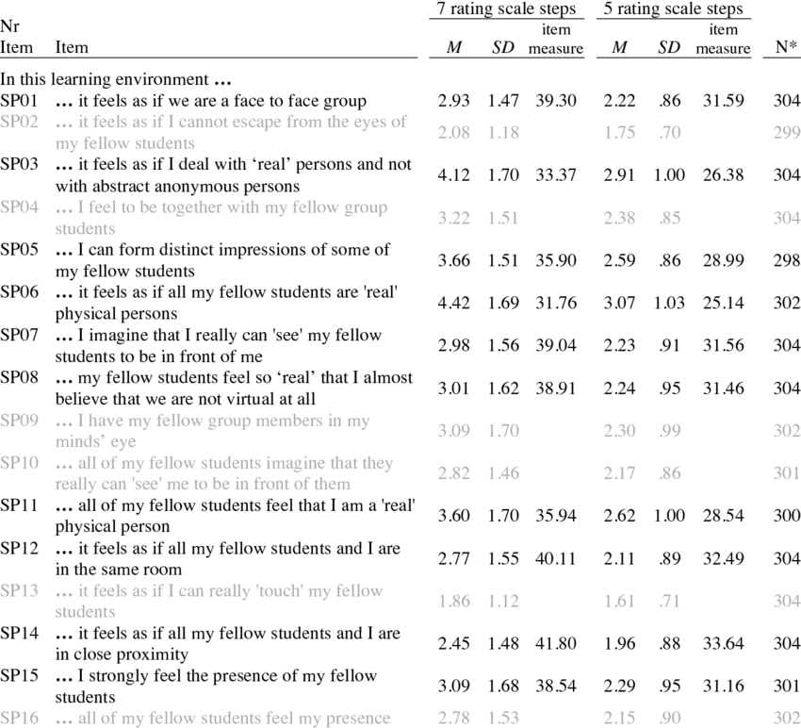
Lecture 4
Measurements
Social Presence Theory
There is still little agreement on how to measure social presence (Lin, 2004; Stein & Wanstreet, 2003). Below we provide three examples of instruments:
The Social Presence Scale (SPRES) was developed by Gunawardena and Zittle (1997) to measure the “immediacy” concept. On this scale, the respondents were asked to complete fourteen Likert items to indicate their perceived social presence at an inter-university “GlobalEd” computer conference.

Slide 12
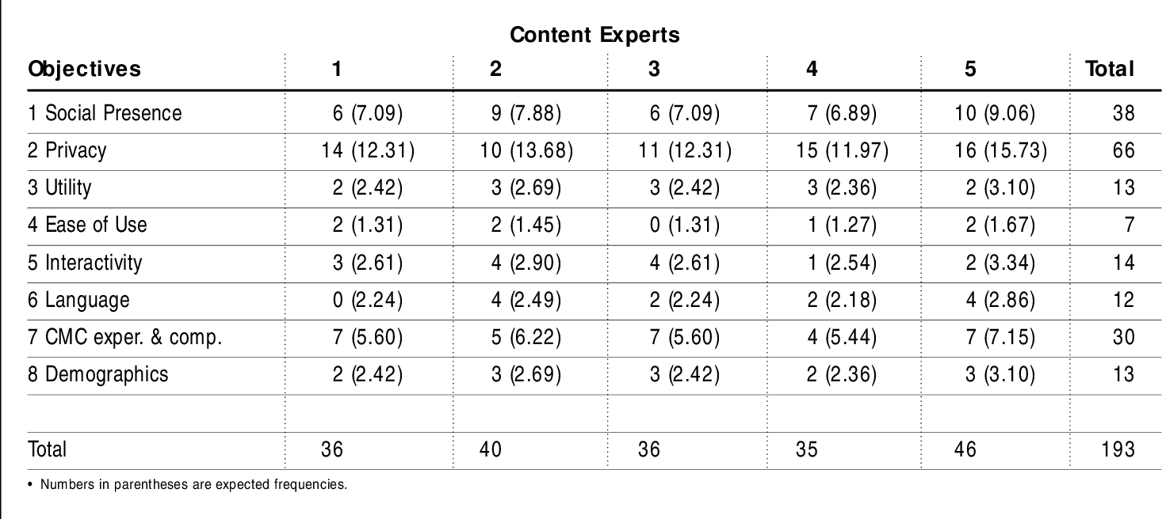
Lecture 4
The Social Presence and Privacy Questionnaire (SPPQ) was developed by Tu (2002), distinguishing three dimensions: social context, online communication, and interactivity. SPPQ was created based on two instruments: CMC attitude instrument (Steinfield, 1986) and perceived privacy (Witmer, 1997). The content validity and the construct validity of SPPQ was tested with factor analysis.
The final version of SPPQ contains 17 social presence items and 13 privacy items, rated on a five-point rating scale.
A self-reporting Social Presence Scale was developed by Kreijns, Kirschner, Jochems, and Buuren (2011). The scale consisted of five items with an internal consistency of .81.
Measurements
Social Presence Theory

Slide 13
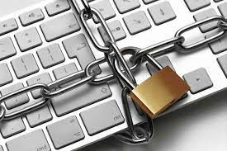

Lecture 4
Privacy and computer-mediated communication
Still, it is a general insight from previous research on digital media that people often disclose more intimate and private things in computer-mediated communication when compared to face-to-face communication (Joinson 2001).
In contrast to how interaction happens in a classroom, for example, online invisibility means we don’t have to worry about our physical appearance or the sound of our voice as we post a message. As McKenna and Bargh (2000: 64) put it: ‘physical appearance does not stop potential relationships from getting off the ground’. In online interaction, other and less superficial aspects — such as similarity of values and interests, or conversational style — can determine attraction to a larger extent than in some cases of face-to-face interaction.

Slide 14
Lecture 4
Privacy and computer-mediated communication
Likewise, we don’t have to deal with verbal or non-verbal cues or reactions from our audience. No frowns, no shaking heads, no sighs, but, on the other hand, no big smiles, oohs and aahs, or applause either.
As Suler (2004: 322) writes: ‘Text communication offers a built-in opportunity to keep one’s eyes averted.’ In addition to the fact that digital interaction can enable invisibility — a form of visual anonymity — it can also warrant other forms of anonymity.
One such form is discursive anonymity, which is the situation when things that are written and posted can’t be attributed to any specific and known source (Qian & Scott 2007).

Slide 15
Lecture 4
Privacy and computer-mediated communication
Of course, digital interaction is not the only mode of communication where it is possible to avoid identification. But the multitude of communication channels on the internet, in combination with the separation of users in space and time, makes it relatively easy to evade identification.
With anonymity as a protective cloak, people tend to take more risks, and to express more directly what they truly think or feel. Once again, that online disinhibition.
With identities concealed, we may share more intimate confidences earlier in potential relationships, and develop closeness faster than we would in face-to-face offline relationships.

Slide 16
Lecture 4
Privacy and computer-mediated communication
In fact, a number of studies undertaken in the 1990s demonstrated that people tended to forge strong friendships based on high levels of self-disclosure on the internet (Henderson & Gilding 2004: 490).
Yet the same mechanism — the fact that we feel less restrained by social norms — might also lower the thresholds for expressing views and behaviors that are racist and so on.

Slide 17
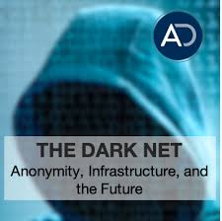
Lecture 4
In the Dark
Anonymity can definitely be both good and bad for social interaction.
On the internet, the ‘large numbers’ might make us overestimate how many people share our views (McKenna & Bargh 2000: 64). We might see, for example, the number of views of a YouTube video or the number of times a tweet has
been retweeted and make a rough translation between such numbers and the general legitimacy of the content.

Slide 18
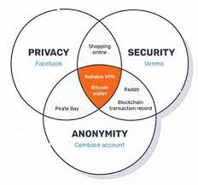
Lecture 4
In the Dark
When anonymity removes personal responsibility and generates a perceived loss of individuality, it can also lead to people becoming more altruistic and more willing to help others. In a digital society, then, anonymity can be a force of unity and solidarity as well as fragmentation and nihilism. This is a longstanding debate.
Some claim that anonymous interaction in digital media is a major cause of hate speech, racism, etc

Slide 19
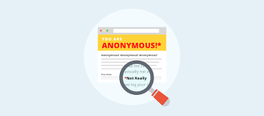
Lecture 4
In the Dark
The researchers (Gergen et al. 1973: 38) found that these results challenged previous studies that had shown that anonymity fed aggression. They wrote: Both laboratory and field studies have demonstrated that when a person is without markers or personal identity when he or she becomes deindividuated in the researchers’ terms, the stage is set for increased aggression. Faceless people are more likely to harm each other.

Slide 20
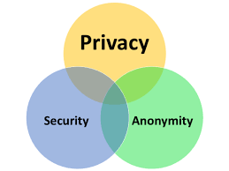
Lecture 4
In the Dark
On the internet, there are several possibilities to maintain anonymity at the technological level. Users might connect via servers that conceal their actual IP address, use anonymous email or messaging services, or use other forms of anonymity-enabling hardware and software. With some of these methods, it is next to impossible for anyone, even with the right expertise, to reveal the true identity of someone. With others, the protection might not be as secure as the user would hope.

Slide 21
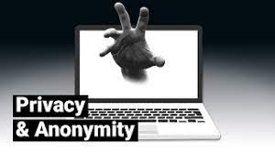
Lecture 4
In the Dark
However, from a sociological perspective, the most interesting part of online anonymity is that even those who interact online with little to none of these protective layers tend to feel that they are quite anonymous as well. This is because when we post on a forum — even if it is easy to see the IP address behind our username — or when we upload a tweet — even if we have information about who we are on our Twitter profile .

Slide 22
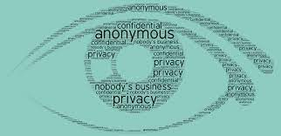
Lecture 4
Anonymity and Privacy in Social Media
technology is evolving quicker than most peoples’ ability to understand it; therefore it is increasingly critical to be safe online and to protect ones' personal privacy.
Privacy and Anonymity are not the same things. However, they do get confused with one another regularly so it is important to tell one from the other.
Terminology explained...

Slide 23
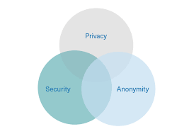
Lecture 4
Anonymity and Privacy in Social Media
Privacy
Privacy is when nobody is aware of what you are doing but potentially they know your identity.
Privacy relates to the content. Refraining from the public eye and maintaining confidentiality. If you send an encrypted email to a friend so only the two of you can open it, this is private. It is not public.

Slide 24
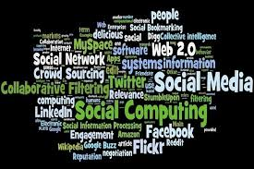
Lecture 4
Anonymity and Privacy in Social Media
Anonymity
Anonymity is when nobody knows who you are but potentially they know what you are doing.
When one keeps their actions and activities separate from their identity. Where, from a set of all possible number of people, there is an equal probability it could be anybody. This setting could serve for viewing content but not for producing it. Anonymity is having nothing attributed to what you do. To be faceless and nameless.

Slide 25
Lecture 4
Anonymity and Privacy in Social Media
Privacy and Anonymity often get substituted for one another and in the wrong context so it is easy to get confused. It is key to understand the difference as solutions will vary in how they provide privacy or anonymity.
What is Pseudonymity?
Say you choose to use an alias for social media or for a forum online to hide your identity, an adversary may not know who you are but can still attribute posts and activity to you.
This is an alias, a cover, a false identity. This is often referred to as 'pseudonymity'.

Slide 26
Lecture 4
Anonymity and Privacy in Social Media
The amount of information shared via social media is rapidly increasing. All major websites and operating systems have adopted features to simplify and encourage information sharing on various social media platforms.
At the same time, there are growing concerns over online privacy and the handling of sensitive social media data. There exists a fundamental trade-off between the utility that can be derived from social media and individual privacy.

Slide 27
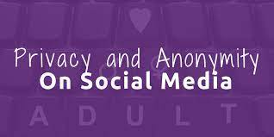
Lecture 4
Anonymity and Privacy in Social Media
This “privacy dilemma” (Brandtzæg, Luders, and Skjetne 2010) has challenged researchers to develop interface designs that reconcile people’s desire to share information with concerns over privacy.
A substantial body of literature has shown how the state of anonymity impacts online behavior (e.g., Bernstein et al. 2011; Postmes et al. 1998). Since many social networking sites do not allow users to share information anonymously, it raises an important set of research questions around effects on information-sharing behavior in the presence of the option to share anonymously.

Slide 28
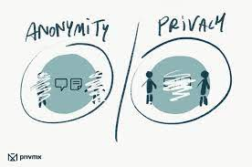
Lecture 4
Anonymity and Privacy in Social Media
Prior research suggests that people share information to receive attention and enhance their reputation and popularity among an audience (Ames and Naaman 2007; Lee and Ma 2012).
A fundamental trade-off arises between the utility that can be derived from social media and the concern over privacy, which has led researchers to call for interface designs that “simultaneously ensure privacy and promote content sharing and sociability” (Brandtzæg, Luders, and Skjetne 2010, p. 1007).

Slide 29
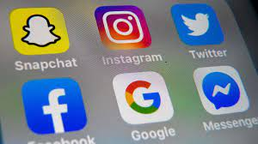
Lecture 4
Anonymity and Privacy in Social Media
Anonymity and Social Norms
Social psychological research has long established that the state of anonymity strongly influences people’s behavior. The most notable work has been carried out by Phillip Zimbardo (1969). In a series of experiments, he found a tendency toward greater aggression and violence when people were
anonymous than when they were identifiable by name tags.

Slide 30
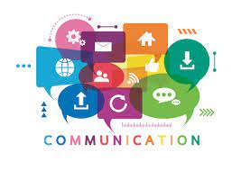
Lecture 4
Hyperpersonal Interaction
Anonymity as such is of course not new, but before digital society, people generally only had the opportunity to be anonymous in random, occasional, and impersonal forms of interaction.
On the internet and in social media, anonymity can be maintained in interaction that is not just brief and on a one-time-only basis. In some online environments, people can communicate over a period of time, get to know each other well, and share intimate things, while still keeping their true identities concealed.

Slide 31
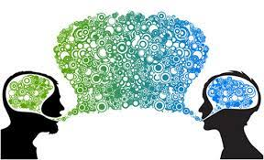
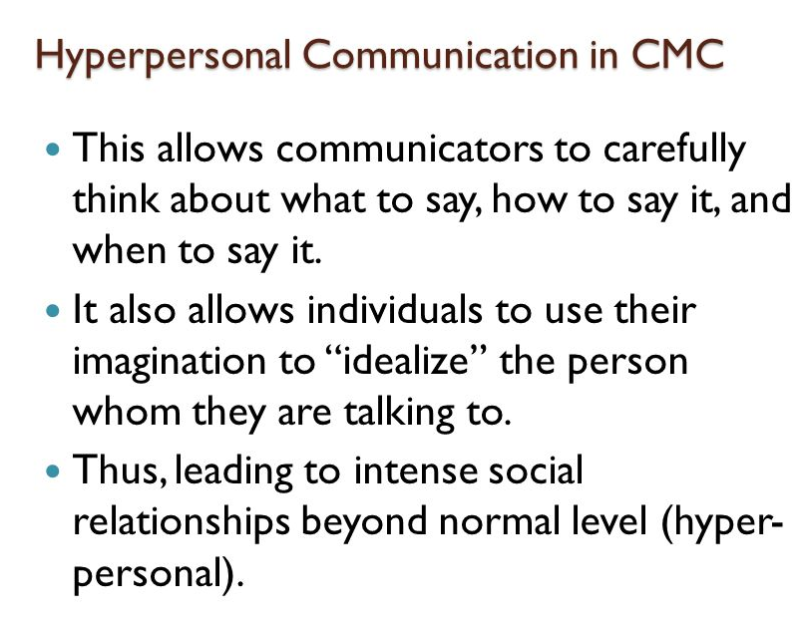
Lecture 4
Hyperpersonal Interaction

Slide 32
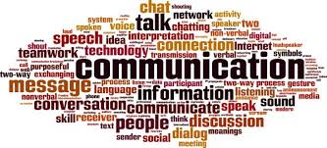
Lecture 4
Hyperpersonal Interaction
Furthermore, there is also an ongoing debate about whether the internet and social media offer any real anonymity, as users are increasingly mapped, tracked, and watched by governments, as well as corporations, who use the data for purposes ranging from surveillance to marketing.
Another point to explore is, as discussed previously, that the rise of web 2.0 has arrived with a decrease in the importance of anonymity online. Social media, when compared to the earlier forms of internet sociality, are more based on users being visible to each other, where our identities tend to be grounded to a larger extent in relationships with the offline friends that we also have contact with online.

Slide 33
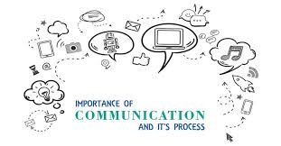
Lecture 4
Hyperpersonal Interaction
Walther also found that what he called hyperpersonal interaction could be developed online. This is a notion which may account for why some forms of interaction though digital media sometimes are marked by higher levels of emotional intensity and self-disclosure than face-to-face interaction.
He explained that people communicating digitally — with fewer cues than in face-to-face communication — might succumb to over-reliance on the information that they have.

Slide 34
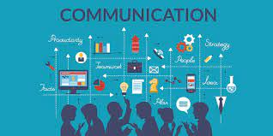
Lecture 4
Hyperpersonal Interaction
In other words, computer-mediated communication seems to be able to make interaction either impersonal, or increasingly (hyper-)personal, and possibly anything in between.
Walther writes that digital media alone do not decide which one of these forms of interaction are realised in any given situation. Rather, the internet and social media afford opportunities for people to communicate as they like.

Slide 35
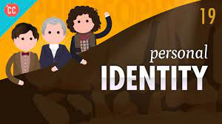
Lecture 4
Writing Ourselves Into Being
The affordances of social media enable us to document, display, and share our lives, and to do this in more than one fixed and specific way. Identities are always open to negotiation and, a key element of being in society is the management of our identities in relation to others — showing some aspects, hiding others — depending on audience, context, and situation.

Slide 36
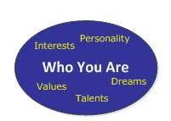
Lecture 4
Writing Ourselves Into Being
Of course, identities are always formed in relation to what position the individual has within the larger cultural and economic framework of society, and they are constrained by dominant sorting systems that might be rooted in class, gender, race, (dis)ability, and so on.
Still, with interaction on the internet being potentially disinhibited, anonymous, and thus free and open, there is considerable room for people in digital society to construct and perform different features (and even versions) of themselves.

Slide 37
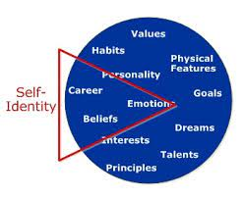
Lecture 4
Writing Ourselves Into Being
This is due to the relative fluidity of the digital environment, because, as McKenna and Bargh (2000: 62) write:
it is quite difficult for a person to effect changes in his or her self-concept when the surrounding social environment (i.e., one’s network of acquaintances, colleagues, family, and friends) remains static.

Slide 38
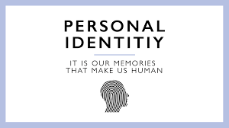
Lecture 4
Writing Ourselves Into Being
On the internet and in social media, people have the social opportunity and the technological tools for ‘writing themselves into being’ (Barton & Lee 2013: 84). By posting text, images, or video, by commenting on the posts of others, and when creating profiles, and so on, we are actively constructing who we are, or at least who we want to be seen as by others.
Managing and working with identity in such ways can be seen as ‘a process of exploring and discovering new aspects of the self’ (Barton & Lee 2013: 85). It is important to note, however, that our own self-presentations are not the only information that is available about us online.

Slide 39
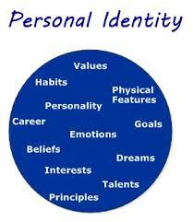
Lecture 4
Writing Ourselves Into Being
We may also be liked, tagged, mentioned, or discussed by others. This means that anyone looking someone up with a search engine will find ‘a mix of what the person has put online and information placed there by others’ (Baym 2010: 112).
These dynamics are further complicated by the interesting tension between what the ‘old’ internet was and is — largely an archive of traces — and new forms of ephemeral media, such as Snapchat snaps that only live for seconds, consisting not of traces, facelessness, or asynchronicity, but of pure erasure.

Slide 40
Lecture 3
Thank You

