Slide 1


Slide 2


Slide 3
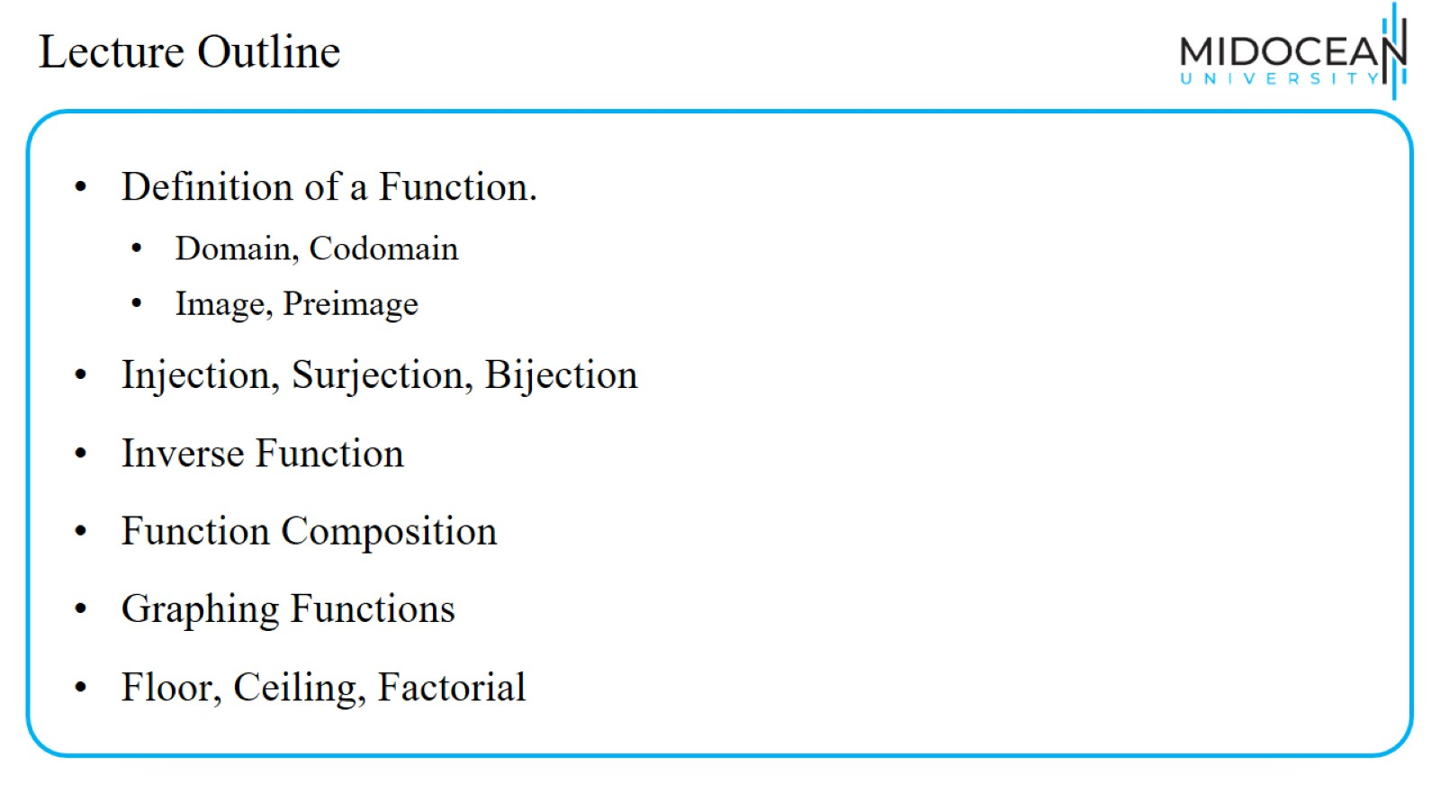
Lecture Outline

Slide 4
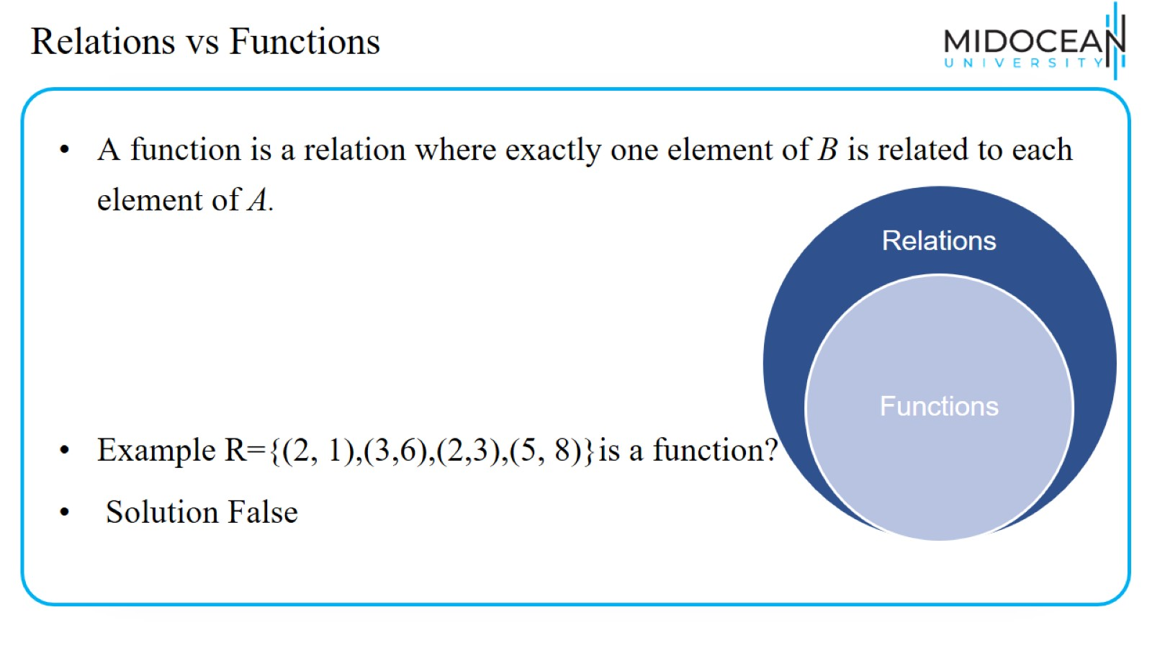
Relations vs Functions

Slide 5
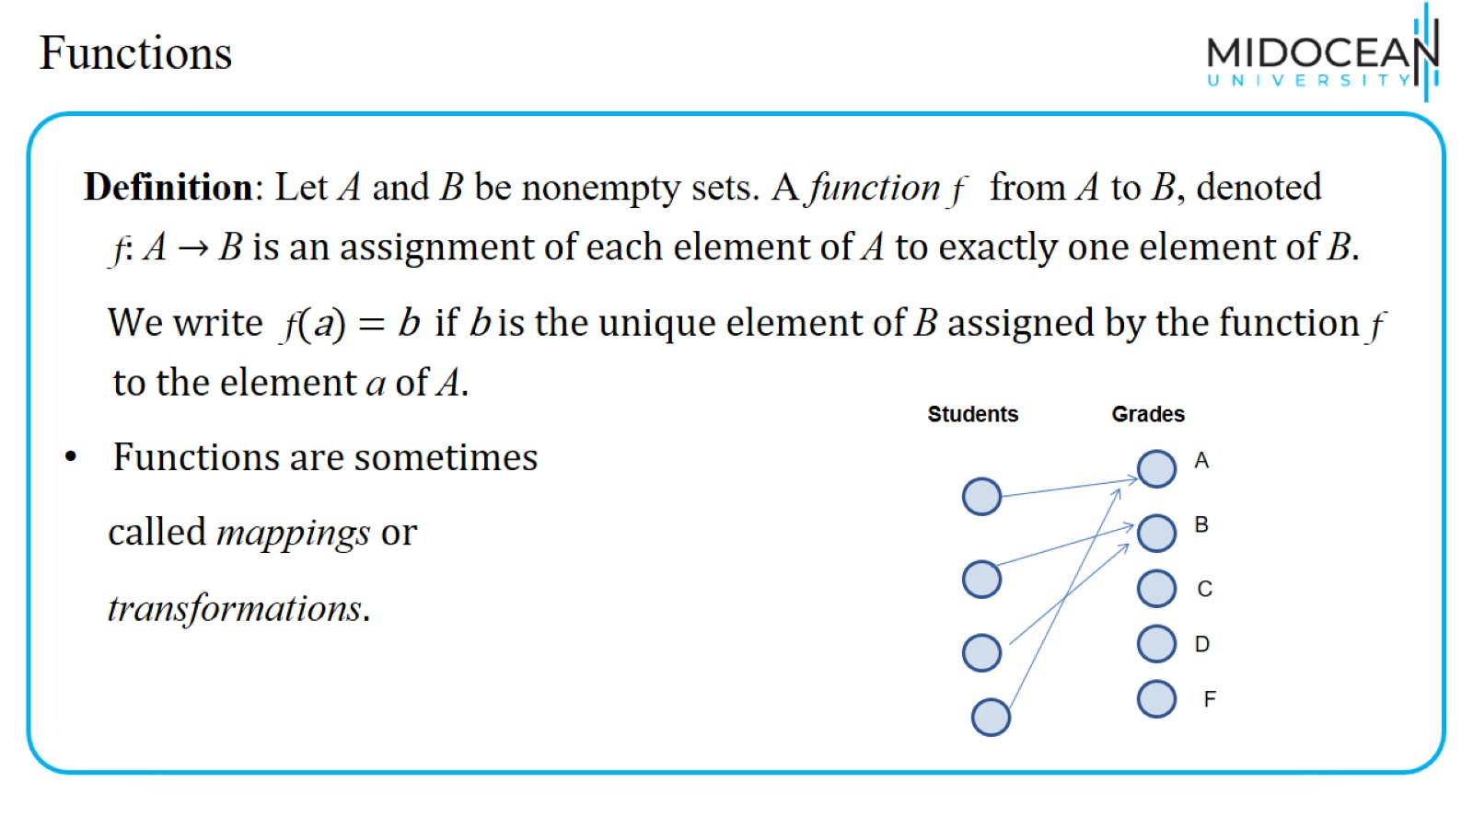
Functions

Slide 6
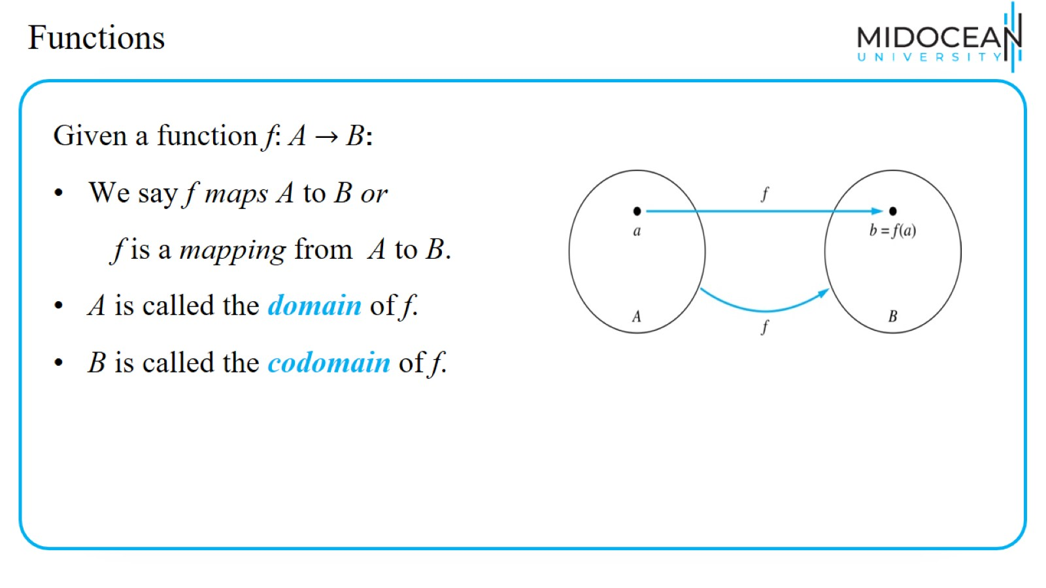
Functions

Slide 7
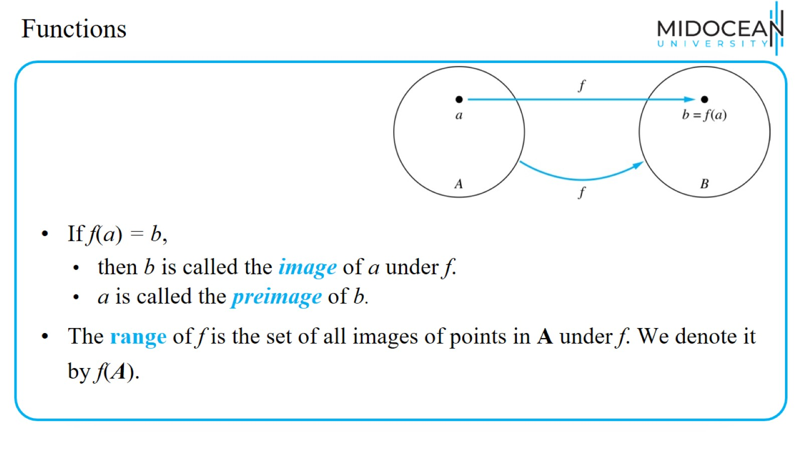
Functions

Slide 8
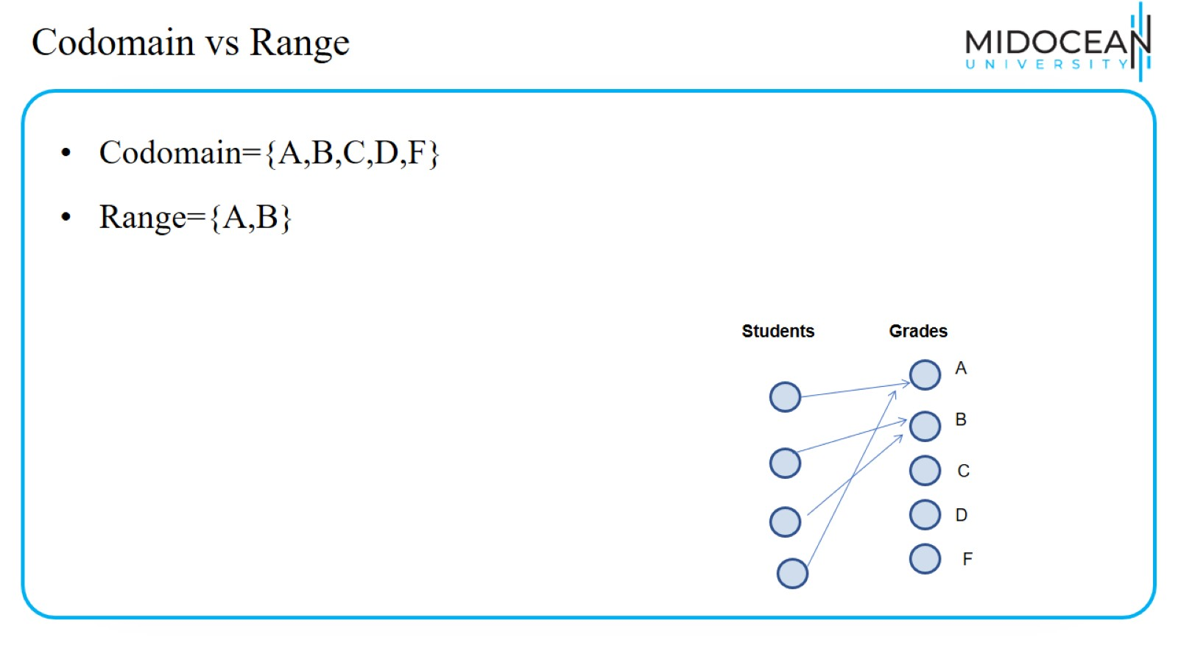
Codomain vs Range

Slide 9
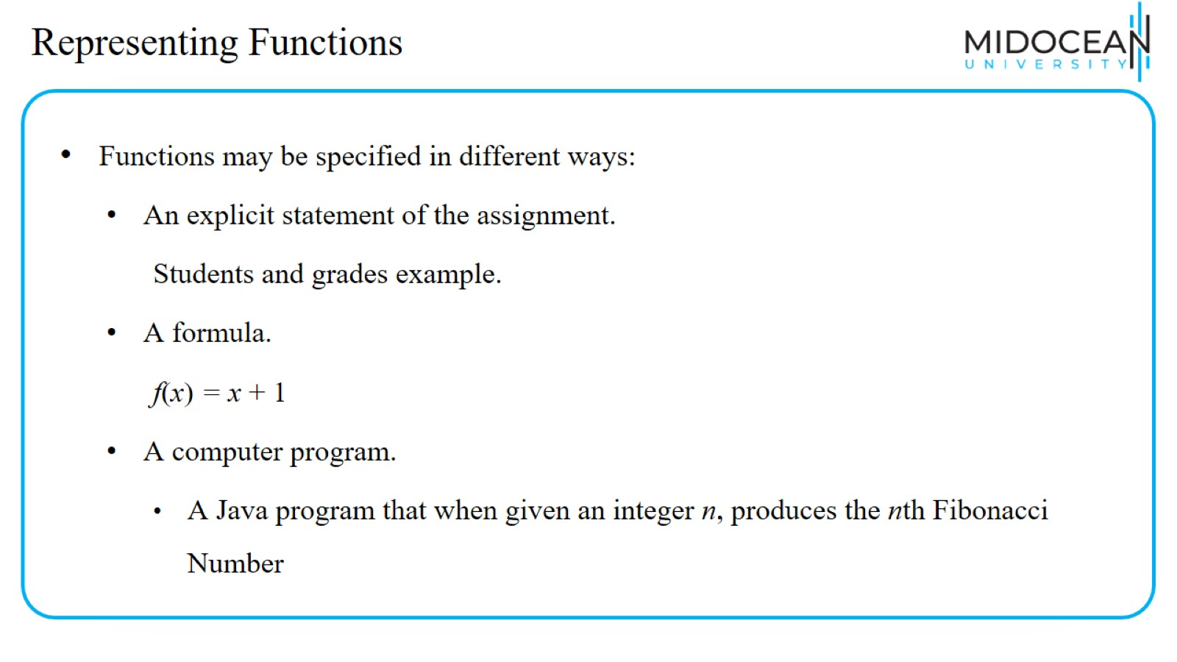
Representing Functions

Slide 10
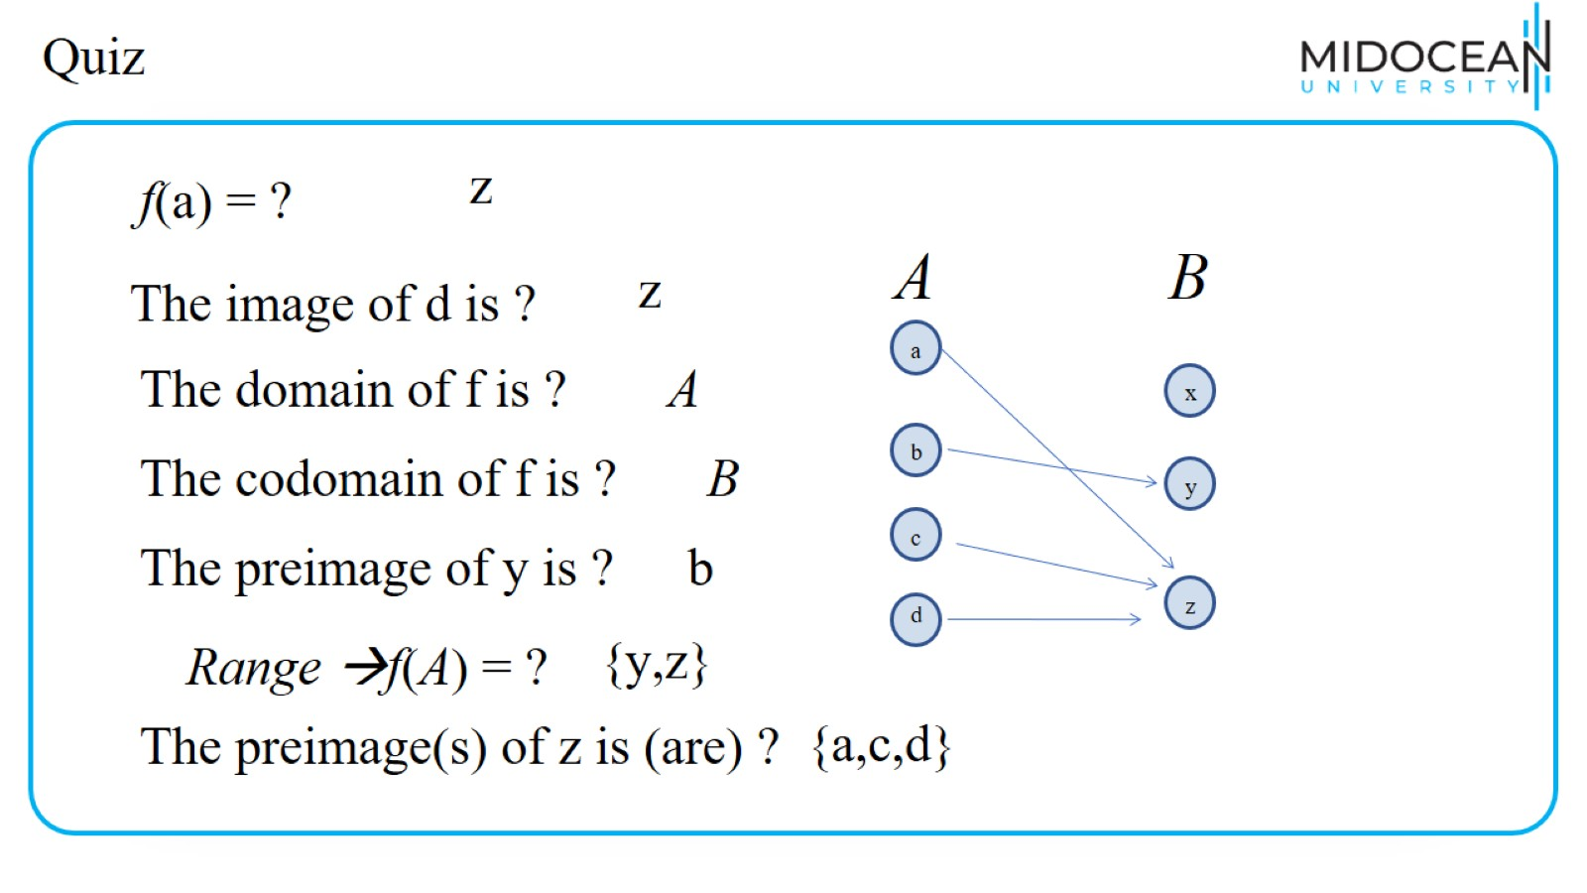
Quiz

Slide 11
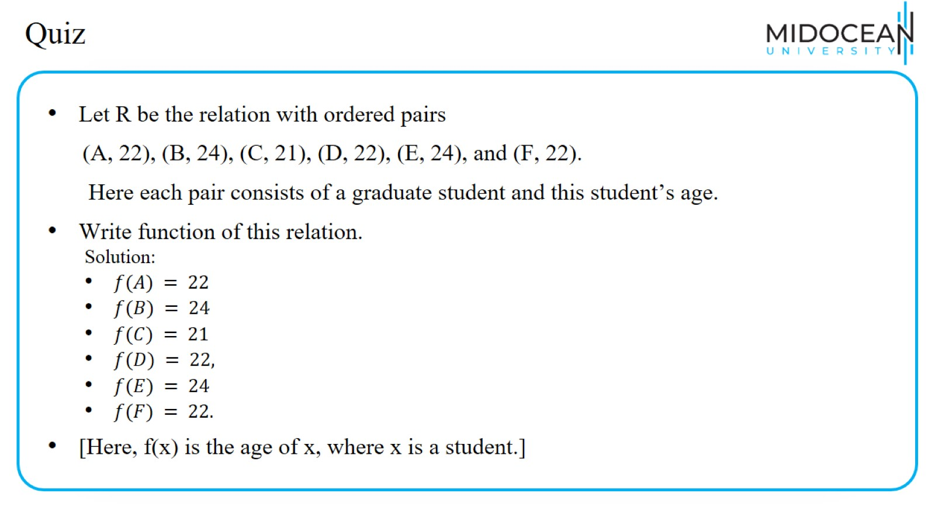
Quiz

Slide 12
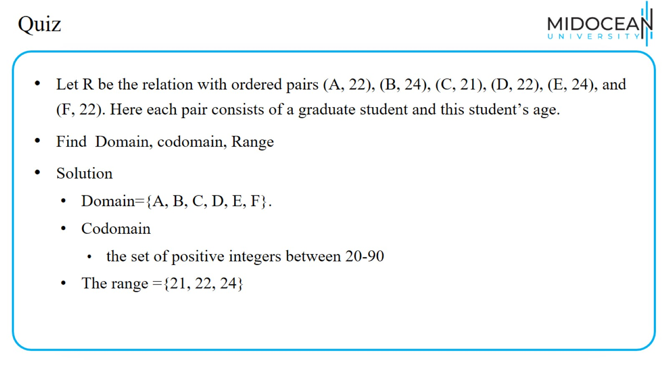
Quiz

Slide 13
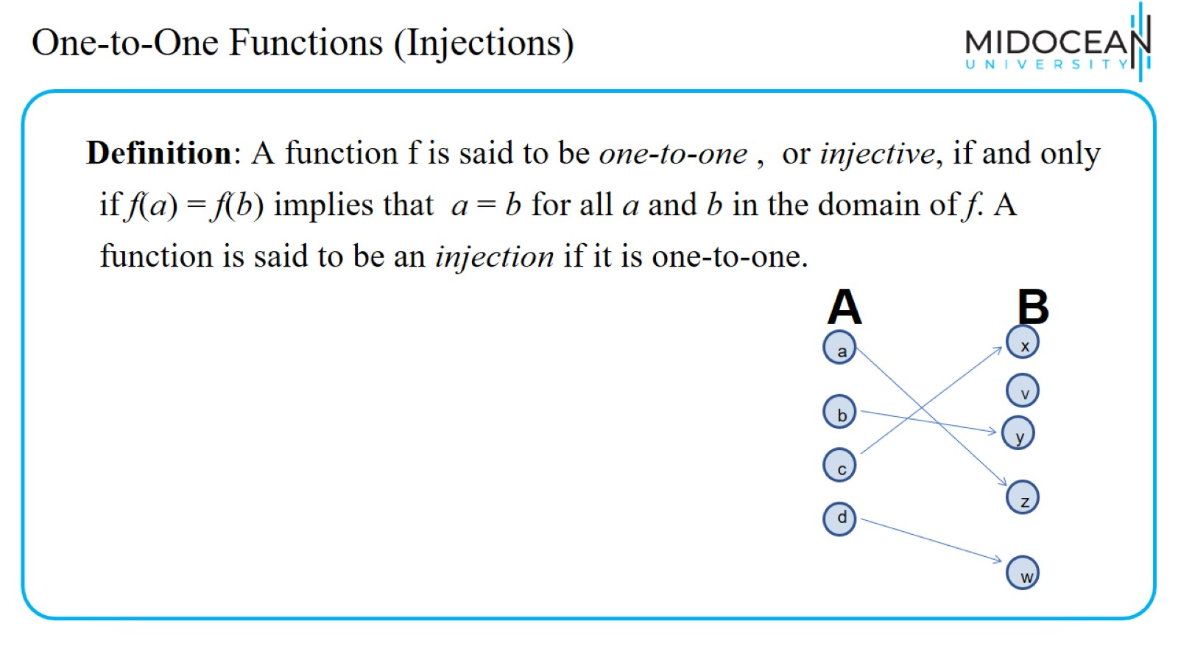
One-to-One Functions (Injections)

Slide 14
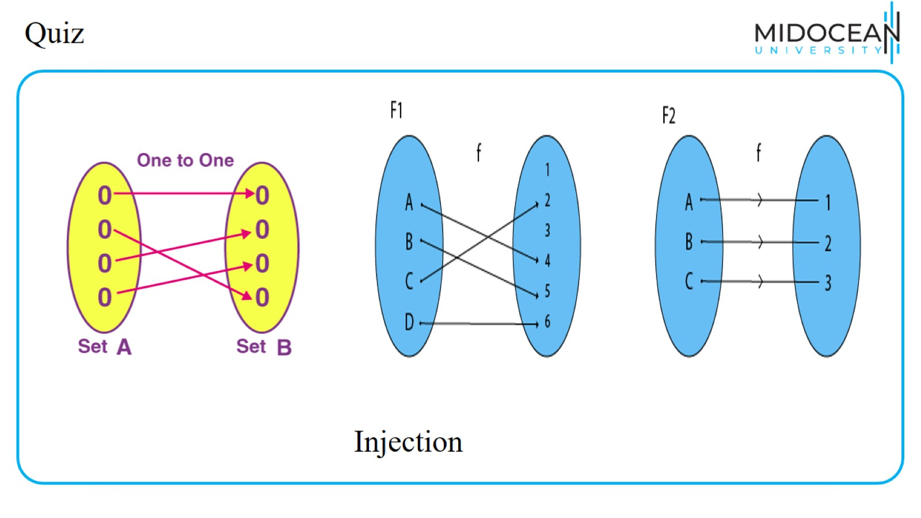
Quiz

Slide 15
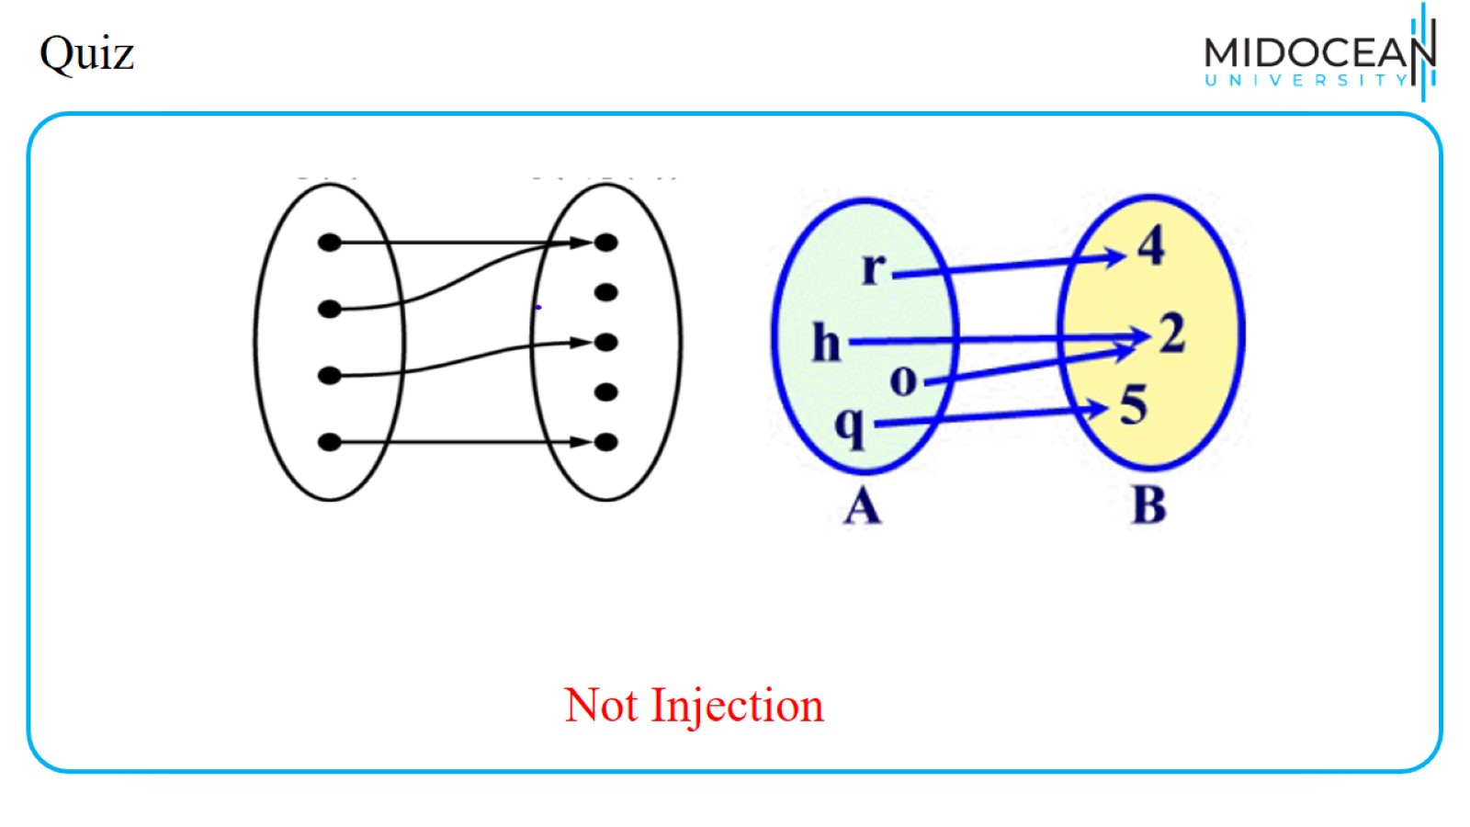
Quiz

Slide 16
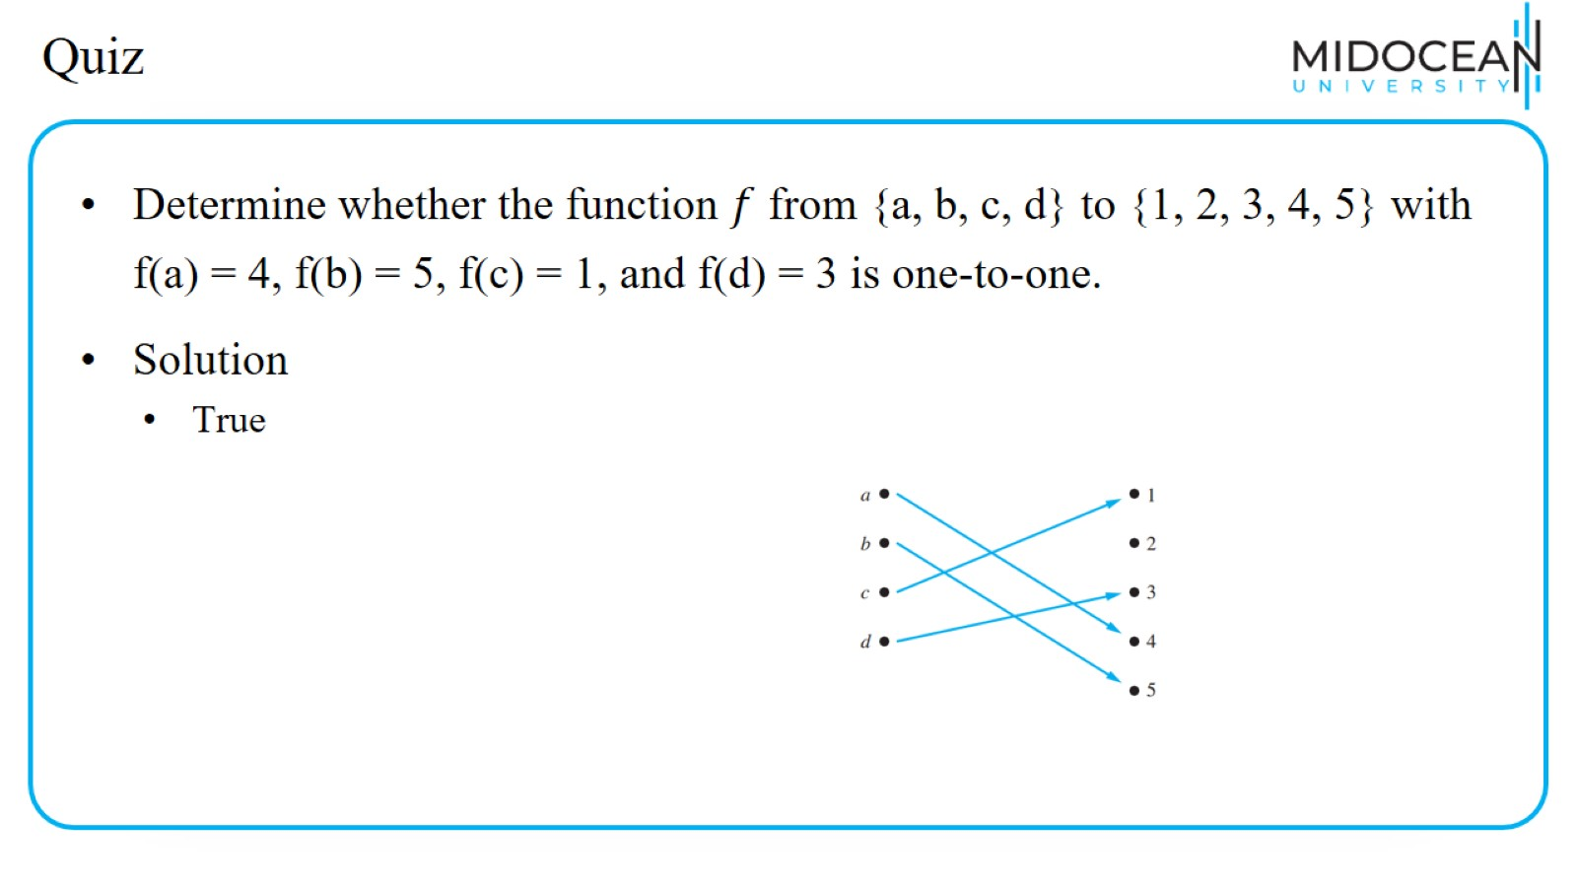
Quiz

Slide 17
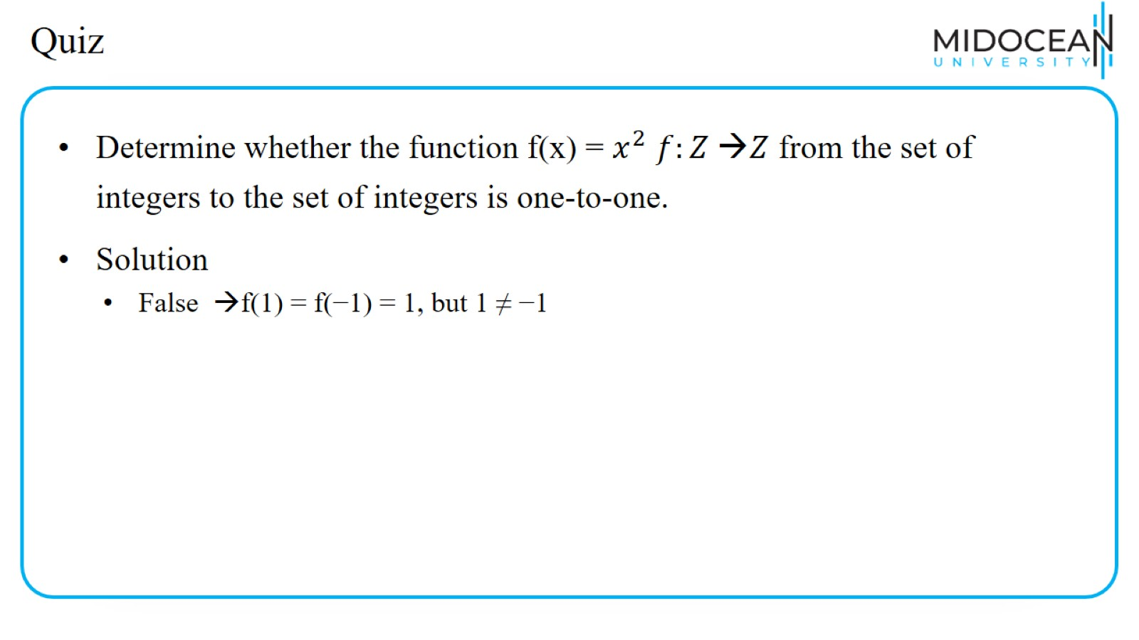
Quiz

Slide 18
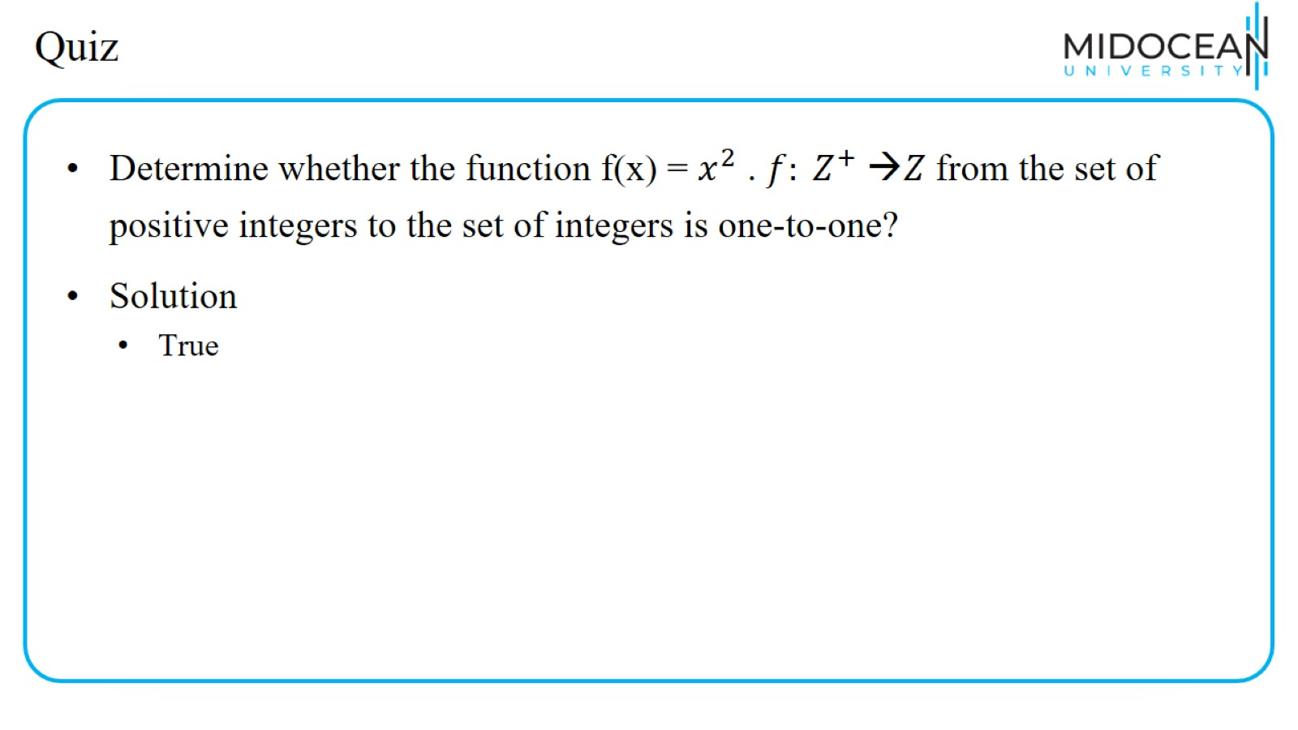
Quiz

Slide 19
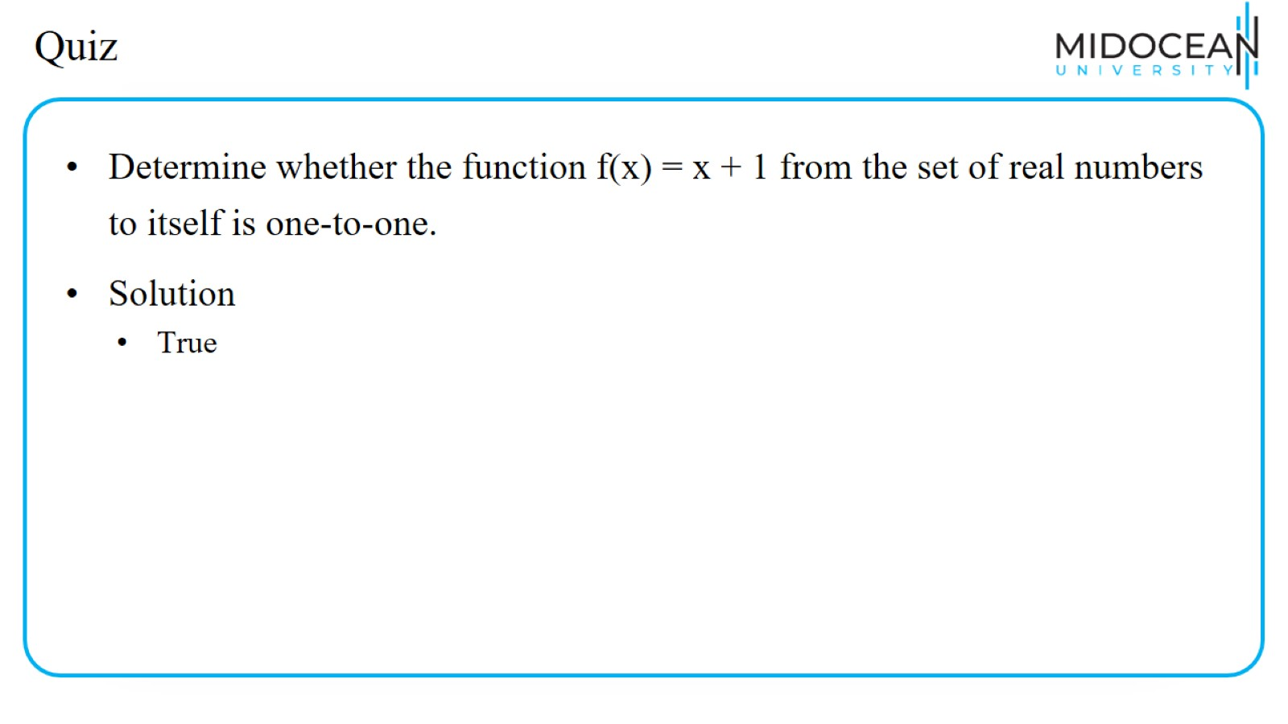
Quiz

Slide 20
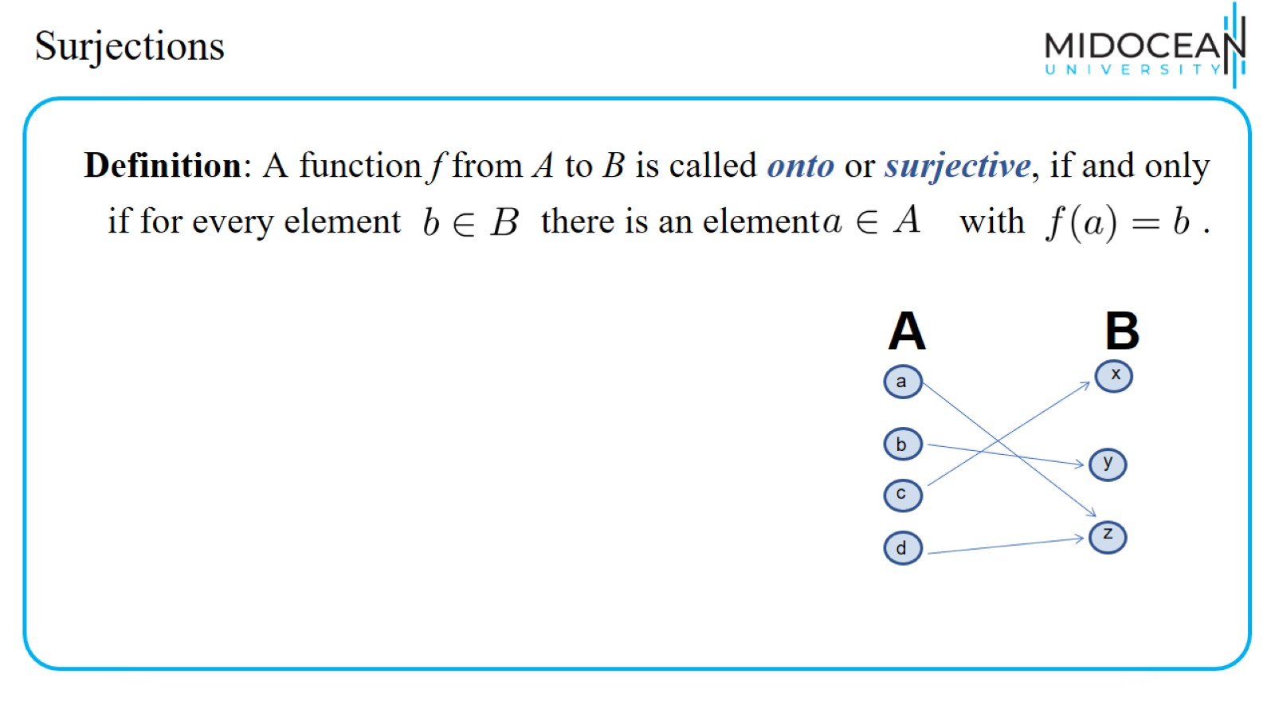
Surjections

Slide 21
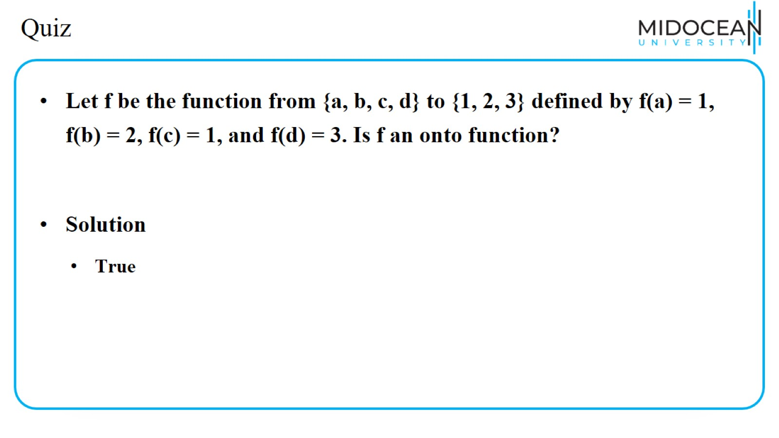
Quiz

Slide 22
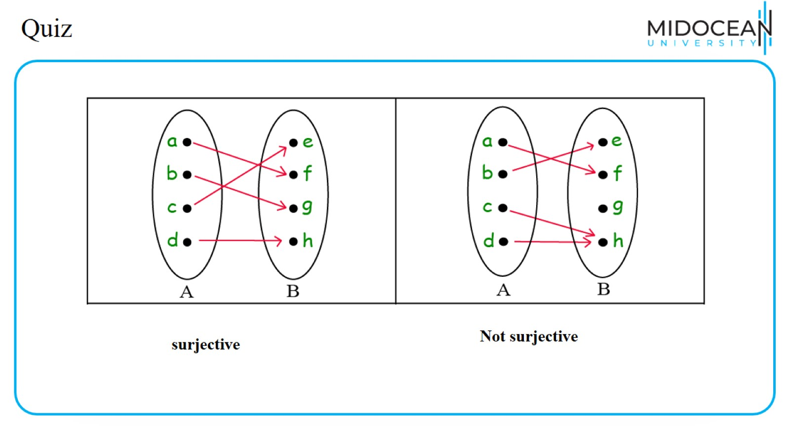
Quiz

Slide 23
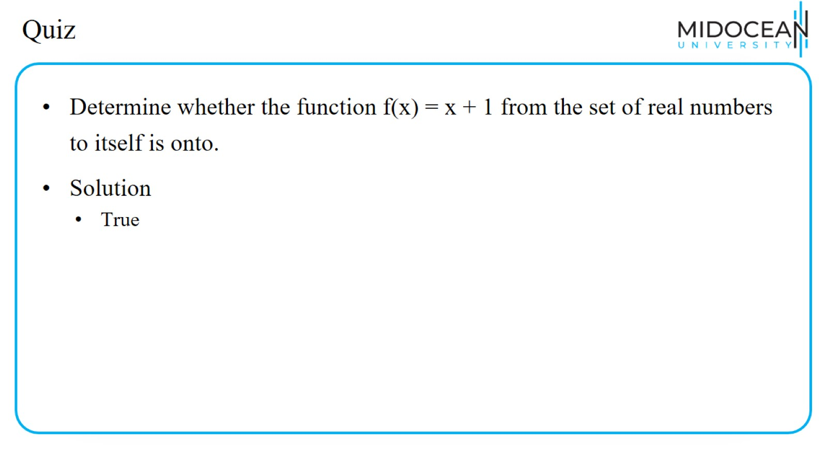
Quiz

Slide 24
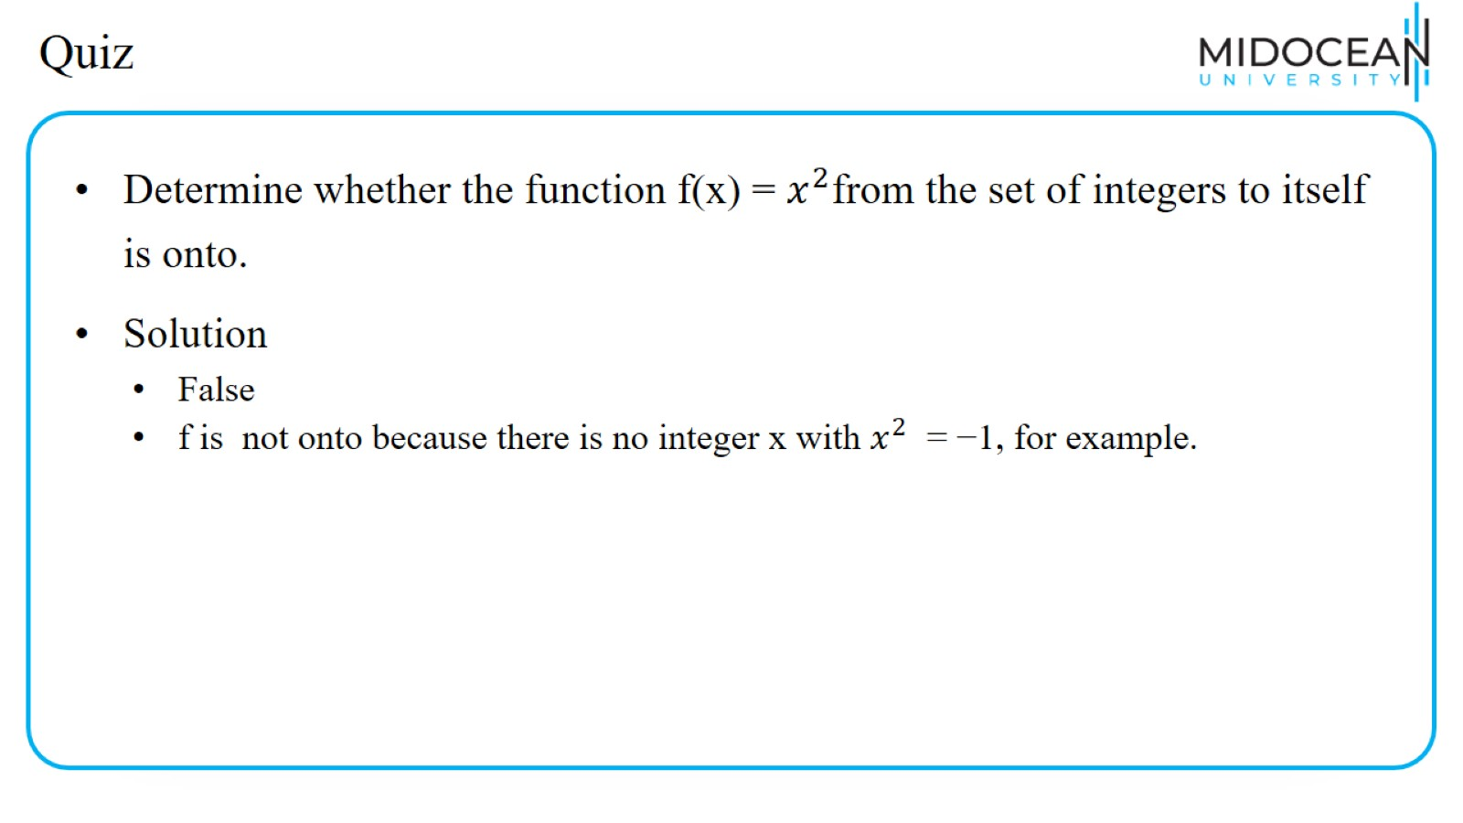
Quiz

Slide 25
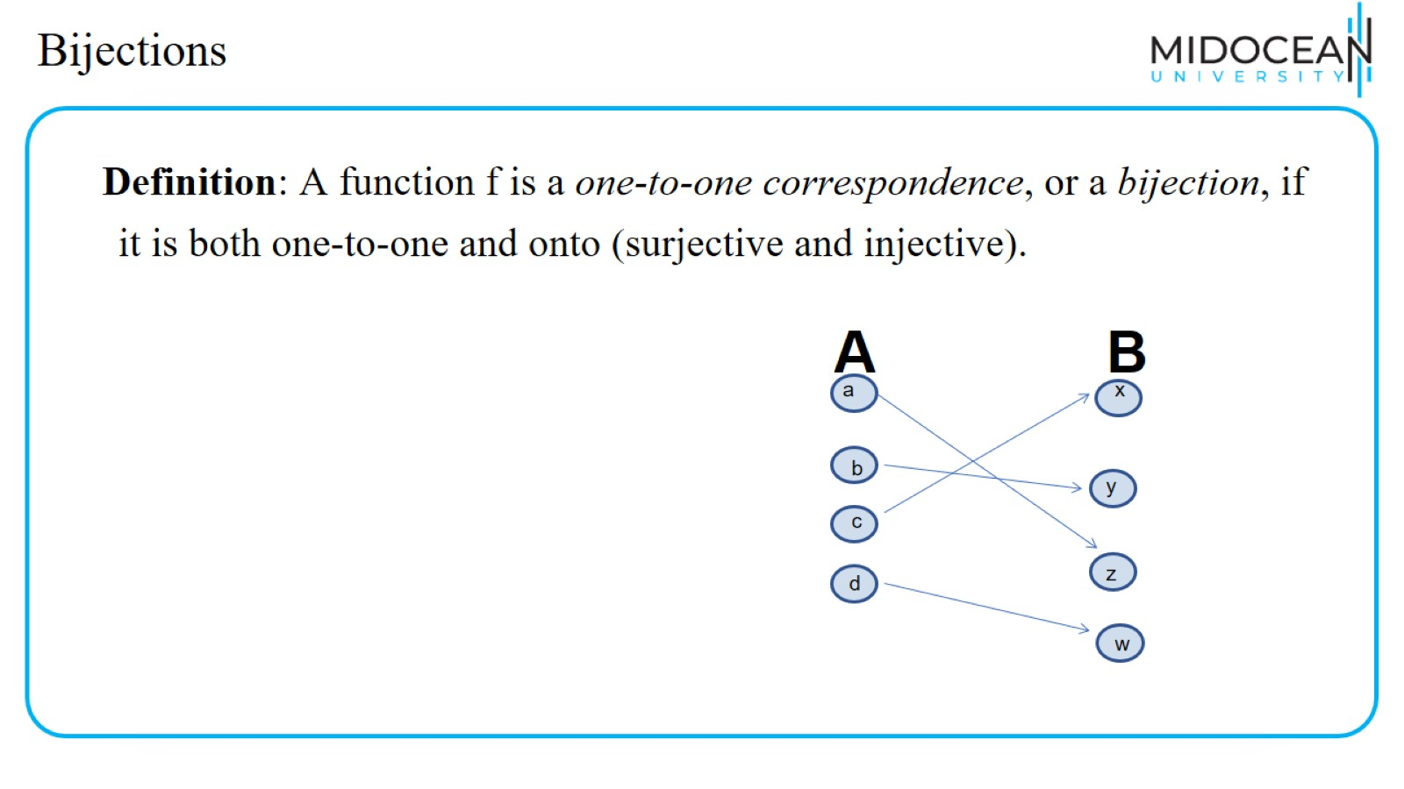
Bijections

Slide 26
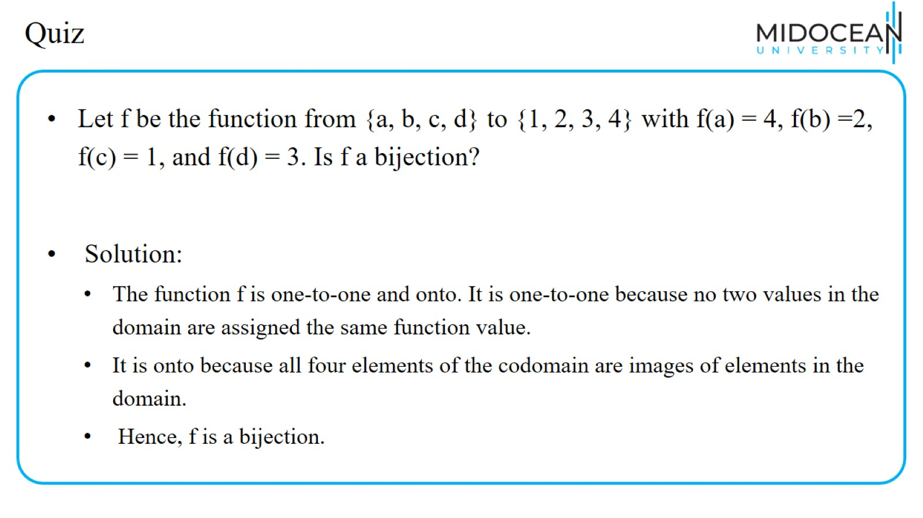
Quiz

Slide 27
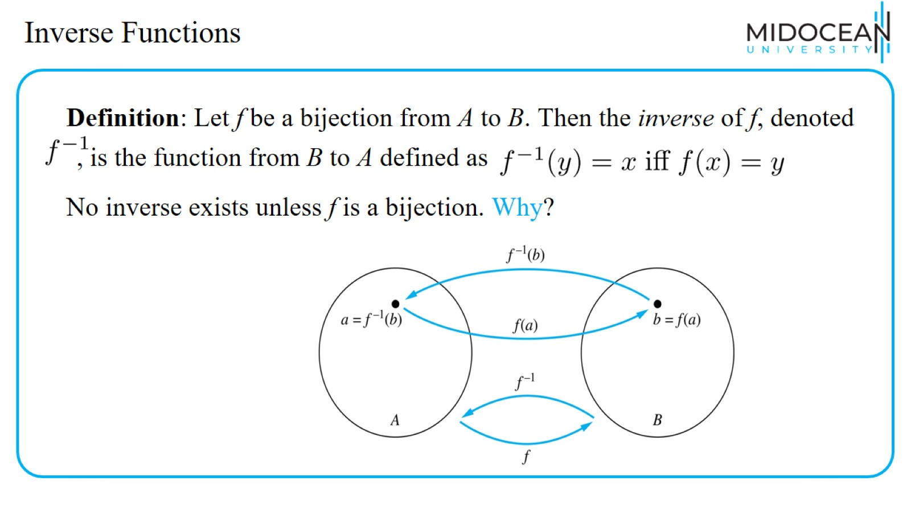
Inverse Functions

Slide 28
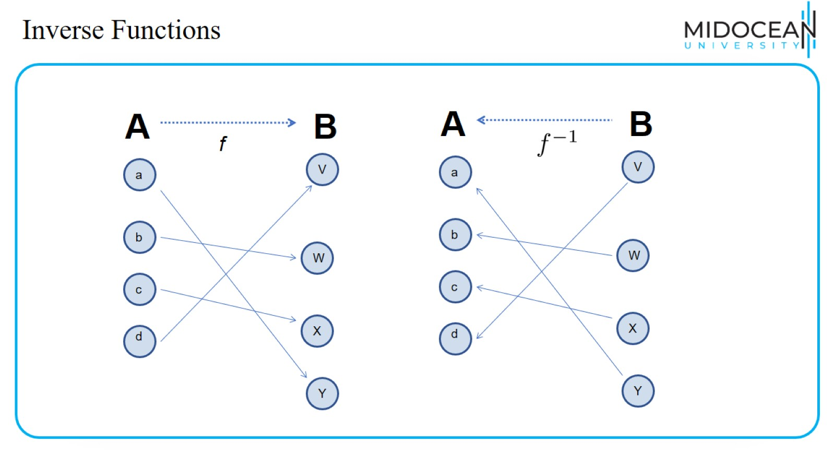
Inverse Functions

Slide 29
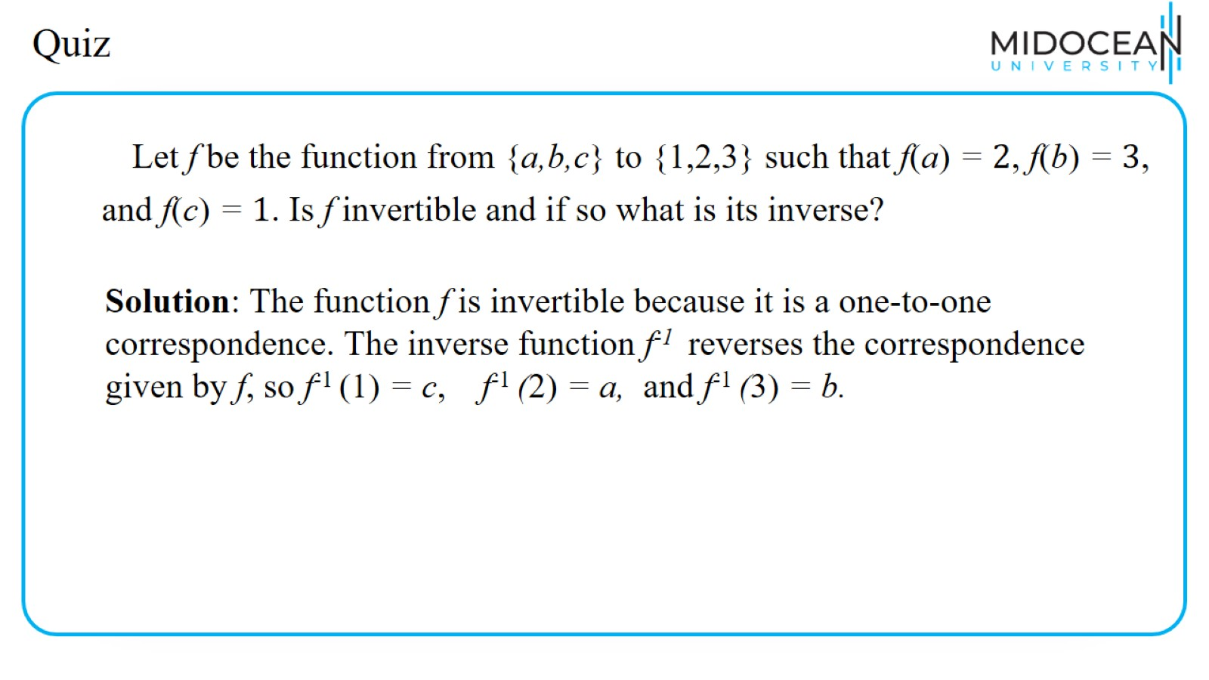
Quiz

Slide 30
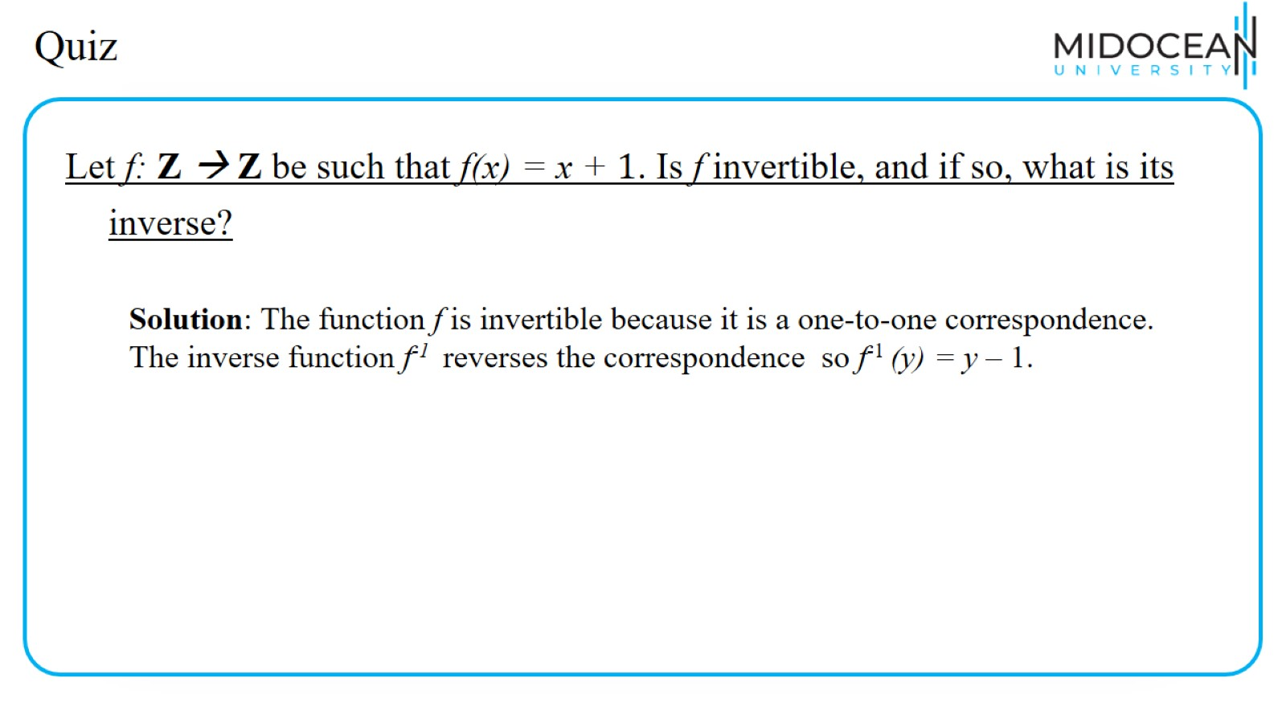
Quiz

Slide 31
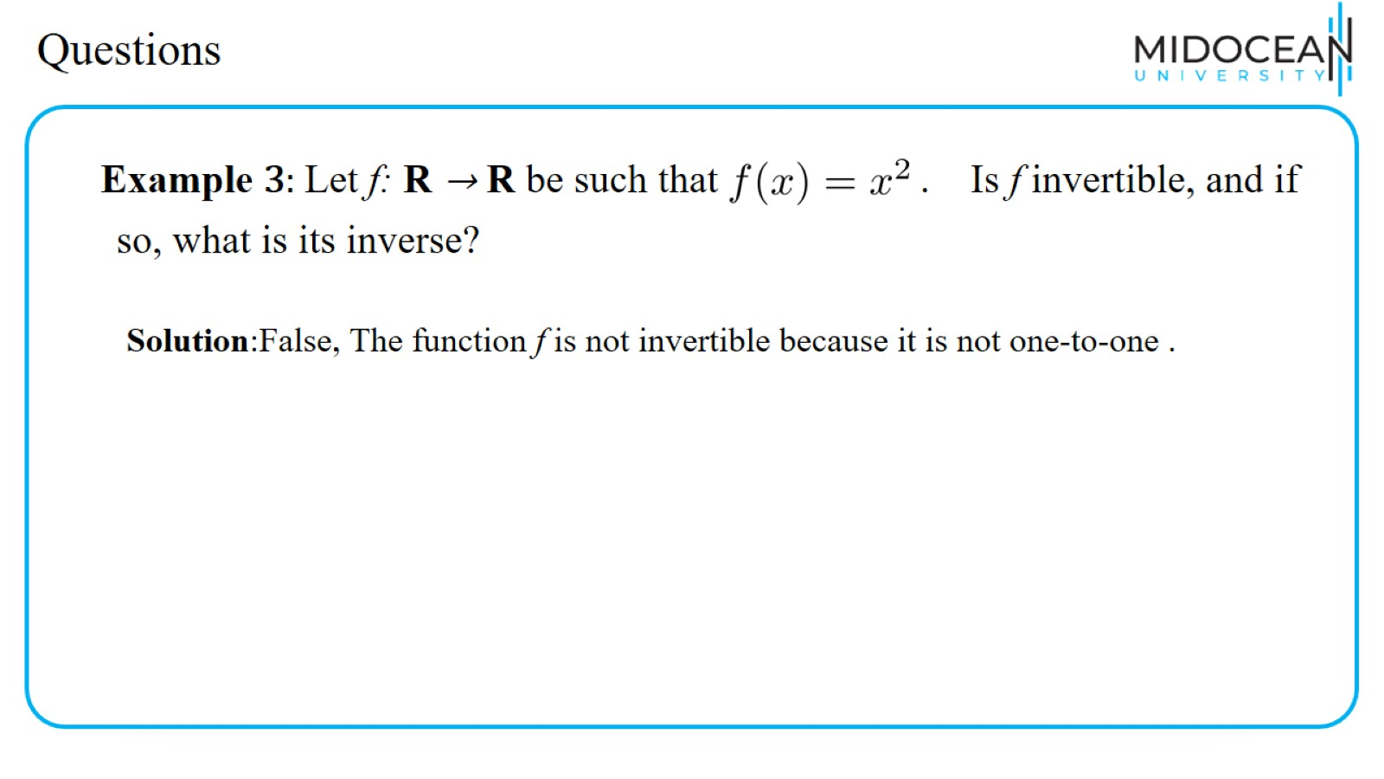
Questions

Slide 32
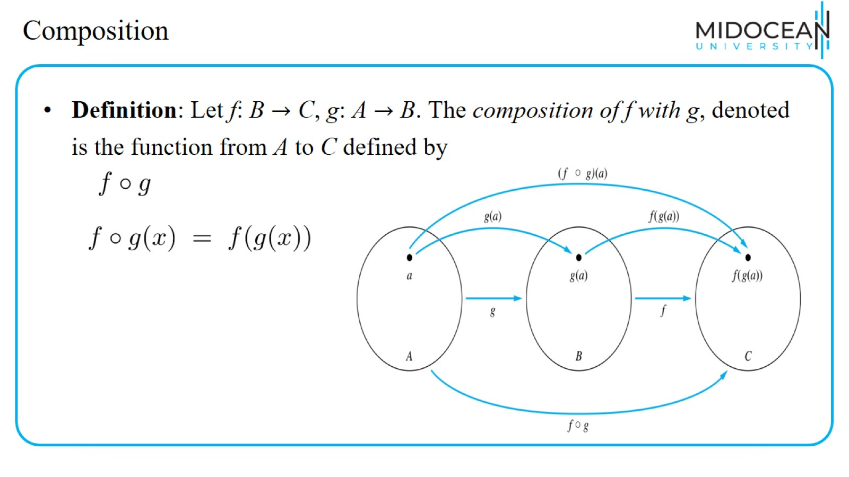
Composition

Slide 33
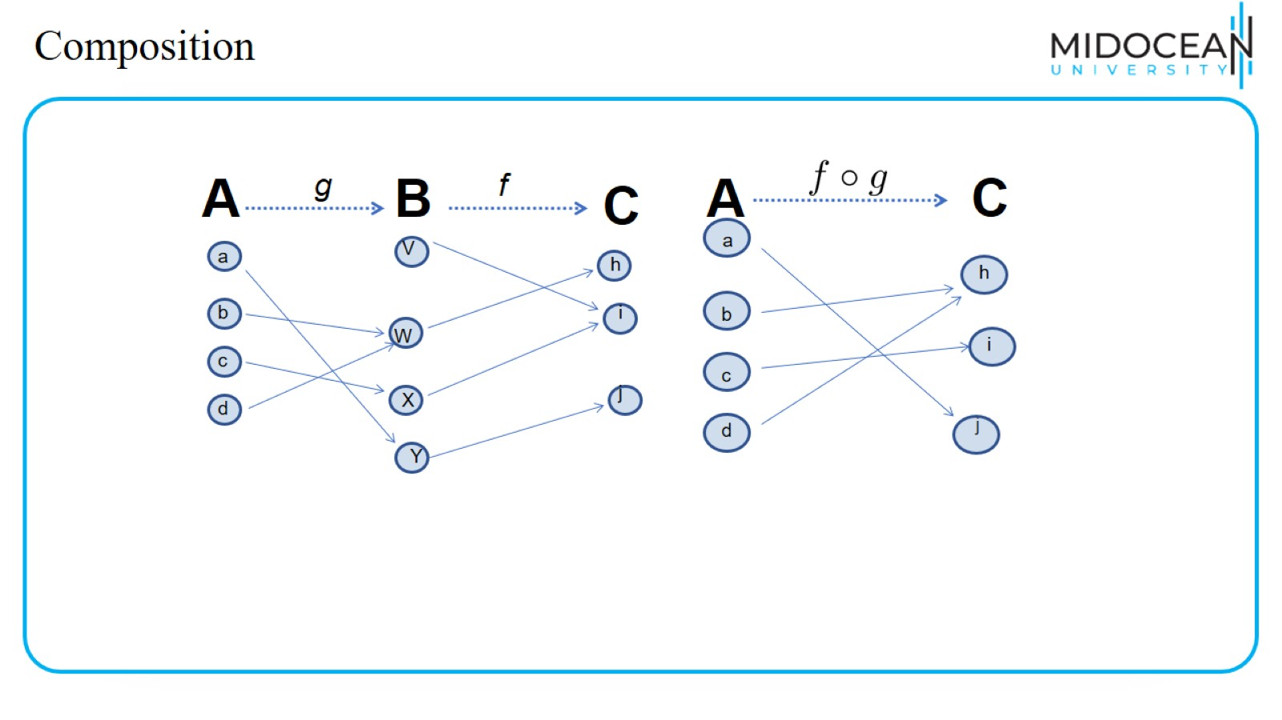
Composition

Slide 34
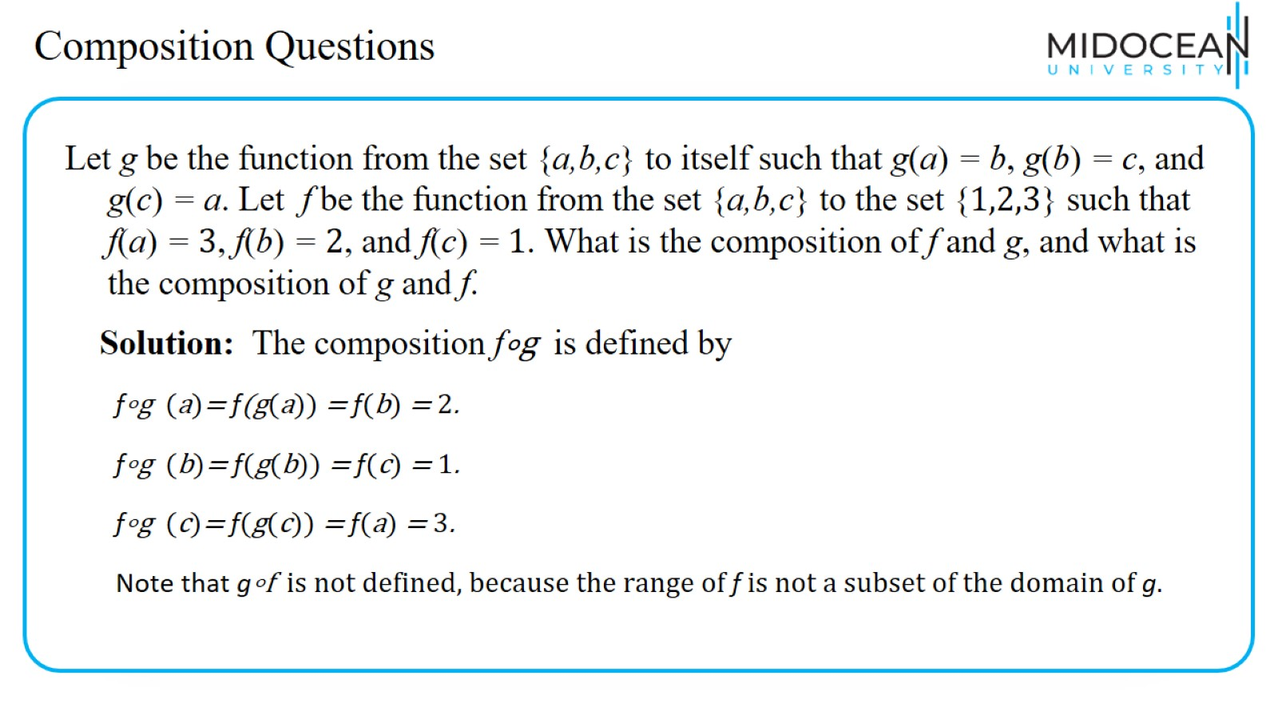
Composition Questions

Slide 35
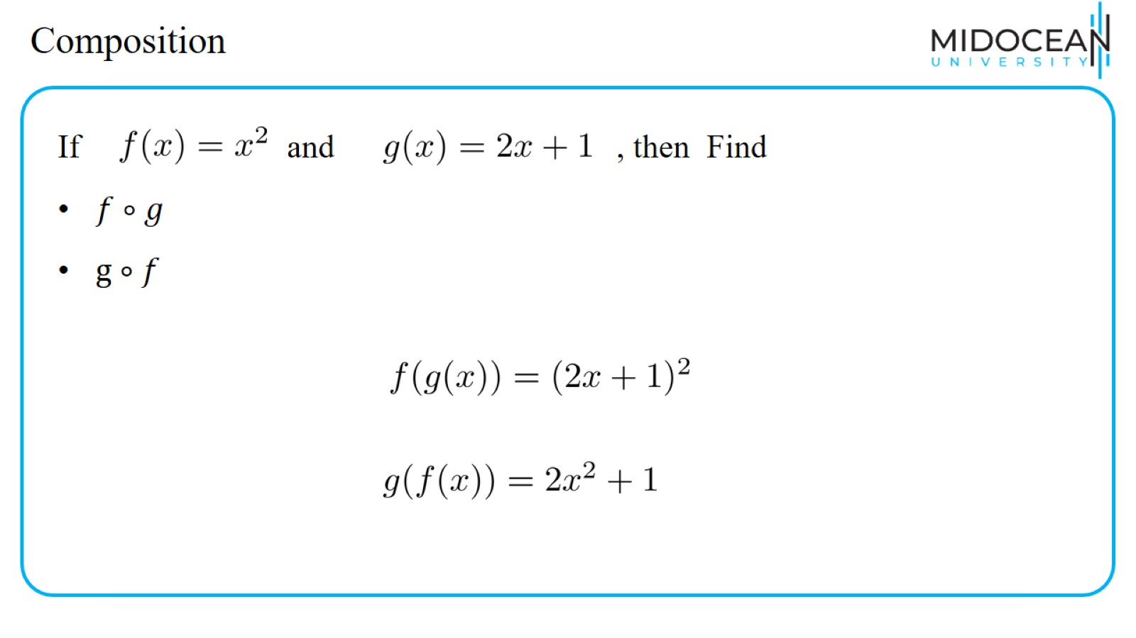
Composition

Slide 36
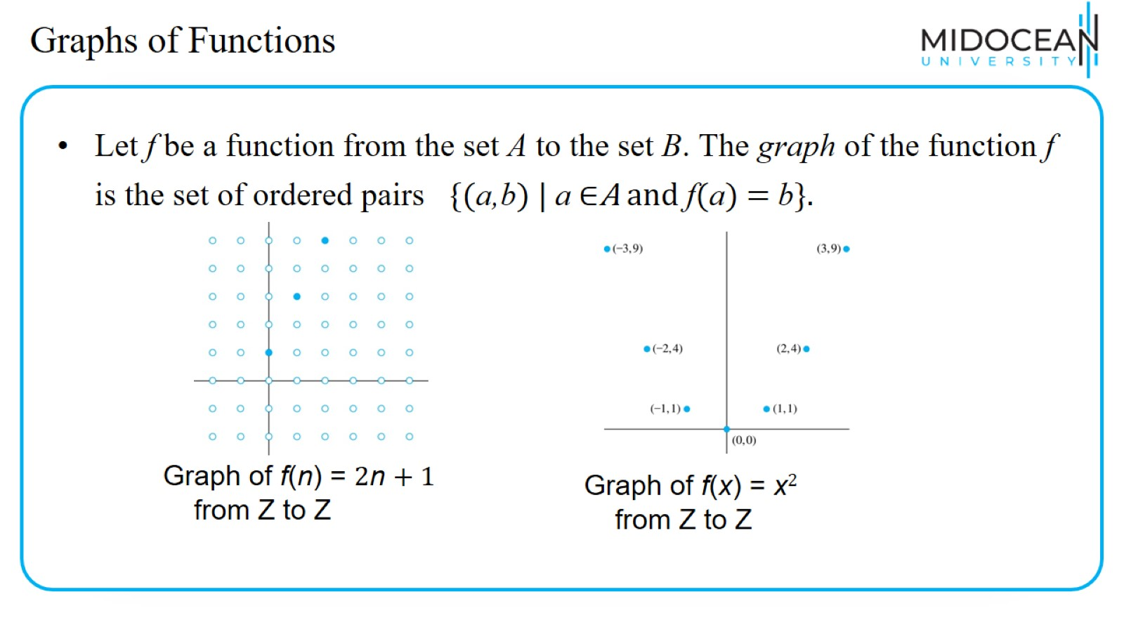
Graphs of Functions

Slide 37
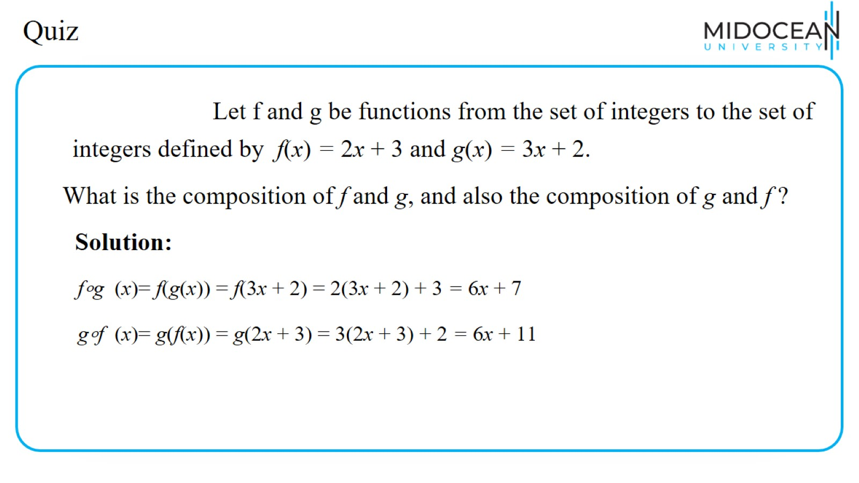
Quiz

Slide 38
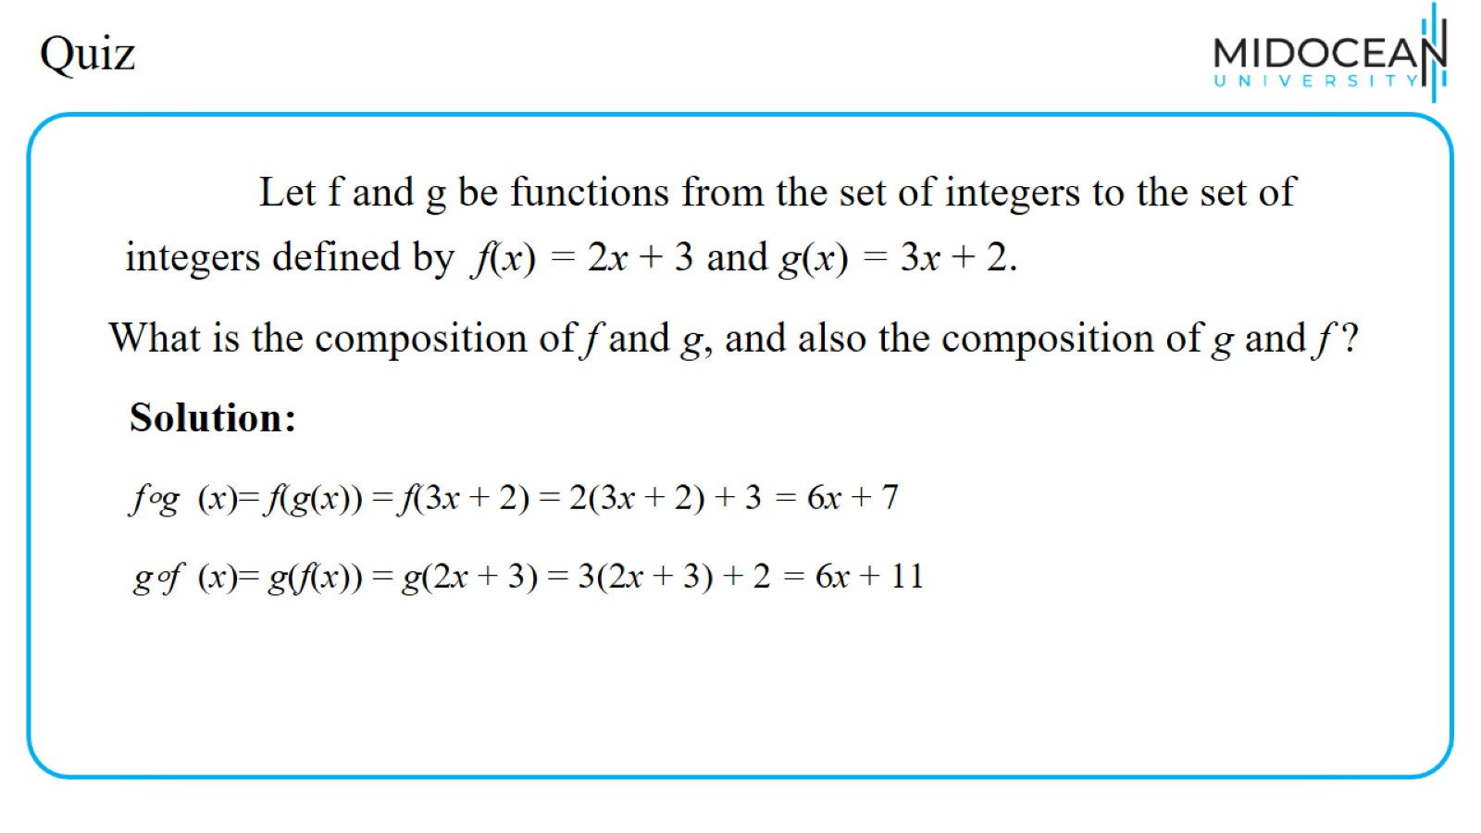
Quiz

Slide 39
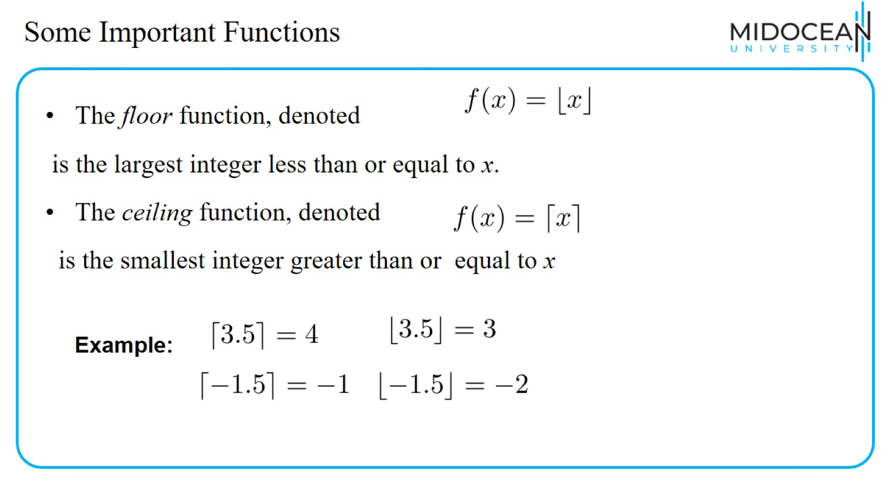
Some Important Functions

Slide 40
Some Important Functions

Slide 41
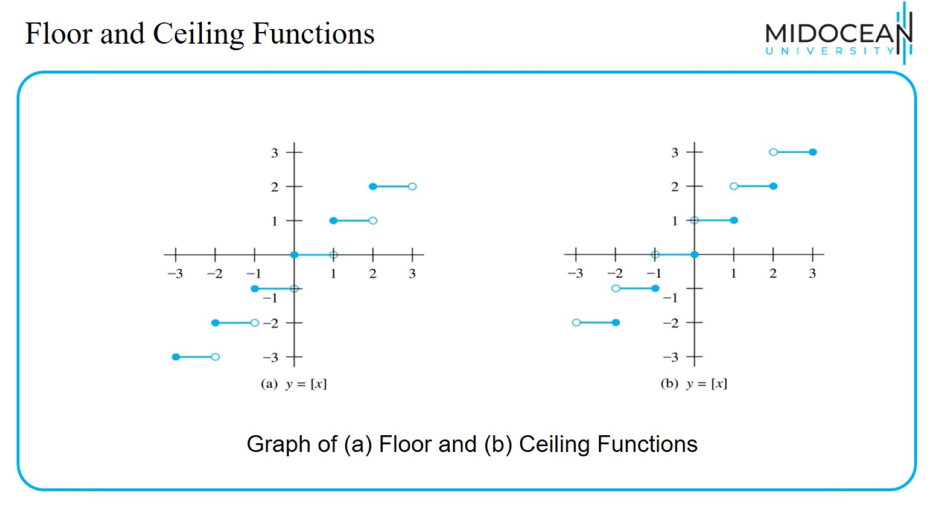
Floor and Ceiling Functions

Slide 42
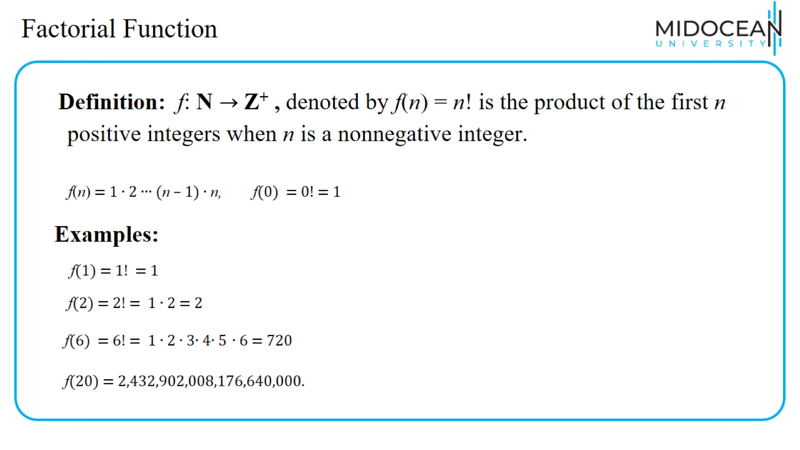
Factorial Function

Slide 43
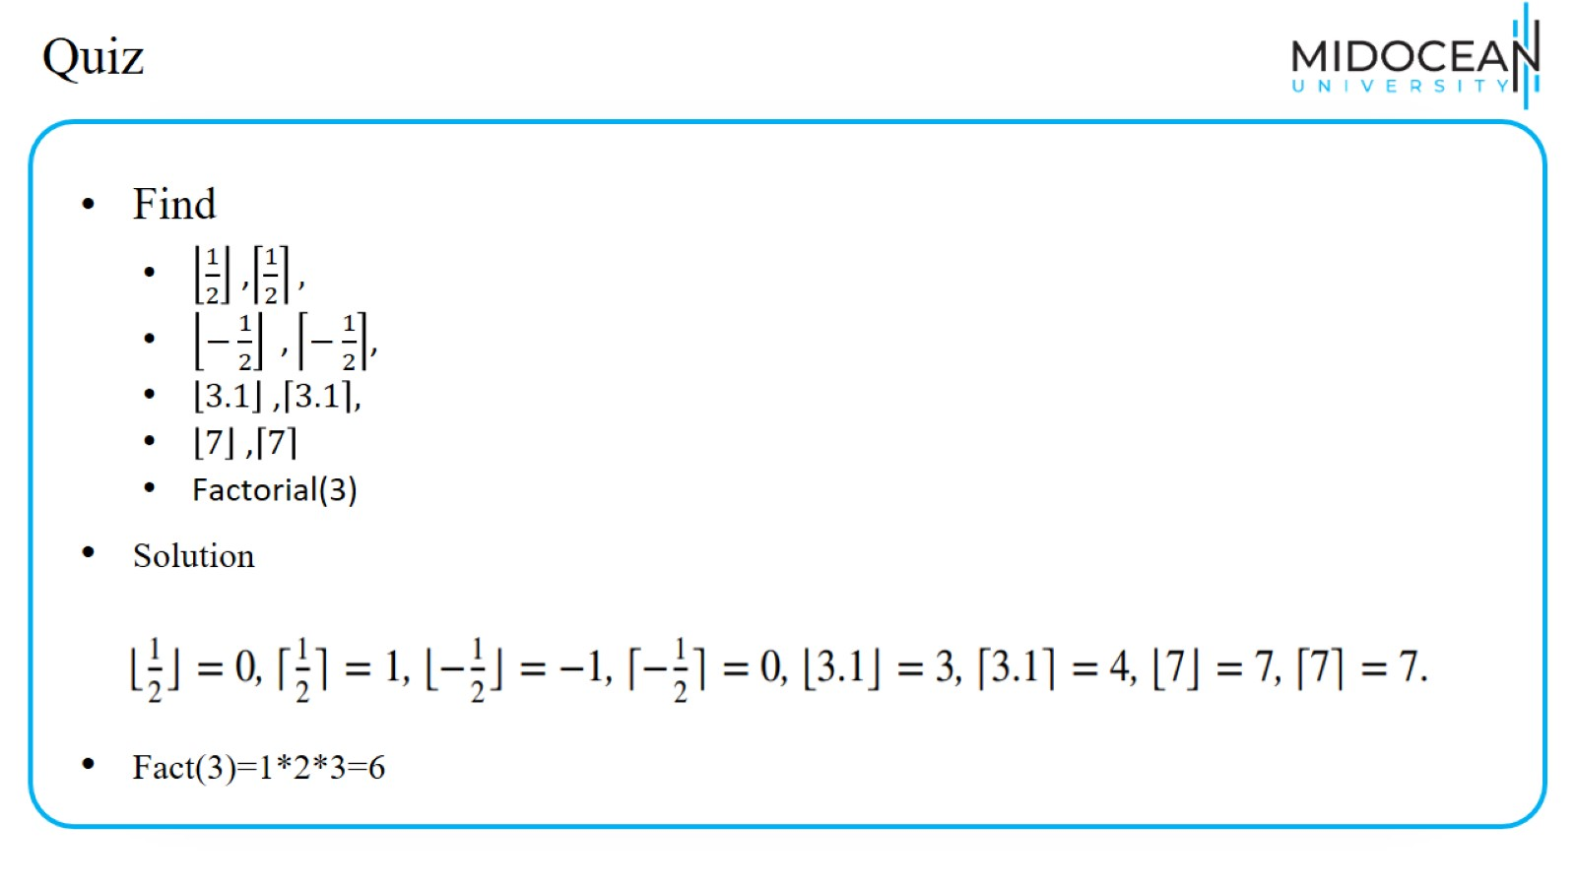
Quiz

Slide 44
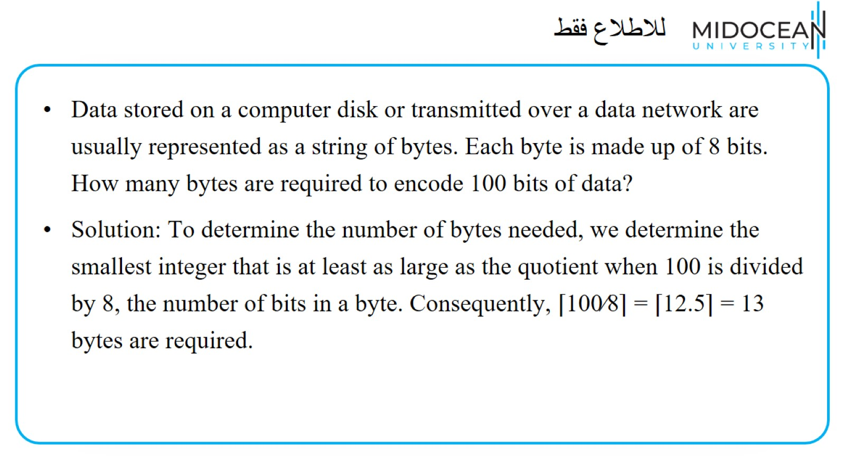
للاطلاع فقط

Slide 45
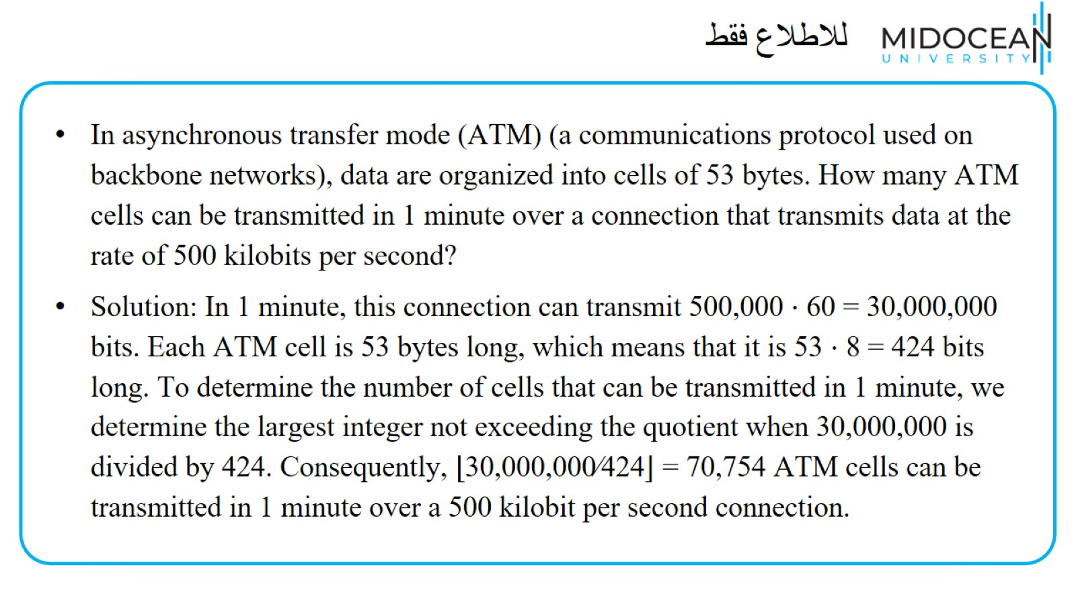
للاطلاع فقط

Slide 46
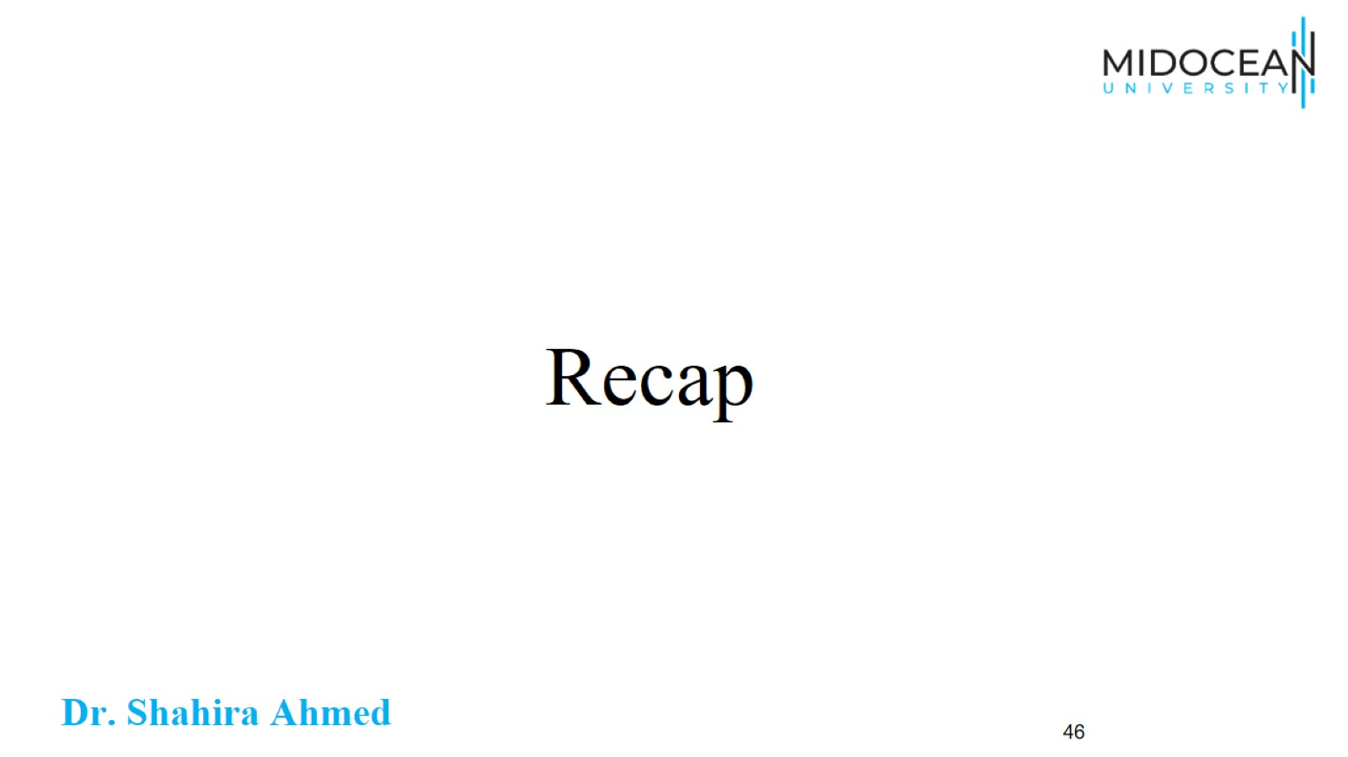
Recap

Slide 47
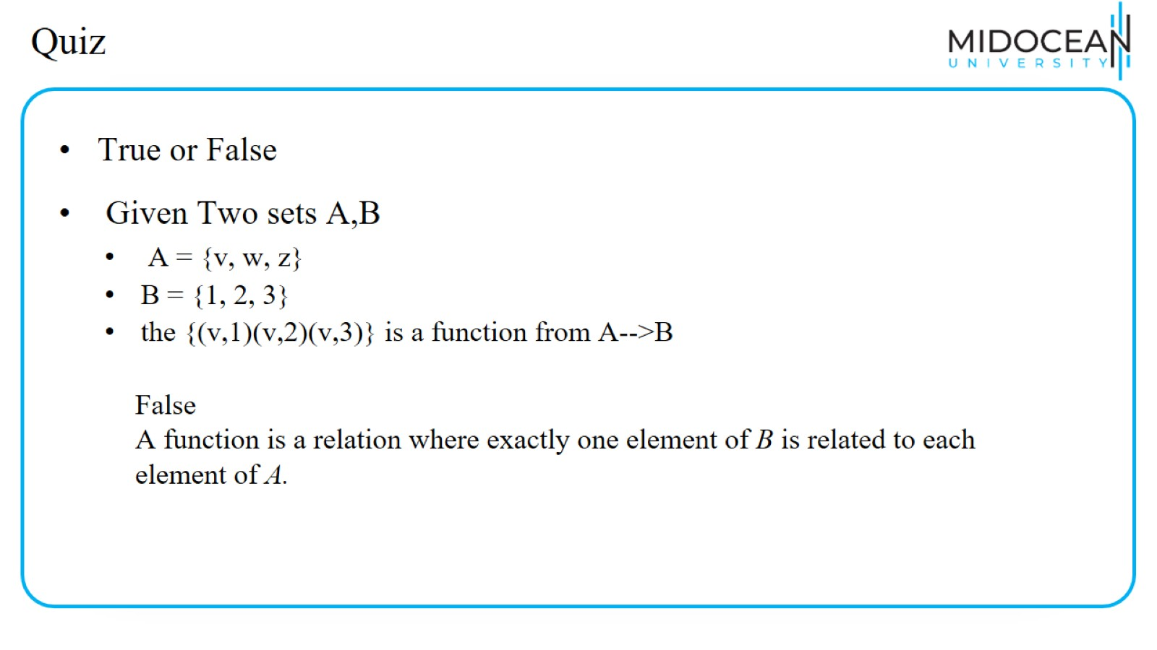
Quiz

Slide 48
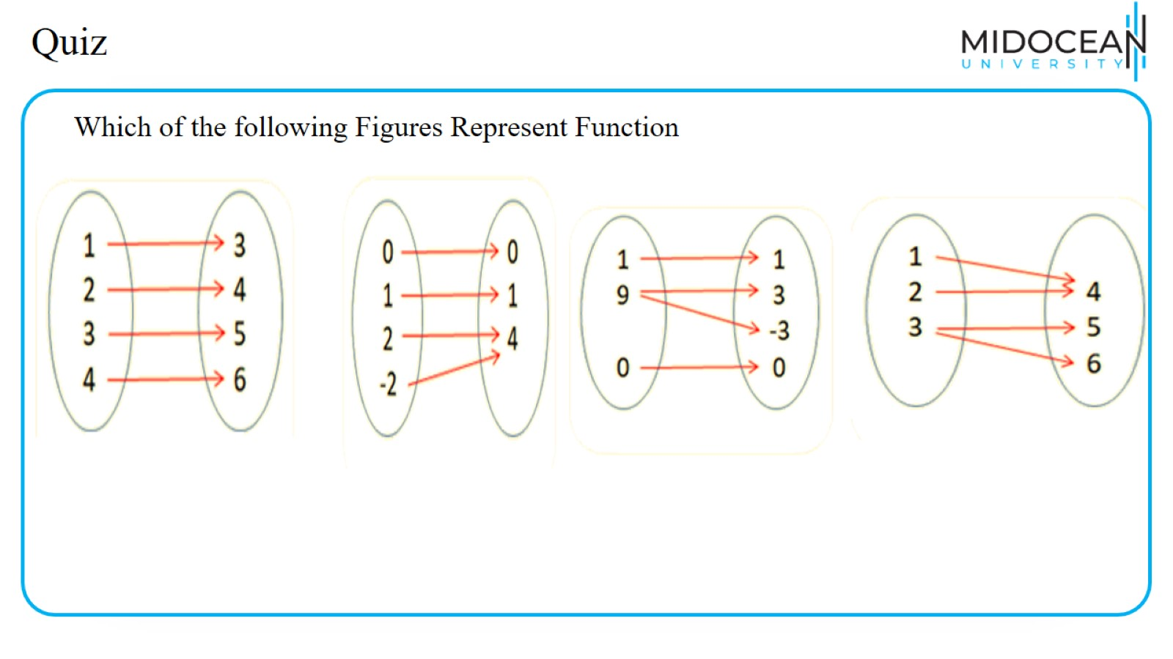
Quiz

Slide 49
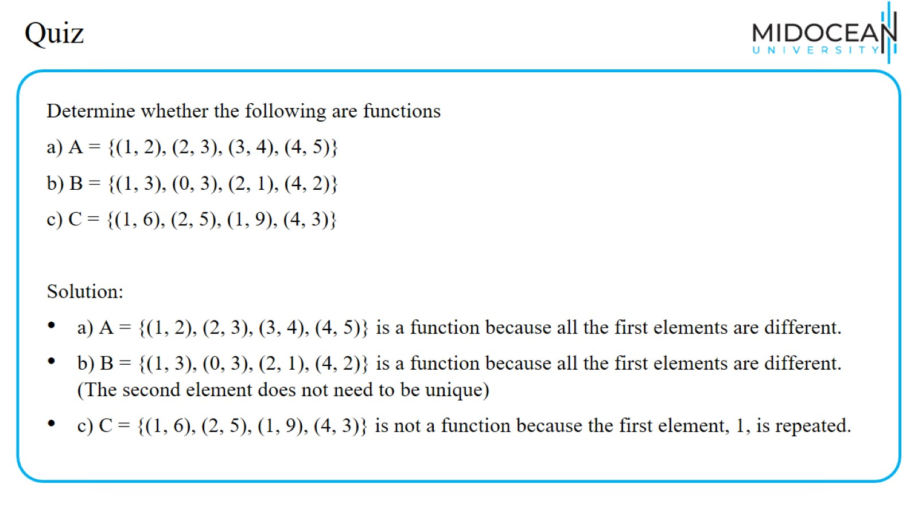
Quiz

Slide 50
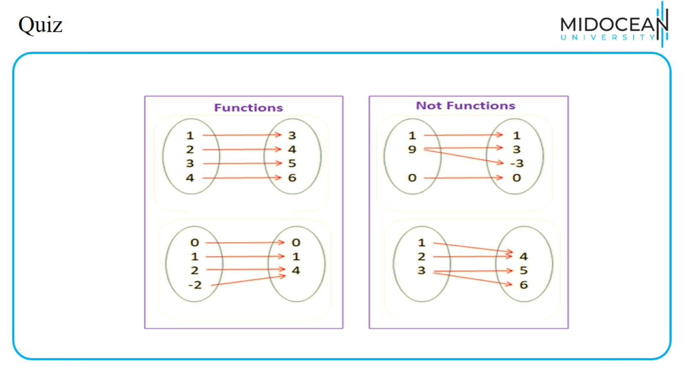
Quiz

Slide 51
Quiz

Slide 52
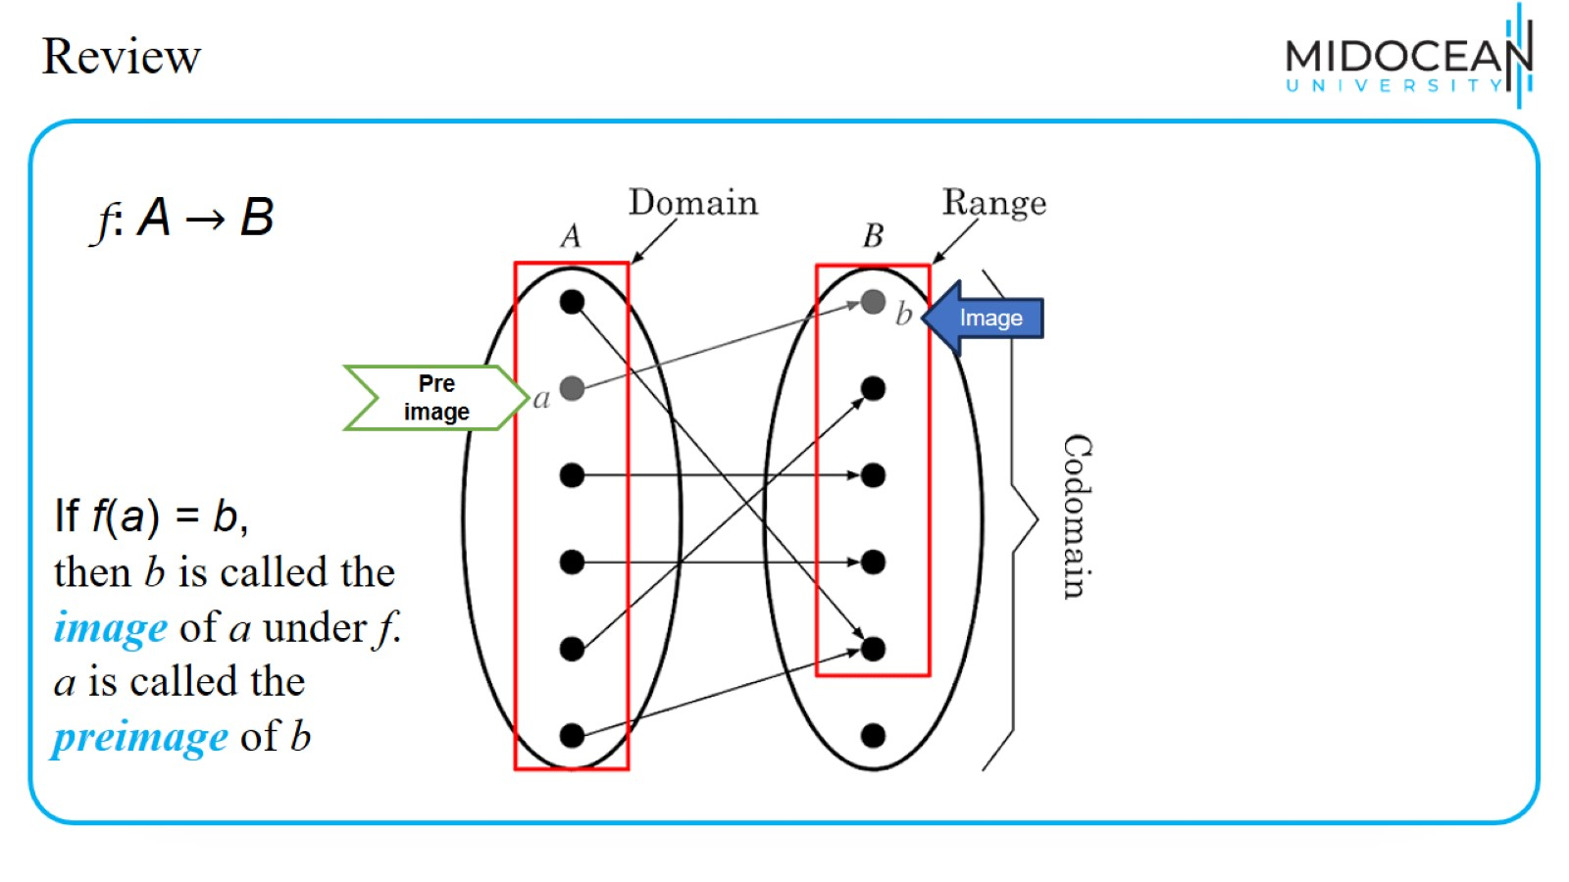
Review

Slide 53
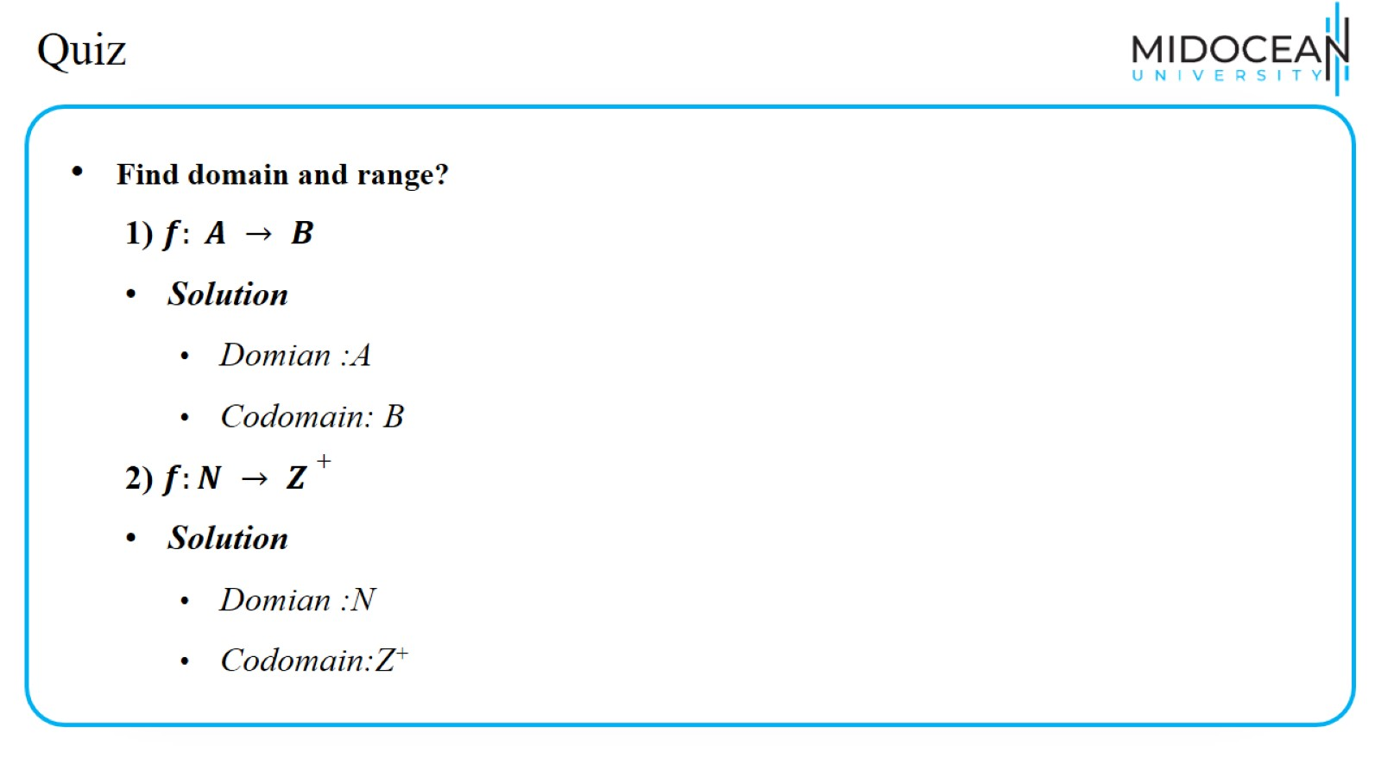
Quiz

Slide 54
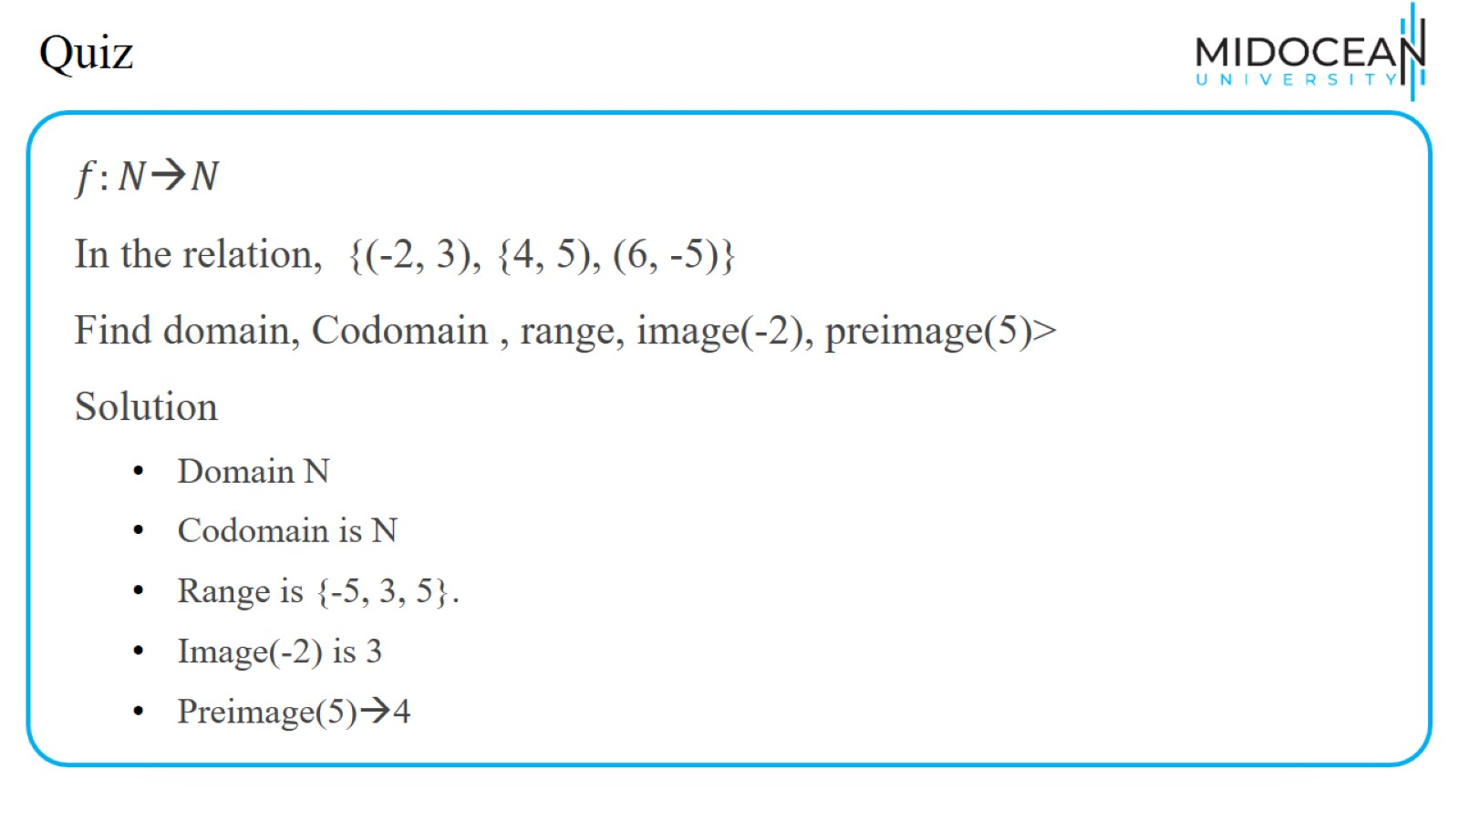
Quiz

Slide 55

Quiz

Slide 56

Quiz

Slide 57

Quiz

Slide 58

Quiz

Slide 59

Quiz

Slide 60
Quiz

Slide 61
Quiz

Slide 62

Quiz

Slide 63

Quiz

Slide 64

Quiz

Slide 65

Quiz

Slide 66

Quiz

Slide 67

Summary

Slide 68


