Slide 1



Project Procurement and Supply Chain Management.
Prepared by Dr. Tarek Mohamed
PMG 433
Orientation Show

Slide 2


Course Agenda
1-Introduction about the professor of the course.
2-Introduction to the course.
3-Primary goal of this course.
4-Learning outcomes.
5-Learning resources.
6-Units of course contents.
7-Assessment method.
8-Academic calendar.
www.midocean.ae

Slide 3
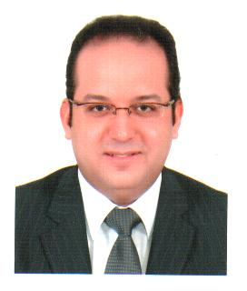
Who Am I ?
Dr. Tarek Mohamed
Doctorate degree in Business Administration- Cairo University.
Master degree in Business Administration- Arab Academy for Science & Technology and Maritime Transport .
Executive Management Diploma- The American University in Cairo.
Senior Lecturer at Post-Graduate Studies and Research Department - Faculty of Commerce -Cairo University.
Supply Chain Consultant & Certified Trainer in manufacturing and service fields.
Professional Consultant of applying Value Chain framework analysis at manufacturing companies.
www.midocean.ae

Slide 4
How to reach me ?
By Email : tarek.mohamed @ esu.ac.ae.
Pls include“ Supply Chain Management ” in the subject line.
Via Moodle messages.
Zoom Meeting.
Discussion time on Tuesday ( 7.30-8.30 PM ) Every Week.
www.midocean.ae

Slide 5

Introduction to Project Procurement and Supply Chain Management
Project supply chain value drivers.
Optimizing value in project supply chains.
Project supply chain process framework.
Project supply chain performance metrics categories.
Project procurement management.
www.midocean.ae

Slide 6
Primary Goal of this Course
To outline the key features of project procurement and supply chain management.
To understand the role of supply chain in project management.
To understand how procurement adds value in project management.
To identify the process overview and emerging project management techniques.
To examine various success factors and how these impact on the procurement activity.
To examine the issues project-planning chain and project-delivery chain.
To appreciate the importance of procurement within project control.
To appreciate the issues involved in contract & tendering management.
To consider the various project changes including sources, impacts, mitigation, pricing, litigation, and excellence.
www.midocean.ae

Slide 7
Learning Outcomes
At the end of the course, the students will be able to :
Evaluate the role of supply‐chain management in PM and identify the impact of tangible and intangible components of supply chains on the project’s management and processes.
Given a specific project context and plan, construct a procurement management plan to ensure the effective integration of supply‐chain components throughout the project life cycle.
Construct a procurement management plan that reflects the project’s procurement needs.
Analyze different types of contracts and the risks associated with each type of contract and determine contract incentives.
www.midocean.ae

Slide 8
Learning Outcomes
At the end of the course, the students will be able to :
Evaluate and recommend best practices for vendor management and contract‐procurement monitoring.
Evaluate the best practices of project closeout and show how they must be adapted, depending upon how the project context varies in formality, scale, and complexity.
Incorporate into a PM plan appropriate approaches and methods for project audits, reviews, and performance reporting.
www.midocean.ae

Slide 9

Learning Resources
TITLE OF SLIDE
Credit Hours : 3 Credit Hours.
Required Textbook :
The Wiley Guide to Project Technology, Supply Chain, and Procurement Management by Peter Morris and Jeffrey K. Pinto.
Essential References :
The main material and reference for each course will be the textbook mentioned in the course specifications,lecture notes and slides are additional resources that are prepared by the professor.
www.midocean.ae

Slide 10

Units of course contents
TITLE OF SLIDE
Course Unit | No.of.Weeks | Contact Hours
Lecture 1- Introduction to supply chain management. | 1st | 3
Lecture 2- Understanding the role of supply chain in project management. | 2nd | 3
Lecture 3- Plan, execute, and control of supply‐chain projects. | 3rd | 3
Lecture 4- The project-planning chain and project-delivery chain. | 4th | 3
Lecture 5- Foundational knowledge of procurement. | 5th | 3
Lecture 6- Procurement: Process overview and emerging project management techniques. | 6th | 3
Lecture 7- Procurement systems. | 7th | 3
Lecture 8 -Tender management. | 8th | 3
Lecture 9 - Contract management. | 9th | 3
Lecture 10 -Project changes: Sources, Impacts, Mitigation, Pricing, Litigation, and Excellence. | 10th | 3
www.midocean.ae

Slide 11
Assessment Method
TITLE OF SLIDE
Short Exam:
80% marks.
Count of short Exam ( 10 Weekly ).
8 Marks for each of the short Exam.
20% Final Exam
www.midocean.ae

Slide 12
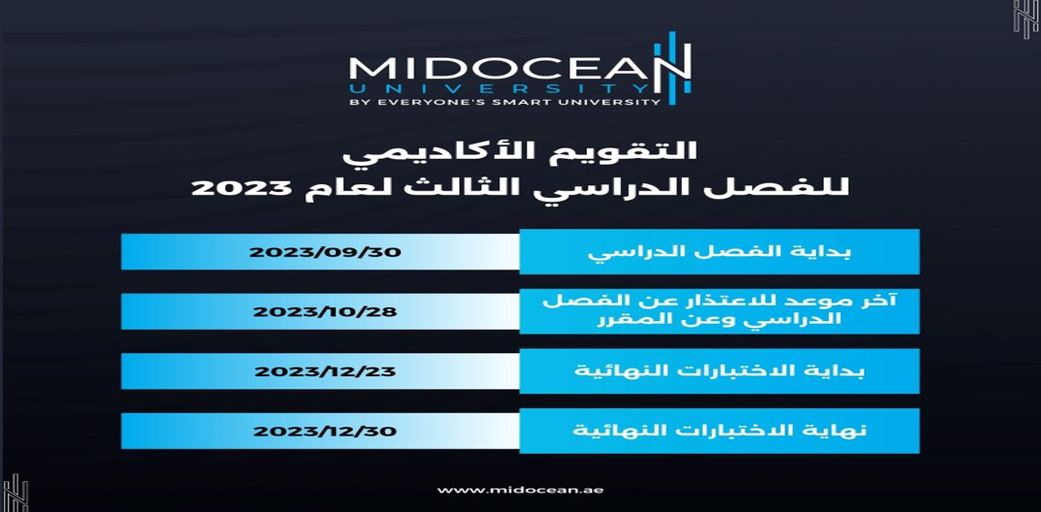
Academic Calendar
TITLE OF SLIDE

Slide 13
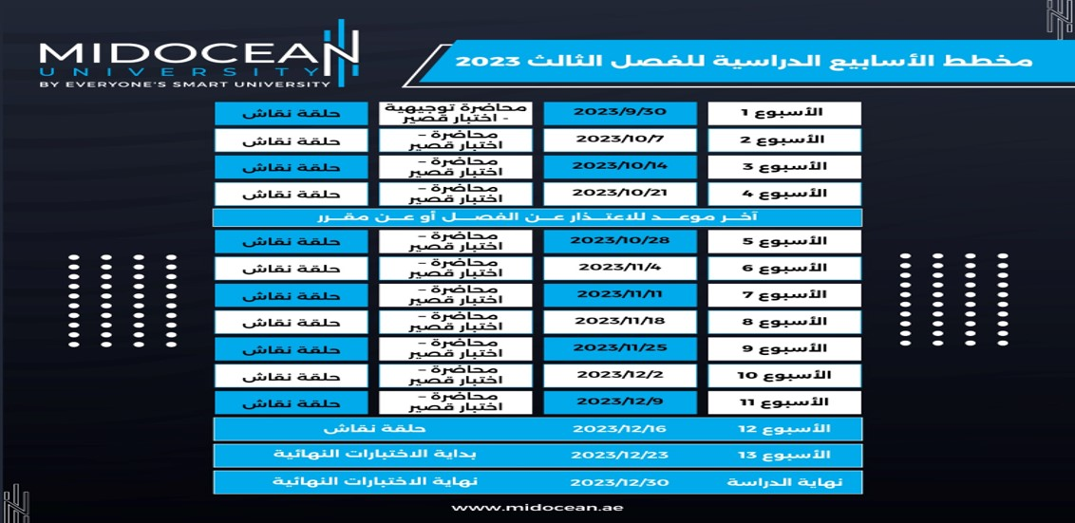
Academic Weeks Agenda for the Third Trimester 2023
TITLE OF SLIDE

Slide 14


Slide 15



Thank You

