Slide 1

PMG 622
Agile Project Management
ZOOM MEETING: 02
(07-Feb-2022)
Everyone’s Smart
University
دكتور مهندس استشاري ادارة المشروعات
Eng. Dr. Akram Mustafa Suliman Ali,
PhD. AU, BEng. & MSc. AAST, CEng CMarEng MIMarEST, PE, PMP®,
ASQ CSSBB, ISO Lead Auditor, NDT Level II,

Slide 2
PMIAA
Forum Topic: Tell us anything about PMIAA
Program Management Improvement and Accountability Act

Slide 3
Types of PM LIFECYCLES
  Predictive life cycle. A more traditional approach, with the bulk of planning occurring upfront, then executing in a single pass; a sequential process.
  Iterative life cycle. An approach that allows feedback for unfinished work to improve and modify that work.
  Incremental life cycle. An approach that provides finished deliverables that the customer may be able to use immediately.
  Agile life cycle. An approach that is both iterative and incremental to refine work items and deliver frequently.

Slide 4
NON-AGILE (NON-ADAPTIVE) APPROACHES
Predictive
Linear
Waterfall
Plan-driven
Serial
Notes:
In the end, we settled on the term predictive since it is used in A Guide to the Project
Management Body of Knowledge (PMBOK® Guide) [3] and the Software
Extension to the PMBOK® Guide Fifth Edition [4].
If agile is at one end, we call the other end
predictive.

Slide 5
Characteristics of Four Categories of Life Cycles

Slide 6
The agile manifesto consists of 4 values and how many principles?
6
8
10
12

Slide 7
Laws that describe requirements that must be present at bodies undertaking government contracts provide good support to the projects management profession.
القوانين التي تصف متطلبات يجب توافرها لدى المنشئات التي تتولى عقود حكومية تدعم مهنة ادارة المشروعات
True
False

Slide 8
Ref. Agile Manifesto:
Through this work we have come to value individuals and interactions over processes and tools
True
False

Slide 9
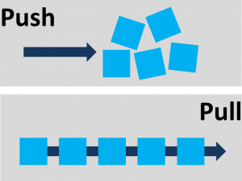

Slide 10
Kanban
Is a Japanese word meaning signboard, sign, or card. A Kanban system primarily uses visual cues to signal when a particular action should occur

Slide 11
A Brief History of the Kanban
Methodology
Kanban was first used in manufacturing environments by Taiichi Ohno of the Toyota Motor Company in the mid-20th century.
Kanban began with American supermarket stocking techniques that caught Ohno’s attention, and while he observed their methods, he noticed the supermarkets were able to function without storing excessive amounts of inventory.
Notes:
Point of Sales

Slide 12
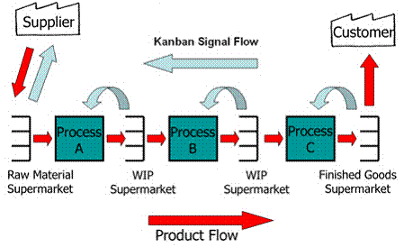

Slide 13
A System for Value Delivery
PMBok 7th ed.
2.1 CREATING VALUE

Slide 14
Examples of ways that projects produce value include
Creating a new product, service, or result that meets the needs of customers or end users;
Creating positive social or environmental contributions;
Improving efficiency, productivity, effectiveness, or responsiveness;
Enabling the changes needed to facilitate organizational transition to its desired future state; and
Sustaining benefits enabled by previous programs, projects, or business operations.
Notes:
Projects exist within a larger system, such as a governmental agency, organization, or contractual arrangement. For the sake of brevity, this standard uses the term organization when referring to government agencies, enterprises, contractual arrangements, joint ventures, and other arrangements.
Organizations create value for stakeholders. Examples of ways that projects produce value include, but are not limited to:

Slide 15
VALUE DELIVERY COMPONENTS
There are various components, such as portfolios, programs, projects, products, and operations, that can be used individually and collectively to create value.
Working together, these components comprise a system for delivering value that is aligned with the organization's strategy.

Slide 16
Example of a System for Value Delivery
Notes:
Figure 2-1
shows an example of a system to deliver value that has two portfolios comprised of programs and projects.
It also shows a stand-alone program with projects and stand-alone projects not associated with portfolios or programs.
Any of the projects or programs could include products.
Operations can directly support and influence portfolios, programs, and projects, as well as other business functions, such as payroll, supply chain management, and so forth.
Portfolios, programs, and projects influence each other as well as operations.

Slide 17
Components of a Sample System for Value Delivery
Notes:
As shown in Figure 2-2,
a system for value delivery is part of an organization's internal environment that is subject to
policies, procedures, methodologies, frameworks, governance structures, and so forth.
That internal environment exists within the larger external environment, which includes
The economy, the competitive environment, legislative constraints, etc.
Section 2.4 provides more detail on internal and external environments.

Slide 18
Products of a value delivery system
The components in a value delivery system create deliverables used to produce outcomes.
An outcome is the end result or consequence of a process or a project.
Focusing on outcomes, choices, and decisions emphasizes the long-range performance of the project.
The outcomes create BENEFITS, which are gains realized by the organization.
Benefits, in turn, create VALUE, which is something of worth, importance, or usefulness.

Slide 19
INFORMATION FLOW
A value delivery system works most effectively when INFORMATION and FEEDBACK are shared consistently among all components, keeping the system aligned with strategy and attuned to the environment.

Slide 20
BLACK ARROWS: information from senior leadership to portfolios, portfolios to programs and projects, and then to operations
LIGHT GRAY ARROWS: represent the reverse flow of information.

Slide 21
Flow of Information from senior leadership DIRECTION
Senior leadership shares strategic information with portfolios.
Portfolios share the desired outcomes, benefits, and value with programs and projects.
Deliverables from programs and projects are passed on to operations along with information on support and maintenance for the deliverables.

Slide 22
INFORMATION FLOW FROM OPERATIONS direction
Information from operations to programs and projects suggests adjustments, fixes, and updates to deliverables.
Programs and projects provide performance information and progress on achieving the desired outcomes, benefits, and value to portfolios.
Portfolios provide evaluations on portfolio performance with senior leadership.
Additionally, operations provide information on how well the organization's strategy is advancing.

