Slide 1


Prepared by Dr. Aya Mohamed
ENT 614
New Product Development (Part One)
Lecture 6

Slide 2

In the previous lecture
New Product development Part one
Types of Product Strategies
Elements of a Good Product Strategy
6 Key Ingredients for a Successful Product Strategy
Product Strategies for Businesses

Slide 3
Product Life Cycle
Topics covered :
What Is a Product Life Cycle?
The Importance of Product Life Cycle
5 Stages of the Product Life Cycle
Factors Affecting the Product Life Cycle
Managing the Product Life Cycle

Slide 4

The product lifecycle
The product lifecycle is a model that describes the stages a product goes through from its development to its eventual decline.
It is used by businesses to plan and manage the growth and decline of their products.
Businesses and organizations can make informed decisions about their products when they have a better understanding of the product lifecycle.

Slide 5
Benefits of understanding product Lifecycle
Accurately forecasting the market trends
Allocating resources more effectively, such as investing in product development during the introduction stage and reducing costs during the decline stage
Making informed decisions about their product portfolio, such as which products to continue developing and which to discontinue
Provides valuable insight into a company’s competitors and product offerings.

Slide 6

Product Lifecycle Concept
The concept of the five stages of the product lifecycle is widely attributed to Harvard Business School professor Theodore Levitt. Levitt first introduced the concept in 1965 in his article “Exploit the Product Life Cycle.”
The article provided a framework for understanding how a product progresses through its lifecycle and the challenges and opportunities that businesses face at each stage.

Slide 7
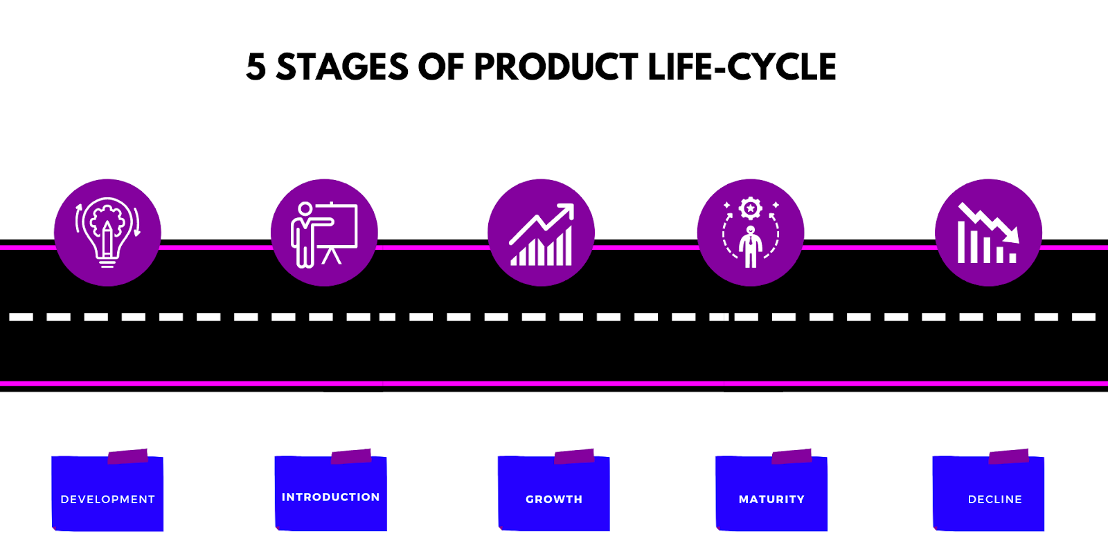
Stages of Product Lifecycle
Development
Introduction
Growth
Maturity
Decline

Slide 8
What Is a Product Life Cycle?
As the name indicates, the product life cycle is the lifespan of a product. It includes the time from product launch until its withdrawal from the market.
For example, CD players
Their sales decreased significantly in the mid-2000s. Despite the discontinued CD players, you can still use them for another decade.

Slide 9

Product Lifecycle Concept (PLC)
The point is that this serves as an excellent example of a product whose life cycle has reached its endpoint
The product life cycle is continuous.
Companies usually rely on product life cycle analysis to understand market demands. They implement strategies to increase their product lifespan.

Slide 10
Product Lifecycle Concept (PLC)
The product life cycle is helpful for managers, developers, and designers.
Identifying the life cycle stage the product is in, offers enough insights.
The insights include increasing that stage’s longevity and implementing strategies that can keep the product from declining.

Slide 11
key advantages of the product life cycle
Sales Forecast: Sales indicates the product’s lifespan. Improving sales maximizes the life cycle of a product.
Effective Planning: Once the company can predict sales performance, it becomes easier to plan and implement strategies that benefit the company in the long run.
Competitive Advantage: The product life cycle helps companies compete effectively since the stage of the product is identified. And then, you can implement a set of strategies accordingly.

Slide 12
key advantages of the product life cycle
Decision Making: The product life cycle can help the company make crucial decisions related to product development. The essential choices include upgrades, improvement, and additional features.
Target Audience: The product life cycle helps target the right audience and identifies if the product meets their needs. In case of decreased sales, you can also determine the focus-reshifting of the target population

Slide 13

The Stages of the Product Life Cycle
Saturation
Decline
Maturity
Growth
Development
Introduction
Sales
Time

Slide 14
Stages of Product Lifecycle PLC
(Stage 1: Development)
This is the stage in which a new product is conceptualized and developed. During this stage, a company will invest in research and development to create a product that meets the needs of its target market.

Slide 15
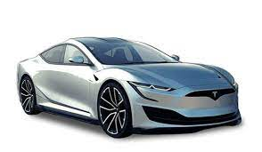
(Stage 1: Development)
The two phases under the Development stage are:
Conceptualization and Research Phase: During this stage, Elon Musk and the team at Tesla began to conceptualize the idea of an all-electric luxury car. They conducted extensive research into the electric vehicle market and the needs and wants of potential customers.
Design and Prototyping Phase: During this stage, Tesla’s engineers and designers worked to create a design for the Model S. Prototypes of the car were built to test its performance, reliability, and safety features.

Slide 16
Stage 1: Development
Development is when the cost of production keeps on rising while there is no revenue generated.
Some products require years of research and tons of capital investment. And others are quicker to develop and launch in the market.
At this stage of the product lifecycle, the risk is very high. Hence, funding is limited.
Thus, many companies use the strategy to direct the revenue generated from their current products toward investing in another startup.

Slide 17
Stage 1: Development
Sales
NO or Low sales
Costs
High cost per customer
Profits
Negative
Marketing Objectives
Create product awareness
and trial
Product
Offer a basic product
Price
Use cost-plus
Distribution
Build selective distribution
Advertising
Build product awareness among early adopters and dealers
Notes:
Introduction. In this stage marketers spend heavily on promotions to inform the target market about the new product's benefits. Low or negative profits may encourage the company to price the product high to help offset expenses. companies can concentrate on skimming strategies to generate high profits now or on penetration strategies to build market share and dominant the market for larger profits once the market stabilizes.
Product Life Cycle Strategies
Product Life-Cycle Strategies
This CTR relates to the material on pp. 289 and 293.

Slide 18
Stage 2: Introduction
The introduction is when the product development has almost reached its end, and it’s time to market the product and create awareness about its launch.
Unlike the previous stage, the marketing costs are higher in this product lifecycle stage. It becomes crucial to reach out to potential clients and customers.

Slide 19
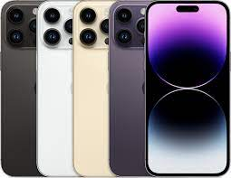
Stage 2: Introduction
There are two phases under this stage:
Market testing and launch phase: Prior to the launch of the iPhone, Apple conducted extensive market research to test the product and gauge interest from potential customers. The iPhone was then officially launched and made available for purchase.
Early adopter phase: During this stage, the iPhone was primarily adopted by early adopters and technology enthusiasts. Sales were modest but growing, as people became more familiar with the product and its features.
Marketing strategies during the introduction stage: Apple included high-profile advertising campaigns, demonstrations in Apple retail stores, and strategic partnerships with major carriers

Slide 20
Introduction Stage: Marketing Strategies
Promotion
High
Low
Rapid-
skimming
strategy
Slow-
skimming
strategy
High
Price
Rapid-
penetration
strategy
Slow-
penetration
strategy
Low

Slide 21
Stage 3: Growth
At this stage, customers finally welcome the product.
Your business competes to increase its market share because other companies know your product and its place in the market.
If there are many competitors, your product’s price is likely less. However, suppose your product is innovative with lesser competition. In such scenarios, the prices of your product may remain high for a longer time
Marketing strategies during the GROWTH stage: Extensive Marketing Campaigns

Slide 22

Stage 3: Growth
Mass Market Adoption Phase: The smartphone industry saw mass market adoption in the late 2000s and early 2010s. This was largely due to the increasing affordability of the devices and the widespread availability of mobile internet access.
Expansion of Product Offerings: Manufacturers began to offer phones in different sizes, with varying levels of processing power and storage capacity, and with different operating systems.
Marketing Strategies: Smartphone manufacturers ran extensive advertising campaigns in traditional media such as television, print, and outdoor advertising, as well as in digital media such as online advertisements, social media, and email

Slide 23
Stage 3: Growth
Sales
Rapidly rising sales
Costs
Average cost per customer
Profits
Rising profits
Marketing Objectives
Maximize market share
Product
Offer product extensions, service, warranty
Price
Price to penetrate market
Distribution
Build intensive distribution
Advertising
Build awareness and interest in the mass market
Notes:
Product Life-Cycle Strategies
This CTR relates to the material on pp. 289-290 and 293.
Product Life-Cycle Strategies
Growth. In this stage the company experiences both increasing sales and competition. Promotion costs are spread over larger volume and strategic decisions focus on growth strategies. Strategies include adding new features, improving quality, increasing distribution, and entering new market segments.

Slide 24


Growth Stage: Marketing Strategies
  Improve product quality and add new product features and improved styling
  Add new models and flanker products
  Enter new market segments
  Increase distribution coverage and enter new distribution channels
  Shift from product-awareness advertising to product-preference advertising
  Lower prices to attract next layer of price-sensitive buyers

Slide 25
Stage 4: Maturity
Maturity is the stage of the product lifecycle where your sales will slow down or, in some cases, even stop. It results from increased competition to maintain your market share and saturation.
We call this the ‘shake-off point,’ when less successful competitors exit the market.
Companies will likely alter or develop a new product to cater to different consumer needs. You strategically use innovation to modify the product and maintain the market share.
Prices are likely to decline to meet high competition. Production costs have decreased due to higher efficiency. You don’t require additional funding at this stage

Slide 26
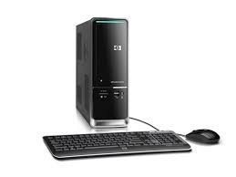

Stage 4: Maturity
Stabilization of Sales and Market Share: During the Maturity stage, the sales of personal computers stabilized, as the market became saturated and the demand for new computers began to level off.
Cost-cutting and Product Improvement Phase: In response to the stabilization of sales, PC manufacturers began to focus on cost-cutting and product improvement. This involved streamlining their operations, reducing the cost of materials and components, and improving the efficiency of their manufacturing processes.
Marketing strategies: During this stage, PC manufacturers shifted their marketing strategies away from the aggressive tactics they used during the Growth stage. Instead, they focused on promoting the reliability and affordability of their products, and on differentiating themselves from their competitors.

Slide 27
Stage 4: Maturity
Sales
Peak sales
Costs
Low cost per customer
Profits
High profits
Marketing Objectives
Maximize profit while defending
market share
Product
Diversify brand and models
Price
Price to match or best competitors
Distribution
Build more intensive distribution
Advertising
Stress brand differences and benefits
Notes:
Product Life Cycle Strategies
Maturity. In this stage the company must manage slower growth over a longer period of time. Strategic decisions made in the growth stage may limit choices now. Marketing managers must proactively seek advantage by either market modification to increase consumption, product modification to attract new users (quality, feature, and style improvements), or marketing mix modification in an attempt to improve competitive position.
Product Life-Cycle Strategies
This CTR relates to the material on pp. 290-292 and 293.

Slide 28

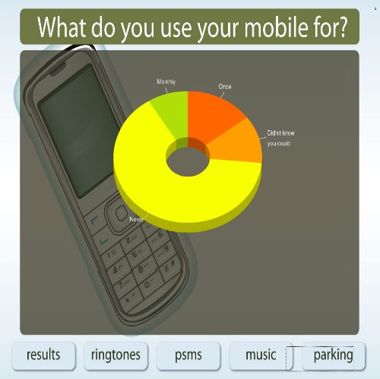

Maturity Stage: Marketing Strategies
  Market Modification
    Expand number of brand users by:
      Converting nonusers
      Entering new market segments
      Winning competitors’ customers
    Convince current users to increase usage by:
      Using the product on more occasions
      Using more of the product on each occasion
      Using the product in new ways
Volume = Number of brand users X Usage Rate per user

Slide 29

Maturity Stage: Marketing Strategies
  Product modification
    Quality improvement: Increasing product’s functional performance- durability, reliability, speed, taste.
    Feature improvement: Adding new features that expand the product’s versatility, safety, or convenience.
    Style improvement: Increasing product’s aesthetic appeal.
  Marketing-Mix Modification
    Prices:
    Distribution
    Advertising
    Sales promotion
    Personal selling
    Services

Slide 30
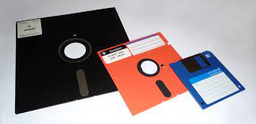
Stage 5: Decline
The product lifecycle stage is associated with a decline in revenue, resulting from several factors.
Factors include market saturation, increased competition, decreased demand, technological evolution, or changing user needs.

Slide 31

Stage 5: Decline
Decreasing Sales and Market Share: During the Decline stage, the sales of floppy disks rapidly declined as newer and more advanced storage technologies became available. As a result, their market share also declined, as customers turned to other options such as USB drives and cloud storage.
Phasing out and Retirement of the Product: In response to the decreasing sales and market share, manufacturers of floppy disks began to phase out the production of the product. This involved reducing the number of factories producing floppy disks and gradually discontinuing the production of the product altogether.
Marketing strategies: During this stage, the strategies for floppy disks shifted from promotion to liquidation. This involved heavily discounting the product to clear inventory, and promoting its retirement to encourage customers to switch to newer technologies.

Slide 32
Stage 5: Decline
Sales
Declining sales
Costs
Low cost per customer
Profits
Declining profits
Marketing Objectives
Reduce expenditure and milk the brand
Product
Phase out weak items
Price
Cut price
Distribution
Go selective: phase out unprofitable outlets
Advertising
Reduce to level needed to retain
hard-core loyal customers
Notes:
Product Life-Cycle Strategies
This CTR relates to the material on pp. 292-293.
Product Life Cycle Strategies
Decline. In this stage the costs of managing the product may eventually exceed profits. Rate of decline is a major factor in setting strategy. Management may maintain the brand as competitors drop out, harvest the brand by reducing costs of support for short term profit increases, or drop the product (divest) altogether.

Slide 33
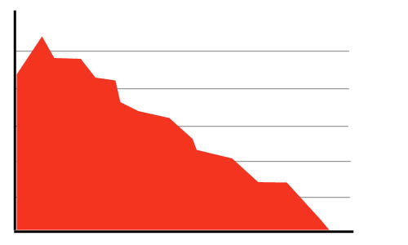
Decline Stage: Marketing Strategies
  Increase firm’s investment (to dominate the market and strengthen its competitive position)
  Maintain the firm’s investment level until the uncertainties about the industry are resolved.
  Decrease the firm’s investment level selectively by dropping unprofitable customer groups, while simultaneously strengthening the firm’s investment in lucrative niches
  Harvesting (“milking”) the firm’s investment to recover cash quickly
  Divesting the business quickly by disposing of its assets as advantageously as possible.

Slide 34
PLC- Important Observations
Individual brands may not follow this pattern
  Sometimes a product may crash and not get to the maturity stage
Product Life Cycle - length of time at each stage - varies
  depends on the products
  can be a few months in each stage
  or it can be years
Generally speaking, due to the
  Competitive Environment
  Technological Environment
  The PLC is getting shorter

Slide 35
Factors Affecting the Product Life Cycle
Competition
The level of competition in the market can impact the rate at which a product moves through each stage of the lifecycle.
For example, a product that is in a highly competitive market may see its sales decline more rapidly than a product in a less one.

Slide 36
Factors Affecting the Product Life Cycle
Consumer Preferences and Behavior
Changes in consumer preferences can impact the demand for a product, and shifts in the consumer behavior can impact the way that customers use and purchase the product.
For example, if a product becomes outdated or less popular, it may see its sales decline, even if there is no direct competition.

Slide 37
Factors Affecting the Product Life Cycle
Technological advancements
New technologies can create new products and make existing products obsolete.
For example, the advent of digital storage technologies has led to the decline of the floppy disk.
Economic factors
Economic factors, such as changes in the overall economy, shifts in consumer spending patterns, and changes in the cost of materials and labor, can also impact the product lifecycle.
For example, a recession may lead to a decline in consumer spending, and a decrease in demand for a product.

Slide 38
Managing the Product Life Cycle
Identifying the Stage of the Product Lifecycle
The first step in managing the product lifecycle is to accurately identify the stage that the product is in.
You can do this by analyzing sales trends, market share, customer feedback, and other data to determine what stage the product is in.

Slide 39
Managing the Product Life Cycle
Adjusting marketing strategies based on the stage of the product lifecycle
Once you identify the stages, you can then adjust the marketing strategies accordingly.
For example, during the Introduction stage, companies may focus on building brand awareness and generating initial sales.
During the Growth stage, they may focus on expanding their product offerings and increasing market share, and so on.

Slide 40

Managing the Product Life Cycle
Planning for product retirement
Effective management of the product lifecycle also involves planning for the retirement of a product. This may involve phasing out the production of the product, discontinuing its marketing, and managing the transition to new products or technologies.
By planning for the retirement of a product, companies can minimize the risk of stranded inventory and ensure a smooth transition for their customers.

Slide 41

Product lifecycle PLC
Overall, by understanding the stage of the product lifecycle, companies can maximize the success and profitability of their products and ensure their long-term success in the market..
Conclusion
A product lifecycle is a crucial tool in today’s market as it helps companies understand and manage the stages of a product’s development, from ideation to discontinuation.
By analyzing the lifecycle, businesses can make informed decisions about investment, marketing strategies, and resource allocation, greater efficiency and profitability.
In a constantly changing market, the product lifecycle remains a relevant and important framework for ensuring the success and sustainability of a product.

Slide 42
Conclusion
New Product Development (Part One)
During PLC, companies need to reformulate their marketing strategies several times.
The general sequence of stages in any life cycle is introduction, growth, maturity and decline.
Many products exhibit a bell-shaped PLC, there are many other patterns also.
Each stage call for different marketing strategies as features at all stages are different.

Slide 43



Thank You

