Slide 1


Entrepreneurial
New Ventures
Prepared by Dr. Sarah Chahine
ENT 634
Developing an Effective Business Model
Lecture 4

Slide 2


Entrepreneurial
New Ventures
Lecture 4
ENT 634
Developing an Effective Business Model
Prepared by
Dr. Sarah Chahine

Slide 3

Chapter
Introduction
04
A business model is a firm’s plan or recipe for how it creates, delivers, and captures value for its stakeholders.

Slide 4

Chapter
Chapter
Introduction
04
Dropbox, for example, has what is referred to as a freemium business model. It offers its customers a free account with a set amount of storage space; the firm earns money by selling premium accounts with more capacity. Dropbox could charge all of its users a monthly fee based on the amount of storage that they use, but that is not its business model. Its business model is based on the belief that by introducing users to its service through a free account, it will ultimately sign up more paid users.

Slide 5
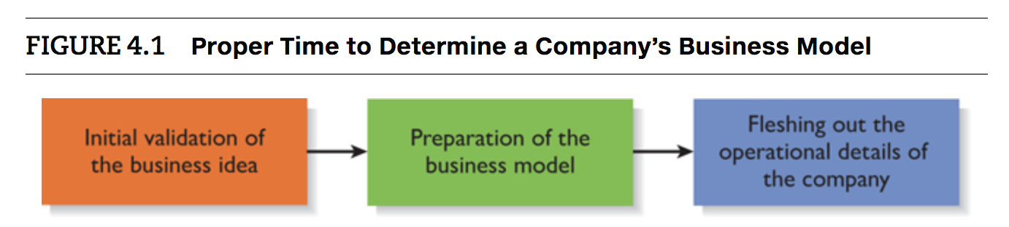
Chapter
04
Introduction
The proper time to determine a company’s business model is following the initial validation of the business idea and prior to fleshing out the details of how the firm will operate to provide its product or service to customers.

Slide 6
Chapter
04
Introduction
In this chapter we first discuss business models and their importance. We then introduce and discuss a template for developing a business model. The template, called the Barringer/Ireland Business Model Template, consists of 4 categories and 12 items that make up a firm’s business model.
A critical factor is that a firm’s business model should not be completed in isolation. The founders of a firm should “get out of the building” and talk to potential customers as a firm’s business model takes shape. This is a facet of developing an effective business model .

Slide 7
Chapter
04
Business Models and Their Importance
A firm’s business model is its plan or recipe for how it creates, delivers, and captures value for its stakeholders.
A firm’s business model represents the core aspects of its business. It also describes how the core aspects fit together and support one another.
Three important elements of a firm’s business model are its target market, its basis for differentiation, and its key assets.

Slide 8

Chapter
04
General Categories of Business Models
There are two general categories of business models:
Standard Business Models
Disruptive business models.

Slide 9
Chapter
04
General Categories of Business Models
Standard Business Models:
This type of model is used commonly by existing firms as well as by those launching an entrepreneurial venture.
Standard business models depict existing plans or recipes firms can use to determine how they will create, deliver, and capture value for their stakeholders.
Most of the standard business models, with the exception of the freemium model, have been in place for some time.

Slide 10
Chapter
04
General Categories of Business Models
Standard Business Models:
Many of the business models utilized by online firms were originally developed by offline firms, and simply transferred to the Internet.
  For example, Amazon did not invent a new business model. It took the mail order business model, pioneered years ago by Sears’ Roebuck and Company, and moved it online.
  Similarly, eBay did not invent the auction business model—that has been in existence for centuries. It only moved the auction format online.

Slide 11
Chapter
04
General Categories of Business Models
Standard Business Models:
Advertising Business Model: Business model based on providing advertisers access to highly targeted customer niches. Example: Facebook, Google, Pinterest.
Auction Business Model: Currently synonymous with eBay, the auction business model has been around since 500 BC. The idea is to provide a platform for individuals and businesses to sell items in an auction format.

Slide 12
Chapter
04
General Categories of Business Models
Standard Business Models:
Bricks and Clicks Business Model: A business model in which a company integrates both offline (bricks) and online (clicks) presences. Example: Adidas.
Freemium Business Model: A business model in which a firm provides a basic version of its service for free, and makes money by selling a premium version of the service. Example: Dropbox, Anghami.

Slide 13
Chapter
04
General Categories of Business Models
Standard Business Models:
Peer-to-Peer Business Model: A model in which a business acts as a matchmaker between individuals with a service to offer and others who want the service. Example: Uber.
Razor and Blades Business Model: This model involves the sales of dependent goods for different prices—one good (a razor) is sold at a discount, with the dependent good (blades) sold at a considerably higher margin. Example: Printers and Ink Cartridges.

Slide 14
Chapter
04
General Categories of Business Models
Standard Business Models:
Subscription Business Model: A business model in which the customer pays a monthly, quarterly, or yearly subscription fee to have access to a product or service. Example: Netflix.
Traditional Retailer Business Model: A business model calling for a firm to sell its products or services, made by others, directly to consumers at a markup from the original price. Can be sold online or offline. Example: Amazon.

Slide 15
Chapter
04
General Categories of Business Models
Disruptive Business Models:
Disruptive business models which are rare, are models that do not fit the profile of a standard business model, and are impactful enough that they disrupt or change the way business is conducted in an industry or an important niche within an industry.

Slide 16
Chapter
04
General Categories of Business Models
Disruptive Business Models:
There are two types of disruptive business models.
A new market disruption addresses a market that previously wasn’t served. An example is Google and its AdWords program. AdWords allows an advertiser to buy keywords on Google’s home page, which triggers text-based ads to the side of the search results when the keyword is used.

Slide 17
Chapter
04
General Categories of Business Models
Disruptive Business Models:
There are three types of disruptive business models.
A low-end disruption is possible when the firms in an industry continue to improve products or services to the point where they exceed the needs or requirements of a significant portion of their customer base. As a consequence, these established companies might end up offering products or services that are more complex and expensive than what a segment of the market demands. Example: Ryanair.

Slide 18
Chapter
04
General Categories of Business Models
Disruptive Business Models:
Below are two example disruptive business models:
Dell: Direct-to-consumer computer sales model, which allowed consumers to customize their computers.
Salesforce.com: SaaS (Software as a Service) provider of customer relationships management (CRM) software. First company to offer CRM software as a SaaS product, making CRM affordable to small companies for the first time.

Slide 19
Chapter
04
The Barringer/Ireland Business Model Template
Although not everyone agrees precisely on the components of a business model, many agree that a successful business model has a common set of attributes. These attributes are often laid out in a visual framework or template.
One widely-used framework is the Business Model Canvas.
The business model framework used here, the Barringer/Ireland Business Model Template, is shown next.

Slide 20
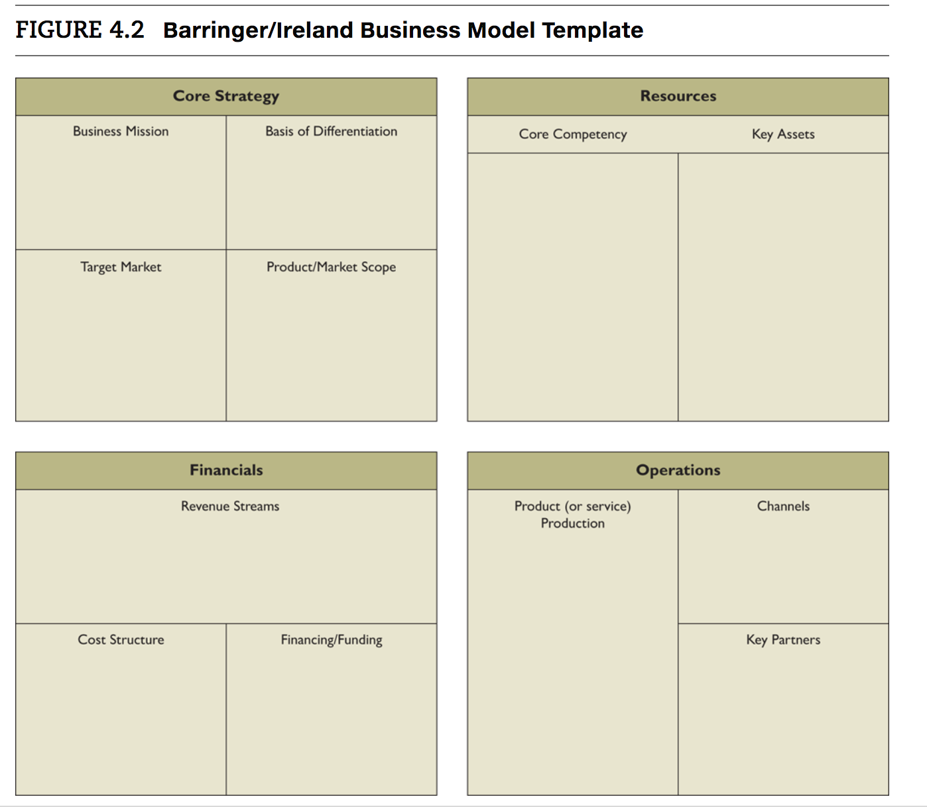
Chapter
04
The Barringer/Ireland Business Model Template
Barringer/Ireland Business Model Template

Slide 21
Chapter
04
The Barringer/Ireland Business Model Template
Barringer/Ireland Business Model Template

Slide 22
Chapter
04
The Barringer/Ireland Business Model Template
Core Strategy
A core strategy describes how the firm plans to compete relative to its competitors.
The business mission, basis of differentiation, target market, and product/market scope are the primary elements of a core strategy.

Slide 23
Chapter
04
The Barringer/Ireland Business Model Template
Core Strategy
Business Mission: A business’ mission or mission statement describes why it exists and what its business model is supposed to accomplish.
  Define its “reason for being
  ”Describe what makes the company different
  Be risky and challenging but achievable
  Use a tone that represents the company’s culture and values
  Convey passion and stick in the mind of the reader
  Be honest and not claim to be something that the company “isn’t”

Slide 24
Chapter
04
The Barringer/Ireland Business Model Template
Core Strategy
Basis of Differentiation:
It is important that a business clearly articulate the points that differentiate its product or service from competitors.
This is similar to what some authors refer to as a company’s value proposition.
A company’s basis of differentiation is what causes consumers to pick one company’s products over another’s. It is what solves a problem or satisfies a customer need.

Slide 25
Chapter
04
The Barringer/Ireland Business Model Template
Core Strategy
Target Market:
A target market is a segment within a larger market that represents a narrower group of customers with similar interests.
Product/Market Scope: defines the products and markets on which it will concentrate. Most firms start narrow and pursue adjacent product and market opportunities as the company grows and becomes financially secure.

Slide 26
Chapter
04
The Barringer/Ireland Business Model Template
Resources
Resources are the inputs a firm uses to produce, sell, distribute, and service a product or service.
For example, a firm may need a patent (a key asset) to protect its basis of differentiation. Similarly, a business may need expertise in certain areas (core competencies) to understand the needs of its target market.
Assets and core competency are the primary elements of resources.

Slide 27
Chapter
04
The Barringer/Ireland Business Model Template
Resources
Core Competencies:
A core competency is a specific factor or capability that supports a firm’s business model and sets it apart from its rivals.
A core competency can take on various forms, such as technical know-how, an efficient process, a trusting relationship with customers, expertise in product design, and so forth.
A firm’s core competencies largely determine what it can do.

Slide 28
Chapter
04
The Barringer/Ireland Business Model Template
Resources
Key Assets:
Key assets are the assets that a firm owns that enable its business model to work.
The assets can be physical, financial, intellectual, or human.
Physical assets include physical space and equipment. Intellectual assets include resources such as patents, and copyrights. Financial assets include cash and commitments from investors. Human assets include a company’s founder or founders, its key employees, and its advisors.

Slide 29
Chapter
04
The Barringer/Ireland Business Model Template
Financials
The third component of a business model focuses on a firm’s financials. This is the only section of a firm’s business model that describes how it earns money—thus, it is extremely important.
Revenue streams, cost structure, and financing/funding are the primary aspects of the financials’ component.

Slide 30
Chapter
04
The Barringer/Ireland Business Model Template
Financials
Revenue streams: A firm’s revenue streams describe the ways in which it makes money. A company may have one or more revenue stream.
Cost structure: A business’ cost structure describes the most important costs incurred to support its business model.

Slide 31
Chapter
04
The Barringer/Ireland Business Model Template
Financials
Financing/Funding: Most businesses incur costs prior to the time they generate revenue. Prior to earning revenue, the company has to make a lot of payments, which typically necessitates an infusion of up-front capital for the business to be feasible.
In many cases, however, an initial infusion of funding or financing is required. In these cases, the business model template should indicate the approximate amount of funding required.

Slide 32
Chapter
04
The Barringer/Ireland Business Model Template
Operations
Operations are both integral to a firm’s overall business model and represent the day-to-day heartbeat of a firm.
The primary elements of operations are: product (or service) production, channels, and key partners.

Slide 33
Chapter
04
The Barringer/Ireland Business Model Template
Operations
Product (or Service) Production:
This section focuses on how a firm’s products and/or services are produced.
If a firm sells physical products, the products can be manufactured or produced in-house, by a contract manufacturer, or via an outsource provider. If it opts to produce in-house, it will need to develop core competencies in manufacturing.

Slide 34
Chapter
04
The Barringer/Ireland Business Model Template
Operations
Channels: A company’s channels describe how it delivers its product or service to its customers. Businesses sell direct, through intermediaries, or through a combination of both.
Key partners: Start-ups typically do not have sufficient resources (or funding) to perform all the tasks needed to make their business models work, so they rely on partners to perform key roles.

Slide 35


Thank You

