Slide 1




Product Analysis and Development
Prepared by Dr. Aya Mohamed
Lecture 1
ENT 614
Product Analysis

Slide 2




ENT 614
Objectives
• Understanding of complete product development process
• Understand how to build products with sustainable competitive advantage

Slide 3
ENT 614
Objectives
• Learn to prioritize new product ideas based on business strategic alignment, return on investments and ability to execute.
• Deliver new product developments on time and how to manage a team (or virtual team) of project resources and multiple business units’ stakeholders

Slide 4

Modules
Product Analysis and Development
Module 1: Product Analysis: Types, Methods, and Examples
Module 2: New Product Development (Part One)
Module 3: New Product Development (Part Two)

Slide 5
Modules
Product Analysis and Development
Module 1: Product Analysis: Types, Methods, and Examples
Module 2: New Product Development (Part One)
Module 3: New Product Development (Part Two)
Module 4: Product Roadmaps & How to Make Them
Module 5: - Business Model (Part One)
- Product and Brand Strategy (Part Two)

Slide 6
Module 1
Product Analysis: Types, Methods,
and Examples
Lecture 1
Dr. Aya Mohamed

Slide 7

Module 1
Product Analysis: Types, Methods, and Examples
Lecture 1
What is Product Analysis?
What Is Product Analysis in Design and Technology?
Why Is Product Analysis Necessary?
Examining the Difference Between Product Screening and Product Analysis
What Is the Difference Between Customer Analysis and Product Analysis?
Difference Between Ladle Analysis and Product Analysis

Slide 8

What is product ??
Lecture 2
I want to travel from one country to another one

Slide 9



What is product ??
Lecture 2
I want to travel from one country to another one

Slide 10
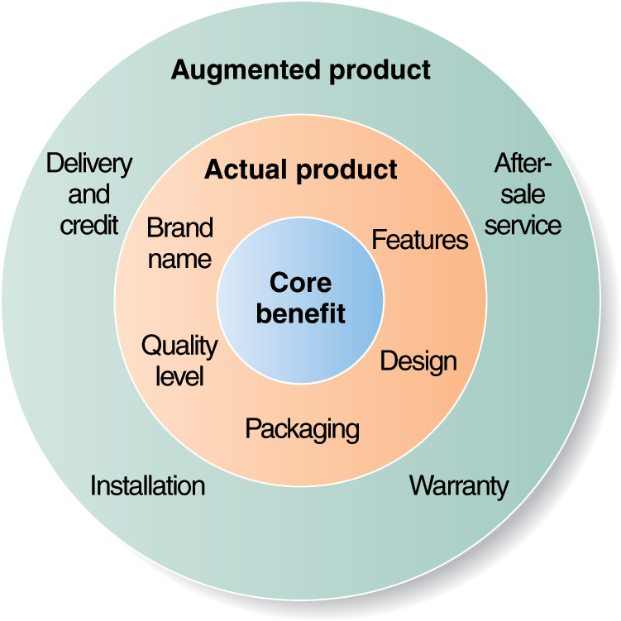
What is product ??
Lecture 2
Level 1

Slide 11
What is product ??
Lecture 2
Level 2
Level 1

Slide 12
What is product ??
Lecture 2
Level 3
Level 2
Level 1

Slide 13
Definition of Product
A product is the item offered for sale.
A product can be a service or an item. It can be physical or in virtual or cyber form.
Every product is made at a cost, and each is sold at a price.
Lecture 2

Slide 14
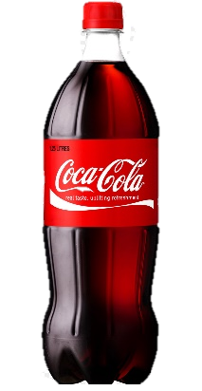

Definition of Product
A product is the item offered for sale.
A product can be a service or an item. It can be physical or in virtual or cyber form.
Every product is made at a cost, and each is sold at a price.
The price that can be charged depends on the market, the quality, the marketing and the segment that is targeted.
Lecture 2
Market
Quality
Marketing strategy
Marketing segment

Slide 15


Characters of Product
1- Relevant: the users must have an immediate use for it.
2- Function ability : functionally able to do what it is supposed to and do it with a good quality.
Lecture 2

Slide 16
Characters of Product
1- Relevant: the users must have an immediate use for it.
2- Function ability : functionally able to do what it is supposed to and do it with a good quality.
3- Easily communicated: Users and potential users must know why they need to use it, what benefits they can derive from it, and what it does difference it does to their lives.
Advertising and 'brand building' best do this.
Lecture 2

Slide 17
Characters of Product
4- Name: a name that people remember and relate to. A product with a name becomes a brand. It helps it stand out from the clutter of products and names.
5-Adaptable: with trends, time and change in segments, the product should lend itself to adaptation to make it more relevant and maintain its revenue stream.
Lecture 2

Slide 18

Characters of Product
4- Name: a name that people remember and relate to. A product with a name becomes a brand. It helps it stand out from the clutter of products and names.
5-Adaptable: with trends, time and change in segments, the product should lend itself to adaptation to make it more relevant and maintain its revenue stream.
Lecture 2
Relevant
Function ability
Communicated
Name
Adaptable

Slide 19
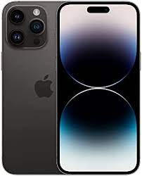

Types of Product
Existing Product
New Product

Slide 20
Types of Product
Existing Product
New Product
Defining Newness
New-to-the-Company like Mac coffee
New-to-the-Market Place like uber introduce into new market

Slide 21


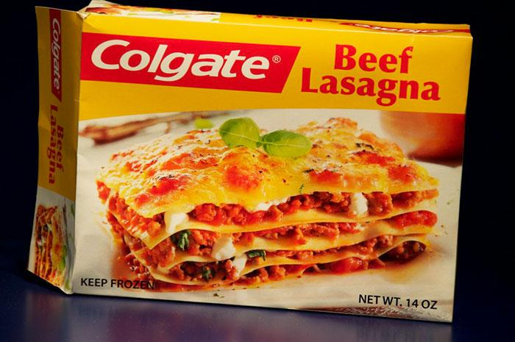
Question
Are All Products Successful ??
When it comes to making products, there’s no room for guesswork.
The market is filled with products that somehow surprisingly fit the exact need of the user.

Slide 22
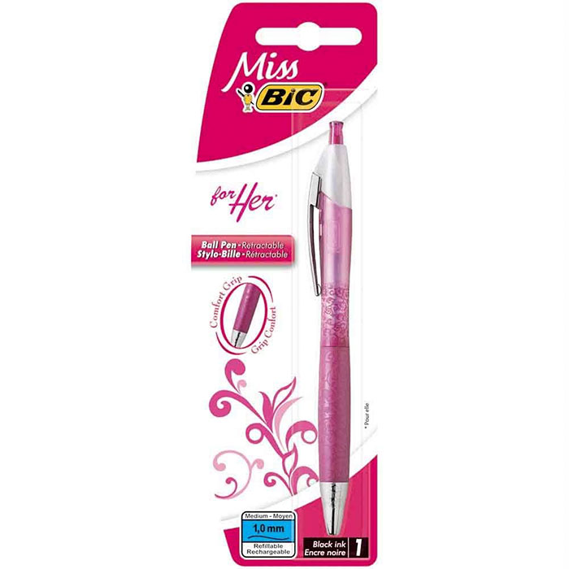


Question
Are All Products Successful ??
When it comes to making products, there’s no room for guesswork.
The market is filled with products that somehow surprisingly fit the exact need of the user.
Moreover, most of these do what the company claims, and some thoroughly fail their product delivery.
All of this is the result of Product Analysis.

Slide 23
Product analysis helps us understand the product down to the End Product.
From manufacturing units to economic costs, utility, services, design, and technology up to its Unique Selling Proposition (USP).
What is the Unique Selling Proposition USP ?

Slide 24
Product analysis helps us understand the product down to the End Product.
From manufacturing units to economic costs, utility, services, design, and technology up to its Unique Selling Proposition (USP).
What is the Unique Selling Proposition USP ?
The distinguishing factor that attracts the customers and makes the product or service stand out from the competitors.
It is a unique point associated with the product like a differentiating feature, capability, cost, or some other customer-centric aspect that accounts for its selling potential

Slide 25
What is Product Analysis?
Product analysis is “the process of gathering, defining, and analyzing data about a product or service to make better decisions.”
To create products that fit the needs of your target market, you need to have a clear understanding of what those needs are.
This is where product analysis comes in.

Slide 26
What is Product Analysis?
Through product analysis, you can understand the following about a product:
The product design
Its component parts
The costs involved in making the product

Slide 27
What is Product Analysis?
Through product analysis, you can understand the following about a product:
The product design
Its component parts
The costs involved in making the product
The design of the product
The product marketing
Competitive analysis

Slide 28
What is Product Analysis?
Through product analysis, you can understand the following about a product:
The product design How it is made
Its component parts The manufacturing process
The costs involved in making the product Its utility and usefulness
The design of the product The technology used in making the product
The product marketing Its unique selling proposition
Competitive analysis.

Slide 29
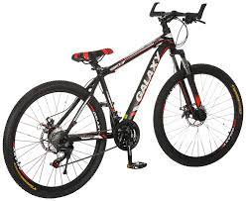
Product analysis is not just limited to physical products, though. It can also be used for services, websites, and even software or SaaS.

Slide 30
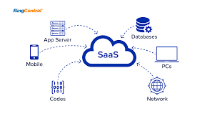

Product analysis is not just limited to physical products, though. It can also be used for services, websites, and even software or SaaS.
Product analysis aims to understand as much as possible about a product so that informed decisions can be made

Slide 31

What Is Product Analysis in Design and Technology?
Product analysis is not just limited to business and economic factors.
It can also be used in the design and technology of products.
A product designer uses product analysis to help understand how well the product meets your customers’ needs.

Slide 32
What Is Product Analysis in Design and Technology?
Product analysis is not just limited to business and economic factors.
It can also be used in the design and technology of products.
A product designer uses product analysis to help understand how well the product meets your customers’ needs.
Product Analysis Evaluate
The usability of your product
The ergonomics of your product
The aesthetic appeal of your product
The durability of your product

Slide 33
What Is Product Analysis in Design and Technology?
By understanding these factors, you can make decisions to
Advance the user experience
Implement the customer’s needs
Improve your product roadmap.
In technology, product analysis helps you understand the feasibility of your product.

Slide 34
Product Analysis used to ASSESS
How well your product meets customer needs
The complexity of your product
The cost of manufacturing your product

Slide 35
Product Analysis used to ASSESS
The time it will take to develop and deploy your product
The demand for the features v/s the capacity of your engineering team.
The prioritization of certain features over others.

Slide 36
Conclusion
Product analysis
Many different types of analyses can be done on a product.
Each one provides valuable information that can be used to make decisions about the product.

Slide 37
Conclusion
Product analysis
Many different types of analyses can be done on a product.
Each one provides valuable information that can be used to make decisions about the product.
Product analysis is essential because it helps you understand your product and how to make it better when it comes down to it.
“ Without product analysis, you would be flying blind and making decisions based on guesswork.”

Slide 38
Wrap Up
Product analysis
The Definition of the product and its characters
The Definition of Product Analysis?
Types of product
The product analysis assess, WHAT??

Slide 39

Product Analysis and Development
Prepared by Dr. Aya Mohamed
Lecture 1
Thank You

