Slide 1



Project Planning
Lecture 7
PMG202
Project Planning- The Project Schedule, and budget
Prepared by
Lec. Dina ElWakkad

Slide 2


.

Slide 3
1) Project Planning
.

Slide 4
Project Planning
Once a project is selected for execution, the structural project planning approach prescribes that the project get planned in detail prior to the actual start of the project.
Project planning consists of 4 main stages:
Risk Management
Quality Management
Human Resource Management
The Project Schedule, and budget
.

Slide 5
The Project Schedule
.

Slide 6
What is a Project Schedule?
We can’t expect a ragingly successful Project without a great Schedule.
A list of required tasks along with the time and the Resources needed will help you arrive at your destination as planned.
Project Scheduling is an important skill for any Project Manager, even if you think it’s a simple Project.
.

Slide 7
What is a Project Schedule?
The Project Schedule:
It is a dynamic document that is created during initial the Planning stage.
The approved Project Schedule acts as a baseline to work to, but it is maintained and updated throughout the Project as things change.
outlines the time needed for the required tasks
  the start and end date of all project tasks
establishes milestones to be met to complete the project on time
  how the tasks relate to each other
allocates resources across tasks
  which team members or other resources are responsible for delivery
.

Slide 8
Types of Project Schedule
.

Slide 9
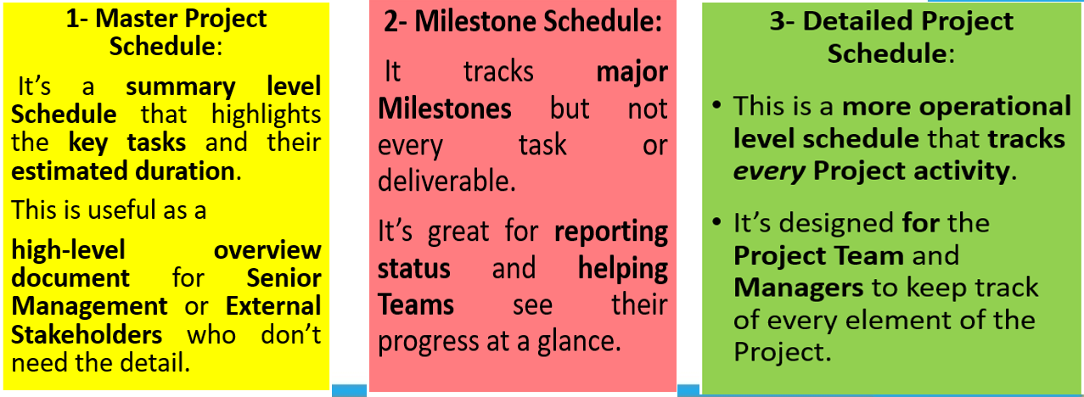
Types of Project Schedule
The 3 main types of Project Schedule
.

Slide 10
Benefits of effective Project Scheduling
.

Slide 11
Benefits of effective Project Scheduling
Provides a clear roadmap to everyone at the beginning of the Project.
It guides the Project Team as they deliver the Project.
It communicates progress to the Team, Management, and other Stakeholders.
Done well, it makes the entire Project run more smoothly and helps you finish up on time and on budget.
Serves as an early warning system for potential Project issues.
Reserves your Resources for when you need them.
.

Slide 12
Project scheduling tools and techniques
.

Slide 13
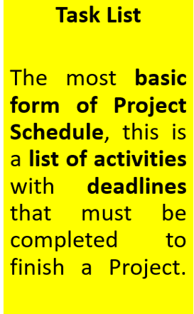
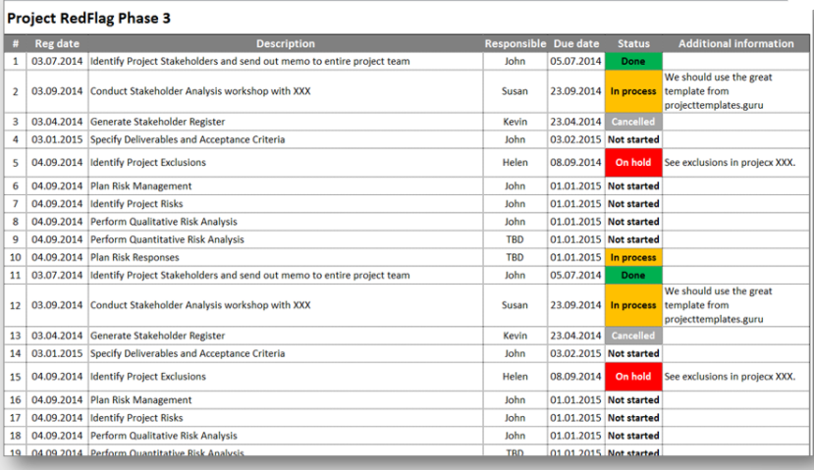
Project scheduling tools and techniques
.

Slide 14
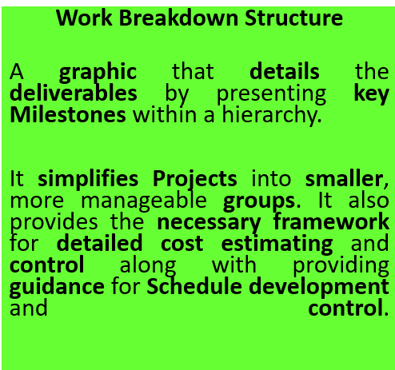
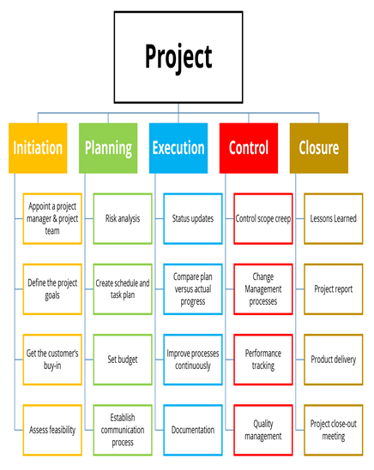
Project scheduling tools and techniques
.

Slide 15
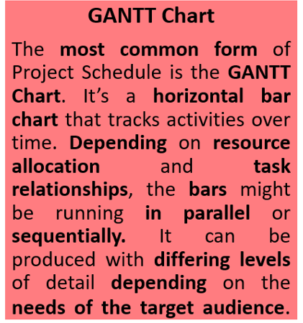
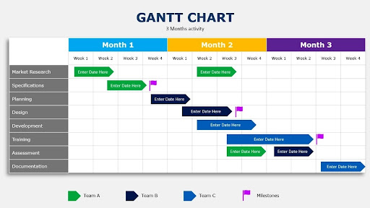
Project scheduling tools and techniques
.

Slide 16
Getting started with your Project Schedule
.

Slide 17
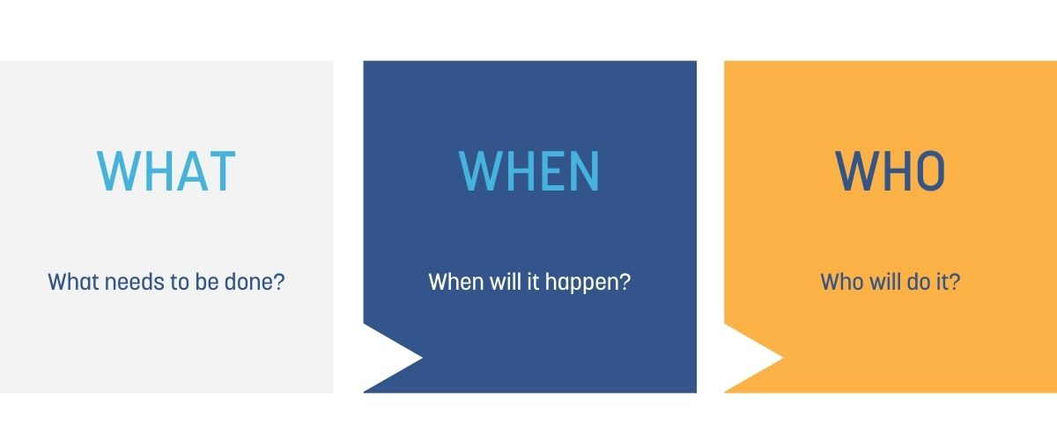
Getting started with your Project Schedule
Scheduling is part of the planning process.
When you are first planning your project, ask yourself these three key questions.
.

Slide 18
Getting started with your Project Schedule
Steps to effectively schedule your projects are to:
Confirm the project activities: make sure they cover your Project Scope
Sequence activities: determine which order the tasks need to be completed
Determine dependencies: identify tasks that rely on each other
Determine durations: accurately estimate how long each task will take
Establish milestones: set the key dates that need to be met
Allocate resources: internal staff, contractors, tools, and workspaces
Assess Risks: and decide how it will be dealt with in your schedule
Monitor and control: decide how you will monitor, control and report on any changes to the schedule.
.

Slide 19
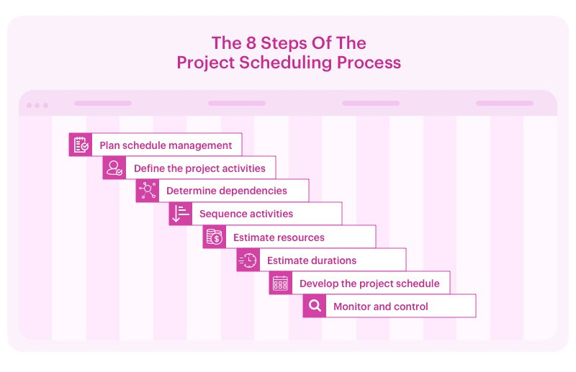

Slide 20
2) Project Budget
.

Slide 21
Project Budget
A Project Budget is a plan that includes every detail on how much money will be spent on a project, its needs and resources, for what, by whom, and when.
It’s a dynamic document, continuously monitored, reviewed, and updated throughout the project.
.

Slide 22
The components of a Project Budge
.

Slide 23
The components of a Project Budget
Project Budgets contain all the costs associated with the project.
It generally includes:
  Labor costs: employee wages, benefits, payroll taxes, and overheads.
  Material procurement costs: goods, services, equipment, and supplies needed for the project that come from external providers.
  Resources cost per quantity;
  Expenses (food, travel, supplies);
  A fund for emergencies;
  Cash flows.
.

Slide 24
Under each of these categories, the costs can usually be separated into two broad categories:
Fixed costs: these are set for the project and will not change. For example, Rent, advertising, and administrative costs.
Variable costs: these change based on activity. For example, if you have a subcontractor working by the hour on your project and it goes over time, the cost goes up. Variable costs need the most monitoring.
.

Slide 25
The purpose of a project budget
.

Slide 26
The purpose of a project budget
The Project Budget is designed to:
Aid in the decision-making process. This could be deciding whether the project goes ahead or choosing how much to invest in different activities within the project.
Communicate to stakeholders how much money is needed and when it’s needed.
Give the project manager a baseline to help them work out if the project is spending along its desired path.
.

Slide 27
The benefits of effective project budgeting
.

Slide 28
The benefits of effective project budgeting
Helps to ensure the project is completed within the constraints of the available financial resources;
Helps to identify and manage risk associated with the project’s finance;
Facilitates the communication between the project manager, team members, and stakeholders;
Helps to make better decisions;
Allows better monitoring and control of the project’s financial performance.
.

Slide 29
Steps for successful project budget
.

Slide 30
Steps for successful project budget
Refer to your Project Scope : the Project Scope contains the goals, deliverables, tasks, and deadlines for the project.
Define the Resources you need: list all the people and items that you need to complete the project within deadlines.
Understand the Resource Rate: people who will be working on the project will work at a specific rate, with more experienced people costing more, but often able to complete tasks faster and to a higher standard. Materials for the project get charged at a rate too
.

Slide 31
Steps for successful project budget
4- Estimate risk and out of scope work
5- Establish a contingency fund: Having an emergency fund means there’s a reserve for when costs increase.
6- Build the Budget: compile the estimates into your project management software or budget template.
7- Obtain approval: When you’re presenting your budget to management or stakeholders, you want it to be right. You’ll also need to be able to confidently justify the thinking behind the numbers.
.

Slide 32
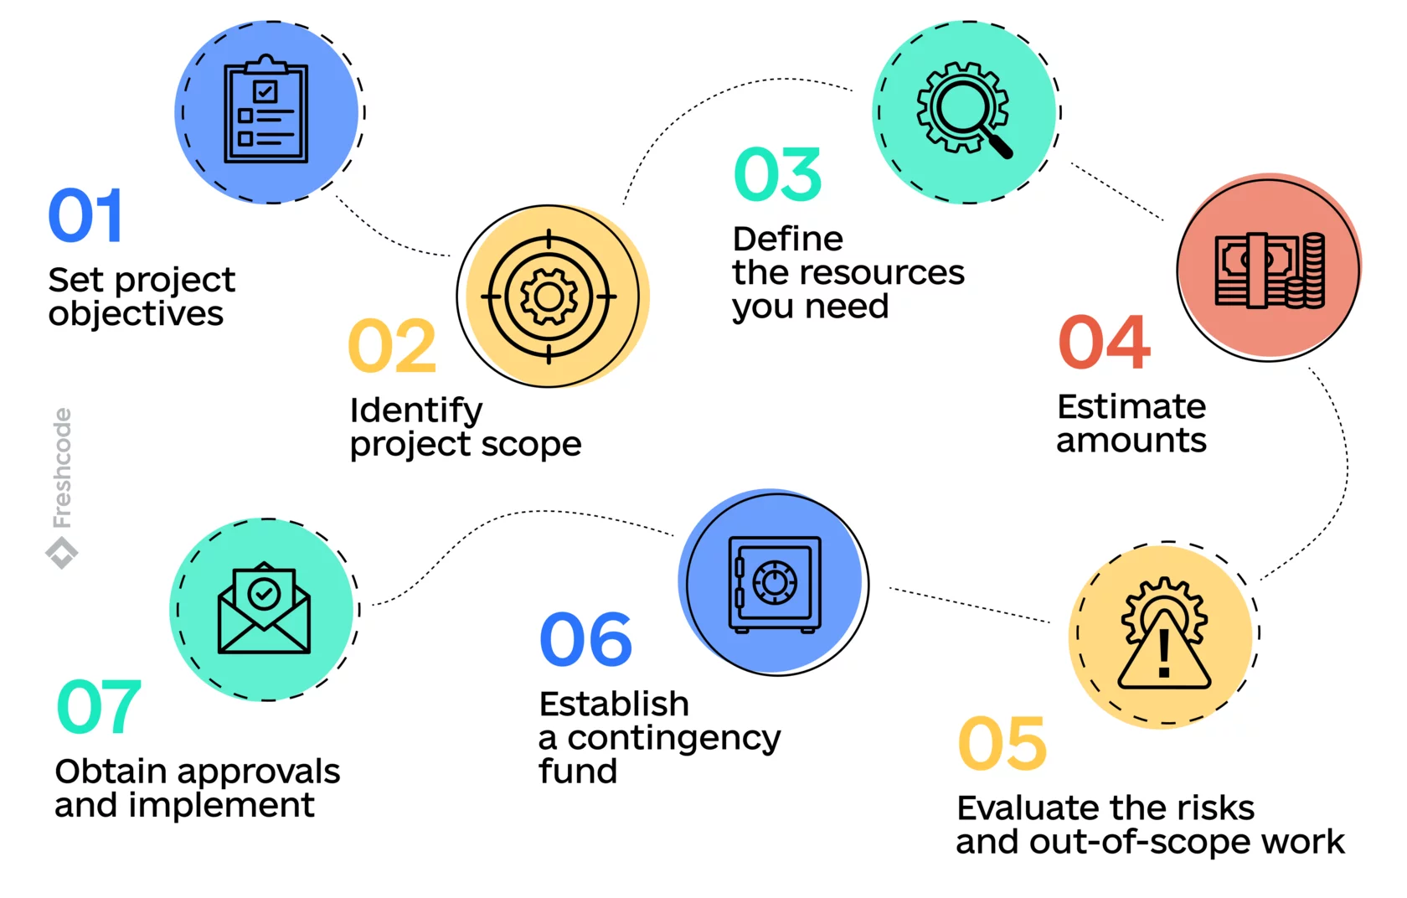
.

Slide 33
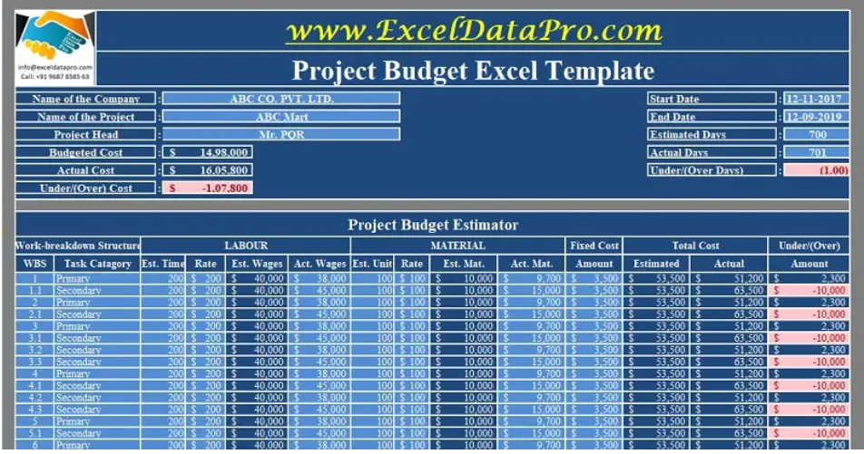

Slide 34


Slide 35
Summary
The Project Schedule
Definition
Types
Benefits
Tools, and techniques
Steps
.

Slide 36
Summary
Project Budget
Definition
Components
Purpose
Benefits
Steps
.

Slide 37

.

Slide 38
Questions
Which of the following types of Projects Schedule? All answers are correct. Master Project Schedule Milestone Project Schedule Detailed Project Schedule
A list of activities with deadlines is--------- Task list Work Breakdown structure GANTT Chart All answers are incorrect
.

Slide 39
Questions
A graphic that details the deliverables by presenting key milestones within a hierarchy Work Breakdown structure Task list GANTT Chart All answers are incorrect
The most common form of project schedule is ------- The GANTT Chart Work Breakdown structure Task list All answers are incorrect
.

Slide 40
Questions
----------is a plan that includes every detail on how much money will be spent on a project. Project Budget Project Schedule Project Risk Project Management
Rent is--------- Fixed cost Variable cost Marginal cost Total cost
.

Slide 41
Questions
---------- contains the goals, deliverables, tasks, and deadlines for the project Project Scope Resources you need. the Resource Rate Approval
In which of the following project phases is the project schedule developed? Planning Conceptual Implementation Design
.

Slide 42
Questions
------------is a summary level schedule that highlights the key tasks and their estimated duration. Master Project Schedule Milestone Project Schedule Detailed Project Schedule All answers are correct.
------is a great for reporting status and helping teams see their progress at a glance. Milestone Project Schedule Master Project Schedule Detailed Project Schedule All answers are correct.
.

Slide 43
Questions
----------is more operational level schedule that tracks every project activity Detailed Project Schedule Milestone Project Schedule Master Project Schedule All answers are correct.
Which of the following is/are purpose of a project budget? All answers are correct. Aid in the decision-making process Communicate to stakeholders how much money is needed. Give the project manager a baseline to help them work out if the project is spending along its desired path.
.

Slide 44
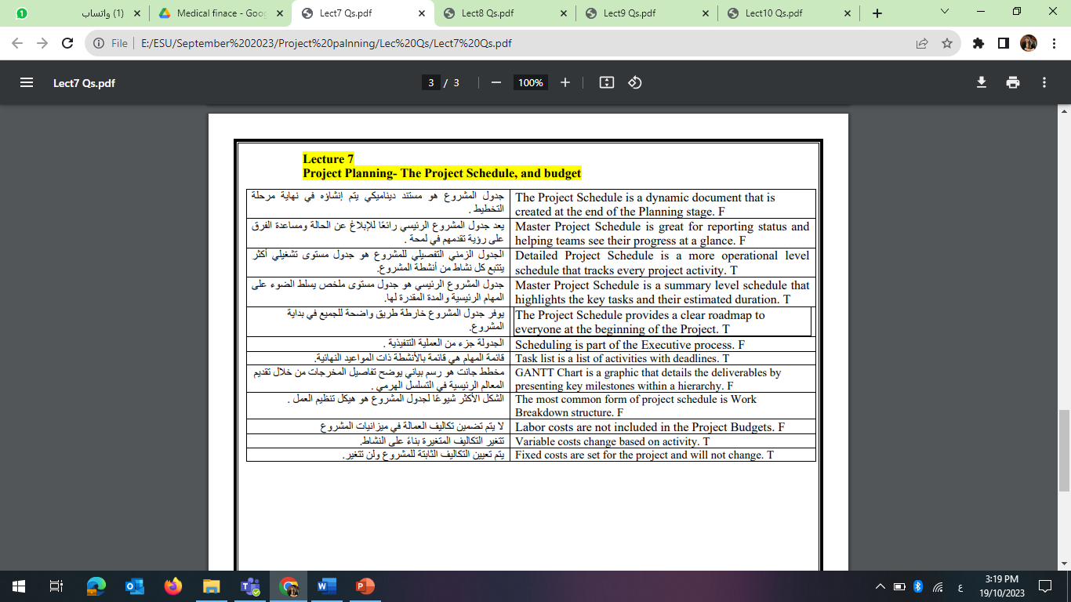
Questions
www.midocean.ae

Slide 45


Thank You

