Slide 1
Risk Management

Slide 2
How risk averse are you?
Risk averse people:
  I like being dependable and I’m usually punctual.
  I am not likely to take chances.
  I am responsible and prefer to work efficiently.
  I am more service oriented than self oriented.
  I value institutions and observe traditions
Risk seeking people:
  I like action, and I act impulsively at times.
  I seek excitement for the thrill of the experience.
  I am resourceful and prefer not to plan or prepare.
  I am more self oriented than service oriented.
  I like to anticipate another person’s position.
Risk neutral people:
  I trust my intuition, and I am comfortable with unknown.
  I think about the future and have long-range objectives.
  I am naturally curious and often ask, “Why?”
  I enjoy generating new ideas.
  I work best when I am inspired.

Slide 3
Black Swans
They are unpredictable or unforeseen event, typically one with extreme consequences.
Risk is an uncertain event or condition that, if it occurs, has a positive or negative effect on project objectives.
While risks can have positive consequences such as unexpected price reduction in materials, the focus of this chapter is on what can go wrong (negative) and the risk management process.

Slide 4
Risk definition
  “Not all risks are bad: Risks can present opportunities as well as threats to a project.
Risk originates in the uncertainty associated with any project – remember, projects are unique
Project Risks
  What can go wrong?
  What is the likelihood?
  What will the damage be?
  What can we do about it?

Slide 5
How to Categorize Risk
Risks: known, unknown, unknowable
Known Risks: Risks that can be uncovered after careful evaluation of the project plan, business and technical environment, and other reliable sources of information (I.e. unrealistic delivery dates, lack of user input, etc.)
  Refer to those risks that can be estimated from historical information
  Can be mitigated by management techniques and through response plans, should they occur
  Example: Potential delay in delivery from third-party vendor

Slide 6
How to Categorize Risk
Predictable Risks [but unknown risks]: Risks that can be extrapolated from past projects. (Staff turnover, poor communication with the customer)
  Refer to those risks that we know have a probability of occurring, but do not know the precise impact
  Cannot be managed directly but can be mitigated by the use of contingency
  Example: Loss of key personnel due to turnover
Unpredictable Risks
“Joker” risks that are hard to predict.
Unknowable risks
  Refer to those risks that are outside the scope of historical or probabilistic models for the project
  Are beyond the scope of risk management and usually are addressed by crisis or disaster management
  Examples: Corporate failures, natural disasters, acts of terrorism or war, major snowstorm and power loss

Slide 7
Risk Management Process
The cost impact of a risk event in the project is less if the event occurs earlier rather than later. The early stages of the project represent the period when the opportunity for minimizing the impact or working around a potential risk exists. Conversely, as the project passes the halfway implementation mark, the cost of a risk event occurring increases rapidly.

Slide 8
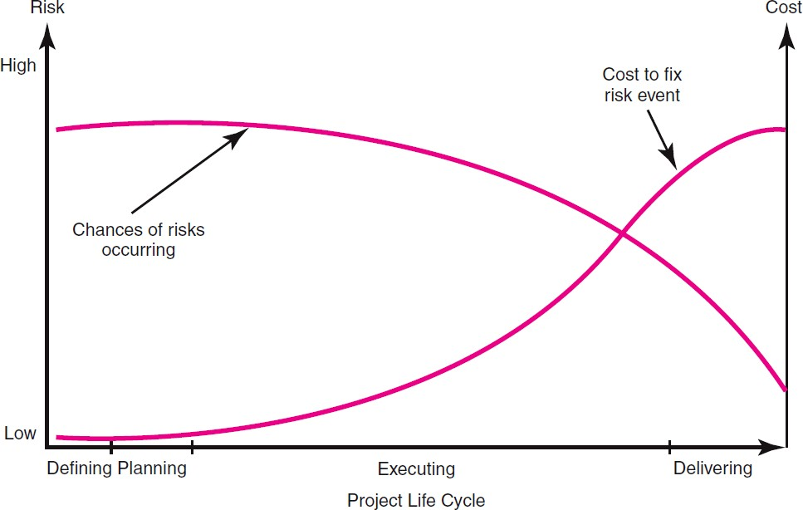
Risk Management Process
For example, the risk event of a design flaw occurring after a prototype has been made has a greater cost or time impact than if the event occurred in the start-up phase of the project. Clearly, identifying project risk events and deciding a response before the project begins is a more prudent approach than not attempting to manage risk.
Figure 7.1: Risk event graph

