Slide 1

Operating Systems
Prepared by Dr. Alaa Mohamed
Module 6
File Systems

Slide 2

Module
06
Memory Management
Objectives:
  File organisation and Access
  File Directories
  File Sharing
  Record Blocking
  Secondary Storage Management

Slide 3
Module
06
Files
Files are the central element to most applications
The File System is one of the most important part of the OS to a user
Desirable properties of files:
  Long-term existence
  Sharable between processes
  Structure
File management system consists of system utility programs that run as privileged applications
Concerned with secondary storage

Slide 4
Module
06
Typical Operations
File systems also provide functions which can be performed on files, typically:
  Create: A new file is defined and positioned within the structure of files.
  Delete: A file is removed from the file structure and destroyed.
  Open: An existing file is declared to be “opened” by a process, allowing the process to perform functions on the file.
  Close: The file is closed with respect to a process, so that the process no longer may perform functions on the file, until the process opens the file again.
  Read: A process reads all or a portion of the data in a file.
  Write: A process updates a file, either by adding new data that expands the size of the file or by changing the values of existing data items in the file.

Slide 5
Module
06
File Management Systems
A file management system is the set of system software that provides services to users and applications in the use of files.
  Typically, the only way that a user or application may access files is through the file management system.
Programmer does not need to develop file management software

Slide 6
Module
06
Objectives for a File Management System
Meet the data management needs of the user
Guarantee that the data in the file are valid
Optimize performance
Provide I/O support for a variety of storage device types
Minimize lost or destroyed data
Provide a standardized set of I/O interface routines to user processes
Provide I/O support for multiple users (if needed

Slide 7
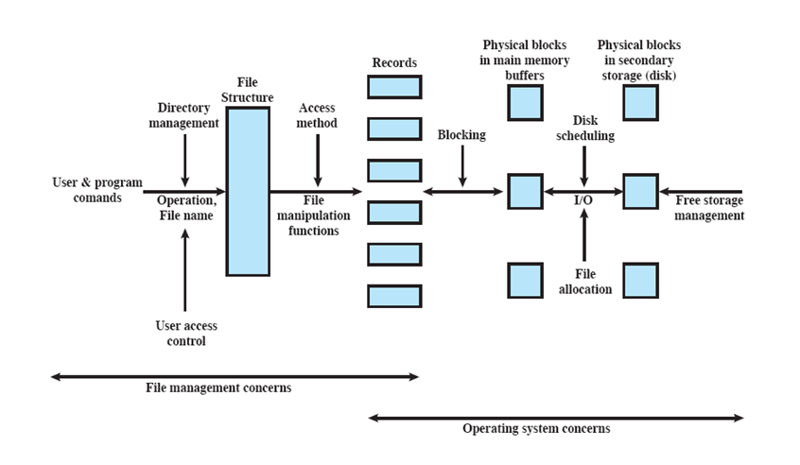
Module
06
Elements of File management systems

Slide 8
Module
06
Elements of File management systems
Before performing any operation, the file system must identify and locate the selected file.
  This requires the use of some sort of directory that serves to describe the location of all files, plus their attributes.
  In addition, most shared systems enforce user access control
The basic operations that a user or application may perform on a file are performed at the record level.
  The user or application views the file as having some structure that organizes the records, such as a sequential structure

Slide 9
Module
06
Elements of File management systems
The secondary storage must be managed.
  This involves allocating files to free blocks on secondary storage and managing free storage so as to know what blocks are available for new files and growth in existing files.
  In addition, individual block I/O requests must be scheduled
Disk scheduling and file allocation are both concerned with optimizing performance.
The optimization will depend on the structure of the files and the access patterns.

Slide 10
Module
06
File organization
File Management Referring to the logical structure of records
  Physical organization discussed later
Determined by the way in which files are accessed

Slide 11
Module
06
Criteria for File Organization
Important criteria include:
  Short access time
  Ease of update
  Economy of storage
  Simple maintenance
  Reliability
Priority will differ depending on the use (e.g. read-only CD vs Hard Drive)
  Some may even conflict

Slide 12
Module
06
File Organization Types
Many exist, but usually variations of:
  Pile
  Sequential file
  Indexed sequential file
  Indexed file
  Direct, or hashed, file

Slide 13
Module
06
Directories Contents
Contains information about files
  Attributes
  Location
  Ownership
Directory itself is a file owned by the operating system
Provides mapping between file names and the files themselves

Slide 14
Module
06
Directory Elements: Address Information
File Name
  Name as chosen by creator (user or program).
  Must be unique within a specific directory.
File type
File Organisation
  For systems that support different organizations

Slide 15
Module
06
Directory Elements: Address Information
Volume
  Indicates device on which file is stored
Starting Address
Size Used
  Current size of the file in bytes, words, or blocks
Size Allocated
  The maximum size of the file

Slide 16
Module
06
Directory Elements: Usage Information
Date Created
Identity of Creator
Date Last Read Access
Identity of Last Reader
Date Last Modified
Identity of Last Modifier
Date of Last Backup
Current Usage
  Current activity, locks, etc

Slide 17
Module
06
Simple Structure for a Directory
The method for storing the previous information varies widely between systems
Simplest is a list of entries, one for each file
  Sequential file with the name of the file serving as the key
  Provides no help in organizing the files
  Forces user to be careful not to use the same name for two different files

Slide 18
Module
06
Operations performed on a Directory
A directory system should support a number of operations including:
Search: When a user or application references a file, the directory must be searched to find the entry corresponding to that file.
Create file: When a new file is created, an entry must be added to the directory.

Slide 19
Module
06
Operations performed on a Directory
Delete file: When a file is deleted, an entry must be removed from the directory.
List directory: All or a portion of the directory may be requested. Generally, this request is made by a user and results in a listing of all files owned by that user, plus some of the attributes of each file
Update directory: Because some file attributes are stored in the directory, a change in one of these attributes requires a change in the corresponding directory entry.

Slide 20
Module
06
Two-Level Scheme for a Directory
One directory for each user and a master directory
  Master directory contains entry for each user
  Provides address and access control information
Each user directory is a simple list of files for that user
  Does not provide structure for collections of files

Slide 21
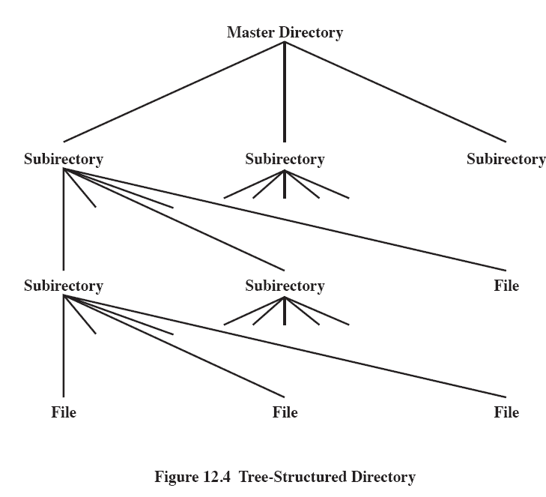
Module
06
Hierarchical, or Tree-Structured Directory
Master directory with user directories underneath it
Each user directory may have subdirectories and files as entries

Slide 22
Module
06
Naming
Users need to be able to refer to a file by name
  Files need to be named uniquely, but users may not be aware of all filenames on a system
The tree structure allows users to find a file by following the directory path
  Duplicate filenames are possible if they have different pathnames

Slide 23
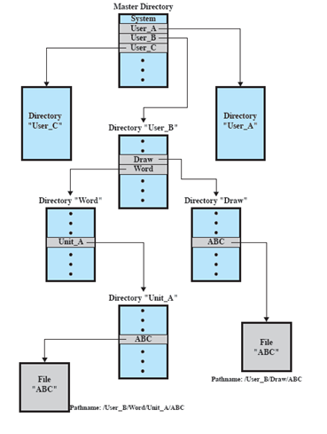
Example of
Tree-Structured Directory

Slide 24
Module
06
File Sharing
In multiuser system, allow files to be shared among users
Two issues
  Access rights
  Management of simultaneous access

Slide 25
Module
06
Access Rights
A wide variety of access rights have been used by various systems
  often as a hierarchy where one right implies previous
None
  User may not even know of the files existence
Knowledge
  User can only determine that the file exists and who its owner is

Slide 26
Module
06
Access Rights Cont…
Execution
  The user can load and execute a program but cannot copy it
Reading
  The user can read the file for any purpose, including copying and execution
Appending
  The user can add data to the file but cannot modify or delete any of the file’s contents

Slide 27
Module
06
Access Rights Cont…
Updating
  The user can modify, delete, and add to the file’s data.
Changing protection
  User can change access rights granted to other users
Deletion
  User can delete the file

Slide 28
Module
06
User Classes
Owner
  Usually the files creator, usually has full rights
Specific Users
  Rights may be explicitly granted to specific users
User Groups
  A set of users identified as a group
All
  everyone

Slide 29
Module
06
Simultaneous Access
User may lock entire file when it is to be updated
User may lock the individual records during the update
Mutual exclusion and deadlock are issues for shared access

Slide 30
Module
06
Blocks and Records
Records are the logical unit of access of a structured file
  But blocks are the unit for I/O with secondary storage
Three approaches are common
  Fixed length blocking
  Variable length spanned blocking
  Variable-length unspanned blocking

Slide 31
Module
06
Fixed Blockings
Fixed-length records are used, and an integral number of records are stored in a block.
Unused space at the end of a block is internal fragmentation

Slide 32
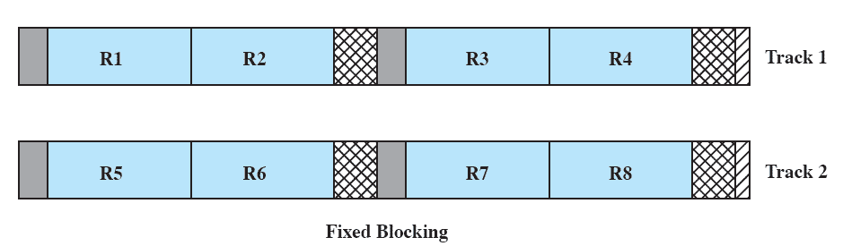
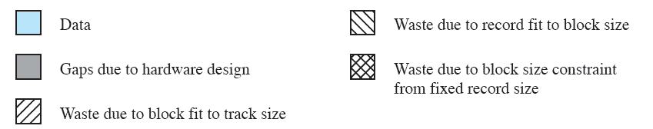
Module
06
Fixed Blockings

Slide 33
Module
06
Variable length Spanned Blocking
Variable-length records are used and are packed into blocks with no unused space.
Some records may span multiple blocks
  Continuation is indicated by a pointer to the successor block

Slide 34
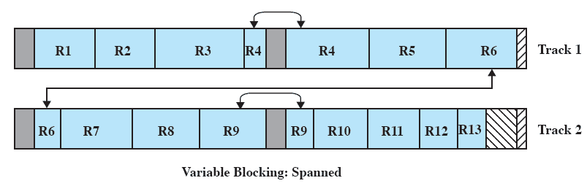
Module
06
Variable Blocking: Spannedg

Slide 35
Module
06
Variable-length unspanned blocking
Uses variable length records without spanning
Wasted space in most blocks because of the inability to use the remainder of a block if the next record is larger than the remaining unused space.

Slide 36
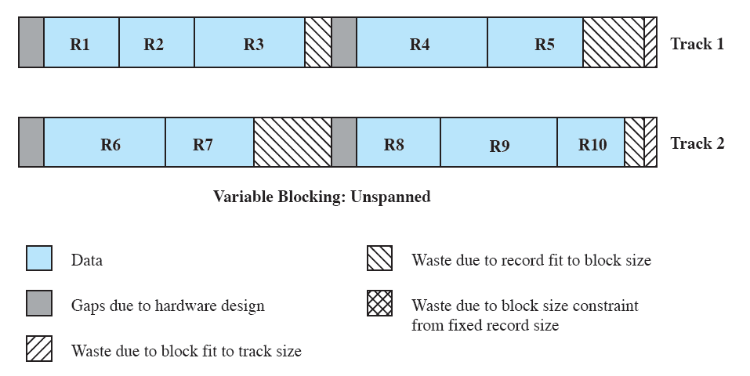
Module
06
Variable Blocking: Unspanned

Slide 37
Module
06
Secondary Storage Managment
The Operating System is responsible for allocating blocks to files
Two related issues
  Space must be allocated to files
  Must keep track of the space available for allocation

Slide 38
Module
06
File Allocation eissues
When a file is created – is the maximum space allocated at once?
Space is added to a file in contiguous ‘portions’
  What size should be the ‘portion’?
What data structure should be used to keep track of the file portions?

Slide 39
Module
06
Preallocation vs Dynamic Allocation
Need the maximum size for the file at the time of creation
Difficult to reliably estimate the maximum potential size of the file
Tend to overestimated file size so as not to run out of space

Slide 40
Module
06
Portion size
Two extremes:
  Portion large enough to hold entire file is allocated
  Allocate space one block at a time
Trade-off between efficiency from the point of view of a single file, or the overall system efficiency

Slide 41
Module
06
File Allocation Method
Three methods are in common use:
  contiguous,
  chained, and
  indexed.

Slide 42
Module
06
Contiguous Allocation
Single set of blocks is allocated to a file at the time of creation
Only a single entry in the file allocation table
  Starting block and length of the file
External fragmentation will occur
  Need to perform compaction
Notes:
A single contiguous set of blocks is allocated to a file at the time of file creation
This is a preallocation strategy, using variable-size portions.
The file allocation table needs just a single entry for each file, showing the starting block and the length of the file.
Contiguous allocation is the best from the point of view of the individual sequential file.
Multiple blocks can be read in at a time to improve I/O performance for sequential processing.
It is also easy to retrieve a single block.

Slide 43
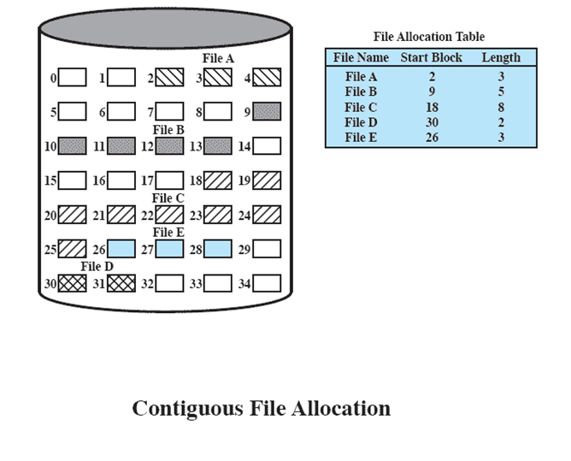
Module
06
External fragmentation

Slide 44
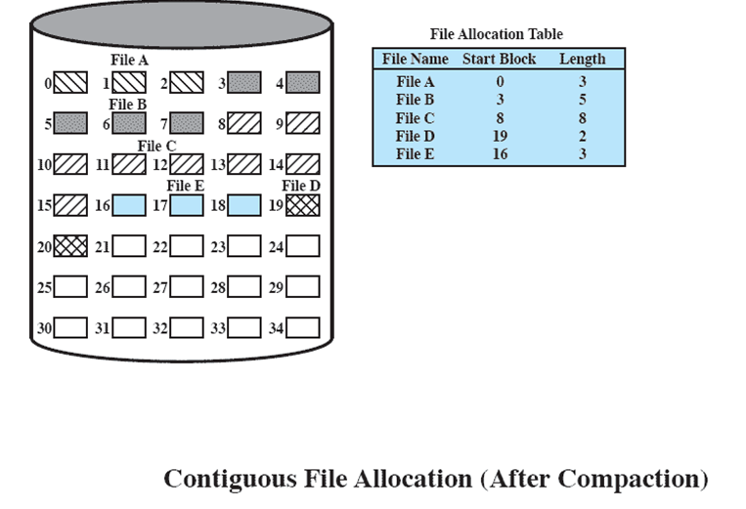
Module
06
Files

Slide 45
Module
06
Chained Allocation
Allocation on basis of individual block
Each block contains a pointer to the next block in the chain
Only single entry in the file allocation table
  Starting block and length of file
No external fragmentation
Best for sequential files

Slide 46
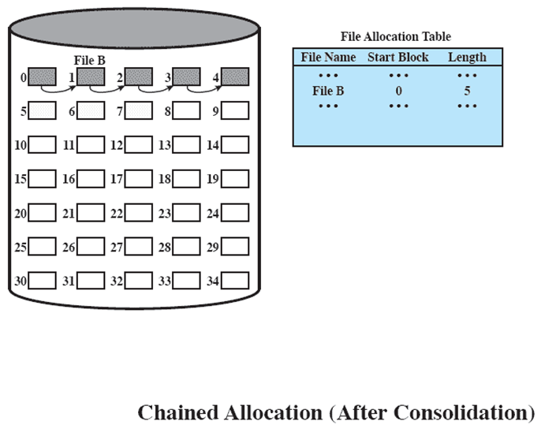
Module
06
Chained Allocation

Slide 47
Module
06
Indexed Allocation
File allocation table contains a separate one-level index for each file
The index has one entry for each portion allocated to the file
The file allocation table contains block number for the index

Slide 48
Module
06
Indexed Allocation Method
Allocation may be either
  Fixed size blocks or
  Variable sized blocks
Allocating by blocks eliminates external fragmentation
Variable sized blocks improves locality
Both cases require occasional consolidation

Slide 49
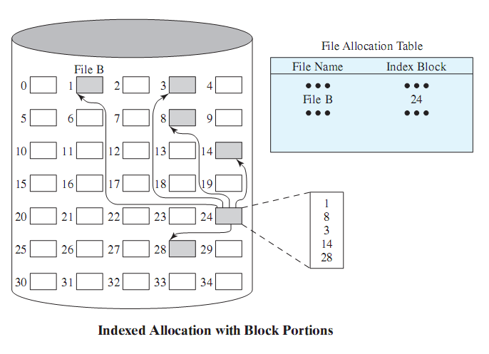
Module
06
Indexed Allocation Method

Slide 50
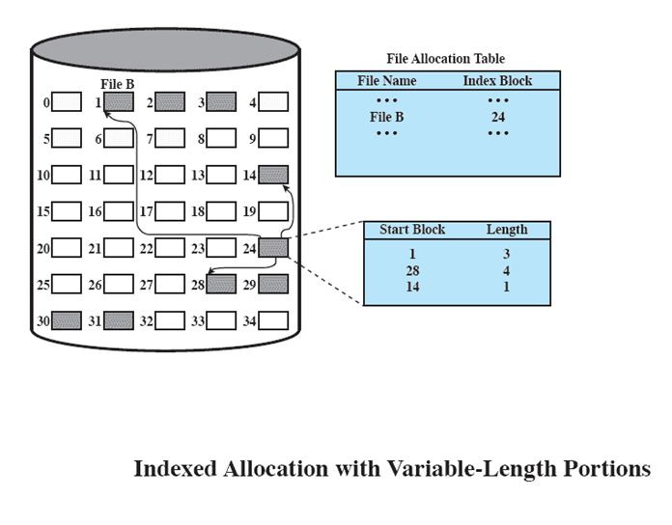
Module
06
Indexed allocation with Block Portions
Indexed Allocation with Variable Length Portionns

Slide 51
Module
06
End of Module 6

