Slide 1


College of Management
Project Communications
Instructure: Dr. Raef Baraka
PMG 112
Lecture 02

Slide 2

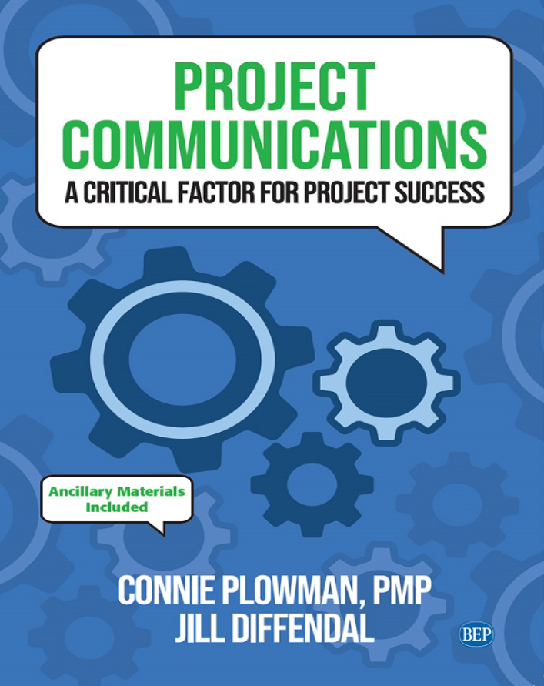
Reference Book:
Ch1: Introduction.
Ch2: Exploring Communication Theories.
Ch3: Knowing Your Audience.
Ch4: Starting with the Basics.
Ch5: Planning Project Communications.
Ch6: Managing and Monitoring Project Communications.
Ch7: Using Project Communication Tools.
Ch8: Communicating Change.
Ch9: Managing Conflict through Communication.
Ch10: Closing.

Slide 3
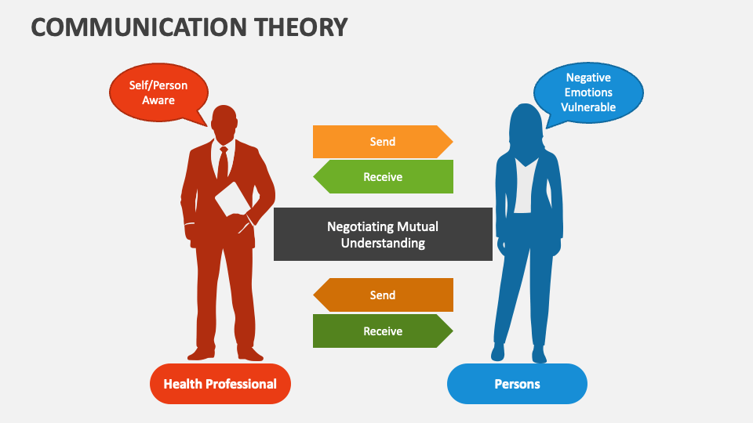
The purpose of this chapter is to help you:
Understand why people communicate by looking at two different communication theories that focus on communication as a way people handle uncertainty.
Evaluate the impact of the quality as well as the quantity of communication in a project.
See the connection between effective communication and stakeholder trust.
Chapter 2: Exploring Communication Theories
Dr. Raef Baraka

Slide 4

Exploring Communication Theories
Communication and Uncertainty
Most project managers and team members will already be familiar with the
term uncertainty; typically, however, it is associated with risk management.

Slide 5
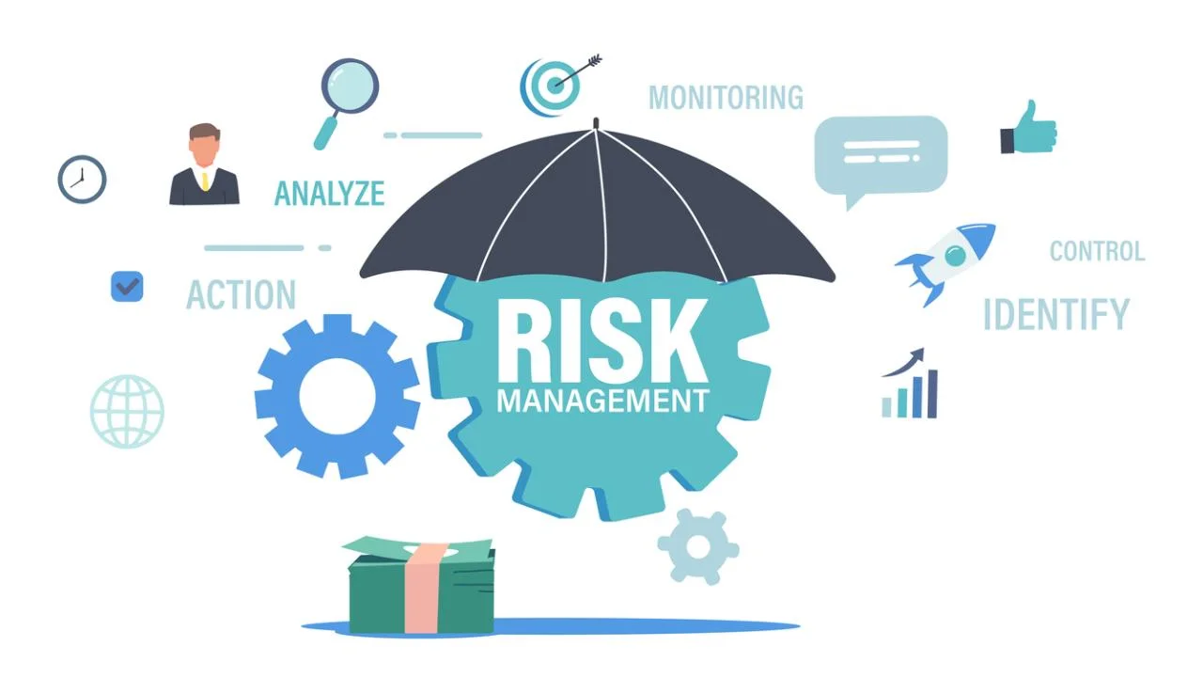
Exploring Communication Theories
Uncertainty, Risks and Communication
Risks are uncertain events or conditions that can affect projects positively or negatively. The process of risk management is oriented toward identifying and managing these uncertainties so that they do not interfere with the accomplishment of project objectives.
In the field of communication, however, uncertainty is a cognitive and emotional state that motivates people’s actions (or inactions) and behaviors.
Dr. Raef Baraka

Slide 6

Exploring Communication Theories
Uncertainty, Risks and Communication
In both the communication world and the project world, uncertainty is about not knowing what will happen.
In a project, uncertainty affects the project itself—it could positively or negatively impact processes or outcomes of the project. Project uncertainty is evaluated by how far the project could deviate from the plan.
Dr. Raef Baraka

Slide 7
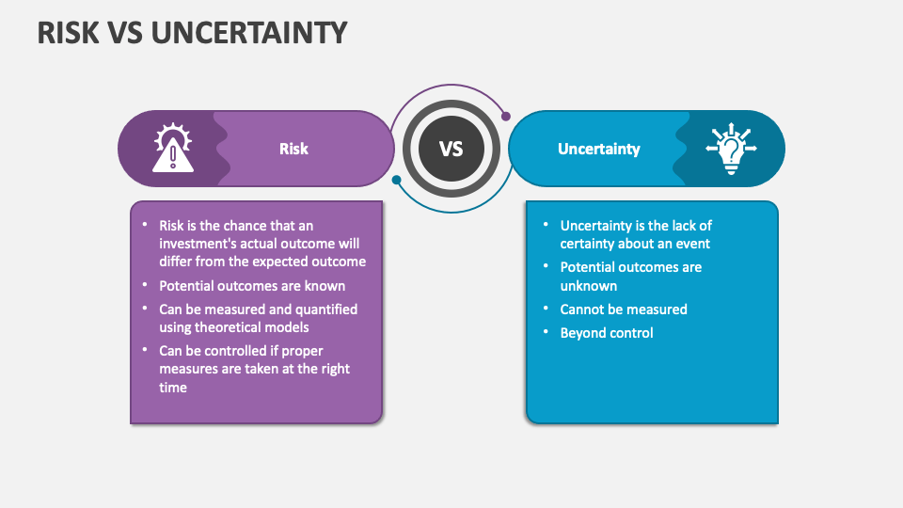
Exploring Communication Theories
Uncertainty, Risks and Communication
It is addressed or managed by considering the likelihood and potential impact of the uncertain condition, and by planning for different strategies and alternatives should the uncertain condition occur.
When it comes to communication theory, uncertainty affects the person rather than the project. An individual evaluates uncertainty based on the perception of how it will affect him or her.
Dr. Raef Baraka

Slide 8
Exploring Communication Theories
Uncertainty, Risks and Communication
Just as project teams use risk management techniques to address the uncertainties in a project, individuals use communication to address the uncertainties in their lives.
The project team attempts to address many of the uncertainties about the project (for example, estimating cost, schedule, scope, and regulatory or environmental impacts) through project planning and risk identification activities.
Dr. Raef Baraka

Slide 9
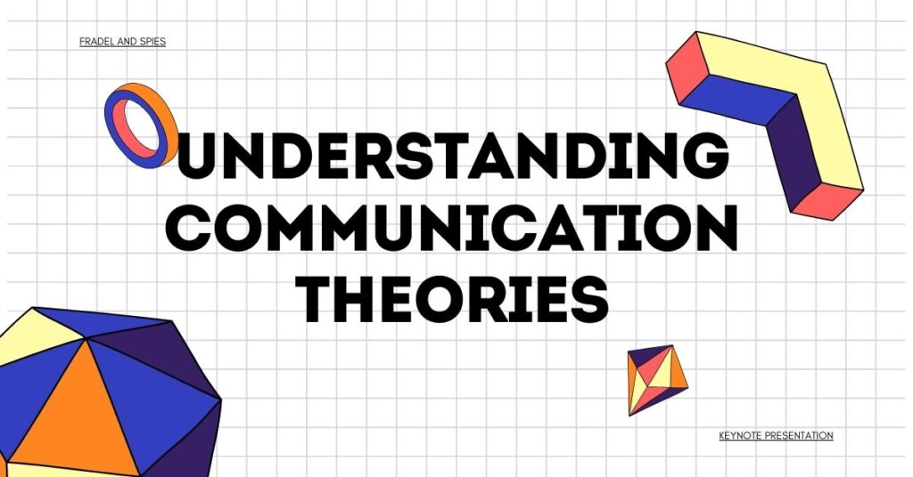
Exploring Communication Theories
Communication theories
Two communication theories that specifically focus on uncertainty, and how
people use communication to manage it: uncertainty reduction theory and
uncertainty management theory.

Slide 10
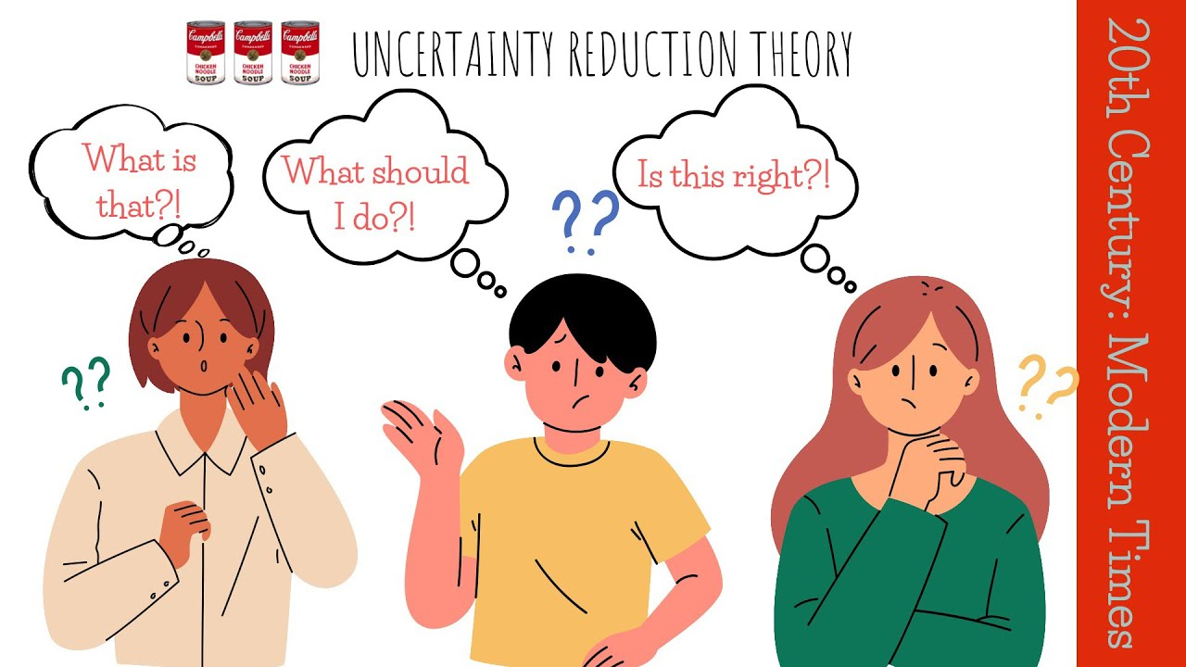
Exploring Communication Theories
1. Uncertainty Reduction Theory
Uncertainty Reduction Theory the older and more well-known of the two theories we will review, defines uncertainty as “having a number of possible alternative predictions or explanations.
This theory presumes that people always try to reduce or make sense of uncertainty from a cognitive, information-based perspective.
Information acquisition, including communication, is the primary means by which people deal with uncertainty.
Dr. Raef Baraka

Slide 11
Exploring Communication Theories
1. Uncertainty Reduction Theory
Two of the main principles of URT can help us understand how uncertainty motivates people to communicate in the context of a project.
The first of these principle states that, “Efforts to reduce uncertainty are linked to the likelihood of future interactions and reward potential of the other person.
The second principle of URT we will review here explains that people reduce uncertainty through knowledge acquisition.
Dr. Raef Baraka

Slide 12
Exploring Communication Theories
1. Uncertainty Reduction Theory
Three main strategies people use to do this:
Passive: Observing other people without actually interacting with them.
Active: Using indirect methods to collect information about the other person (e.g., conducting an internet search, or asking others about them).
Interactive: Seeking information through direct contact with the person (a face-to-face conversation, phone call, e-mail, etc.).
Dr. Raef Baraka

Slide 13
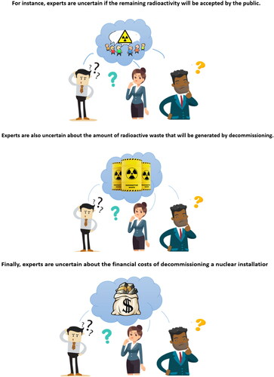
Exploring Communication Theories
2. Uncertainty Management Theory
Uncertainty Management Theory was developed a few decades later. It builds on the work of URT but broadens the impact of uncertainty beyond the cognitive realm to the emotional realm.
This addition of the emotional aspect helps explain why, in practice, people do not always attempt to reduce uncertainty.
Dr. Raef Baraka

Slide 14
Exploring Communication Theories
2. Uncertainty Management Theory
UMT states that “uncertainty exists when details of situations are ambiguous, complex, unpredictable, or probabilistic; when information is unavailable or inconsistent; and when people feel insecure in their own state of knowledge or the state of knowledge in general.
Dr. Raef Baraka

Slide 15
Exploring Communication Theories
2. Uncertainty Management Theory
UMT proposes that people react to uncertainty based on how they evaluate the relevance of the uncertainty to their lives, and how they react emotionally to the uncertainty, i.e., do they view it as a threat or as an opportunity?.
In a project, a stakeholder’s appraisal of and emotional reaction to uncertainty can help explain the communication actions they take (or do not take):
Dr. Raef Baraka

Slide 16
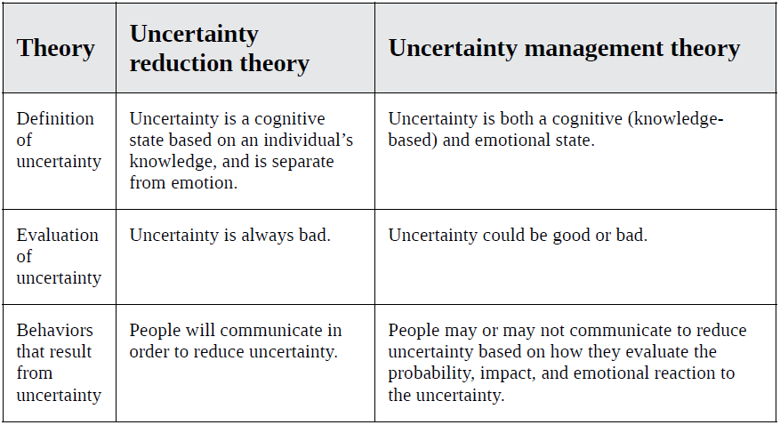
Exploring Communication Theories
Comparison of uncertainty reduction and uncertainty management theories
Dr. Raef Baraka

Slide 17
Exploring Communication Theories
Communication theories
The person subjectively experiences an emotional reaction to the uncertainty that is either positive, negative, or neutral. This is the primary way that UMT differs from URT.
A person reacts positively if the uncertainty could be beneficial, or if they tend toward optimism.
A person reacts negatively if they perceive danger, and may even panic if the reaction is extreme.
Neutral reactions, generally, occur if the person sees the uncertainty as irrelevant or inconsequential.
Dr. Raef Baraka

Slide 18
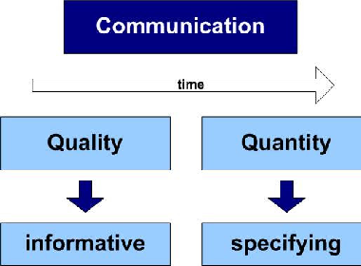
Exploring Communication Theories
Uncertainty and Effective Communication
As a project manager, how do you tackle these stakeholder uncertainties that can impact your project? Through communication! Specifically, by communicating enough (quantity) and by communicating well (quality).
Dr. Raef Baraka

Slide 19
Exploring Communication Theories
Quantity of Communication
People can’t act on, or react to, information they do not have. If information is a primary way to reduce or manage uncertainty, lack of communication limits stakeholders’ ability to make sense of the situation and make decisions about how to think, feel, and act.
Quantity of information doesn’t necessarily mean sending more e-mails —most workers already feel like their inboxes are flooded. But you do need to ensure information is available to people when and how they need it.
Dr. Raef Baraka

Slide 20
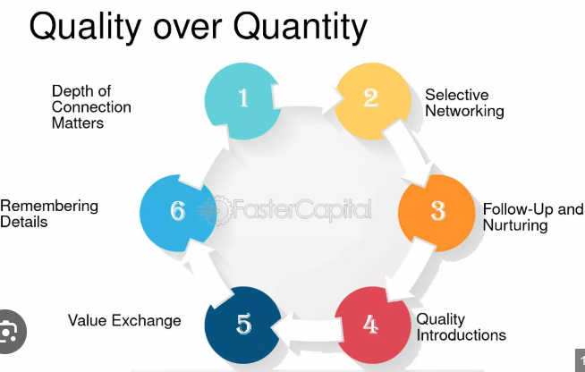
Exploring Communication Theories
Quantity of Communication
Dr. Raef Baraka

Slide 21
Exploring Communication Theories
Quantity of Communication
Another aspect to consider is that communication is not all verbal; in fact, much of it is not. A significant amount of meaning is communicated through physical cues (facial expressions and body language) and voice (tone, inflection, and other vocal cues outside of the words themselves).
This means that communications you are delivering through methods that use only text or voice will have reduced effectiveness.
Dr. Raef Baraka

Slide 22
Exploring Communication Theories
Quantity of Communication
Virtual teams especially can be impacted by this. When there is limited face-to-face interaction, even via methods such as video calls, teams can struggle to develop an effective approach to working together because the opportunities to reduce uncertainty are decreased.
If the vast majority of the team’s interactions are, in fact, virtual, the team will need to work harder to compensate for the lack of nonverbal communication.
Dr. Raef Baraka

Slide 23
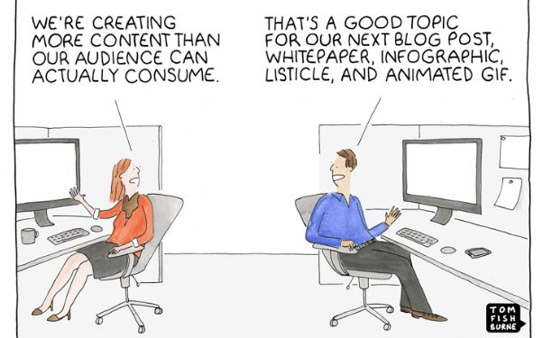
Exploring Communication Theories
Quantity of Communication
Dr. Raef Baraka

Slide 24
Exploring Communication Theories
Quality of Communication
High-quality communication gets your message across clearly and effectively.
Quality communication requires that the person sending the message must make sure that the message he or she wants to send is accurately received.
One way to do this is to be clear and specific about what you are communicating. If you need a task completed by 3 p.m. tomorrow, don’t just say “tomorrow afternoon.
Dr. Raef Baraka

Slide 25
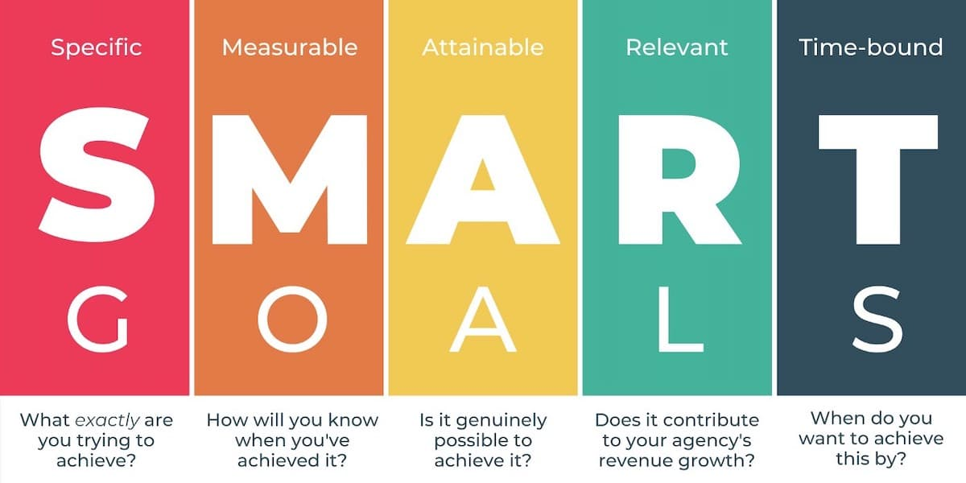
Exploring Communication Theories
Quality of Communication
When communicating an assignment or request, provide as much SMART information as you can.
Dr. Raef Baraka

Slide 26
Exploring Communication Theories
Quality of Communication
When communicating an assignment or request, provide as much SMART information as you can.
Specific: What is the scope of what needs to be done? Make sure the assignment is clearly defined.
Measurable: How will you determine completion/success? State any metrics or parameters for measuring and tracking progress.
Dr. Raef Baraka

Slide 27
Exploring Communication Theories
Quality of Communication
When communicating an assignment or request, provide as much SMART information as you can.
Attainable: Is what you are asking attainable in the parameters given? Ask for feedback on this from the team member(s) involved.
Relevant: Have you tied the task to the overall project goals? Ensure team members involved understand why this task is important.
Time-bound: What is the deadline for this task? Be as precise as you can.
Dr. Raef Baraka

Slide 28
Exploring Communication Theories
Quality of Communication
Another way to communicate clearly is to limit your use of vocabulary that is not universally understood, a.k.a. jargon.
A third way to ensure quality of communication is to seek feedback from the receiver to verify that they understood what you intended to communicate. You can consider feedback a means of quality assurance in your communications.
Dr. Raef Baraka

Slide 29

Exploring Communication Theories
Reducing Uncertainty Builds Trust
Uncertainty is closely tied to trust.

Slide 30

Exploring Communication Theories
Reducing Uncertainty Builds Trust
When you think about whether you trust someone, what factors do you consider?
Most people count honesty (presenting information accurately and truthfully) and reliability (doing what you say you will do) as major factors in trusting others. Both factors speak to the level of uncertainty you have about the other person’s words and resultant behaviors.
Dr. Raef Baraka

Slide 31
Exploring Communication Theories
Reducing Uncertainty Builds Trust
In a team environment like a project, trust is critical to success. Trust results in high-functioning teams that exhibit dedication to successful project outcomes and are often willing to take personal risks to advance common goals.
It also results in stakeholders that develop and maintain support for the project and the project team.
Dr. Raef Baraka

Slide 32

Exploring Communication Theories
Reducing Uncertainty Builds Trust
On the other hand, there are consequences when a team lacks trust.
It’s not just about reduced performance; it is a cycle that feeds itself. Just as good communication cultivates trust, lack of trust can lead to poor communication.
“In lack of trust, members may delay communication, or reduce quality of communication by giving insufficient knowledge and misinforming.
Dr. Raef Baraka

Slide 33
Exploring Communication Theories
Reducing Uncertainty Builds Trust
Stakeholders who do not trust the project team can withhold support and even delay or derail the project entirely.
Trust is “the most essential ingredient in effective communication. It’s the foundational principle that holds all relationships.
Dr. Raef Baraka

Slide 34
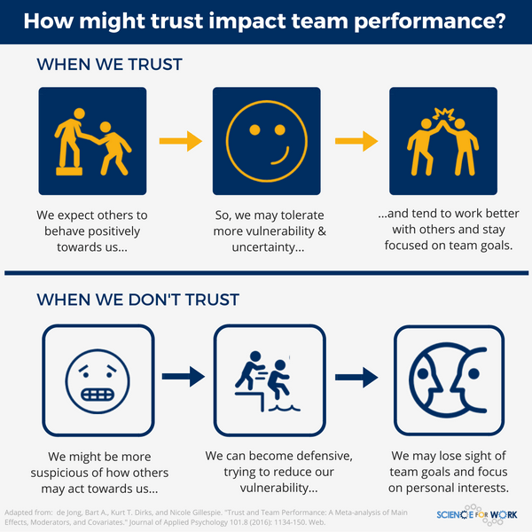
Exploring Communication Theories
Reducing Uncertainty Builds Trust
Dr. Raef Baraka

Slide 35
Exploring Communication Theories
Reducing Uncertainty Builds Trust
Dr. Raef Baraka

Slide 36
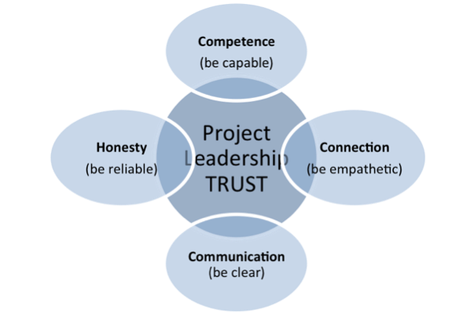
Exploring Communication Theories
Trust in project teams
Trust, at a project team level, involves communication, commitment, collaboration and competence – in other words, social interactions.
Communication with one another: should be consistent and meaningful so as to avoid miscommunication
Commitment to a team: helps teammates meet goals and able to rely on one another.
Dr. Raef Baraka

Slide 37
Exploring Communication Theories
Trust in project teams
Trust, at a project team level, involves communication, commitment, collaboration and competence – in other words, social interactions.
Collaboration: allows sharing of ideas and building stronger bonds through working with each other
Competence: in fulfilling roles and responsibilities, and completing assigned tasks
Dr. Raef Baraka

Slide 38
Exploring Communication Theories
Lecture Summary
Project communication starts by building on a solid foundation—an understanding through communication theory of why people communicate, and what happens when they communicate ineffectively.
Two communication theories that apply well to project communications are URT and UMT. These theories view uncertainty as a primary motivation to communicate (or not to communicate). People use communication as a tool to gain information that will reduce their uncertainty.

Slide 39
Exploring Communication Theories
Lecture Summary
Understanding uncertainty as a motivator can help project managers and stakeholders appreciate the value of communication as a means to manage uncertainty, and therefore manage the project.
Two ways to manage uncertainty are to ensure sufficient quantity and high quality of communications. These strategies for good communication can help build trust among project team members and outside stakeholders, which is a key factor in project success.

Slide 40



Thank You

