Slide 1


Creative and Scientific Thinking
Prepared by Prof. Shereen Taie
CRE252
Information Technology Department
Lecture 2

Slide 2




Creative and Scientific
Thinking
Lecture 2
CRE252
Information Technology Department
Prepared by
Prof. Shereen Taie
www.midocean.ae

Slide 3
Learning Objectives:
Describe the steps in Scientific method
Examples of the Scientific method steps
Thinking traps
Examples of thinking traps
How to get out of thinking traps
Practical tips to avoid thinking traps
What is intelligence
Types of thinking
Chapter
01
www.midocean.ae

Slide 4
Steps of Scientific Method
Chapter
01
www.midocean.ae

Slide 5
Steps of Scientific Method:
The seven steps of the scientific method:
1. Having a problem or question.
2. Gathering information to attempt to answer the question or solve the problem.
3. Propose a solution or answer to the problem or question. Performing a scientific hypothesis.
Chapter
01
www.midocean.ae

Slide 6
4. Testing the hypothesis by conducting an experiment . If the hypothesis fails the test, it must be rejected or modified.
5. Collect and analyze the results
6. Construct support or cast doubt on a scientific theory.
7. Communicating the results.
Chapter
01
www.midocean.ae

Slide 7
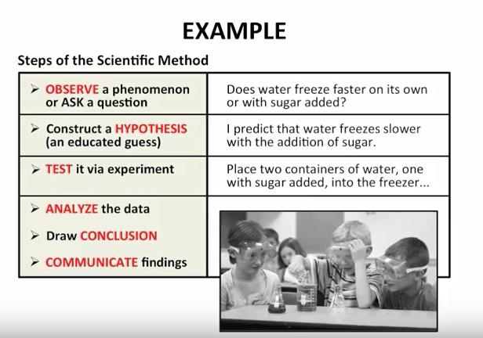
Scientific Method:
Chapter
01
www.midocean.ae

Slide 8
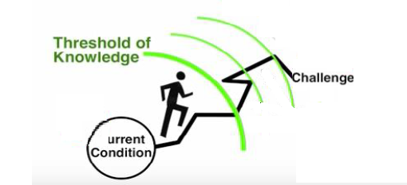
Experiment your way forward, instead of trying to decide your way forward
Chapter
01
www.midocean.ae

Slide 9
Examples
Chapter
01
www.midocean.ae

Slide 10
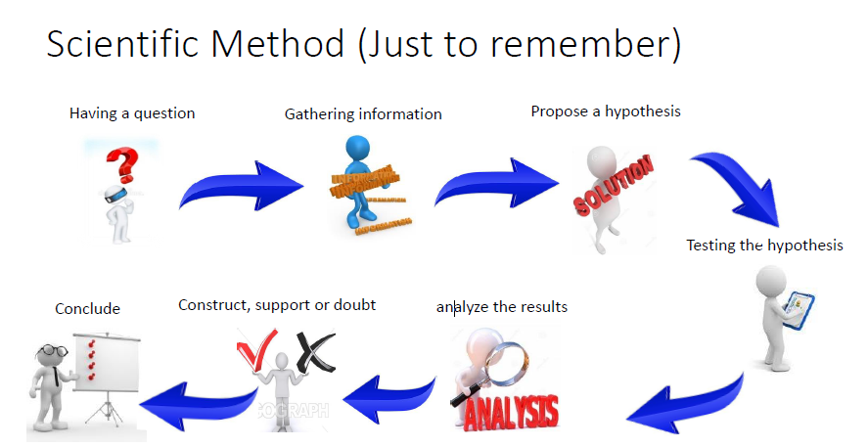
Chapter
01
www.midocean.ae

Slide 11
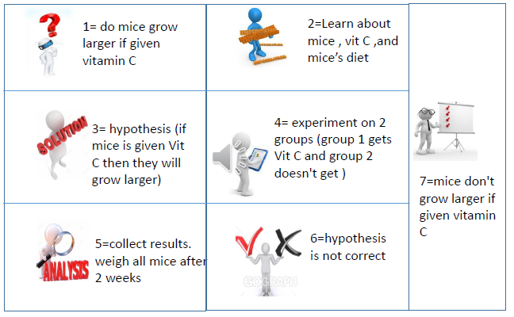
Chapter
01
www.midocean.ae

Slide 12
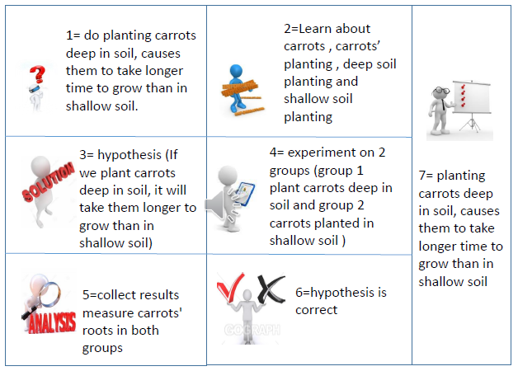
Chapter
01
www.midocean.ae

Slide 13
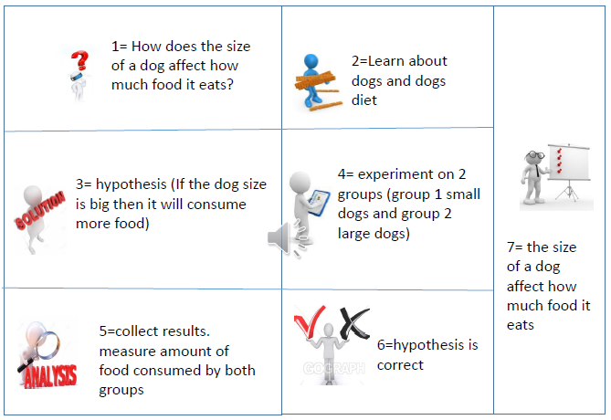
Chapter
01
www.midocean.ae

Slide 14
Thinking traps
Chapter
01
www.midocean.ae

Slide 15
Thinking traps definition :
"I can handle it"
"There is always a way".
• Thinking traps (فخ - مصيدة) are certain types or patterns of thoughts that tend to trap us in anxietyقلق .
• The first important step to overcome Thinking traps is to recognize your personal traps…..then start dealing with it.
Chapter
01
www.midocean.ae

Slide 16

Examples of thinking traps:
• First thinking trap: Being a perfectionist
• Second thinking trap: Self-delusion خداع الذات
Chapter
01
www.midocean.ae

Slide 17
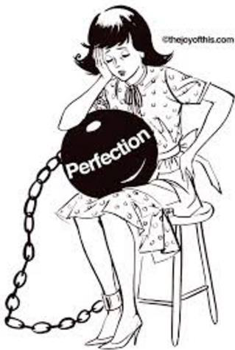
First thinking trap: Being a perfectionist
• If you don't allow yourself to make mistakes ,,, you aren't just putting your self under a lot of pressure BUT you won’t develop any further either.
• It's unrealistic and unattainable بعيد المنالto be perfect
• If you don't allow yourself to make mistakes; you can never develop any further either because, without mistakes, you can't learn.
Chapter
01
www.midocean.ae

Slide 18

How to get out of this thinking trap:
• The goal should be to see the positive in mistakes and to accept them as well as those of others.
• Mistakes are a learning experience and help you to progress.
• Instead of looking into the past with an
"Oh God, how could I have done that”
Chapter
01
www.midocean.ae

Slide 19
How to get out of this thinking trap:
• Think of the future and say to yourself:
"Okay, that went badly but I got an excellent experience
and next time I'll do it better".
• Remember nobody wants to be around someone perfect all the time.
Chapter
01
www.midocean.ae

Slide 20
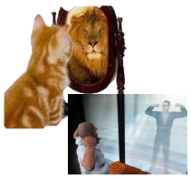
Second thinking trap: Self-delusion
Sometimes it's okay to indulge تنغمس a little, but it can become problematic when this prevents you from achieving your goals on the long term.
• Indulging and telling yourself things that distract يصرف الانتباهyou from what matters is obviously an ineffective approach.
Chapter
01
www.midocean.ae

Slide 21

How to get out of this thinking trap:
• In general, it's good to question yourself, to be critical, and to ask again and again about what is drawing you back.
•In that way, you can consider what to do about it.
Chapter
01
www.midocean.ae

Slide 22
How to get out of this thinking trap:
•It's better to intervene (involve) with yourself as soon as possible.
•Use Useful affirmations such as
"I can stand up for my own goals"
Chapter
01
www.midocean.ae

Slide 23
Practical tips to avoid thinking traps
Chapter
01
www.midocean.ae

Slide 24

You can challenge your own thinking traps by finding a "sparring partner" to support you in changing your behavior and to benefit from his experience and knowledge.
Chapter
01
www.midocean.ae

Slide 25

Thinking traps wouldn't be so awful if we were able to recognize them and out them immediately .
Chapter
01
www.midocean.ae

Slide 26

Think about a certain situation when you were facing a lot of challenges but you were able to overcome this situation and you were able to turn your failure into success–this is called an anchor ملاذ.
• Anchor is a great technique for those thoughts that resurface when you least expect.
Chapter
01
www.midocean.ae

Slide 27
Remember:
1. You don't adopt a new way of thinking overnight simply by flipping a switch.
2. It takes a lot of repetition to get rid of your old thinking patterns.
Chapter
01
www.midocean.ae
Notes:
Pursuit: السعي

Slide 28
Chapter 2
Additional Concepts related to Scientific Thinking
Chapter
02
www.midocean.ae

Slide 29

Chapter
02
What is Intelligence?
www.midocean.ae

Slide 30
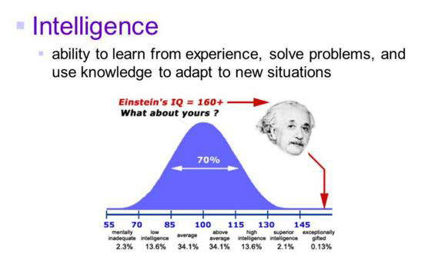
What is Intelligence?
Chapter
02
www.midocean.ae
Notes:
conscious control : التحكم في الإدراك

Slide 31
Types of thinking :
STRATEGIC THINKING
SCIENTIFIC THINKING
Chapter
02
www.midocean.ae

Slide 32

Strategic Thinking:
• Strategic thinking is simply an planned and rational thought process that focuses on the analysis of critical factors and variables that will influence the long-term success of a business, a team, or an individual.
Chapter
02
www.midocean.ae

Slide 33
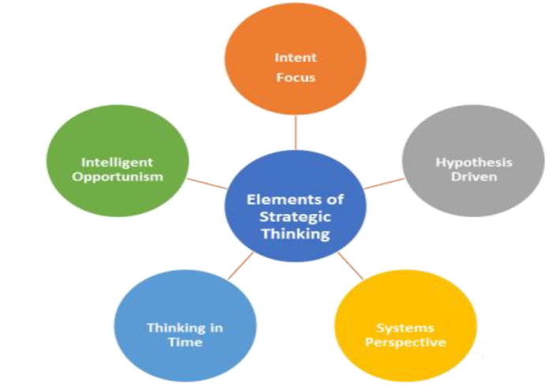
Five elements of thinking strategically
Chapter
02
www.midocean.ae

Slide 34

Five elements of thinking strategically:
1. Intent focused:
The energy to focus attention, to resist distraction, and to concentrate for as long as it takes to achieve a goal.
2. A systems perspective:
It is knowledge about the organization.
Chapter
02
www.midocean.ae

Slide 35
Five elements of thinking strategically:
3. Thinking in Time:
Connecting the past to the present to the future. You learn from the past and use that learning to make predictions.
4. Intelligent Opportunism:
Search for new Ideas and knowledge.
5. Hypothesis driven:
Create new hypothesis for future actions.
Chapter
02
www.midocean.ae

Slide 36
Scientific Thinking:
Creative/Divergent Thinking
Critical/Convergent Thinking
Lateral /Metacognitive (thinking about their thinking)thinking individual.
Chapter
02
www.midocean.ae

Slide 37
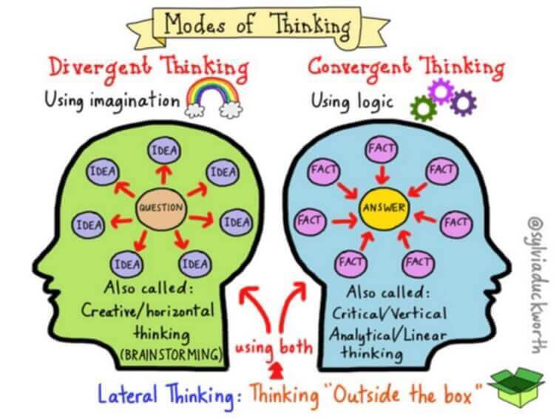
Three types of Scientific thinking
Chapter
02
www.midocean.ae

Slide 38
Scientific Thinking:
1. Creative/Divergent Thinking :
  Using: Imagination
  Called: Creative/horizontal thinking
  Example: Brain Storming
Chapter
02
www.midocean.ae

Slide 39
Scientific Thinking:
2. Critical/Convergent Thinking:
  Using: Logic
  Called: Critical/Vertical thinking
  Called: Analytical/Linear thinking
Chapter
02
www.midocean.ae

Slide 40
Scientific Thinking:
3. Lateral /Metacognitive (thinking about their thinking) thinking individual.
  Thinking : Outside the box”
  Using: both,
  Creative/Divergent Thinking and
  Critical/Convergent Thinking.
Chapter
02
www.midocean.ae

Slide 41
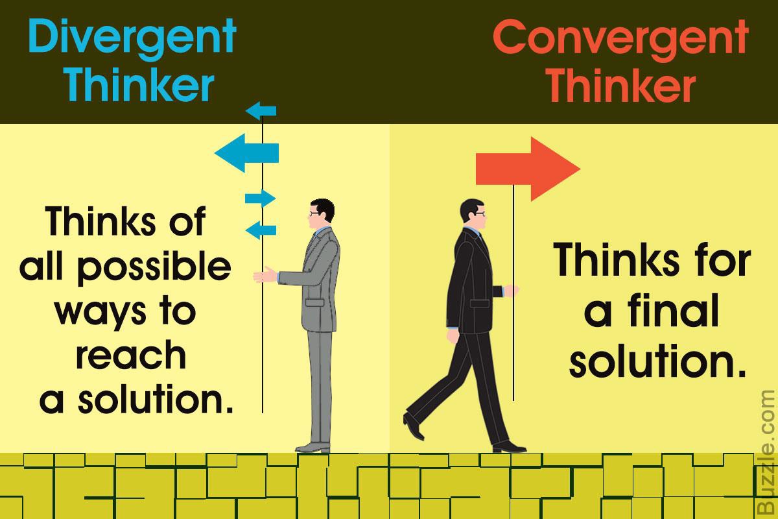
Chapter
02
www.midocean.ae

Slide 42




Thank You

