Slide 1


Red Hat System Administration I
Dr. Eng. Gamal Selim
Lecture 03

Slide 2
Agenda
Chapter 5: Create, View, and Edit Text Files
Chapter 6: Manage Local Users and Groups
Red Hat Linux Administration I
Lecture 03
Dr. Eng. Gamal Selim

Slide 3
Chapter 5: Create, View, and Edit Text Files
Red Hat Linux Administration I
Lecture 03
Dr. Eng. Gamal Selim

Slide 4
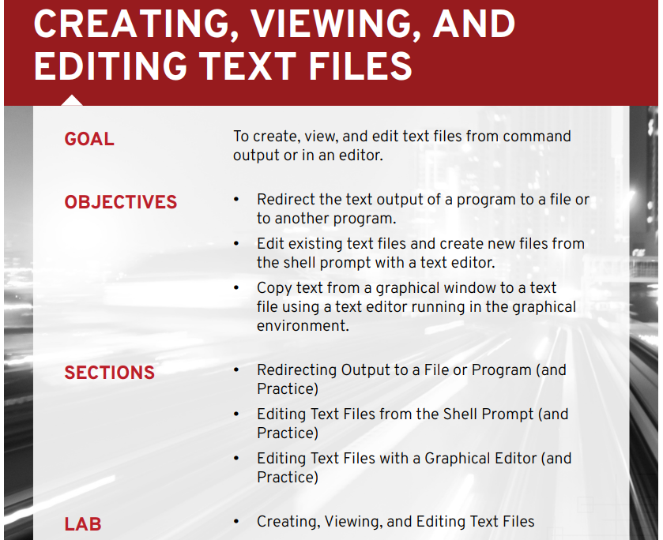
Red Hat Linux Administration I
Lecture 03
Dr. Eng. Gamal Selim

Slide 5
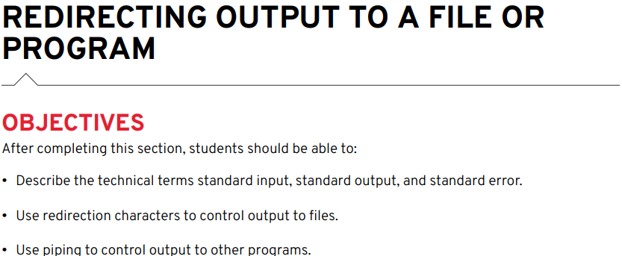
Red Hat Linux Administration I
Lecture 03
Dr. Eng. Gamal Selim

Slide 6
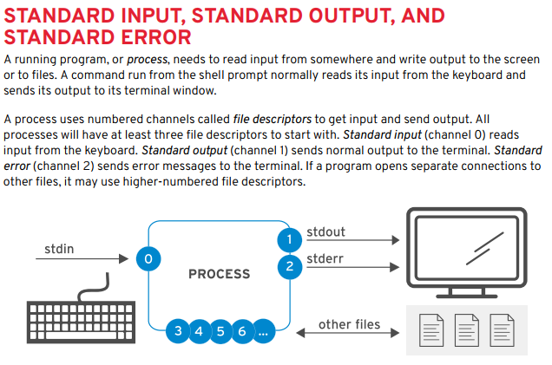
Red Hat Linux Administration I
Lecture 03
Dr. Eng. Gamal Selim

Slide 7
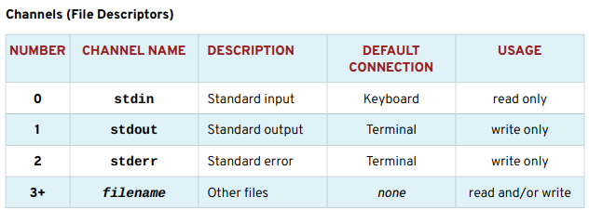

Slide 8
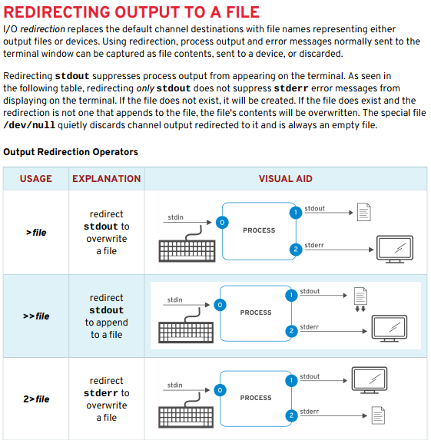
Red Hat Linux Administration I
Lecture 03
Dr. Eng. Gamal Selim

Slide 9
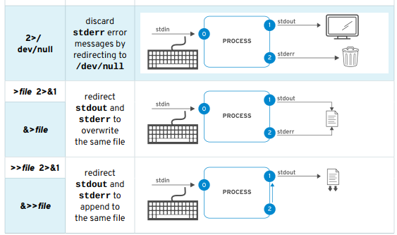
Red Hat Linux Administration I
Lecture 03
Dr. Eng. Gamal Selim

Slide 10
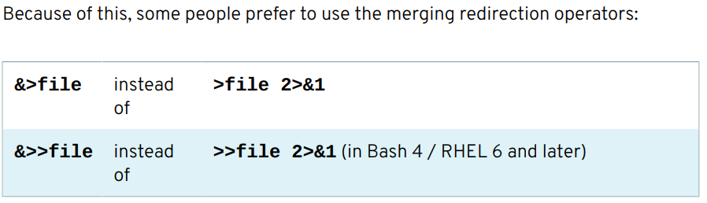
Red Hat Linux Administration I
Lecture 03
Dr. Eng. Gamal Selim

Slide 11
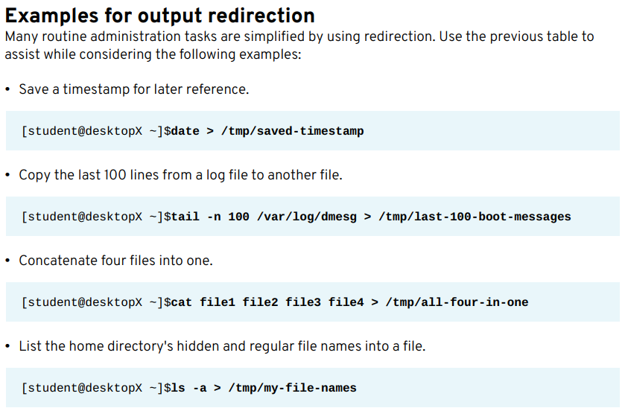
Red Hat Linux Administration I
Lecture 03
Dr. Eng. Gamal Selim

Slide 12
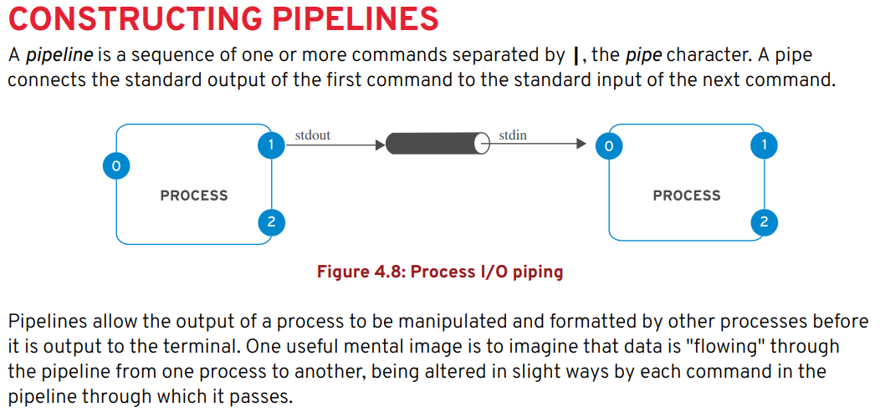
Red Hat Linux Administration I
Lecture 03
Dr. Eng. Gamal Selim

Slide 13
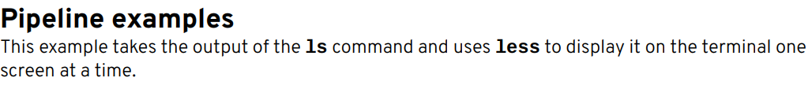
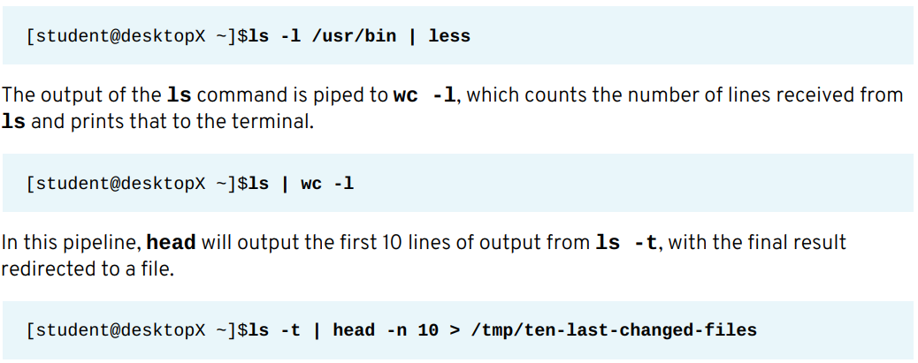
Red Hat Linux Administration I
Lecture 03
Dr. Eng. Gamal Selim

Slide 14
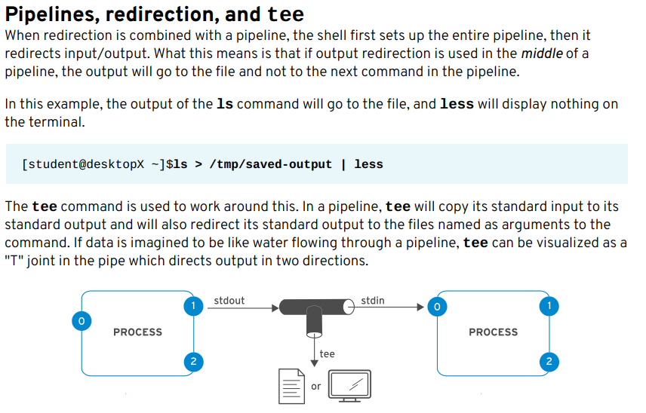
Red Hat Linux Administration I
Lecture 03
Dr. Eng. Gamal Selim

Slide 15
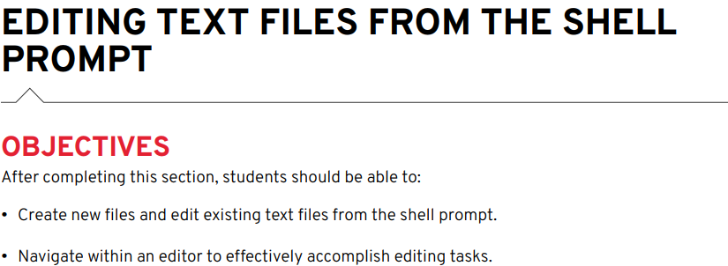
Red Hat Linux Administration I
Lecture 03
Dr. Eng. Gamal Selim

Slide 16
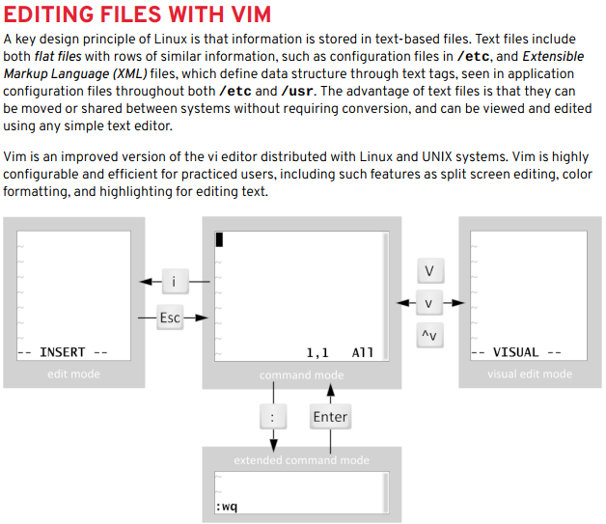
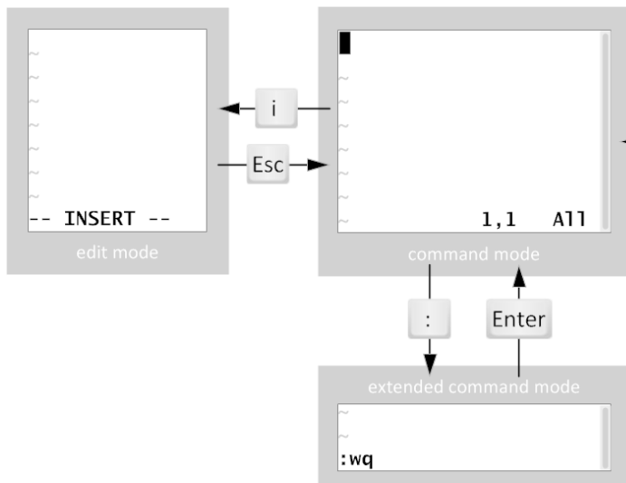
Red Hat Linux Administration I
Lecture 03
Dr. Eng. Gamal Selim

Slide 17
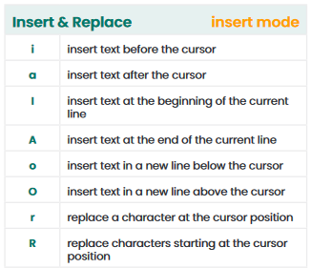
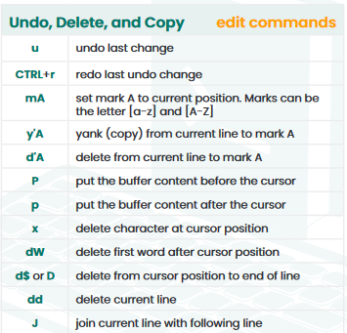
Red Hat Linux Administration I
Lecture 03
Dr. Eng. Gamal Selim

Slide 18
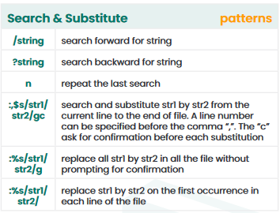
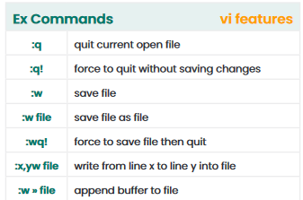
Red Hat Linux Administration I
Lecture 03
Dr. Eng. Gamal Selim

Slide 19

Red Hat Linux Administration I
Lecture 03
Dr. Eng. Gamal Selim

Slide 20
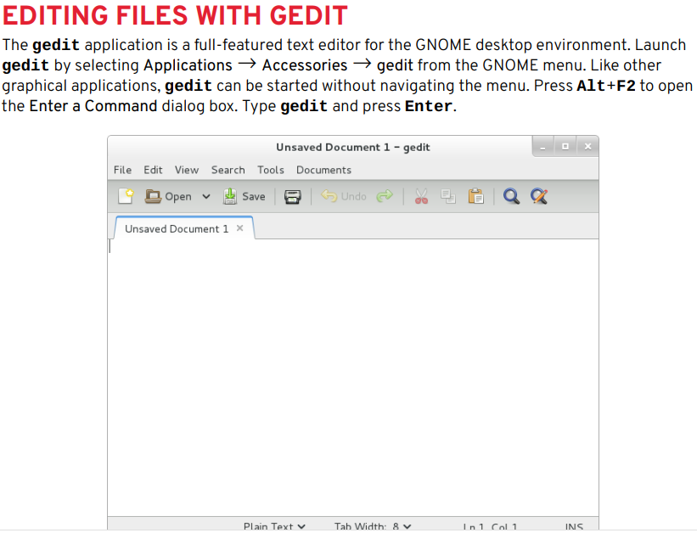
Red Hat Linux Administration I
Lecture 03
Dr. Eng. Gamal Selim

Slide 21
Displaying commands
cat / more / less
head / tail
cut
sort

Slide 22
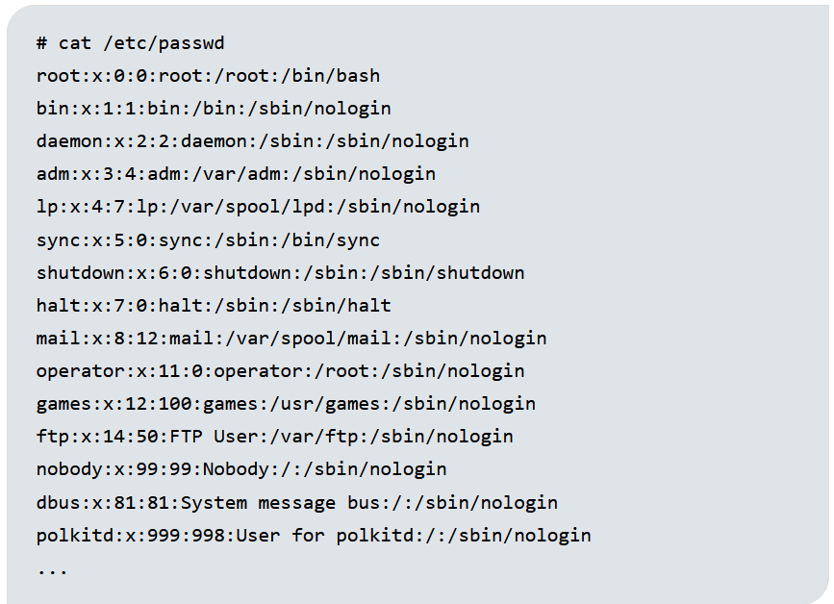
Red Hat Linux Administration I
Lecture 03
Dr. Eng. Gamal Selim

Slide 23
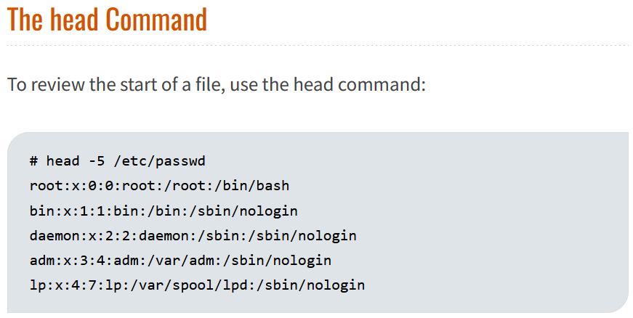
Red Hat Linux Administration I
Lecture 03
Dr. Eng. Gamal Selim

Slide 24
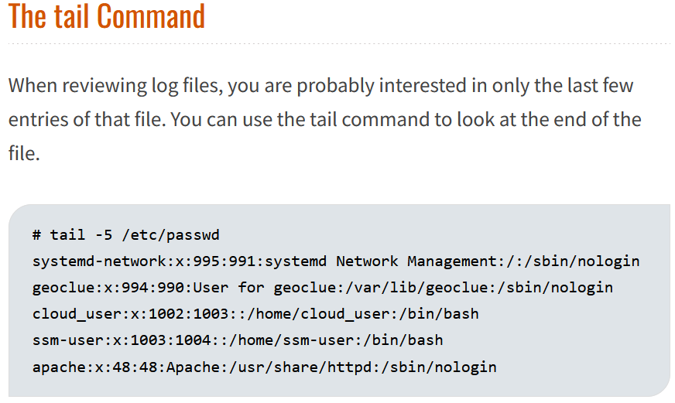
Red Hat Linux Administration I
Lecture 03
Dr. Eng. Gamal Selim

Slide 25
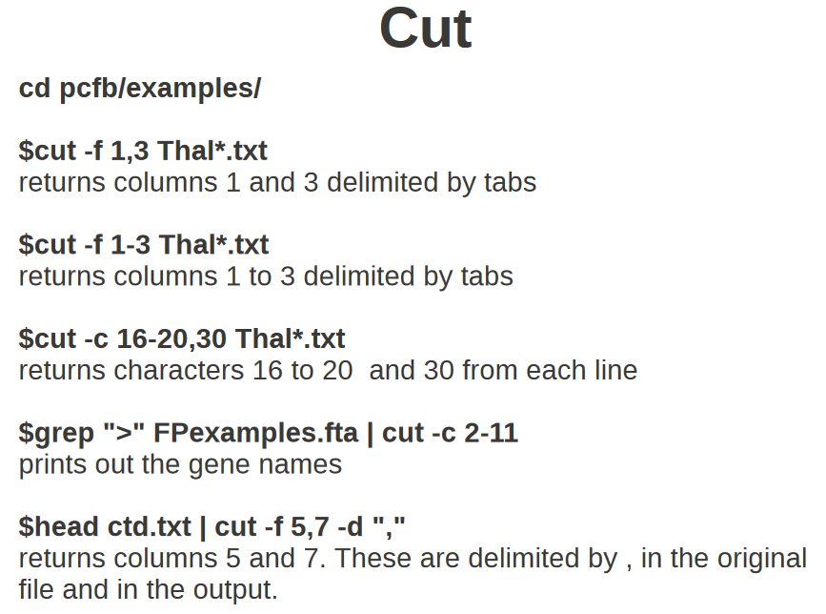
Red Hat Linux Administration I
Lecture 03
Dr. Eng. Gamal Selim

Slide 26
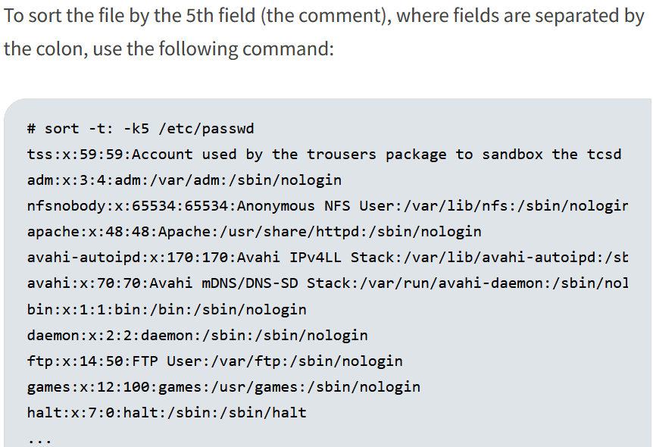
Red Hat Linux Administration I
Lecture 03
Dr. Eng. Gamal Selim

Slide 27
End of Chapter 5
Red Hat Linux Administration I
Lecture 03
Dr. Eng. Gamal Selim

Slide 28
Chapter 6: Manage Local Users and Groups
Red Hat Linux Administration I
Lecture 03
Dr. Eng. Gamal Selim

Slide 29
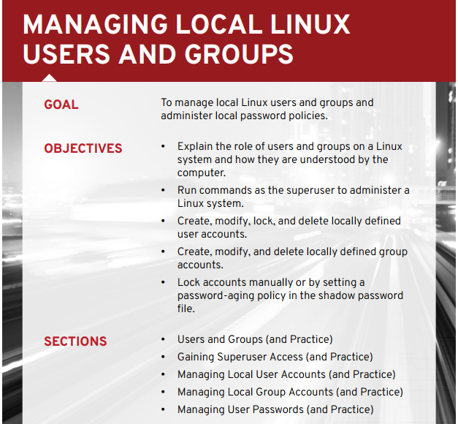
Red Hat Linux Administration I
Lecture 03
Dr. Eng. Gamal Selim

Slide 30
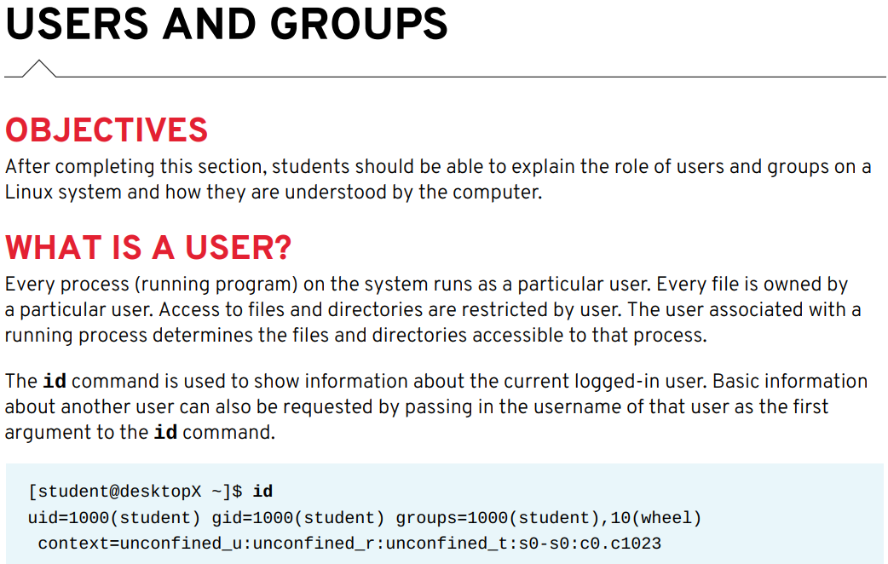
Red Hat Linux Administration I
Lecture 03
Dr. Eng. Gamal Selim

Slide 31
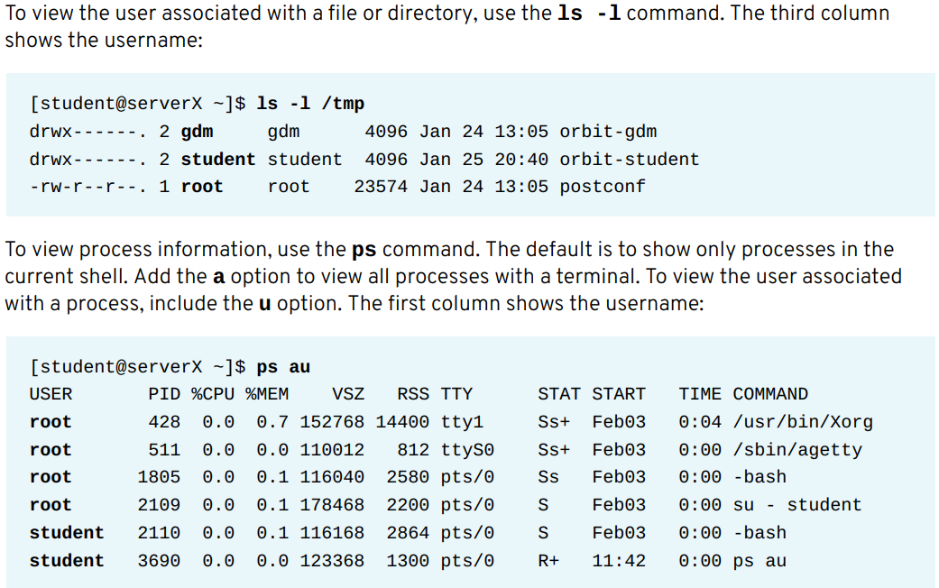
Red Hat Linux Administration I
Lecture 03
Dr. Eng. Gamal Selim

Slide 32
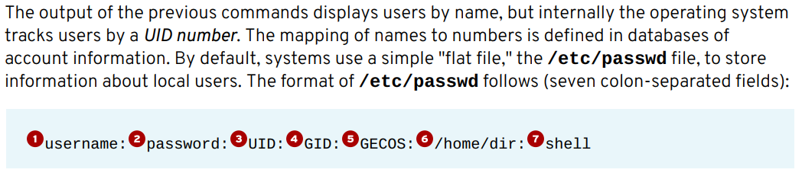
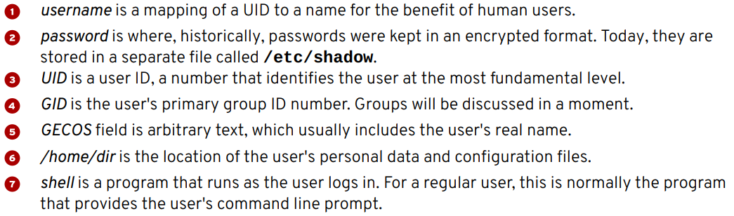
Red Hat Linux Administration I
Lecture 03
Dr. Eng. Gamal Selim

Slide 33
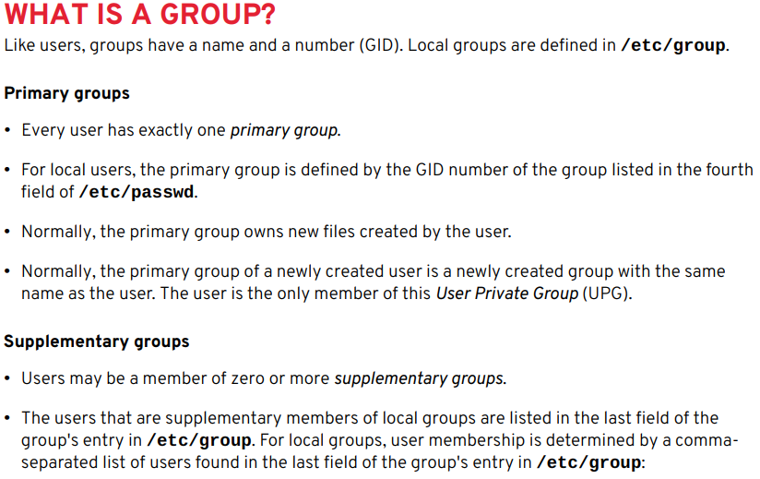
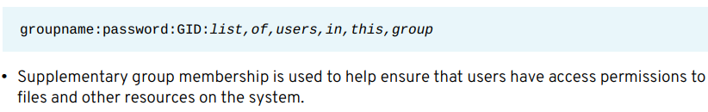
Red Hat Linux Administration I
Lecture 03
Dr. Eng. Gamal Selim

Slide 34
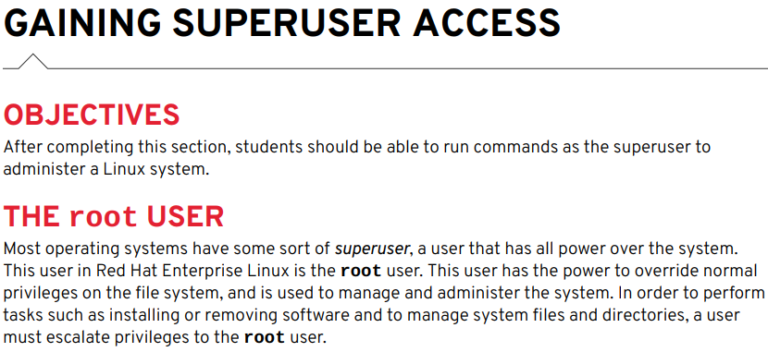
Red Hat Linux Administration I
Lecture 03
Dr. Eng. Gamal Selim

Slide 35
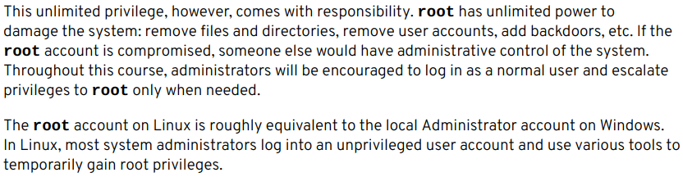
Caution !
Red Hat Linux Administration I
Lecture 03
Dr. Eng. Gamal Selim

Slide 36

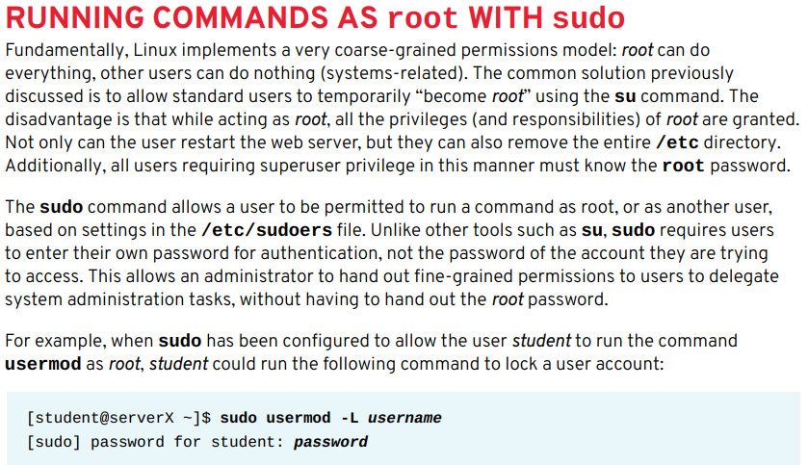
Red Hat Linux Administration I
Lecture 03
Dr. Eng. Gamal Selim

Slide 37
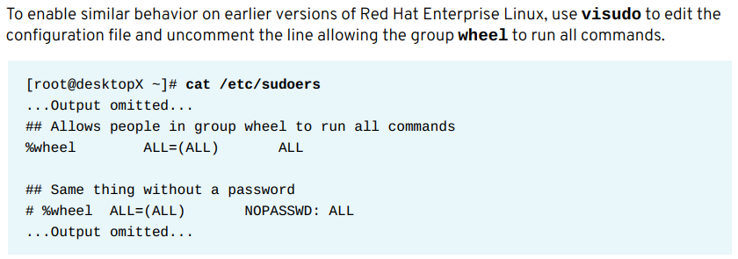
Red Hat Linux Administration I
Lecture 03
Dr. Eng. Gamal Selim

Slide 38
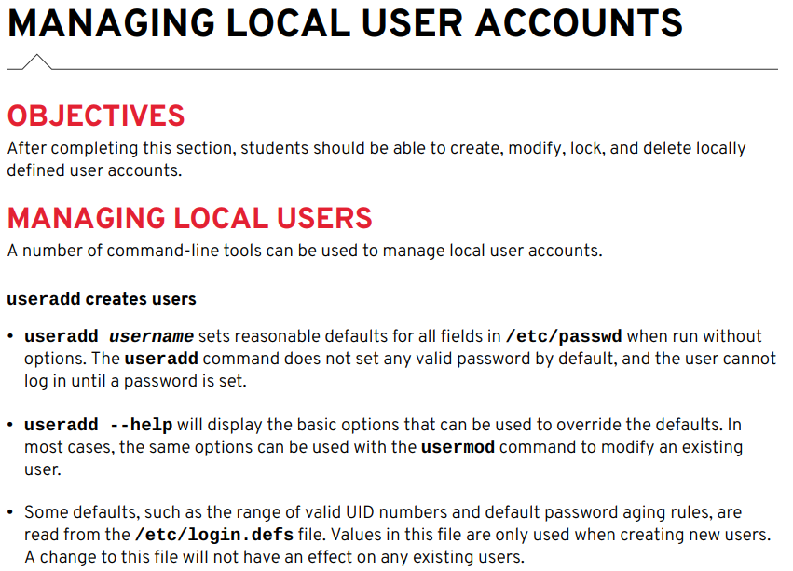
Red Hat Linux Administration I
Lecture 03
Dr. Eng. Gamal Selim

Slide 39
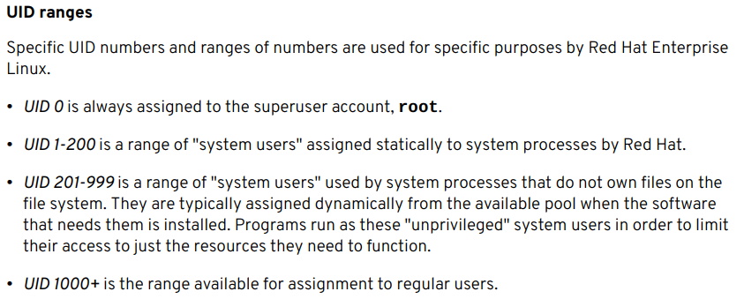
Red Hat Linux Administration I
Lecture 03
Dr. Eng. Gamal Selim

Slide 40
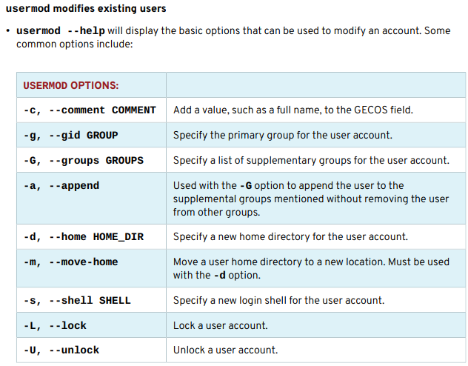
Red Hat Linux Administration I
Lecture 03
Dr. Eng. Gamal Selim

Slide 41
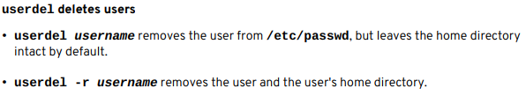
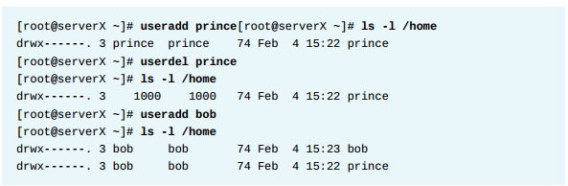
Red Hat Linux Administration I
Lecture 03
Dr. Eng. Gamal Selim

Slide 42
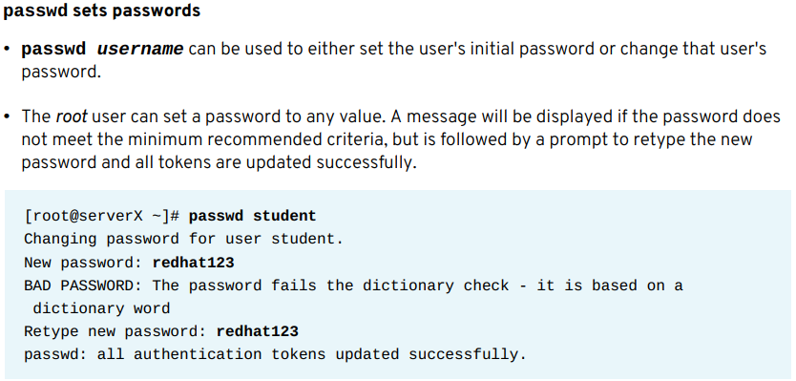
Red Hat Linux Administration I
Lecture 03
Dr. Eng. Gamal Selim

Slide 43
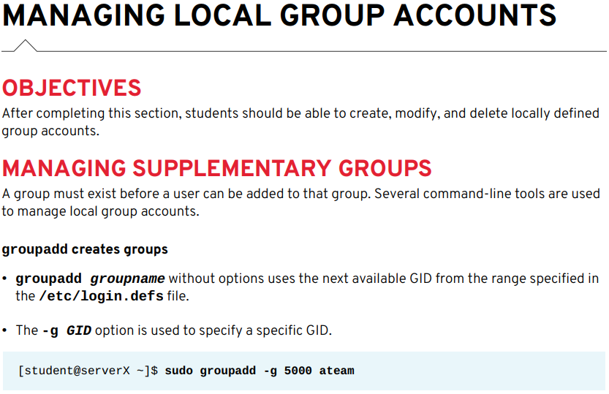
Red Hat Linux Administration I
Lecture 03
Dr. Eng. Gamal Selim

Slide 44
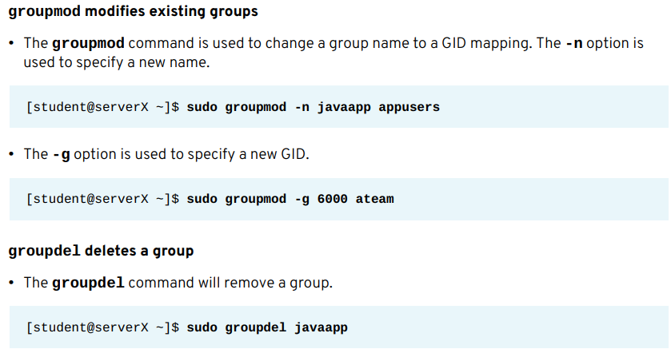
Red Hat Linux Administration I
Lecture 03
Dr. Eng. Gamal Selim

Slide 45
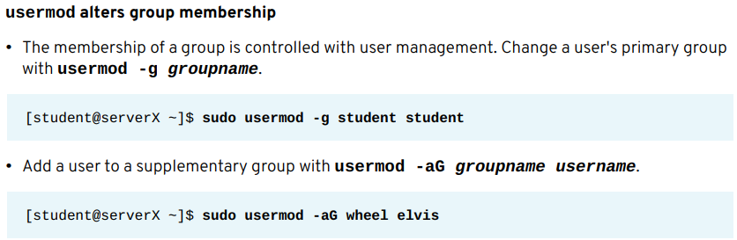
Red Hat Linux Administration I
Lecture 03
Dr. Eng. Gamal Selim

Slide 46
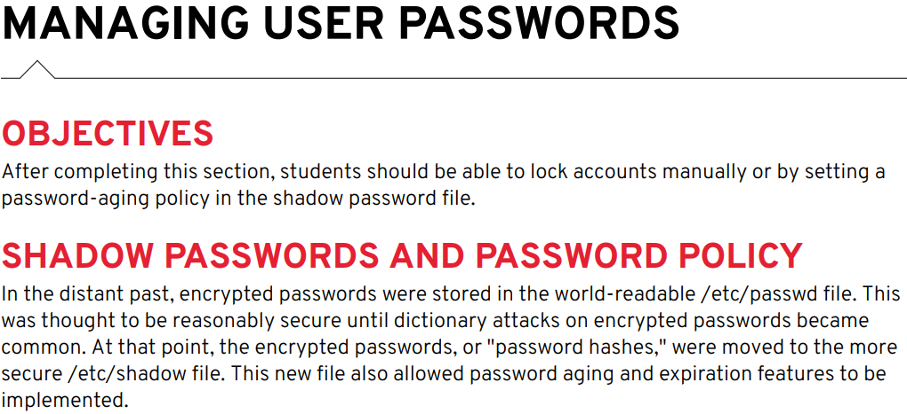
Red Hat Linux Administration I
Lecture 03
Dr. Eng. Gamal Selim

Slide 47
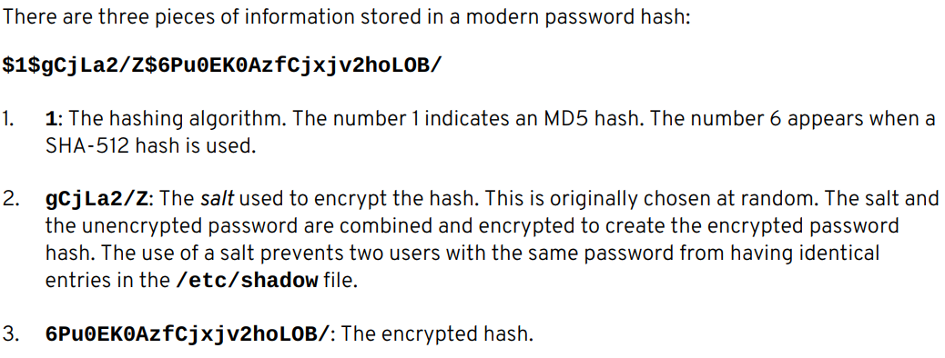
Red Hat Linux Administration I
Lecture 03
Dr. Eng. Gamal Selim

Slide 48
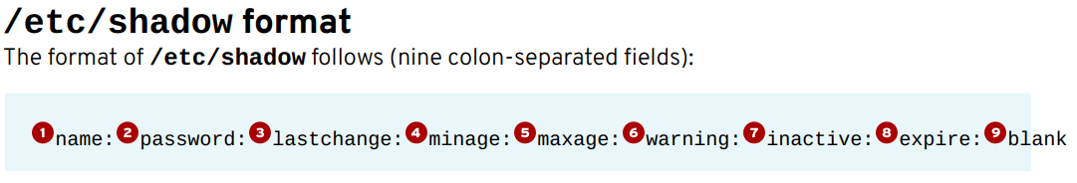
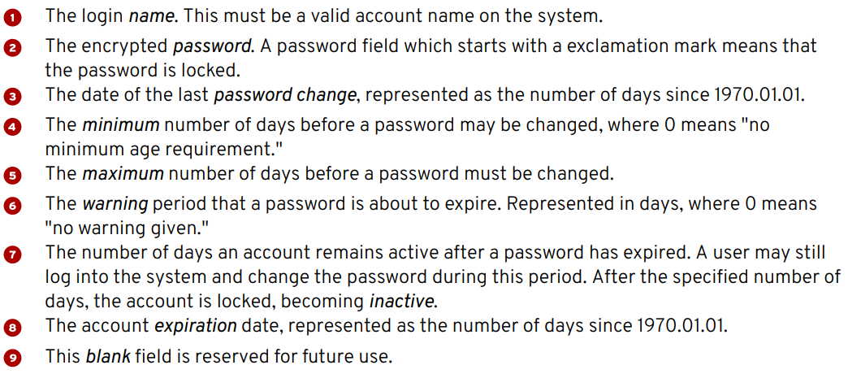
Red Hat Linux Administration I
Lecture 03
Dr. Eng. Gamal Selim

Slide 49
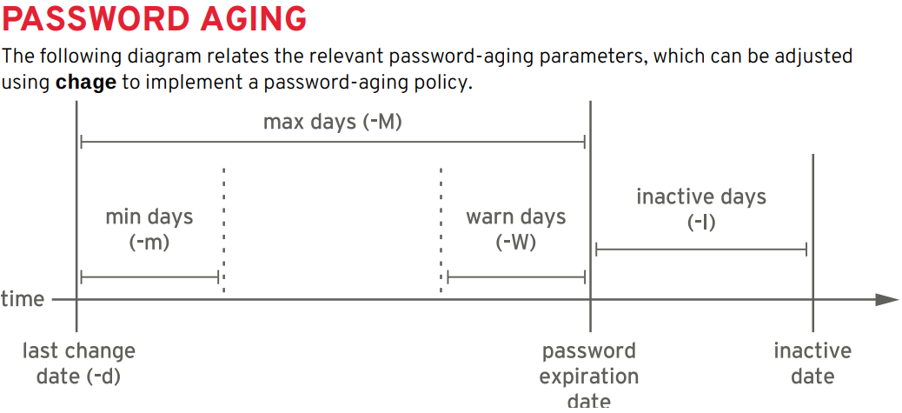
Red Hat Linux Administration I
Lecture 03
Dr. Eng. Gamal Selim

Slide 50

Red Hat Linux Administration I
Lecture 03
Dr. Eng. Gamal Selim

Slide 51

Red Hat Linux Administration I
Lecture 03
Dr. Eng. Gamal Selim

Slide 52


Red Hat Linux Administration I
Lecture 03
Dr. Eng. Gamal Selim

Slide 53
End of Chapter 6
Red Hat Linux Administration I
Lecture 03
Dr. Eng. Gamal Selim

Slide 54


