Slide 1


Introduction to Hypothesis Testing
Prepared by Dr. Hesham Mousli
MHA 613
Statistics in Healthcare
Lecture 5

Slide 2

Chapter
INTENDED OBJECTIVES
02
Define hypothesis testing and its role in Healthcare-related decision-making & research.
Understand the concept of normal distribution and its importance.
Learn how hypothesis testing and p-values are interconnected.
Differentiate between Type I and Type II errors.
Learn graphical & numerical methods to test normality.

Slide 3

Chapter
What is the Hypothesis Testing?
05
In healthcare-related research, hypothesis testing is a fundamental statistical method used to make decisions based on data.

Slide 4
Chapter
What is the Hypothesis Testing?
05
It allows researchers to evaluate whether the observed data supports a specific claim (hypothesis) about a population parameter.

Slide 5
Chapter
What is the Hypothesis Testing?
05
The process begins by formulating two competing hypotheses:
  The null hypothesis (H₀): assumes no effect or no difference.
  The alternative hypothesis (H₁): suggests the presence of an effect or difference.

Slide 6
Chapter
Why Hypothesis Testing Matters?
05
Through hypothesis testing, we assess evidence from a sample to determine whether it is strong enough to reject the null hypothesis in favor of the alternative.

Slide 7

Chapter
Why Hypothesis Testing Matters?
05
This process helps researchers and clinicians make informed decisions in clinical and healthcare settings.

Slide 8
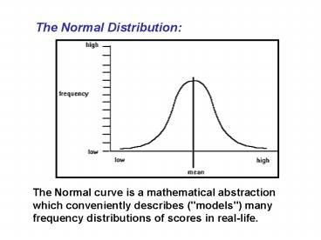
Chapter
Why Hypothesis Testing Matters?
05
A Normal Distribution is a symmetrical probability distribution with most values clustered around the mean and fewer values tapering off equally on both sides.

Slide 9
Chapter
Why Hypothesis Testing Matters?
05
It has the shape of a bell.
Can entirely described by its mean and standard deviation.

Slide 10
Chapter
Why Hypothesis Testing Matters?
05
It’s found naturally in social and human sciences.
Example: Population systolic blood pressure.

Slide 11
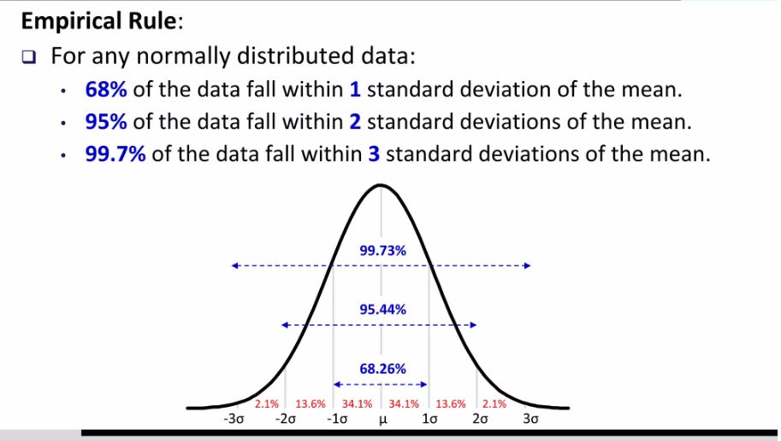
95% Confidence Interval for the population (95%CI)

Slide 12
Chapter
Hypothesis Testing
05
Hypothesis testing refers to:
  Making an assumption, called a hypothesis, about a population parameter.
  Collecting the sample data.
  Calculating a sample statistic, P-value, and Confidence Interval (CI).

Slide 13
Chapter
Hypothesis Testing
05
Hypothesis testing refers to:
  Using sampling to evaluate the hypothesis (how likely is it that our hypothesized parameter or conclusion regarding the population is correct).

Slide 14
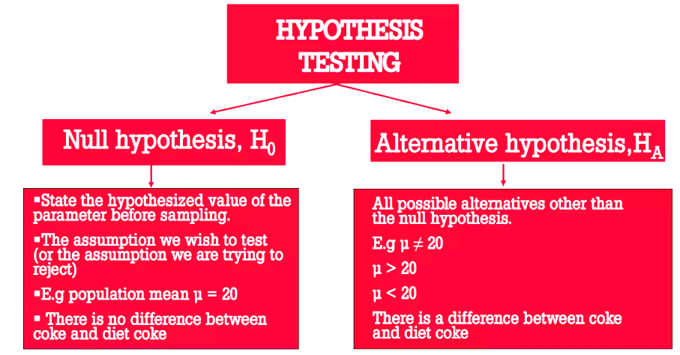

Slide 15
Chapter
Hypothesis Testing
05
Resulting P-value of Hypothesis Testing:
  P-value is defined as the probability of obtaining a result equal to or more extreme than what was actually observed.
  The smaller the P-value, the larger the significance of my alternative hypothesis.

Slide 16
Chapter
Hypothesis Testing
05
Resulting P-value of Hypothesis Testing:
For any hypothesis testing:
  Arbitrary cut-off 0.05 (5% chance of false positive conclusion) is commonly set.
  If P-value < 0.05: Reject the Null Hypothesis, and accept the Alternative hypothesis.
  If P-value > 0.05: Accept the Null Hypothesis, and reject the Alternative hypothesis.

Slide 17
Chapter
Type I vs. Type II error
05
A hospital management researcher is conducting a study to assess the effectiveness of a new staff training program designed to reduce medication errors in the hospital.

Slide 18

Type of error | The truth | Manager concluded | P-value
Type I error | The new training program does not reduce medication errors compared to the standard training. | The new training program reduces medication errors compared to the standard training. | < 0.05
Type II error | The new training program reduces medication errors compared to the standard training. | The new training program does not reduce medication errors compared to the standard training. | > 0.05
 | The new training program reduces medication errors compared to the standard training. | The new training program reduces medication errors compared to the standard training. | < 0.05
 | The new training program does not reduce medication errors compared to the standard training. | The new training program does not reduce medication errors compared to the standard training. | > 0.05

Slide 19
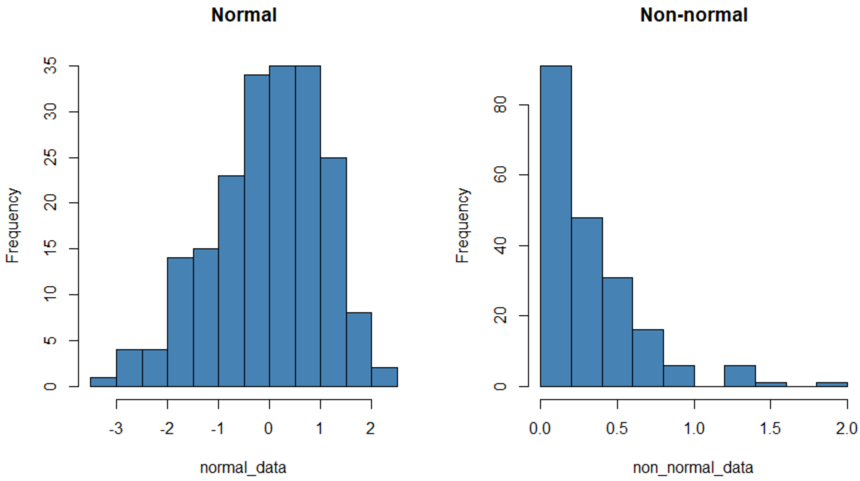
Testing Normality for Continuous Data
(Graphically)

Slide 20
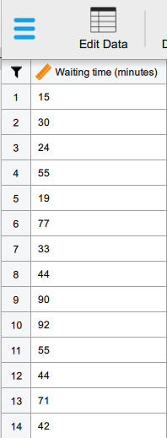
Testing Normality for Continuous Data
(Graphically)

Slide 21
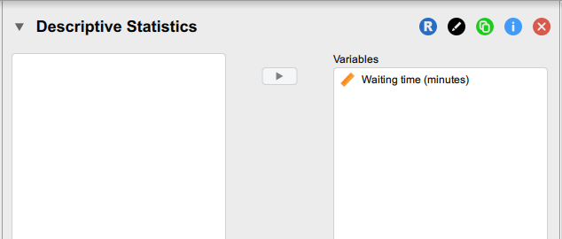
Testing Normality for Continuous Data
(Graphically)

Slide 22
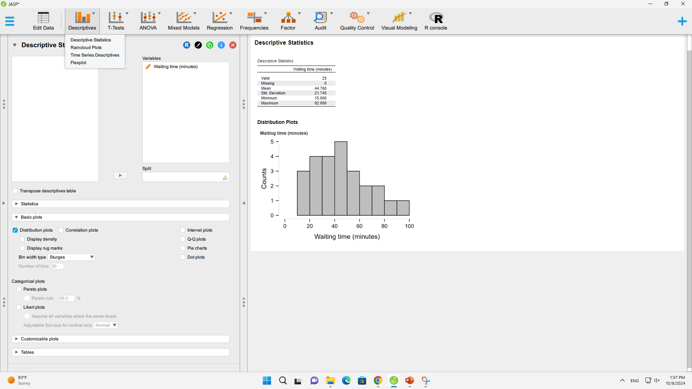
Testing Normality for Continuous Data
(Graphically)

Slide 23
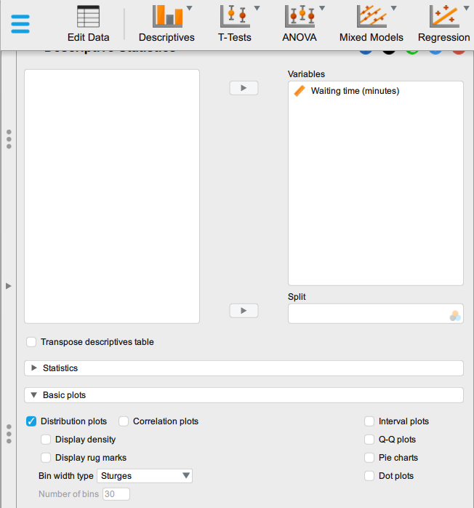
Testing Normality for Continuous Data
(Graphically)

Slide 24
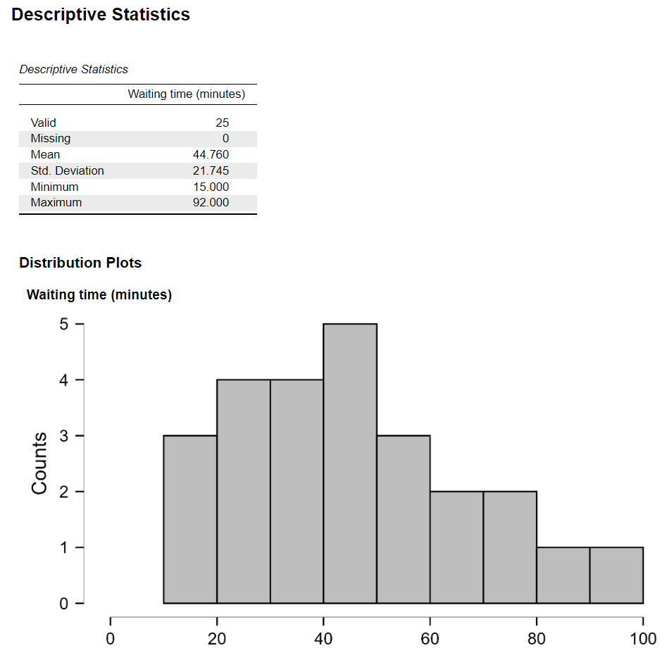
Testing Normality for Continuous Data
(Graphically)

Slide 25
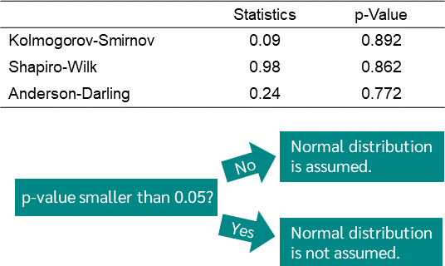
Testing Normality for Continuous Data
(Numerically)
Null Hypothesis
Alternative Hypothesis

Slide 26
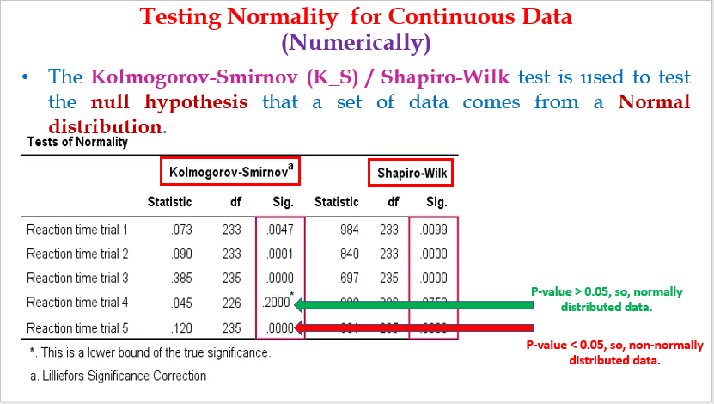
Testing Normality for Continuous Data
(Numerically)

Slide 27
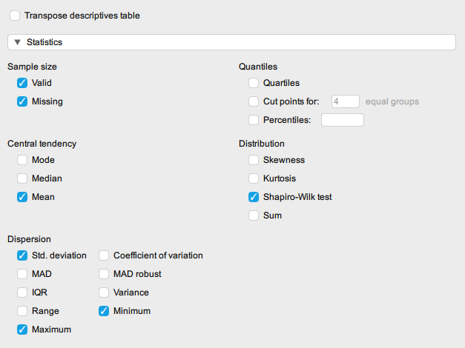
Testing Normality for Continuous Data
(Numerically)

Slide 28
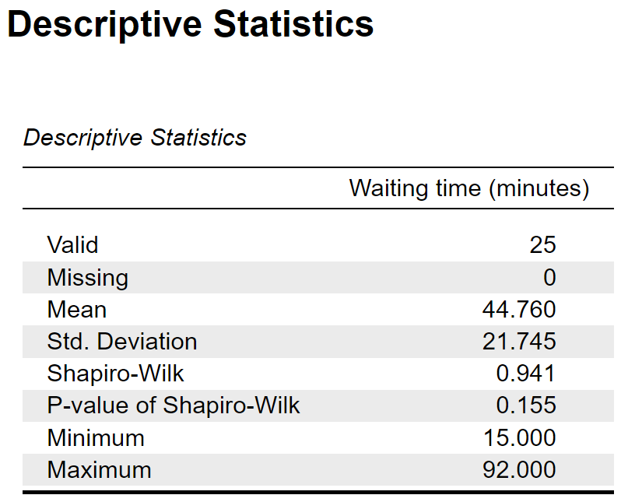
Testing Normality for Continuous Data
(Numerically)

Slide 29
Chapter
Case Scenario (1)
05
Electronic Health Record (EHR) Implementation and Operational Efficiency:
A healthcare system introduces a new EHR system to reduce administrative errors and improve workflow efficiency. Management wants to evaluate whether the implementation of the EHR system reduces the average time physicians spend on documentation.

Slide 30
Chapter
Case Scenario (1)
05
Electronic Health Record (EHR) Implementation and Operational Efficiency:
Null Hypothesis (H₀): The implementation of the EHR system does not reduce the time physicians spend on documentation.
Alternative Hypothesis (H₁): The implementation of the EHR system reduces the time physicians spend on documentation.

Slide 31
Chapter
Case Scenario (2)
05
Healthcare Costs and Readmission Rates:
A hospital introduces a new discharge protocol aimed at reducing 30-day readmission rates for patients with chronic heart failure. The hospital wants to test whether this intervention reduces overall healthcare costs.

Slide 32
Chapter
Case Scenario (2)
05
Healthcare Costs and Readmission Rates:
Null Hypothesis (H₀): The new discharge protocol does not reduce overall healthcare costs associated with chronic heart failure readmissions.
Alternative Hypothesis (H₁): The new discharge protocol reduces overall healthcare costs associated with chronic heart failure readmissions.

Slide 33
Chapter
Case Scenario (3)
05
Training Programs and Clinical Error Rates:
Management implements a new training program for surgical staff to reduce the occurrence of clinical errors during operations. They need to test if the training program is effective.

Slide 34
Chapter
Case Scenario (3)
05
Training Programs and Clinical Error Rates:
Null Hypothesis (H₀): The new training program does not reduce the clinical error rate in surgeries.
Alternative Hypothesis (H₁): The new training program reduces the clinical error rate in surgeries.

Slide 35
Chapter
Case Scenario (4)
05
Telemedicine and Follow-Up Compliance:
A hospital implements a telemedicine platform to improve follow-up compliance among chronic disease patients. Management wants to investigate whether this improves patient compliance with follow-up visits.

Slide 36
Chapter
Case Scenario (4)
05
Telemedicine and Follow-Up Compliance:
Null Hypothesis (H₀): The telemedicine platform does not improve follow-up compliance among chronic disease patients.
Alternative Hypothesis (H₁): The telemedicine platform improves follow-up compliance among chronic disease patients.

Slide 37
Chapter
TO WRAP UP
05
Hypothesis Testing is a fundamental tool in healthcare-related research for making decisions.
Many statistical tests rely on the assumption of normality, making it crucial to assess whether your data meets this assumption.
P-value Interpretation is a key metric in determining whether your results are statistically significant.

Slide 38
Chapter
TO WRAP UP
05
Type I vs. Type II Errors: Both errors have implications for research and decision-making. Minimizing these errors is critical for reliable conclusions.
Testing Normality can be done using graphical and numerical methods to assess the normality of your data before conducting hypothesis testing.
You can apply these concepts to real-life healthcare scenarios to make informed, evidence-based decisions.

Slide 39



Thank You

