Slide 1

Operating Systems
Prepared by Dr. Alaa Mohamed
Module 4
Scheduling and Deadlocks

Slide 2

Module
04
Scheduling and Deadlocks
Objectives:
  Basic Concepts
  Scheduling Criteria
  Scheduling Algorithms
  Deadlock Characterization
  Methods for Handling Deadlocks
    Deadlock Prevention
      Deadlock Avoidance
      Deadlock Detection
  Recovery from Deadlock

Slide 3
Module
04
Scheduling
Topics To Be Covered:
  To introduce CPU scheduling, which is the basis for multiprogram on operating systems
  To describe various CPU-scheduling algorithms
  To discuss evaluation criteria for selecting a CPU-scheduling algorithm for a particular system

Slide 4
Module
04
CPU Scheduling
The Objective is to Maximum CPU utilization obtained with multiprogramming
A process is executed until it must wait, typically for the completion of some I/O request.
In a simple computer system, the CPU then sits idle. All this is wasted: no useful work is accomplished.
Several processes are kept in memory at one time.
When one process has to wait, the operating system takes the CPU away from that process and gives the CPU to another process and this pattern continues.

Slide 5
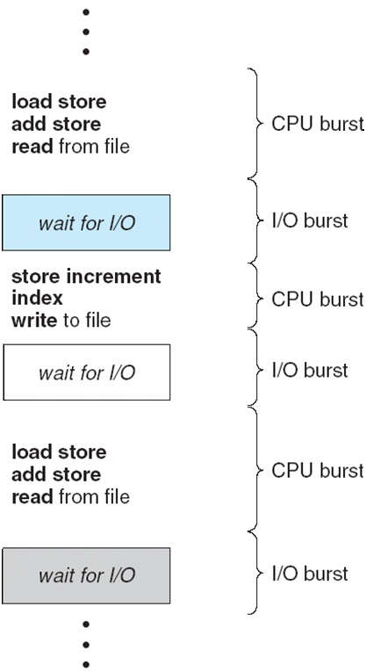
Module
04
CPU and I/O Burst Cycles
CPU–I/O Burst Cycle ,
Process execution consists of
a cycle of CPU execution and
I/O wait.
Processes alternate between.
those two states,
CPU Burst is the time when
the process is being executed in CPU.
I/O burst is the time when a process
wait for I/O to complete.

Slide 6
Module
04
CPU Scheduler
Selects from among the processes in memory that are ready to execute, and allocates the CPU to one of them
CPU scheduling decisions may take place when a process:
  Switches from running to waiting state
  Switches from running to ready state
  Switches from waiting to ready
  Terminates
Scheduling only under 1 and 4 is nonpreemptive
All other scheduling is preemptive

Slide 7
Module
04
Preemptive and Non Preemptive Scheduling
Nonpreemptive
    Once a process is allocated the CPU, it does not leave unless:
      it has to wait, e.g., for I/O request or for a child to terminate
      it terminates
  Preemptive
    OS can force (preempt) a process from CPU at anytime
      Say, to allocate CPU to another higher-priority process

Slide 8
Module
04
Scheduling
Which is harder to implement? and why?
  Preemptive is harder: Need to maintain consistency of data shared between processes, and more importantly, kernel data structures (e.g., I/O queues)
      Think of a preemption while kernel is executing a sys call on behalf of a process (many OSs, wait for sys call to finish)

Slide 9
Module
04
Dispatcher
Dispatcher module gives control of the CPU to the process selected by the short-term scheduler; this involves:
  switching context
  switching to user mode
  jumping to the proper location in the user program to restart that program
Dispatch latency – time it takes for the dispatcher to stop one process and start another running

Slide 10
Module
04
Scheduling Criteria
CPU utilization – keep the CPU as busy as possible
  Maximize
Throughput – # of processes that complete their execution per time unit
  Maximize
Turnaround time – amount of time to execute a particular process (time from submission to termination)
  Minimize
Waiting time – amount of time a process has been waiting in ready queue
  Minimize
Response time – amount of time it takes from when a request is submitted until the first response is produced, not output (for time-sharing environment)
  Minimize

Slide 11
Module
04
Scheduling Algorithms
First Come, First Served
Shortest Job First
Priority
Round Robin

Slide 12
Module
04
First-Come, First-Served
(FCFS) Scheduling
Burst Time | Process
24 | P₁
3 | P₂
3 | P₃
Suppose that the processes arrive in the order: P₁ , P₂ , P₃
The Gantt Chart for the schedule is:
Waiting time for P₁ = 0; P₂ = 24; P₃ = 27
Average waiting time: (0 + 24 + 27)/3 = 17
P₁
P₂
P₃
0
24
27
30

Slide 13
Module
04
First-Come, First-Served
(FCFS) Scheduling
Suppose that the processes arrive in the order
P₂ , P₃ , P₁
3, 3, 24
The Gantt chart for the schedule is:
Waiting time for P₁ = 6; P₂ = 0; P₃ = 3
Average waiting time: (6 + 0 + 3)/3 = 3
Much better than previous case
Convoy effect: short process behind long process
P₂
P₃
P₁
0
3
6
30

Slide 14
Module
04
First-Come, First-Served
(FCFS) Scheduling
FCFC is fair in the formal sense or human sense of fairness
but it is unfair in the sense that long jobs take priority over short jobs and unimportant jobs make important jobs wait
One of the major drawbacks of this scheme is that the waiting time and the average turnaround time is often quite long
FCFS Scheme is not useful in scheduling interactive users because it cannot guarantee good response time.
The code for FCFS scheduling is simple to write and understand.

Slide 15
Module
04
Shortest-Job-First (SJF) Scheduling
Associate with each process the length of its next CPU burst. Use these lengths to schedule the process with the shortest time
Two schemes:
  Non-preemptive – once CPU given to the process it cannot be preempted until completes its CPU burst
  preemptive – if a new process arrives with CPU burst length less than remaining time of current executing process, preempt. This scheme is known as the
  Shortest-Remaining-Time-First (SRTF)
SJF is optimal – gives minimum average waiting time for a given set of processes
The difficulty is knowing the length of the next CPU request

Slide 16
Module
04
Shortest-Job-First (SJF) Scheduling
SJF scheduling chart
Average waiting time = (3 + 16 + 9 + 0) / 4 = 7
Burst Time | Process
6 | P₁
8 | P₂
7 | P₃
3 | P₄
P₄
P₁
P₃
P₂
0
3
9
16
24

Slide 17
Module
04
Example of Non-Preemptive SJF
Burst Time | Arrival Time | Process
7 | 0.0 | P₁
4 | 2.0 | P₂
1 | 4.0 | P₃
4 | 5.0 | P₄
The Gantt chart for non-preemptive SJF is:
Average waiting time = (0 + 6 + 3 + 7)/4 = 4
P₁
P₃
P₂
P₄
0
3
7
8
12
16

Slide 18
Module
04
Priority Scheduling
A priority number (integer) is associated with each process
The CPU is allocated to the process with the highest priority (smallest integer ≡ highest priority)
  Preemptive
  Non-preemptive
SJF is a priority scheduling where priority is the predicted next CPU burst time
Problem ≡ Starvation – low priority processes may never execute
Solution ≡ Aging – as time progresses increase the priority of the process

Slide 19
Module
04
Example of Priority Scheduling (nonpreemptive)
Priority | Burst Time | Process
3 | 10 | P₁
1 | 1 | P₂
4 | 2 | P₃
5 | 1 | P₄
2 | 5 | P₅
The Gantt chart is (all processes arrive at time 0):
Average waiting time = (6 + 0 + 16 +18+1)/5 = 8.2
P₂
P₅
P₁
P₃
P₄
0
1
6
16
18
19

Slide 20
Module
04
Round Robin (RR)
Each process gets a small unit of CPU time (time quantum), usually 10-100 milliseconds. After this time has elapsed, the process is preempted and added to the end of the ready queue.
If there are n processes in the ready queue and the time quantum is q, then each process gets 1/n of the CPU time in chunks of at most q time units at once. No process waits more than (n-1)q time units.
Performance
  q large ⇒ FIFO
  q small ⇒ q must be large with respect to context switch, otherwise overhead is too high

Slide 21
Module
04
Example of RR with Time Quantum = 4
Burst Time | Process
24 | P₁
3 | P₂
3 | P₃
The Gantt chart is:
Typically, higher average turnaround than SJF, but better response
P₁
P₂
P₃
P₁
P₁
P₁
P₁
P₁
0
4
7
10
14
18
22
26
30

Slide 22
Module
04
Deadlock
System consists of resources
Resource types R₁, R₂, . . ., R_{m}
    CPU cycles, memory space, I/O devices
Each resource type R_{i} has W_{i} instances.
Each process utilizes a resource as follows:
  request
  use
  release
Deadlock is a situation where a set of processes are blocked because each process is holding a resource and waiting for another resource acquired by some other process.

Slide 23
Module
04
Deadlock Characterization
Deadlock can arise if four conditions hold simultaneously.
Mutual exclusion: only one process at a time can use a resource
Hold and wait: a process holding at least one resource is waiting to acquire additional resources held by other processes
No preemption: a resource can be released only voluntarily by the process holding it, after that process has completed its task
Circular wait: there exists a set {P₀, P₁, …, P_{n}} of waiting processes such that P₀ is waiting for a resource that is held by P₁, P₁ is waiting for a resource that is held by P₂, …, P_{n–1} is waiting for a resource that is held by P_{n}, and P_{n} is waiting for a resource that is held by P₀.

Slide 24
Module
04
Resource-Allocation Graph
A set of vertices V and a set of edges E.
V is partitioned into two types:
  P = {P₁, P₂, …, P_{n}}, the set consisting of all the processes in the system
  R = {R₁, R₂, …, R_{m}}, the set consisting of all resource types in the system
request edge – directed edge P_{i} → R_{j}
assignment edge – directed edge R_{j} → P_{i}

Slide 25
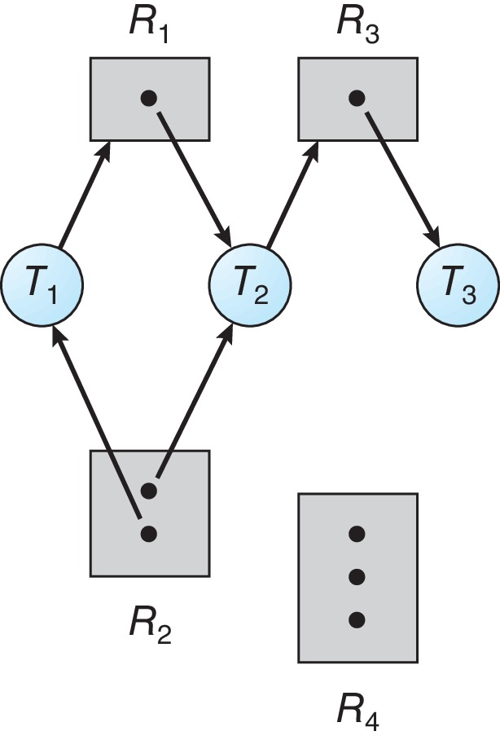
Module
04
Resource Allocation Graph Example
One instance of R1
Two instances of R2
One instance of R3
Three instance of R4
T1 holds one instance of R2 and is waiting for an instance of R1
T2 holds one instance of R1, one instance of R2, and is waiting for an instance of R3
T3 is holds one instance of R3

Slide 26
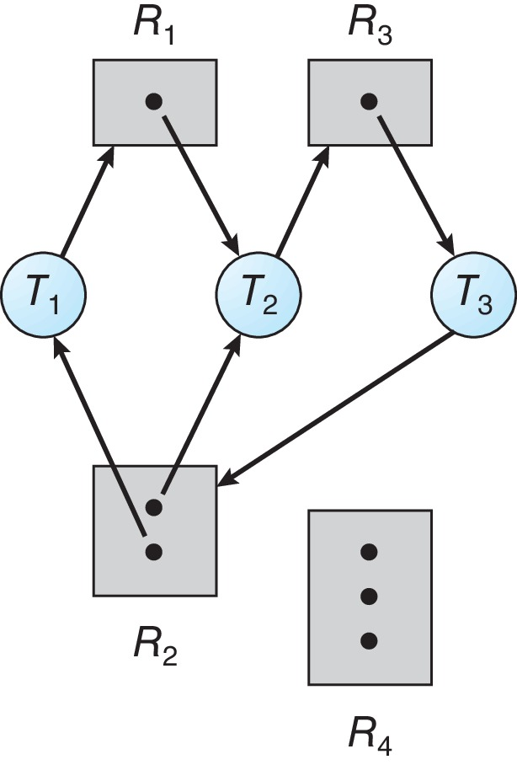
Module
04
Resource Allocation Graph Example with Deadlock

Slide 27
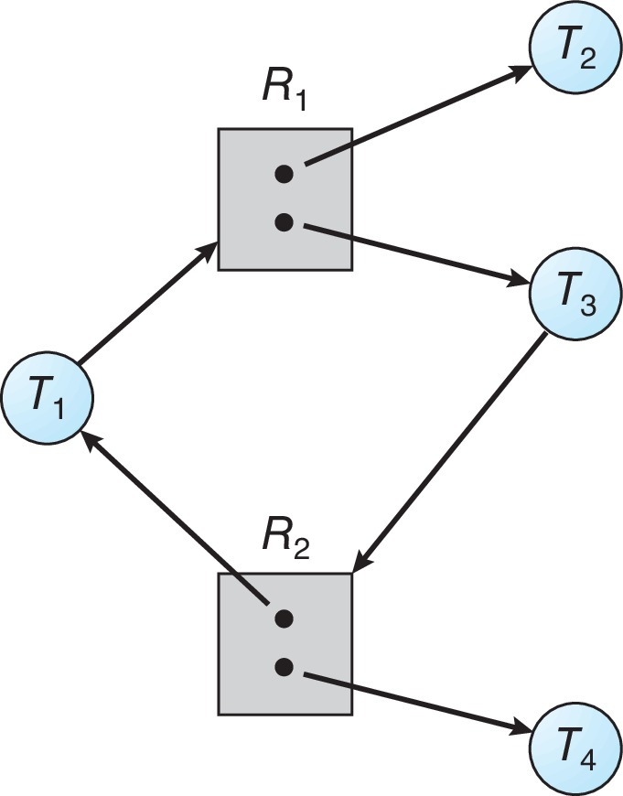
Module
04
Graph With A Cycle But No Deadlock

Slide 28
Module
04
Basic Facts
If graph contains no cycles ⇒ no deadlock
If graph contains a cycle ⇒
  if only one instance per resource type, then deadlock
  if several instances per resource type, possibility of deadlock

Slide 29
Module
04
Methods for Handling Deadlocks
Ensure that the system will never enter a deadlock state:
  Deadlock prevention
  Deadlock avoidance
Allow the system to enter a deadlock state and then recover
Ignore the problem and pretend that deadlocks never occur in the system.

Slide 30
Module
04
Deadlock Prevention
Invalidate one of the four necessary conditions for deadlock:
Mutual Exclusion – not required for sharable resources (e.g., read-only files); must hold for non-sharable resources
Hold and Wait – must guarantee that whenever a process requests a resource, it does not hold any other resources
  Require process to request and be allocated all its resources before it begins execution or allow process to request resources only when the process has none allocated to it.
  Low resource utilization; starvation possible

Slide 31
Module
04
Methods for Handling Deadlocks
No Preemption –
  If a process that is holding some resources requests another resource that cannot be immediately allocated to it, then all resources currently being held are released
  Preempted resources are added to the list of resources for which the process is waiting
  Process will be restarted only when it can regain its old resources, as well as the new ones that it is requesting
Circular Wait – impose a total ordering of all resource types, and require that each process requests resources in an increasing order of enumeration

Slide 32
Module
04
Deadlock Avoidance
Requires that the system has some additional a priori information
available
Simplest and most useful model requires that each process declare the maximum number of resources of each type that it may need
The deadlock-avoidance algorithm dynamically examines the resource-allocation state to ensure that there can never be a circular-wait condition
Resource-allocation state is defined by the number of available and allocated resources, and the maximum demands of the processes

Slide 33
Module
04
Safe State
When a process requests an available resource, system must decide if immediate allocation leaves the system in a safe state
System is in safe state if there exists a sequence <P₁, P₂, …, P_{n}> of ALL the processes in the systems such that for each P_{i}, the resources that P_{i} can still request can be satisfied by currently available resources + resources held by all the P_{j}, with j < I
That is:
  If P_{i} resource needs are not immediately available, then P_{i} can wait until all P_{j} have finished
  When P_{j} is finished, P_{i} can obtain needed resources, execute, return allocated resources, and terminate
  When P_{i} terminates, P_{i +1} can obtain its needed resources, and so on

Slide 34
Module
04
Basic Facts
If a system is in safe state ⇒ no deadlocks
If a system is in unsafe state ⇒ possibility of deadlock
Avoidance ⇒ ensure that a system will never enter an unsafe state.

Slide 35
Module
04
Deadlock Detection
Allow system to enter deadlock state
Detection algorithm
Recovery scheme

Slide 36
Module
04
Single Instance of Each Resource Types
Maintain wait-for graph
  Nodes are processes
  P_{i} → P_{j} if P_{i} is waiting for P_{j}
Periodically invoke an algorithm that searches for a cycle in the graph. If there is a cycle, there exists a deadlock

Slide 37
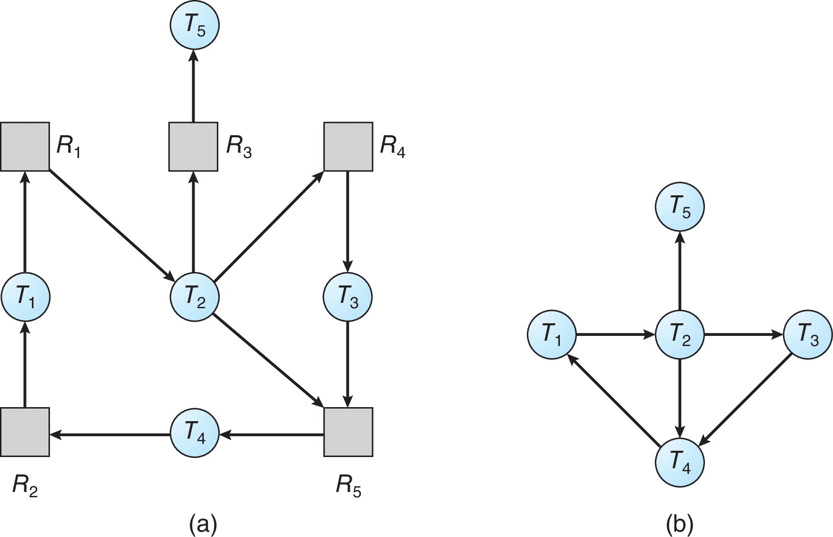
Module
04
Resource-Allocationk Graph
and Wait-for Graphs

Slide 38
Module
04
Recovery from Deadlock: Process Termination
Abort all deadlocked processes
Abort one process at a time until the deadlock cycle is eliminated
In which order should we choose to abort?
  Priority of the process
  How long process has computed, and how much longer to completion
  Resources the process has used
  Resources process needs to complete
  How many processes will need to be terminated
  Is process interactive or batch?

Slide 39
Module
04
Recovery from Deadlock: Resource Preemption
Selecting a victim – minimize cost
Rollback – return to some safe state, restart process for that state
Starvation – same process may always be picked as victim, include number of rollback in cost factor

Slide 40
Module
04
End of Module 4

