Slide 1



Project operations
management
Prepared by Dr. Mahmoud Ibrahim
MGM415
Introductory lecture:
The project’s operational root cause for"Doing" the efficient project performance and “Making” the effective project progress .

Slide 2

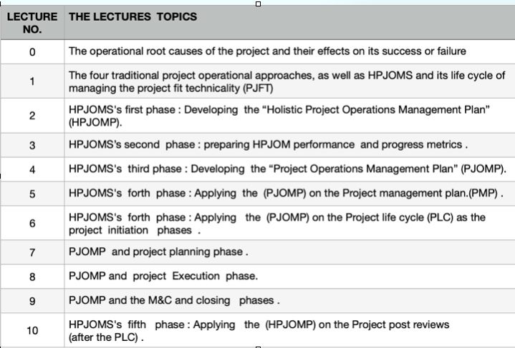

Slide 3
Course objectives
-it includes understanding the principles and techniques used in managing projects, developing skills in effectively planning and organizing project activities, and gaining knowledge of how to monitor and control project progress.
-Additionally, students will learn how to identify and mitigate project risks, and how to effectively communicate and collaborate with project stakeholders. The course also aims to develop critical thinking and problem-solving skills, as well as enhance students' ability to make informed decisions in project management.
-Overall, the learning objectives of the professional project operations management course are designed to prepare students for successful project management careers.

Slide 4
Lecture outline
1st section contents :
Some statistic of the failed project
2nd section contents :
The relationship between the DFT and the PJFT
3rd section contents :
The integration between the efficiency of project performance and the effectiveness project progress

Slide 5

Coca-Cola wasted $4 million in development and another $30 million in back stocked products after releasing New Coke.

Slide 6

Organizations that undervalue project management see 50% more of their projects failing.
Project management statistics show that in 2018 organizations that overlooked the PM process reported failure of half or more of their projects. This means huge financial losses, along with potential missed business opportunities and lost clients.
The latest project management stats show that 58% of organizations fully understand the value of implementing project management as a way to achieve better performance. This means that 42% of companies undervalue the importance of project management as a crucial component for project success.

Slide 7

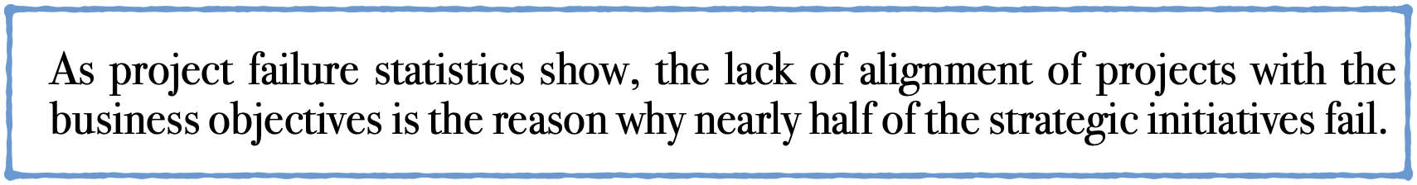
A lack of clear goals is the most common factor (37%) for project failure.
Setting clear goals helps you to track the milestones and the progress, giving you a clear picture of where you are at the moment.

Slide 8
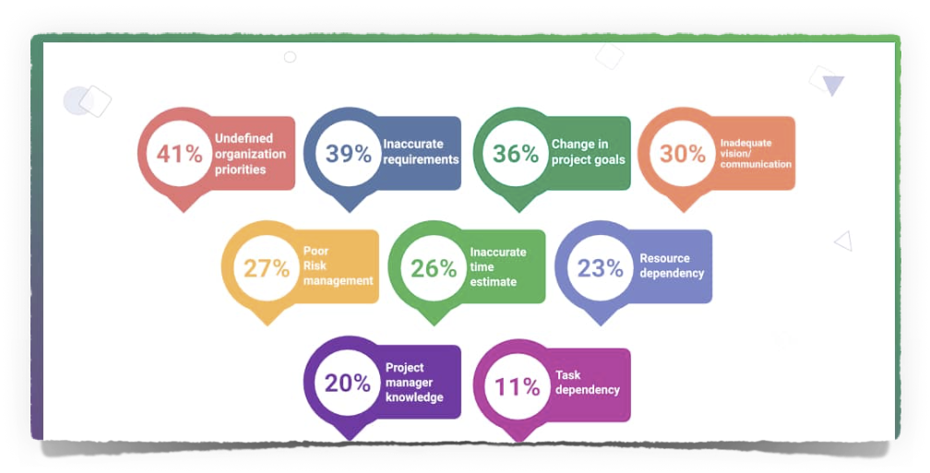
The project operational root cause for failing the project
(Having poor PJT and missing the guide of managing the project success.)

Slide 9
The impact of poor project technicality(PJT)
can lead to delays, budget overruns, and unacceptable outcomes.
can uncover gaps in skills or knowledge within the team
can lead to inefficiencies and decreased productivity.
maximizing the potential risks and challenges.
Maximizing the chances of misunderstandings or dissatisfaction.
Cannot Recognize that technical requirements that is changed throughout the project lifecycle
Cannot ensuring they remain relevant and aligned with project goals.

Slide 10
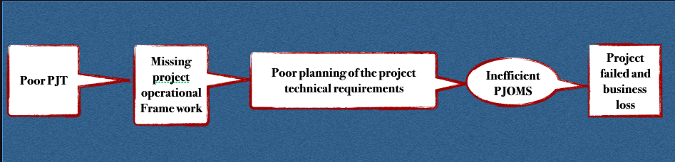



The project’s operational root cause
Poor PJT
Missing project operational
Frame work
Poor planning of the project technical requirements
source:Developed by Dr Mahmoud Ibrahim @2023

Slide 11
project operational plan
(framework)
-It is the framework for decision-making and problem-solving, these guidelines can ensure that the project stays on track and achieves its intended results by establishing a set of guidelines that outline the steps and actions necessary for operating the project successfully.
-it is crucial to establish a set of guidelines that outline the steps and actions necessary for operating the project successfully.
—These guidelines should address various aspects, such as project management methodologies, communication protocols, and performance metrics.
11

Slide 12
the project's technical requirements
-It should also be clearly defined and communicated to all stakeholders involved. This ensures that everyone is on the same page and understands what needs to be achieved from a technical standpoint.
◊◊-Overall, the project's technical requirements play a vital role in guiding the execution and success of the project,

Slide 13
The output of the project's technical requirements analysis
By conducting analysis of the project current technical capabilities is crucial in determining if any additional resources or expertise need to be acquired or developed.
This could involve:
1-Assessing the required PJT skills and knowledge of the existing team members,
2- Evaluating the available equipment and technology, and
3-Considering any limitations or constraints that may impact the project's technical feasibility.

Slide 14
A project operations management system
(PJIMS )
It is a comprehensive framework that includes the planning, execution, and control of all activities related to project operations.
- It involves the integration of various tools, techniques, and methodologies to effectively manage resources, timelines, and budgets.
According to the Project Management Institute (PMI), “a project operations management system should also include risk assessment and mitigation strategies, stakeholder communication, and continuous monitoring and evaluation”.
-Overall, the goal of aPJOMS is to ensure the successful completion of projects while meeting the objectives and requirements of all stakeholders involved.

Slide 15
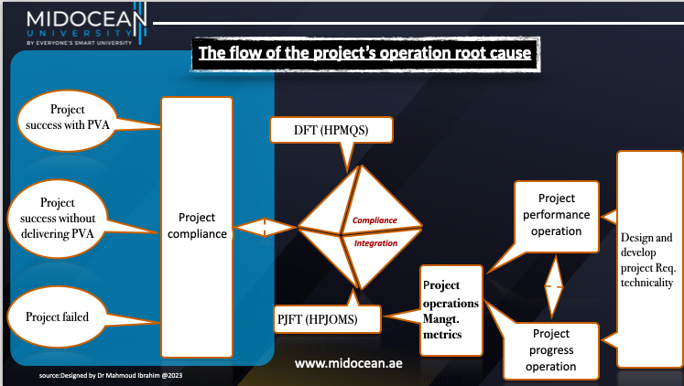

Slide 17
Based on that :
Regrading the PMP
We should ask the most common questions to deeply understand why this could happen.
1. How can we know that PMPs are developed correctly?
2. How can we know the performance of the PMP is done right?
3: How can we know the PMP performance has reached the right level of progress?
4: How can we ensure that the PMP is on the right track with the project success?

Slide 18
Based on that :
Regrading the PMP
We should ask the most common questions to deeply understand why this could happen.
1. How can we know that PMPs are developed correctly?
2. How can we know the performance of the PMP is done right?
3: How can we know the PMP performance has reached the right level of progress?
4: How can we ensure that the PMP is on the right track with the project success?

Slide 19
Secondly :Regrading the project life cycle
How can we know?
1. The phases are well planned.
II. The activities and tasks of each phase are well done.
III. The depth of the pass dead points
IV. The progress of the phases is as planned.
The phases, targets, and milestones are efficiently done.
VI: managing the phases on the right track of project success
VII: managing the phases on the right track of customer satisfaction

Slide 20
Finally ,the integration between the PMP and the PLC
How can we know
1- the performance of the DFT is well intergrated with the PJFT
2- the progress will lead to success the project and satisfy the customers
3- the integration on the right track for developing the PVA
4- the integration will lead to the readiness deliverable for the acceptance test .
5- the project is healthy enough to proceed and capable eenought for delivering the required benefits or not not just a uniqued product

Slide 21
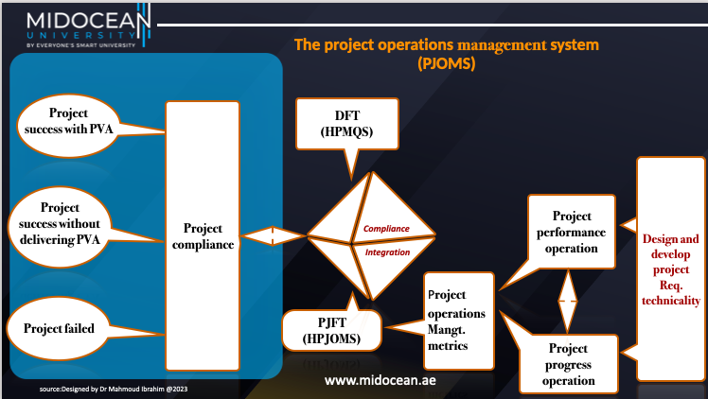

Slide 22
The relationship between the DFT and the PJFT

Slide 23
Project Fit technicality
It refers to the alignment between the project's technical requirements and the available resources and capabilities. It involves assessing whether the project can be successfully executed given the technical expertise, equipment, and infrastructure available within the organization.
-it is managed by the HPJOMS

Slide 24
Deliverable Fit technicality
-it is managed by the HPMQS
◊It refers to the degree to which a project's deliverables meet the technical requirements and specifications outlined in the project scope.
It encompasses the alignment between the final output of a project and the predetermined technical standards that must be adhered to.
◊It is a crucial aspect of project operations management as it ensures that the project's outcomes are in line with the desired technical outcomes and meet the expectations of stakeholders.
◊ According to the Project Management Institute (PMI), deliverable fit technicality is a key component of project quality management and is closely tied to the project's success

Slide 25
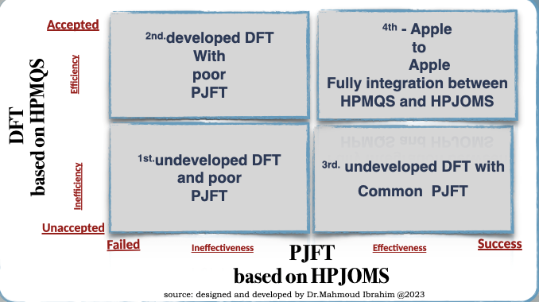

Slide 26
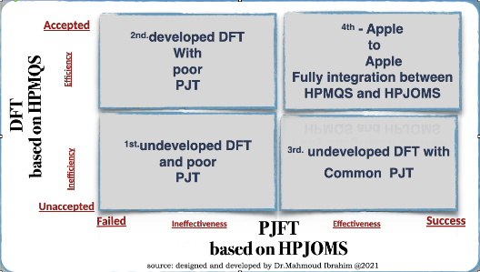
1st the project is failed and the company loss
The project is failed and the business is loss
1. Because the HPMQS is not applied and relies only on the project quality plan
2: Project managers apply the business operations management framework to the project execution phase only based on the project management plan, which leads to poor performance without any project progress to achieve the project goal.

Slide 27
2nd.developed DFT with poor PJT
The project has limited success, and the business is losing money.
Just delivering the required product with inefficient project performance and very poor project progress and with the customer acceptance but with unsatisfactory
1. Because the HPMQS is not applied and relies only on the project quality plan, it may have the support of a third party as a consultant.
2: Project managers apply the business operations management framework to the project execution phase only based on the project management plan.

Slide 28
3rd. undeveloped DFT with Common PJT
The project is a success based on the PMP, and the business is a loss.
Just delivering the project with the right time and budget, but with very poor scope management and deliverables, is not accepted by the customers.
1. Because the HPMQS is not applied and relies only on the project quality plan, it may have the support of a third party as a consultant.
2: Project managers apply the project operations framework to the project execution phase with little focusing on the project objectives only based on the project management plan.

Slide 29
4th - Apple to Apple
The project is a success and delivers the required PVA to the business effectively with full customer acceptance and satisfaction.
Because they are designing, developing ,planning ,directing and controlling the integration between the HPMQS, which is managing the effectiveness of the DFT as it is known as the scope keeper, and its subset, the HPJOM, which is managing the efficiency of the PJFT.

Slide 30
The integration between the of project performance operations and the project progress operation
(Project operations metrics )

Slide 31
The “Doing”Project performance operation
IT refers to the evaluation of how well a project is meeting its objectives, goals, and expectations.
It is an assessment of various factors such as cost, schedule, quality, and scope.
.According to the Project Management Institute (PMI), “project performance is measured by comparing actual results to planned outcomes, ensuring that the project is on track and delivering the desired outcomes.

Slide 32
The “Making”Project Progress operation
project progress is a measure of the advancement or movement JUST toward the project's completion. It involves tracking and monitoring the activities, tasks, and milestones that contribute to the project's overall timeline.
1-Project Progress can be measured by tracking the completion of scheduled tasks, the amount of work remaining, and the overall percentage of project completion.
2- Project progress can also be assessed by evaluating the achievement of key deliverables and milestones within specific timeframes.

Slide 33
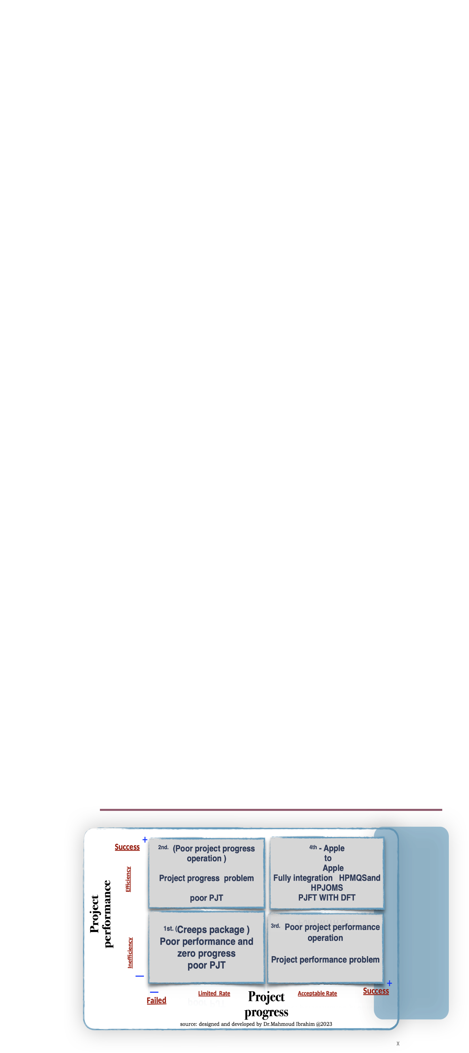

Slide 34
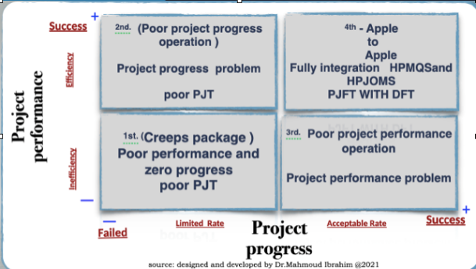
1st :Inefficient project performance and limited project progress
(Creeps Package)
Inefficient project performance and limited project progress rate will because of A lack of clear goals and objectives, and Unrealistic expectations and that leads to creeps of the scope ,cost and the time which is ensuring the poor PJFT and this will lead to :
1- the project will be failed
II-the business will loss money and its brand publicity
III-the customer will be dissatisfied

Slide 35
2nd.Efficient project performance and limited project progress
Apply the project operations only at the execution phase, and that has a limited impact on the rate of project progress because a lack of focus on risk management and quality control often leads to poor project performance, which leads to poor PJFT.
1: missing taking the corrective action in a timely manner
2: missing managing the stakeholder conflicts and developing a feedback loop (no transparency) and limited communications
3: Missing the effectiveness of customer involvement
4. Less focus on customer satisfaction

Slide 36
3rd-Inefficient project performance and accepted rate of the project progress
By focusing on the deliverables operations and applying project quality management more than balancing with project performance operations
So the product is delivered with a failed project that was overbought or behind schedule, and so on, and that leads to
-The customer is not satisfied.
-Loss of company time and cost and loss of customer confidence
-Limited transparency and poor reporting and documentation procedures

Slide 37
4th.Inefficient project performance and limited project progress
-Full integration between the HPMQS and HPJOMS
For having a ready deliverable with potential project value added and a positive impact on stakeholder satisfaction

Slide 38
conclusion
misunderstanding and Without clear guidelines well-defined plan for achieving success, of the project's objectives and desired outcomes.
the project may lack direction and struggle to meet its goals.

Slide 39
Do not forget
Powerful career =knowledgable+ skilled +expertise

Slide 40


Thank You

