Slide 2


Plan Communication Management
Chapter 4
Everyone’s Smart University
PMG101
Project communication

Slide 3
Section 2
Four Steps Process for Effective Communication
Lecture
Putting it into Practice
Section 1
Understanding the Communications
Communication Methodologies

Slide 4
Section one
Understanding the Communications

Slide 5
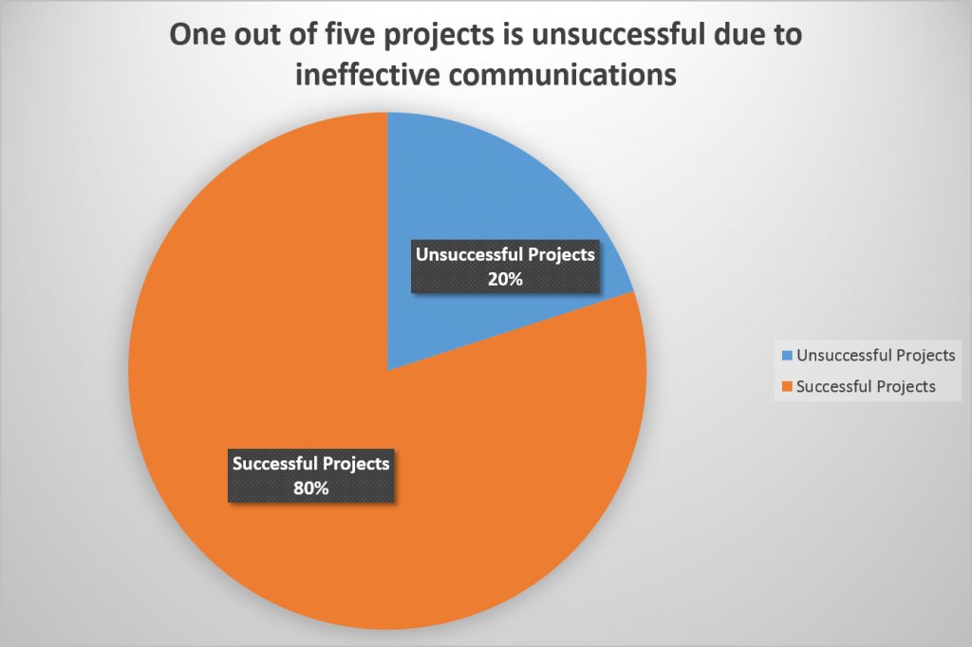
Understanding the Communications
The Importance of Project Communication
Without a sufficient project communication plan, it’s impossible to keep all responsible parties up-to-date on the changing status of the project. There’s a lack of transparency which eventually leads to inefficient, counterproductive decisions that will hinder the aims of the project in question.

Slide 6
Understanding the Communications
The Importance of Project Communication
Good communication keeps conflict and confusion from bogging your project down by ensuring key players are aligned on project goals and know exactly what’s expected of them.
It also helps build team-wide trust so everyone works better together from project start to finish

Slide 7
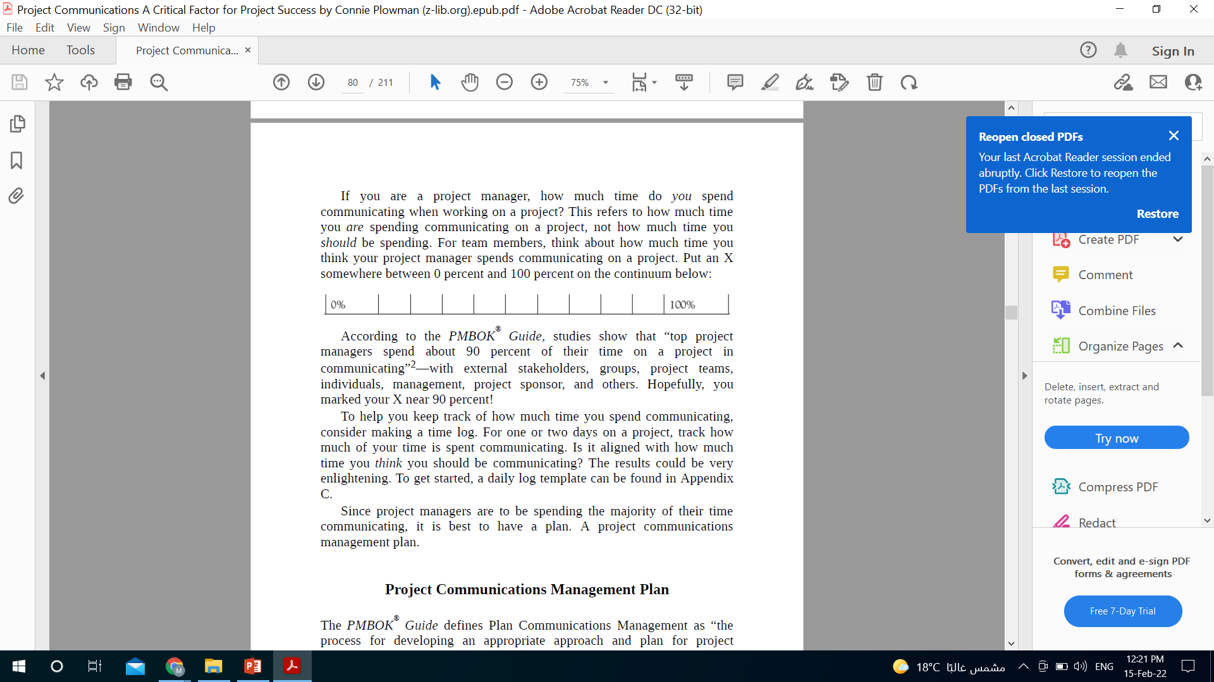
Understanding the Communications
According to the PMBOK® Guide, studies show that “top project managers spend about 90 percent of their time on a project in communicating”—with external stakeholders, groups, project teams, individuals, management, project sponsor, and others.

Slide 8
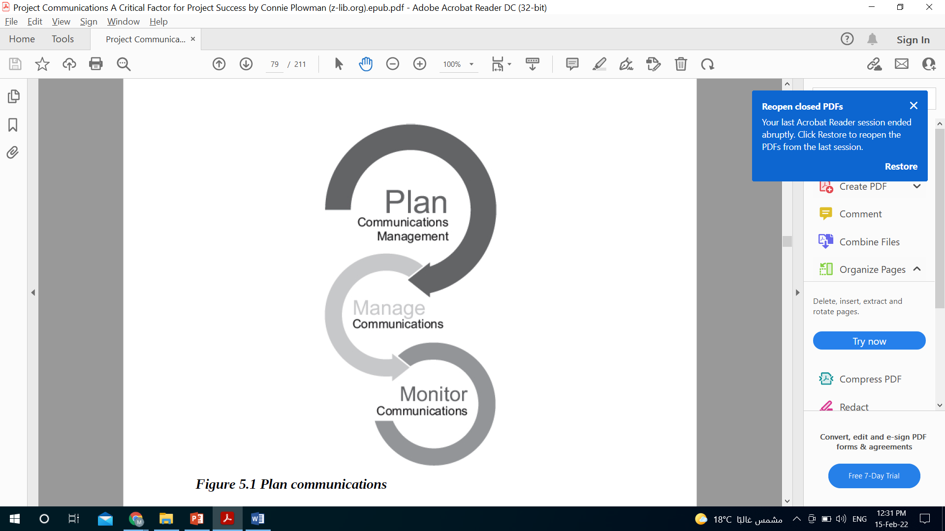
Understanding the Communications
Project Communications Management Plan

Slide 9
Understanding the Communications
Project Communications Management Plan
The PMBOK® Guide defines Plan Communications Management as “the process for developing an appropriate approach and plan for project communications activities based on the information needs of each stakeholder or group, available organizational assets, and the needs of the project.”

Slide 10
Understanding the Communications
Project Communications Management Plan
In other words
Consider it your “how to” document. How will you communicate with various stakeholder groups? How will you utilize the processes, procedures, policies, plans, and knowledge already established by the organization? What new processes or procedures might be needed? What, when, and who will send and receive information—and how will that information be distributed? Where will project information be stored and how will it be retrieved? How will the information be disposed of at the end of the project?

Slide 11
Understanding the Communications
Project Communications Management Plan
The Purpose
The purpose of a project communications management plan is to answer these and other questions in guiding the project team’s communications to “ensure timely and appropriate planning, collection, creation, description, storage, retrieval, management, control, monitoring, and ultimate disposition of project information.”

Slide 12

Understanding the Communications
Project Communications Management Plan
In short
Plan Communications Management happens in the planning process group. It is “communications road map.” It is our guide for keeping everyone informed—with the right message, at the right time, using the right methods, for the right reasons.

Slide 13
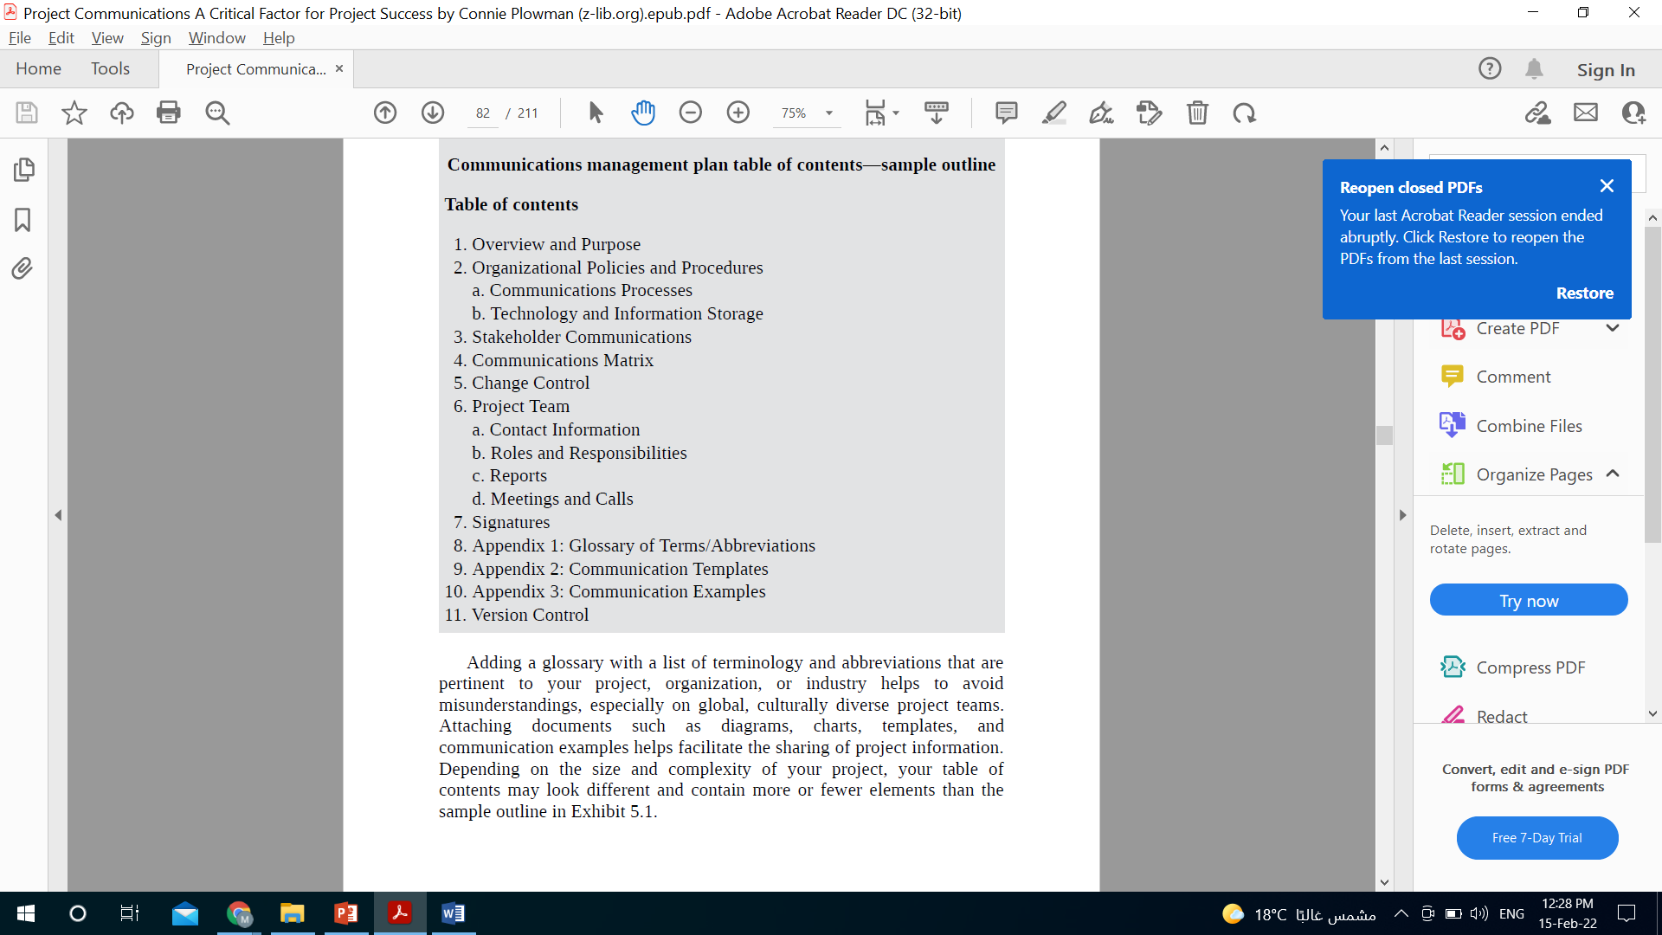
Understanding the Communications
Project Communications Management Plan

Slide 14
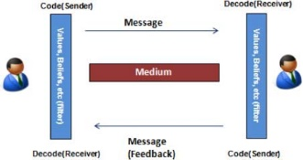
Understanding the Communications
The Communication process
To communicate effectively, project managers must have a good understanding of the communications process.

Slide 15
Understanding the Communications
The Communication process
To understand the communications process, project managers must understand all the relevant factors.
The communications process requires a sender and receiver.
The sender formulates the message to communicate, which is meant for a receiver. The sender creates the content with some intent in mind. The receiver, of course, receives the message and then deals with it according to personal reactions. He or she may accept, revise, or reject the message.

Slide 16
Understanding the Communications
The Communication process
To understand the communications process, project managers must understand all the relevant factors.
The communications process requires a medium to communicate the content of a message.
The medium may take just about any form, each unique in its ability to influence the receptivity of the receiver. As with the message itself, the receiver may elect to accept or reject the medium employed. The receiver may even elect to alter the medium so that he or she can receive and interpret the message according to his or her preferences.

Slide 17
Understanding the Communications
The Communication process
To understand the communications process, project managers must understand all the relevant factors.
The communications process requires a message.
The message can take many different forms, usually in hard or soft format. The hard format is usually written on paper whereas soft format is electronic. Regardless of the format, a message is necessary to initiate a communication and stimulate a relationship between two or more people.

Slide 18
Understanding the Communications
The Communication process
To understand the communications process, project managers must understand all the relevant factors.
The communications process requires feedback between the sender and receiver.
Feedback may be positive, negative, or neutral, indicating the receptivity of the sender or receiver. Feedback can also be simple or complex. Simple feedback occurs when it involves just two people; complex feedback is when the process involves three or more people. The movement from simple to complex is because the number of channels and opportunities for misinterpretation increase geometrically as each one codes their message and the other decodes the same.

Slide 19
Understanding the Communications
The Communication process
To understand the communications process, project managers must understand all the relevant factors.
The communications process is rarely “clean,” meaning that what the recipient receives may not be necessarily what the sender sent.
A number of variables can affect the quality of a message including the following: beliefs, values, the emotional impact of a message, and the medium employed. These variables and others often referred to as “noise,” can affect the degree of receptivity of a message and the feedback on the part of the sender or receiver. For example, the sender may not really believe in a message he or she formulates, but this person may be compelled to send it; the content of the message and its mode of delivery may influence the quality of the message and, ultimately, its receptivity.

Slide 20
Understanding the Communications
The Communication process
To understand the communications process, project managers must understand all the relevant factors.
The communications process will always be in a setting or context that influences results.
This context often involves time, space, and structure. Time may refer to the day of the week. Space may be as simple as the location of a person, or it may involve a project spread over a wide geographical area. Structure may be the organizational network in place for supporting the communications process of a project. For example, a project manager may want to communicate negative information about a schedule performance only in a specific setting, such as a project status review. Understanding the influence and interplay of the different variables involved requires a deep appreciation of these elements: sender and receiver, message, medium, feedback, variables, and setting.

Slide 21
Understanding the Communications
Communication Mediums
Given the organizational and geographical diversity of project teams – it is important to consider all methods of communication. Today’s enhanced technology allows us to communicate easily where ever the team members may be. A communication strategy should be conceived at the project planning stages, so key is its influence on the success of the project.
Communication Mediums can either be active or passive.
ACTIVE communication Mediums being those used to communicate in the here and now, for example the use of:
Face to Face meetings
Video conference, meeting – one on one, or group
Telephone conference, or voice only web conference
Webinars, becoming increasingly popular for the delivery of presentation based activities
Telephone – good old fashioned call

Slide 22
Understanding the Communications
Communication Mediums
Given the organizational and geographical diversity of project teams – it is important to consider all methods of communication. Today’s enhanced technology allows us to communicate easily where ever the team members may be. A communication strategy should be conceived at the project planning stages, so key is its influence on the success of the project.
Communication Mediums can either be active or passive.
Passive communication Mediums would be those which recipients can adopt in their own time, for example:
Pod cast
Web cast
Email
Intranet bulletin boards
Blogs
Website
Project newsletter – paper based
Table top presentation

Slide 23
Understanding the Communications
Communication Types
In addition to a myriad of channels, there are also dozens of types of communication. The type of communication you choose to use can have a huge effect on how that communication is received. Essentially, the type of communication as well as the medium or channel chosen is a part of the message itself. Some include:
• Internal/External: These communications vary based on whom they are directed to. External (to the organization, team, etc.) communications tend to be more formal.
• Formal/Informal: “Official,” formal communications often require much more work and approval. “Unofficial,” informal communications usually adopt an interpersonal tone.
• Vertical/Horizontal: The way that “higher-ups” are addressed often varies widely from the way team members communicate with one another. In the case of a project leader, vertical communication could include management. project groups. Peer-to-peer communication is typically horizontal and less formal.

Slide 24
Understanding the Communications
Communication Types
In addition to a myriad of channels, there are also dozens of types of communication. The type of communication you choose to use can have a huge effect on how that communication is received. Essentially, the type of communication as well as the medium or channel chosen is a part of the message itself. Some include:
• Written/Oral: These two common types of communication can have very different implications, especially down the line. Written communication is often considered more permanent whereas oral communication can be more appropriate in certain situations. Which of these you choose to use may have a big effect on how the message is perceived and may even carry legal repercussions down the road.
• Verbal/Nonverbal/Paralingual: When we communicate, our messages are influenced both by what we say and how we sat it. Verbal communication is almost always accompanied by nonverbal (posture, gestures, expression, etc.) and paralingual (pitch, tone of voice, channel, etc.) cues.

Slide 25
Understanding the Communications
Communication Blockers
In order to understand major obstacles that come a long way in a project, it is essential to know the interfaces any project may have. The interfaces are as follows:
Between organizations (e.g., customer-supplier);
Between departments within an organization (e.g., marketing-IT);
Between teams within a department (e.g., testers-developers); and
Within distributed teams (e.g., part of the team is in Seattle and the other in Sydney).
The main communication obstacles (across interfaces listed earlier) can be drilled down to the following three broad areas

Slide 26
Understanding the Communications
Communication Blockers
• Obvious Communication Blockers
– Language or cultural differences
– Interruptions by other parties
– Technical breakdowns
– Distractions to one or both parties such as fatigue
• Hidden Communication Blockers
– Negativity or hostility between the sender and the receiver
– Context known by one party but not the other
– Incorrect assumptions of shared understanding by both parties
– A lack of active listening on the receiver’s part.

Slide 27
Communication Methodologies

Slide 28
Communication Methodologies
Interactive communication
Pull communication
Push communication

Slide 29
Communication Methodologies
Interactive communication
Interactive Communication is a fairly self-explanatory term. As the name suggests, it is a multidirectional form of communication. When you require an immediate response, and when the information you are communicating is sensitive with the possibility of being misinterpreted, you turn to interactive communication. It involves one or more people exchanging thoughts and ideas, where participants respond in real-time.
Project managers prefer in-person interactive communication. When communication is performed over media, like video conferences, phones, meetings, etc., a project manager may not be able to pick up on facial expressions and body language of the stakeholders.

Slide 30
Communication Methodologies
Interactive communication
To understand this concept better, consider an example.
Let’s say you need to have a meeting with the stakeholders about the progress of a project, or you have a glitch in the project. Interactive communication would be preferred over using mails to convey messages and having them respond by email. Rather than being unsure of what is happening, you’d be better off calling for a meeting or a video conference so you can convey the problem to them and receive feedback.

Slide 31
Communication Methodologies
Push communication
– Primary Strength: The sender knows when and to whom it was directed.
– Ideal Uses: Non-urgent communication or information not requiring immediate response.
This kind of communication is from sender to receiver, and is preferable when you distribute information, yet are not looking for an immediate response—or if the matter you are trying to convey is not urgent or sensitive. However, as soon as the recipient views the message, some action is required.

Slide 32
Communication Methodologies
Push communication
– Primary Strength: The sender knows when and to whom it was directed.
– Ideal Uses: Non-urgent communication or information not requiring immediate response.
Push communication includes memos, letters, emails, reports, faxes, etc. It is not face-to-face but is instead typically done through some written medium. The one disadvantage of this type of communication is that the sender can only identify that the message has been successfully sent. Some email systems can notify you when an email has been opened, but this feature can’t guarantee that the recipient has understood the message trying to be communicated.

Slide 33
Communication Methodologies
Pull communication
– Primary Strength: Access is at the receiver’s discretion, which helps to avoid “information overload.”
– Ideal Uses: Non-vital communications or information that needs to be accessed frequently by multiple parties.
Pull communication doesn’t involve pulling in a reader to read your message. Instead, pull communication is all about providing group access to common information. The receiver, however, must recover this information. This method is used for a large audience who require access to information for their use.

Slide 34
Communication Methodologies
Pull communication
– Primary Strength: Access is at the receiver’s discretion, which helps to avoid “information overload.”
– Ideal Uses: Non-vital communications or information that needs to be accessed frequently by multiple parties.
When your communication is informational, make use of this kind of information. If a receiver does not read your message, it will in no way affect the project. Since information will be accessed only when the need arises, pull communication is known to be the most appropriate kind of communication. Methods of pull communication include posting information on websites, wikis, knowledge repositories, bulletin boards, etc.

Slide 35
Section two
Four Steps Process for Effective Communication

Slide 36
Four Steps Process for Effective Communication
Identify Communication Requirements
The project manager and the project team work together to identify who needs what information. In other words, project management needs to know what the requirements of successful communications are in order to plan on how to achieve those requirements.
First, the team to whom communication is essential needs to be determine the number of channels of communication possible using the communication formula
Stakeholders will need different types of information, depending on their interest in project and the priority of the project. The project manager will need to complete the analysis of the identified stakeholders to determine what information they actually need as well as how often the information is needed.

Slide 37
Four Steps Process for Effective Communication
Identify Communication Requirements
The project manager and the project team can identify the demand for communications using the following:
Organization charts,
The project structure within the performing organization,
Stakeholder responsibility relationships,
Departments and disciplines involved within the project work,
The number of individuals involved in the project and their locales,
Internal and external information needs, and
Stakeholder information.

Slide 38
Four Steps Process for Effective Communication
Identify the 5Ws (Why, What, When, Where, Who) and 1H (How)
Who needs to be communicated to. This is based on the communication formula and needs to be determined.
What needs to be communicated. All information related to the project need not be communicated to everyone in the team.
When it should be communicated. The timeline of communication should be monitored.

Slide 39
Four Steps Process for Effective Communication
Identify the 5Ws (Why, What, When, Where, Who) and 1H (How)
Where should it be communicated. If the team involves many people, then individual level and team level communications needs to be resolved.
Why communication of information is essential and to what level is important. Why is it not encouraged as it is blame rather than change.
How the communication needs to be done. Is it conducted via e-mail, phone, or a presentation done to the team members?

Slide 40
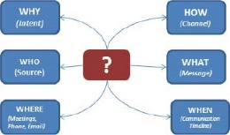
Four Steps Process for Effective Communication
Identify the 5Ws (Why, What, When, Where, Who) and 1H (How)

Slide 41
Four Steps Process for Effective Communication
Identify and Accommodate the Enterprise Environmental Factors
Much of the communications management processes are linked to the enterprise environmental factors. Enterprise environmental factors that affect project communications are as follows:
Organizational culture and structure,
Standard and regulations the project must comply with,
The logistics and the organizational infrastructure,
The human resources the project will rely on and interact with,
The policies and procedures for personnel administration,

Slide 42
Four Steps Process for Effective Communication
Identify and Accommodate the Enterprise Environmental Factors
Much of the communications management processes are linked to the enterprise environmental factors. Enterprise environmental factors that affect project communications are as follows:
The project's work authorization system,
The marketplace conditions,
Stakeholder risk tolerances,
Commercial databases that the project may use for estimating, and
Project management information system.
These enterprise factors should be identified and reviewed and the project manager should align his or her project initiative considering all of these factors.

Slide 43
Four Steps Process for Effective Communication
Identify Organizational Process Assets
The organizational process assets affect how the project manager, project team, and the stakeholders will communicate within a project. The primary organizational process assets that affect communication include the following:
Standards and policies unique to the organization;
Organizational guidelines, work instructions and performance measurement criteria;
Organizational communication requirements for all projects considering required and approved technology, security issues, archiving and allowed communication media;
Project closure requirements;

Slide 44
Four Steps Process for Effective Communication
Identify Organizational Process Assets
The organizational process assets affect how the project manager, project team, and the stakeholders will communicate within a project. The primary organizational process assets that affect communication include the following:
Financial controls and procedures;
Issue and defect management procedures for all projects;
Change control procedures;
Risk control procedures;
Work authorization systems;
Process measurement database;
Project file structure, organization, and retention;
Historical information and lessons learned requirements;
Issue and defect management databases;

Slide 45
Four Steps Process for Effective Communication
Identify Organizational Process Assets
The organizational process assets affect how the project manager, project team, and the stakeholders will communicate within a project. The primary organizational process assets that affect communication include the following:
Project file structure, organization, and retention;
Historical information and lessons learned requirements;
Issue and defect management databases;
Configuration management databases; and
Project financial databases detailing labor hours, costs, budget issues, and cost overruns.
These process assets may be unique for each organization, but if this is reviewed before the initiation of the project and reflected in the communication to the team, then there will never be a problem throughout the project.

Slide 46
Section Two
Putting it into Practice

Slide 47
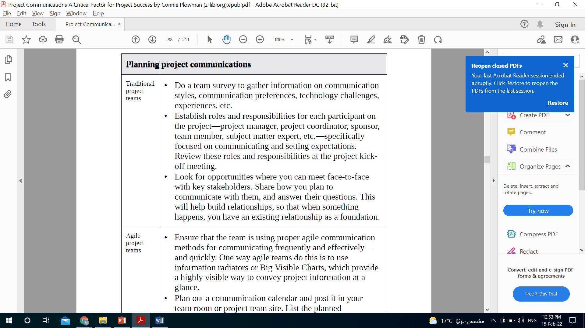
Putting it into Practice
Traditional teams

Slide 48
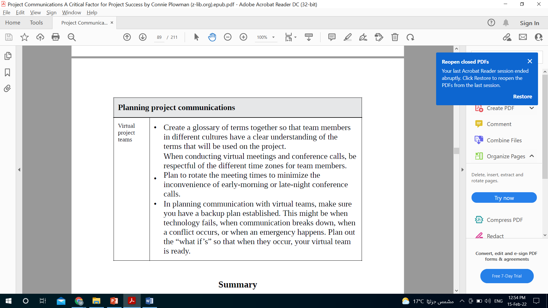
Putting it into Practice
Virtual teams

Slide 49


