Slide 1


Employment Relations
Employee relations issues and strategies for improvement
Prepared by Dr. Nourhan Sayed
HRM 624
7th Lecture
Lecture (7)

Slide 2



Employment Relations
Employee relations issues and strategies for improvement
Lecture (7)
HRM 624
7th Lecture
Prepared by
Dr. Nourhan Sayed
www.midocean.ae

Slide 3
Common Employee Relations Issues
Efforts towards employee relations will always face challenges and issues, both for small and large businesses.

Slide 4
A. Pay Rise
Common Employee Relations Issues

Slide 5
A. Pay Rise
Probably the most challenging conversation in a workplace revolves around pay rise requests. They are veritable minefields, some of them escalating into full confrontations or resignations just because of a single misconstrued word.
Use this as an opportunity to acknowledge that employees decided to talk before they walked to better pay.

Slide 6
B. Hours and Wage Issues
Common Employee Relations Issues

Slide 7
B. Hours and Wage Issues
To maintain a strategic distance from wage and hour infringement and decrease the possibility that workers will debate their paychecks, consider self-service timekeeping computer program that permits them to clock in and out from their keen gadgets. Self-service will empower representatives to keep track of and oversee their plans.

Slide 8
c. Interpersonal Conflicts
Common Employee Relations Issues

Slide 9
c. Interpersonal Conflicts
Conflict can happen in any environment, and the work environment is certainly no diverse. Debate between workers can emerge due to individual or work-related reasons, dissimilar points of view, or communication issues. In the event that there's not a straightforward way for the two parties to communicate, the struggle can turn into poor worker morale or the termination of a team member.

Slide 10
c. Interpersonal Conflicts (Cont’d)
Often, resolving such disputes creates better employee relationships, paving the way for future success.
Here are some solutions to resolve such argument.
Let's talk about it.
Listen to both sides of the story without bias and help them reach a common perspective.

Slide 11
c. Interpersonal Conflicts (Cont’d)
Be empathetic:
Understand that employees have concerns too and listen to their frustrations.
Be an active listener:
Listening to employee concerns without interrupting to get to the root of the problem can be of great help.

Slide 12
D. Annual Leave
Common Employee Relations Issues

Slide 13
D. Annual Leave
Annual leave is another sensitive issue that can give rise to disputes.
When poorly managed, annual leave issues can have a negative impact on your business.
annual leave is important for employees for many reasons: it's a way to reduce stress levels, boost motivation within the company, and increase productivity.

Slide 14
D. Annual Leave (Cont’d)
Many HR departments struggle with annual leave, especially when planning and tracking leave.
Other leave situations, such as sick leave, stress leave and parental leave, require better and more effective ways to monitor and avoid complications.

Slide 15
F. Attendance issues
Common Employee Relations Issues

Slide 16
F. Attendance issues
Attendance issues are a common problem in most workplaces.
Perhaps some employees are late for work, others don't come to work at all, or a buddy punching covering up for them.

Slide 17
F. Attendance issues (Cont’d)
Additionally, most managers are unable to reach out to their employees, probably because they don't want to be "that guy" within the company.
However, lateness or absence without unavoidable reasons will not be accepted.

Slide 18
F. Attendance issues (Cont’d)
Time tracking and attendance issues are common problems, but many can be solved by using employee self-service software.
Enabling employees to manage their time and communicate directly about time and attendance issues through their smart devices reduces the risk of conflicts and provides practical benefits.

Slide 19
G. Adequate workplace safety
Common Employee Relations Issues

Slide 20
G. Adequate workplace safety
Employee injuries and accidents are one of a manager's worst nightmares.
Regardless of industry or sector, companies should do more to promote workplace safety.

Slide 21
G. Adequate workplace safety (Cont’d)
Workplace safety starts with providing employees with the proper safety equipment, such as masks, goggles, and gloves.
A good policy should also ensure that employees don't work too much overtime and become unduly fatigued.

Slide 22
Best Strategies To Enhance Employee Relations

Slide 23
Introduction
Small businesses have an advantage in relation to their employees.
The smaller the number of employees, the easier it is to build a foundation for a good work culture and strong relationships.
By investing in the company's goals and vision from the beginning, you set yourself up for a successful relationship in the future.

Slide 24
1. Honest communication

Slide 25
1. Honest communication
Best Strategies To Enhance Employee Relations

Slide 26
1. Honest communication
Good and honest communication is the basis of any relationship.
It's important to communicate openly with your employees and create a safe space where everyone feels free to speak up and ask questions.
Communication between managers and employees is always a challenge.

Slide 27
1. Honest communication (Cont’d)
You want to focus on your future work, set goals, and move forward with important projects.
Your team is looking for your advice across multiple channels.
Approaching communication effectively can contribute to a dynamic workplace culture that reduces conflict, increases engagement, and increases productivity.

Slide 28
1. Honest communication (Cont’d)
How we can improve communications between managers and employees:
a. Schedule frequent one-on-one meetings. These kind of meetings are the ideal way to find out about the specifics, obstacles, and concepts that your employees are thinking about.

Slide 29
1. Honest communication (Cont’d)
How we can improve communications between managers and employees:
b. Set up team meetings every week. Every member has to know about the current tasks and difficulties as well as the upcoming deadlines. Encouraging colleagues to ask questions during meetings and maintaining a casual tone are two effective practices.

Slide 30
1. Honest communication (Cont’d)
How we can improve communications between managers and employees:
c. Adopt contemporary means of communication.
We already know that a variety of applications facilitate better collaboration at work. There are several solutions available to you, ranging from chat platforms (Slack, Teams) to tracking project/task updates (Asana, Monday), document collaboration (Docs), and video conferencing (Meet, Zoom).

Slide 31
1. Honest communication (Cont’d)
How we can improve communications between managers and employees:
d. Ask and give constructive feedback. . When discussing performance, the progress of a project, or team dynamics, be explicit about your expectations, what is successful, and what still needs improvement. People feel more confident when obstacles are overcome and they know that the management is rooting for them. Additionally, don't be hesitant to offer both favourable and negative criticism.

Slide 32
2. Cultivate a trustworthy relation
Best Strategies To Enhance Employee Relations

Slide 33
2. Cultivate a trustworthy relation
Prevent micromanaging your staff. Make sure everyone is aware of your expectations of them, what they should do, and that you are there to help if needed. Then move away and give them space. Have faith in them.

Slide 34
2. Cultivate a trustworthy relation (Cont’d)
The foundation of a successful business is trust. And there are a number of other kinds of trust you should take into account: faith in the mission and guiding principles of the company; trust in your selection of deserving candidates for important roles; trust in HR procedures and leadership; and trust amongst coworkers.

Slide 35
2. Cultivate a trustworthy relation
(Cont’d)
How to build trust at work, how to build confidence with coworkers:
Be honest
Be considerate
Offer support
Show appreciation
Respect people.

Slide 36
3. Develop a listening habit
Best Strategies To Enhance Employee Relations

Slide 37
3. Develop a listening habit
Keep in mind to pay attention to their responses the next time you engage in conversation with your team. Listening, communicating, and problem-solving are all necessary for talks to be healthy, productive, and effective.
Although it's important for every employee to be a good listener, this isn't always the case. We listen at work in order to gain new information, comprehend the task at hand, and improve as professionals.

Slide 38
4. Write a transparent employee relations policy
Best Strategies To Enhance Employee Relations

Slide 39
4. Write a transparent employee relations policy
The company's standards and regulations, as well as instructions for handling issues pertaining to employees, must be included in the policy. Remember that you will probably handle individual employees differently from your organisation as a whole. It is helpful to have an employee handbook that explains such regulations in detail.

Slide 40
5. Invest in your people
Best Strategies To Enhance Employee Relations

Slide 41
5. Invest in your people
Investing in your staff is another way to demonstrate your concern and foster a positive work environment. The following are some aspects of learning and growth that are important to consider:
a.Feedback: We are able to comprehend the viewpoints of our staff and offer guidance on next steps because of their helpful criticism.

Slide 42
5. Invest in your people
b. Flexibility: Allow your staff to plan times for their own learning and allow them to manage their time and responsibilities.
c. Career paths: For every position you have inside the company, have a career path.
d. Mentorship programmes: When your company want to help seasoned leaders and novice managers exchange information, expertise, and experience.
c. People skills and technical trainings: Investing in the training of current staff is the first step towards having better employees.

Slide 43
6. Train your managers in employee relations
Best Strategies To Enhance Employee Relations

Slide 44
6. Train your managers in employee relations
Managers are playing a bigger role than ever in their relationships with employees.
When you train your managers on teamwork, conflict resolution, and change management, your employees will notice a difference right away.
Learn some of the most important skills in human resources management.
Managers can be selfish and self-centered (also known as narcissism).

Slide 45
6. Train your managers in employee relations (Cont’d)
Poor employee relationships can negatively impact a company in a variety of ways:
High Absenteeism
Poor Performance
Damaged Company Reputation
Lack of Employee Commitment
Interpersonal Conflicts
Unpleasant Work Environment.

Slide 46
7. Promote healthy work-life balance
Best Strategies To Enhance Employee Relations

Slide 47
7. Promote healthy work-life balance
Unfortunately, some managers and employees forget that their personal lives come first. The only good thing about coronavirus is that it makes us a little more hedonistic.
We are increasingly seeking and valuing benefits that allow us to achieve a better work-life balance.This includes flexible working hours, paid time off, and health benefits.But it's not just about the benefits.
Changes occur depending on the attitude of management.Employees often welcome the opportunity to work from home, but that doesn't mean they should be asked to take their work home with them.

Slide 48
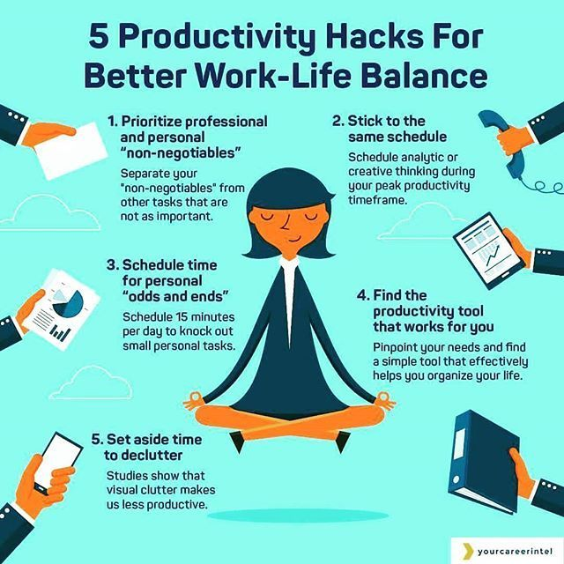
7. Promote healthy work-life balance

Slide 49
8. Inspire and reward
Best Strategies To Enhance Employee Relations

Slide 50
8. Inspire and reward
Don't just communicate your vision and goals, create them with your employees.
Employees often have insights that can make a big difference to their efficiency and the success of their company.
Creating a positive work environment and a healthy company culture begins with valuing your employees and giving them the recognition and recognition they deserve.
Remember that everything is based on mutual respect, trust and compassion.

Slide 51
8. Inspire and reward(Cont’d)
When building your recognition program, consider the following:
Provide employees with clear growth factors.
Treat employees fairly.
Track Performance.
Introducing variety.
Celebrate success.
Share credit in a timely manner.

Slide 52
References
The Key Pillars of Employee Relations | LeaveBoard
John W. Budd , Labor relations textbook , MC Graw-Hill , 6th edition .

Slide 53
Thank you .

