Slide 1





The Financial Environment
Lecture 1
Prepared by Dr. Walaa Mohamed
MGM 237
Introduction to Finance

Slide 2
LEARNING OBJECTIVES
After studying this lecture, you should be able to do the following:
LO 1.1 Deﬁne ﬁnance and describe the three areas of ﬁnance.
LO 1.2 Explain why ﬁnance should be studied.
LO 1.3 Describe and discuss the six principles of ﬁnance.
LO 1.4 Identify the four components of the ﬁnancial system and describe their roles.
LO 1.5 Describe ﬁnancial markets characteristics and the four types of ﬁnancial markets.

Slide 3
1. What Is Finance?
Almost every day we hear news reports about economic conditions, unemployment, price changes, interest rates, stock prices, government expenditures and taxes, and monetary policy. Many of us are often overwhelmed trying to understand and interpret developments and inter- actions among these topics. We begin this textbook by deﬁning ﬁnance and describing the ﬁnancial environment and the three areas of ﬁnance.
Finance is the study of how individuals, institutions, governments, and businesses acquire, spend, and manage money and other ﬁnancial assets. Understanding ﬁnance is important to all students regardless of the discipline or area of study, because nearly all business and economic decisions have ﬁnancial implications. The decision to spend or consume now (for new clothes or dinner at a fancy restaurant) rather than save or invest (for spending or consuming more in the future) is an everyday decision that we all face.

Slide 4
The ﬁnancial environment encompasses the ﬁnancial system, institutions or intermediaries (we will use these terms interchangeably throughout this text), ﬁnancial markets, business ﬁrms, individuals, and global interactions that contribute to an efficiently operating economy.
Figure 1.1 depicts the three areas of ﬁnance—institutions and markets, investments, and ﬁnancial management—within the ﬁnancial environment. Note that while we identify three distinct ﬁnance areas, these areas do not operate in isolation but rather interact or intersect with each other.

Slide 5
Financial institutions are organizations or intermediaries that help the ﬁnancial system operate eﬃciently and transfer funds from savers and investors to individuals, businesses, and governments that seek to spend or invest the funds in physical assets (inventories, buildings, and equipment).
Financial markets are physical locations or electronic forums that facilitate the ﬂow of funds among investors, businesses, and governments. The investments area involves the sale or marketing of securities, the analysis of securities, and the management of investment risk through portfolio diversiﬁcation.
Financial management involves ﬁnancial planning, asset management, and fund-raising decisions to enhance the value of businesses. Its objective is to maximize the value of the firm for stockholders.

Slide 6
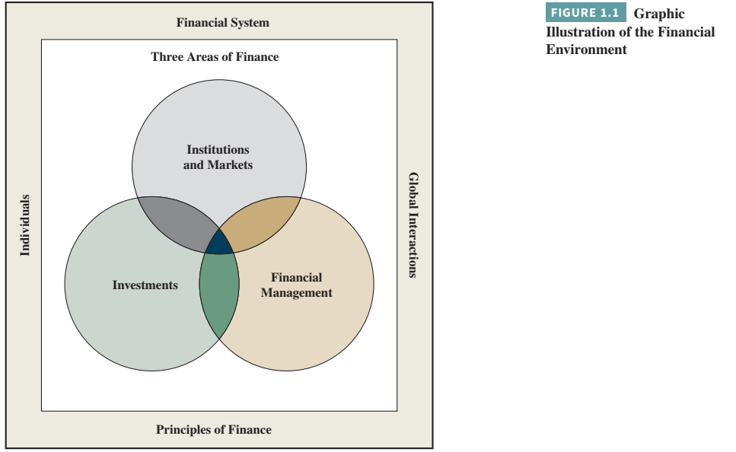

Slide 7
Financial institutions are intermediaries, such as banks, insurance companies, and investment companies that engage in ﬁnancial activities to aid the ﬂow of funds from savers to borrowers or investors.
Investment management involves making decisions relating to issuing and investing in stocks and bonds. Financial management in business involves making decisions relating to the efficient use of ﬁnancial resources in the production and sale of goods and services. The goal of the ﬁnancial manager in a proﬁt-seeking organization should be to maximize the owners’ wealth. This is accomplished through effective ﬁnancial planning and analysis, asset management, and the acquisition of ﬁnancial capital. Financial managers in not-for-proﬁt organizations aim to provide a desired level of services at acceptable costs and perform the same ﬁnancial management functions as their for-proﬁt counterparts.

Slide 8
Successful businesses typically progress through a series of life-cycle stages—from the idea stage to exiting the business. More speciﬁcally, the successful business typically moves through ﬁve stages: development, start-up, survival, rapid growth, and maturity. Individuals who choose to become small business owners do so for a number of different reasons.
Some small business owners focus on salary-replacement opportunities, where they seek income levels comparable to what they could have earned by working for much larger ﬁrms. Other individuals pursue lifestyle small business opportunities, where they get paid for doing things they like to do. Entrepreneurs seek to own and run businesses that stress high growth rates in sales, proﬁts, and cash ﬂows.

Slide 9
Entrepreneurial ﬁnance is the study of how growth driven, performance focused, early stage ﬁrms (from development through early rapid growth) raise ﬁnancial capital and manage their operations and assets. Our small business practice boxes focus on operational and ﬁnancial issues faced by early stage ﬁrms.
Personal ﬁnance is the study of how individuals prepare for ﬁnancial emergencies, protect against premature death and the loss of property, and accumulate wealth over time. Our personal ﬁnancial planning boxes focus on planning decisions made by individuals, regarding saving and investing their ﬁnancial resources.

Slide 10
2. Why Study Finance?
    1. To make informed economic decisions.
As we will see, the operation of the ﬁnancial system and the performance of the economy are inﬂuenced by policy makers. Individuals elect many of these policy makers in the United States, such as the president and members of Congress. Since these elected officials have the power to alter the ﬁnancial system by creating laws, and since their decisions can inﬂuence economic activity, it is important that individuals be informed when making political and economic choices. Do you want a balanced budget, lower taxes, free international trade, low inﬂation, and full employment? Whatever your ﬁnancial and economic goals may be, you need to be an informed participant if you wish to make a diﬀerence. Every individual should attain a basic understanding of ﬁnance as it applies to the ﬁnancial system.

Slide 11
    2. To make informed personal and business investment decisions.
An understanding of ﬁnance should help you better understand how the institution, government unit, or business that you work for ﬁnances its operations. At a personal level, the understanding of investments will enable you to better manage your ﬁnancial resources and provide the basis for making sound decisions for accumulating wealth over time. Thus, in addition to understanding ﬁnance basics relating to the ﬁnancial system and the economy, you also need to develop an understanding of the factors that inﬂuence interest rates and security prices.

Slide 12
    3. To make informed career decisions based on a basic understanding of business ﬁnance.
    Even if your business interest is in a nonﬁnance career or professional activity, you likely will need to interact with ﬁnance professionals both within and outside your ﬁrm or organization. Doing so will require a basic knowledge of the concepts, tools, and applications of ﬁnancial management.

Slide 13
3. Six Principles of Finance
Finance is founded on six important principles. The ﬁrst ﬁve relate to the economic behavior of individuals, and the sixth focuses on ethical behavior. Knowing about these principles will help us understand how managers, investors, and others incorporate time and risk into their decisions, as well as why the desire to earn excess returns leads to information-efficient ﬁnancial markets in which prices reﬂect available information. Unfortunately, sometimes greed associated with the desire to earn excess returns causes individuals to risk losing their reputations by engaging in questionable ethical behavior and even unethical behavior in the form of fraud or other illegal activities. The bottom line is, “Reputation matters!”

Slide 14
The following are the six principles that serve as the foundation of ﬁnance:
• Money has a time value.
• Higher returns are expected for taking on more risk.
• Diversiﬁcation of investments can reduce risk.
• Financial markets are efficient in pricing securities.
• Manager and stockholder objectives may differ.
• Reputation matters.

Slide 15
1. Time Value of Money
Let’s look at these principles one by one. Money in hand today is worth more than the promise of receiving the same amount in the future. The “time value” of money exists because a sum of money today could be invested and grow over time.
For example, assume that you have $1,000 today and that it could earn $60 (6 percent) interest over the next year. Thus, $1,000 today would be worth $1,060 at the end of one year (i.e., $1,000 plus $60). As a result, a dollar today is worth more than a dollar received a year from now.
The time-value-of-money principle helps us to understand the economic behavior of individuals and the economic decisions of the institutions and businesses that they run.

Slide 16
2.Risk Versus Return
A trade-off exists between risk and expected return in all types of investments—both assets and securities. Risk is the uncertainty about the outcome or payoﬀ of an investment in the future. For example, you might invest $1,000 in a business venture today. After one year, the ﬁrm might be bankrupt and you would lose your total investment. On the other hand, after one year your investment might be worth $2,400. This variability in possible outcomes is your risk. Instead, you might invest your $1,000 in a U.S. government security, where after one year the value may be $950 or $1,100. Rational investors would consider the business venture investment to be riskier and would choose this investment only if they feel the expected return is high enough to justify the greater risk. Investors make these trade-oﬀ decisions every day.
Business managers make similar trade-oﬀ decisions when they choose between different projects in which they could invest. Understanding the risk/return trade-oﬀ principle also helps us understand how individuals make economic decisions.

Slide 17
3. Diversification of Risk
While higher returns are expected for taking on more risk, all investment risk is not the same. In fact, some risk can be removed or diversiﬁed by investing in several diﬀerent assets or securities. Let’s return to the example involving a $1,000 investment in a business venture, where after one year the investment could provide a return of either zero dollars or $2,400.
Now let’s assume that there also is an opportunity to invest $1,000 in a second, unrelated business venture in which the outcomes would be zero dollars or $2,400. Let’s further assume that we will put one-half of our $1,000 investment funds in each investment opportunity such that the individual outcomes for each $500 investment would be zero dollars or $1,200.

Slide 18
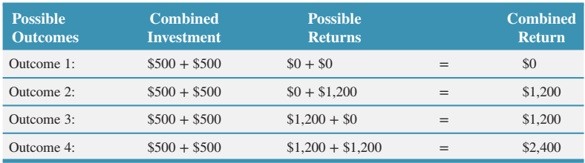
While it is possible that both investments could lose everything (i.e., return zero dollars) or return $1,200 each (a total of $2,400), it is also possible that one investment would go broke and the other would return $1,200. So, four outcomes are now possible:

Slide 19
If each outcome has an equal, one-fourth (25 percent), chance of occurring, most of us would prefer this diversiﬁed investment. While it is true that our combined investment of $1,000 ($500 in each investment) at the extremes could still return zero dollars or $2,400, it is also true that we have a 50 percent chance of getting $1,200 back for our $1,000 investment. As a result, most of us would prefer investing in the combined or diversiﬁed investment rather than in either of the two investments separately.

Slide 20
4. Financial Markets Are Efficient
A fourth ﬁnance-related aspect of economic behavior is that individuals seek to ﬁnd undervalued and overvalued investment opportunities involving both real and ﬁnancial assets. It is human nature, economically speaking, to search for investment opportunities that will provide returns higher than those expected for undertaking a speciﬁed level of risk. This attempt by many to earn excess returns, or to “beat the market,” leads to information- eﬃcient ﬁnancial markets.
However, at the same time it becomes almost impossible to consistently earn returns higher than those expected in a risk/return trade-oﬀ framework. Rather than looking at this third pillar of ﬁnance as a negative consequence of human economic behavior, we prefer to couch it positively in that it leads to information-eﬃcient ﬁnancial markets.
A ﬁnancial market is said to be information eﬃcient if at any point the prices of securities reﬂect all information available to the public. When new information becomes available, prices quickly change to reﬂect that information

Slide 21
For example, let’s assume that a ﬁrm’s stock is currently trading at $20 per share. If the market is eﬃcient, both potential buyers and sellers of the stock know that $20 per share is a fair price. Trades should be at $20, or near to it, if the demand (potential buyers) and supply (potential sellers) are in reasonable balance. Now, let’s assume that the ﬁrm announces the production of a new product that is expected to substantially increase sales and proﬁts. Investors might react by bidding up the price to, say, $25 per share to reﬂect this new information. Assuming this new information is assessed properly, the new fair price becomes $25 per share.
This informational eﬃciency of ﬁnancial markets exists because a large number of professionals are continually searching for mispriced securities. Of course, as soon as new information is discovered, it is immediately reﬂected in the price of the associated security. Information-eﬃcient ﬁnancial markets play an important role in the marketing and transferring of ﬁnancial assets between investors by providing liquidity and fair prices.

Slide 22
5. Management Versus Owner Objectives
A ﬁfth principle of ﬁnance relates to the fact that management objectives may differ from owner objectives. Owners, or equity investors, want to maximize the returns on their investments but often hire professional managers to run their ﬁrms. However, managers may seek to emphasize the size of ﬁrm sales or assets, have company jets or helicopters available for their travel, and receive company-paid country club memberships.
Owner returns may suﬀer as a result of manager objectives. To bring manager objectives in line with owner objectives, it often is necessary to tie manager compensation to measures of performance beneﬁcial to owners. Managers are often given a portion of the ownership positions in privately held ﬁrms and are provided stock options and bonuses tied to stock price performance in publicly traded ﬁrms. The possible conﬂict between managers and owners is sometimes called the principal-agent problem.

Slide 23
6.Reputation Matters
The sixth principle of ﬁnance is, “Reputation matters!” An individual’s reputation reﬂects his or her ethical standards or behavior. Ethical behavior is how an individual or organization treats others legally, fairly, and honestly. Of course, the ethical behavior of organizations reﬂects the ethical behaviors of their directors, oﬃcers, and managers. For institutions or businesses to be successful, they must have the trust and conﬁdence of their customers, employees, and owners, as well as that of the community and society they operate in.
All would agree that ﬁrms have an ethical responsibility to provide safe products and services, to have safe working conditions for employees, and not to pollute or destroy the environment. Laws and regulations exist to ensure minimum levels of protection and maintain the diﬀerence between unethical and ethical behavior. Examples of high ethical behavior include when ﬁrms establish product safety and working-condition standards well above the legal or regulatory standards.

Slide 24
Unfortunately, and possibly due in part to the greed for excess returns (such as higher salaries, bonuses, more valuable stock options, personal perquisites, etc.), directors, oﬃcers, managers, and other individuals sometimes are guilty of unethical behavior for engaging in fraudulent or other illegal activities.
Reputations are destroyed, criminal activities are prosecuted, and involved individuals may receive jail sentences. The unethical behavior of directors, officers, and managers also may lead to a loss of reputation and even destruction of the institutions and businesses for which they work.

Slide 25
4. Overview of the Financial System
The ﬁnancial system is a complex mix of ﬁnancial intermediaries, markets, instruments, policy makers, and regulations that interact to expedite the ﬂow of ﬁnancial capital from savings into investment.
Figure 1.2 provides a graphical review of the four major components of the U.S. ﬁnancial system. First, an effictive ﬁnancial system must have several sets of policy makers who pass laws and make decisions relating to ﬁscal and monetary policies. These policy makers include the president, Congress, and the U.S. Treasury, plus the Federal Reserve Board. Since the United States operates within a global economy, political and economic actions of foreign policy makers inﬂuence, although indirectly, the U.S. ﬁnancial system and its operations.

Slide 26
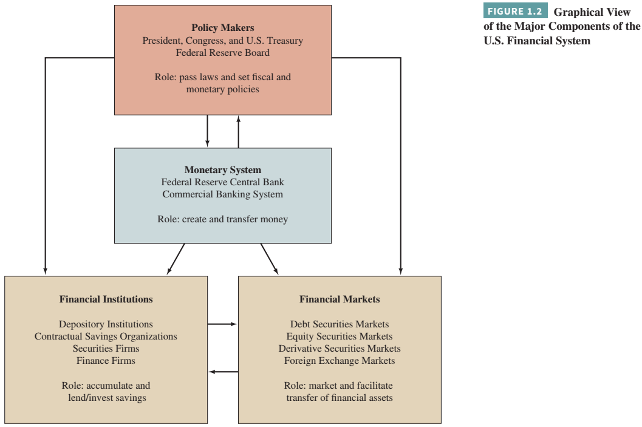

Slide 27
Second, an eﬀective ﬁnancial system needs an eﬃcient monetary system that is composed of a central bank and a banking system that is able to create and transfer a stable medium of exchange called money. In the United States, the dollar is the medium of exchange, the central bank is the Federal Reserve System, and the banking system is commonly referred to as the commercial banking system.
Third, an eﬀective ﬁnancial system also must have ﬁnancial institutions, or intermediaries, that support capital formation either by channeling savings into investment in real assets or by fostering direct ﬁnancial investments by individuals in ﬁnancial institutions and businesses.
Fourth, an eﬀective ﬁnancial system must also have ﬁnancial markets that facilitate the transfer of ﬁnancial assets among individuals, institutions, businesses, and governments. Figure 1.2 identiﬁes three types of ﬁnancial markets—debt securities markets, equity securities markets, and derivative securities markets.

Slide 28
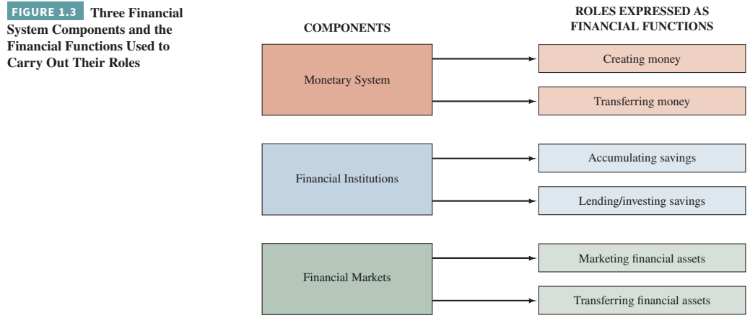
Financial System Components and Financial Functions

Slide 29
1. Creating Money
One of the most signiﬁcant functions of the monetary system within the ﬁnancial system is creating money, which serves as a medium of exchange. A sufficient amount of money is essential if economic activity is to take place at an efficient rate. Having too little money constrains economic growth. Having too much money often results in increases in the prices of goods and services.

Slide 30
2. Transferring Money
Individuals and businesses hold money for purchases or payments they expect to make in the near future. One way to hold money is in checkable deposits at depository institutions. When money is held in this form, payments can be made easily by check. The check is an order to the depository institution to transfer money to the party who received the check. Institutions can also transfer funds between accounts electronically, making payments without paper checks. Funds transfers can be made by telephone, at automated teller machines (ATMs) connected to a bank’s computer, and via the Internet.

Slide 31
3. Accumulating Savings
A function performed by ﬁnancial institutions is the accumulation or gathering of individual savings. Most individuals, businesses, and organizations do not want to take the risks involved in having cash on hand. Even if cash amounts are relatively small, these are put into a depository institution for safekeeping. When all the deposits are accumulated in one place, they can be used for loans and investments in amounts much larger than any individual depositor could supply.

Slide 32
4. Lending and Investing Savings
Another basic function of ﬁnancial institutions is lending and investing. The money that has been put into these intermediaries may be lent to businesses, farmers, consumers, institutions, and governmental units. It may be lent for varying periods and for diﬀerent purposes, such as to buy equipment or to pay current bills. Some ﬁnancial institutions make almost all types of loans. Others specialize in only one or two types of lending. Still other ﬁnancial institutions invest all or part of their accumulated savings in the stock of a business or in debt obligations of businesses or other institutions.

Slide 33
5. Marketing Financial Assets
New ﬁnancial instruments and securities are created and sold in the primary securities market. For example, a business may want to sell shares of ownership, called stock, to the general public. It can do so directly, but the process of ﬁnding individuals interested in investing funds in the business is likely to be diﬃcult, costly, and time consuming. One particular ﬁnancial intermediary—an investment banking ﬁrm—can handle the sale of shares of ownership. The function of the investment banking ﬁrm is essentially one of merchandising. Brokerage ﬁrms market existing, or “seasoned,” instruments and securities.
Initial public offering (IPOs) occur when a privately-owned company decides to raise revenue, offering ownership shares of stock or debt securities to the public for the first time. A seasoned issue occurs when a company that was previously listed releases additional shares or debt instruments.

Slide 34
6. Transferring Financial Assets
Several types of ﬁnancial institutions facilitate or assist in the processes of lending and selling securities. Brokerage ﬁrms market and facilitate the transferring of existing, or seasoned, instruments and securities. Also, if shares of stock are to be sold to the general public, it is desirable to have a ready market in which such stocks can be resold when the investor desires. Organized stock exchanges and the over-the-counter market provide active secondary markets for existing securities. The ability to buy and sell securities both quickly and at fair-market values is important in an eﬃcient ﬁnancial system.

Slide 35
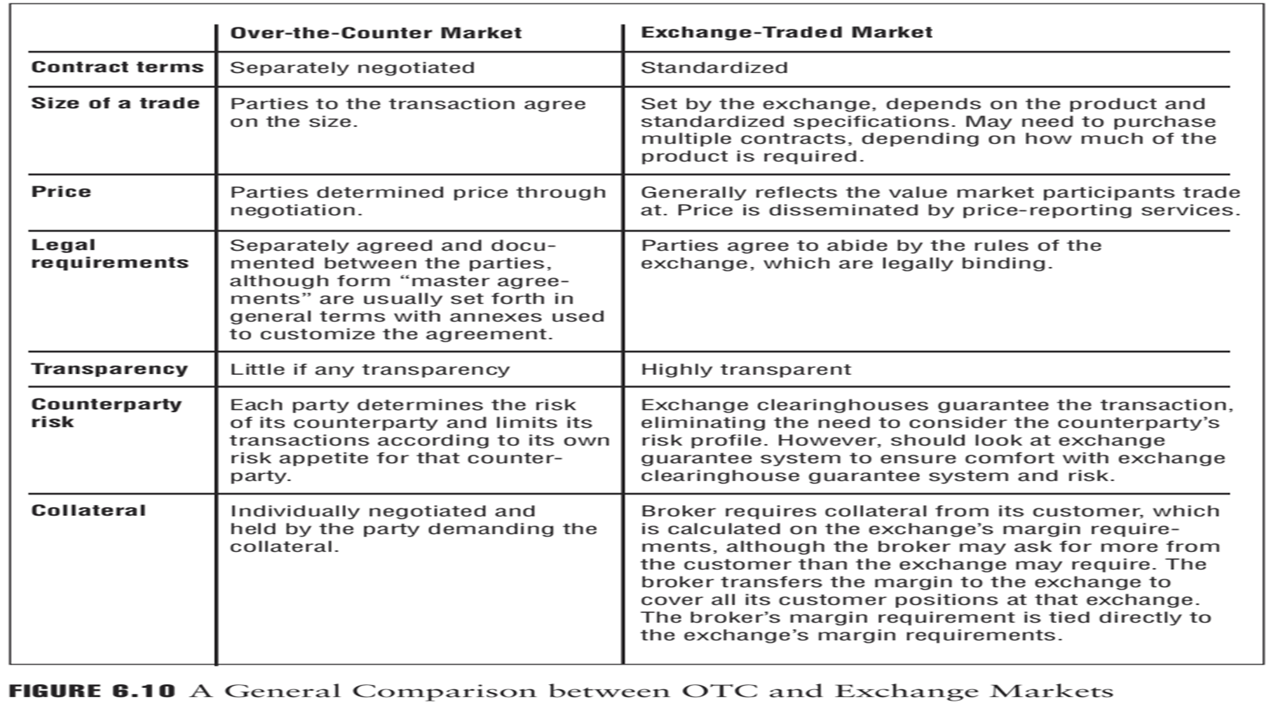

Slide 36
5. Financial Markets: Characteristics and Types
Financial markets facilitate the raising of ﬁnancial capital by government entities and business ﬁrms. Government entities can issue or sell debt securities to ﬁnance the building of roads and bridges or to provide added services to the people. Business ﬁrms can issue debt securities, and corporations can sell equity securities or stocks to raise funds to invest in and grow their businesses. Financial markets also facilitate the transfer of previously issued debt and equity securities from existing to new investors.

Slide 37
1. Money and Capital Markets
Money markets are where debt securities with maturities of one year or less are issued and traded. These markets are generally characterized by high liquidity whereby money market securities can be easily sold or traded with little loss of value. These short-lived securities generally have low returns and low risk.
Capital markets are where debt instruments or securities with maturities longer than one year and corporate stocks or equity securities are issued and traded. Capital market securities are generally issued to ﬁnance the purchase of homes by individuals, buildings and equipment by businesses, and for provision of infrastructure (roads, bridges, buildings, etc.) by governments. Business ﬁrms and governments issue long-term debt securities, called bonds, to ﬁnance their assets and operations. Mortgages are issued to ﬁnance homes and buildings. Corporations also issue stocks to meet their ﬁnancing needs.

Slide 38
2. Primary and Secondary Markets
There are primary and secondary markets for debt (bonds and mortgages) and equity securities. The initial oﬀering, or origination, of debt and equity securities takes place in a primary market. Proceeds from the sale of new securities after issuing costs go to the issuing business or government issuer. The primary market is the only “market” where the security issuer directly beneﬁts (receives funds) from the sale of its securities. Mortgage loans provide ﬁnancing for the purchase of homes and other real property.

Slide 39
Secondary markets are physical locations or electronic forums where debt (bonds and mortgages) and equity securities are traded. Secondary markets for securities facilitate the transfer of previously issued securities from existing investors to new investors. Security transactions or transfers typically take place on organized security exchanges or in the electronic over-the-counter market.
Individuals and other investors can actively buy and sell existing securities in the secondary market. While these secondary market investors may make gains or losses on their securities investments, the issuer of the securities does not beneﬁt (nor does it lose) from these activities. The secondary market for securities is typically divided into short-term (money) and long-term (capital) market categories. There also is an active secondary market for real estate mortgages.

Slide 40
Major Types of Financial Markets
There are four main types of ﬁnancial markets—debt securities markets, equity securities markets, derivative securities markets, and foreign exchange markets. Debt securities are obligations to repay borrowed funds. Debt securities markets are markets where money market securities, bonds (corporate, ﬁnancial institution, and government), and mortgages are originated and traded. Bond markets are where debt securities with longer-term maturities are originated and traded. Government entities (federal, state, and local), ﬁnancial institutions, and business ﬁrms can issue bonds.
Mortgage markets are where loans to purchase real estate (buildings and houses) are originated and traded.

Slide 41
Equity securities, also called common stocks, are ownership shares in corporations. Equity securities markets are markets where ownership shares in corporations are initially sold and traded. Corporations can raise funds either through a private placement, which involves issuing new common stocks directly to speciﬁc investors, or through a public oﬀering, which involves selling new common stocks to the general public. Financial institutions can also raise equity capital by selling common stocks in their ﬁrms.

Slide 42
There are also derivative securities markets, which are markets for ﬁnancial contracts or instruments that derive their values from underlying debt and equity securities. A familiar form of derivative security is the opportunity to buy or sell a corporation’s equity securities for a speciﬁed price and within a certain amount of time. Derivative securities may be used to speculate on the future price direction of the underlying ﬁnancial assets or to reduce price risk associated with holding the underlying ﬁnancial assets. Organized exchanges handle standardized derivative security contracts, while negotiated contracts are handled in electronic markets often involving commercial banks or other ﬁnancial institutions.

Slide 43
Foreign exchange markets (also called FOREX markets) are electronic markets in which banks and institutional traders buy and sell various currencies on behalf of businesses and other clients. In the global economy, consumers may want to purchase goods produced or services provided in other countries. Likewise, an investor residing in one country may wish to hold securities issued in another country.
For example, a U.S. consumer may wish to purchase a product in a foreign country. If the product is priced in the foreign country’s currency, it may be necessary to exchange U.S. dollars for the foreign currency in order to complete the transaction. Businesses that sell their products in foreign countries usually receive payment in the foreign currencies. However, because the relative values of currencies may change, ﬁrms often use the currency exchange markets to reduce the risk of holding too much of certain currencies.

Slide 44



Book:
Introduction to finance book 16th edition
حساب اللينكد ان الخاص بي
https://www.linkedin.com/in/walaa-mohamed-95a402122/

