Slide 1



Firewall User Management
Lecture 7
HCIA-Security
Prepared by
Dr. Abdelrhman Ahmed

Slide 2
Chapter
07
Objectives
• Upon completion of this course, you will be able to understand:
□ AAA technologies
□ User authentication technologies
□ User authentication management configurations

Slide 3
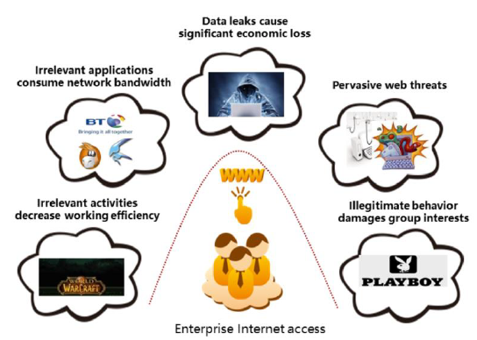
Chapter
07
User Authentication Background
• The growing number of application-layer attacks not only brings additional threats to network security but also places further strain on network access control. Enterprises want the capability to precisely identify users, ensure legitimate applications operate normally, and block applications that may bring security risks. However, IP addresses and ports are no longer sufficient to distinguish users and applications. Traditional access control policies based on quintuples cannot adapt to changes in the current network environment.

Slide 4
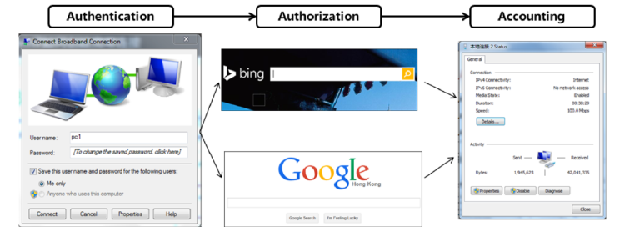
Chapter
07
What is AAA?
• Authentication
• Authorization
• Accounting
• Example:
□ When accessing the Internet, a user needs to enter a username and a password for authentication.
□ After authentication, the firewall starts to authorize the user and grant permissions for access to different resources, such as baidu.com or google.com.
□ During user access, accounting is performed to record the user's operations and online duration.

Slide 5
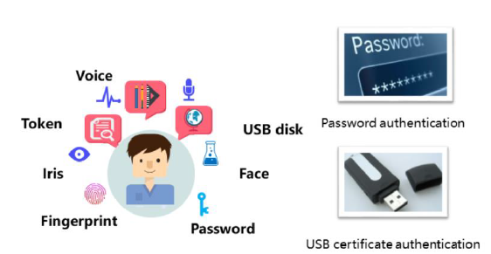
Chapter
Authentication
07
Authentication refers to the confirmation of user identities using various factors.
• Authentication mode:
□ What I know: includes the information that a user knows (password and PIN)
□ What I have: includes the information that a user has (token cards, smart cards, and various bank cards)
□ What I am: includes unique biometric features that a user has (fingerprint, voice, iris, and DNA)

Slide 6
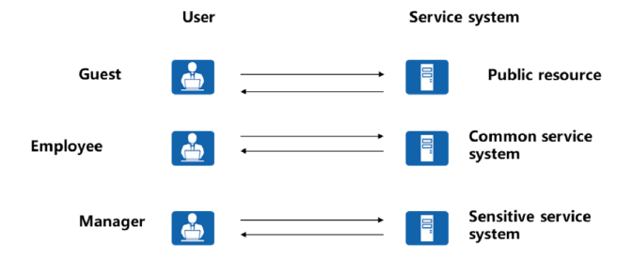
Chapter
Authorization
07
• Authorizes accessible resources.
• Authorizes available commands.
• Authorizes users to access certain services, including public services and sensitive services.
• Authorizes users to use certain commands for device management. For example, authorizes users to use only display commands but not delete or copy commands.

Slide 7

Chapter
Accounting
07
• The accounting function covers the following aspects:
□ How long do users stay online?
□ How much money do users spend?
□ What operations do users perform?

Slide 8
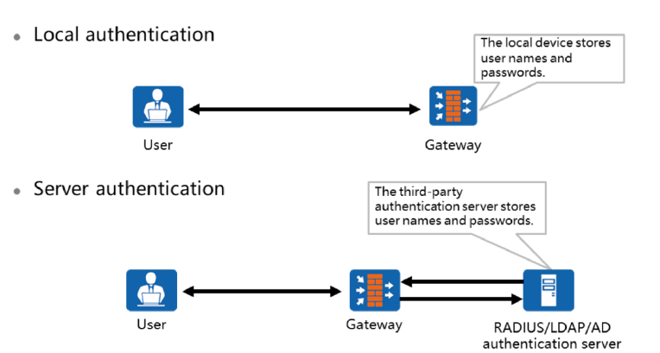
Chapter
07
AAA Technologies

Slide 9
Chapter
07
AAA Technologies
• No authentication:
□ No authentication is performed on trusted users. In most cases, this type of authentication mode is not recommended.
• Local authentication:
□ Configures user information, including the username, password, and attributes of local users, on a Network Access Server (NAS). Local authentication offers fast processing and low operation cost. However, the capacity to store user information is limited by the hardware.
• Server authentication:
□ Configures user information, including the username, password, and attributes, on a third-party authentication server. AAA can remotely authenticate users through the Remote Authentication Dial In User Service (RADIUS) protocol or the Huawei Terminal Access Controller Access Control System (HWTACACS) protocol.

Slide 10
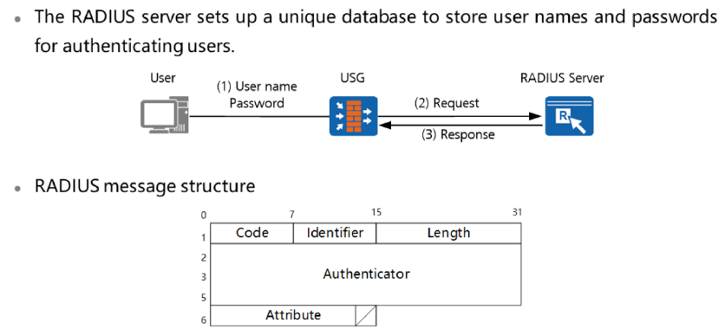
Chapter
RADIUS
07

Slide 11
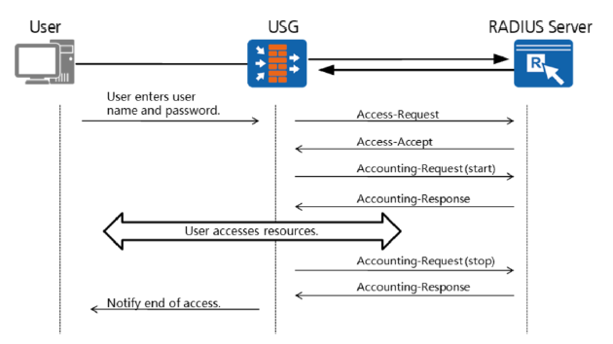
Chapter
07
RADIUS Application Scenarios

Slide 12
Chapter
07
HWTACACS Overview
• HWTACACS is an enhancement of TACACS. Similar to RADIUS, HWTACACS uses the client/server model to implement communication between NAS and TACACS+ servers.
• A typical application of HWTACACS is to perform authentication, authorization, and accounting for a user logging in to a device. The device functions as the HWTACACS client to send the username and password to the HWTACACS server for authentication. If a user is authenticated and authorized, the user can log in to the device to perform operations.
• HWTACACS: Huawei Terminal Access Controller Access Control System

Slide 13
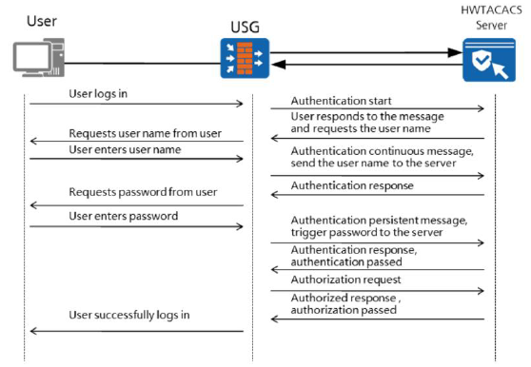
Chapter
07
HWTACACS Application Scenario

Slide 14
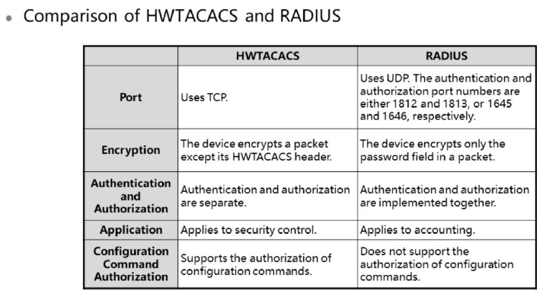
Chapter
07
Comparison of HWTACACS and RADIUS

Slide 15
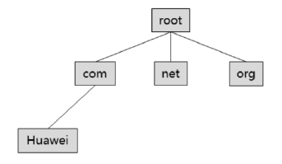
Chapter
07
LDAP Overview
• Lightweight Directory Access Protocol (LDAP) is developed from the X.500 directory access protocol. X.500 organizes objects hierarchically into a tree structure. The X.500 directory service implements identity authentication and access control. LDAP simplifies the X.500 directory and meets Internet requirements.
• The directory service is a system consisting of directory databases and a set of access protocols. The following information can be stored in the directory:
□ Information about an enterprise employee, for example, a name, email address, and mobile number
□ Physical information of a device, for example, the IP address, location, vendor, and purchase time
□ Public certificate and security key
• The features are as follows:
□ Data is organized in directory mode.
□ A unified access point is provided for external systems.
□ Data is stored in distributed mode.
□ Data query is optimized for fast read operations.

Slide 16
Chapter
07
LDAP’s Basic Concepts
• In LDAP, information is organized in a tree structure. The basic data unit is an entry, and each entry consists of multiple attributes. An attribute consists of a type and one or more values.
• Directory Information Tree (DIT)
□ A DIT is a collection of directory entries.
• Entry
□ An entry is a node in a DIT and consists of a series of attributes.
• Attribute
□ An attribute describes a feature of an object. It consists of an attribute type and one or more attribute values.
• Relative Distinguished Name (RDN)
□ An RDN uniquely identifies child entries of an entry.
• Distinguished Name (DN)
□ A DN uniquely identifies an entry in a DIT.

Slide 17
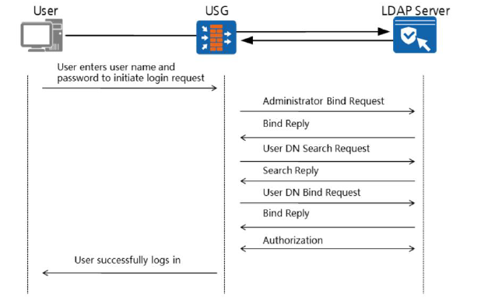
Chapter
07
LDAP Authentication Process

Slide 18
Chapter
User Authentication Classification
07
The AAA technology provides various user authentication methods.
• User authentication methods include:
• Local authentication
□ A user sends the username and password that identify the user to the firewall through the portal authentication page. The firewall stores the password and performs authentication. This method is called local authentication.
• Server authentication
□ A user sends the username and password that identify the user to the firewall through the portal authentication page. The firewall does not store the password. Instead, the firewall sends the username and password to a third-party authentication server for it to perform authentication. This method is called server authentication.
• Single Sign-on SSO
□ A user sends the username and password that identify the user to a third-party authentication server. After the user passes the authentication, the third-party authentication server sends the user's identity information to the firewall. The firewall only records the user's identity information but does not perform authentication. This process is called SSO.
• SMS authentication
□ A user accesses the portal authentication page and requests an SMS verification code. Authentication succeeds after the user enters the correct verification code on the portal authentication page. This process is called SMS authentication.

Slide 19
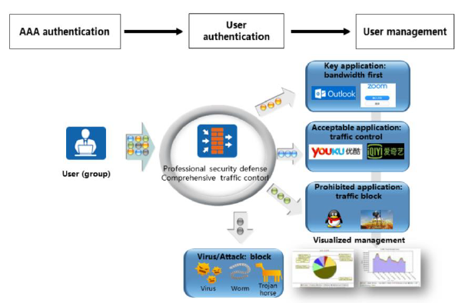
Chapter
07
User Management Background

Slide 20
Chapter
07
Organizational Structure of Users
• A firewall provides user-level behavior and access control on a network.
• The user organizational structure involves three concepts:
□ Authentication domain: The authentication domain is a container of the user organizational structure, similar to the domain in Microsoft's Active Directory (AD) service. The firewall provides a default authentication domain and supports additional user-created authentication domains.
□ User/User group: Users and the departments to which they belong are the basic units of an enterprise. An administrator can divide users into user groups based on their departments to form a tree-shaped organizational structure for the intranet. This commonly used structure facilitates lookup and location of users and user groups.
□ Security group: A security group is a cross-department group in the horizontal organizational structure. Security groups enable you to manage users in a dimension other than by department. For example, you can create a group between multiple departments.
• Similar horizontal groups can be used for enterprises that use third-party authentication servers to store organizational structures. For policies based on cross-department security groups, the security groups created on the firewall must be consistent with the organizational structures on the authentication servers.

Slide 21
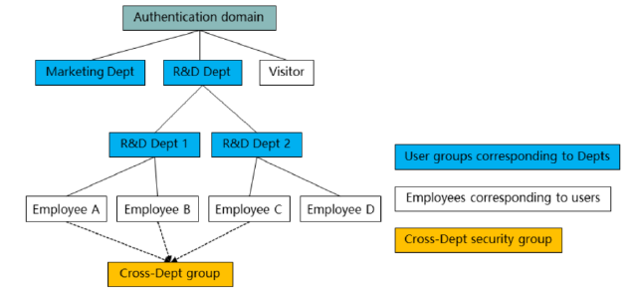
Chapter
07
Organizational Structure Management
• The system has a default authentication domain. Each user group can contain multiple users and user groups.
• Each user group belongs to only one parent user group, and each user belongs to at least one user groups.

Slide 22
Chapter
07
User Classification
• Administrator
□ An administrator is a user who accesses the device through Telnet, SSH, web, FTP, or the console port and configures or operates the device.
• Internet access user
□ An Internet access user is an intranet entity that accesses Internet resources-for example, an internal employee at the headquarters of an enterprise. Such a user can directly access network resources through the firewall, which authenticates the user and performs access control according to the policy applied to the user.
• Remote access user
□ A remote access user is an extranet entity that accesses intranet resources-for example, an employee ata branch of an enterprise or an employee on a business trip. Such a user must first access the firewall through SSL VPN, L2TP VPN, IPsec VPN, or PPPoE before accessing network resources at the headquarters.

Slide 23
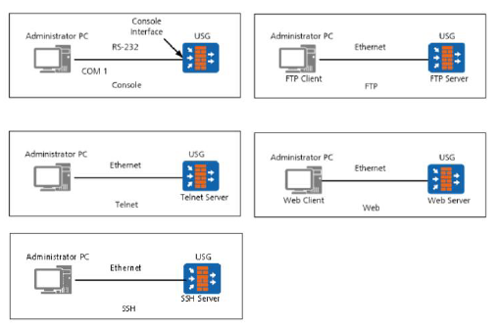
Chapter
07
Administrator Login Modes
• Console
• Telnet
• SSH
• FTP
• Web

Slide 24
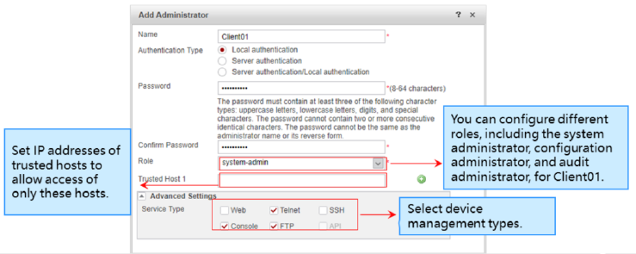
Chapter
07
Device Management Using Console, Telnet & FTP
• Choose System > Administrator > Administrator and click Add to create administrator Client OI. Set the device management type to Console, Telnet, and FTP.

Slide 25
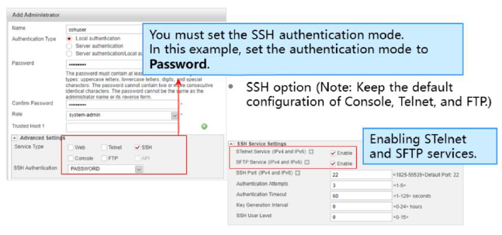
Chapter
07
Device Management Using SSH
• Create administrator Client01 and set the device management type to SSH.

Slide 26
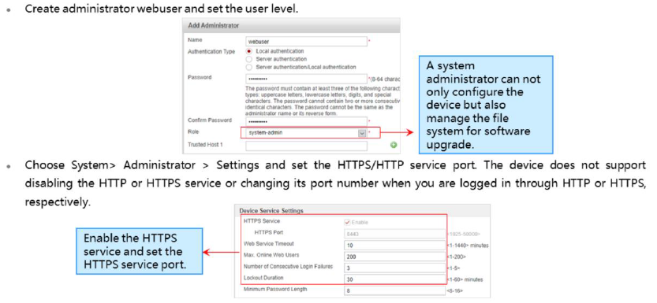
Chapter
07
Device Management Using the Web UI

Slide 27
Chapter
07
SSO
• SSO refers to that the firewall obtains user login information from other authentication systems instead of authenticating users so that users can go online from the firewall.
• If users need to directly access network resources after being authenticated by an AD server, you can configure AD SSO to trigger authentication. AD SSO can be implemented in the following modes:
□ Install the SSO service program to receive messages from PCs.
□ Install the SSO service program to query AD server security logs.
□ The firewall monitors AD authentication packets.
• Users can use AD SSO to trigger authentication on the firewall. The firewall can have SSO enabled to identify the users that have been successfully authenticated by these authentication systems. In doing so, these users do not need to enter their usernames or passwords when accessing the network. The firewall supports multiple modes for obtaining user authentication success messages during AD SSO.

Slide 28
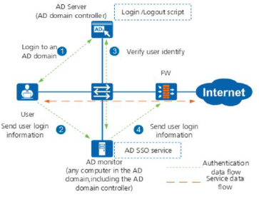
Chapter
07
AD SSO (Receiving Message from the User PC)
• You need to deploy AD SSO service on the AD monitor (AD domain controller or other devices in the AD domain), configure login and logout scripts on the AD server (AD domain controller), and set AD SSO parameters on the firewall to receive the user login and logout information from the AD SSO service.

Slide 29
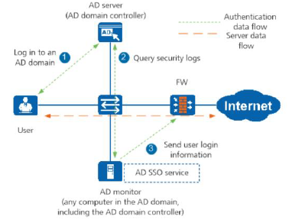
Chapter
07
AD SSO (Querying Security Logs from the AD Server)
You need to deploy the AD SSO service on the AD monitor (this can be an AD domain controller or another device in the AD domain), set AD SSO parameters on the firewall to receive the user login and logout information from the AD SSO service.

Slide 30
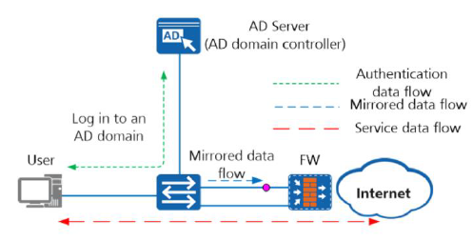
Chapter
07
AD SSO (with the Firewall Listening to AD Authentication Packets)
• In this mode, the program does not need to be installed on the AD server. The firewall listens to the authentication packets sent by users who log in to the AD server (AD domain controller) to obtain authentication results. If a user is authenticated, the firewall adds the mapping between the username and the user's IP address to the online user list.

Slide 31
Chapter
07
Portal Authentication for Internet Access Users
• In portal authentication, the firewall or a third-party server provides a portal authentication page to authenticate users. you can trigger built-in portal authentication using the following methods:
□ Redirected authentication:
■ Redirected authentication implements authentication for Internet access users when they attempt to
access HTTP services.
□ User-initiated authentication:
■ User-initiated authentication indicates that Internet access users proactively access web pages for
identity authentication before accessing network resources.

Slide 32
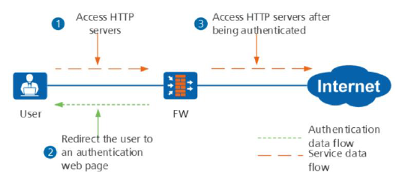
Chapter
07
Built-in Portal Authentication Triggering Mode-Redirected Authentication
• When receiving the first HTTP service access data flow traffic from a user, the firewall redirects the HTTP request to the authentication page to trigger identity authentication. If authentication is successful, the user can access HTTP and other services.
• After receiving HTTP packets whose destination port is 80 from an Internet access user, a firewall redirects the user to an authentication web page and triggers identity authentication. The user can access network resources after being authenticated.

Slide 33
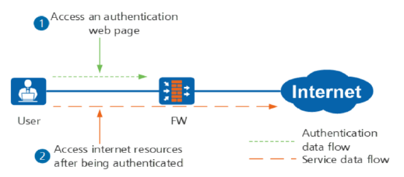
Chapter
07
Built-in Portal Authentication Triggering Mode User-Initiated Authentication
• An Internet access user initiates an authentication request on the authentication web page hosted on the firewall. After receiving the authentication request, the firewall implements identity authentication for the user.
• The firewall supports user-defined Portal authentication. There are currently two types of user-defined Portal authentication.

Slide 34
Chapter
07
Remote Access User Authentication
• Remote access user authentication refers to the authentication of various VPN access users. The authentication triggering mode is determined by the access mode. Modes include:
□ SSL VPN
□ L2TPVPN
□ IPSecVPN
□ PPPoE

Slide 35
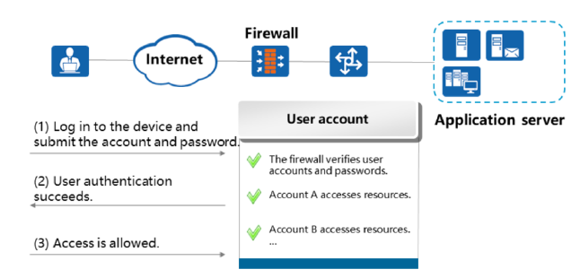
Chapter
07
Example of SSL VPN Users Accessing Intranet Resources

Slide 36
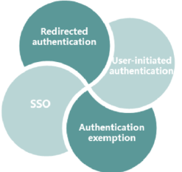
Chapter
07
Authentication Policy
• Authentication policies determine which data flows need to undergo portal authentication and authentication exemption.
• The firewall does not authenticate passing-by data flows by default. Authentication policies are required to filter data flows that require authentication. An authentication policy takes effect on the following authentication modes:

Slide 37
Chapter
07
Authentication Policy Explanation
• An authentication policy is a set of authentication rules that determine whether to authenticate a data flow. An authentication rule consists of conditions and an action. The conditions used by a firewall to match packets are as follows:
□ Source/ Destination zone
□ Source/ Destination address/region
• An action indicates how a firewall processes packets. Possible actions are as follows:
□ Portal authentication
□ Authentication exemption
□ No authentication
□ SMS authentication

Slide 38
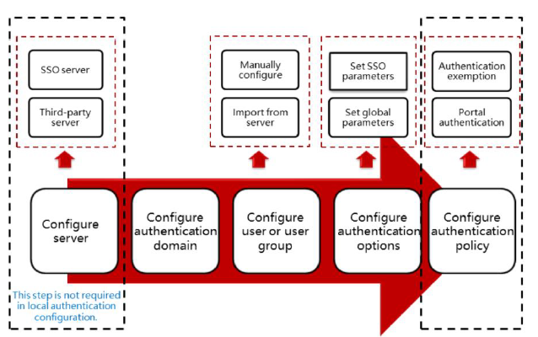
Chapter
07
Configuration Process

Slide 39
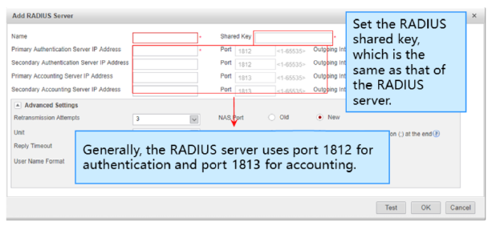
Chapter
07
Configuration a Server (RADIUS)
• Choose Object > Authentication Server > RADIUS and click Add to create a RADIUS server.

Slide 40
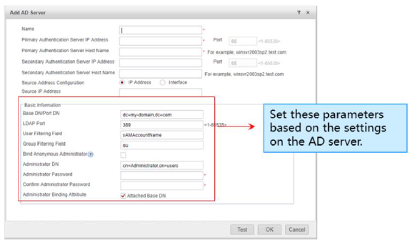
Chapter
07
Configuration a Server (AD)
• Choose Object > Authentication Server > AD and click Add to create an AD server.
• During AD server configuration, the system time and time zone of the firewall must be the same as those on the AD server.

Slide 41
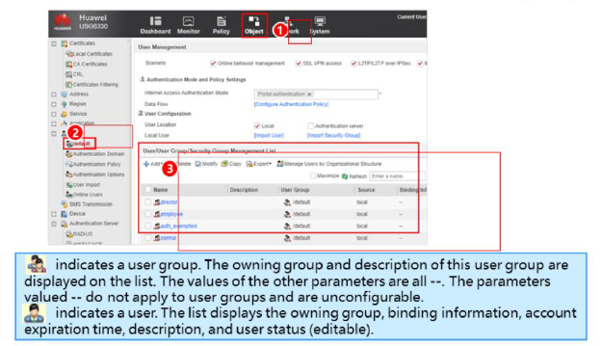
Chapter
07
Creating Users & User Groups
• Choose Object > User > default and create a user or user group.

Slide 42
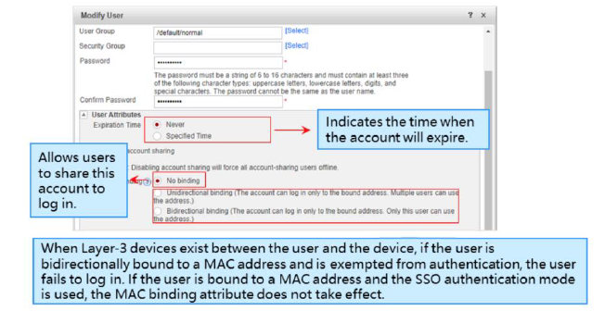
Chapter
07
Configuring User Attributes
• For existing users, you can click Edit to modify their attributes.

Slide 43
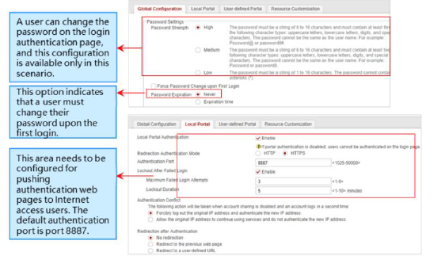
Chapter
07
Configuring Authentication Options (Global Configuration)
• Choose Object > User > Authentication option > Global configuration/Local Portal and perform the configuration.

Slide 44
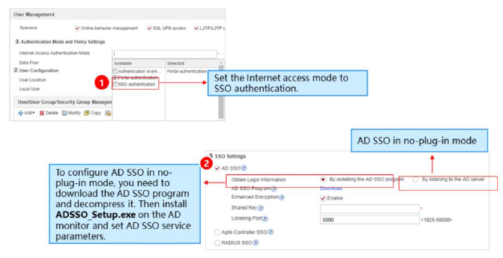
Chapter
07
Configuring Authentication Options (SSO)
• Choose Object > User > default > Authentication Mode and Policy Settings and configure SSO.

Slide 45
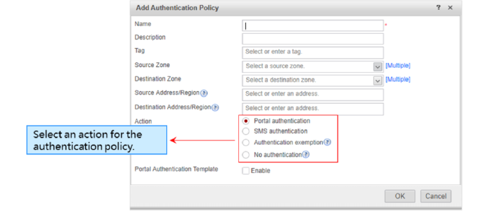
Chapter
07
Configuring an Authentication Policy
• Choose Object > User > Authentication Policy, click Add, and configure an authentication policy.

Slide 46
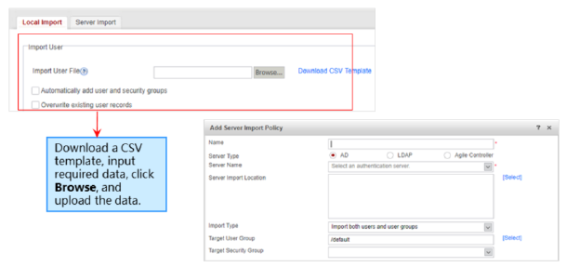
Chapter
07
Importing Users Locally or from a Server
• Choose Object > User > User Import.
□ Local import: supports the import of user information in CSV files and database DBM files to the local device.
□ Server import: Importing users from the authentication server in batches refers to importing user or user group
information on the authentication server to the device based on the server import policy.

Slide 47
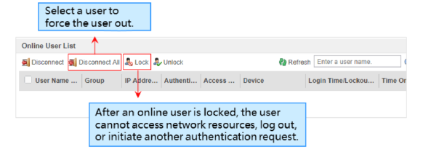
Chapter
07
Online User Management
• Choose Object > User > Online User and perform online user management.
• To restrict all Internet access behaviors of some users within a time segment, you can lock out these online users.
• You can also force some untrusted online users to log out.

Slide 48



Thank You

