Slide 1
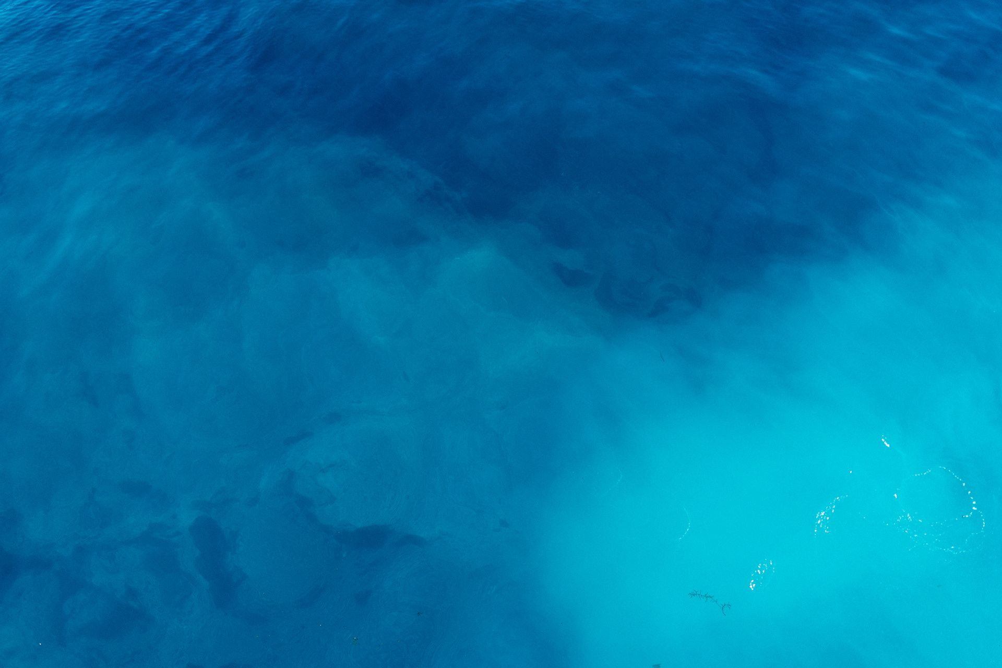

Leakage Detection in Water Meters Network
Using AI-Driven Consumption Analysis
Author: Hani Al-Jundi
Supervisor: Dr. Khaled Eskaf | Midocean / Master of Artificial intelligence

Slide 2


Agenda
Introduction & Problem Definition
Limitations of Traditional Methods
Research Objectives
Proposed Methodology
Data Acquisition & Preprocessing
Experimental Results
Impact & Future Work

Slide 3
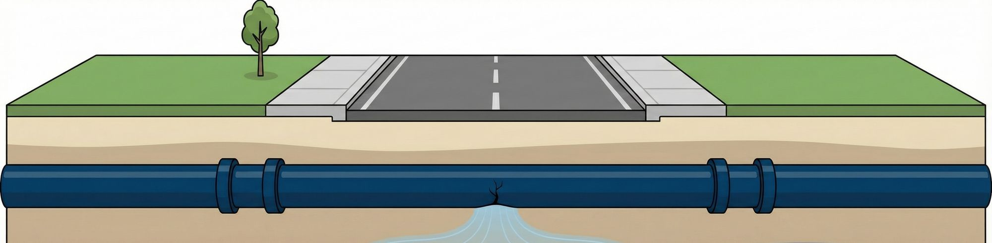
Introduction & Problem Definition Pt.1
20-40%
80%
Of all treated drinking water is lost in urban distribution networks globally
The proportion of water loss caused by non-surfacing leaks the underground
The vast majority of this loss comes from non-surfacing leaks that can go undetected for weeks, months, or even years.

Slide 4



Introduction & Problem Definition Pt.2
Economic Loss:
Significant financial drain for utilities due to lost revenue and high repair costs.
Environmental Strain: Unsustainable abstraction of limited water resources.
Infrastructure Degradation: Unseen leaks silently erode infrastructure, leading to larger, more catastrophic failures.

Slide 5
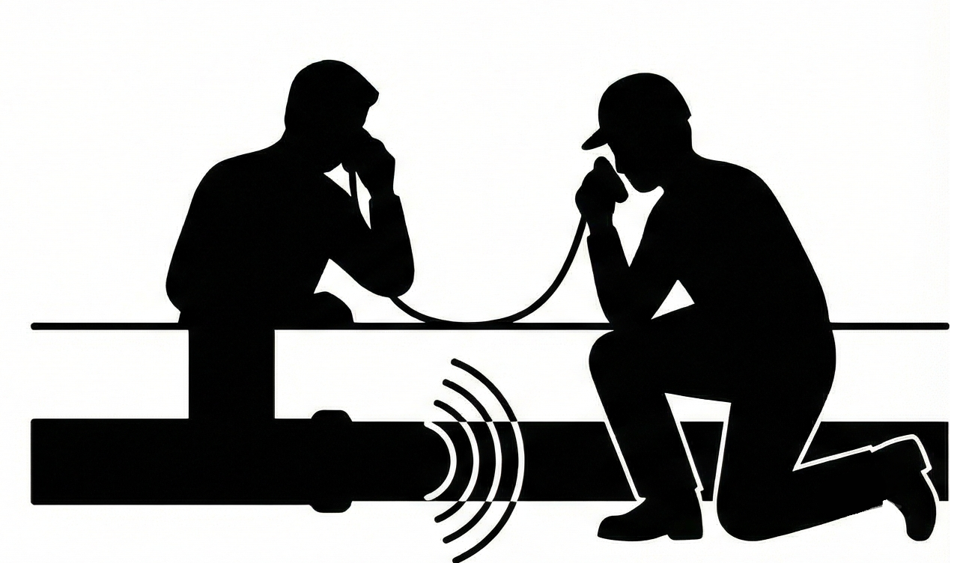

Limitations of Traditional Methods
Reactive & Slow: Leaks are typically found only after significant failure or visible water surfacing. A city- wide acoustic survey can take years to complete.
Labor-Intensive & Expensive: Relies on manual field canvassing by highly trained technicians, incurring significant operational costs,
and In some countries, they have a dedicated call centers receiving calls about water leaks.
Ineffective on Modern Infrastructure: Acoustic signals are severely diminished by non-metallic pipes (e.g., PVC) and deep burial depths, making them increasingly obsolete.
Snapshot in Time: Provides only a momentary assessment, leaving vast temporal gaps in network monitoring.

Slide 6
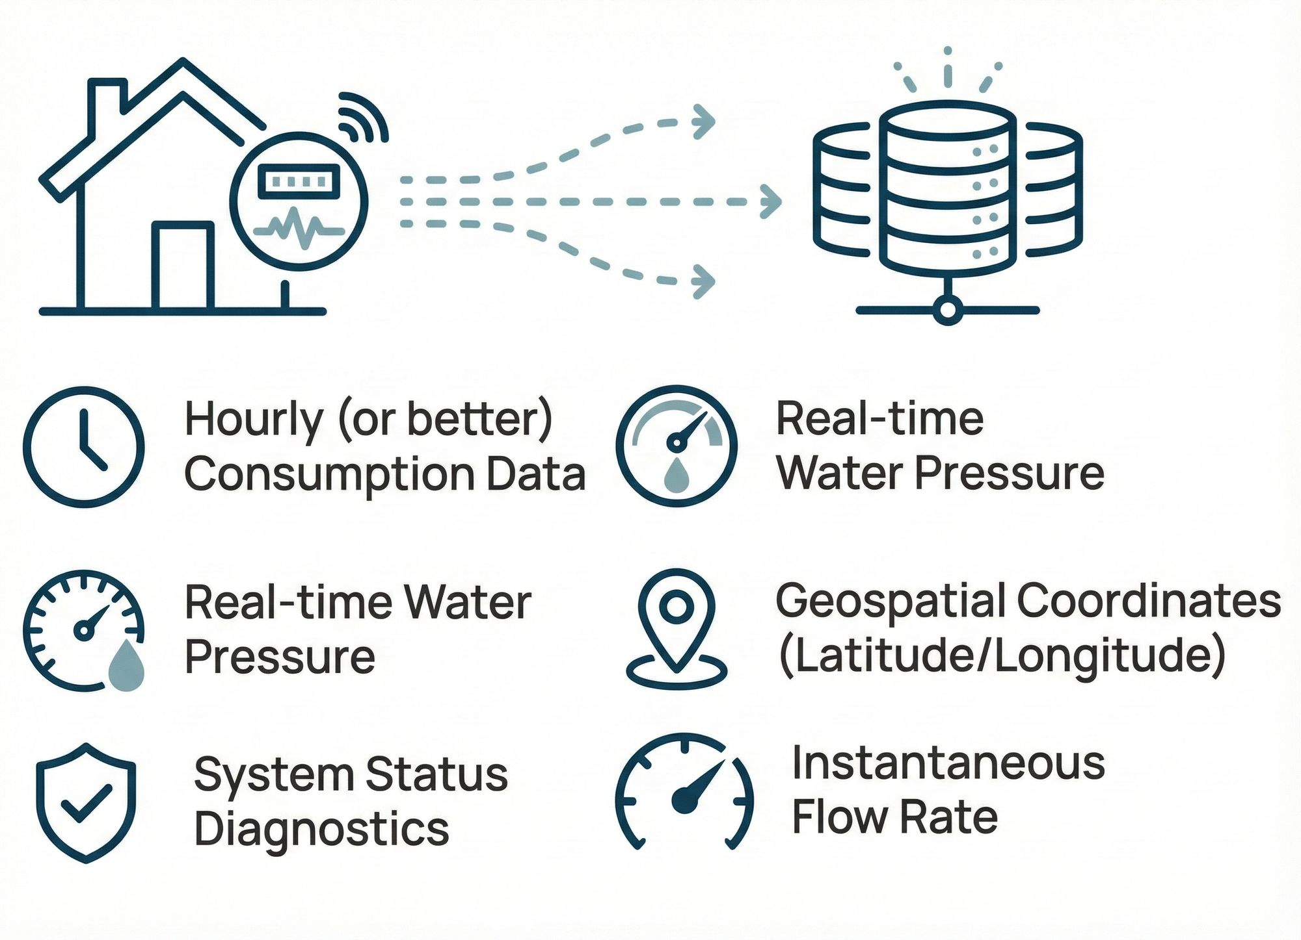
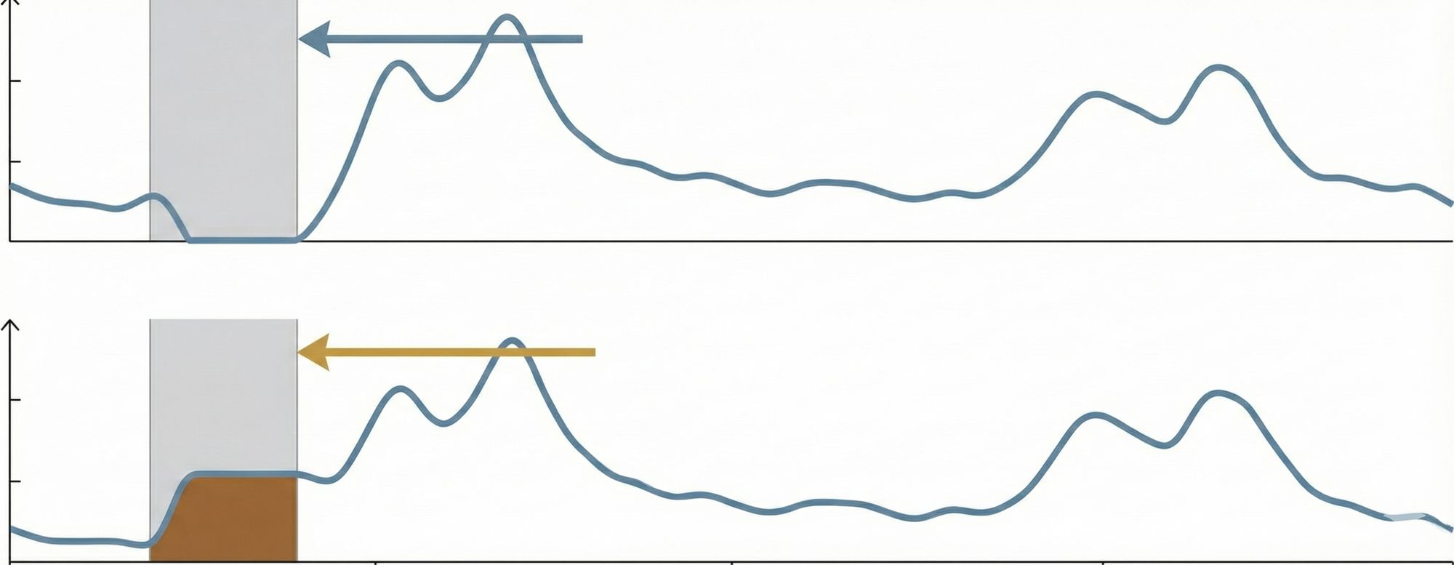
Research Objectives Pt.1
The constant stream of data from Advanced Metering Infrastructure (AMI) contains a hidden signature of network health. The key is knowing when and how to listen.
Minimum Night Flow (MNF) During the quietest hours of the night (typically 02:00-04:00), legitimate water consumption drops to near zero in residential areas.
The key wasn't to listen for sound in the ground, but to find the pattern in the data.
Normal Usage
(MNF): Legitimate usage approaches zero.
Flow Rate" (Mᶾ /h)
Between 2 AM and 4 AM, legitimate water consumption ceases. A persistent, non-zero flow during this window is the unambiguous signature of a leak.
Leak Detected
The Leak Signature:
A persistent, non-zero flow.
00:00
06:00
12:00
18:00
24:00

Slide 7
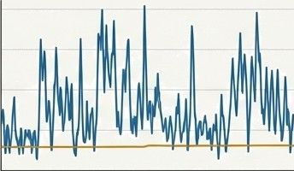
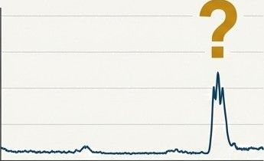
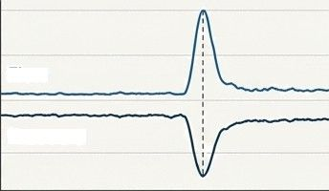
Research Objectives Pt.2
While the MNF provides a clear signal, isolating it requires understanding complex temporal patterns and multivariate context.
Flow Rate
Flow Rate
Flow Rate
Flow
Pressure
0
Time
24h
0
2
Time
48
72h
Time
1. Distinguishing Signal from Noise
The model must differentiate a small, persistent leak from legitimate but unusual events (e.g., filling a swimming pool, a single late-night shower).
2. Long-Term Context
A single data point is meaningless. The model needs to analyze patterns over multiple days (e.g., a 72-hour window) to confirm a recurring anomaly.
3. Multivariate Analysis
A leak isn't just a flow rate. A pipe burst causes a pressure drop; high usage does not. Simple thresholds miss this nuance.

Slide 8
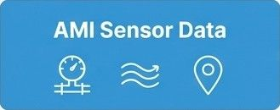



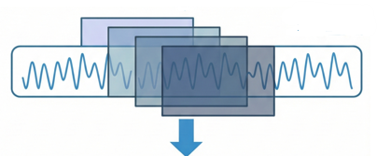
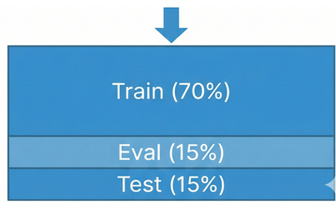
Data Acquisition & Preprocessing
Data Ingestion: Using a simulated but realistic dataset from 50 residential smart meters.
Temporal Feature Engineering: Extracting 'Hour of Day' to help the model identify night-time windows.
Sliding Window Segmentation: Slicing the continuous data stream into overlapping 72-hour windows. This provides three full diurnal cycles, allowing the model to distinguish sustained leaks from one-off events (like filling a pool).
Label Generation: A heuristic based on hydraulic engineering was used for training: a sample is labeled ”Leak” if the flow rate is sustained above 0.05 m^/h during the critical 02:00—04:00 MNF window.
Data Split: Chronological split into Training (70%), Evaluation (15%), and Test (15%) sets to ensure the model predicts future events from past data.
1
Raw
Telemetry
2
Feature Engineering
ALSTM-FCN Model
72-hour Window
3
Actionable Intelligence
4
Leak/Normal Labels
No-Leak
Leak Detected + Location
5

Slide 9
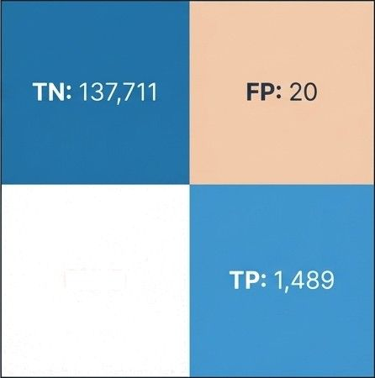
Experimental Results
Predicted Class
Normal
Leak
Accuracy: 99.99%0 l39,180 of 139,200 instances correctly classified).
Precision: 0.99 (Only 20 false alarms). This is critical for minimizing Operational Expenditure (OPEX) by avoiding unnecessary field crew dispatches.
F1-Score: 0.99. This balanced score confirms the model achieves high recall without sacrificing precision.
Actual Class
Normal
Leak
FN: 0

Slide 10



Impact & Future Work Pt.1
Drastically Reduce Water leakage | Optimize Resource Deployment | Enable Sustainable Water Management
By catching leaks at their onset (enabled by 1.00 Recall), utilities can fix small issues before they become catastrophic main breaks, directly curtailing water and revenue loss | A near-zero false positive rate combined with precise geospatial data (Lat/Long) means field crews are dispatched only to confirmed leak locations, eliminating wasted time, fuel, and labor | Move from a reactive, wasteful maintenance cycle to a proactive, conservation-focused strategy, securing a critical resource for the future
Economic implications, environmental benefits, and scalability.

Slide 11
Impact & Future Work Pt.2
The Future of Intelligent Infrastructure
Future Application 1: Deployment on the Edge
The model's efficiency allows for deployment directly onto smart meters ('Edge AI'), enabling real-time, on-device alarms without reliance on the cloud.
Future Application 2: Digital Twin Integration
Serve as the intelligence engine for a network's 'Digital Twin,' allowing utilities to simulate and stress-test their infrastructure against various scenarios.
Future Application 3:
Cross-Domain Scalability
The core principles of analyzing flow and temporal patterns are directly applicable to Smart Gas Grids and District Heating Networks, paving the way for universal utility anomaly detection.

Slide 12

THANK YOU

